Slide 1
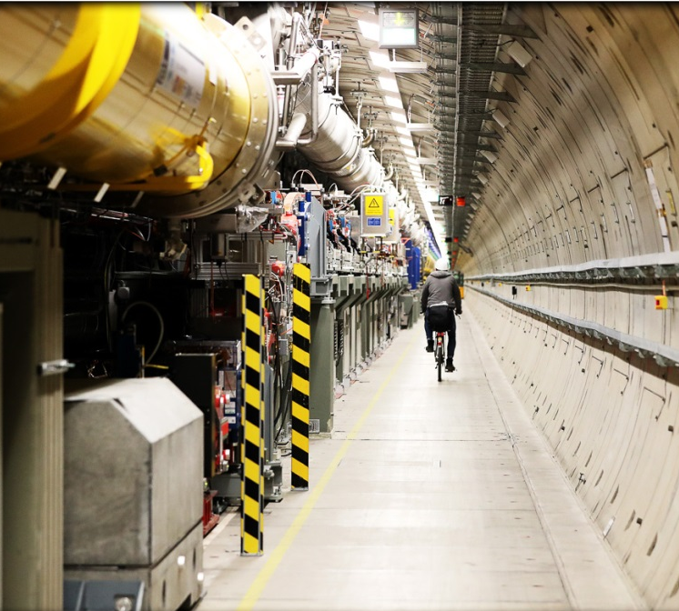
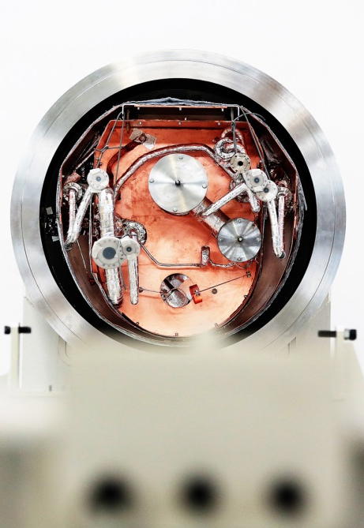
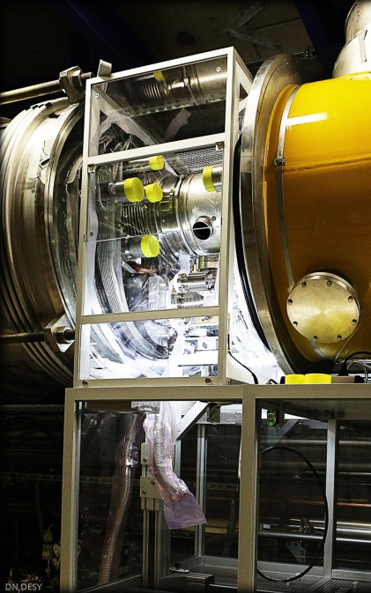
XFEL SASE tuning
Matthias Scholz
November 19, 2019

Slide 2
What is the aim of this operator training?
We will discuss how to find and maximize the SASE signal in all beamlines of European XFEL.

Slide 3
Assumed starting conditions
The electron beam can be transported through the undulator beamline.
It was verified that the electron beam quality is prepared/sufficient for SASE. A few critical items are:
beam optics matching in the injector.
correct magnet setup along the beamline.
closed dispersion in the injector.
proper compression settings in I1, L1 and L2.
All kind of feedbacks have to be operational e.g. trajectory and compression FB, IBFB etc.
There are no hardware errors from any undulator component.
The photon diagnostics in the respective beamline works (especially the FEL imager and the XGM including the HAMP).

Slide 4
Assumed starting conditions
These steps were covert in the operator training
Start-up procedure
The electron beam can be transported through the undulator beamline.
It was verified that the electron beam quality is prepared/sufficient for SASE. A few critical items are:
beam optics matching in the injector.
correct magnet setup along the beamline.
closed dispersion in the injector.
proper compression settings in I1, L1 and L2.
All kind of feedbacks have to be operational e.g. trajectory and compression FB, IBFB etc.
There are no hardware errors from any undulator component.
The photon diagnostics in the respective beamline works (especially the FEL imager and the XGM including the HAMP).

Slide 5
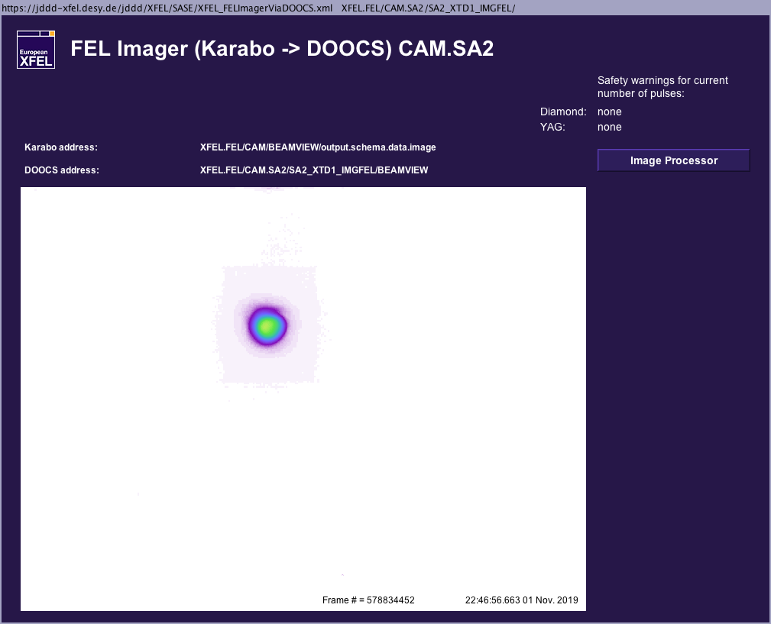
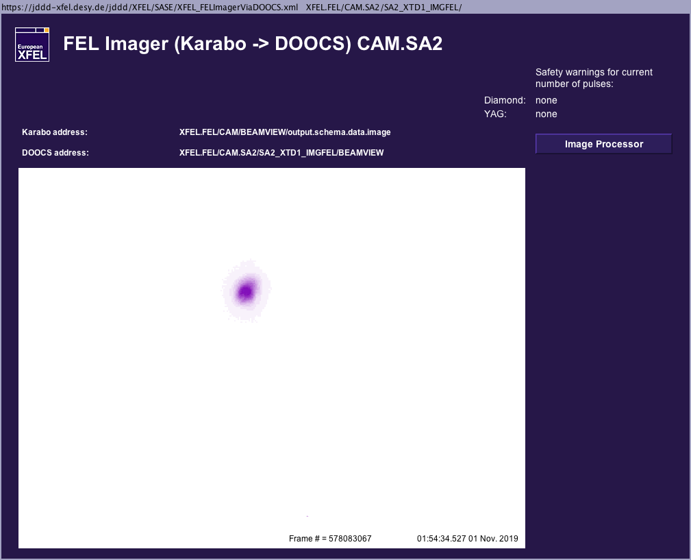
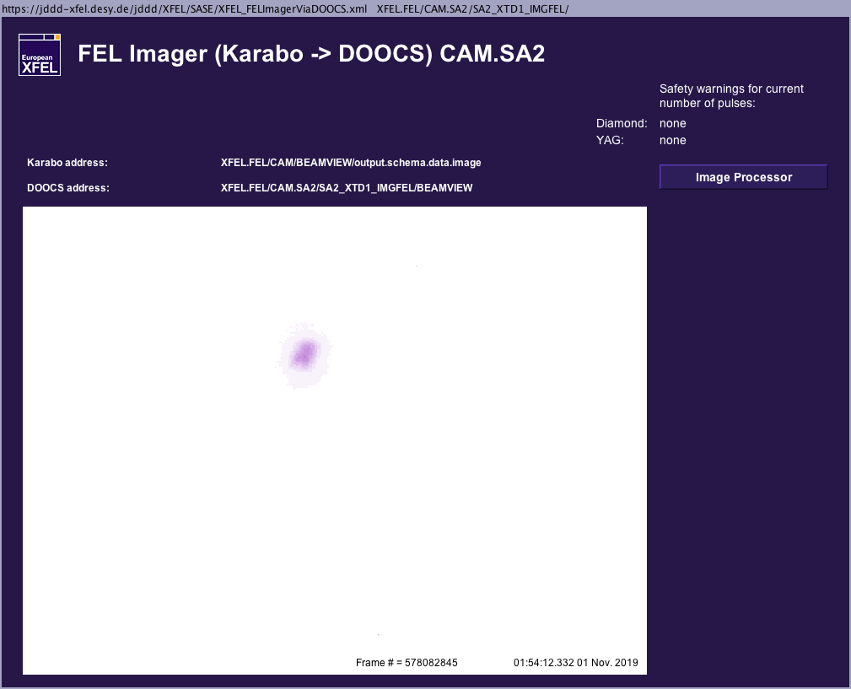
Crucial photon diagnostics devices, FEL imager
If you have no signal at all, you will need the FEL imager for sure.
The FEL imager is the device that will show you even the first glow of your signal.
In addition, the position on the screen gives a first indication on how to continue tuning with orbit modifications (launch).
The XGM will still show only noise when you have already a clear signal on the FEL imager like shown on the picture on the right hand side.

Slide 6
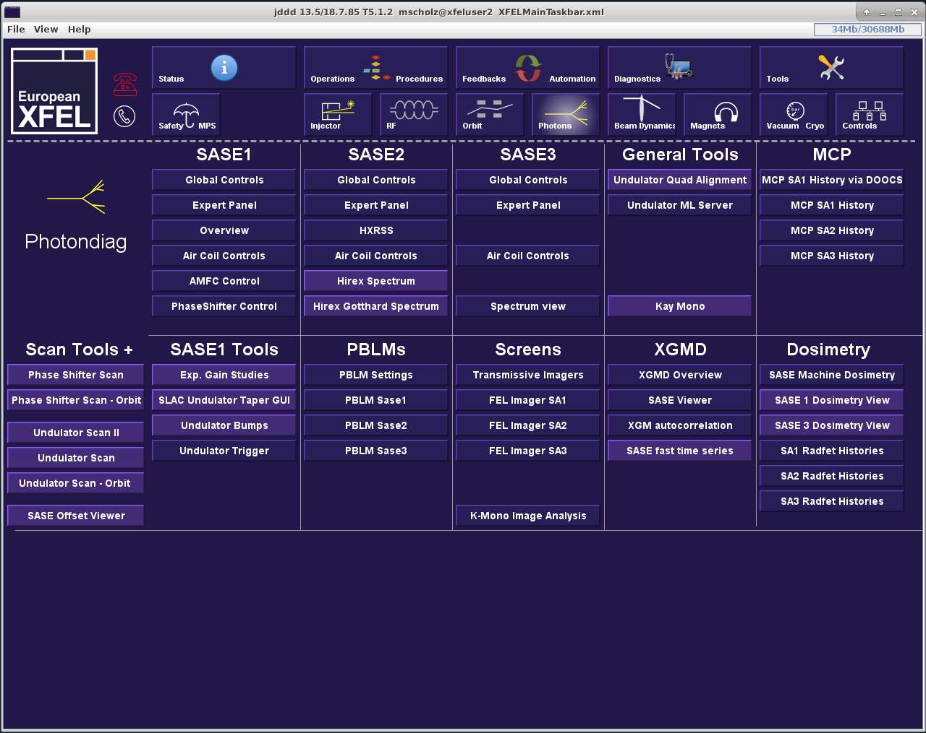
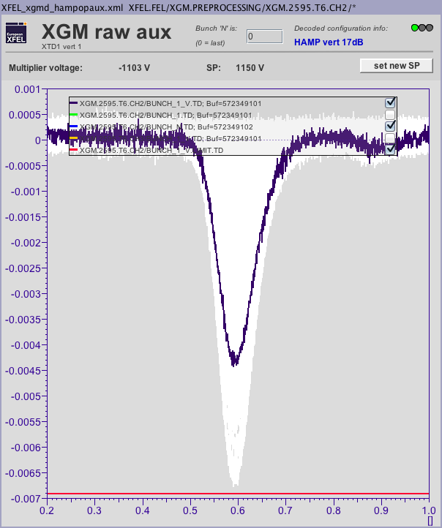
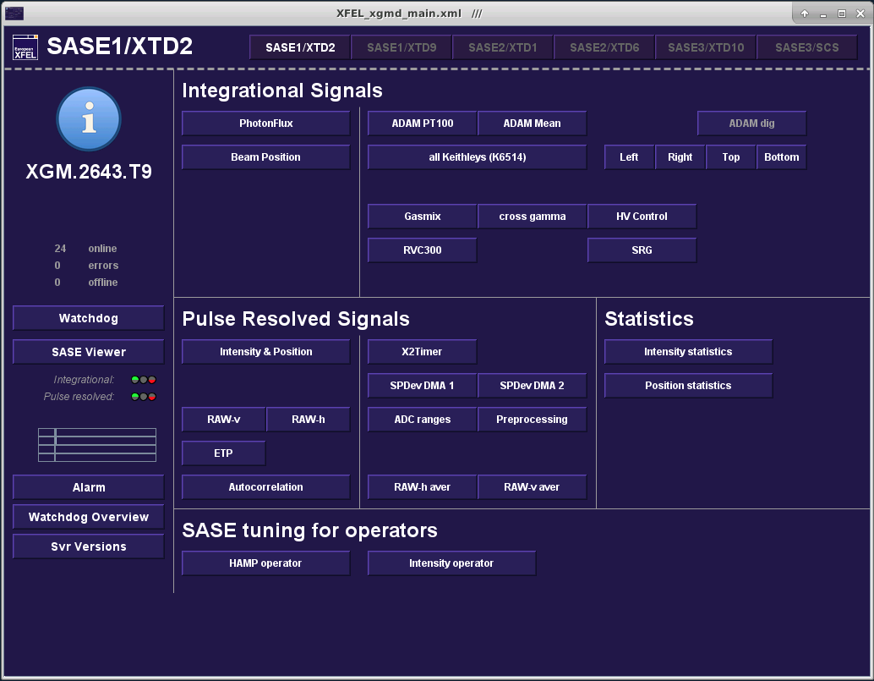
Crucial photon diagnostics devices, HAMP
The HAMP detector is also very sensitive to small SASE pulse energies.
Keep in mind that the maximum current of the HAMP must not exceed 7 mA!
That is also indicated by the red line at the bottom of the plot.
The maximum voltage setpoint is 1700!
Please do not forget to reduce the voltage when you are finished.

Slide 7
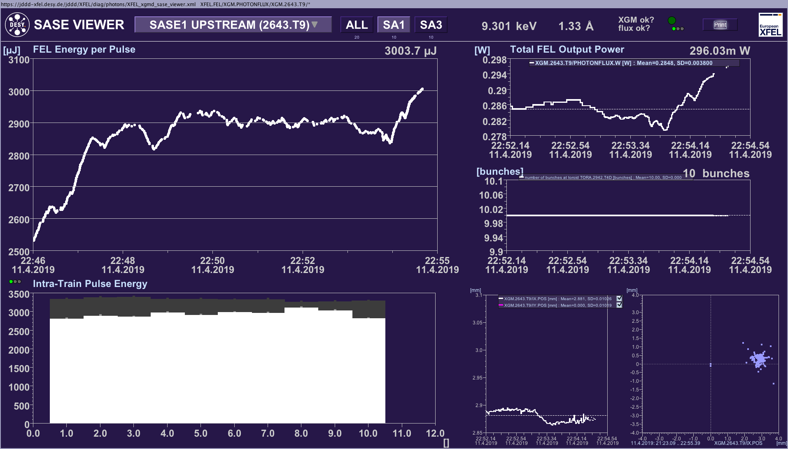
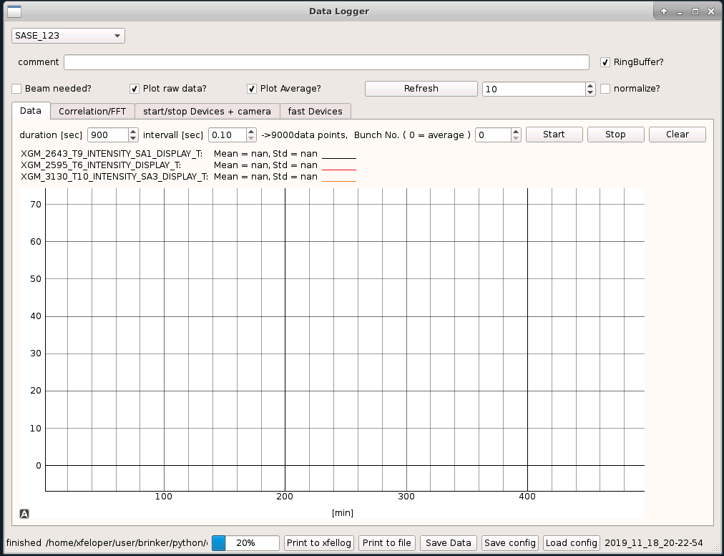
Crucial photon diagnostics devices, XGM signals
You can start using the following tools as soon as you have a decent SASE signal (>40 uJ).
SASE fast timing series
It shows fast signals (crucial for tuning).
You can follow all three beamlines which is helpful e.g. during compression tuning.
It is possible to show the SASE signals in normalized mode. That helps when the hard X-ray beamlines and SASE3 are at completely different levels.
JDDD SASE viewer.
Fast signals are shown in the bar plot bottom left. Change the repetition rate of this plot to 10 Hz!
You can see the impact on the different bunches along the pulse train when you use more than 2 bunches.

Slide 8
Groups of actuators for SASE tuning
Launch corrector and aircoil settings
Bunch compression
Undulator taper settings
Phase shifter settings
Trajectory in the injector section up to L1 (dispersion?)
Settings of matching quads (beam optics)
Intensity and position of the IR laser in the laser heater

Slide 9
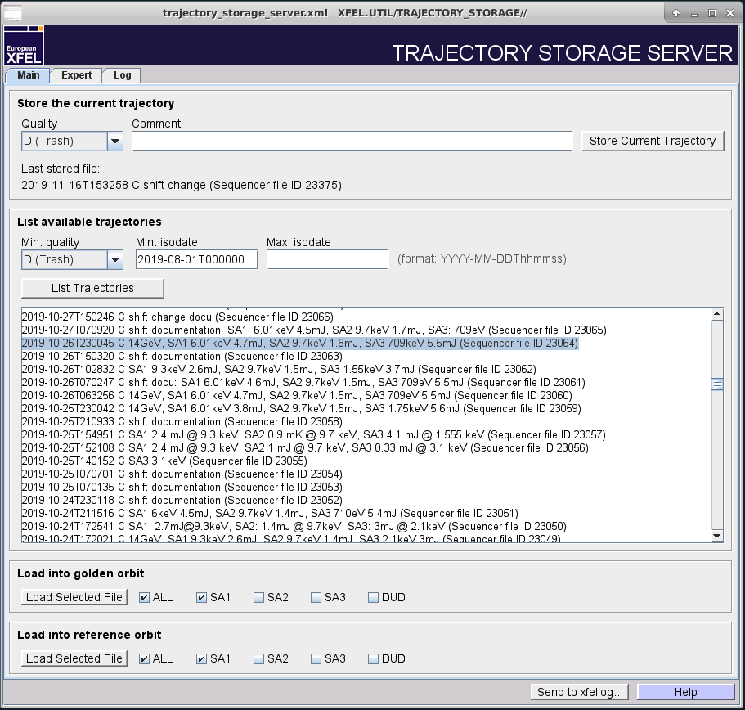
Trajectory in the undulator
-> how to set up the air coils in the undulator.
Case one: you have already a trajectory stored for the same (or for a higher) photon energy.
Select the file in the trajectory storage server.
Load the trajectory to the golden and to the reference orbit. Choose the respective subtrain (beamline) before.
Load the reference orbit into the undulator orbit FB by pressing the button ‘From Orbit serv.’
Start the FB without taking an additional golden orbit.
Configure the undulator orbit FB such that
Launch and undulator BPMs are selected.
Launch correctors and and at least one pair of aircoils are selected.
BTW: all these steps are taken over by the photon energy change tool when you use it.

Slide 10
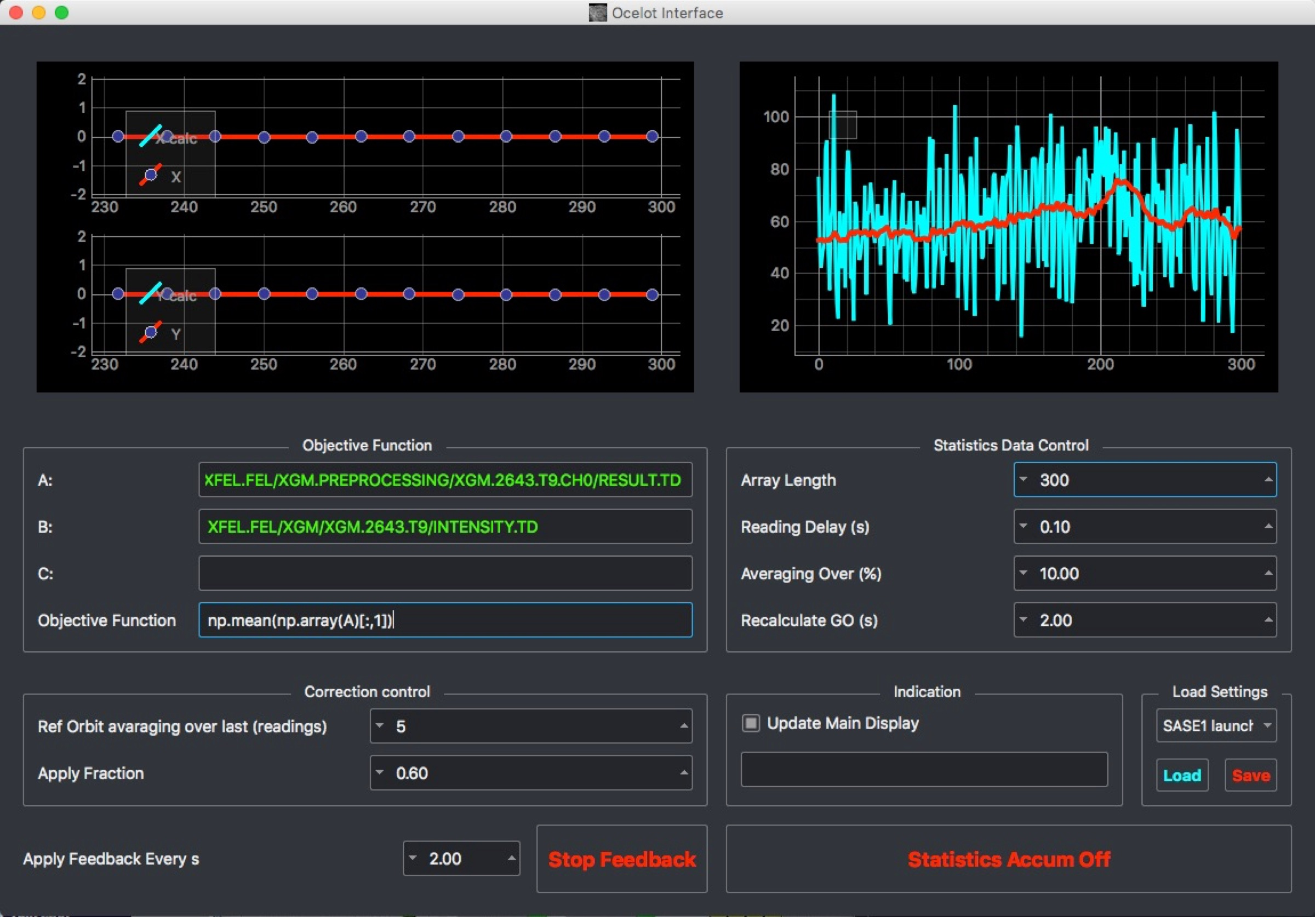
Trajectory in the undulator
-> how to set up the air coils in the undulator.
Case one: you have already a trajectory stored for the same (or for a higher) photon energy.
Switch off the default feedback.
Run the adaptive FB to optimize the launch trajectory into the undulator.
Remember that it always helps to assist the feedback with some induced orbit jitter using the correctors on the SASE tuning panels.
Take a new golden orbit with the default orbit feedback and run it again.

Slide 11
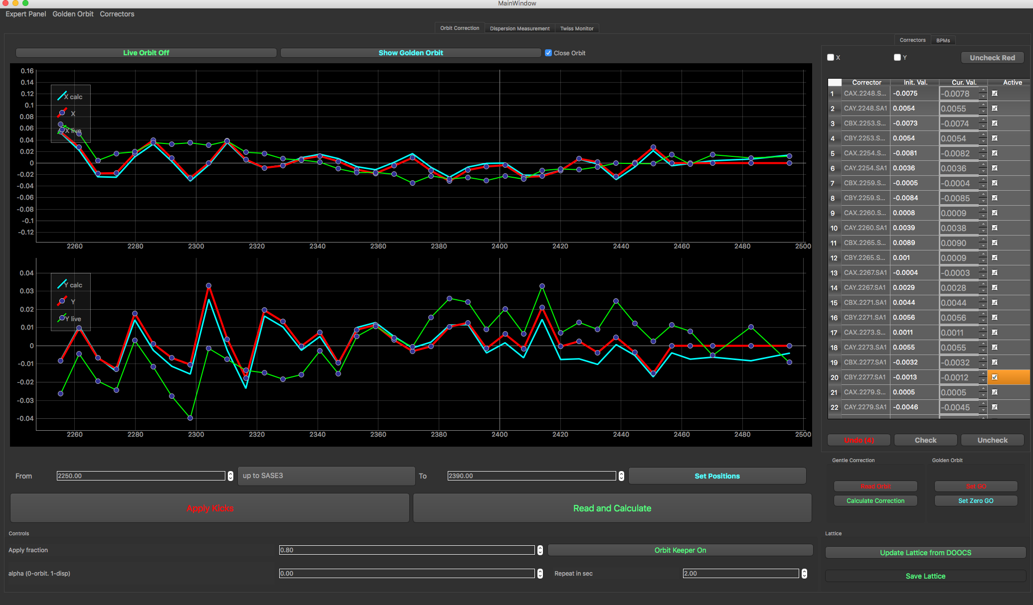
Trajectory in the undulator
-> how to set up the air coils in the undulator.
Case two: you have to start from scratch.
The best solution when starting from scratch is to establish the BBA orbit which means typically zero offset in all BPMs.
This can be achieved using the orbit FB.
Set the target orbit of the feedback to zero by pressing the respective button.
Start the feedback.
Configure the undulator orbit FB such that
Launch and undulator BPMs are selected.
Launch correctors and and at least one pair of airs coils are selected.
As an alternative, you can also use the orbit correction tool to steer the beam to the zero orbit in the undulator.

Slide 12
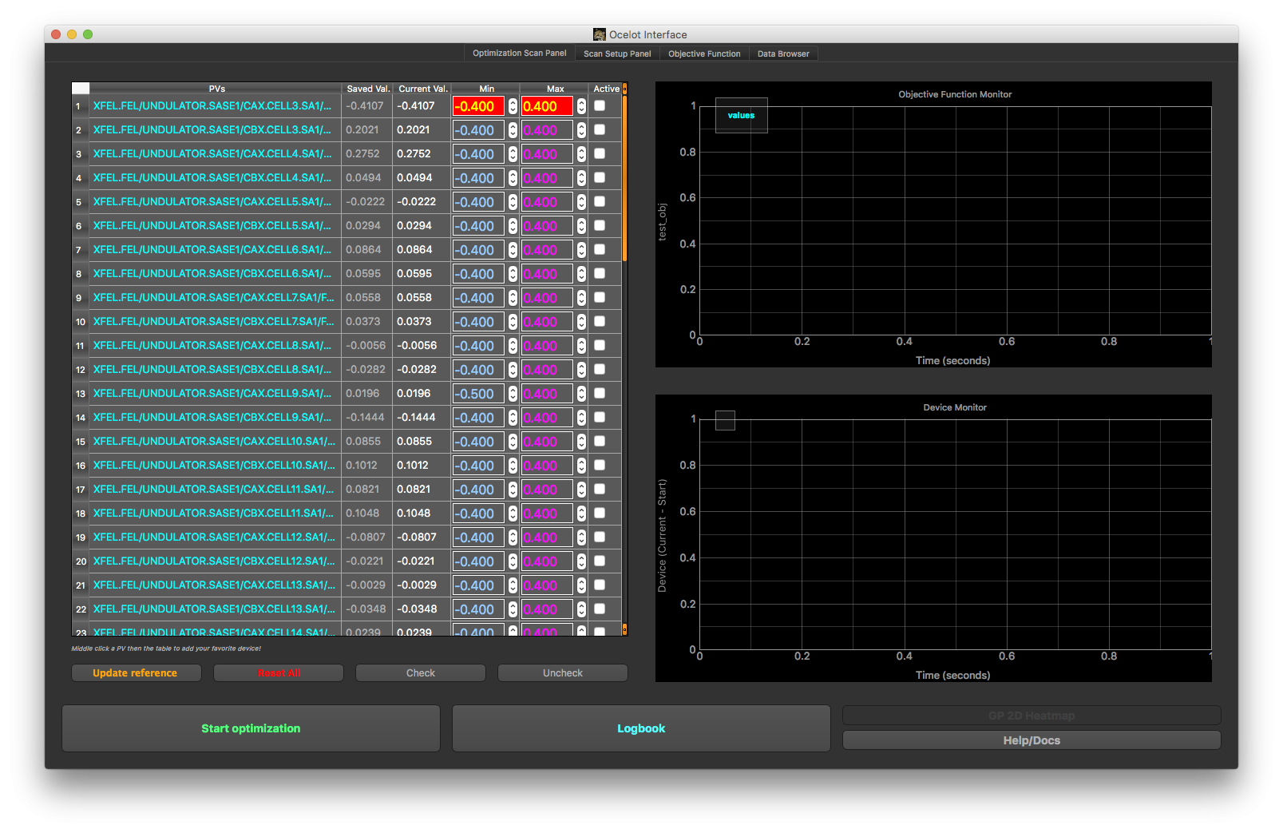
Trajectory in the undulator
-> how to set up the air coils in the undulator.
Case two: you have to start from scratch.
The trajectory achieved with the beam based alignment (BBA) should be good enough to get some lasing. But it does not necessarily have to be the optimum trajectory.
An optimization of aircoil settings is necessary.
The maximum number of aircoils in one optimization setup should not be larger than 8.
Start with aircoils in both planes. Use only aircoils in one plain in the second or third iteration steps.
Be careful that the section you are optimizing is not monitored by the orbit feedback.
Start with as few undulator cells closed as necessary to get lasing in the range of 100-200 uJ Add more and more cells during the optimization.

Slide 13
Bunch compression
A design bunch compression setup can be found in the logbook.
doc -> Beam dynamics -> bunch compression setup
Remember that the calculated curvature has to be reduced by 150 (e.g. 120 instead of 270). This difference was found by measurements.
The theoretical compression setting can be used as a start setting.
Compression setup using the BC2 TDS would be the ideal way how to prepare the bunch compression. This should be used more often in the future!
However, the practical experience is currently that the final setup is found by empirical tuning of chirps, curvature and third derivative.

Slide 14
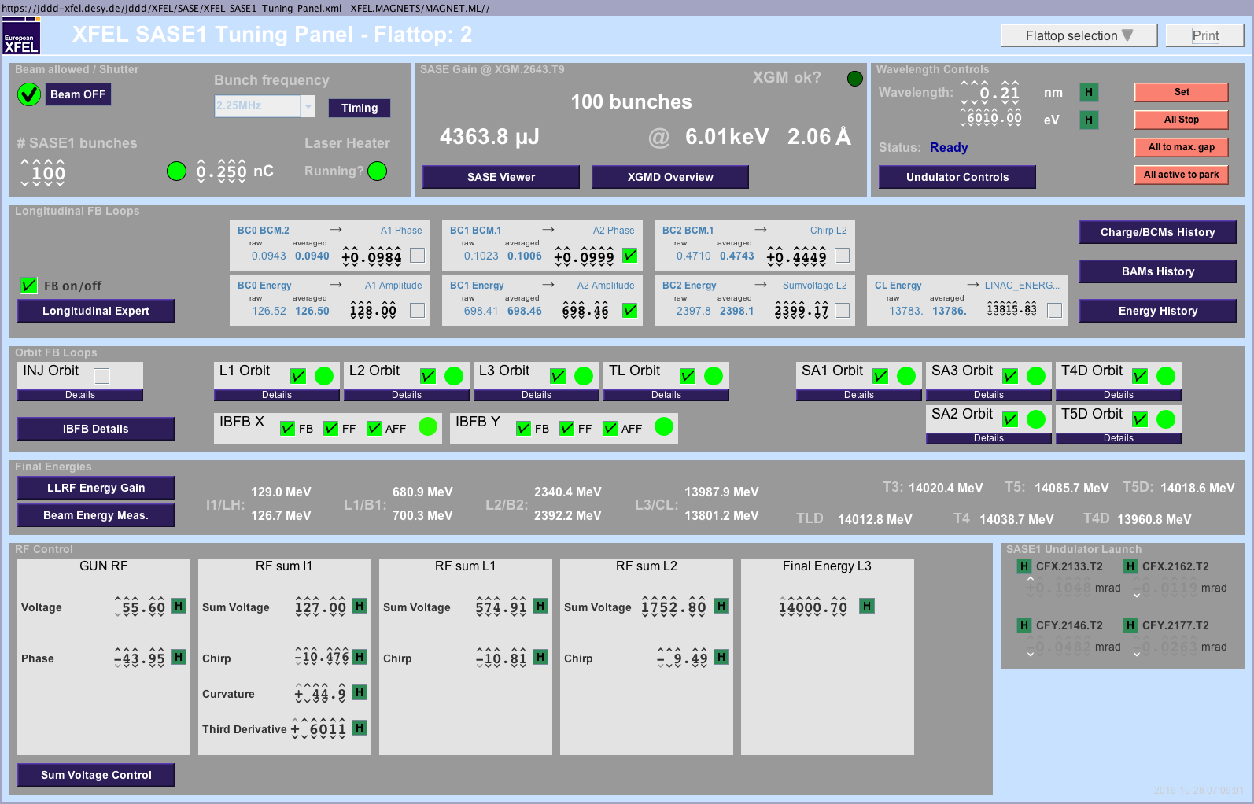
Bunch compression, details
Keep in mind that there is possibly more than one RF-flattop active!
Case one: No SASE signal at all
Use the BCO readback values to compare the actual settings with previous setups (for the same bunch charge).
Ensure that the bunches are not already over compressed (more chirp has to lead to higher BCO read back values).
Use the FEL Imager to look for the first SASE glimmer on the screen that no other device can already detect.
Case two: Improve an existing SASE signal
New distribution of compression between sections: reduce the compression in I1 slightly and compensate with the compression in L1. Redo the same with more compression in I1 and less in L1. Try also all possible combinations of I1, L1 and L2.
Change the curvature and compensate the compression with the chirp in I1. Redo the same with the third derivative.

Slide 15
Injector trajectory
It is well known that the wrong injector trajectory can suppress lasing completely.
Start with a corrector setup in the injector that was saved before while the machine was lasing.
Or correct the beam’s trajectory in the section to a golden/reference trajectory saved before when the machine was lasing.
We have indications that closing the spurious dispersion in the I1-section increases the SASE signals. This can be achieved with the Ocelot optimization tool using the prepared settings (horizontal dispersion and vertical dispersion in the injector).
You can also use the same correctors (those for dispersion correction) with the optimizer using the SASE signal as target function. Keep in mind that this does only work with about 15 seconds delay between the modification of the corrector’s currents and the data taking. This time is needed by the feedback systems along the beamline to restore the previous system setup (in this case mainly the beam’s trajectory).

Slide 16
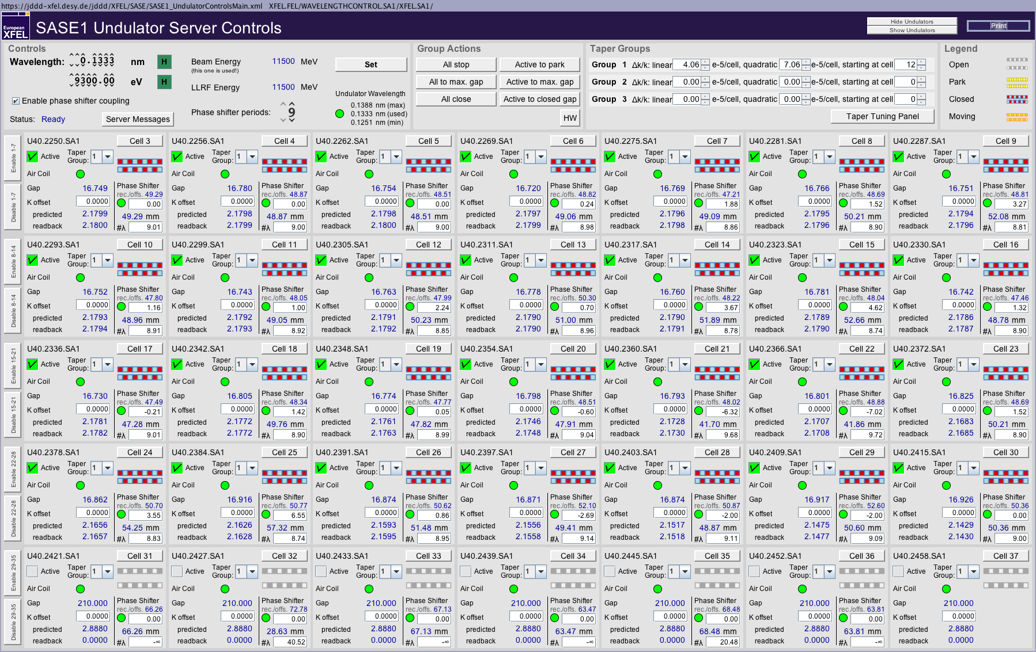
Undulator taper settings
Taper settings are currently often found by empirical tuning based on start values from previously used settings.
Keep in mind that the start of the quadratic taper moves downstream with increasing photon energies.
Try combinations like: reduce the quadratic taper but move it’s start one cell upstream.
Check the movement of all undulator cells! You can see that best on the ‘Taper Tuning Panel’ available via the button on the top right.
Start a new photon energy typically with zero offsets for the phase shifter gaps.
Check whether the chosen period of the phase shifters is suitable for the current combination of electron beam energy and photon beam energy.

Slide 17
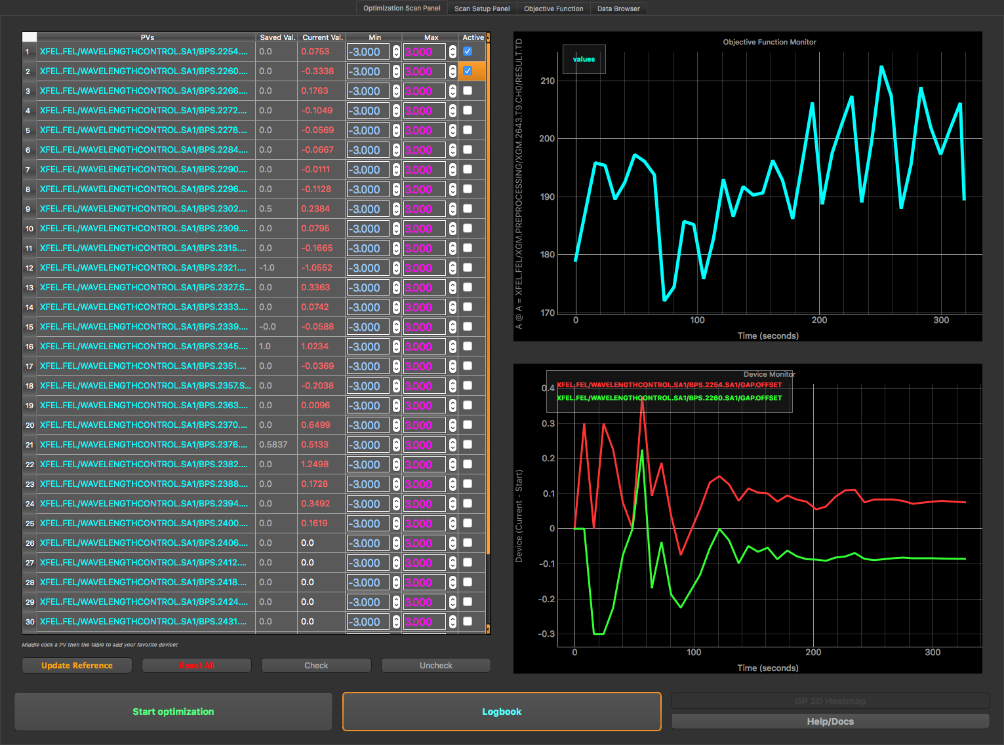
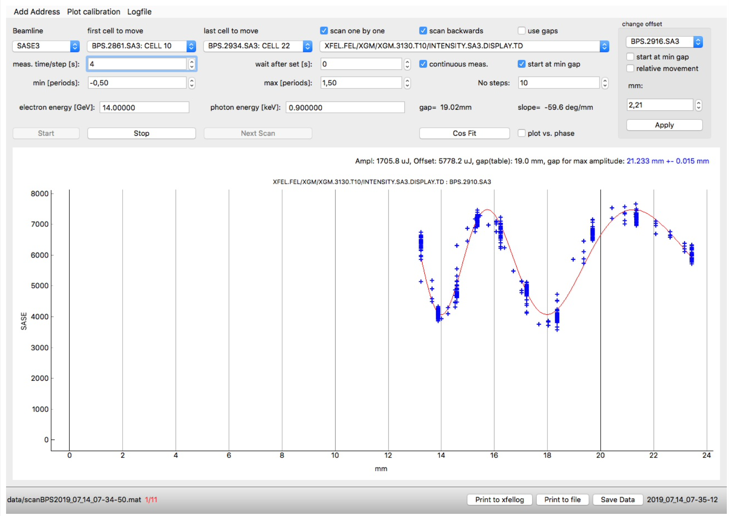
Phase shifter optimizations
We have learned in the past that the setup of phase shifters can have a tremendous impact on the SASE pulse energy.
There are currently two tools available to optimize the phase shifter’s setup:
The Ocelot optimizer using the prepared settings.
The phase shifter scan tool. Please start with the last closed cells when using this tool.
Keep in mind that the phase shifters are not completely steering free!
For that reason, the scanning/optimization of the phase shifters should be done with the trajectory feedback running using also the undulator BPMs as well as the CBX/CBY aircoils. Use the Matlab tool for this configuration.

Slide 18
Beam optics matching and optimization
Optics match in the injector using the multi quad scan tool (See the emittance measurement and beam optics matching operator training).
Set all main magnets to design values and cycled them (use the design kick server panel).
Optimize the matching upstream the undulators using Ocelot with the prepared settings (e.g. SASE1 matching quad).
Last chance: One of the last tuning knobs can be the two air coils quads on the main solenoid in the injector.

Slide 19
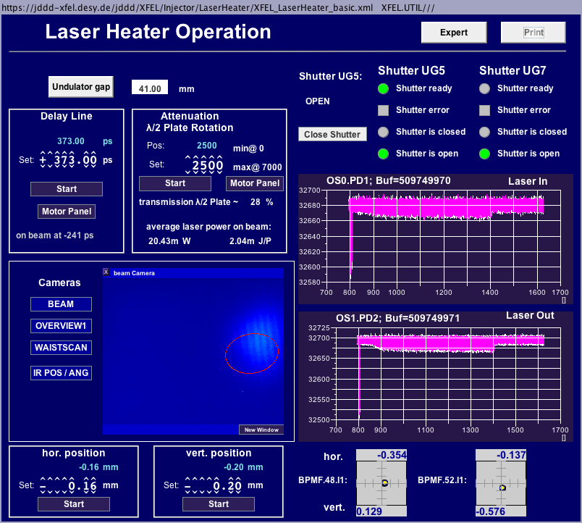
Laser heater setup
The laser heater can be currently used for optimization with 3 different parameters:
Intensity (change in steps of 100 – 1000).
Horizontal offset (change in steps of 0.01 – 0.1 mm).
Vertical offset (change in steps of 0.01 – 0.1 mm).
Test different settings like:
More power but also a lager offset and vice versa.
Different combinations of horizontal and vertical offsets.

