Slide 1
Feedbacks
Common XFEL/FLASH Tutorial on orbit feedback operation
Raimund Kammering
Hamburg, 08.11.2019

Slide 2
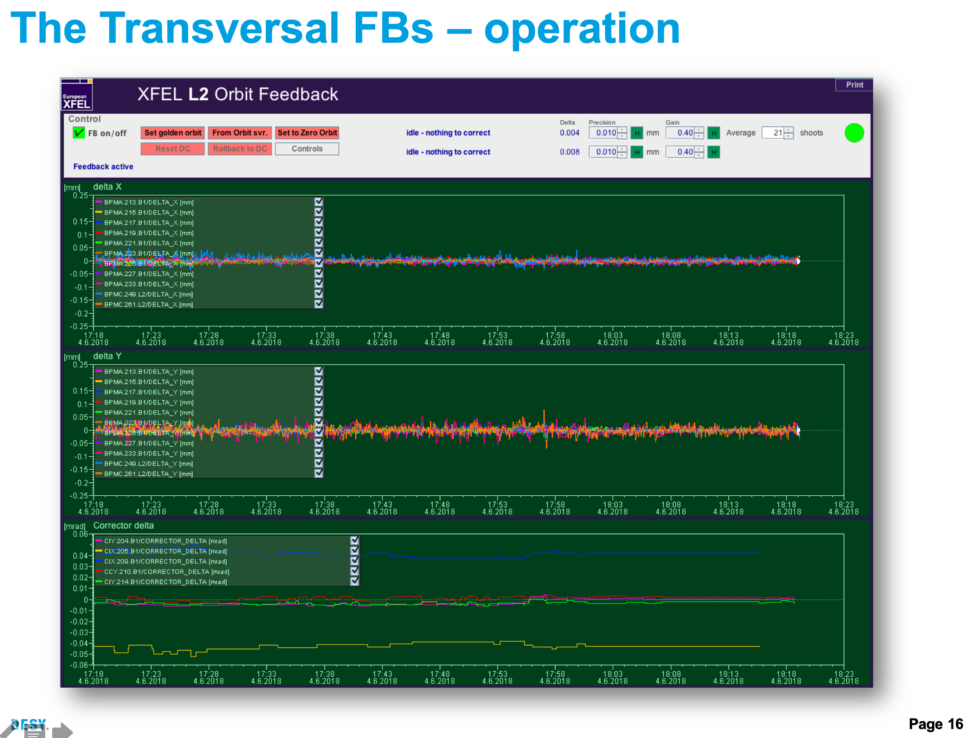
Introduction
Much will be left out, since …
it has been covered elsewhere!
Intra Bunch Train FBs (only XFEL)
slow RF FBs (same for XFEL and FLASH)
orbit FBs basics (same for XFEL and FLASH)
see: https://flash.desy.de/training/ and/or https://xfel-wiki.desy.de/Training
but all more on the level of “what’s behind the slow FBs” and less on “how to operate the FBs”

Slide 3
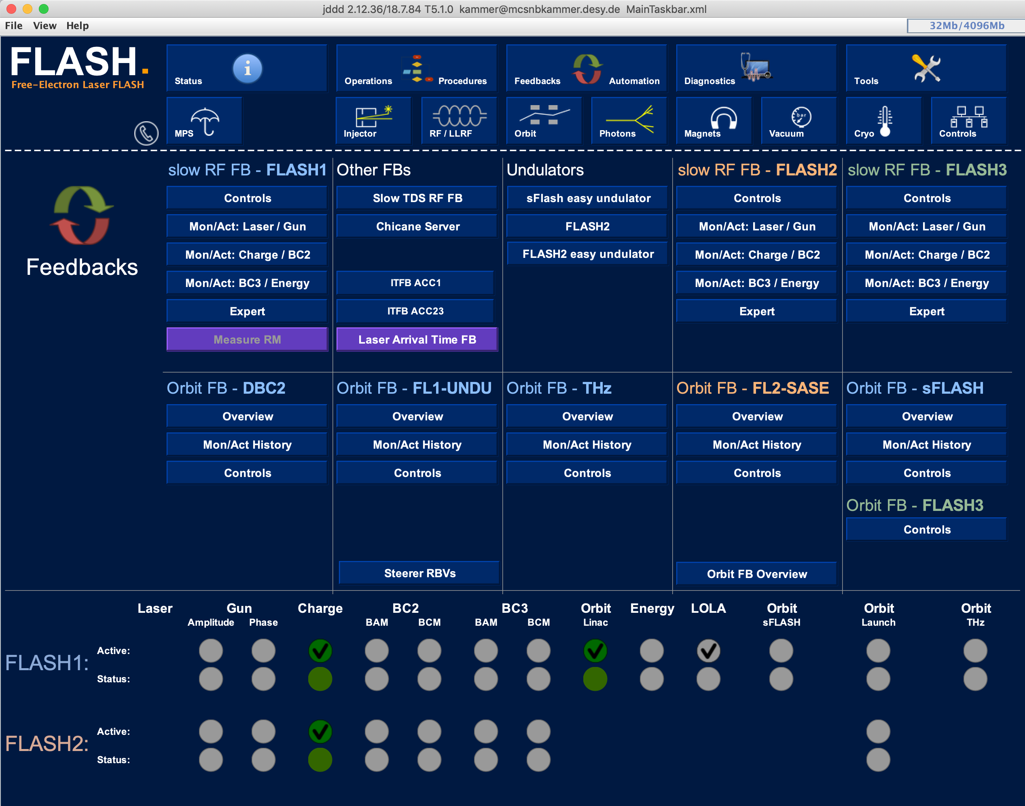
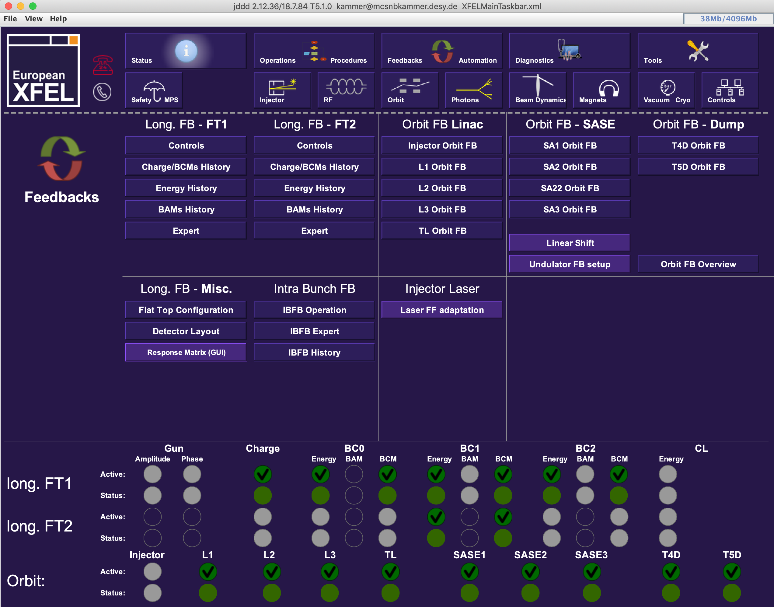
Introduction
the DOOCS base slow orbit FB
running the same code on FLASH and XFEL
➔ user interfaces are (mostly) the same
BUT some operation habits differ – later more on this

Slide 4
The Orbit Feedback at FLASH and XFEL
The Orbit Response Matrix (ORM)
FLASH
no online optic model server
➔ need to get ORM via measurements
XFEL
very good online optics model
➔ all ORM from server

Slide 5
The Orbit Feedback at FLASH and XFEL
The Orbit Response Matrix (ORM)
Working with changing configurations one might need to pay attention to the inverse ORM
A trustworthy inverse ORM should:
be lower triangular
have no astronomical values (e.g. 10¹³ or 10⁻¹¹)
reflect symmetry of the lattice

Slide 6
The Orbit Feedback at FLASH and XFEL
The Orbit Response Matrix (ORM)
Measuring a new ORM (only FLASH)
is easy and known to the operators
needs time and is inversive
should give best FB performance
derives mostly not all elements
A theoretic ORM (only XFEL)
can be derived offline
gives all elements
might not match real machine

Slide 7
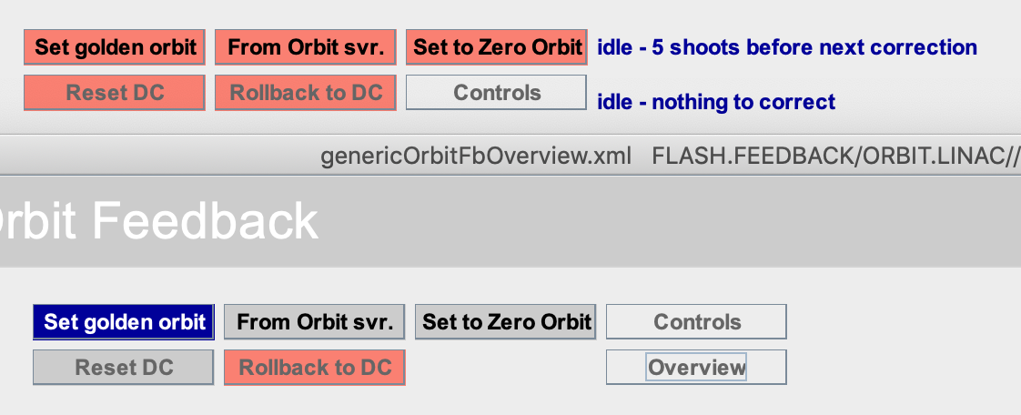
Operation of the orbit FB
Usually the orbit FBs are used to “just keep a certain orbit”
This can be done using the standard jddd panels
but there are other operation scenarios possible:
get target from sequencer (FLASH) or trajectory storage server (XFEL)
toggling between adaptive and normal FB

Slide 8
Operation of the orbit FB
Working with target orbits – restore old orbit
FLASH
Open sequencer file catalog view
right click on file of interest
XFEL
from trajectory storage server select file to ‘restore’
load orbit to reference orbit

Slide 9
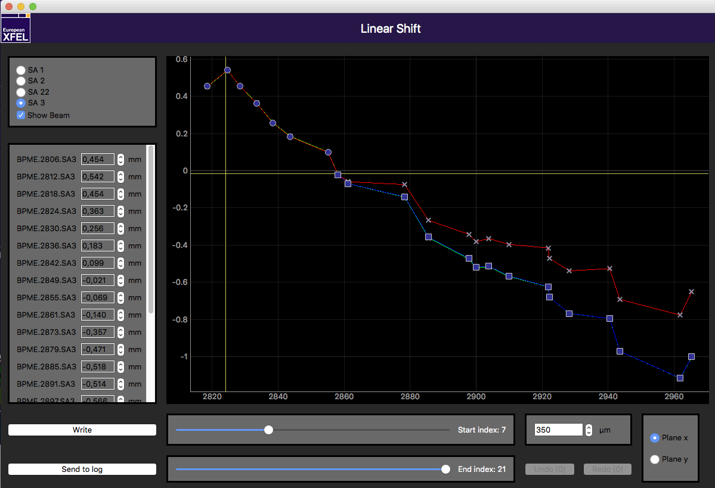
Operation of the orbit FB
Working with target orbits – restore old orbit
Both FLASH and XFEL
Orbit server now holds desired orbit in the reference orbit field
a simple python script allows to pull orbit from orbit server into orbit FB targets
Working with target orbits – arbitrary orbits
Orbit targets are simple DOOCS properties:
can be manipulated from outside
build a small python GUI to do so

Slide 10
Thank you

