Slide 1
Machine Learning for PETRA IV
Orbit correction and beam accumulation
Andrei Ivanov
Hamburg, 03.12.2019

Slide 2
Overwiew
01 Problem Formulation
Linear dynamics
Nonlinear effects
Misalignements
02 ML-based solutions
Learning dynamics
Control policy
03 Next steps
2

Slide 3
Problem Formulation

Slide 4
The linear models are used to correct orbit
Reference orbit is designed along centers of elements
x
quadrupole
dipole
sextupole
3

Slide 5
The linear models are used to correct orbit
Because of imperfections the actual orbit has deviations
x
quadrupole
dipole
sextupole
3

Slide 6
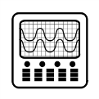
The linear models are used to correct orbit
To measure the beam deviation a BPM is used
x
Δx₁
Δx₂
quadrupole
dipole
sextupole
BPM₁
BPM₂
Orbit correction: Δx1⟶ 0, Δx2⟶ 0
3

Slide 7

The linear models are used to correct orbit
Additional magnets correct the orbit
corrector magnet С₁
corrector magnet С₂
x
Δx₁
Δx₂
quadrupole
dipole
sextupole
BPM₁
BPM₂
Orbit correction: Δx1⟶ 0, Δx2⟶ 0
M $\left(\begin{matrix}С1 \\ С2\end{matrix}\right)=$ $\left(\begin{matrix}\text{Δ}\text{x}\text{1} \\ \text{Δ}\text{x}\text{2} \end{matrix}\right)$
SVD
Least-Squares Method
M is response matrix, is calculated from the lattice as an initial approach and clarified with measured data
3

Slide 8
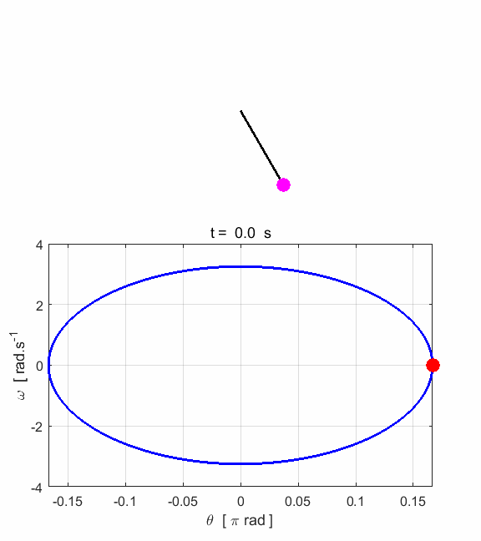
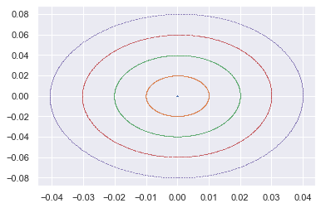
The linear dynamics of particles
Linear oscillations around the reference orbit
x'
x
Linear dependencies between correctors and orbit deviation at BPMS
Δx
Control
4

Slide 9
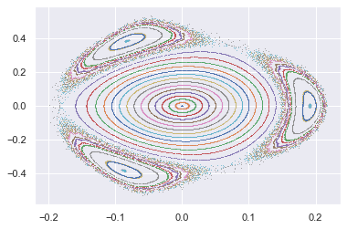
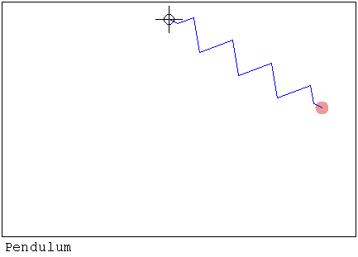
The linear dynamics of particles
Nonlinear dynamics
x'
x
Linear dependencies between correctors and orbit deviation at BPMS
Δx
Control
5

Slide 10
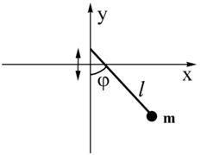
The linear dynamics of particles
Nonlinear dynamics
x'
The vibration of pivot point can cause both stabilization of the inverted position and chaotic regime for bottom position
x
Linear dependencies between correctors and orbit deviation at BPMS
Δx
Control
5

Slide 11
Dynamics between BPMs
Local bumps can arise
x
Δx₁ = 0
Δx₂ = 0
Δx_{hidden} >> 0
BPM₁
BPM₂
6

Slide 12
Misalignments
affect lattice optics
x
quadrupole
F₁ ~ g₁· x
dipole
F₂ ~ g₂
sextupole
F₃ ~ g₃· x²
7

Slide 13
Misalignments
affect lattice optics
x
quadrupole
F₁ ~ g₁· (x + Δx)
dipole
F₂ ~ g₂
sextupole
F₃ ~ g₃· (x + Δx)²
7

Slide 14
Misalignments
affect lattice optics
x
quadrupole
F₁ ~ g₁· (x + Δx)
dipole
F₂ ~ g₂
sextupole
F₃ ~ g₃· (x + Δx)²
+
+
+
quadrupole
F₁ ~ g₁· x
dipole
F₁₂ ~ g₁· Δx
sextupole
F₃ ~ g₃· x²
quadrupole
F₃₁ ~ g₃· 2xΔx
dipole
F₃₂ ~ g₃· Δx²
7

Slide 15
Misalignments
affect lattice optics
x
quadrupole
F₁ ~ g₁· x
dipole
F₂ ~ g₂
sextupole
F₃ ~ g₃· x²
Design lattice
x
Actual lattice
7

Slide 16
PETRA IV
Challenges for the orbit correction and beam accumulation
Low emittance and strong sextupoles introduces sensitivity against lattice imperfections
Large amount of BPMs (~1000) along with the huge amount of control elements
8

Slide 17
PETRA IV
Challenges for the orbit correction and beam accumulation
Low emittance and strong sextupoles introduces sensitivity against lattice imperfections
Large amount of BPMs (~1000) along with the huge amount of control elements
To tackle these problems one can enhance control with ML
Learning model of misalignments with the measurements from BPM
Predict model of misalignments for new runs
Virtual BPMs (simulation of dynamics between BPM)
8

Slide 18
ML-based solutions

Slide 19
ML methods
Learning dynamics
high-order maps for dynamics simulation (Taylor maps, Lie transform, Differential Algebra)
import tensorflow as tf
from keras.models import Sequential
from Taylor_Map import Drift, Diplole, Quadrupole, Sextupole
lattice = Sequential()
9

Slide 20
ML methods
Learning dynamics
import tensorflow as tf
from keras.models import Sequential
from Taylor_Map import Drift, Diplole, Quadrupole, Sextupole
lattice = Sequential()
lattice.add(Quadrupole(length=0.1, k1=1.0))
9

Slide 21
ML methods
Learning dynamics
import tensorflow as tf
from keras.models import Sequential
from Taylor_Map import Drift, Diplole, Quadrupole, Sextupole
lattice = Sequential()
lattice.add(Quadrupole(length=0.1, k1=1.0))
lattice.add(Drift(length=0.25)
lattice.add(Dipole(length=0.1, angle=0.01))
…
lattice.predict()
9

Slide 22
ML methods
Learning dynamics
import tensorflow as tf
from keras.models import Sequential
from Taylor_Map import Drift, Diplole, Quadrupole, Sextupole
lattice = Sequential()
lattice.add(Imperfection()) # nonlinear model with trainable_weights
lattice.add(Quadrupole(length=0.1, k1=1.0)) # lattice design
10

Slide 23
ML methods
Learning dynamics
import tensorflow as tf
from keras.models import Sequential
from Taylor_Map import Drift, Diplole, Quadrupole, Sextupole
lattice = Sequential()
lattice.add(Imperfection()) # nonlinear model with trainable_weights
lattice.add(Quadrupole(length=0.1, k1=1.0)) # lattice design
…
lattice.fit() # fit model of imperfections with data from BPMs
Imperfection():
simple shifts for misalignments, neural networks for considerations of nonlinear effects, etc.
10

Slide 24
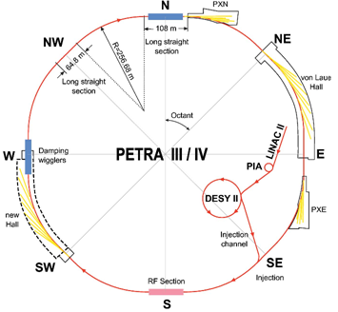
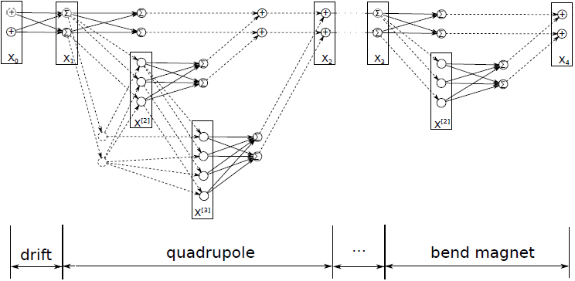
ML methods: control policy
Classical Control Theory or Reinforcement Learning with continuous actions
temperature, etc.
observations
OCELOT Optimizer
A computational graph in TensorFlow
RL
control
11

Slide 25
Next steps
Build models for orbit correction with simulated data
OCELOT:
open source project for beam dynamics simulation of the whole machine in modern electron-based x-ray sources
Work with infrastructure
in terms of data acquisition and interfaces to be able to introduce implemented models into existing control environment
12

Slide 26
Thank you
Andrei Ivanov
MPY
andrei.ivanov@desy.de

