Slide 1
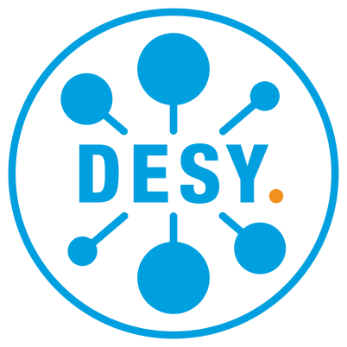

ML methods for FEL data analysis
By: Alireza Sadri
DESY-CFEL/ AMALEA
26 Slides
References are given below each slide

Slide 2
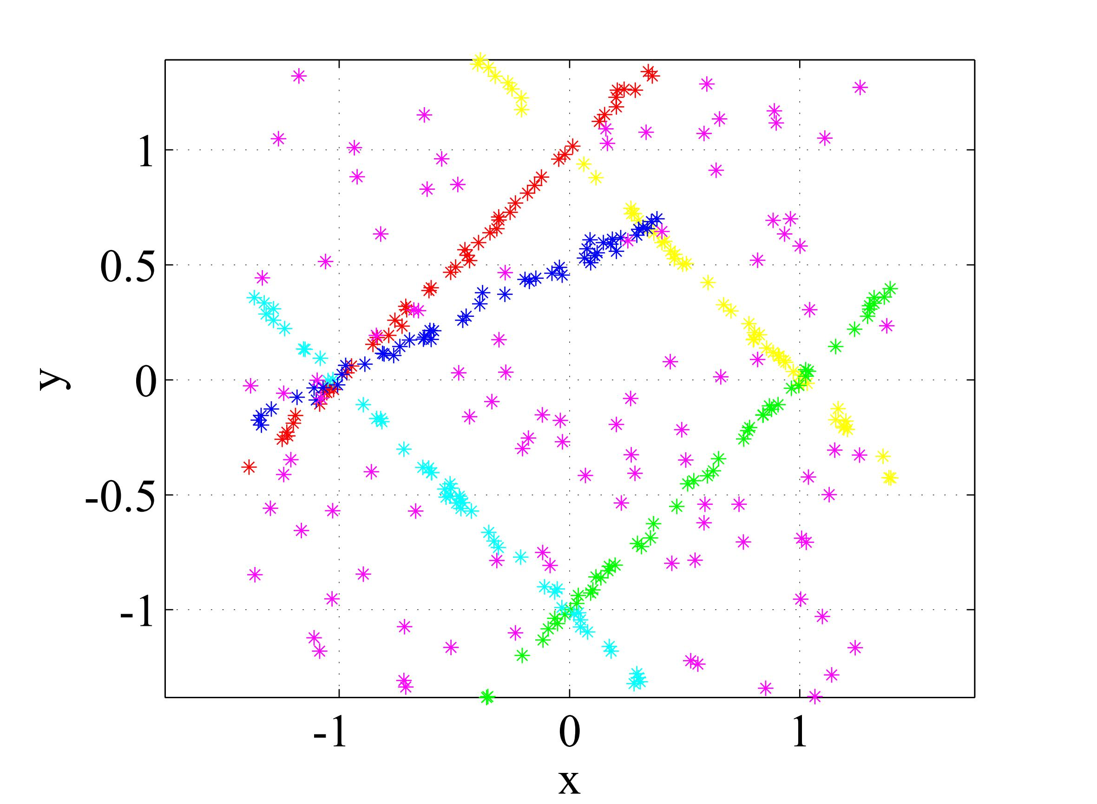



Data segmentation via clustering
Lines with algebraic Gaussian noise
Test parameters:
Number of inliers
Number of outliers
Noise scales
Data points
Models parameters
Structures sizes

Slide 3
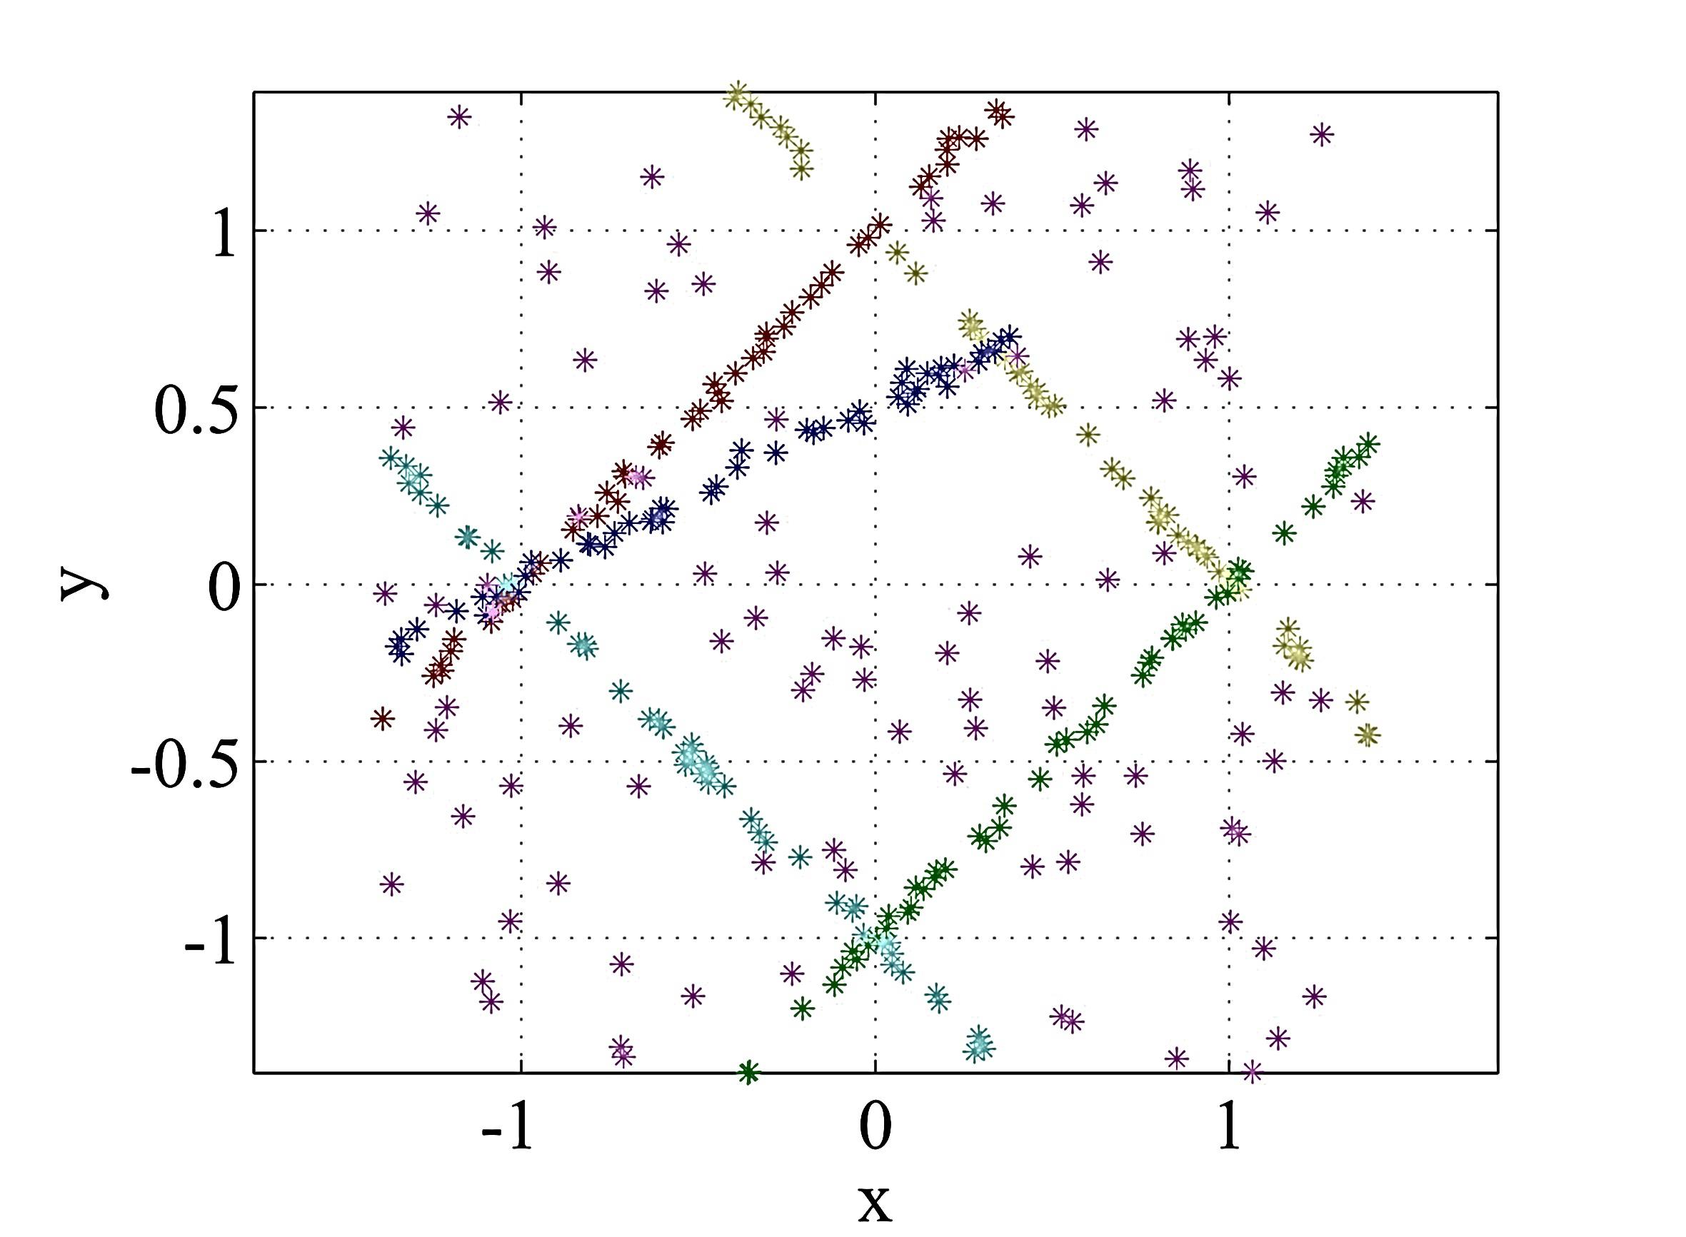
Data segmentation via clustering

Slide 4
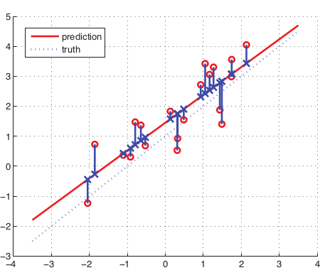




Line fitting problem in presence of noise
Data sample:
Evalutaion Function
Model fitting cost function
For line fitting with algebraic error values assuming data points have iid Gaussuan distributed noise, and L=2, the Total Least Squares gives MLE and can be easily achieved via SVD.
This will be one sample.
Image from the book: “ML from probabilistic perspective by A. Murphy

Slide 5

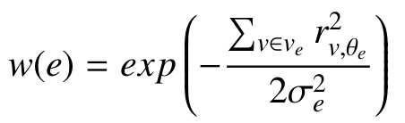
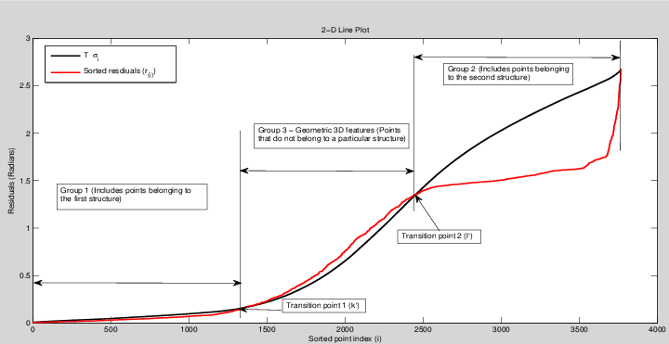
Robust Segmentation by fitting to distributions
Estimating scale of noise:
Model goodness:
Image from the book: “ML from probabilistic perspective by A. Murphy

Slide 6
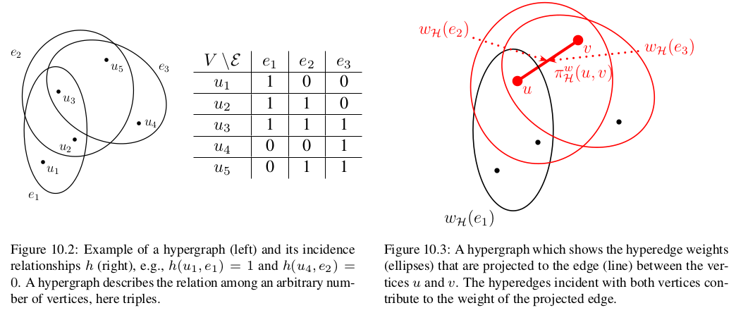



Mutli-way distances (Hypergraphs)
Reducing to graph for cutting by Normalized cut

Slide 7
Data segmentation via clustering

Slide 8
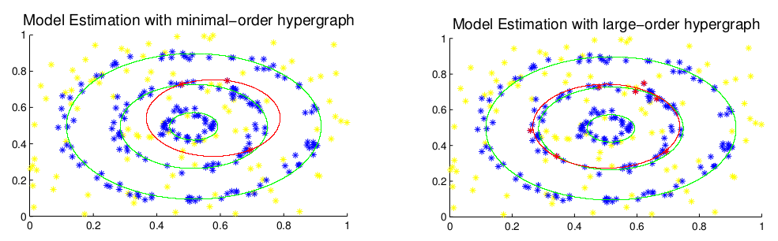
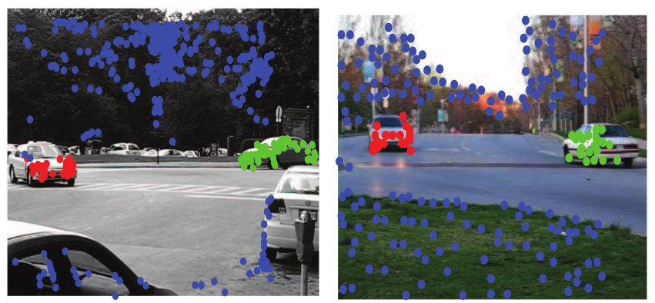
Effect of sample size

Slide 9
Data segmentation via clustering

Slide 10
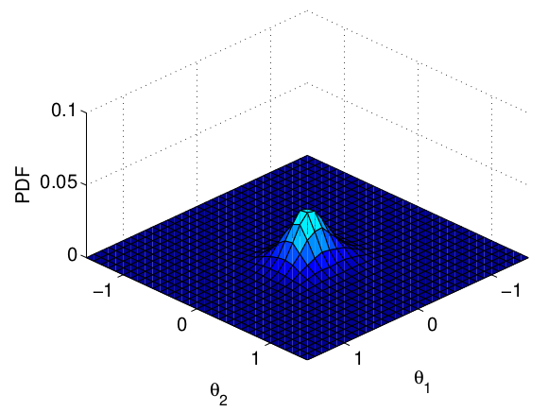
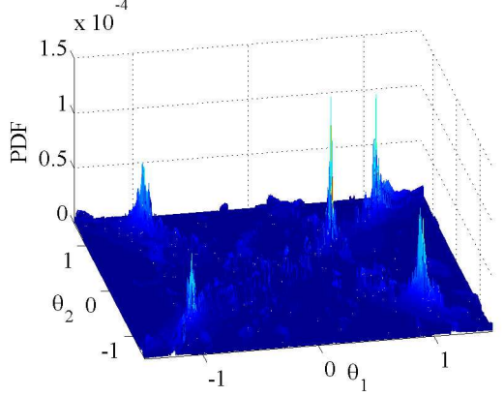
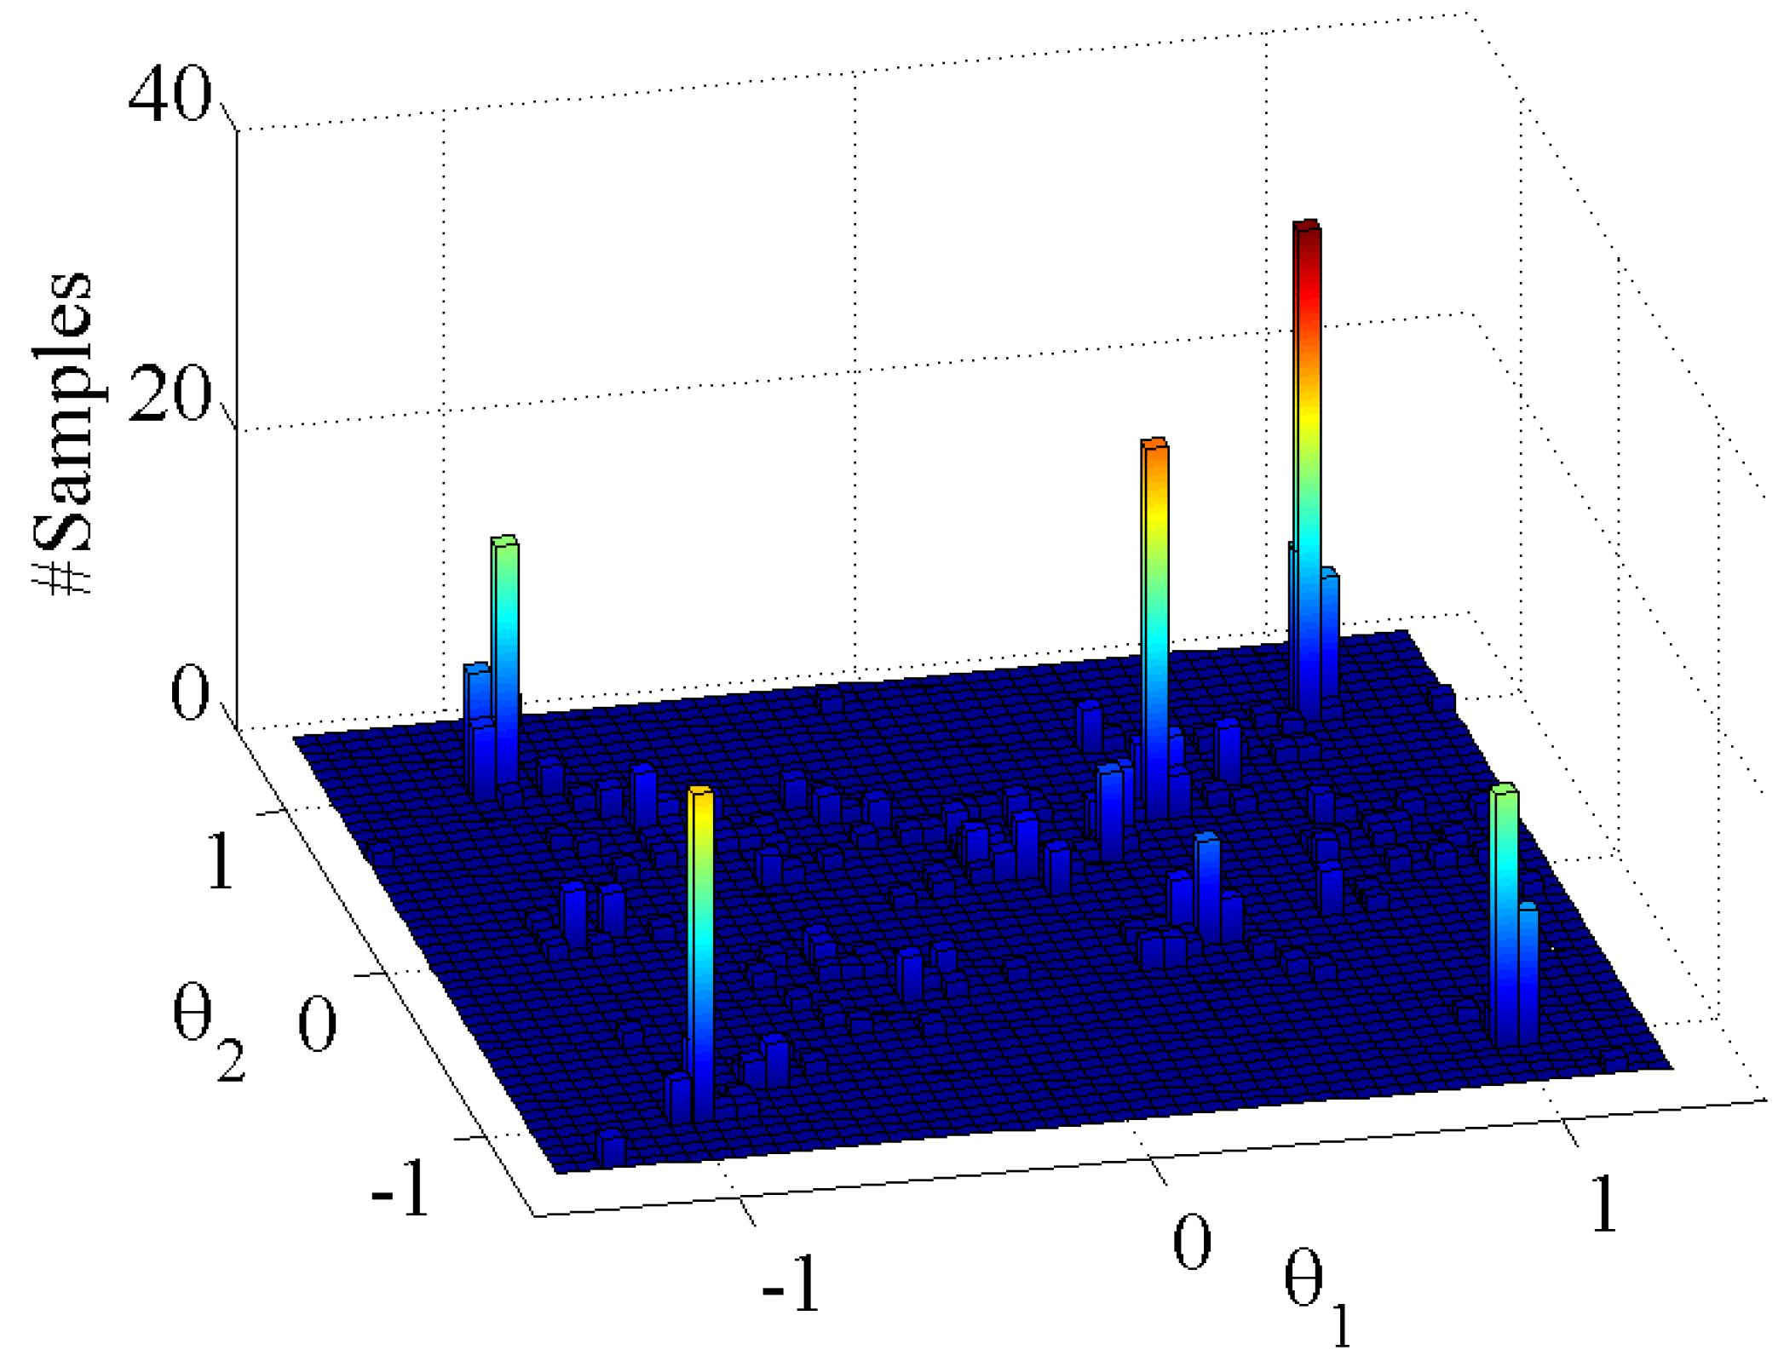
Markov-Chain-Monte-Carlo sampling method
Likelihood by worst residual

Slide 11
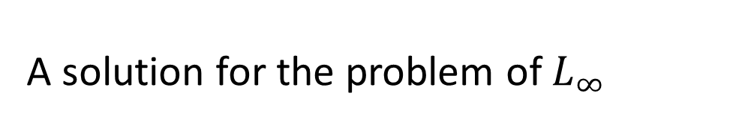
A solution for the problem of $L_{∞}$
Challenge: you don’t know the size of the structure.
My PhD finale: sample from density of structure size
Image from the book: “ML from probabilistic perspective by A. Murphy

Slide 12
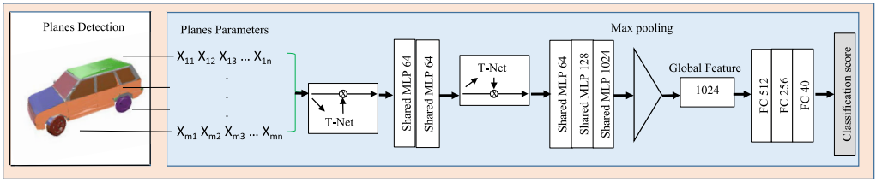
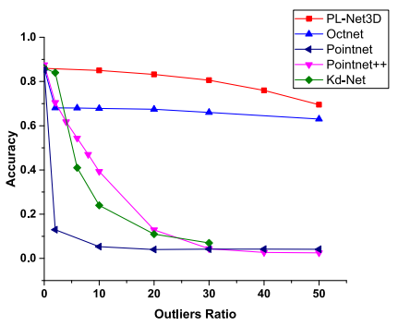
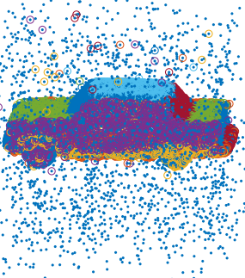
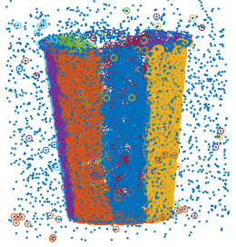
Robust methods for deep learning: PL-Net3d
https://ieeexplore.ieee.org/stamp/stamp.jsp?arnumber=8895750

Slide 13
That’s where I came from and now....

Slide 14
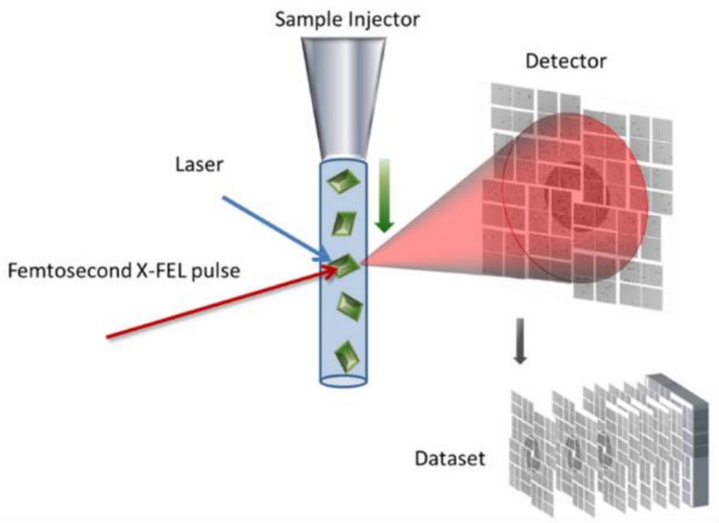
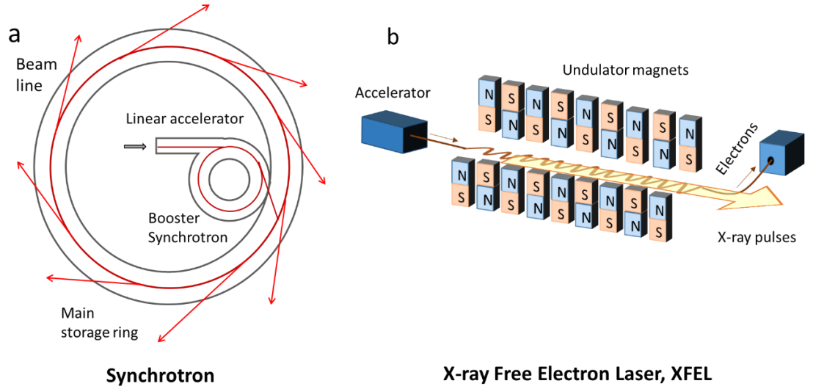
FEL Data volume challenge
An example AGIPD detector at the European XFEL:
~3,500 1 Mpx (4 Mpx soon!) images per second.
Millions of images and hundreds of TB per experiment:
to solve a structure or retrieve the electron density of a particle, we need maybe thousands of good images...
Petra Edlund,, “ Structural Features of Bacteriophytochromes“ 2018, University of Guthenburg

Slide 15
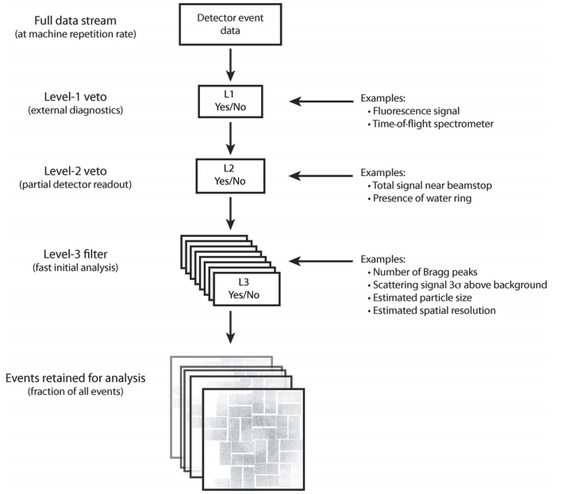
Data reduction chances at each stage
Data correction by calibration constants
Bad pixel mask
Pedestal correction
Gain correction
Runtime
pre-processing
Artefacts detection and segmentation
Common mode removal
https://www.ncbi.nlm.nih.gov/pmc/articles/PMC4038800/pdf/j-47-01118.pdf

Slide 16
FEL data reduction by Machine Learning
(Literature that I’ve reviewed)
Improving data quality:
  Bad pixel mask for FEL detectors
  My current focus because of dire need
Improving other stages of analysis pipeline
  More accurate Bragg-Peak finding in Crystallography
  Faster indexing methods in Crystallography
  More accurate phasing

Slide 17
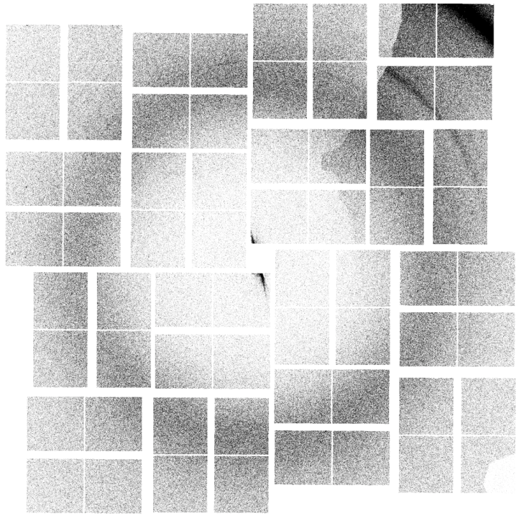
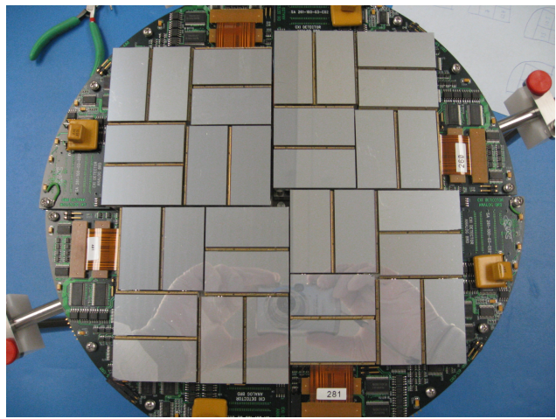
Bad pixel mask for FEL detectors
(current task)
Must account for different types of “bad” pixels
  Permanently damaged: Hot pixels, Cold pixels ,Flickering pixels, Dead ASICs,
  Runtime artifacts: Shadows, “Chatty” panels, streaks, too bright water rings
Previous works include Streak finder by Yaroslav Gevorkov in CFEL
CsPad
  Yaroslav Gevorkov, “Real-time image analysis and data compression in high throughput X-ray diffraction experiments”

Slide 18
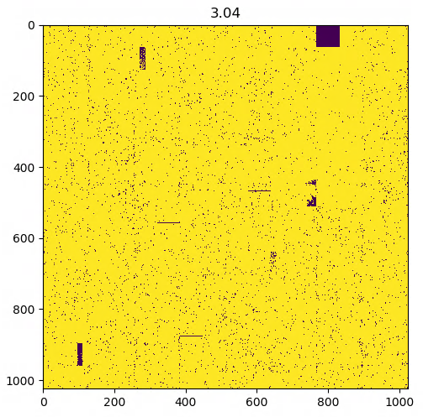
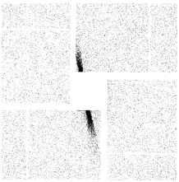
Bad pixel detection solutions (current task)
Modern robust statistical analysis (to improve previous works)
Segmentation using DNNs
Anomaly detection using DNNs (VAEs or GANs)
  Bad pixels
  Bad diffraction patterns
  Yaroslav Gevorkov, “Real-time image analysis and data compression in high throughput X-ray diffraction experiments”

Slide 19
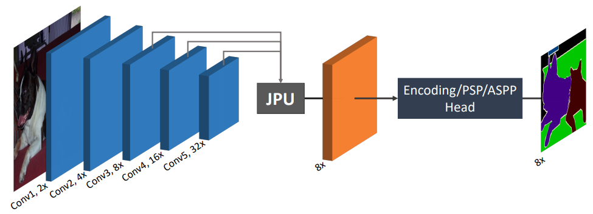
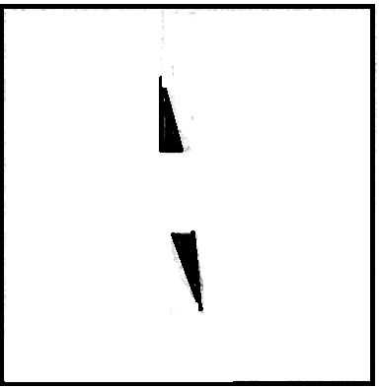
Segmentation using DNNs
Pattern segmentation methods
  Seg-Net, U, V, Y, W-Nets, FCN, Deeplab3+, pix2pix, cycleGAN…
  FastFCN
https://arxiv.org/abs/1903.11816

Slide 20
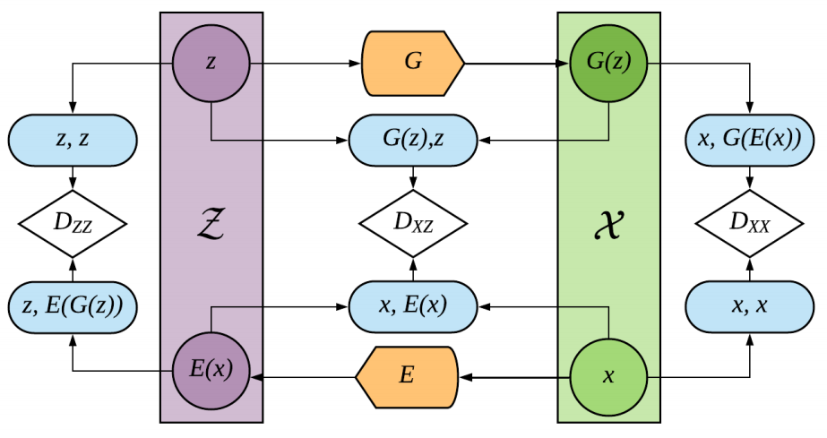
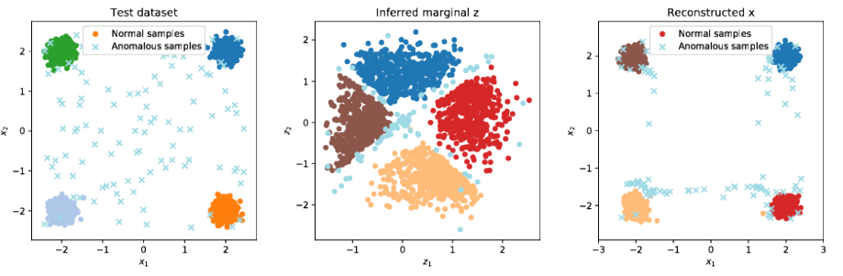
Adversarially Learned Anomaly Detection
https://arxiv.org/abs/1812.02288

Slide 21
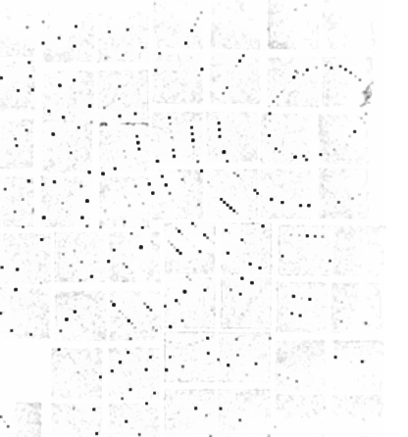
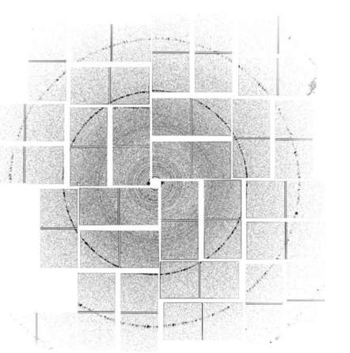
Bragg Peak Finding in Crystallography
Bragg peaks are hard to find (noise, artifacts, outliers)
There are many methods
https://www.ncbi.nlm.nih.gov/pmc/articles/PMC4038800/pdf/j-47-01118.pdf

Slide 22
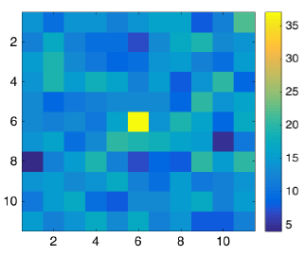
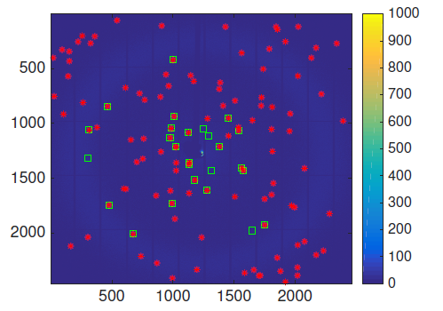
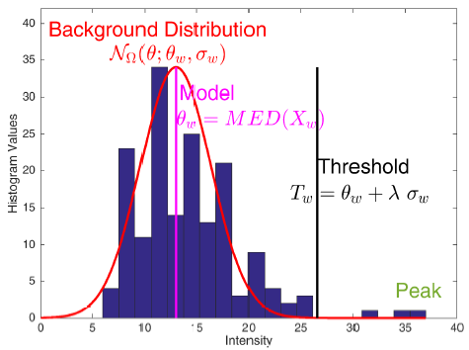
Bragg-Peaks finding algorithm for crystallography
http://scripts.iucr.org/cgi-bin/paper?S1600576717014340

Slide 23
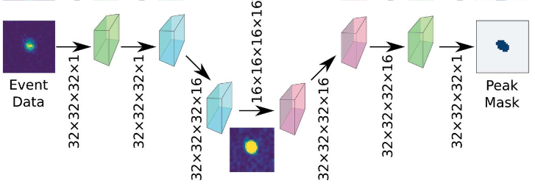
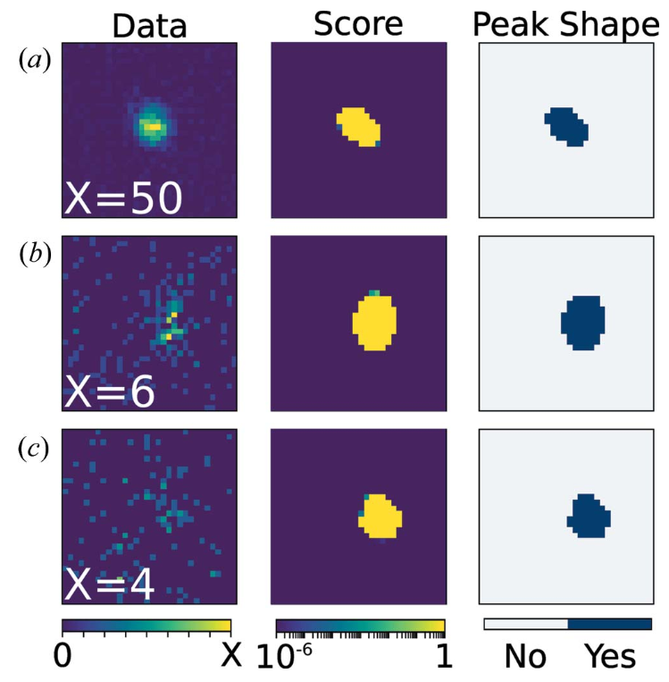
BraggNet: integrating Bragg peaks using neural networks
Based on U-Net
convolution
Transposed convolution
https://onlinelibrary.wiley.com/doi/abs/10.1107/S1600576719008665

Slide 24
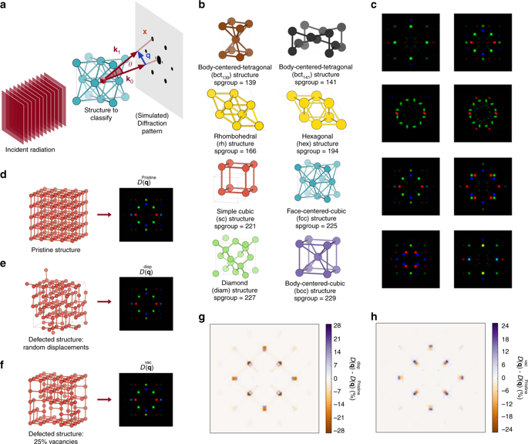
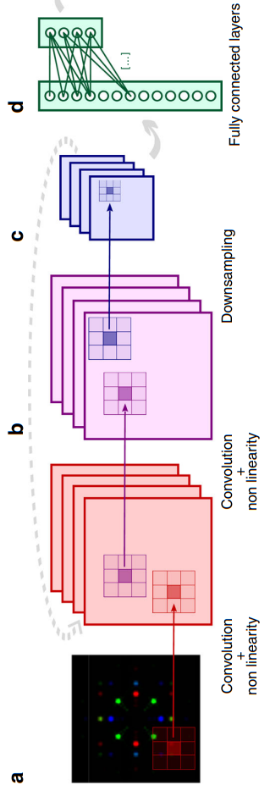
Insightful classification of crystal structures using deep learning
https://www.nature.com/articles/s41467-018-05169-6

Slide 25
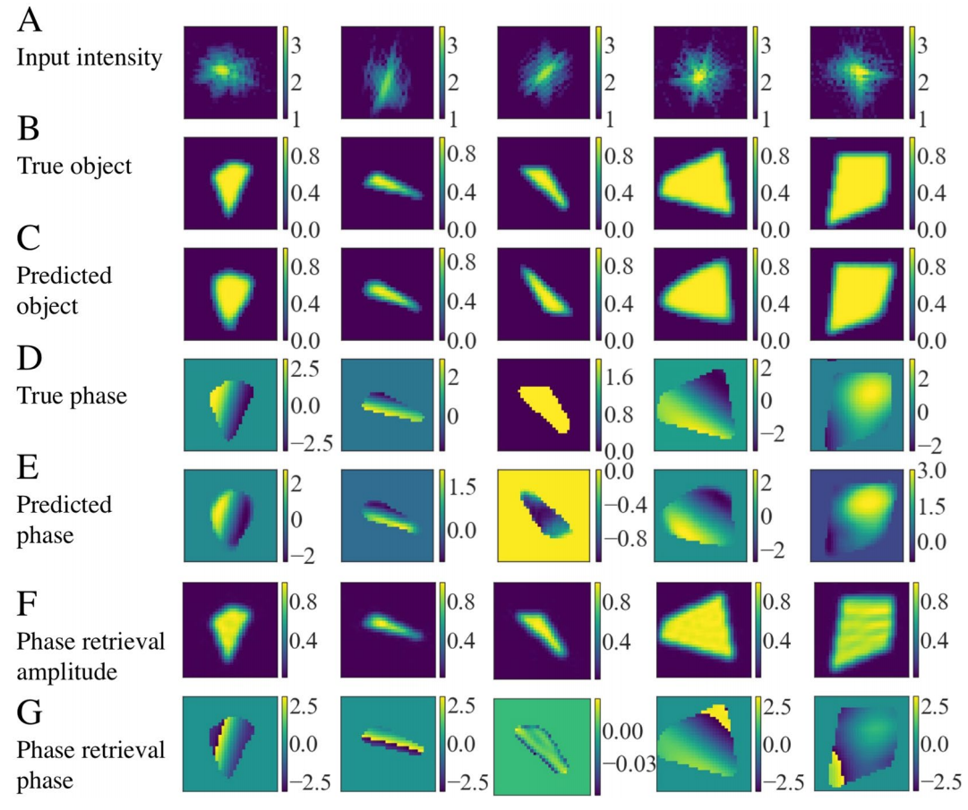
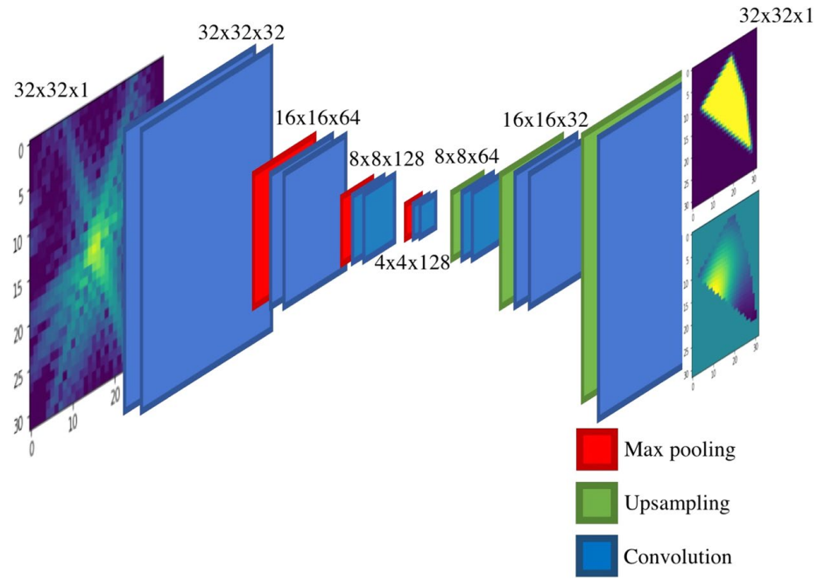
Real-time coherent difraction inversion using deep generative networks
https://www.nature.com/articles/s41598-018-34525-1.pdf

Slide 26
In conclusion
What is the vision?
  To deliver generic methods to improve data analysis and allow for heavier vetoing of uninformative data in FEL data analysis pipelines
Where is the potential?
  Improving each stage of the analysis pipeline using modern ML methods
Where are the challenges?
  Generalization of ML methods to new datasets
  Adaptation of delivered softwares in current frameworks
Many thanks goes to DESY, CFEL and AMALEA for this opportunity.

Slide 27
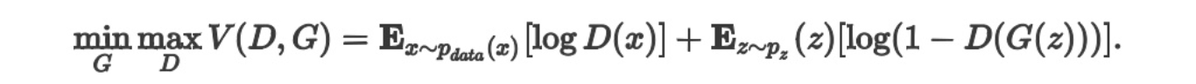
Review a few GANs (all slides are copies)
http://digital-thinking.de/watchgan-using-generative-adversarial-networks-for-artificial-generated-watch-art/
https://arxiv.org/pdf/1611.07004.pdf
https://www.slideshare.net/JunhoCho1/image-translation-with-gan

Slide 28
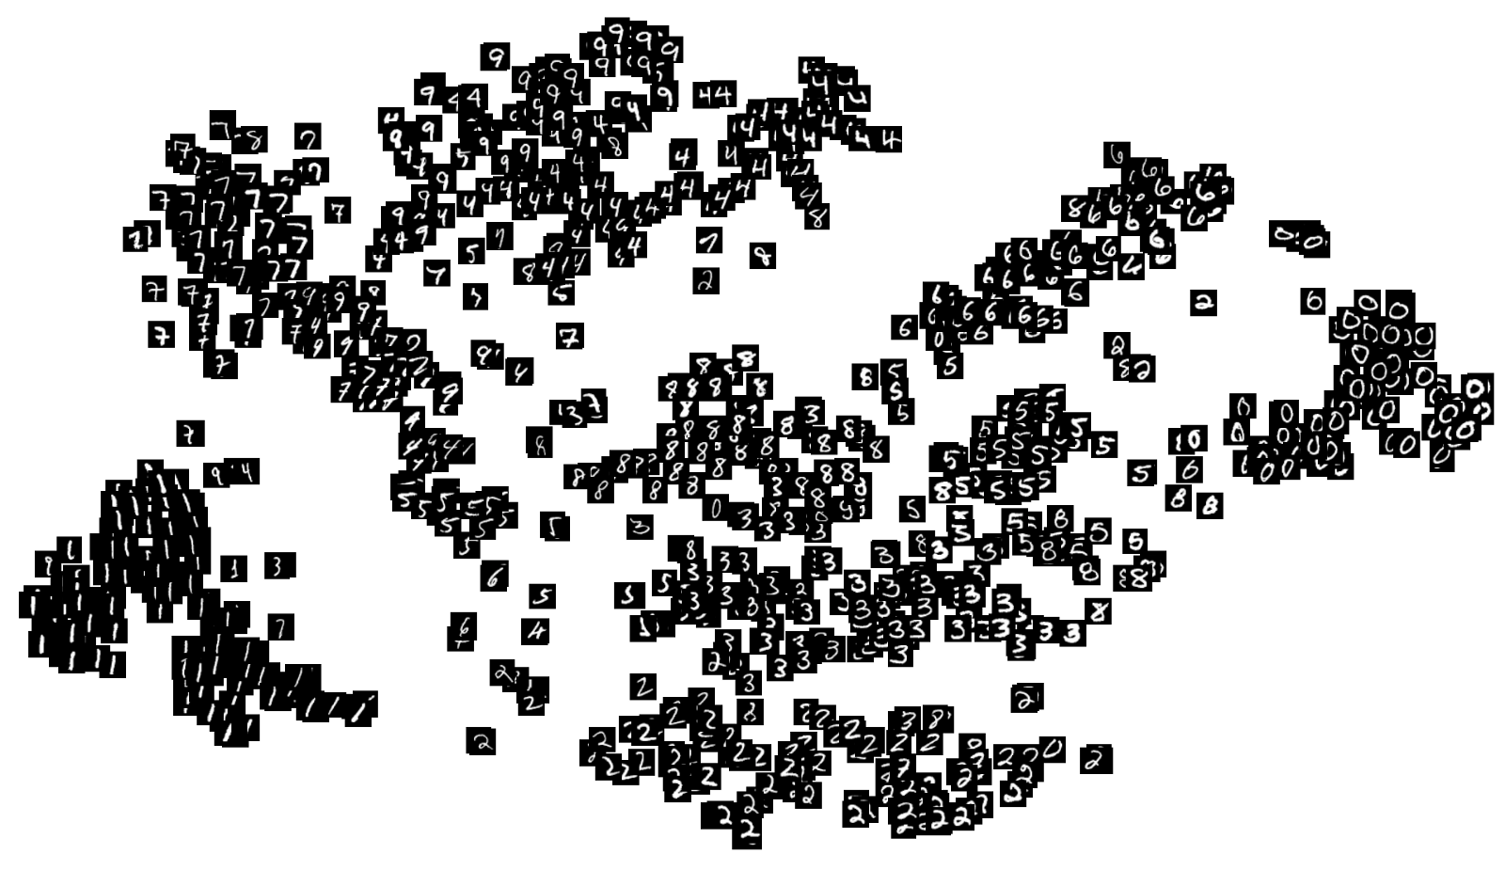
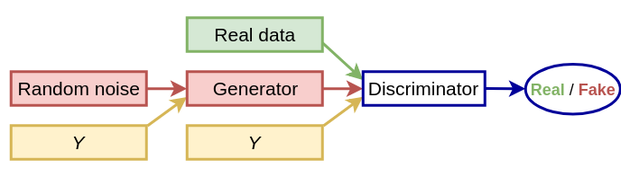
Mapping digits to a 3D space, conditional GAN

Slide 29
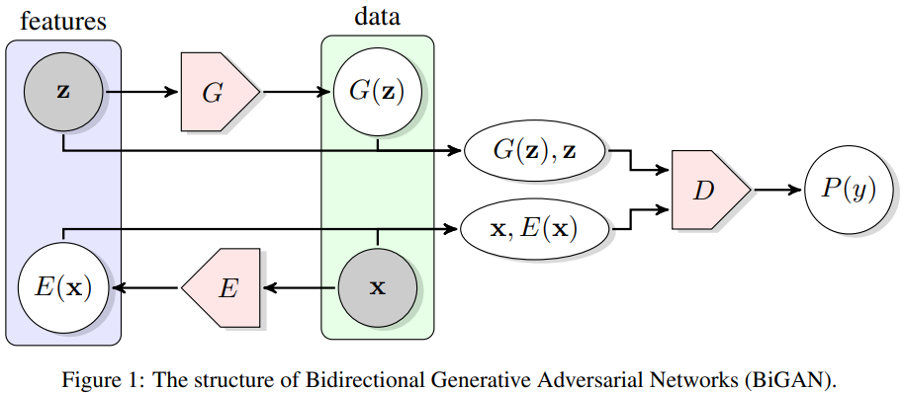
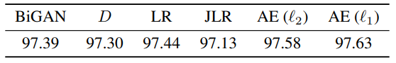

BiGAN: feature representation using GANs
In VAE, the output of Encoder goes directly to decoder
https://arxiv.org/pdf/1605.09782.pdf

Slide 30
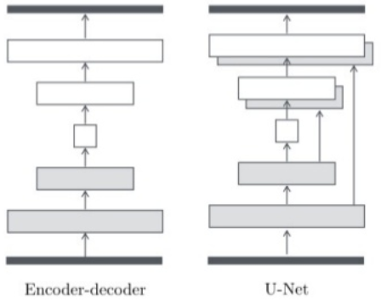
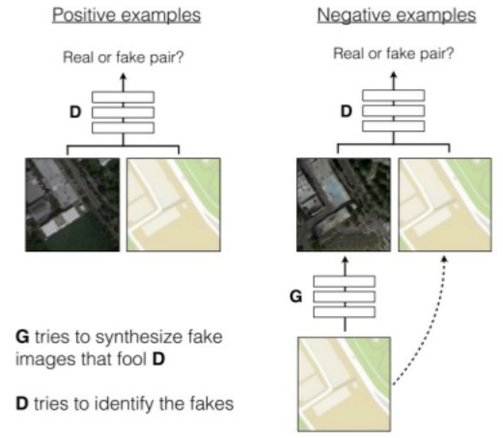
Pix2pix (all slides are copies)
https://arxiv.org/pdf/1611.07004.pdf
https://www.slideshare.net/JunhoCho1/image-translation-with-gan

Slide 31
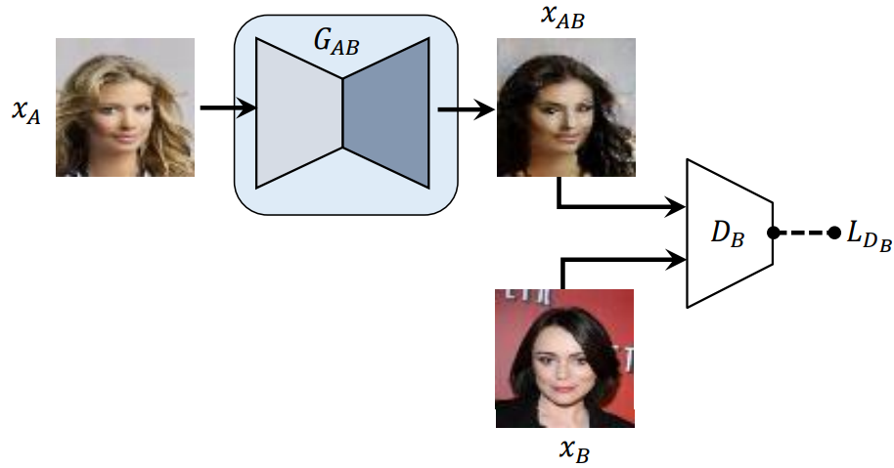
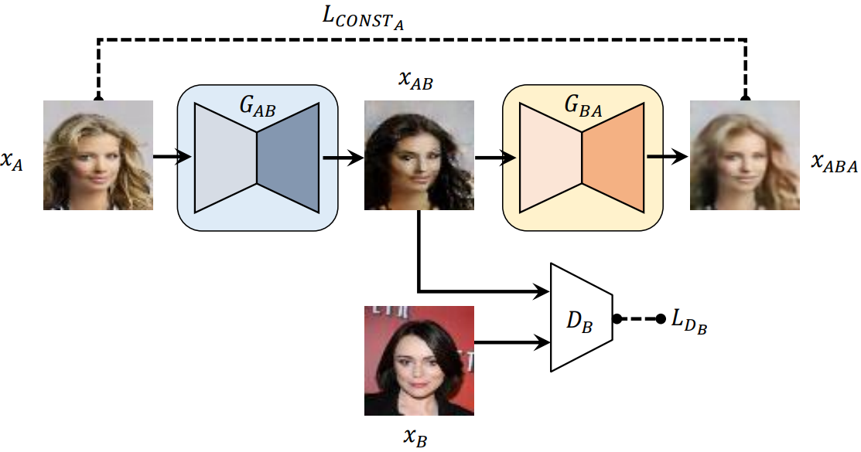
Reconstruction loss
https://arxiv.org/pdf/1703.05192.pdf

Slide 32
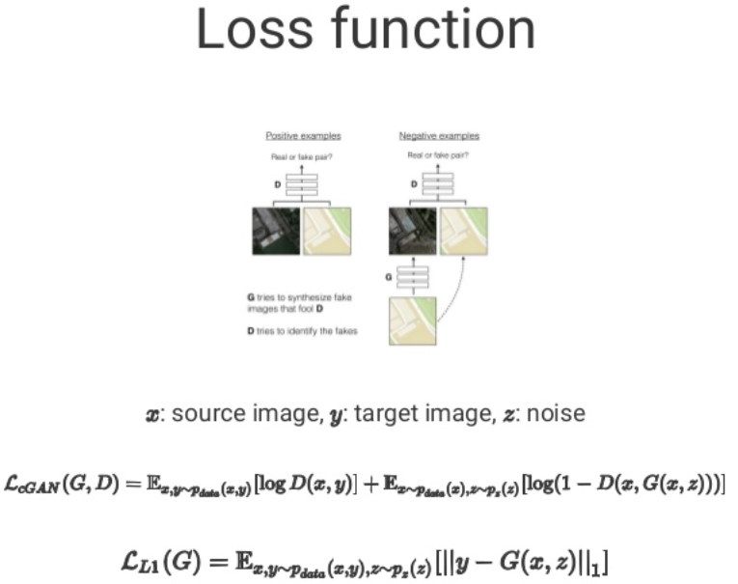
https://arxiv.org/pdf/1611.07004.pdf

Slide 33
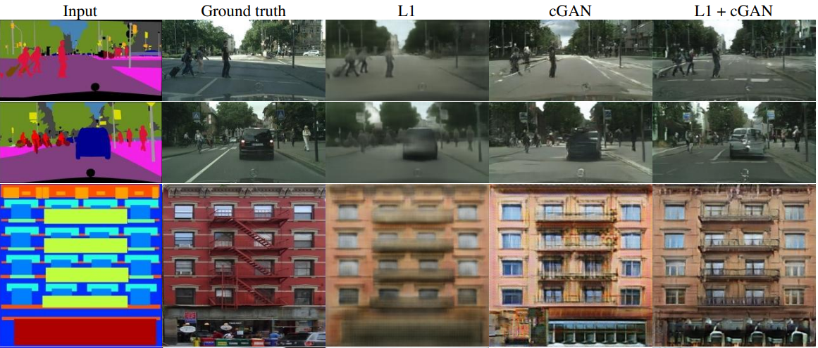
More loss functions: discriminative and images differentes
https://arxiv.org/pdf/1611.07004.pdf

Slide 34



CycleGAN/DiscoGAN
https://arxiv.org/pdf/1703.05192.pdf

Slide 35

Less labeling: Translation from one group to another
https://arxiv.org/pdf/1703.10593.pdf

Slide 36


https://arxiv.org/pdf/1703.10593.pdf

Slide 37


https://arxiv.org/pdf/1809.07294.pdf

Slide 38


Slide 39


Slide 40

Serial Crystallography data analysis pipeline
Data Collection
Bad pixel masking
Data Correction
Bragg-peak finding
Phasing
and structure definition
Integration and Merging
Indexing
Geometry correction

Slide 41


Classification of crystal structure using a convolutional neural network
http://journals.iucr.org/m/issues/2017/04/00/fc5018/index.html

Slide 42


VAEs for improved reconstruction and anomaly detection
https://arxiv.org/pdf/1906.00446.pdf
https://arxiv.org/pdf/1911.12161.pdf

Slide 43


A survey on the use of Machine Learning in analysis of crystallographic diffraction patterns
https://www.ncbi.nlm.nih.gov/pubmed/29714177

Slide 44


A survey on the use of Machine Learning in analysis of crystallographic diffraction patterns
https://arxiv.org/abs/1904.11834

Slide 45


Markov-Chain-Monte-Carlo method sampling from model distribution
Notes:
MAYBE WE DON’t NEED THIS SLIDE

