Slide 1
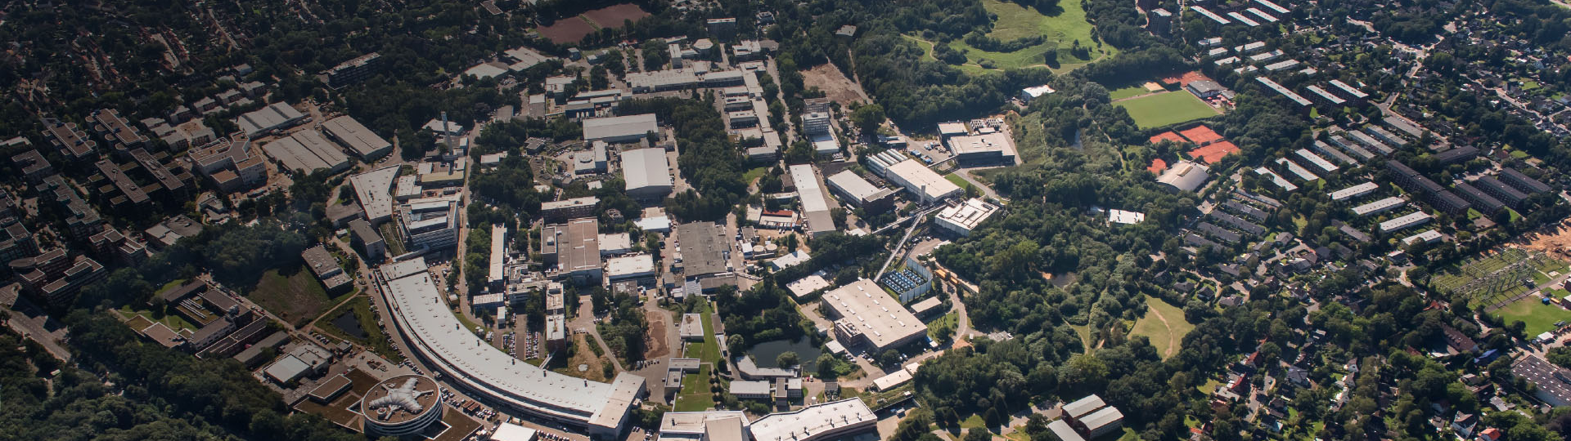
Intelligent Process Control and
Machine Learning in M
DESY 2019/11
Outline:
Introduction & changes due to digitalization
AI & Machine Learning for accelerators
Initiative M-Division / DESY / Helmholtz
Holger Schlarb, Annika Eichler,
Raimund Kammerign and Ilya Agapov
DESY
Hamburg, 2nd Dec 2019

Slide 2
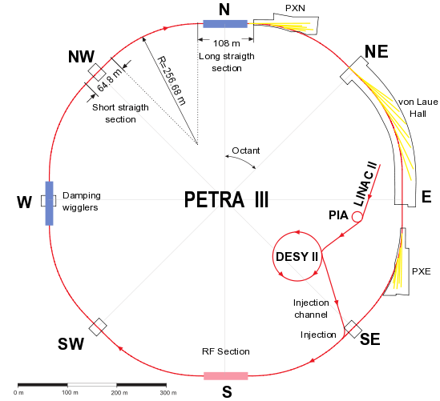
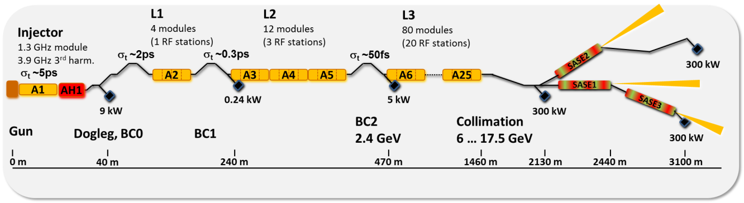
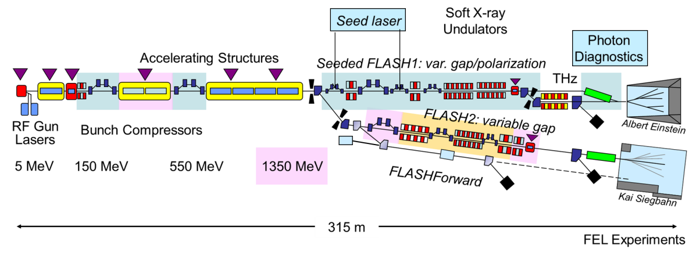


Intelligent Process Control and Machine Learning
Accelerators at DESY …
FELs…. (reproducibility / optimization / flexibility / …)
Storage ring
(lattice / beamlines /
optic &orbit /
injection /
availability/...)
Plasma accelerators (lasers control/ HPC /in-situ FB)
Challenges and degree of maturity very different, but
Increased complexity of controls
Higher demands on accelerator operations
Pushing the limits in terms of performance / reliability / availability

Slide 3
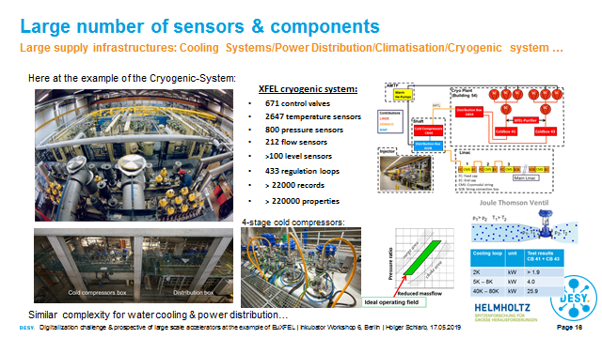
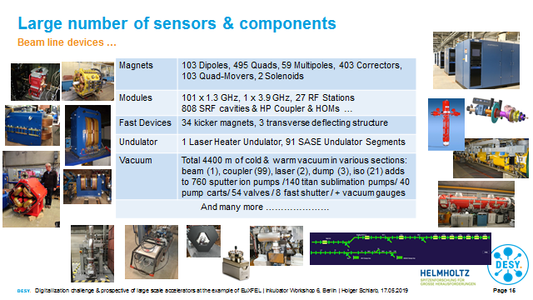
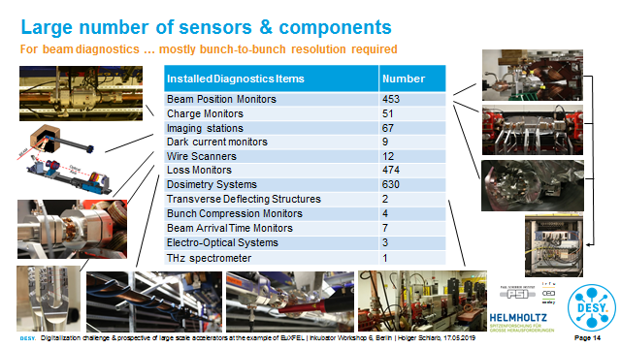
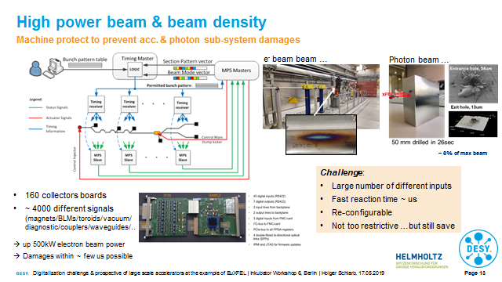
Intelligent process control and Machine Learning
Infrastructure systems (Cryo/Cooling/Power) & large and diverse components ~ 10000 typically
Infrastructure
Magnets & RF
Diagnostics
Machine Protection

Slide 4
Intelligent process control and Machine Learning
Challenge caused by combination of performance / flexibility & availability…
Particle accelerators are ...
Largely distributed …
Various types of systems …
Highly non-linear processes …
Strongly coupled (sub-)systems …
Timing varying disturbances …
High dimensionality ~ few 1000
Use of cutting-edge technologies… (sensors / front-end electronics / real-time processing)
Limited access to key observables
Facing:
Increasing demand on Performance, Flexibility & Availability
e.g. EuXFEL
Performance
~ µm x-y orbits & <dispersion
~ mdeg / 0.01% RF phase/ampl.
~ fs arrival time @ km scale
~ mK temperature stability in parts
~ 30 ubar 2K pressure
~ beam parameters (λ,σ_{t}, E_{ph}, chirp..)
…
Flexibility
Availability
Bunch pattern (flexible, on demand)
Switching bunch pattern modes (10Hz)
Multi-beamline operation
Fast tuneability within trains
Special modes
…
- Ideally 99%
Small setup times (reproducibility)
Small tuning times (operability)
Reduced scheduled down
…

Slide 5
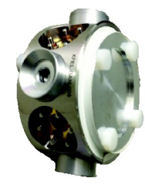
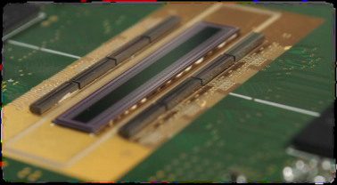
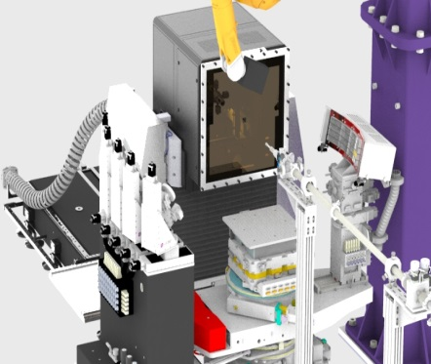
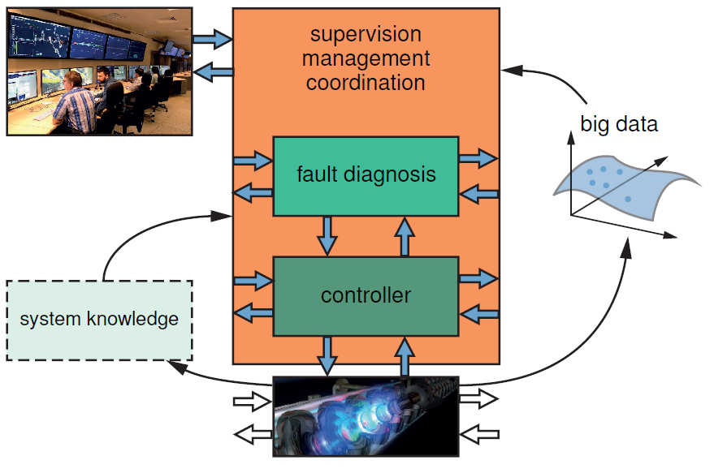

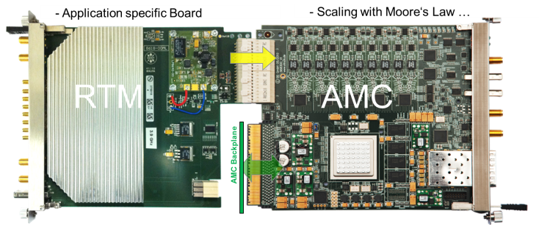
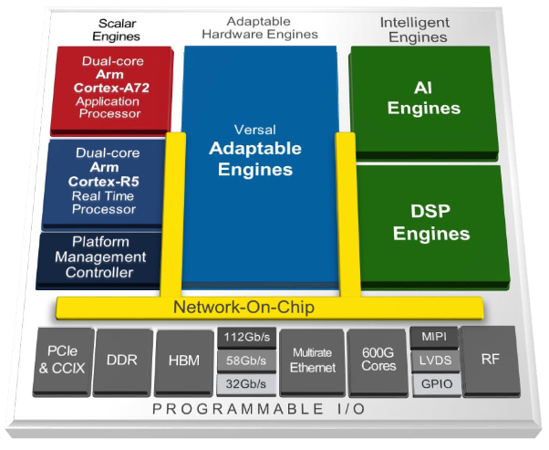
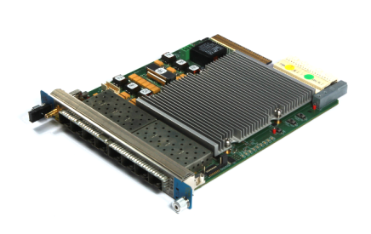
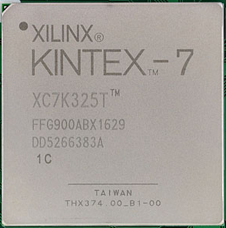
Intelligent process control and Machine Learning
Digitalization changes …
Very complex sensor technologies …
& analog / digital processing units ….
Separation from human controls …
2D detectors / high-speed cameras
40 GHz
pickup
THz
det.
1D detector
KALYPSO
…where next evolution is already on the way (Network on Chip = NoC)
system bandwidth
<< fault bandwidth
Configuration → data quality
Demand on supervisory systems
New HW technologies
MicroProc. → DSP‘s → FPGA‘s → SoC → MPSoC → NoC

Slide 6

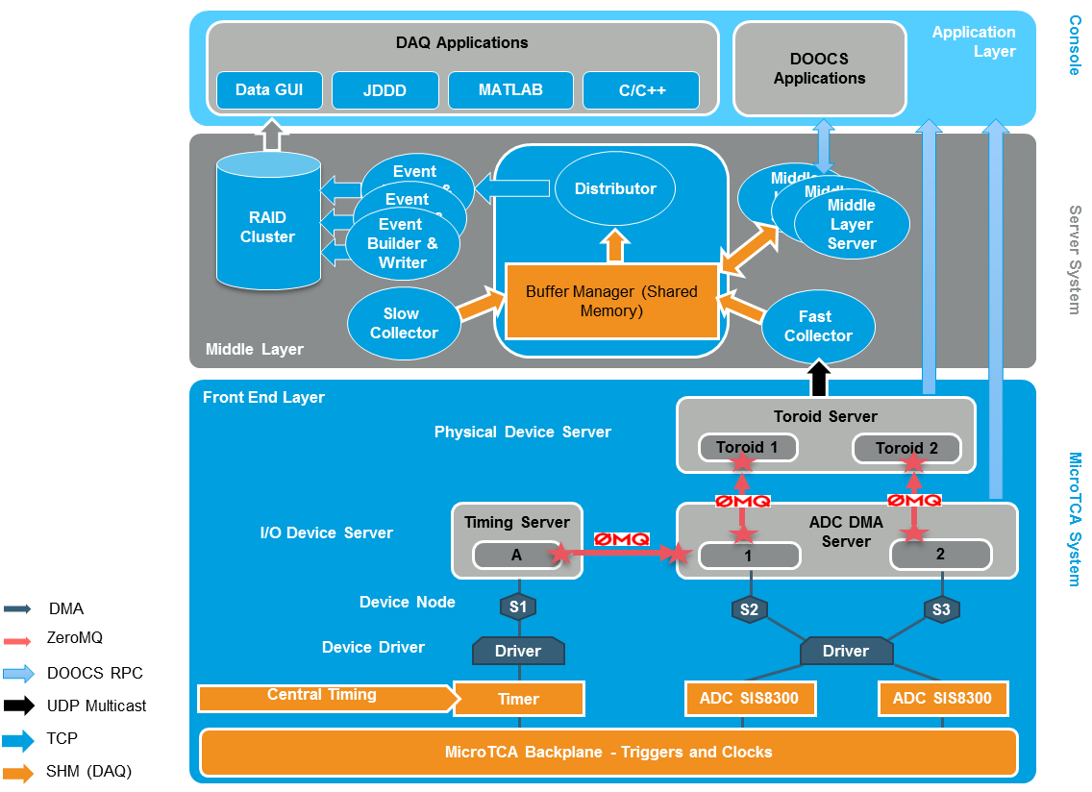
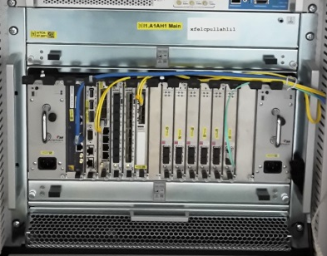
Intelligent process control and Machine Learning
Digitalization changes …
Classical 3 tier structure + in cooperated Data Acquisition System at EuXFEL
> 10 million control parameters
> 700.000 local archives
> 20.000 high data rate channels
> 30 TB/day DAQ (compressed)
Standardize
hardware & software
Configuration management already challenging
Large amount of data available
  data mining
  information extraction
  machine / system optimization
  failure detection
  predictive maintenance
  …
< 1% sent from front-ends
MicroTCA .4
Courtesy: T. Wilksen
Requires new techniques & technologies → AI/ML & automation
Integration into control architecture → needs carefully to be reviewed

Slide 7
AI & Machine Learning for accelerators… hype or (r)evolution….

Slide 8
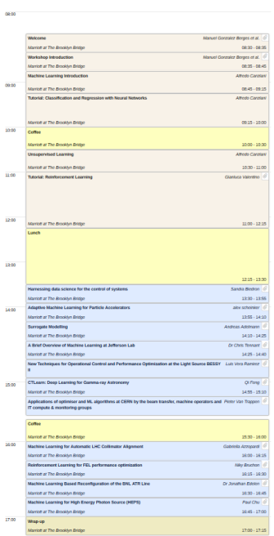
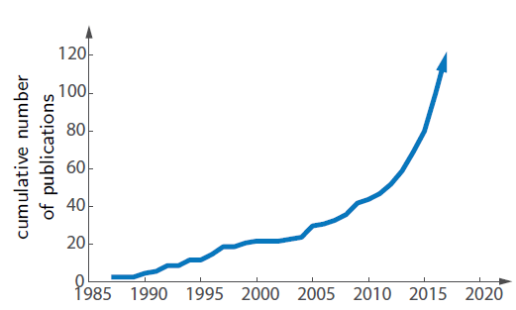
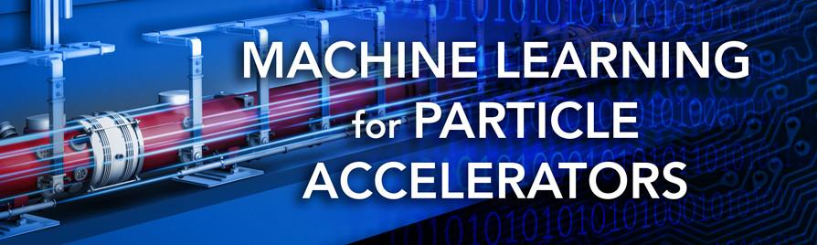
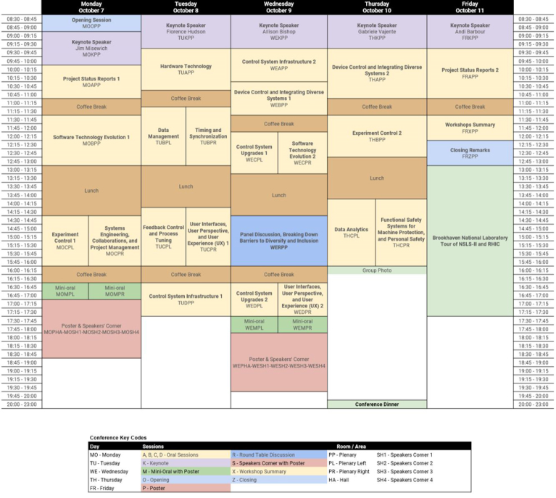
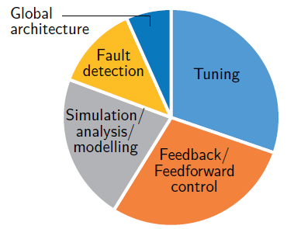
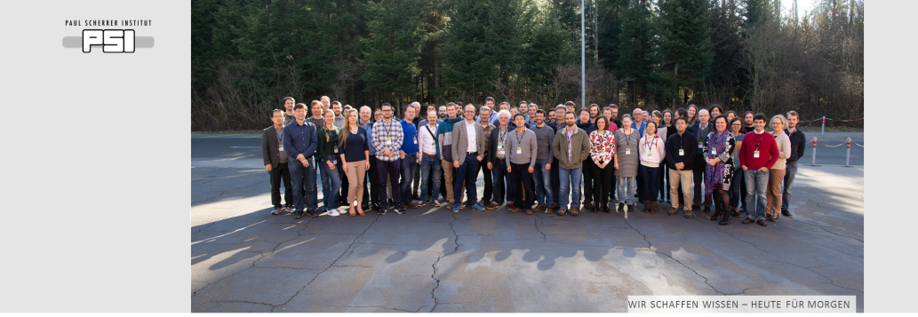
Intelligent process control and Machine Learning
AI & Machine Learning… currently ramps up …
ICFA Mini-Workshops
ICALEPCS 2019 / PCaPAC 2019 / PAC 2019
Publications…
ICFA Beam Dynamics Mini-Workshop: Machine Learning Applications for Particle Accelerators
Dates: Tuesday, February 27 through Friday, March 2, 2018
SLAC National Accelerator Laboratory, Menlo Park, CA
Courtesy: A. Eichler
Application fields
Tracks & Topics:
Tuning/optimization/control
Prognostics/alarm handling/anomaly-breakout detection
Data analysis
Simulations/modeling
2nd ICFA Beam Dynamics Mini-Workshop: Machine Learning Applications for Particle Accelerators
Dates: 26 February to 1 March, 2019
Villigen PSI

Slide 9
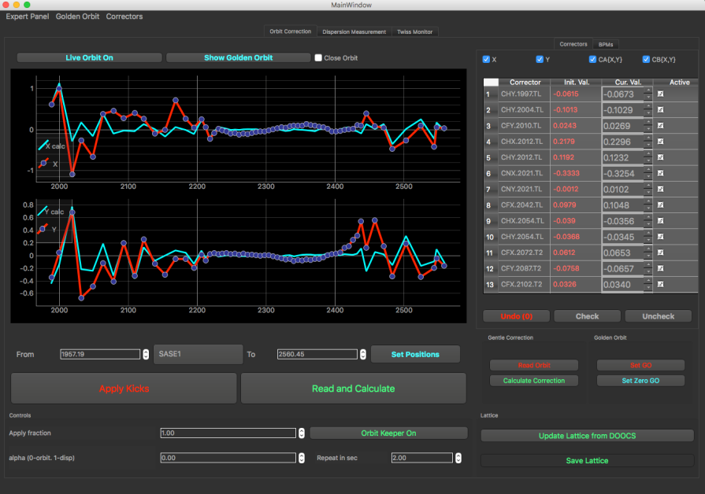

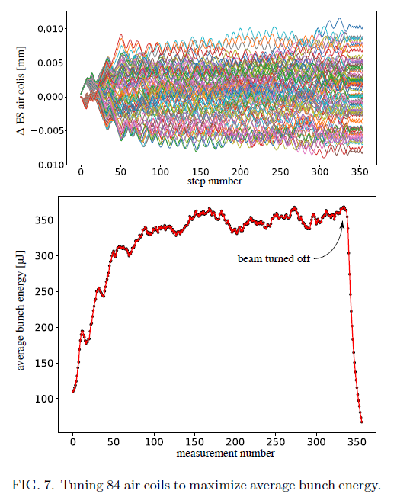
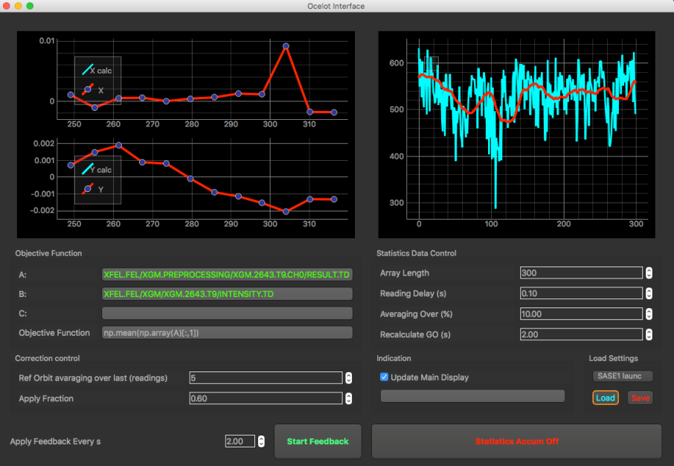
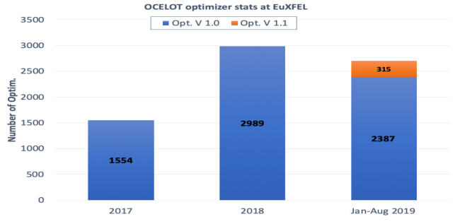
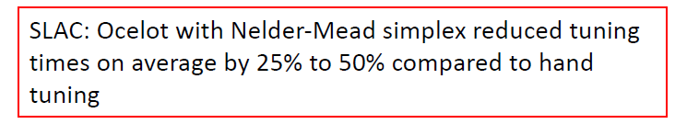
Intelligent process control and Machine Learning
Examples: Tuning & Optimization ➔ with advanced algorithm / ML
OCELOT orbit correction standard tool (using SVD algorithm)
Adaptive feedback
  Shot-to-shot orbit collection (~ 300 - 700)
  Sorting orbits according to SASE energy.
  Orbit with highest SASE → new golden orbit
Optimizer for FEL pulse energy
  Launch & orbit inside undulator
  Phase-shifters
  Orbit in low energy sections
  Matching quads
  Local dispersion correction
  …
Orbit correction GUI
Beam based alignment
(initial setup / timing consuming..)
+ modern FB algorithm (extremum seeking)
1-d cost function
Model independent
Orthogonal through different frequencies
Robust against noise
Courtesy: Alex Scheinker, LANL
PRAB 22, 0802802
2019
Adaptive feedback GUI
Nelder-Mead simplex
Usage EuXFEL
84 parametric opt.
S. Tomin/ I. Agapov (XFEL/DESY)

Slide 10
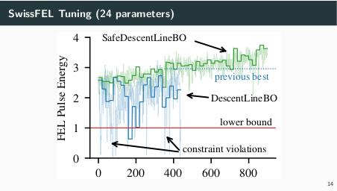
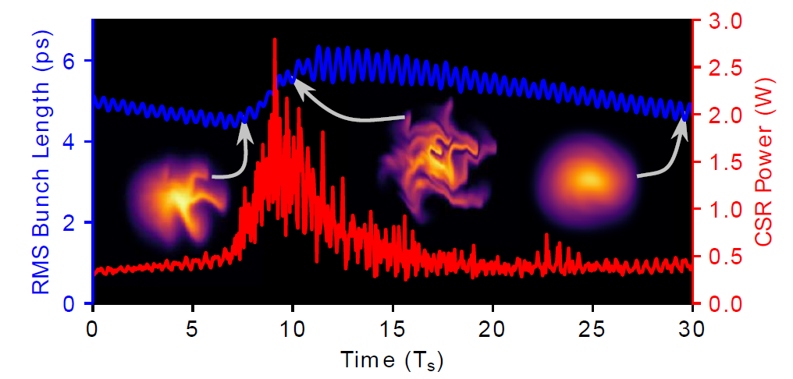
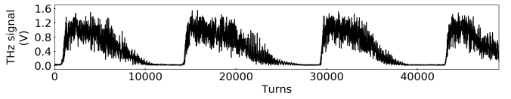
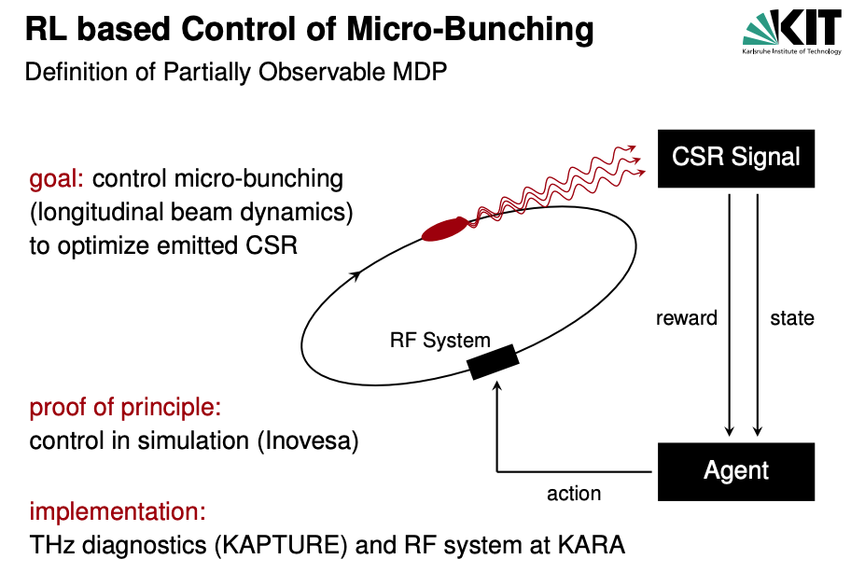

Intelligent process control and Machine Learning
Examples: Tuning & Optimization ➔ with advanced algorithm / ML
Courtesy: M. Brosi et al.
Bayesian optimization…
Reinforcement learning…
stabilize THz output
Courtesy:
A. Adelmann et al.
Method to safely optimize parameters…
Currently implemented by OCELOT-collaboration

Slide 11
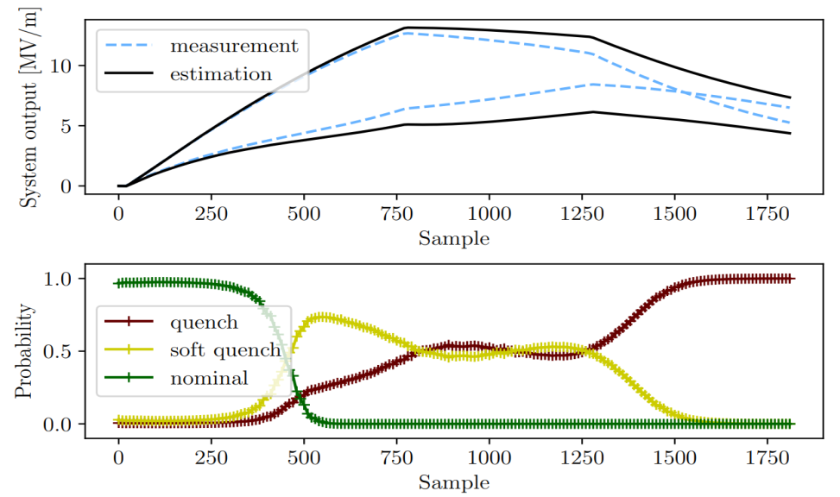
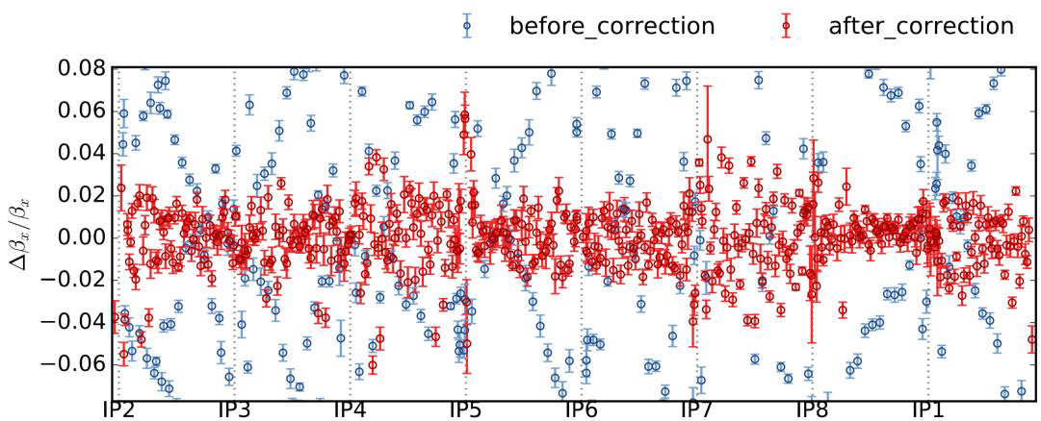
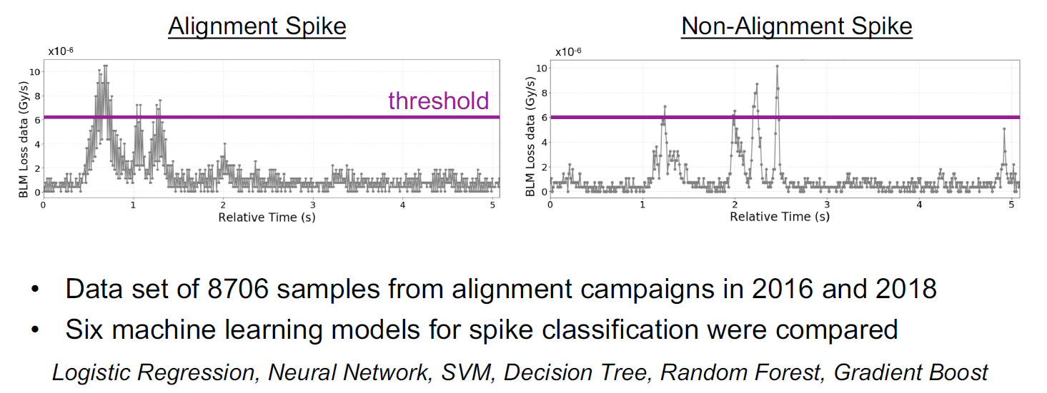
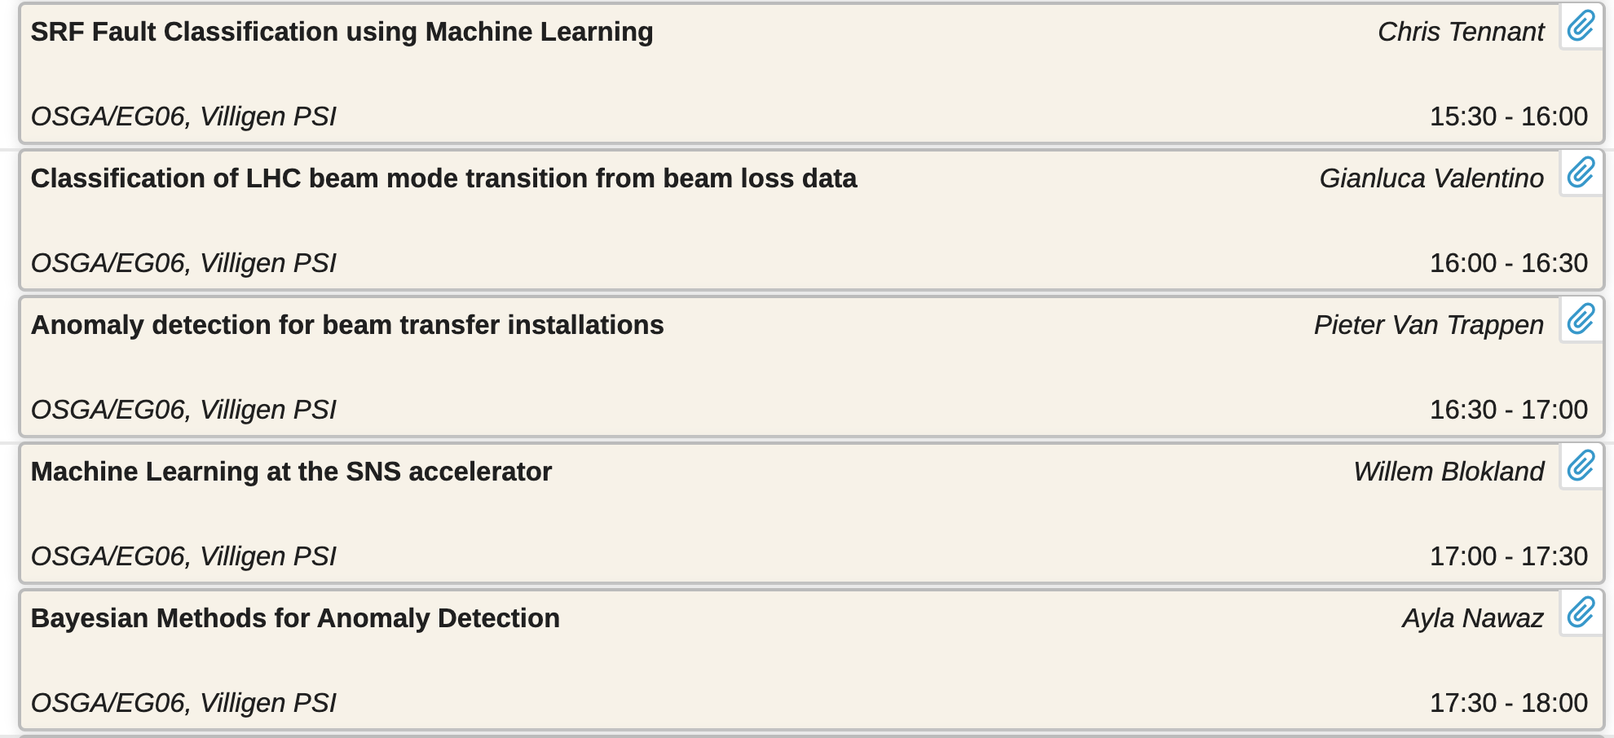
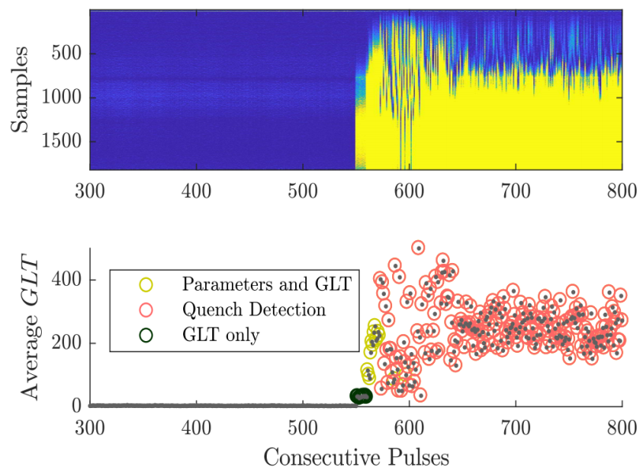
Intelligent process control and Machine Learning
Examples: Prognostics/alarm handling/anomaly-breakout detection…
Personnel remark: one of the largest applications for ML
Courtesy: A. Nawas; Model-based quench detection
Courtesy: Elena Fol; Optics correction for LHC with DBSCAN cleaned BPM data
unpublished
Courtesy: Gabriela Valentino; Automatic LHC Collimator Align.
And many more….
GLR = generalized likelihood ratio
0
nominal behavior
quench
GLR: Generalized Likelihood Ratio
Predictive maintenance
Preventive action
Supervisory control
GLR
Average GLR
GLR

Slide 12
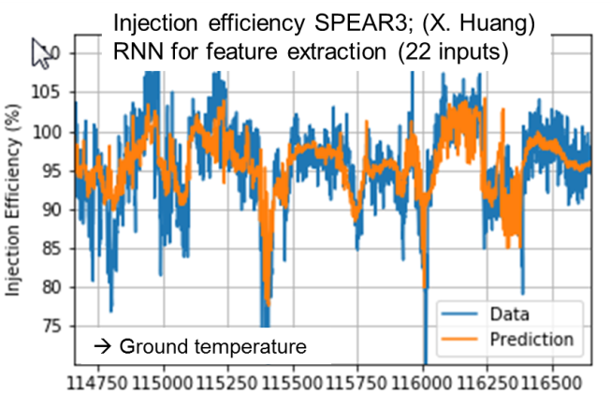
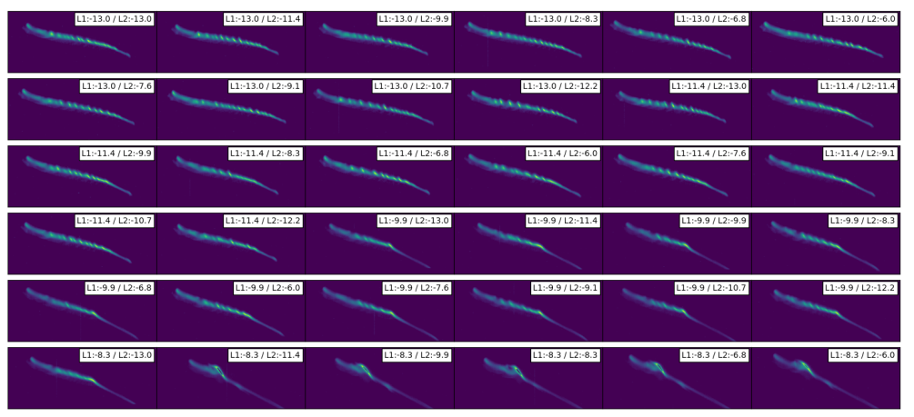
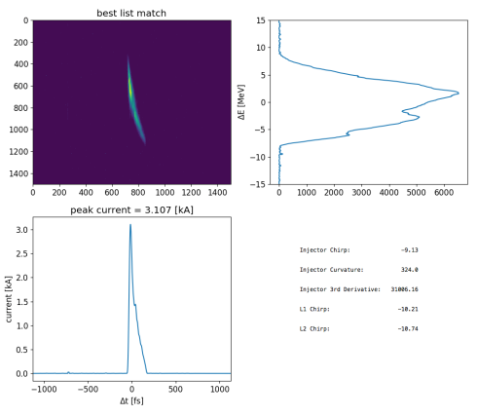
Intelligent process control and Machine Learning
Examples: Data analysis … dimensional reduction … hidden parameter
EuXFEL ‘full’ scan of long. phase space with TDS → 100k images, 1 TB… Big Data
  Derived principle-components (PCA)
Started to work with this data:
  nearest-neighbors to create ‘virtual diagnostics’
  training a neural-network to e.g. predict beam images
Courtesy:
A. Scheinker
Few years of history data were used …
Courtesy: Xiaobiao Huang

Slide 13
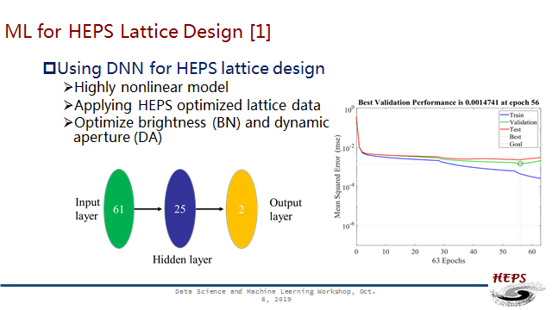
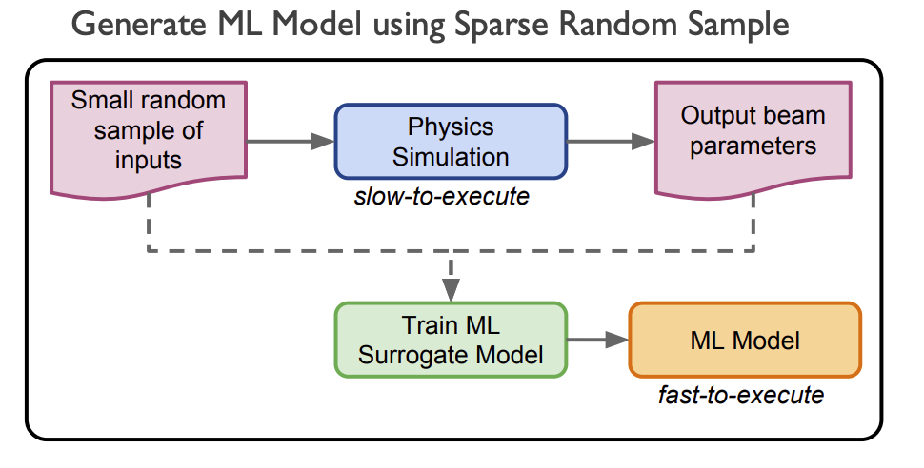
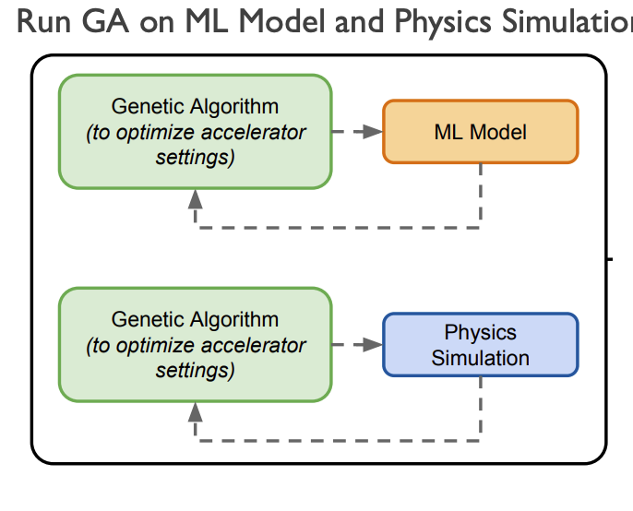
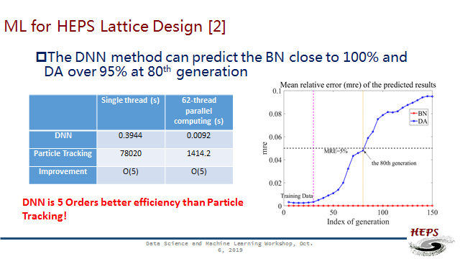
Intelligent process control and Machine Learning
Examples: Simulation and Modeling
Courtesy:
Paul Chu, IHEP
1) First train surrogated model...
2) Then use optimizer...
Result:
several orders faster than GA directly
Courtesy:
A. Edelen et al.

Slide 14
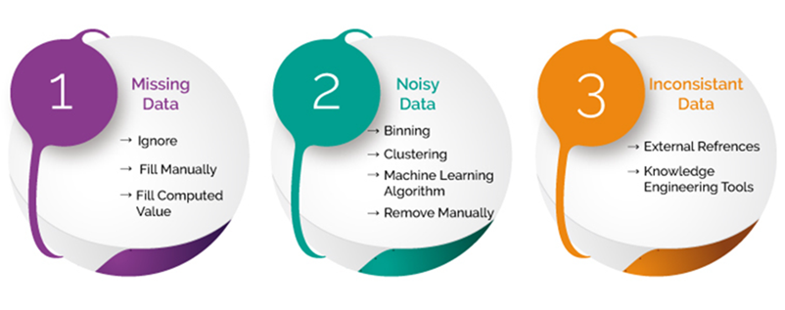
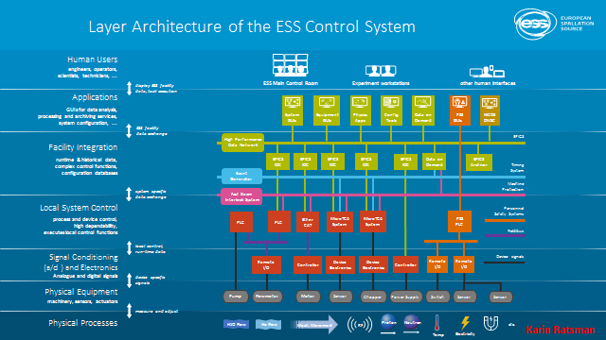




Intelligent process control and Machine Learning
Intensive discussion during ML workshops / sessions…
How to ensure data quality ….
How ML effects the control system architecture….
… keeping / tracking configuration data
… meta data & change management
Ideally including all possible data of devices …
with easy access to inventory …
&
even procurement …
… database structures…
… name conventions
…
in
out
But most important: data has to be reviewed else these are useless data

Slide 15
Initiative M-Division
& DESY

Slide 16
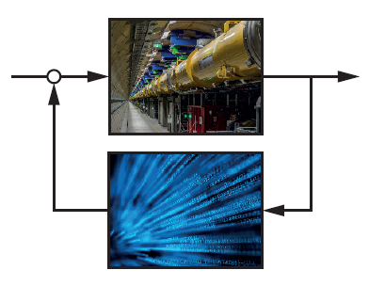
Intelligent process control and Machine Learning
Objectives and goals
Optimal use of data potential via AI/ML & advanced methods to
  Quality: Increase of accelerator performance and flexibility for user experiments
  Efficiency: Reduction of tuning & recovery times
  Availability: Minimization of off/dark times (predictive maintenance health monitoring / root cause analysis / supervisory control)
b) Controls and Data Acquisition Architecture for the next generation
  Existing Acc.: how to further develop….use cases
  PETRAIV/PWA: make use of lesson learnt
  c) Design of future accelerators
  PETRAIV/PWA: evaluated potentials / develop state-of-the-art controls
d) Evaluation of transfer potential for industry and visa versa (IoT / Industrie4.0 / DB)

Slide 17
Intelligent process control and Machine Learning
Analysis M-division
Status within M-division (…2018):
  Some initiatives have been undertaken (e.g. OCELOT, DMA-ST3 speaker, W1TT, …fragmented)
  The need to further strengthen the scientific computing resources in M is accepted
  Recruitment of skilled personnel often not successful (positions could not be filled)
  Little dedicated personnel in M for scientific computing ( % level of many ..)
  Only weak connection to computer science institutes in universities
  Several proposal for 3rd party funding submit (some successful … unfortunately some not, HYIG/Inkubator)
Demands within M-division
  Across all accelerators … and also for beamline controls (topics close to FS…)
  Across different groups … machine operation / controls / diagnostics / RF / infrastructure /…
Initiative: To build up and establish “Intelligent Process Control” core-group
    Internal: communication within M, sharing of expertise, consistent strategy and coordinate effort
    External: visibility, build-up and coordinate cooperation & research programs, apply to funding

Slide 18
Intelligent process control of distributed systems
Analysis … required expertise in core group
Control System Architecture
Software Quality
Machine-human interface
Software
Engineering
Data Base
Technology
Streaming Technologies
Data Analytics
Intelligent Process Controls
Hardware Technology
AI &
Machine
Learning
HPC
Feedback Controls
Mathematical
Methodology
Modelling
Accelerator Infrastructure Systems
Accelerator Expertise
Fault Diagnosis
~ 15-20 FTE

Slide 19

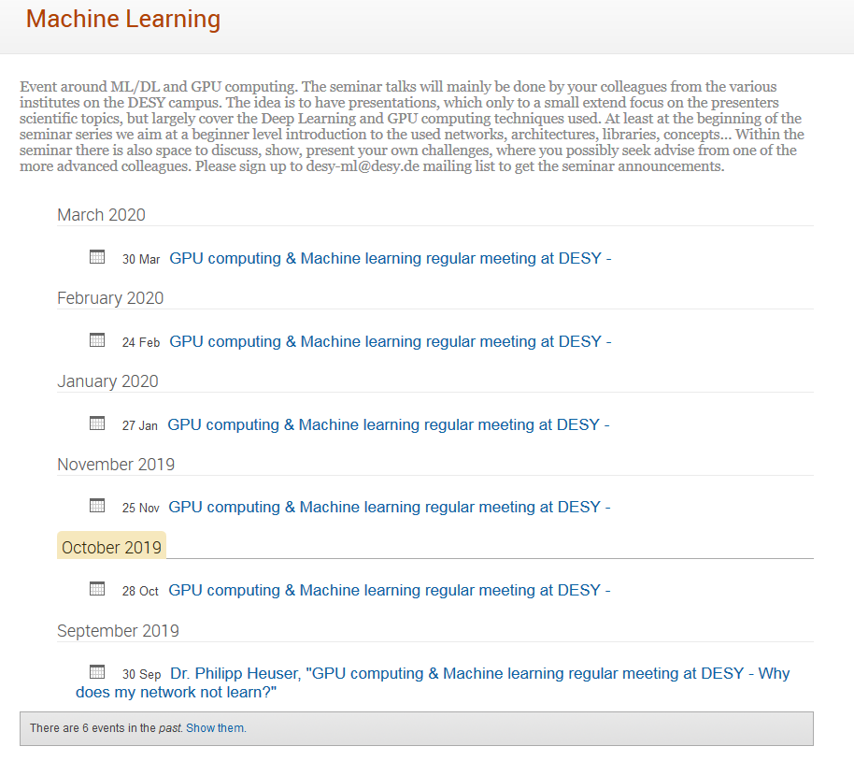
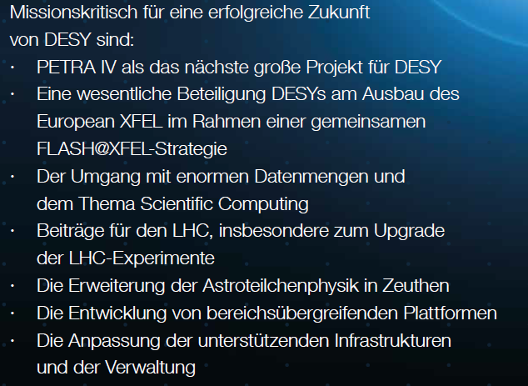





Intelligent process control and Machine Learning
Analysis … DESY / Helmholtz….
DESY 2030 strategy:
Scientific Computing identified as one of the most important topics for DESY’s future!
DESY wide activities (IT especially)
Initiative CDCS
Helmholtz:
New topic DMA: Data Management Analysis within Matter/Matter and Technology
Helmholtz-Inkubator program with several funding options
  DASHH = Data Science in Hamburg – Helmholtz Graduate School for the Structure of Matter
  AMALEA = Accelerating Machine Learning for physics (DESY, HZB, HZDR, KIT)
  HIFIS = Helmholtz Federated IT Services
  HIP = Helmholtz Imaging Plattform
  HAICU = Helmholtz Artificial Intelligence Cooperation Unit
  …
➔ Needs coordination & requires dedicated resources for science management

Slide 20

Networking / Outreach and Visibility/ Embedment DESY
Different M-Groups
Direct cooperation with FS: FS-LA/FLASH-xxx
MT-DMA:
Data Management and Analysis
Scientific Computing Groups with DESY
Helmholtz Inkubator Programm
HIP / HAICU /…
CDCS /
HamburgX
(CDL4 + Core)
DASHH
Joint Labs
DESY - SLAC
Universities
TUHH / UHH
Other 3rd party funding
BMBF e.g. KfB
External cooperation
e.g. Berkeley,…
Outreach / Visibility / Recruitment initiative

Slide 21
Thanks for attention

