Slide 1

SINBAD ARES
Beam commissioning
Beschleuniger-Betriebsseminar
Travemünde, 12. Februar 2020
Eva Panofski for MPY1 team

Slide 2
Acknowledgments
Many thanks for the support from
DESY technical groups (MEA, MIN, MSK, MKK, MVS, MDI, MPA, MLS, FS-LA)
MPY
BKR shift crews
University Hamburg
AXSIS project
ACHIP collaboration
PolariX X-band collaboration
…

Slide 3
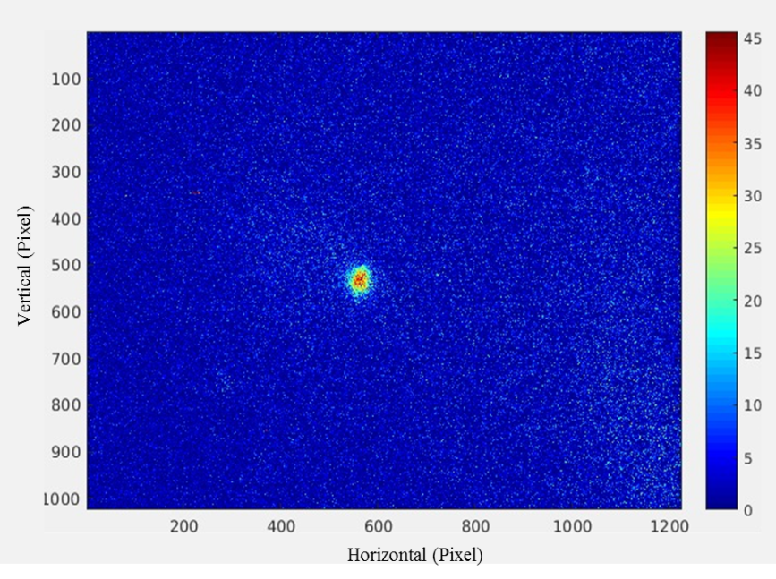
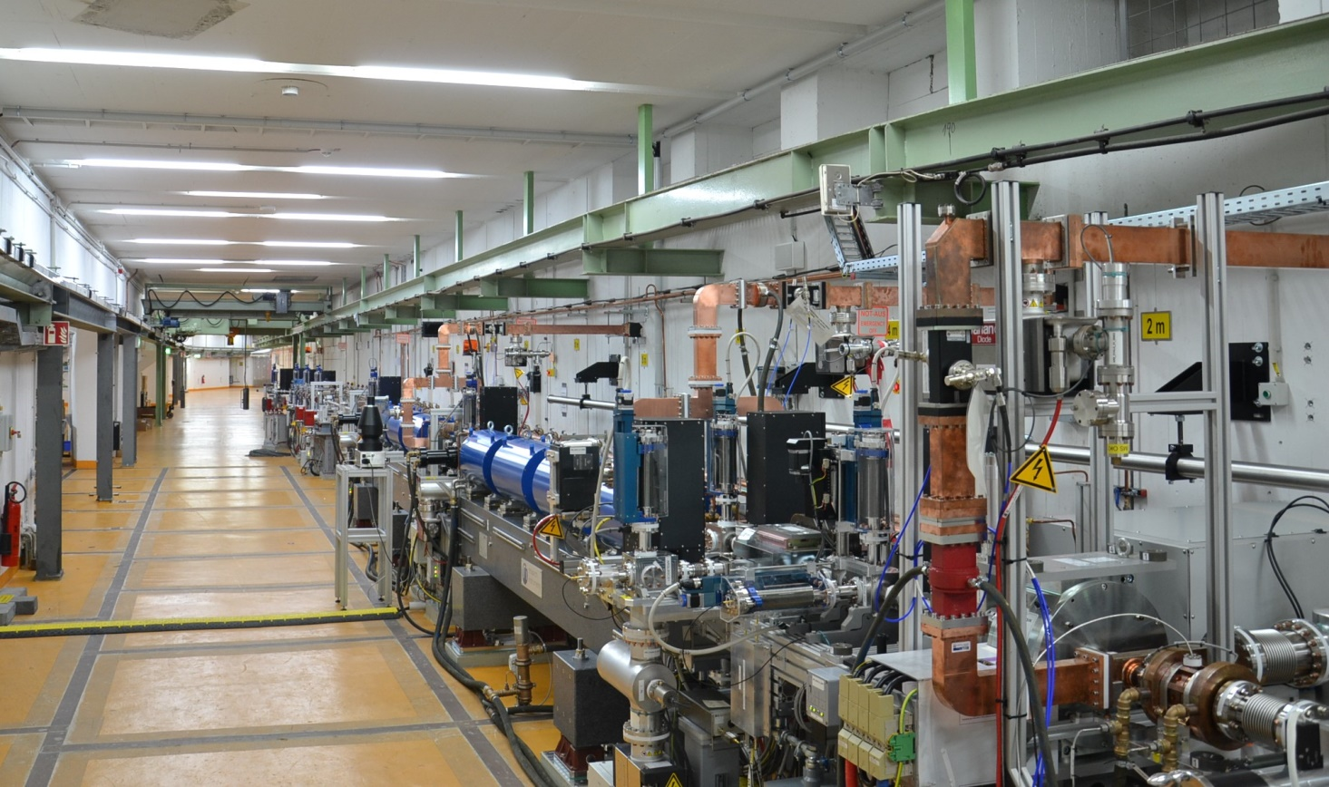
First electron beam at the ARES RF gun
30.10.2019
First beam measured with the first screen in the gun section
The SINBAD ARES linac

Slide 4
Outline
ARES RF gun infrastructure
Beam operation at ARES
RF settings for beam commissioning
Electron beam characterization in the ARES RF photoinjector
ARES linac commissioning
Next steps in the ARES commissioning

Slide 5
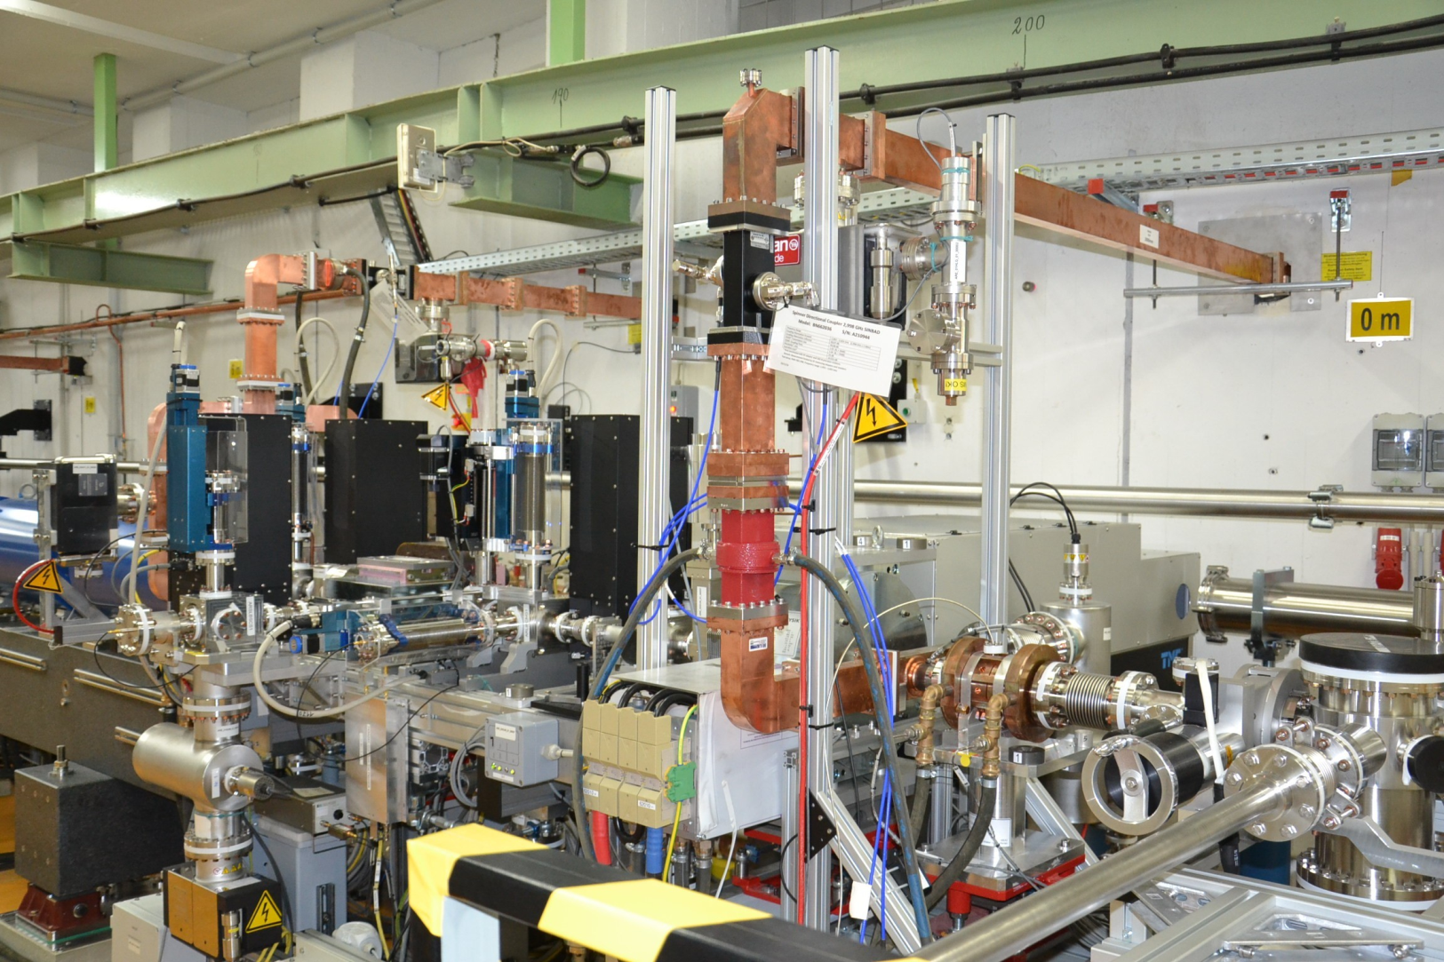
ARES RF gun
ARES hardware
RF waveguide
Screen station
Dual plane steerer
DaMon
Laser
Spectrometer dipole with
screen and Faraday Cup in the dispersive section
RF gun
Photocathode and transfer system
Screen station and Faraday Cup
Dual plane steerer
Solenoid
Many thanks for the support
From MEA, MVS, MDI, MIN, FSLA

Slide 6

ARES RF gun
ARES hardware
Screen stations
RF gun
Faraday Cups
Laser
DaMon
Photocathode and transfer system
Solenoid
Dual plane steerers
Spectrometer dipole
ARES software
conditioning tool
measurement tools
(image taking, parameter scans)
analysis tools (image analysis, solenoid alignment, emittance measurements)
ARES control
jddd based control system
ML-server for magnet controls
Sequencer tool
DAQ server
Many thanks for the support by MCS
Many thanks to Max Hachmann (REGAE)

Slide 7
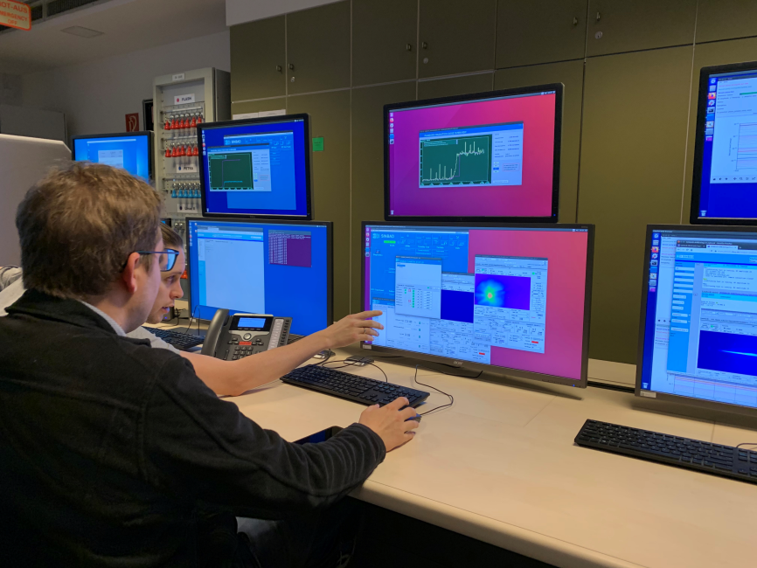
Beam operation at ARES
First beam on the 30th of October 2019
Exchange of the waveguides and the vacuum windows
(ARES linac) in November 2019
Beam commissioning started on the 1st of December 2019
8 weeks of beam time in total
Beam operation 4 days per week; day shifts 8-10h
Monday reserved for tunnel access (technical works),
works on the control system, operation meeting,
data analysis, preparatory work for the upcoming week
Organization of the runs:
- 2 run coordinators (working also as shift leaders):
hardware commissioning (Florian Burkart), beam commissioning (Eva Panofski)
- additional shift leaders: B. Marchetti, occasionally supported by persons presently on ACHIP/AXSIS funding
(F. Mayet, T. Vinatier → preparing ACHIP experiment in ARES, setting up analysis software for diagnostics to be used also at AXSIS)
- Shift coverage: Always 1 shift leader and 1 PhD student
SINBAD console in the BKR.

Slide 8
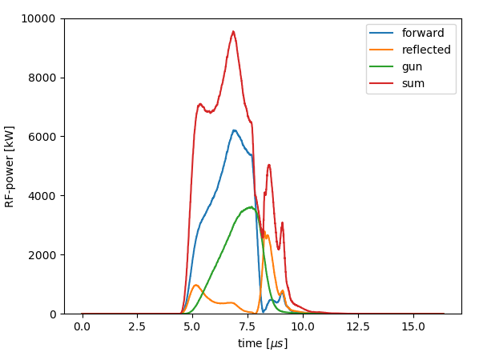
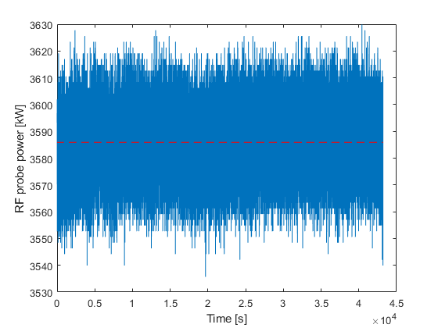

RF settings for beam commissioning
Gun cavity is fully RF conditioned.
Current RF settings:
4.03 µs RF pulse length, max. RF power 3.7 MW (stable)
Feed forward correction was optimized by MSK
and is now working.
Design value for maximum RF probe power of
6 MW is not yet achieved
→ Maximum sum power limit (forward+reflected power)
of the klystron: 11 MW
→ Circulator will solve this issue, ordered and currently
manufactured in China
RF power 3.59$±$ 0.01 MW
Many thanks for the support by MIN and MSK

Slide 9
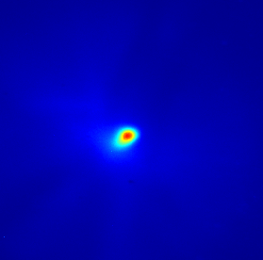
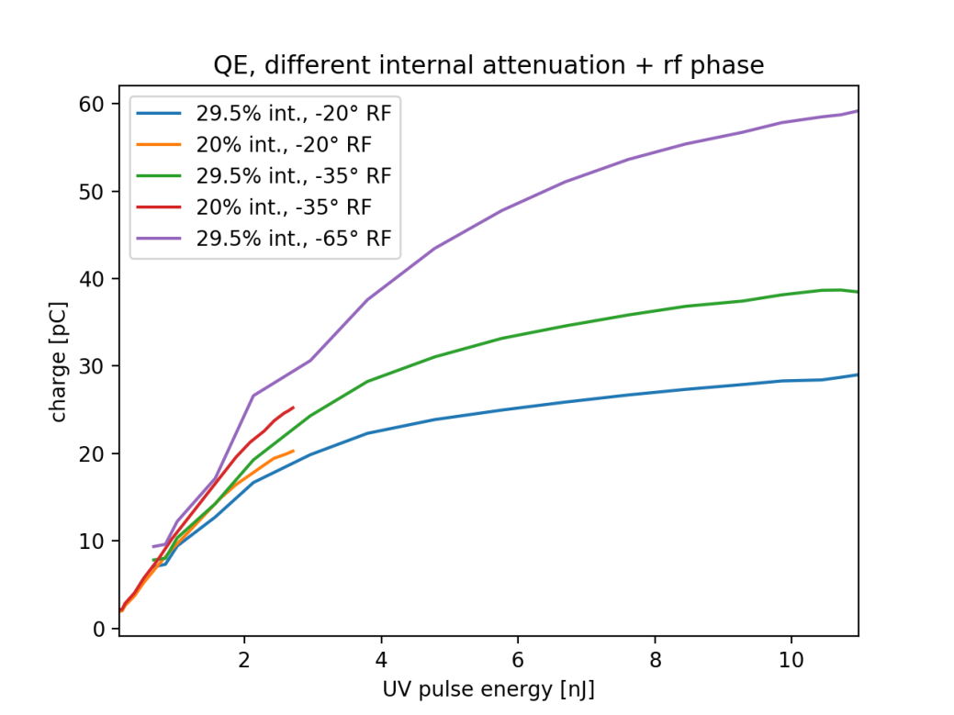

Bunch charge measurements
Many thanks for the support by MDI group
Charge measurement with 2 Faraday Cups and DaMon possible
Charge measurement done at 3.6 MW RF power, -20° RF phase,
maximum charge due to focused solenoid:
Scan of the laser attenuator position vs. the bunch charge
(measured with the Faraday Cup) for 3 different RF phases*:
-20° RF phase
-30° RF phase (maximum momentum)
-65° RF phase (maximum charge output)
Measured QE of the Cs₂Te cathode $\sim$3.5%
Device | Charge
1st FCup ARLIFCNG1 | 16.1 pC
2nd FCup ARSLFCNG1 | 16.3 pC
DaMon | 12.6 pC
Beam on the first screen in the ARES gun section.
* Zero-crossing at phase +2°
Bunch charge vs. laser pulse energy.

Slide 10
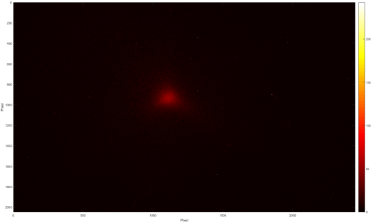
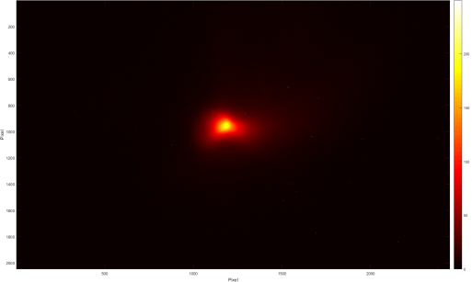
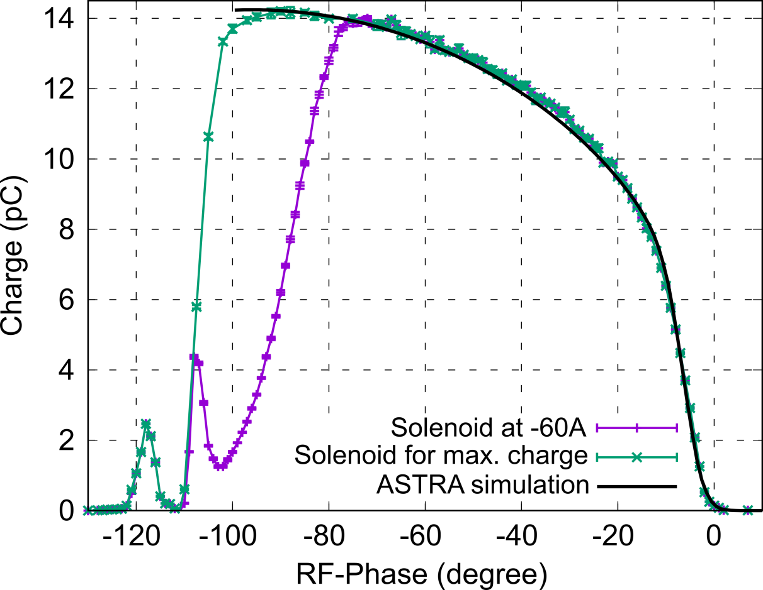
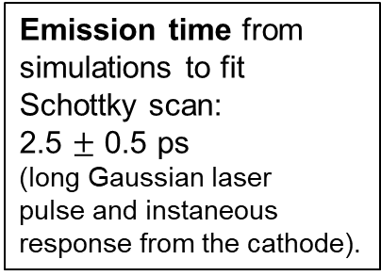
Bunch Charge measurement
Courtesy T. Vinatier
Schottky scan and emission length
Measurement conditions:
Cs₂Te cathode, 3.6 MW gun power, Sol -60 A and max. charge, DAMON used
Beam images on X1 at -107.5° of phase for solenoid
at -80 A (left) and -16 A (right)
→ Beam splitts into two dominant energy peaks.
Emission time from
simulations to fit
Schottky scan:
2.5 $±$ 0.5 ps
(long Gaussian laser
pulse and instaneous
response from the cathode).
Secondary electrons and
electrons travelling back and forth

Slide 11
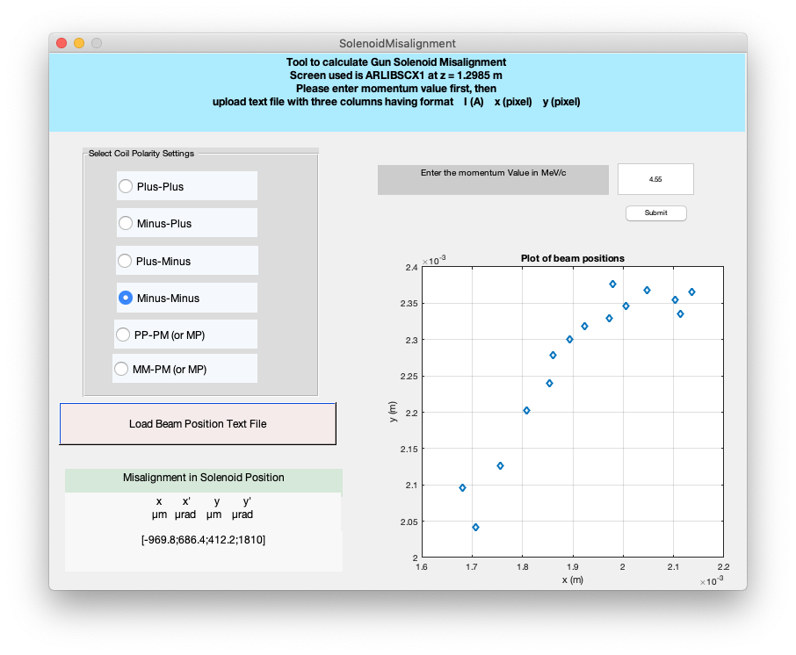
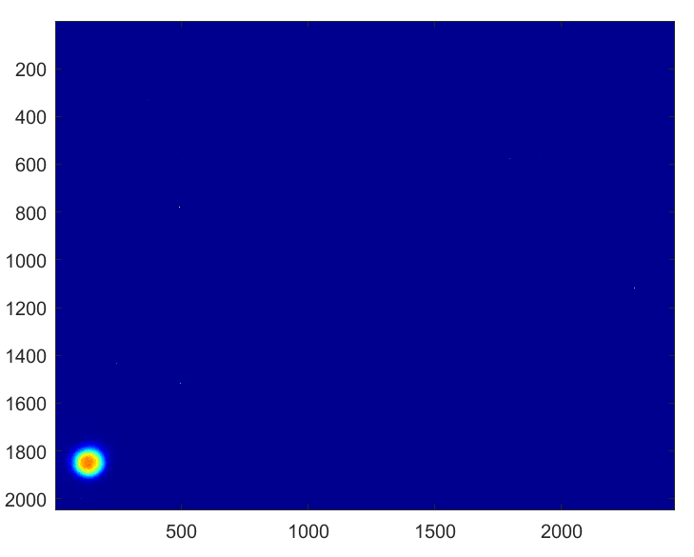
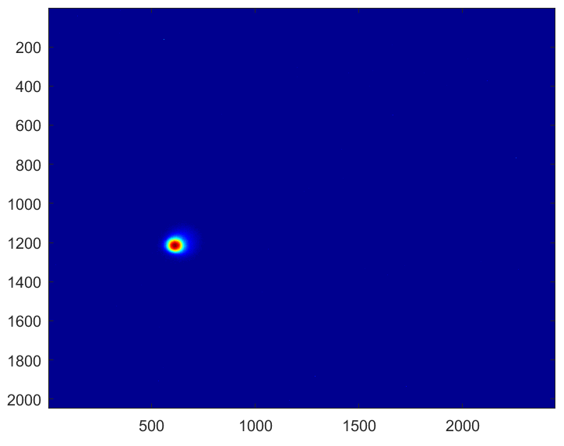
Beam Based Alignment (BBA) of the Gun Solenoid
Courtesy S. Yamin, F. Mayet
An algorithm based on linear transfer matrices was developed for BBA
of the Gun Solenoid and implemented as a Matlab tool.
(Ref: S. Yamin et al, J. Physics: Conf. Series 1350 (2019) 012014)
Data taken and analyzed for 2 power levels (3.6 MW and 2.6 MW) with
++ and +- polarity settings of the gun solenoid during ARES beam time.
First iteration:
The calculated offsets from multiple data sets were averaged
– x offset correction was applied.
Screenshot of the tool used for calculating misalignments of the gun solenoid
Table: Misalignments as calculated from the tool
SOL Configuration | Average Misalignment
dX (mm) | -0.81
dXrot (mrad) | 1.33
dY (mm) | 0.38
dYrot (mrad) | 1.98
The next iteration of BBA of Gun solenoid will continue after the shutdown.
Comparison of the beam position on the 1st Screen before (left) and after (right) the correction
Many thanks for the support by MEA and MKK group

Slide 12
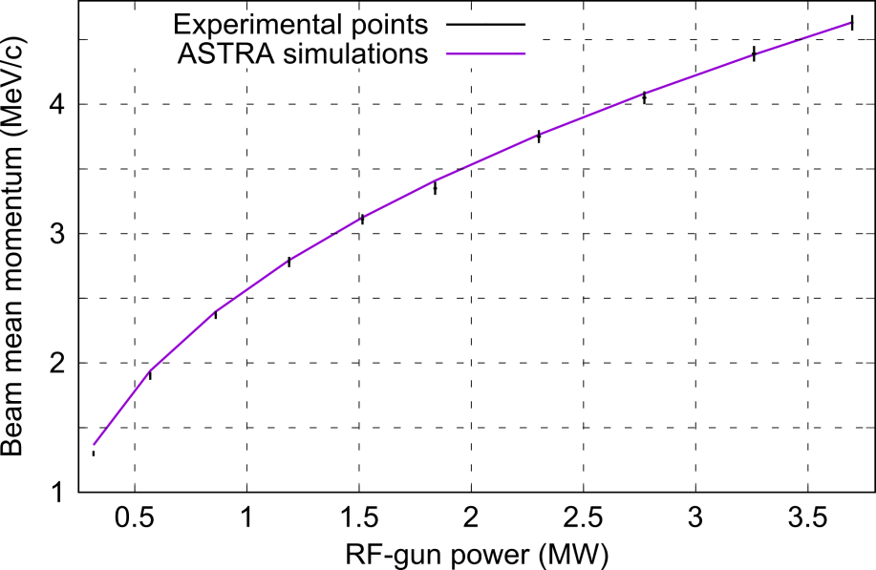
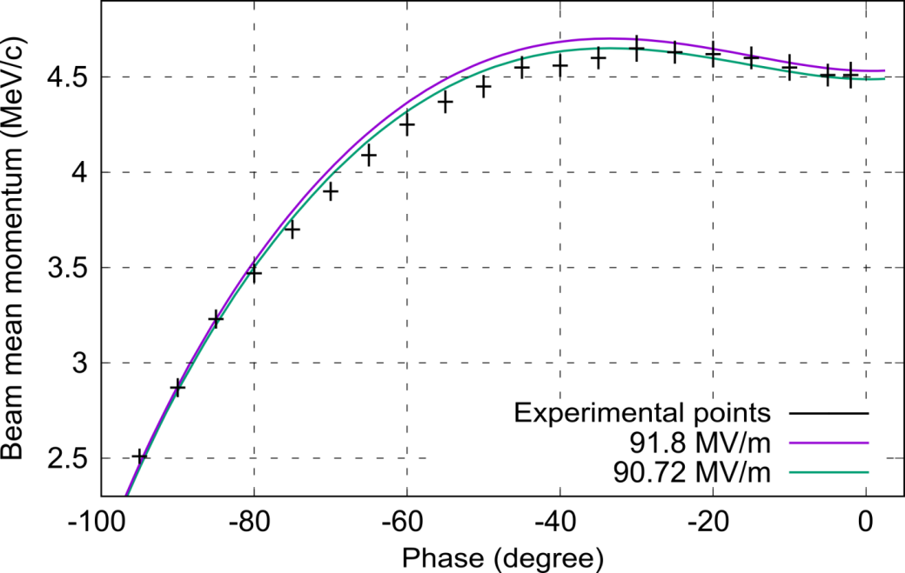
Momentum and momentum spread measurement
ARES beam characterization
Courtesy T. Vinatier
Comparison of the momentum measurement with
steerer and spectrometer dipole:
Power [MW] | pc steerer [MeV/c] | pc dipole [MeV/c]
3.70 | 4.63 +/- 0.06 | 4.64 +/- 0.04
3.26 | 4.39 +/- 0.06 | 4.39 +/- 0.06
2.77 | 4.05 +/- 0.05 | 4.09 +/- 0.05
RF phase: -20°
Momentum spread measurement with spectrometer dipole:
Power [MW] | σ_{pc} dipole [keV/c] | σ_{pc} simulations* [keV/c]
3.70 | 8.84 +/- 0.09 (0.19%) | 11.9
3.26 | 9.00 +/- 0.14 (0.21%) | 9.3
2.77 | 9.66 +/- 0.13 (0.23%) | 5.3
* 2.5 ps emission time

Slide 13
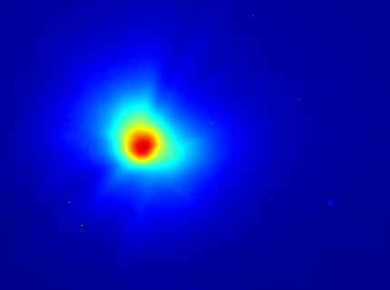
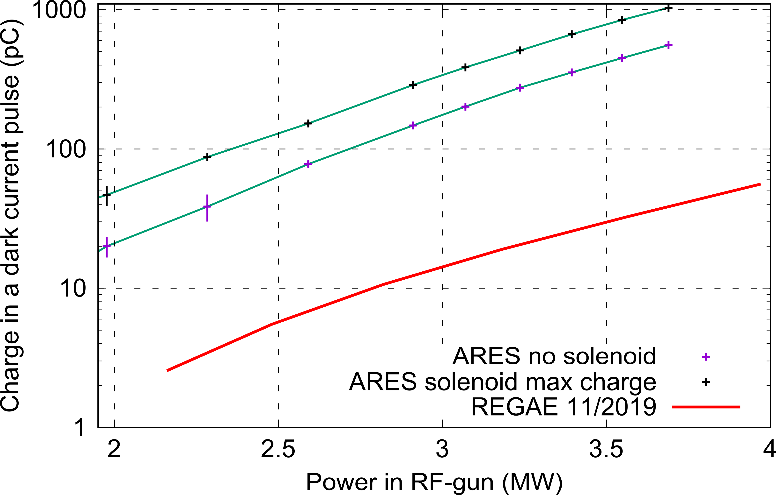
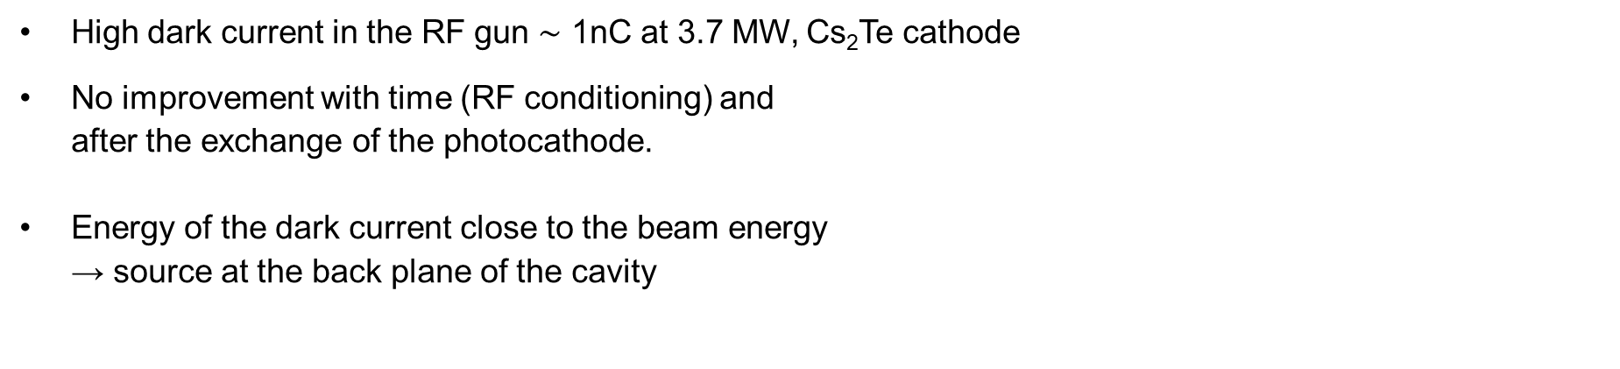
Dark current
High dark current in the RF gun $\sim$ 1nC at 3.7 MW, Cs₂Te cathode
No improvement with time (RF conditioning) and
after the exchange of the photocathode.
Energy of the dark current close to the beam energy
→ source at the back plane of the cavity
Dark current on the first screen in the ARES gun section.
Dark current vs. RF power measurement
Measurement conditions:
- Cs₂Te cathode
- Measurement with Faraday Cup
- Solenoid off and adjusted to the field
maximizing the dark current
Courtesy T. Vinatier

Slide 14
Dark current
High dark current in the RF gun $\sim$ 1nC at 3.7 MW, Cs₂Te cathode
No improvement with time (RF conditioning) and
after the exchange of the photocathode.
Energy of the dark current close to the beam energy
→ source at the back plane of the cavity
Dark current on the first screen in the ARES gun section.
Plan: Installation of upgraded RF gun with better solenoid focusing
→ Optimize emittance for higher beam charge
Dark current vs. RF power measurement
Measurement conditions:
- Cs₂Te cathode
- Measurement with Faraday Cup
- Solenoid off and adjusted to the field
maximizing the dark current
Courtesy T. Vinatier

Slide 15
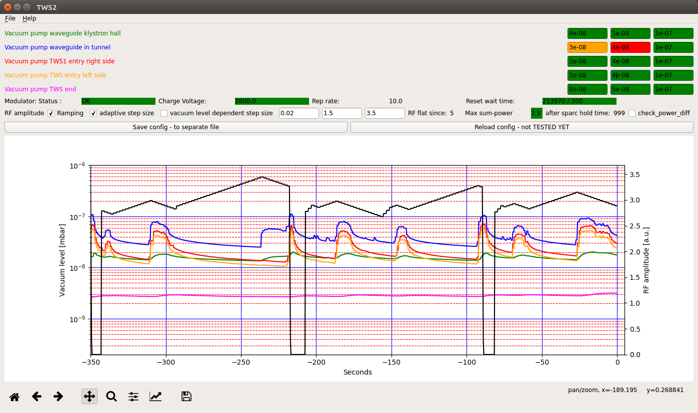
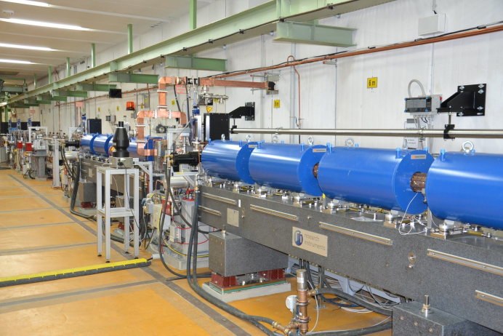
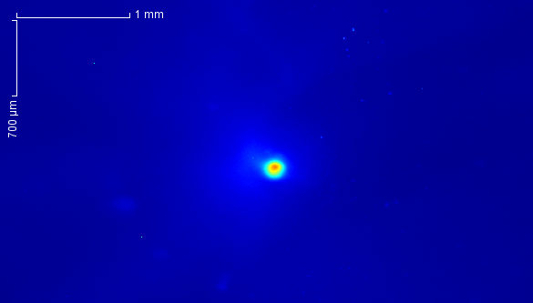
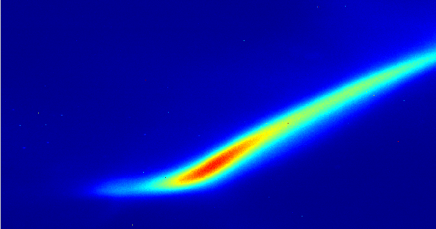
Linac commissioning
Both travelling wave structures are fully RF conditioned (using condition tool)
Current settings:
40 MW RF probe power, 2.2 µs long RF pulses,
10 Hz rep rate, successful test of 50 Hz operation
Magnets (8 solenoids, 2 dual plane steerers, 4 high energy steerers) and diagnostics (4 screens, toroid) are implemented, controls were tested
Beam of a good quality on the last screen of the gun section
Conditioning tool written by U. Dorda.
8 pC bunch on screen R1 at the linac entrance.
Dark current on screen after first TWS.

Slide 16
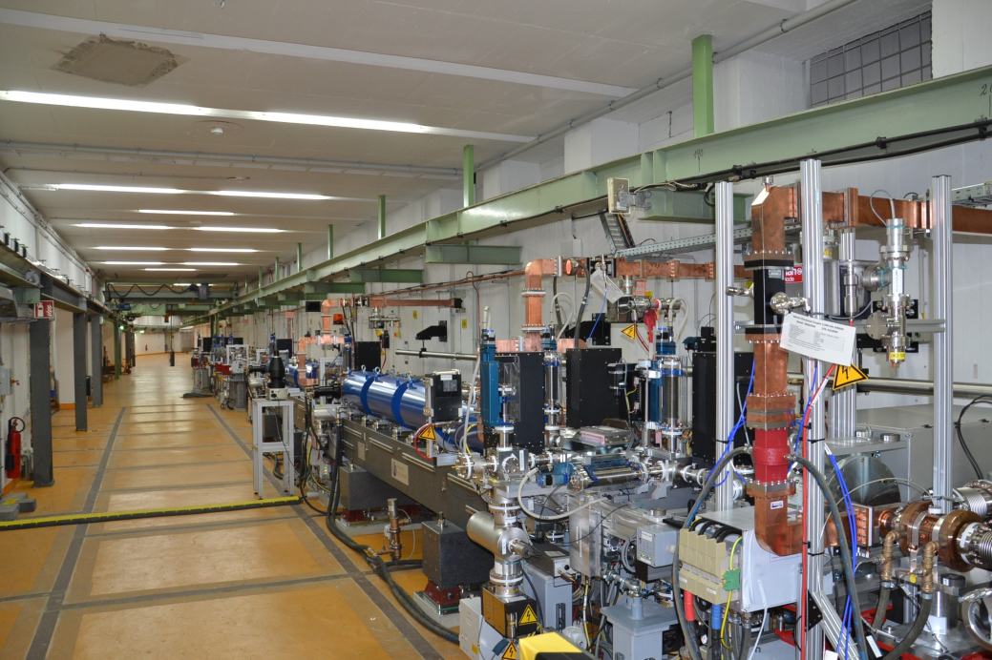
Outlook – Plan for the next months
Installation of the upgraded RF gun planned for the end of the current shutdown (begin of March 2020)
Conditioning of the new RF gun (mid of March 2020)
Beam characterization in the new RF gun (starting April 2020)
Beam commissioning and characterization in the linac section (starting May 2020)
Commissioning of the Experimental Area and first ACHIP experiments (summer/fall 2020)

Slide 17
Thank you

Slide 18
Dr. Eva Panofski
MPY1
eva.panofski@desy.de
+49 40 8998 3009

Slide 19
Backup

Slide 20
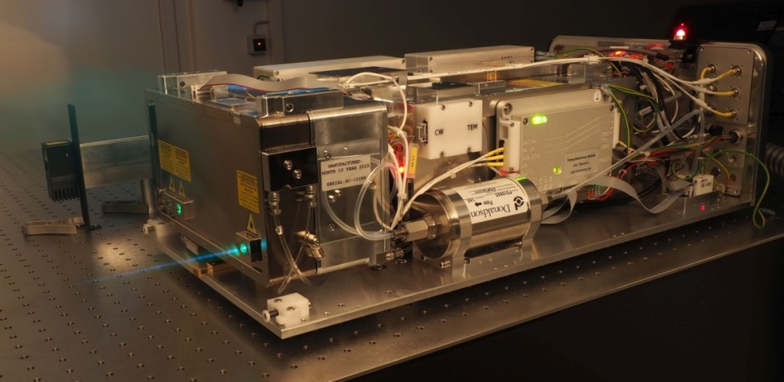
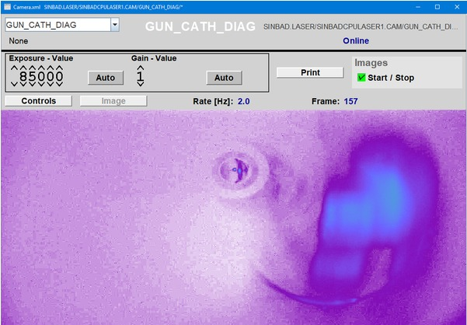
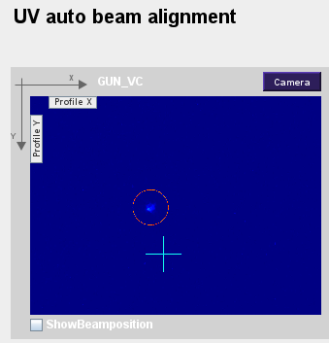
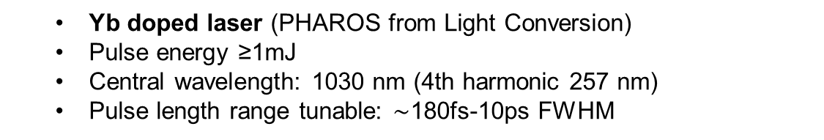
Photocathode drive laser
Laser alignment
Laser spot on the scintillating cathode
Laser on the Mo cathode
  Yb doped laser (PHAROS from Light Conversion)
  Pulse energy ≥1mJ
  Central wavelength: 1030 nm (4th harmonic 257 nm)
  Pulse length range tunable: $\sim$180fs-10ps FWHM
Laser aligned on the photocathode
(checked with RF phase scan).
Laser timing adjusted by MSK.
Remote control
Work on laser diagnostics is ongoing
(pulse energy, spot size, pulse length)
New laser colleague since 20.1.2020 (Caterina Vidoli)
DESY-developed transverse flat-top shaping system
Range for flat-top shaping: 20µm-0.2mm RMS
Design by Lutz Winkelmann & Sebastian Pumpe – group I. Hartl

Slide 21
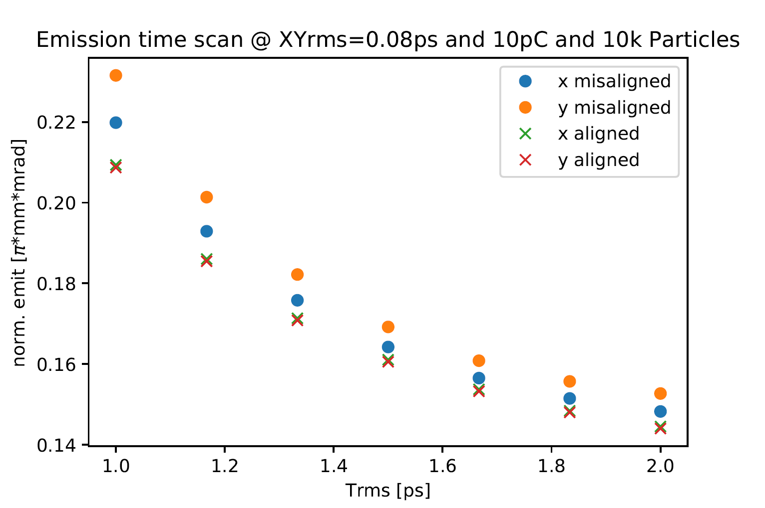
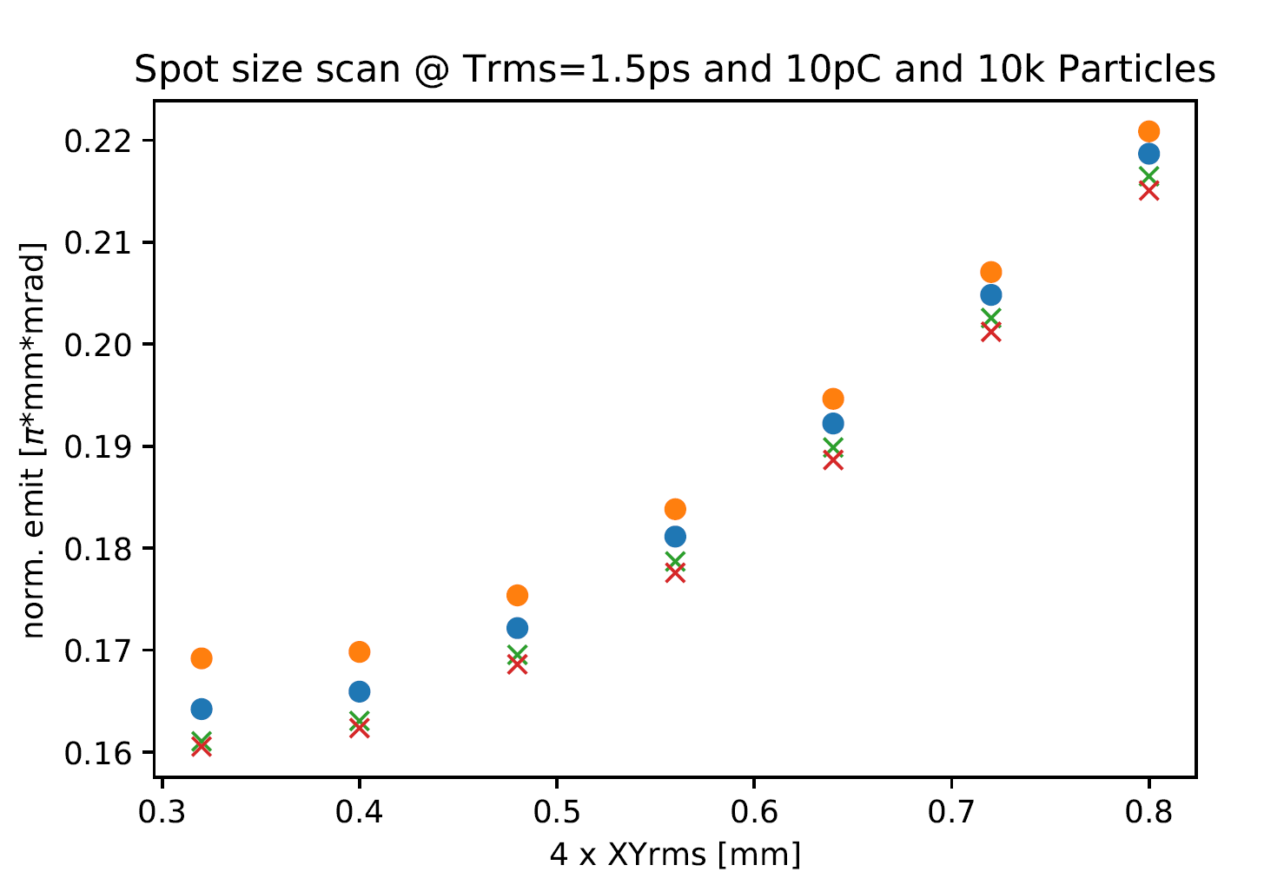
Transverse emittance – Astra simulations
Due to the misaligned solenoid and camera issues no transverse emittance measurement yet.
Transverse emittance measurements with solenoid scan and TEM grid/pepperpot planned.
Astra simulations were done for different laser parameters and solenoid misalignment.
Measurement tool and analysis software available and tested.
Courtesy W. Kuropka

Slide 22
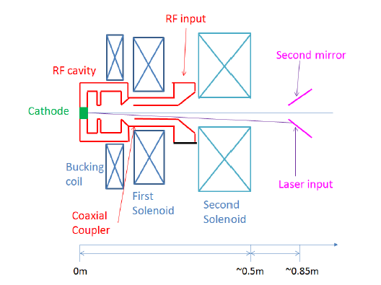
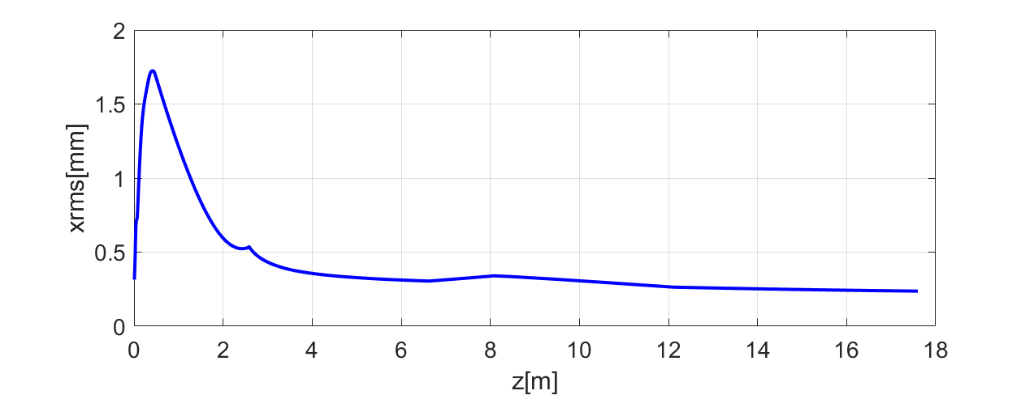
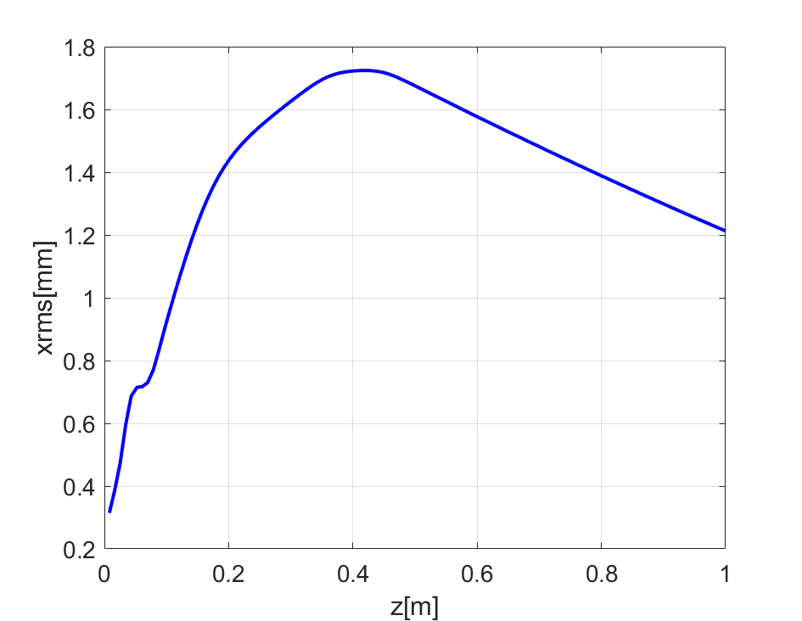
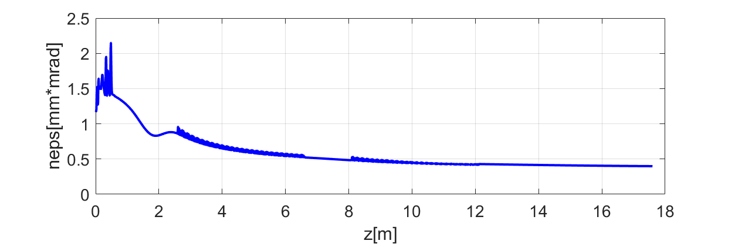
Upgrade of the RF-gun for ARES
Modified cooling channels to allow integration of additional gun solenoid that is necessary to optimize the emittance for higher beam charge
Example of matched beam Q=200pC
Zoom of cathode area
Simulation by Jun Zhu

Slide 23
Beam based Solenoid alignment
Courtesy S. Yamin, F. Mayet
Misalignment calculation → Analysis tool with MATLAB GUI
Solenoid scans were done for
- different solenoid polarities
- different RF power
Solenoid was shifted by -0.8mm in the horizontal direction
→ Beam is more centred on the screen ü
(without using steerer magnet)
Solenoid alignment will be continued after the gun exchange.
Shift | 22.01.2020 |  | 30.01.2020
SOL Config | ++ |  | +-
 | 3.6 MW, neg | 2.6 MW, neg | 3.6 MW, neg | 3.6 MW, pos | Average
dX (mm) | -0.97 | -0.87 | -0.15 | -0.6 | -0.81
dXrot (mrad) | 0.69 | 1.02 | -0.46 | -2.28 | 1.33
dY (mm) | 0.4 | 0.44 | -13.07 | 0.3 | 0.38
dYrot (mrad) | 1.81 | 1.97 | 3.19 | 2.15 | 1.98
Measurement power | 2.5 MW | 3.5 MW
 | +- configuration with negative current
dX (mm) | -0.65 | -0.64
dX_{rot} (mrad) | 2.86 | 0.60
dY (mm) | -0.14 | -0.12
dY_{rot} (mrad) | 2.70 | 2.79
Many thanks for the support by MEA and MKK group

