Slide 1
Advanced beam diagnostics and handling
On the use dielectric structures for beam manipulation, diagnostics and radiation generation
François Lemery, Ralph Assmann, Hannes Dinter, Martin Dohlus, Klaus Floettmann, Luca Genovese, Max Kellermeier, Willi Kuropka, Michaela Marx, Frank Mayet, Thomas Vinatier, Igor Zagorodnov
Vasili Tsakanov, Mikael Ivanyan, Bagrat Grigoryan (CANDLE, Armenia)

Slide 2
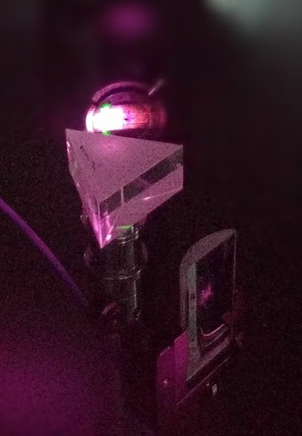
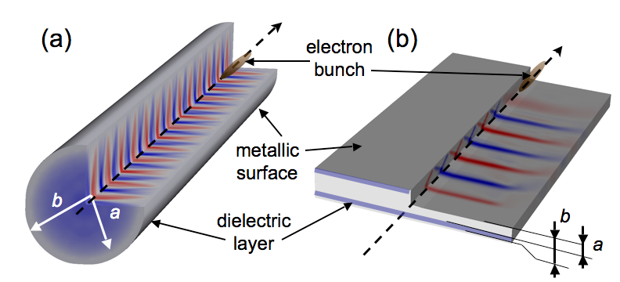
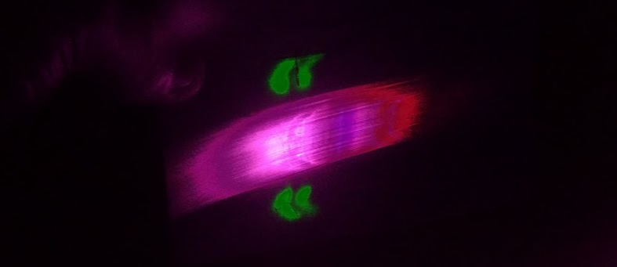
Terahertz radiation, scientific case and applications to accelerators
Motivating the generation of high-power THz, for users and emerging accelerators
  THz radiation loosely spans the range ~0.1-10 THz (3 mm- 30 um) with overlap in the mid-infrared (MIR) ~ 30 THz
  THz has broad applications in the science, including condensed matter physics, biology, imaging, advanced chemistry and more.
  THz also has a very appealing scale in the accelerator community, where electron bunches typically have sub-mm bunch lengths and beam sizes.
  THz can be produced via an assortment of laser-based and beam-based approaches.
  These generated waveforms have a variety of applications to conventional accelerators, and also emerging laser-based accelerators.

Slide 3
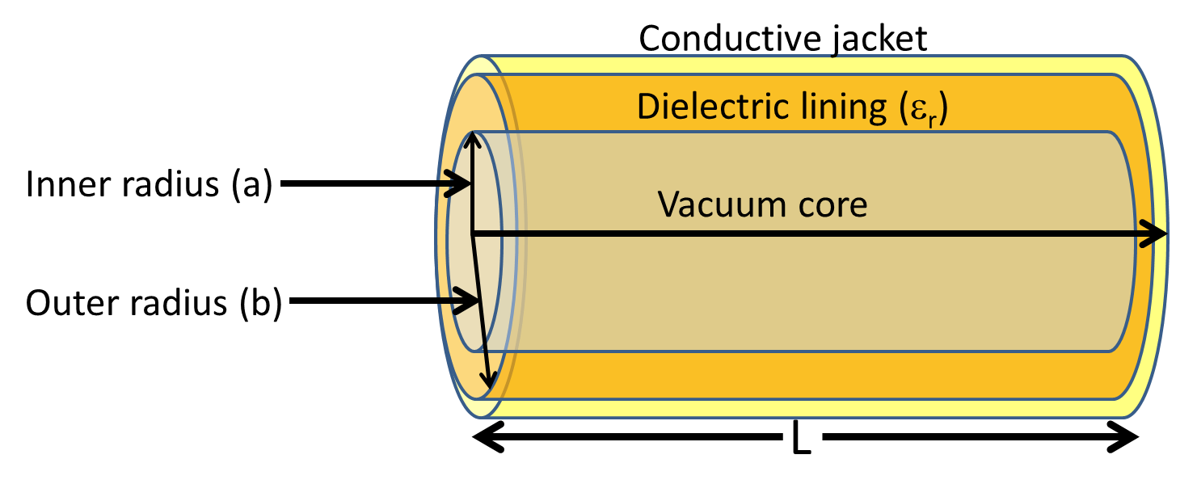
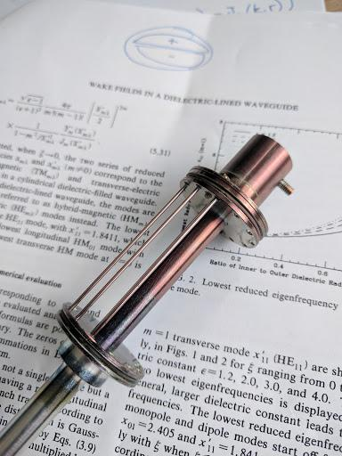
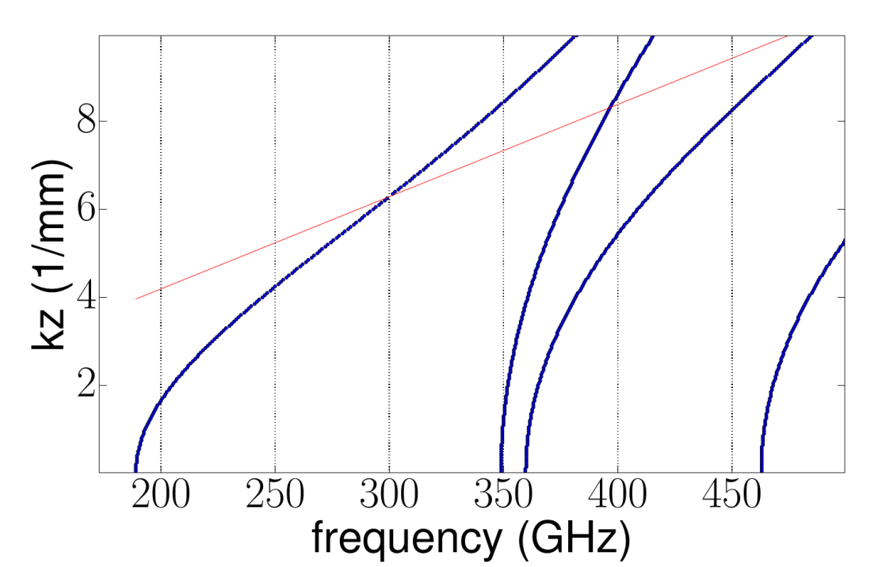
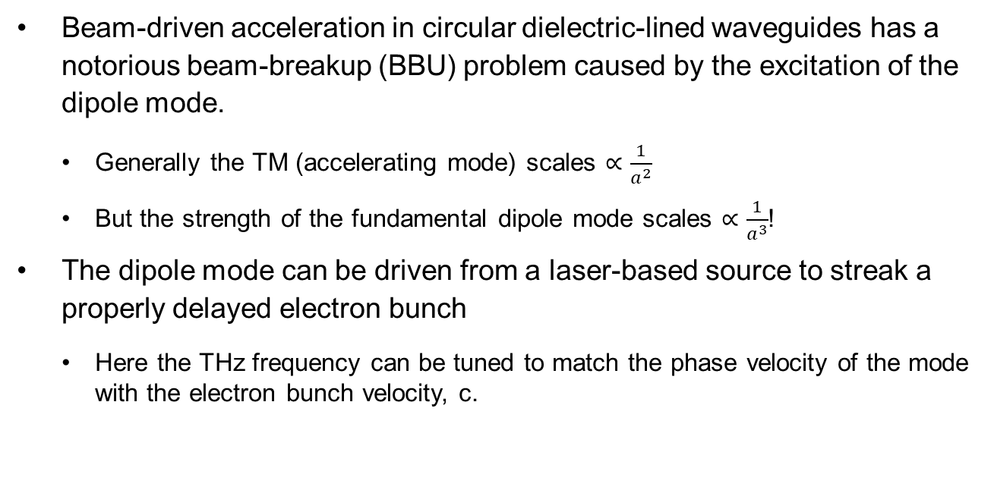
Longitudinal bunch diagnostics with DLWs
THz streaking with multicycle pulses
Beam-driven acceleration in circular dielectric-lined waveguides has a notorious beam-breakup (BBU) problem caused by the excitation of the dipole mode.
  Generally the TM (accelerating mode) scales $∝\frac{1}{a^{2}}$
  But the strength of the fundamental dipole mode scales $∝\frac{1}{a^{3}}$!
The dipole mode can be driven from a laser-based source to streak a properly delayed electron bunch
  Here the THz frequency can be tuned to match the phase velocity of the mode with the electron bunch velocity, c.

Slide 4
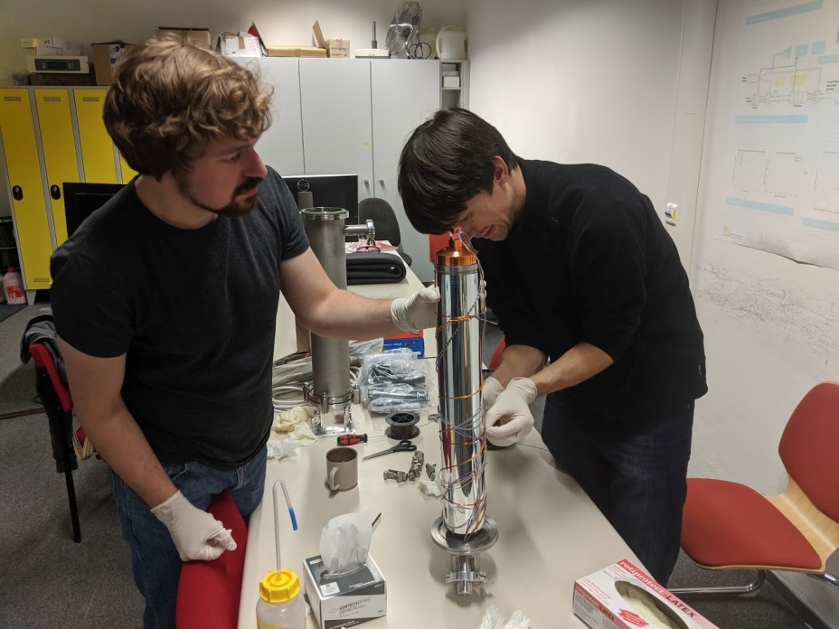
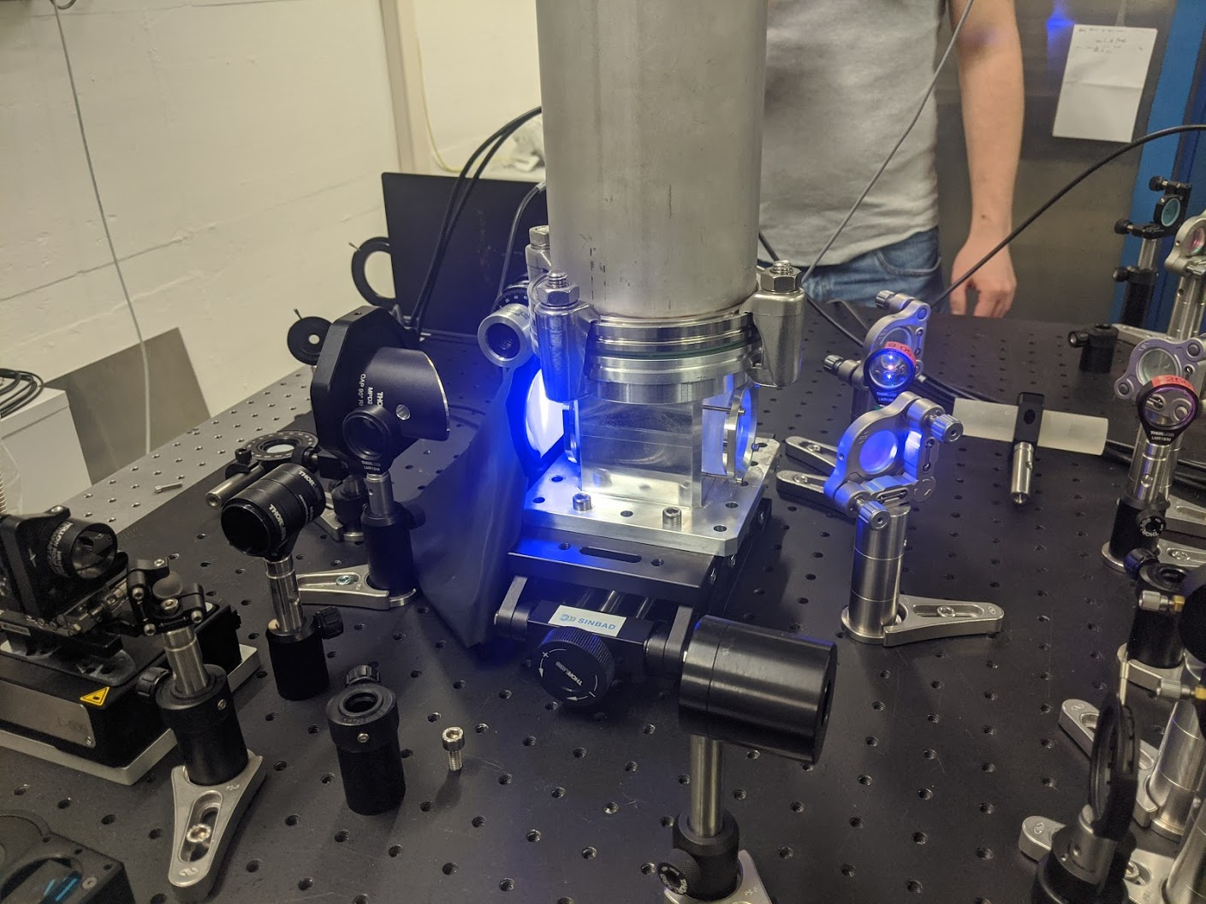
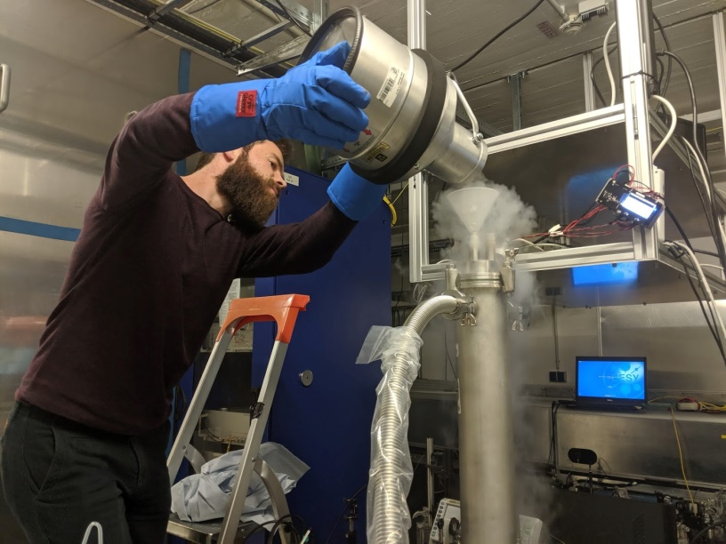
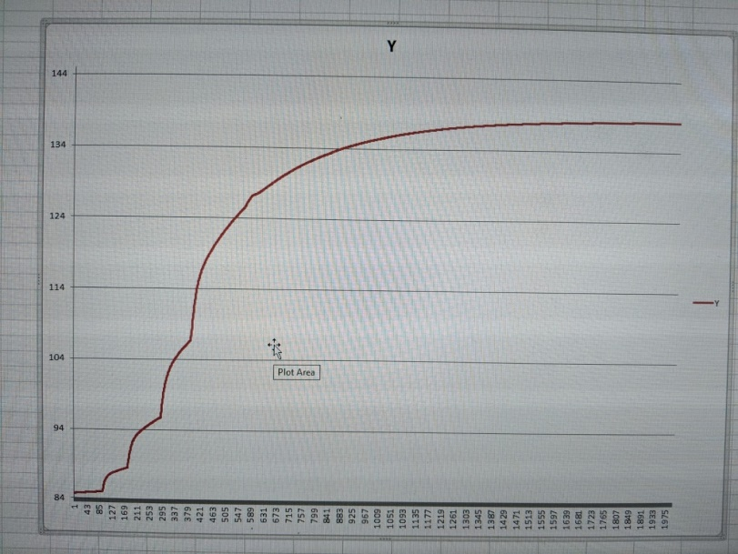
Status at REGAE
THz streaking with multicycle pulses
New temperature controllable setup (~60 K) has been implemented, providing a tunable range of ~25 GHz or 0.07c.
Now producing >2 uJ of energy
Characterization of structures and coupling studies will soon begin
Laser has been brought upstairs with help from Max Planck, stabilizers and synchronization underway.

Slide 5
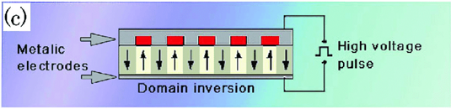
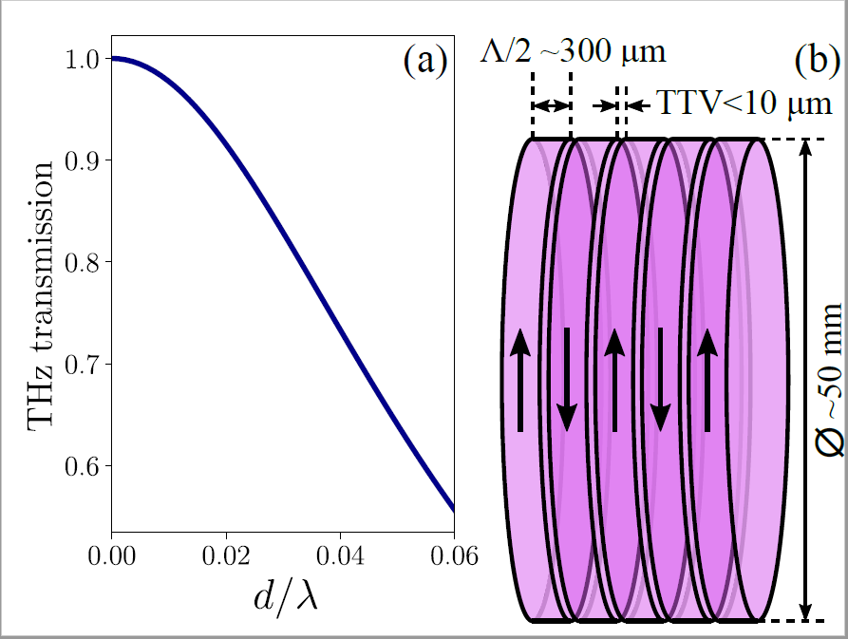
Making high-peak power THz
Duc Thien Trinh
How to overcome crystal fabrication limitations
Quasi-phase matching alternates the polarity of the generated THz to stitch a waveform together, much like an undulator.
These crystals are grown in a single polarization and later, the periodicity is applied via large voltages, overcoming the coercive field strength.
  A prime limitation is electric breakdown which limits the apertures of periodically poled crystals, and therefore the total THz power which can be produced
Alternatively, could we produce a “macrocrystal” and stack lithium niobate wafers with alternating polarity

Slide 6
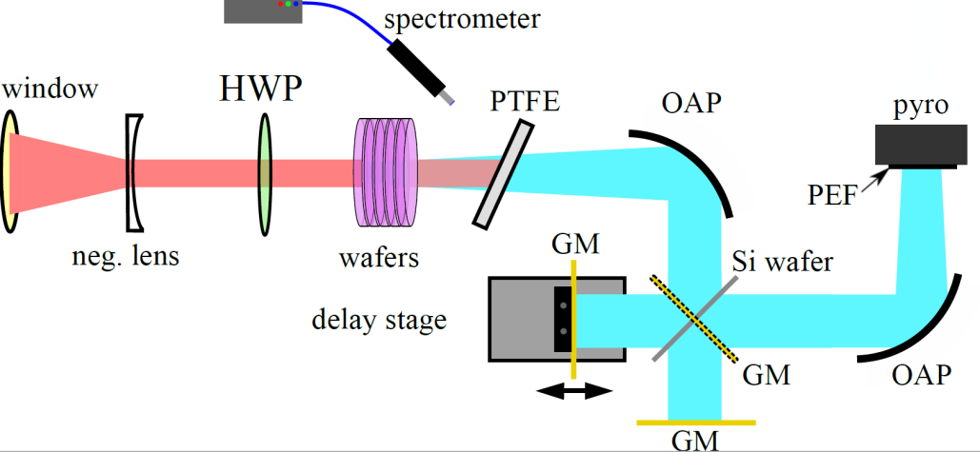
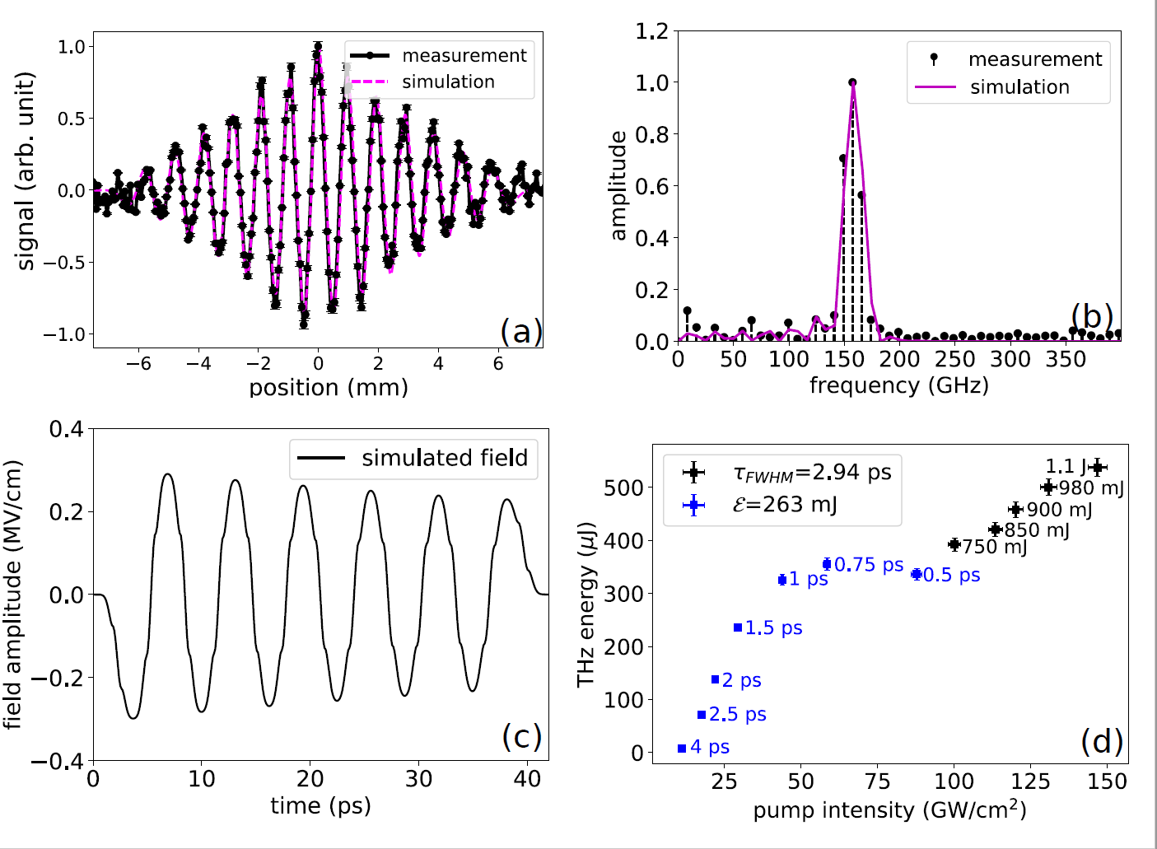
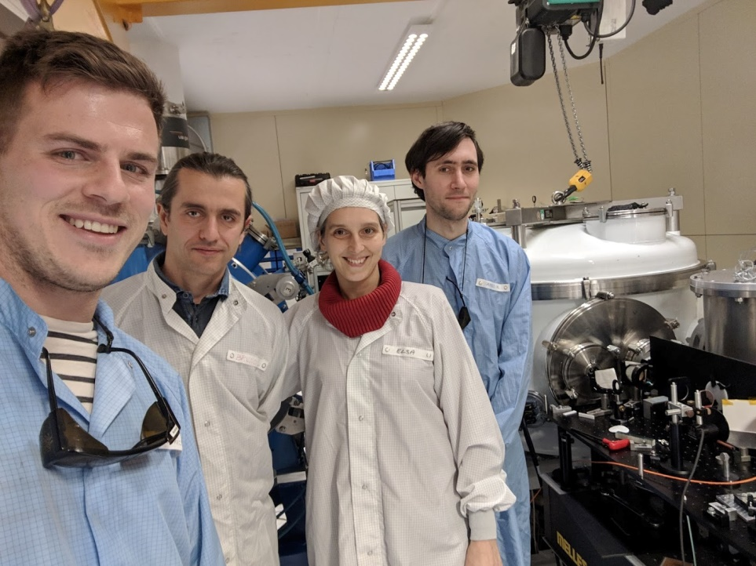
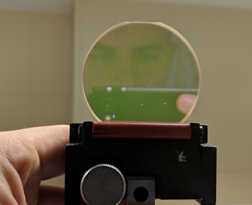
Making high-peak power THz
The scheme was developed and demonstrated with a Joule-class ti:saph laser, we measured up to 1.3 mJ for 165 GHz pulses- corresponding to 35 MW peak powers.
See “35 megawatt multicycle THz pulses from a homemade periodically poled macrocrystal”, F. Lemery et. al. arXiv:1909.07472 – Submitted to Nature Comm. (2019)
The laser-based scheme could be very interesting for laser-based accelerators

Slide 7
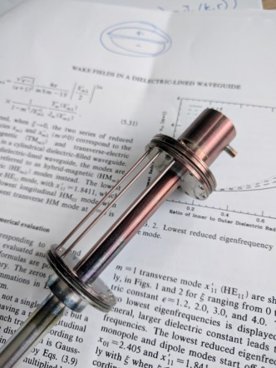
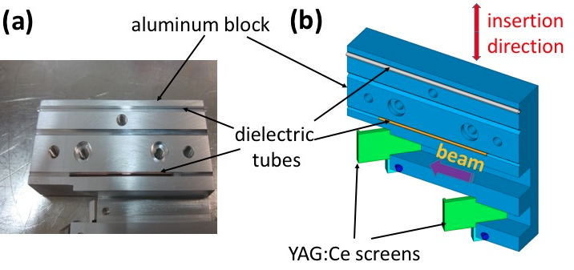
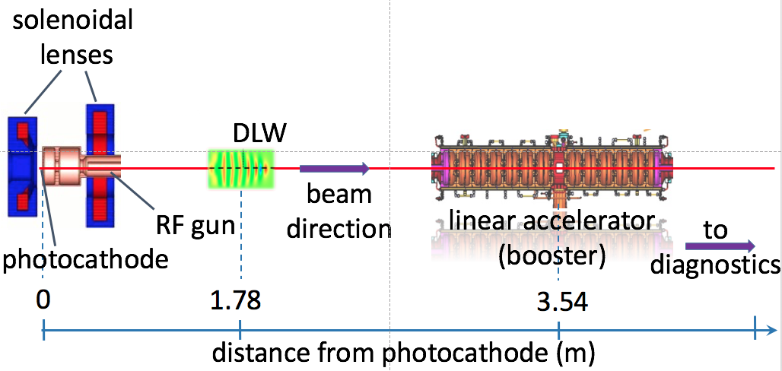


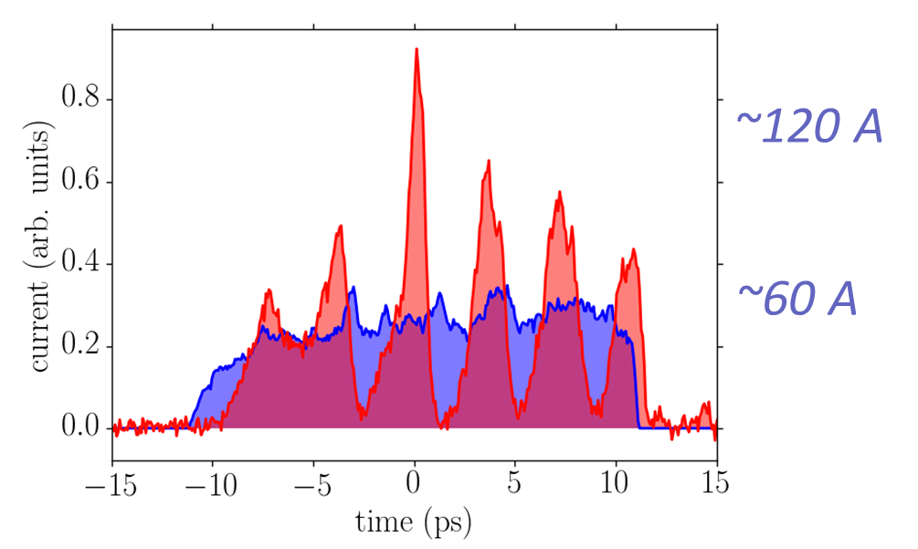
Beam based THz generation and a collaboration with CANDLE, Armenia
At low-energies
The advent of the photoinjector has led to high-brightness beams.
The Cherenkov wakefields produced in these waveguides are given simply by the convolution of the current profile with the Greens function (a cosine)
In this particular experiment a simple dielectric tube led to the microbunching of the beam with its self wake in a ~1 m drift.
The gain length in these conditions was ~1.5 cm motivating an investigation into Cherenkov FELs which was first investigated in the 1980s (Walsh, Gerate)
F. Lemery, P. Piot et. al. Phys. Rev. Lett. 122, 044801

Slide 8
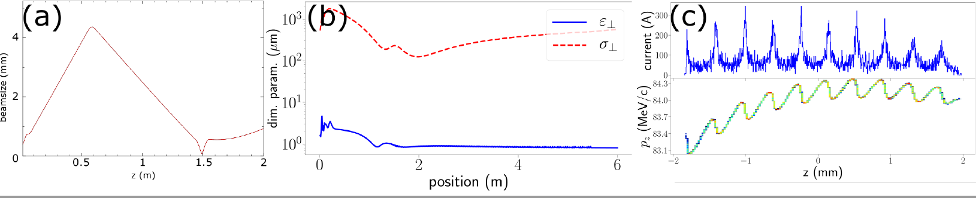
Beam based THz generation and a collaboration with CANDLE, Armenia
Beam manipulation for THz generation
We are performing several investigations with our friends at CANDLE:
  A simple configuration with RF gun+ solenoid + a permanent magnetic solenoid around a DLW (a) – here the interaction length in the DLW can be extended to ~50 cm.
  Alternatively, a ballsitically bunched beam can be injected into a linac with an additional solenoid, under the right circumstances emittance compensation can occur.
    This beam can have peak currents ~1 kA, and could be well transported through longer DLWs for efficient energy extraction.

Slide 9
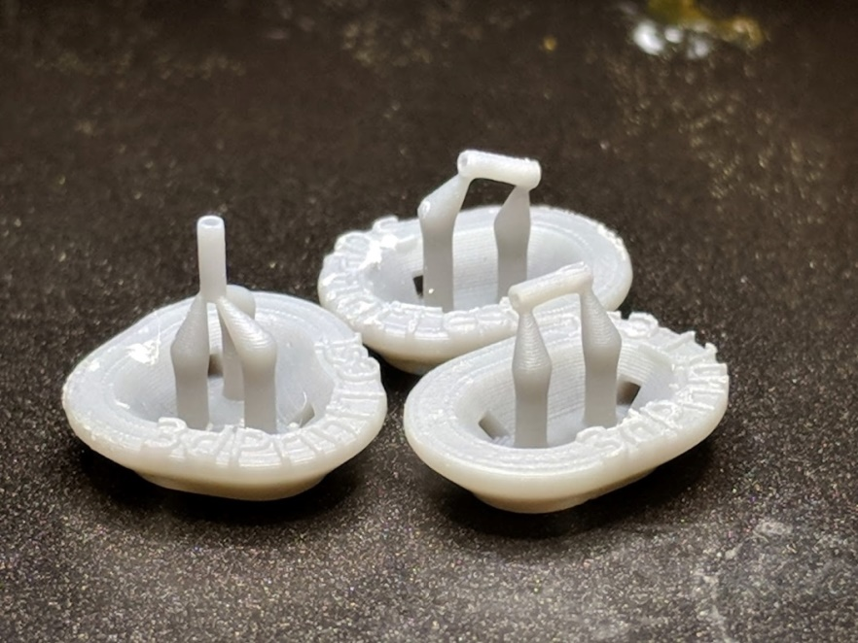
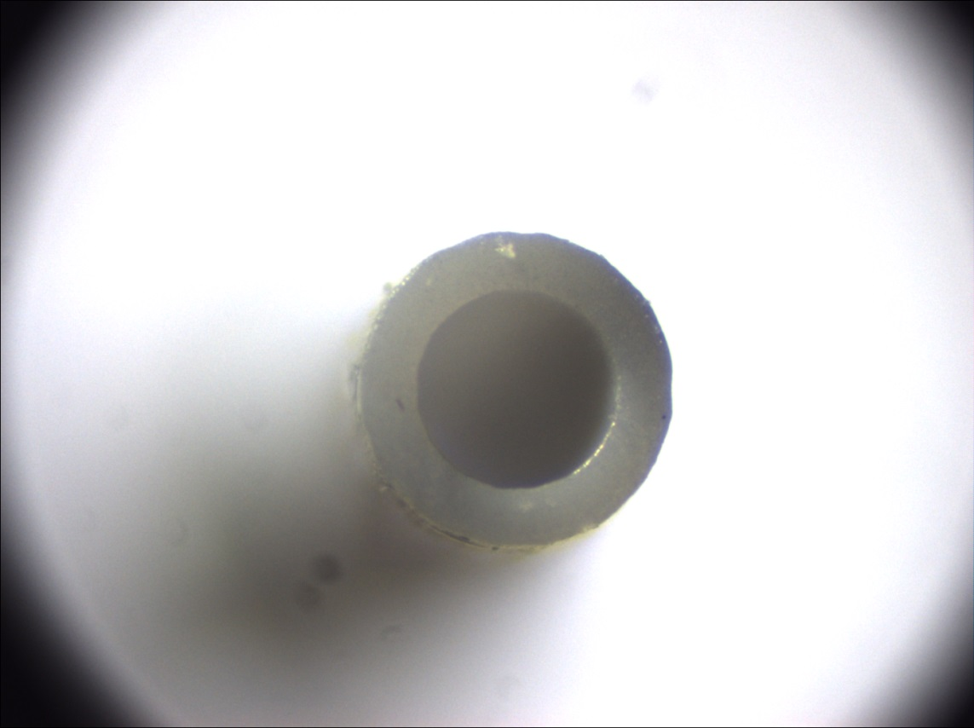
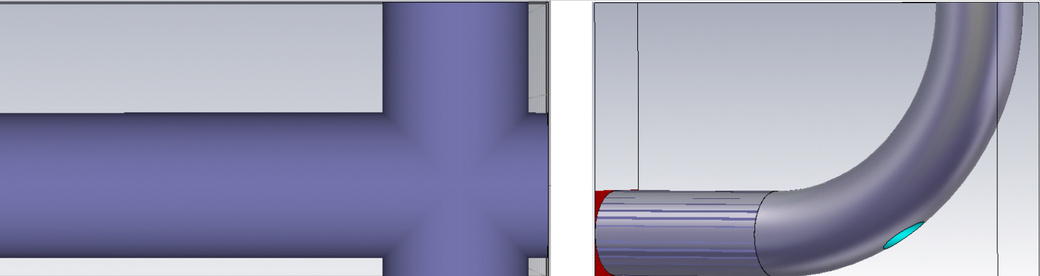
Development of 3D printed dielectric structures
The rise of SLA printers with micron-level resolutions presents a very promising path toward printing accelerator based components.
We now investigate with simulation software various couplers to incouple or outcouple THz from these waveguides.
Simultaneously we perform tests on new resins for vacuum and THz absorption compatibility.
300 um inner radius
100 um wall thickness

Slide 10
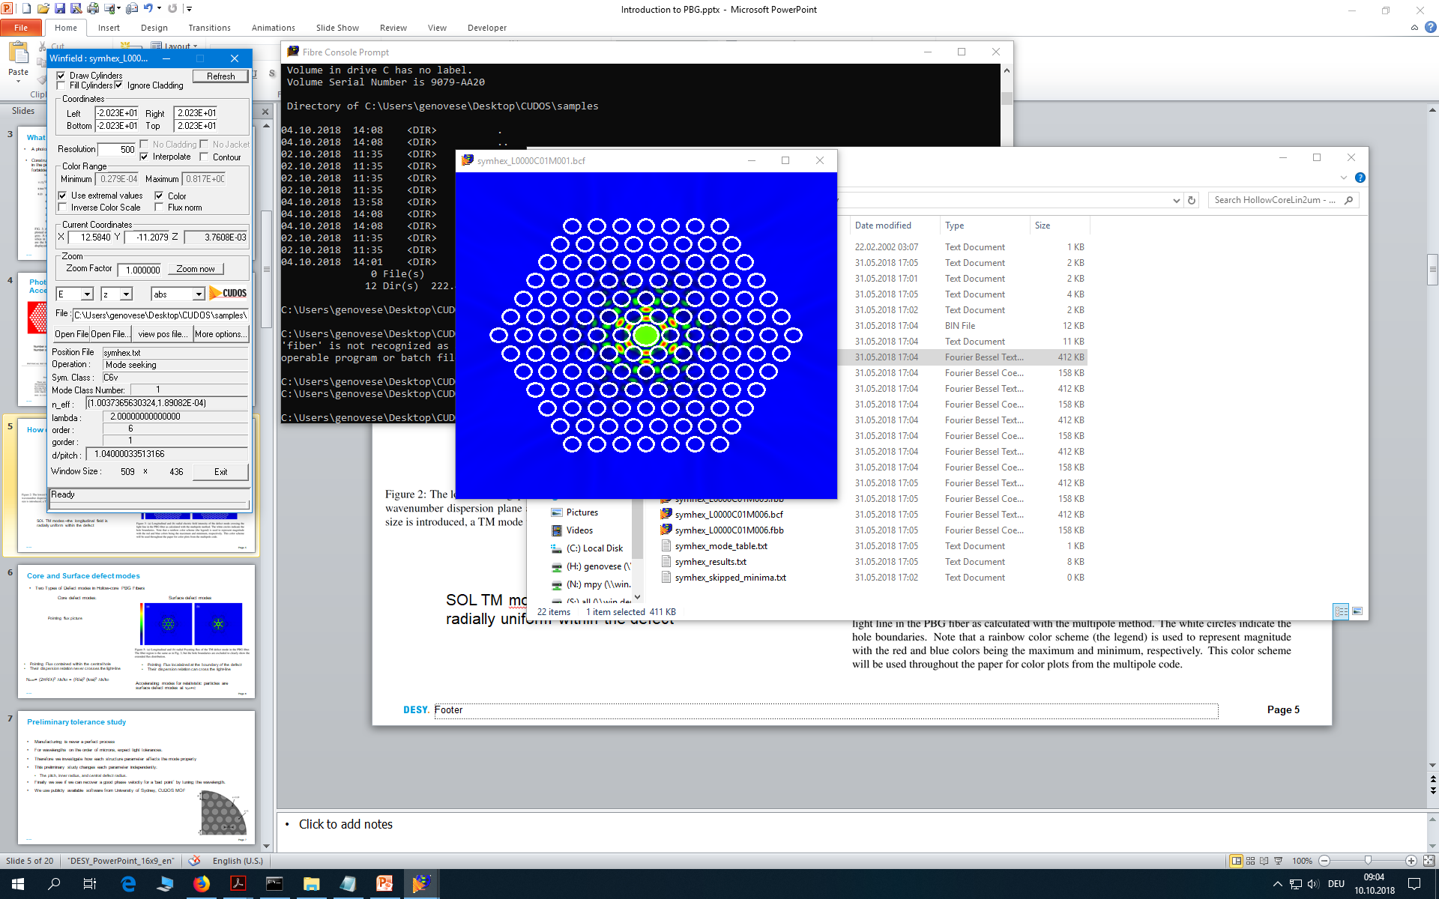
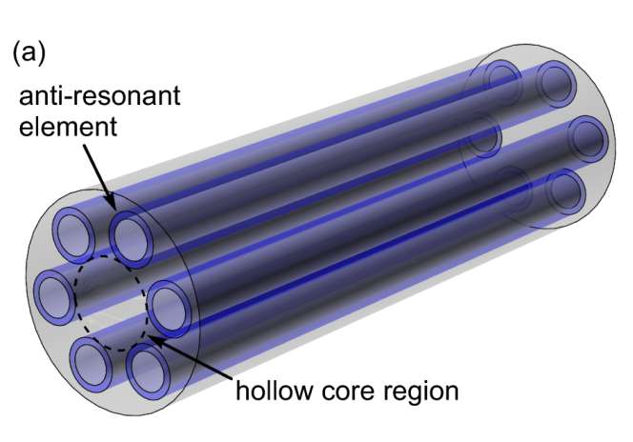
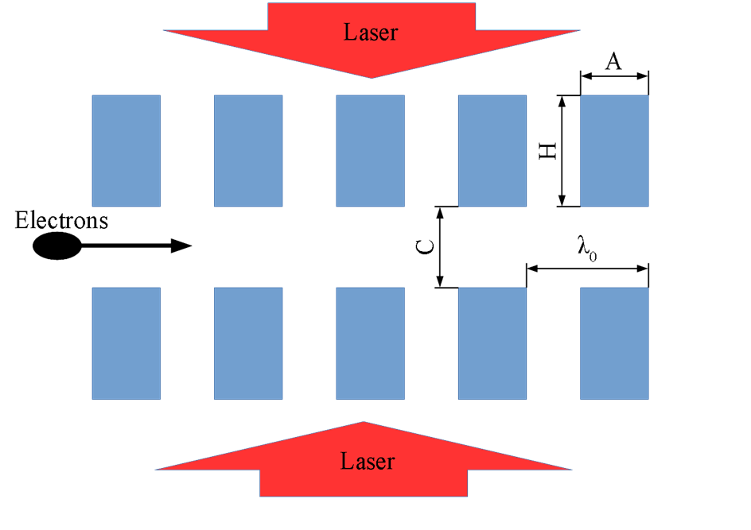
Dielectric-laser acceleration (DLA)
DLA investigates beam acceleration, manipulation and diagnostics with lasers.
DLA uses the fields directly, i.e. with micron-scale structures which permits GV/m field gradients with ~mJ laser energies.
In collaboration with ACHIP we are investigating grating-DLAs which support various operational modes
We are also investigating optical fibers as an alternative which support collinear acceleration
L. Genovese, F. Lemery, M. Kellermeier, F. Mayet, W. Kuropka, U. Dorda, R. Aßmann. Tolerance Studies and Limitations for Photonic Bandgap Fiber Accelerators - DOI: 10.18429/JACoW-IPAC2019-THPGW014
Microbunch production using fiber

Slide 11
Acknowledgments
We thank Klaus Balewski for help finding a new 3D printing lab!
This work was funded by European Union’s Horizon 2020 Research and Innovation programme under Grant Agreement No 730871.
The authors thank M. Kellermeier, C. Bosch, and P. Altmann (DESY) for engineering support (Paris exp.)
We thank K. Ravi, M. Hemmer, H. Olgun, N. Matlis and F. X. Kaertner within the AXSIS collaboration for support in preliminary simulations and experiments.

