Slide 1
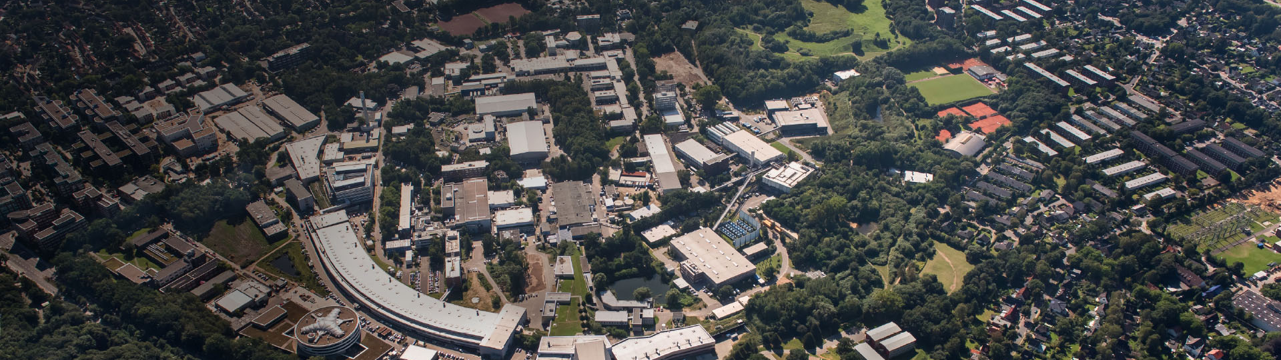

PolariX TDS Project
Barbara Marchetti for the PolariX TDS team.

Slide 2


Collaboration DESY-CERN-PSI
Development of an X-band TDS RF system, comprising innovative
X-band TDSs, high power waveguide components and any other required components
Experiments participating to the Project and specific needs:
  FLASHForward (DESY) : 1 structure (prototype) for fs-longitudinal diagnostics of driver/witness beams used in PWFA to optimize the acceleration process.
  FLASH2 (DESY) : 2 structures for online longitudinal phase space measurement with fs resolution of e-bunches at the exit of the undulator for optimizing FEL emission process.
  SINBAD-ARES (DESY): 2 structures for sub-fs resolved phase-space characterization of ultra-short e-bunches for novel acceleration techniques.
  ATHOS (beamline at SwissFEL, PSI): 2 structures for optimization of the FEL process.
Measurement of longitudinal bunch profile and slice beam properties (energy spread, emittance etc.) with fs or sub-fs resolution
  Eu XFEL also part of collaboration but without commitment in purchasing the structures.

Slide 3
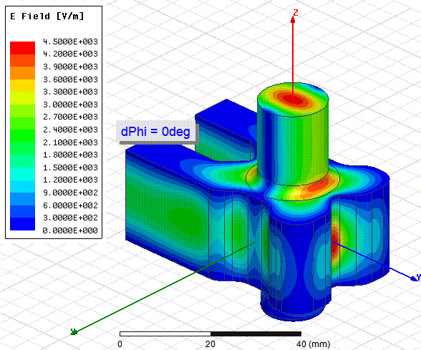
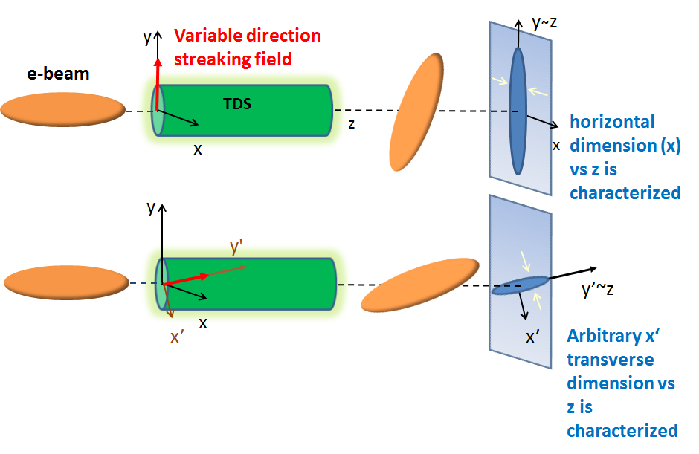
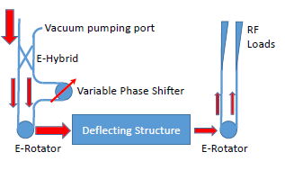
The PolariX TDS Project focuses on the Development of a new Generation of TDS with Variable Streaking Direction
PolariX TDS = Polarizable X-band Transverse Deflection Structure
The concept of variable streaking direction has been invented at CERN:
A. Grudiev, CLIC-note-1067 (2016)
New: Variable direction of the streaking field !
Variable Polarization Circular TE11 Mode Launcher
Phase difference between port 1 and port 2:
0 degree -> vertically streaking field
180 degree -> horizontally streaking field
It makes possible the Characterization of the slice properties of the e-beam on arbitrary x’ direction

Slide 4
The PolariX TDS Project focuses on the Development of a new Generation of TDS with Variable Streaking Direction
PolariX TDS = Polarizable X-band Transverse Deflection Structure
The concept of variable streaking direction has been invented at CERN:
A. Grudiev, CLIC-note-1067 (2016)
New: Variable direction of the streaking field !
The manufacturing of the structure requires very precise azimuthal symmetry in manufacturing!
→Tuning free assembly procedure (PSI)
Variable Polarization Circular TE11 Mode Launcher
Phase difference between port 1 and port 2:
0 degree -> vertically streaking field
180 degree -> horizontally streaking field
It makes possible the Characterization of the slice properties of the e-beam on arbitrary x’ direction

Slide 5
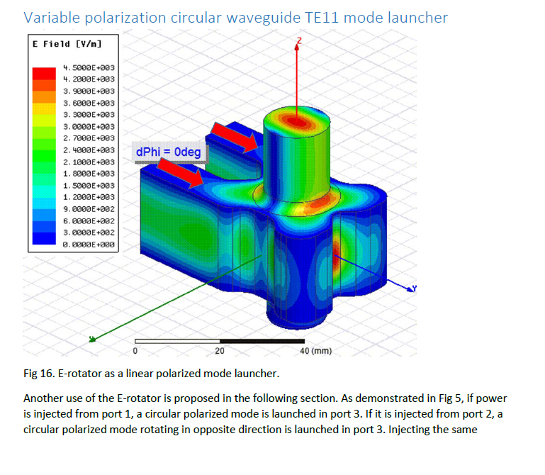
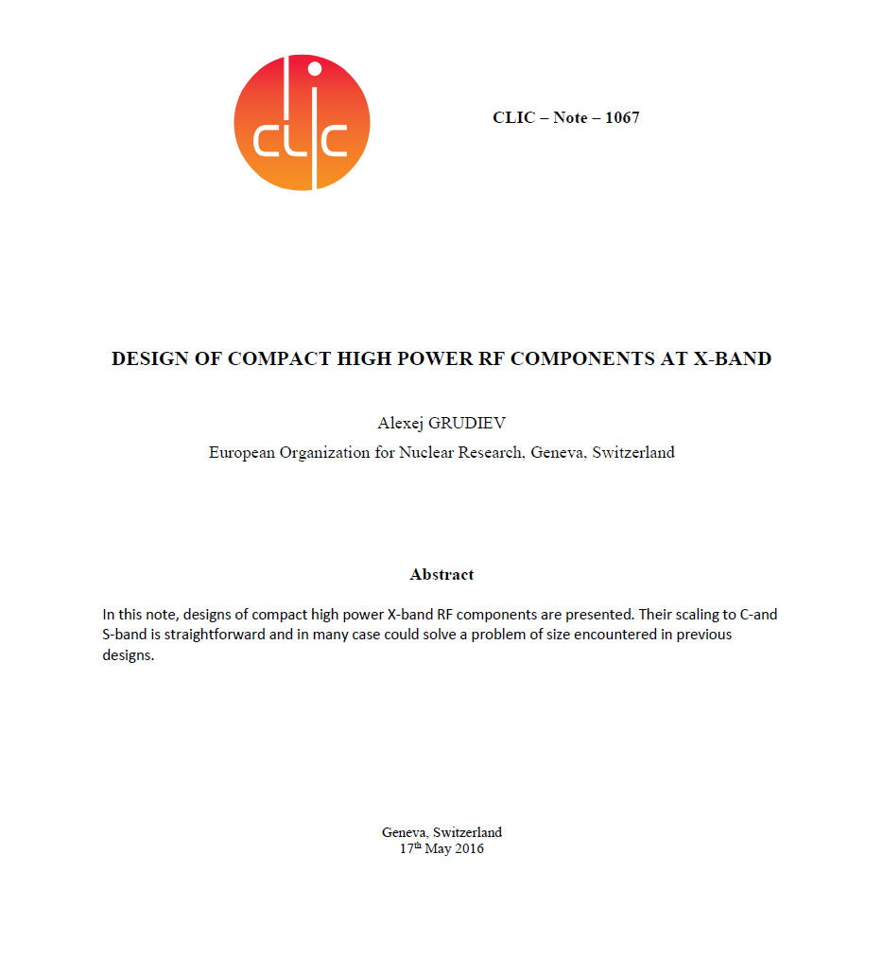
Brief History of the Project
In 2016 : A. Grudiev, CLIC-note-1067 (2016)
    → Idea of the variable polarization TDS.

Slide 6
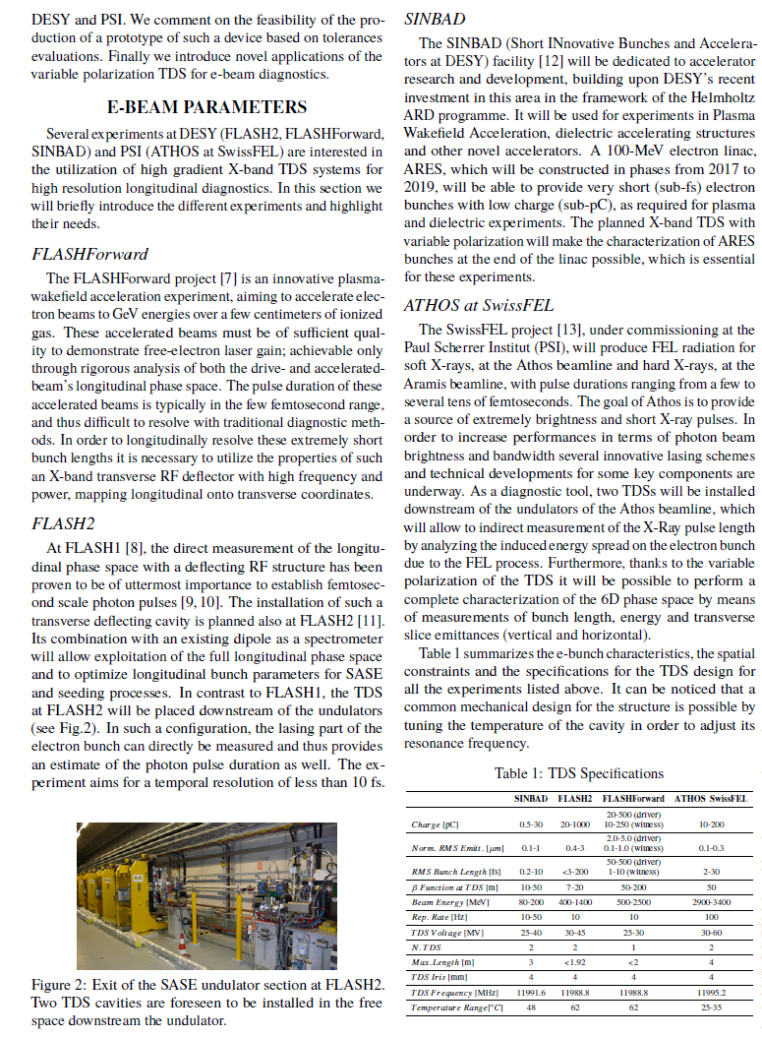
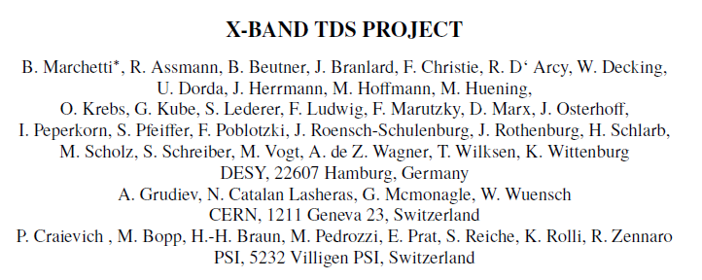
Brief History of the Project
In 2016 : A. Grudiev, CLIC-note-1067 (2016)
    → Idea of the variable polarization TDS.
In 2017: first IPAC contribution: community interested in the development worked on the study of the specifications for the prototype structure.

Slide 7

The mechanical design of the PolariX TDS fulfills the requirements of many experiments
Parameters | SINBAD ARES | FLASH II | FLASHForward | ATHOS SwissFEL | Unit
Charge | 0.5-30 | 20-1000 | 20-500 (driver) 10-250 (witness) | 10-200 | pC
Norm. emit. (rms) | 0.1-1 | 0.4-3 | 2.0-5.0 (driver) 0.1-1.0 (witness) | 0.3 | mm
Bunch length (rms) | 0.2-10 | <3-200 | 50-500 (driver) 1-10 (witness | 2-30 | fs
β function @TDS | 10-50 | 7-20 | 50-200 | 50 | m
Beam energy | 80-200 | 400-1400 | 500-2500 | 3400 | MeV
Rep. rate | 10-50 | 10 | 10 | 100 | Hz
TDS voltage | 25-40 | 30-45 | 25-30 | 30-60 | MV
# TDS | 2 | 2 | 1 | 2
Max. length (flange to flange) | 3 | <1.91(8) | <2 | 4 | m
TDS iris | 4 | 4 | 4 | 4 | mm
TDS frequency | 11991.6 | 11988.8 | 11988.8 | 11995.2 | MHz
Temperature range | 48 | 62 | 62 | 25-35 | °C

Slide 8
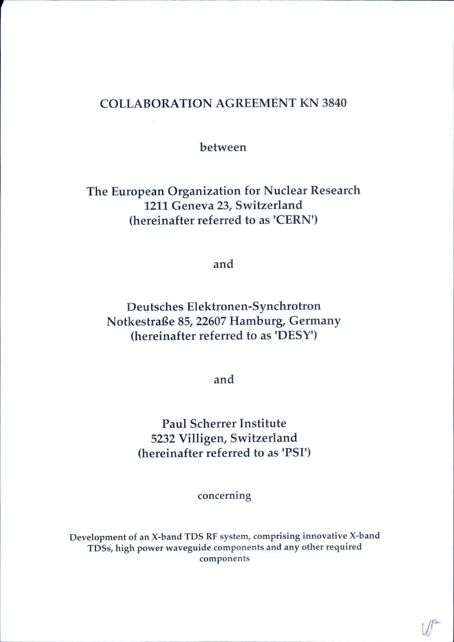
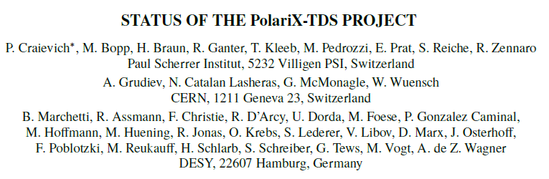
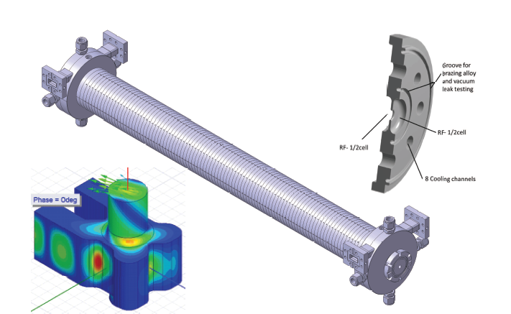
Brief History of the Project
In 2016 : A. Grudiev, CLIC-note-1067 (2016)
    → Idea of the variable polarization TDS.
In 2017: first IPAC contribution: community interested in the development worked on the study of the specifications for the prototype structure.
In 2018:
  Collaboration Agreement signed by DESY-CERN-PSI.
        Commitment in realization of prototype structure + 6 “in-series” structures after prototype’s positive test.
      Completion of the mechanical design of the prototype (done at PSI). Start of the procurement of the prototype.

Slide 9
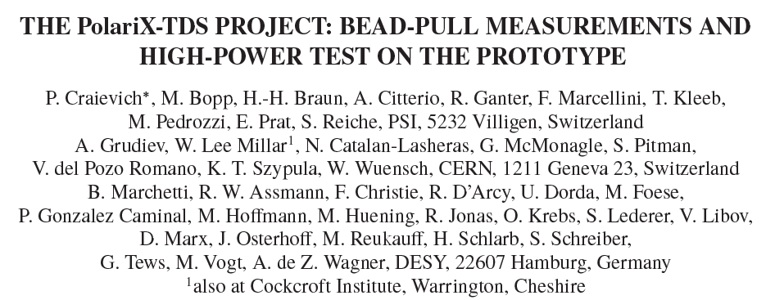
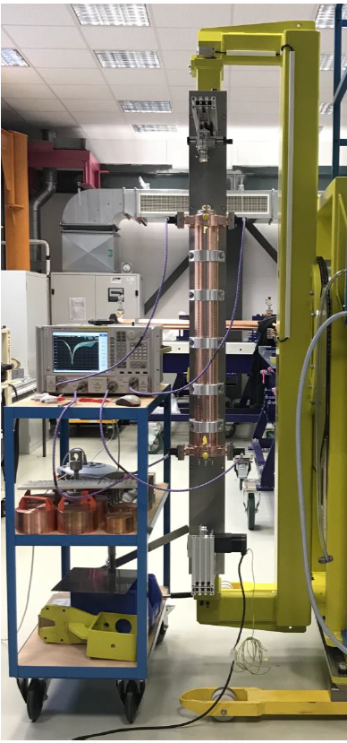
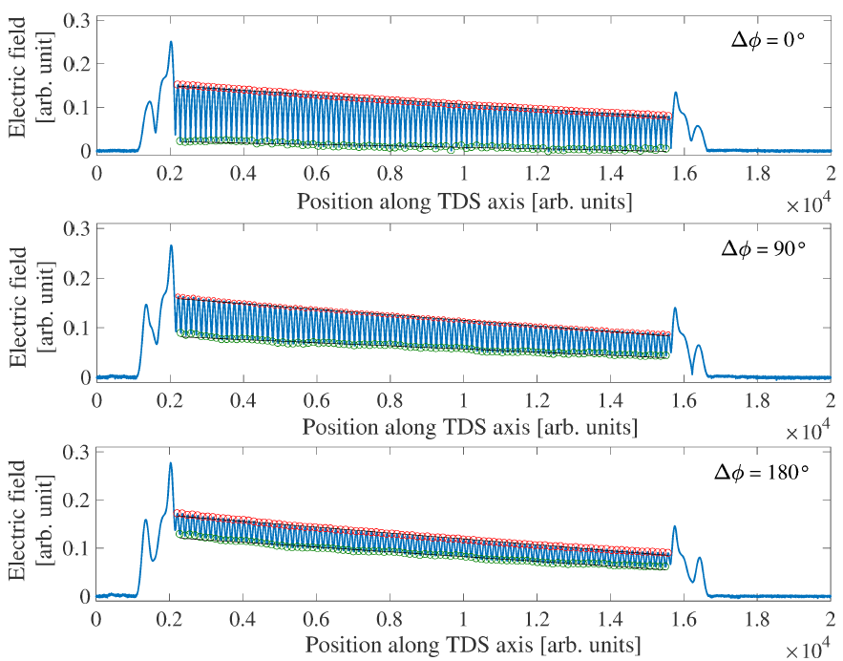
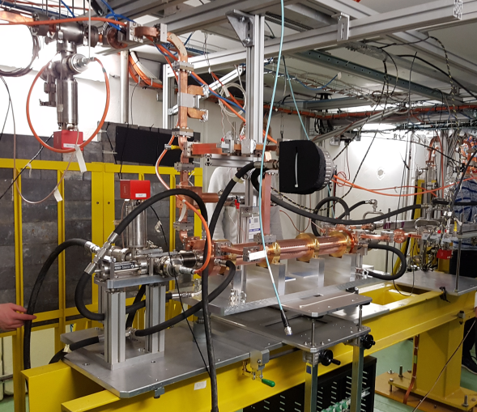
Brief History of the Project
In 2016 : A. Grudiev, CLIC-note-1067 (2016)
    → Idea of the variable polarization TDS.
In 2017: first IPAC contribution: community interested in the development worked on the study of the specifications for the prototype structure.
In February 2018 – Collaboration Agreement signed by DESY-CERN-PSI.
    → Commitment in realization of prototype structure + 6 “in-series” structures after prototype’s positive test.
In 2018:
  Collaboration Agreement signed by DESY-CERN-PSI.
        Commitment in realization of prototype structure + 6 “in-series” structures after prototype’s positive test.
      Completion of the mechanical design of the prototype (done at PSI). Start of the procurement of the prototype.
In 2019: prototype machined. Its characterization starts:
    Field measurement of the structure at low power (PSI) → Specifications fulfilled!
    Achieved RF-conditioning up to 26.6 MW (CERN) !
    Installation of the structure at DESY and first tests with e-beam → I will focus on this in the next slides.
Conditioning at CERN
Bead Pull at PSI

Slide 10
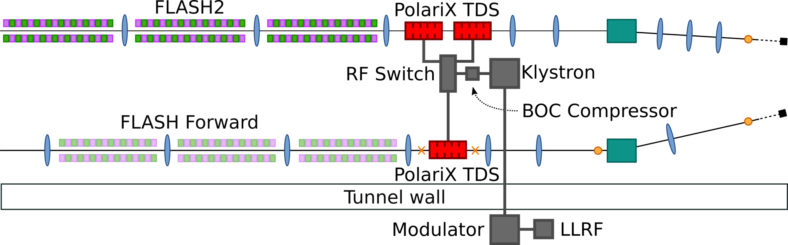
Description of the Installation of the Prototype at DESY
This is the final RF-Scheme for the Installation of the PolariX Structures at FLASH (2019 + 2020)
Measurement Screens
Figure Courtesy – Pau Gonzalez Caminal
• FLASHForward PolariX TDS beamline: Richard D’Arcy
• FLASH2 PolariX TDS beamline: Mathias Vogt, Florian Christie
• Technical coordinator: Karsten Klose

Slide 11
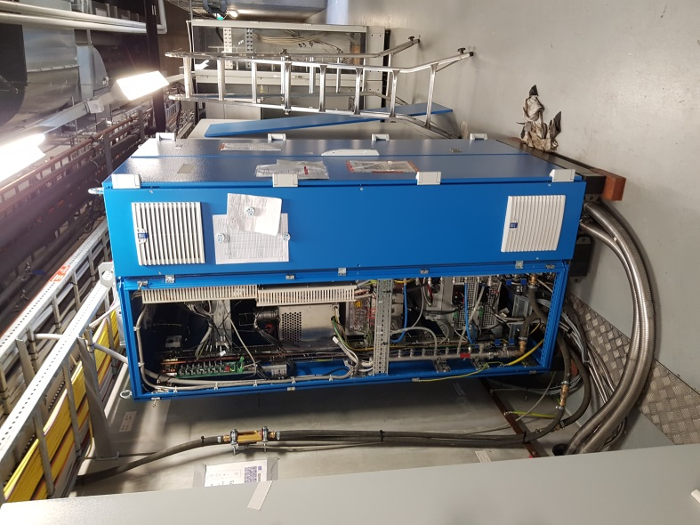
Description of the Installation of the Prototype at DESY
Those components have been installed in the Summer Shutdown 2019
Ampegon Type M-Class Modulator
Located outside the tunnel
Connected to the klystron via a ~12 m long high power cable

Slide 12
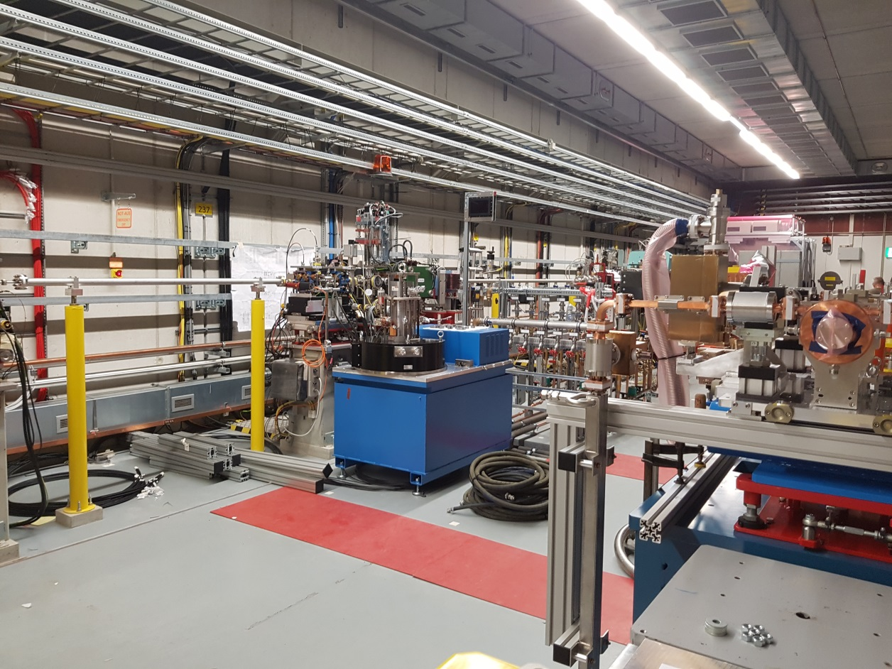
Description of the Installation of the Prototype at DESY
Those components have been installed in the Summer Shutdown 2019
Space for F2 TDS
FF>>TDS
Klystron
6MW Toshiba E37113A Klystron
No XBOC nor RF switch installed in 2019
The initially foreseen SLED has been replaced by an XBOC that will be installed in 2020 (together with the RF switch)

Slide 13
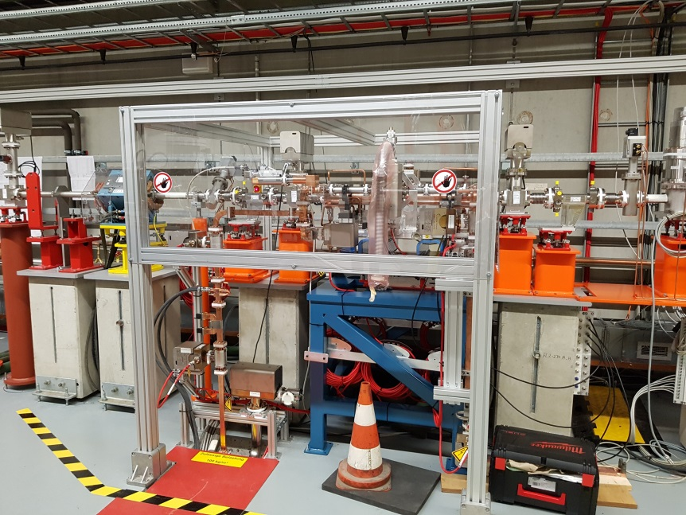
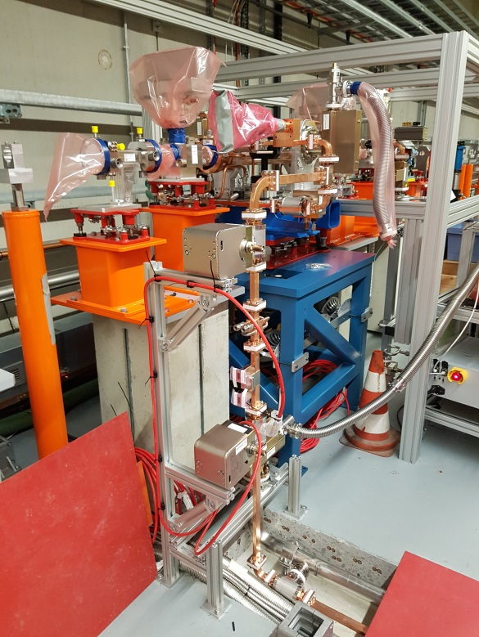
Description of the Installation of the Prototype at DESY
Those components have been installed in the Summer Shutdown 2019
Prototype cavity installed in the FLASHForward beamline, here shown:
in its final state (figure above)
and during installations (on the left)
Reference for beam dynamics studies related to the diagnostics beamline and applications at FLASHForward:
R. D’ Arcy et al., Proceed. IPAC18, TUPML017 (2018).

Slide 14
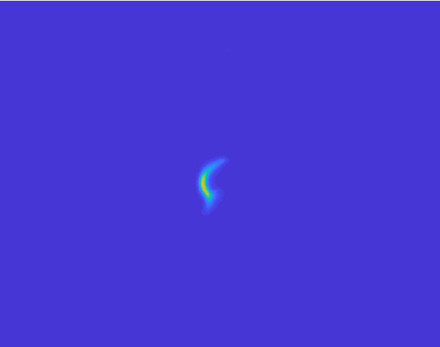
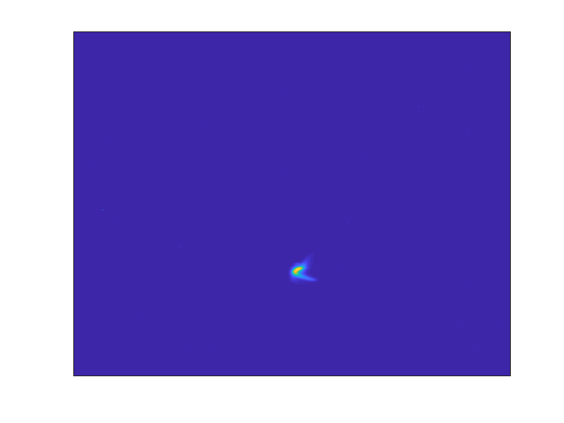
In the first PolariX beamtime (Sept. 5th- Sept 10th) at FLASHForward‣‣ we have observed for the first time the streaking of the electron beam at variable direction
Streaked beam at the measurement screen for different settings of the phase-shifter
TDS OFF
First Experimental Data
TDS ON
Each image corresponds to a different position of the phase shifter

Slide 15
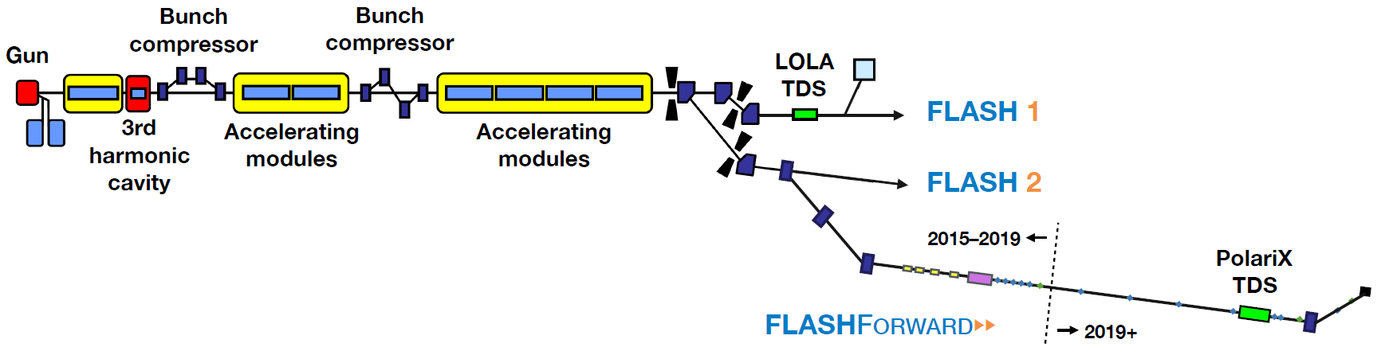
Longitudinal Phase Space (PolariX vs LOLA)
Figure Courtesy R. D’ Arcy, P. Gonzalez
e-Beam:
Q=600pC, E=1.1GeV
Measurements on same beam settings, different pulses, different locations

Slide 16
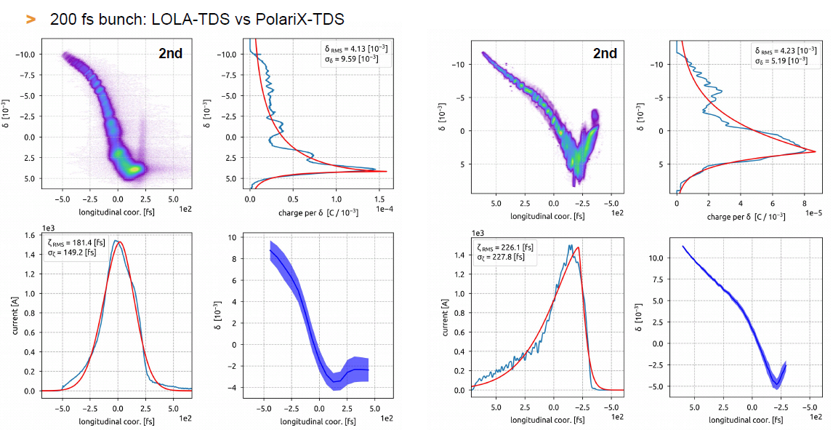
Longitudinal Phase Space (PolariX vs LOLA)
Figure Courtesy R. D’ Arcy, P. Gonzalez
LOLA
Down to 10 fs longitudinal resolution
(NOT in this specific shot)
PolariX
~ 6 fs longitudinal resolution
1 ps
1 ps
First experimental data, article in preparation.

Slide 17
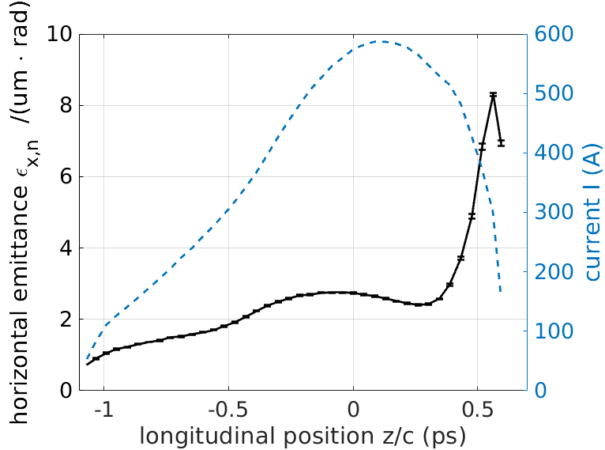
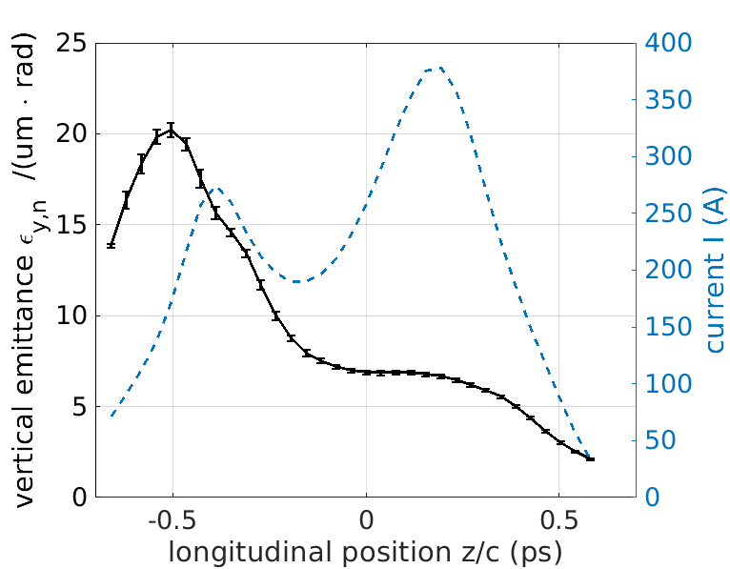
Measurement of Slice Emittance in X and Y Planes
Data analysis done by Florian Christie
E= 1.140 GeV
Q= 600 pC
σ_{t}~ 400 fs rms
R_{t} < 17 fs
Demonstrated feasibility slice emittance measurements in X and Y
Two measurements not done on the same e-beam (and machine shift) !
E= 670 MeV
Q= 300 pC
σ_{t}~ 250 fs rms
R_{t} < 15 fs
First experimental data, article in preparation.

Slide 18
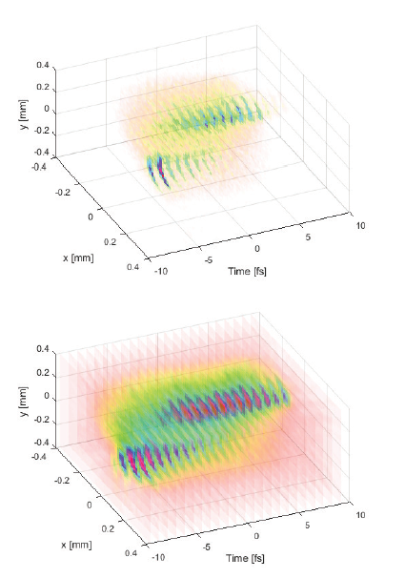
3D Beam Charge Density Reconstruction
Our Team has proposed a novel Method for the reconstruction of the 3D charge distribution of the beam
Real beam at the screen
(TDS off)
Simulation of the measurement
Reconstructed beam at the screen
Relatively quick measurement useful for e.g. identifying correlations, tilts of the beam distribution in 3D
References:
D Marx et al 2017 J. Phys.: Conf. Ser. 874 012077
D Marx, “Characterization of Ultrashort Electron Bunches at the
SINBAD-ARES Linac”, PhD Thesis

Slide 19
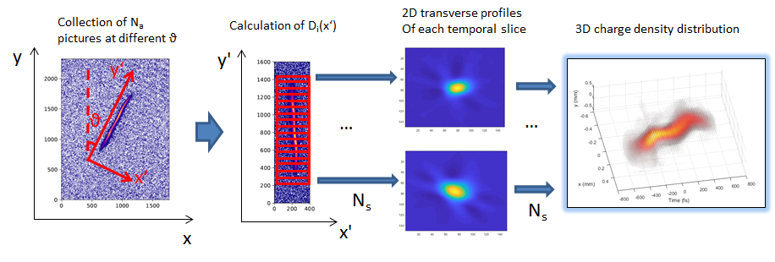
3D-Charge Density Beam Reconstruction
Description of the data analysis

Slide 20
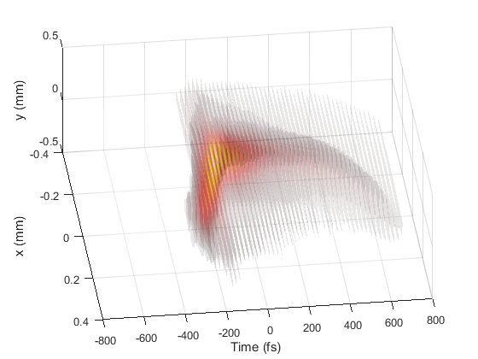
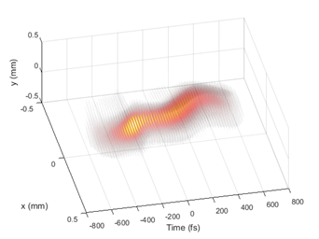
Data Analysis and tomographic Reconstruction
3D-reconstruction of the electron bunch at FLASHForward
Data analysis done by D. Marx
First analysis of experimental data !
article in preparation.
E= 1.140 GeV
Q= 600 pC
σ_{t}~ 220 fs rms
R_{t} ~ 24 fs
E= 680 MeV
Q= 300 pC
σ_{t}~ 270 fs rms
R_{t} ~ 32 fs

Slide 21
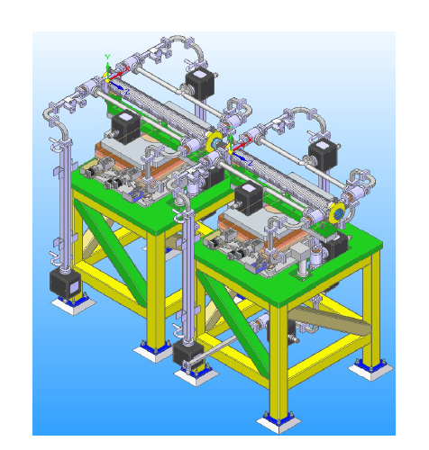
Next Installations at DESY: FLASH2
In 2020 DESY will receive other 4 structures (2 structures for FLASH2 and 2 structures for SINBAD) :
  FLASH2:
    In Summer 2020 FLASH shutdown: installation of the first TDS structure at FLASH2 and upgrade of the RF system including the XBOC.
    The second structure for FLASH2 will be delivered in Summer and is foreseen to be installed in 2021.
With both structures goal temporal resolution ~1fs for low emittance bunches
    Reference: F. Christie et al., Proceed. FEL2019, WEP006 (2019).

Slide 22
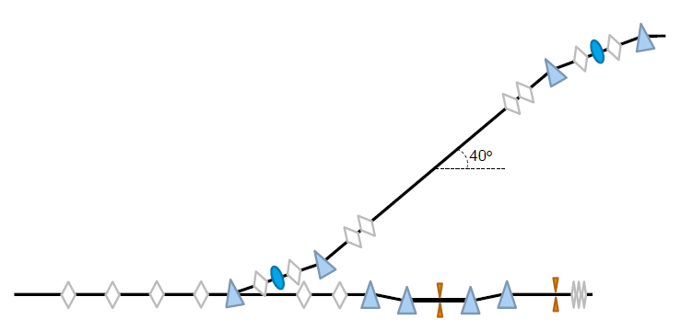
Next Installations at DESY: SINBAD-ARES
In 2020 DESY will receive other 4 structures (2 structures for FLASH2 and 2 structures for SINBAD) :
  SINBAD:
    In fall 2020 SINBAD will receive its 2 structures and 2 XBOCs. Installation of the complete diagnostic beamline is foreseen by 2020. Experimental plan will follow in 2021.
It will be moved at the exit of the experimental area after the commissioning of the linac
Dogleg
Photo-Injector
Matching Beamline
PolariX TDS & diagnostics Beamline
Linac
Exp. Area 1

Slide 23
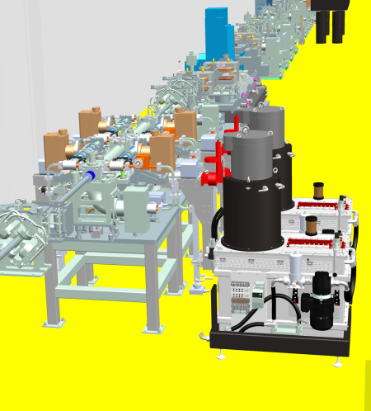
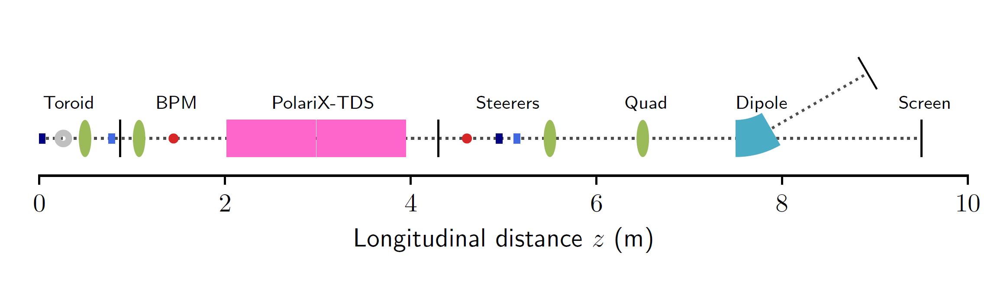
Next Installations at DESY: SINBAD-ARES
In 2020 DESY will receive other 4 structures (2 structures for FLASH2 and 2 structures for SINBAD) :
  SINBAD:
    In fall 2020 SINBAD will receive its 2 structures and 2 XBOCs. Installation of the complete diagnostic beamline is foreseen by 2020. Experimental plan will follow in 2021.
The modulators will be located in the underlying cellar.
Klystron 1
Klystron 2
← Exit of the ARES bunch compressor
XBOC1
XBOC2

Slide 24
Next Installations at DESY: SINBAD-ARES
In 2020 DESY will receive other 4 structures (2 structures for FLASH2 and 2 structures for SINBAD) :
  SINBAD:
    In fall 2020 SINBAD will receive its 2 structures and 2 XBOCs. Installation of the complete diagnostic beamline is foreseen by 2020. Experimental plan will follow in 2021.
← Exit of the ARES bunch compressor
Longitudinal phase space measurement (R~4fs)
3D charge density reconstruction (R~2fs)
Slice-emittance (R~1fs)
Longitudinal charge profile (R~200 as)
Reference: D. Marx et al., Scientific Reports 9, 19912 (2019).

Slide 25
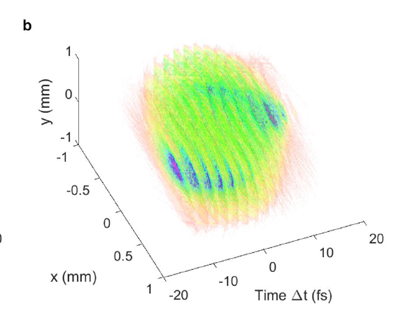
Overview of the Project Milestones (DESY)
Achieved with prototype installation/commissioning at FLASHForward:
  first demonstration of the PolariX TDS variable streaking;
  First demonstration of 3D charge reconstruction with e-beam (resolution <30 fs);
  Achieved resolution <10 fs.
Next Milestones (ordered with increasing complexity):
  Installation of XBOC RF-pulse compressor and RF-switch at FLASH:
    Achievement of goal temporal resolution at FLASHForward (~2 fs) for GeV e-beam;
    Demonstration of functionality parallel (one-at-the-time) operation FL2-FF>>;
  Installation of 2 structures at FLASH2:
    Demonstration of control of 2-TDS-structures run with GeV e-beam;
    Achievement of goal temporal resolution at FLASH2 (~1 fs) for GeV e-beam.
  Installation of 2 structures and 2 XBOCs with RF stations at SINBAD:
    Measurement of the bunch length of SINBAD-ARES beam (1 fs length, 100 MeV);
    Demonstration of sub-fs resolution for bunch profile measurements at 100 MeV;
    Demonstration of <5 fs resolution for 3D charge reconstruction with 100 MeV beam;
    Full-characterization of phase space of few few fs-long electron bunches.
More structure used
Better resolution needed
Smaller beam energy → more sensible to jitter, field imperfections, space charge and velocity bunching effects

Slide 26
Thank you for the attention!
Credits:
R. W. Assmann, B. Beutner, F. Christie, R. D’Arcy, B. Conrad, M.K. Czwalinna, U. Dorda, M. Foese, P. Gonzalez Caminal, M. Hoffmann, M. Huening, R. Jonas, K. Klose, O. Krebs, S. Lederer, D. Marx, J. Osterhoff, M. Reukauff, J. Rönsch-Schulenburg, H. Schlarb, S. Schreiber, G. Tews, M. Vogt, A. de Zubiaurre Wagner, S. Wesch, J. Zemella and to all the technical groups supporting us! (DESY)
P. Craievich, M. Bopp, H.-H. Braun, A. Citterio, R. Ganter, F. Marcellini, T. Kleeb, M. Pedrozzi, E. Prat, S. Reiche (PSI)
A. Grudiev, W. Lee Millar, N. Catalan-Lasheras, G. McMonagle, S. Pitman, V. del Pozo Romano, K. T. Szypula, W. Wuensch (CERN)

Slide 27
Barbara Marchetti
MPY1
barbara.marchetti@desy.de
+49-40-8998-3840

