Slide 1
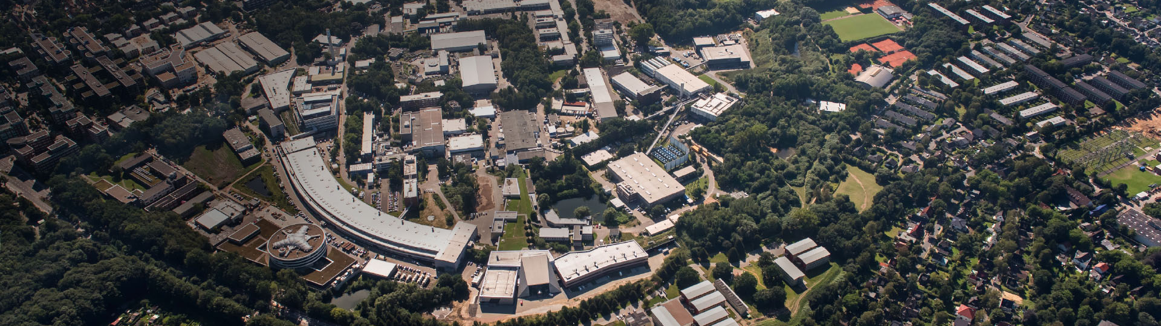
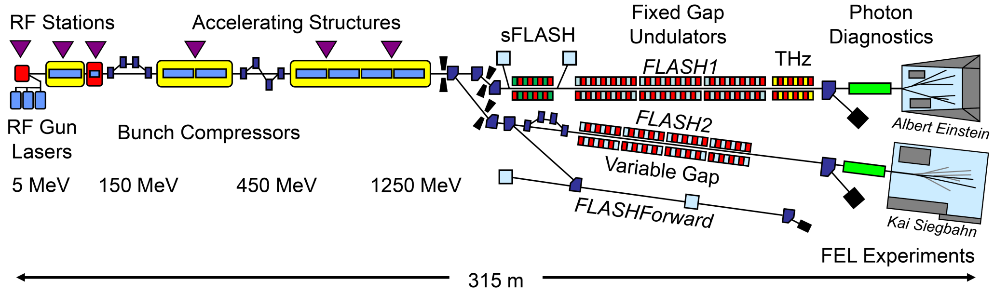
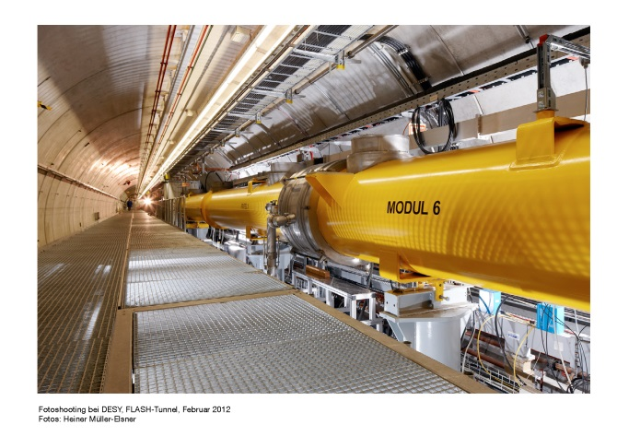
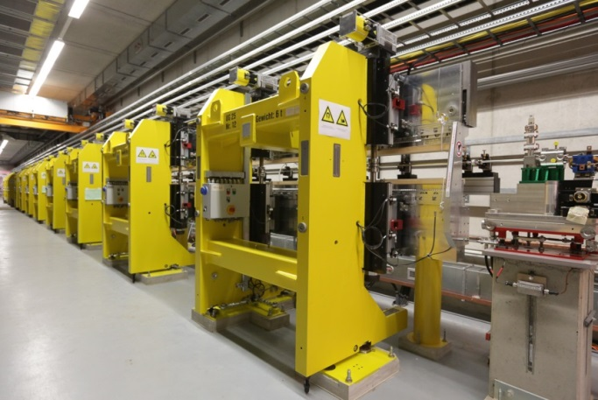
FLASH 2020+ Project
FLASH: the first soft X-ray FEL operating two undulator beamlines simultaneously
Siegfried Schreiber
Betriebsseminar
Travemünde
12-14-Feb-2020

Slide 2
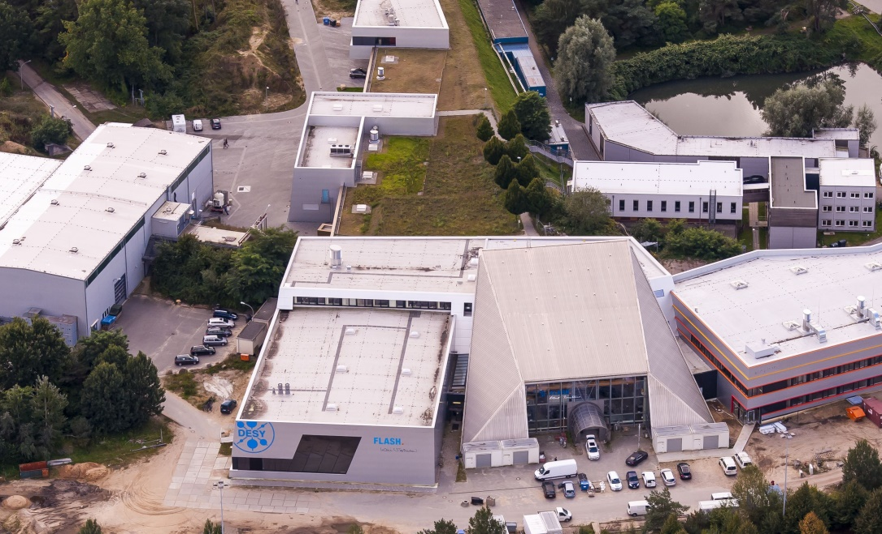
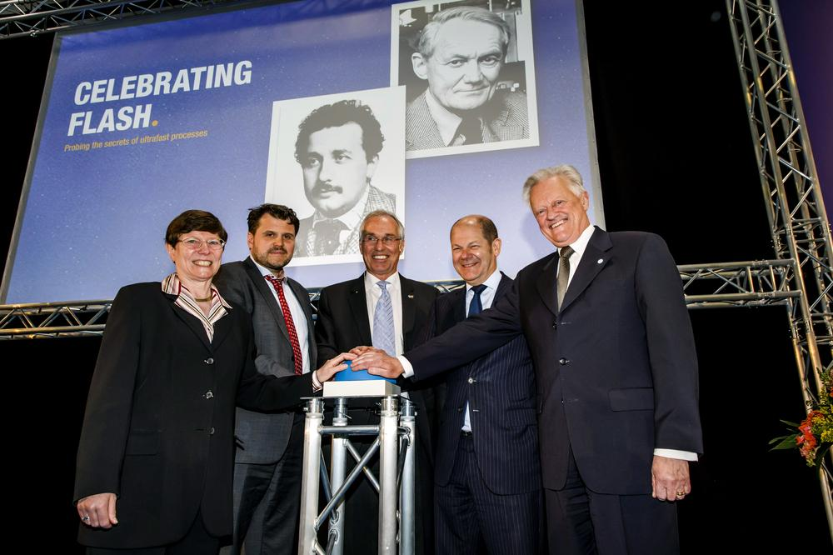
Path towards the FLASH2020+ Project
From first ideas to realization
The last big project was FLASH2 – finished in 2014
At that time, after 10 years of user runs, many components of FLASH1 required refurbishments
  to replace outdated equipment with modern
    A few examples: uTCA, jddd, timing, BLMs, MPS, LLRF upgrade, RF steps, slow and fast feedbacks, BPM (electronics), toroids, BAMs, BCMs, and many more
  to improve the beam properties to cope with increasing demands of user experiments
    Shorter pulses, better stability (energy, wavelength, spectrum, arrival time)
    more uptime, less tuning time
    better and more flexible compression schemes
    and so on
“Celebrating FLASH in 2015”

Slide 3
Path towards the FLASH2020+ Project
From first ideas to realization
Smaller refurbishments have been triggered using the basic FLASH operation budget
For larger refurbishments special funding sources have been used:
  Exchange accelerator modules
    First those which still have type I/II cryostats (ACC2/3)
    With XFEL-type modules
    Better performance (more acceleration, Piezo’s, remote tunable couplers, new waveguide distribution)
  New photocathode lasers
  Improved synchronization and diagnostics for low charges (new synch system, new BPM electronics)
  Circular polarized beam in FLASH2 (with an afterburner of APPLE III type)
  Laser 3 (for ultra-short few fs SASE pulses – single spikes)
  BACCA (S-band structure before 1st BC to stabilize arrival time to less than 5 fs along the train)
  TDS for FLASH2 (PolariX - to measure the longitudinal phase space)

Slide 4
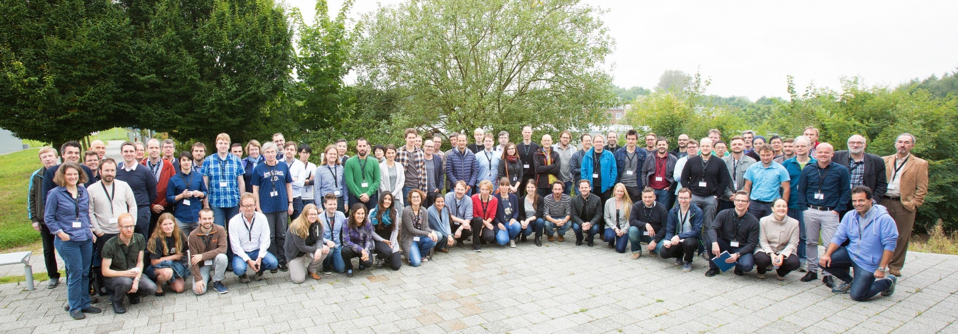
Meetings with FLASH users to define scientific goals
From first ideas to realization
FLASH is science driven
“Future of Science at FLASH” Workshop, Sept. 25-27, 2017 concluded with a list of important items for a larger upgrade in the long term – the “Dream Facility”
The FLASH2020 project has been launched to define the way to realize these dreams
In the DESY 2030 strategy process, a decision has been made: cw option moves to the European XFEL
All other visions and goals stayed alive – under the name FLASH2020+
120 participants
15 contributed talks
6 facility talks
Poster session
Breakout sessions
  AMO, Chemistry and Life Sciences, and Condensed Matter Science
FLASH User Workshop Sept. 2017

Slide 5
FLASH 2020+
Within the DESY 2030 strategy

Slide 6
User Requirements vs. upgrade plans
Dream facility expressed within the “Future of Science at FLASH” Workshop Sept. 25-27, 2017
Dream Facility | FLASH 2020+ Goals | FEL Line
Fundamental up to O-K-edge | Extend wavelength range of the fundamental → novel undulator schemes, increase beam energy | FLASH2
Variable polarization | Variable polarization (FL2 with afterburner) | FLASH1 and 2
Flexible pump-probe schemes (THz → XUV) | Provide flexible laser- and FEL based schemes for multi-color pump-probe experiments | FLASH1 and 2
Fourier-limited pulses (transverse and longitudinal) | Laser manipulate electron bunches in burst mode with up to 1 MHz rate → external seeding with high rep. rate | FLASH1
Few fs- and sub-femtosecond pulses | Enable dynamic studies with sub-femtosecond to attosecond precision | FLASH2
100 kHz cw |  | FLASH@XFEL

Slide 7
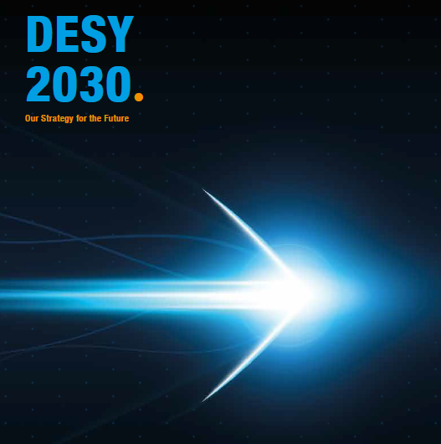
FLASH within the DESY 2030 strategy
Our Strategy for the Future
Page 40:
… The FLASH2020+ development program of the two FEL lines and the accelerator includes
the operation of two independent FEL lines (FLASH1 and FLASH2) with variable magnet structures (undulators) for trend-setting new lasing concepts and „seeding“ with a high repetition rate
the extension of the wavelength range in the fundamental to the oxygen K-edge, in order to reach the important elements for energy research and to cover the whole water window for biological questions(*)
flexible pump-probe schemes for time-resolved experiments(*)
variable polarization for the investigation of the light-induced switching of magnetic storage media; and
shortest pulses up to the attosecond range.
(*) Original document in German, the official English translation is corrected to express the scientific content as expressed in German.

Slide 8
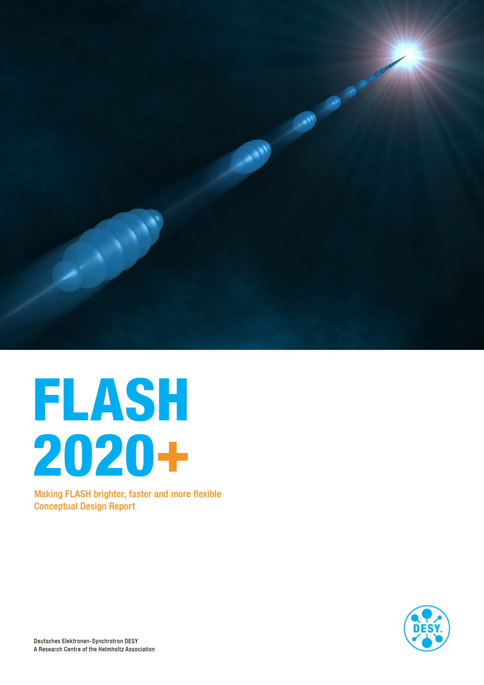
FLASH 2020+ Conceptual Design Report
Handing out a convincing concept
The FLASH competence team compiled a FLASH2020+ Conceptual Design Report (CDR)
It includes:
  The science case
  An upgrade of the accelerator
  New undulators with variable gaps and polarization for FLASH1
  Seeding at FLASH1 with high repetition rate (goal 1 MHz)
  New configuration of magnet structures at FLASH2 for novel lasing concepts
Available at flash.desy.de

Slide 9
Parameter Space FLASH2020+
The only seeded high repetition rate XUV and soft X-ray FEL
 | FLASH1 (Seeded) | FLASH1 (SASE) | FLASH2
Wavelength range | 4 – 60 | 4 – 60 | 1.3 – 60* | nm
Pulse energy | <100 | <1000 | <1000 | µJ
Pulse duration (FWHM) | 30*** | 5 – 200 | 0.1 – 200 | fs
Spectral width | Fourier limited | 0.5 – 2 | 0.5 – 2 | %
Pulses per second** | 10 – 5000 | 10 – 5000 | 10 – 5000
* including third harmonic ** to be shared between FLASH1 and FLASH2 (goal: 1 ms RF pulse length) *** from 23 fs @ 4nm → 45 fs @ 60 nm

Slide 10
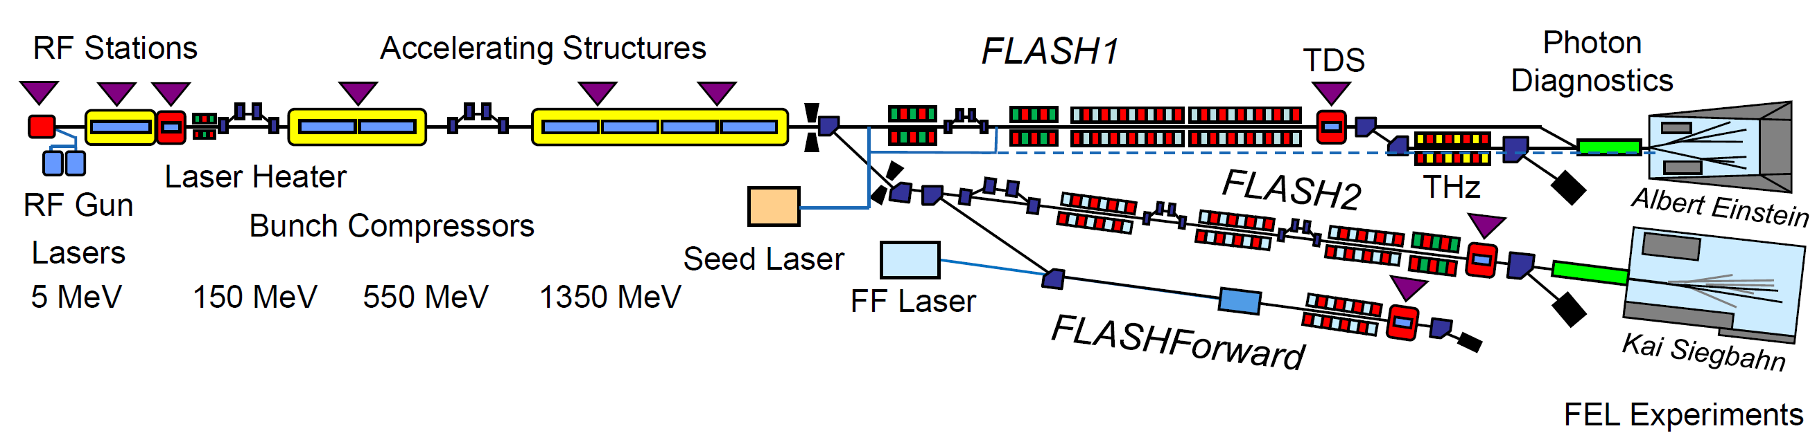
Layout FLASH2020+
Towards a seeded high repetition rate XUV and soft X-ray FEL
Phase 0
Energy upgrade
Injector Lasers
3rd BC (FLASH2)
TDS (FLASH2)
Afterburner FLASH2
Phase 1
Variable gap undulators (FLASH1)
Pump-Probe laser (FLASH1)
Phase 1+
High rep.rate seeding (FLASH1)
Photon diagnostics (FLASH1)
Phase 2
New variable gap undulators + chicanes
for new lasing concepts (FLASH2)
Laser heater in 1st BC
New 2nd bunch compressor (BC)

Slide 11
Milestones
Towards the only seeded high repetition rate XUV and soft X-ray FEL
FLASH2020+
preparation phase
FLASH2020+
Construction Phase
CDR
TDR
2017
2018
2019
2020
2021
2022
2023
2024
2025
2026
Phase 0
Phase 1
Phase 1+
Phase 2
Phase 0: Upgrade Linac (beam energy, new compression scheme, TDS, afterburner) – 2021
Phase 1: New variable gap undulators FLASH1, laser heater, pump-probe laser FLASH1 – 2023
+ Upgrade FLASH1 Photon diagnostics, seeding with high repetition rate 100kHz+ – 2023/24
Phase 2: New configuration of magnet structures at FLASH2 for novel lasing concepts – 2025/26

Slide 12
Summarized Comments from the MAC, PSC, and LAC
Very positive feedback from all committees
MAC
  “The MAC is impressed with the completion of FLASH2020+ CDR, a thorough conceptual design report for FLASH upgrade from the accelerator, to the two FEL undulators, and to the experimental end stations.”
  “ The science cases for the upgrades are strong and clearly articulated.”
PSC (Photon Science Committee)
  “PSC very strongly supports the strategy presented, which is in line with earlier PSC recommendations. The plans put forward will make FLASH 1 and 2 unique in the international landscape as a seeded, high repetition rate (i.e. superconducting) facility, with game-changing potential in selected scientific fields.”
  “The scientific case for FLASH2020+ is described in a convincing manner.”
LAC (Laser Advisory Committee)
  “LAC reviewers strongly endorse establishing an active R&D effort for laser systems and critical optical technology, as described in Section 6.3. This measure will enable testing of planned concepts and pre-aligning of systems before installation in the FLASH experimental hall, which will mitigate risk and minimize facility shutdowns associated with implementing new laser technology.“

Slide 13
FLASH2020+ endorsed by Scientific and Foundation Council
Part of DESY’s priority projects
Budget
  Main refurbishment: 3.35 MEuros
  Variable Gap undulators: 6 MEuros
  FLASH1 (external seeding) and experimental beamlines: 14 MEuros
  Other refurbishments: from operation budget
  FLASH2 upgrade
    no funding yet
    except those included in the operational budget/refurbishment budgets (BC, TDS, afterburner)

Slide 14
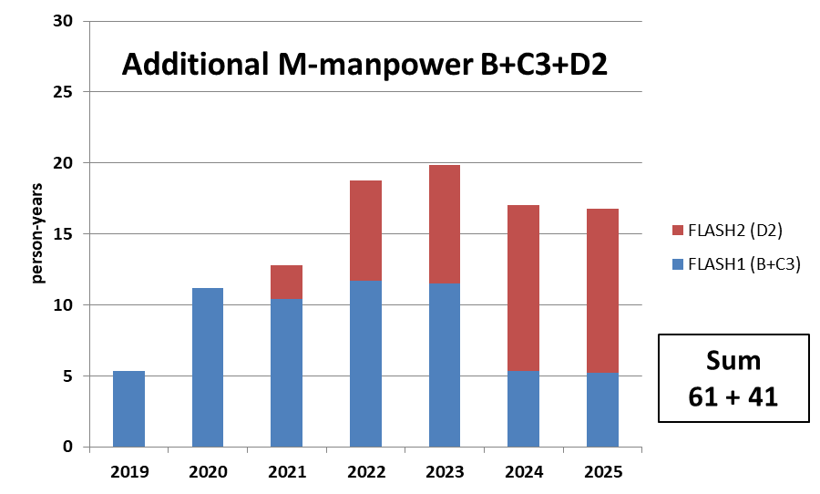
Manpower required FLASH2020+ M-division + ZM1
Data from survey mid 2018
M-groups plus ZM1 have been asked to estimate the required man-power for certain upgrade options
Data shown are for the modification of BCs (B) plus seeding upgrade (C3) and FLASH2 upgrade (D)
Start of the project: 1-Jan-2019, B in 2021 (6 months), C3 in 2023 (9 months), D2 in 2025
Additional annual M-manpower requirements in person-years for the FLASH1 upgrades B+C3 (Seeding) and FLASH2 upgrades D2 (with attosecond option).
The service personal required during FLASH operation - which is freed during a FLASH shutdown – is subtracted from the total person-years required.

Slide 15
FLASH2020+
Next Steps
Elaborating budget in more detail (basic cost estimate ready)
  This includes the operational budget and refurbishment requirements
Establishing a work package and organizational structure (almost ready)
  Find/hire project leader and work package leaders (on-going)
  Update of the FTE survey from 2018 with all M-GLs + cost evaluation
What comes first:
  Basic infrastructure and detailed technical design and construction
    Construction office (ZM1) stepped in with increased personnel dedicated to FLASH2020+
  Write-up of a TDR
The DESY management pushes towards a timely realization
(before the PETRA IV project comes to full swing)

Slide 16
