Slide 1
Fully-integrated and high radiation hardened DC-DC Converter
Innovative power supply for future pixel detectors
Jeremias Kampkötter
Heidelberg – 02. December 2019

Slide 2
Introduction
Powering concepts for the supply of pixel modules
  Serial Powering
  Parallel Powering
Buck converter basics
Goals and Challenges for the design of a high frequency radiation hardened buck converter

Slide 3
Power Supply of the Pixel Modules

Slide 4







Serial Powering
$$V_{drop}=R_{C}I_{m}$$
Modules are connected in series
Powered by constant current source
Total supply current is defined by maximum load
current of a single module
Total supply voltage across the chain scales with
the number of powered modules
Regulator circuitry required to generate
constant supply voltage out of constant current
$$I_{0}=I_{m}$$
$$V_{m}$$
$$η=\frac{1}{1+\frac{R_{C}I_{m}}{nV_{m}}}$$
$$V_{m}$$
$$V_{m}$$
$$V_{0}=nV_{m}$$

Slide 5
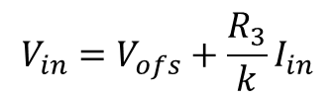




Design Concept for Serial Powering
The Shunt-LDO regulator combines the functionality of an LDO voltage regulator with the capability of a shunt regulator to drain a constant current
Two control loops: 1) constant output voltage 2) constant current flow through the regulator
The Shunt-LDO regulator combines the functionality of an LDO voltage regulator with the capability of a shunt regulator to drain a constant current
Two control loops: 1) constant output voltage 2) constant current flow through the regulator
$$I_{in}≈kI_{Ref}$$
$$I_{Ref}$$
$$I_{Ref}≈\frac{V_{in}−V_{ofs}}{R_{3}}$$
$$V_{in}=V_{ofs}+\frac{R_{3}}{k}I_{in}$$
k : 1
$$V_{out}=2V_{ref}$$

Slide 6











Parallel Powering
$$V_{drop}=nR_{C}I_{m}$$
Modules are connected in parallel
Current depends on number of modules
Large supply currents affect efficiency
IR drops on power cables
DC/DC conversion decreases supply
current and increases efficiency
Conventional DC/DC converters require bulky coils (only limited area)
$$R_{C}$$
$$I_{o}=nI_{m}$$
$$V_{0}$$
$$V_{m}$$
$$V_{m}$$
Use of air-core conductors due to high magnetic field
High conversion ratio is required to achieve high efficiencies (in the range of 4)
$$I_{m}$$
$$V_{m}$$
$$I_{m}$$
$$η=\frac{1}{1+n\frac{I_{m}R_{C}}{V_{m}}}$$
$$I_{m}$$

Slide 7
Basics of Buck Converter

Slide 8

Buck Converter Basics
Simplest inductive DC/DC-Converter with few components
Output voltage is reduced
Conversion ratio: $r=\frac{U_{in}}{U_{out}}$
Duty Cycle: $D=\frac{t_{on}}{T}$
Fully-integrated or monolithic DC/DC-Converters:
  All components including the LC-stage are integrated on the chip
  Operating at high switching frequencies

Slide 9
Buck Converter Operation Modes
Continuous conduction mode (CCM)
  Current iL(t) through inductance L is always positive
  composed of two phases: inductance charging phase & inductance discharging phase
Discontinuous conduction mode (DCM)
  Current iL(t) varies between a positive finite value and zero
  composed of three phases: inductance charging phase; inductance discharging phase & dead time phase
To achieve DCM a current detection is needed!
  Without a detection device, the current would become negative and will decrease the efficiency

Slide 10
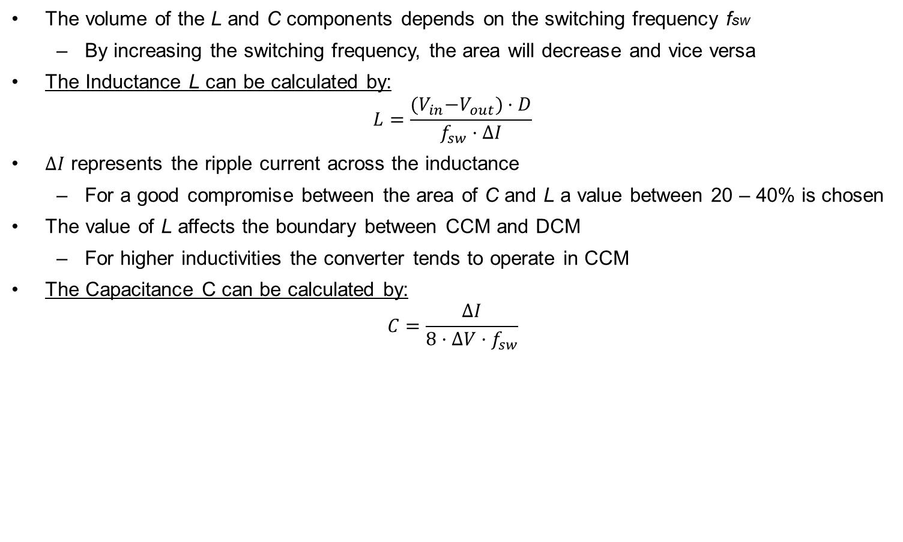
Design of the LC-stage
The volume of the L and C components depends on the switching frequency fsw
  By increasing the switching frequency, the area will decrease and vice versa
The Inductance L can be calculated by:
$$L=\frac{{(V}_{in}−V_{out})·D}{f_{sw}·ΔI}$$
$ΔI$ represents the ripple current across the inductance
  For a good compromise between the area of C and L a value between 20 – 40% is chosen
The value of L affects the boundary between CCM and DCM
  For higher inductivities the converter tends to operate in CCM
The Capacitance C can be calculated by:
$$C=\frac{ΔI}{8·ΔV·f_{sw}}$$

Slide 11
Inductance over Switching Frequency
f_{sw} = 50kHz
L = 36µH
f_{sw} = 50MHz
L = 36nH
f_{sw} = 100MHz
L = 18nH
V_{in} = 4.8V, V_{Out} = 1.2V, f_{sw} = 50kHz – 100MHz, ΔI = 50%

Slide 12
Control System
The DC-DC power stage needs drive signals to enable the switches
  The control system enables a certain voltage conversion
  Uout is controlled to the demanded level, regardless of load and input voltage variations
Output voltage is controlled by means of a feedback mechanism
  PWM and PFM are the most common methods
Challenges for high-Frequencies:
  Demand for high switching frequencies and fast switching times to ensure the optimal performance
  Timing problems must be avoided

Slide 13
Pulse Width Modulation (PWM)
The control signal for SW1 is generated by comparing a triangular waveform Utria, to an error voltage Uerr
  Utria is driven with a constant switching frequency fsw
Uerr is generated by subtracting the output voltage Uout from a reference value Uref
When Uout is smaller than Uref, the error amplifier outputs a low signal which will increase the on time ton of the High side switch SW1
  Duty Cycle D is proportional to the amplitude of Uerr

Slide 14
Pulse Frequency Modulation (PFM)
The on-time ton to drive switch SW1 is kept constant between the respective switching cycles
The regulation of Uout under varying loads is achieved by changing fsw
  This is in contrast to PWM, where fsw is constant and the regulation of Uout is achieved by altering ton
The PFM method has an improvement for low loads, since fsw is reduced and therefore the switching losses decrease

Slide 15
Goals and Challenges

Slide 16
Challenges Overview
Main Goals:
Reduced area of passive components
  Can be achieved by increasing the switching frequency (in the range of 100MHz)
  Leads to higher switching losses
Radiation-hard
  By use of TSMC 65nm technology with thin gate oxide MOSFETs with a nominal voltage of 1.2V (max. voltage of 1.32V)
High voltage conversion ratio
  A value of 4 is targeted
  High side and low side switches need to be stacked (high-voltage driver needed)
Full integration
  Possibility of fully integration of the Inductance and Capacitance
  Usually leads to higher series resistances
Control system
  Has to operate correctly in the high frequency range
  Usually choice between PWM and PFM control scheme

Slide 17
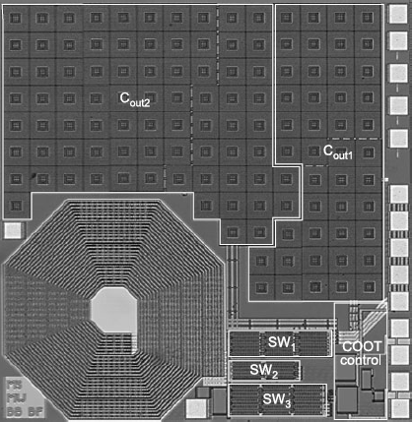
Integration of Inductance (Metal Track Inductors)
The inductivity can be integrated into the chip as metal track inductors
Difficulties are mainly the results of a low inductance density and a high parasitic resistance
Disadvantages
  High parasitic series resistance (due to small thickness)
  Series resistance in the range of 250mΩ/nH @ 1GHz
  Capacitive coupling between substrate and interlayer
  Eddy currents have to be considered
  Low quality factor Q
Layout of the conductors for a metal track inductivity
Chip die of a boost converter with a metal-track inductance [1]

Slide 18
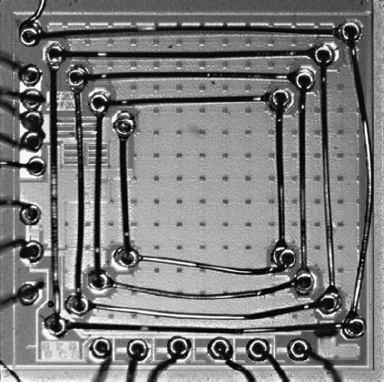
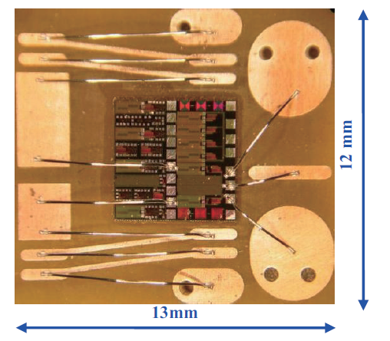
Integration of Inductance (Bondwire Inductors)
Bondwires naturally show some inductive characteristics
  Inductivity in the range of ≈ 1nH/mm
  Can be placed on top of the active circuit
  Bondwires can be placed above active circuit
Advantages compared to metal track inductors
  They achieve a higher inductance L for the same parasitic series resistance → Higher quality factor Q
    Due to the increased conductor thickness
  Series resistance in the range of 50mΩ/nH @ 100MHz [3]
  Increased distance of the windings to the chip substrate
    Reduces the capacitive coupling to the substrate
Disadvantages
  less reliable due to variations in bond wire lengths
Chip die with bondwire inductor [1]
Top view of buck converter with bondwire inductor [3]

Slide 19
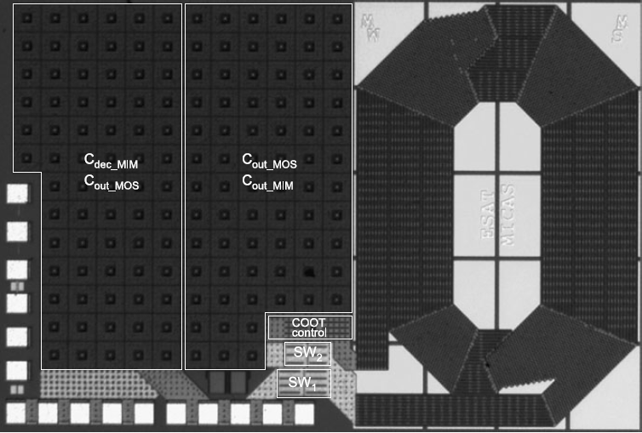
Integration of Capacitance
On-chip capacitors can be realized by using standard CMOS technology features
  e.g. can be realized by combination of a MOScap and MIMcap [1]
Alternative
  It can be expected that the use of small SMD capacitor is more useful
Chip die for a buck converter with integrated capacitances

Slide 20
Summary – Design Trade-Offs
Design of the buck converter for a high frequency range
  In order to reduce the size of the passive components
    A lower efficiency is to be expected (higher switching losses)
Radiation hard
  Build with 4 – 5 stacked transistors to achieve a high conversion ratio
LC-stage
  Implementation as bondwire or metal track inductance
  Integrated capacitors or small SMD devices
  Higher ΔI to reduce inductivity and increase capacitance

Slide 21
Reference List
[1] Mike Wens, Michiel Steyaert; Design and Implementation of Fully-Integrated Inductive DC-DC Converters in Standard CMOS
[2] Hongwei Jia et al. Package Level Integration of a Monolithic Buck Converter Power IC and Bondwire Magnetics
[3] M. Steyaert, et al. DC-DC Converters: From Discrete Towards Fully Integrated CMOS

Slide 22
Appendix

Slide 23
Buck Converter in CCM-Operation
Continuous conduction mode composed of two phases
Current iL(t) through inductance L is always positive
1. Phase: Charging the inductance
  High side SW1 is closed and low side switch SW2 is opened for a certain on time ton
  Inductance L is charged by supply voltage Uin causing iL(t) to increase
  RL is first powered by capacitance C
  When iL(t) becomes greater than iout(t), C is also being charged and RL is powered by Uin
2. Phase: Discharging the Inductance
  SW1 is opened and SW2 is closed
  First, L is discharged into C and RL, causing iL(t) to decrease
  When iL(t) becomes lower than iout(t), the output load is powered by discharging L and C

Slide 24
Buck Converter in DCM-Operation
Discontinuous conduction mode consists of two phases
Current iL(t) varies between a positive finite value and zero
First and second phase are equal to the CCM-Mode
3. Phase: The dead-time phase
  Both switches are opened for a certain dead time tdead
  During the dead time C is being discharged by RL causing the output voltage to decrease
To achieve DCM a current detection is needed!
  As soon as the current across the inductance is detected to be zero, SW2 will be opened
Without a detection device, the current would become negative and will decrease the efficiency

Slide 25
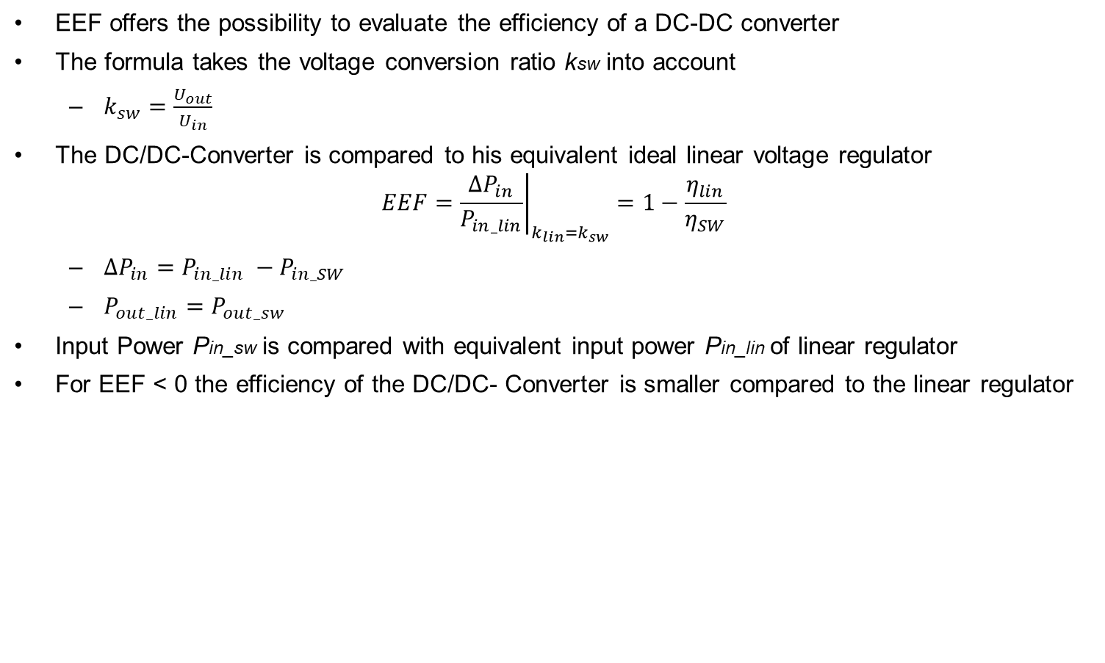
Efficiency Enhancement Factor (EEF)
EEF offers the possibility to evaluate the efficiency of a DC-DC converter
The formula takes the voltage conversion ratio ksw into account
  $k_{sw}=\frac{U_{out}}{U_{in}}$
The DC/DC-Converter is compared to his equivalent ideal linear voltage regulator
$$EEF={\left.\frac{ΔP_{in}}{P_{in_lin}}\right|}_{k_{lin}=k_{sw}}=1−\frac{η_{lin}}{η_{SW}}$$
  $ΔP_{in}=P_{in_lin} −P_{in_SW}$
  $P_{out_lin}=P_{out_sw}$
Input Power Pin_sw is compared with equivalent input power Pin_lin of linear regulator
For EEF < 0 the efficiency of the DC/DC- Converter is smaller compared to the linear regulator

