Slide 1
Comparison of agreed task with recent situation
We agreed in the last cooperation meeting to work on different tasks for the XFEL BPMs, see slides 2 to 6, each task has an enumeration
The tasks will be compared with the recent situation, an enumeration to each task
Tasks are listed in priorities: color code
In the following slide on page 7 more tasks are defined and listed

Slide 2
Hardware
3 RFFEs at PSI (2 Button and 1 Cavity RFFE), will we get them back? Yes with the other both RFFEs, see 3. point.
Not done
3 power supplies at PSI repaired, just arrived in DESY, check next. Need for SASE2 SEED.
Finished
In general: when a card needs repair, can PSI repair it (procedure, still 2 Button RFFEs and 1 Cavity RFFE need repair)? DL will send this to PSI and when repaired it will be send back.
Not done
For repair of component: at the end DESY will get a sum of exchanged components, send a quote to DESY. Maybe costs for transportation back can be included here.
Since the points above are not done no quote could be send
Info: 2 additional BPMAs will be installed. One MBU with free Button RFFE can be used. Another MBU needs upgrade of GPAC with ADCs, can been remotely with FW and SW update. Already done during the workshop.
Finished

Slide 3
Hardware
Production of spares schedule according offer
Ongoing
PileUp: reason resonances of accelerator cavity at 2.4 GHz, special filter necessary, development filter
Ongoing
Reentrant RFFE redesign 2020+
Not done

Slide 4
Firmware and Software
Power cut can cause that cooling of racks will be established after hours. Therefore high temperature was 2 times observed. Need solution by FW: permanent switch OFF when temperature too high and only switch them ON by experts! Scheduled for Q01/2019
Not done
Implementation of Tuning and Precision Mode: Precision Mode leads to reproduce-able attenuator settings for predefined charge and position range (charge from timing, position from doocs), tuning mode increases gain after N shots and both modes reduce gain immediately when saturated. Q03/2019
Not done
Freeze AGC when no bunch expected: according timing info and BPM location will be implemented. Q02/2019
Implemented for 1 Cavity BPM MBU in injector in Nov. 2019 and successfully tested
Individual button attenuator setting: Idea: check offset and when true attenuate one channel with external attenuator
Not done
Improve resolution for position and charge when external 216 MHz is missing Q04/2019 (until end of November 2019)
Not done
Priority: high, middle, low, ongoing

Slide 5
Firmware and Software
MPS settings of BPMs in internal Button RFFE Save&Restore not save. DESY action
Finished
Internal Save&Restore for Cavity and Reentrant BPM. Q03/2019
Not done
FW for insitu Button BPMs calibration with onboard pulser Q04/2019
Not done
An additional task was defined in Febr. 2019: implement Direct Memory Access in the MBU readout and accordingly for the DAMC02
Not done
Priority: high, middle, low, ongoing

Slide 6
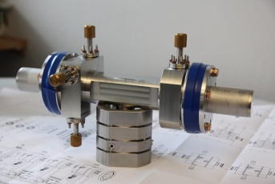
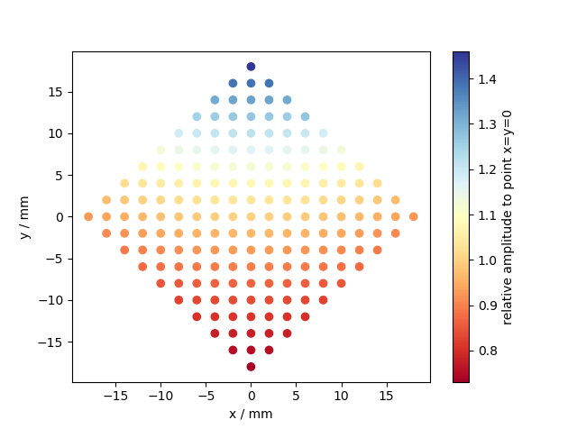
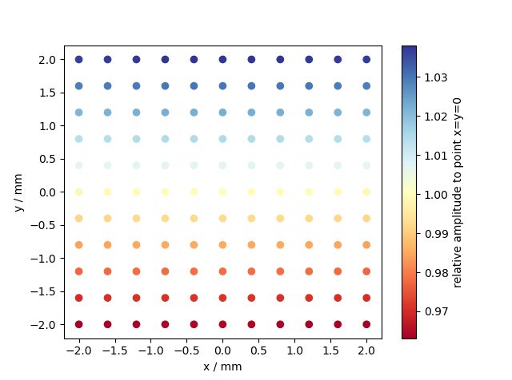
Operation
Improvement beam based calibration of attenuators for cavity and buttons Q01/2020
Not done
Check position dependence of reference cavity signal (DESY)
Finished, see diagrams
Write BPM article (DESY and PSI and CEA Saclay )
Not done
Large
Small
For Beamline CBPM, for Undulator CBPM available too
Priority: high, middle, low, ongoing

Slide 7
Additional tasks
During the year 2019 we worked on following additional tasks:
Hardware:
Installation, testing, commissioning and calibration of additional MBU for SASE2 SEED section including MPS connection, finished
Removed tools and spares of PSI from the MDI guest office to a cupboard at MDI, finished
Corrected the connection of all SASE cavity BPMs for the signal to the IBFB control system, finished
MBU at 1755m: GPAC not responding, ongoing
CRFFE BPME.2867.SA3 reference channel need recalibration, RFFE exchanged, will be shipped to PSI, ongoing
Firmware:
Solved problem with trigger configuration between EPICs and DOOCS in January 2019, solved
Manpower:
Recruited colleague for MBU FW at DESY, available

