Slide 1
DMA implementation for MBU
Bin Yang
BPM/IBFB Collaboration Workshop 11.12.2019

Slide 2
Current limitation by DMA transfer

Slide 3
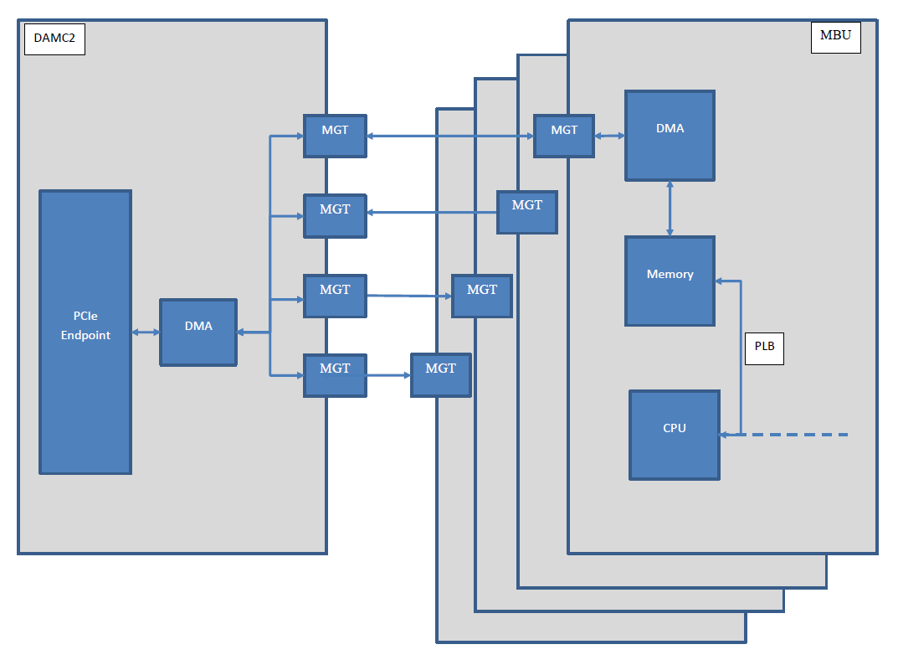
Proposal 1: modify on MBU

Slide 4
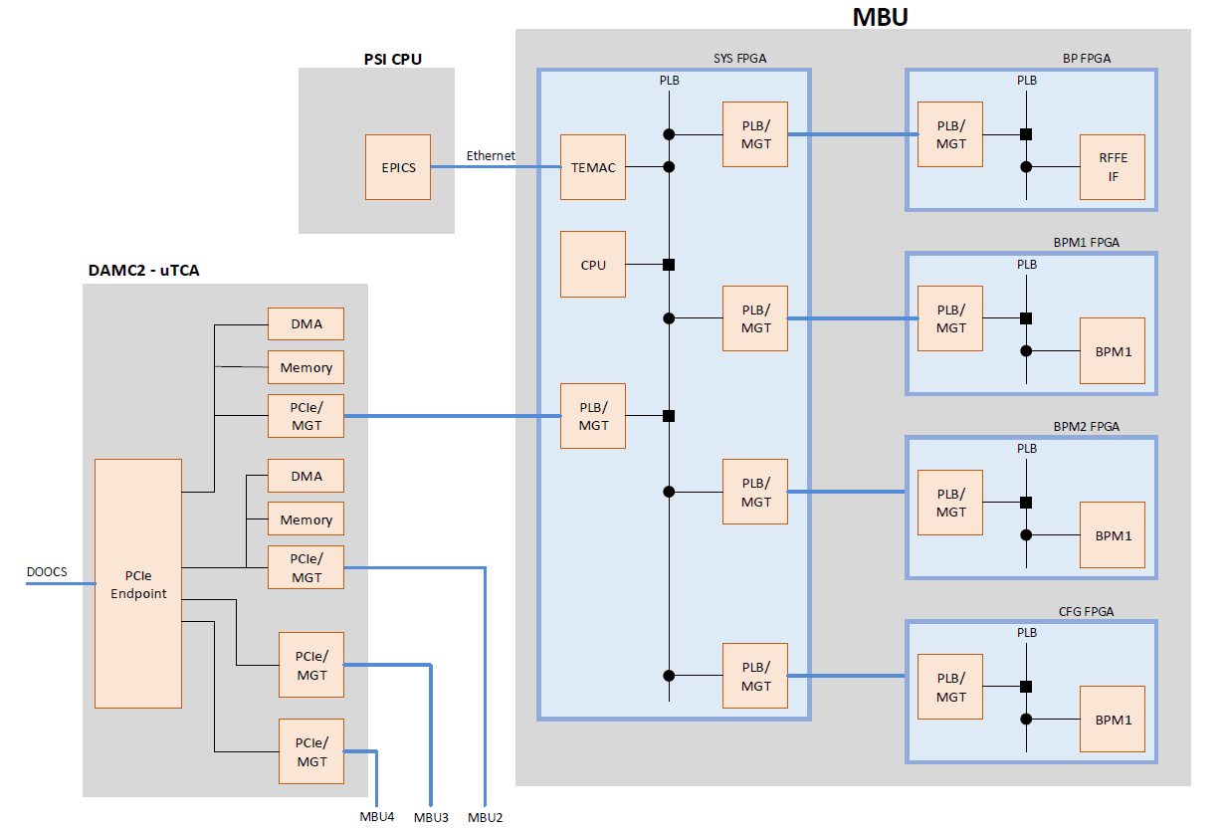
Proposal 2: modify on DAMC2 and MBU

Slide 5
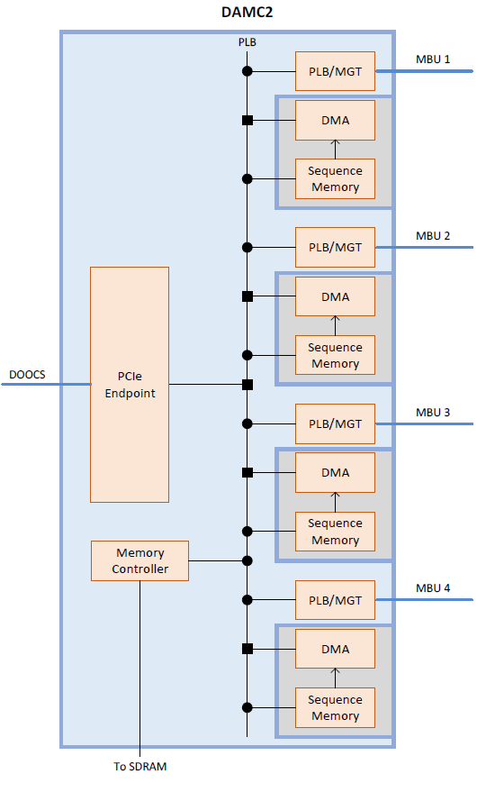
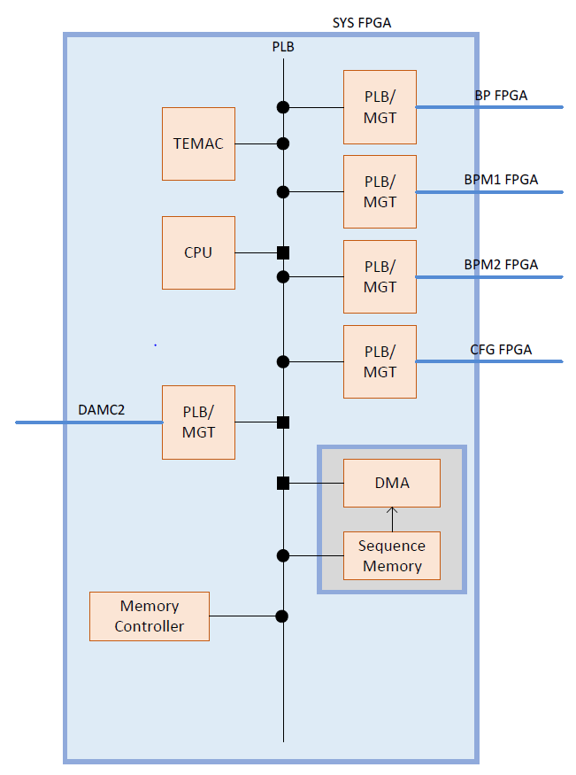
Detail for the implementation

