Slide 1
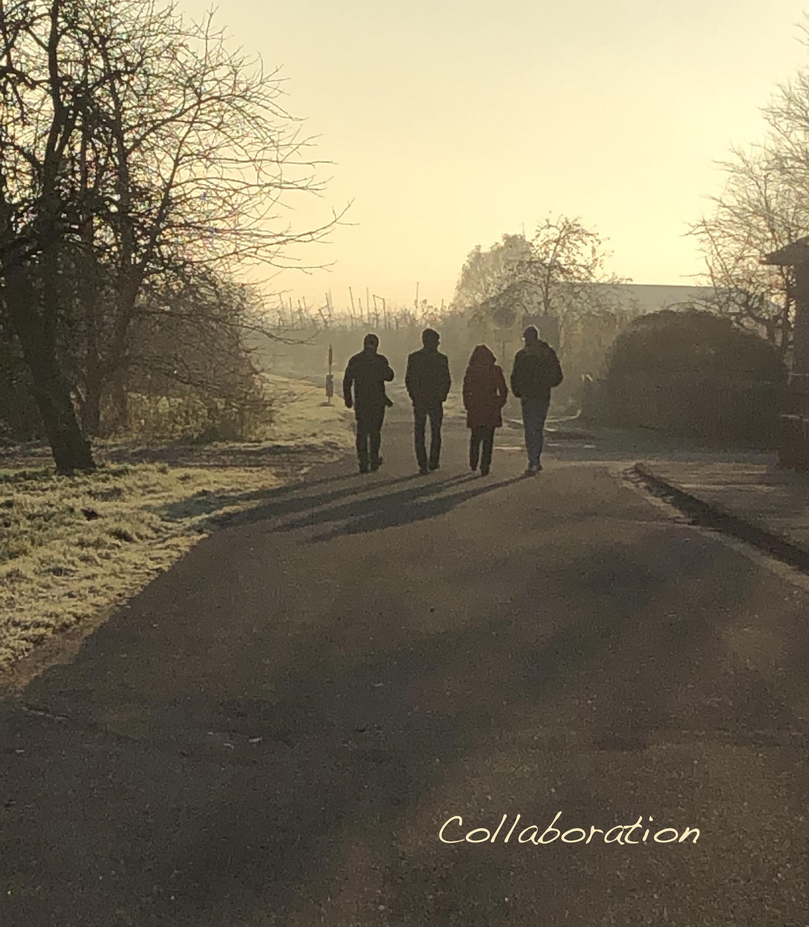
Joint Operations Workshop 2020 Stability and Communication
Hotel Altes Land
Jork
Dec 4 + 5 2019
Link to Indico site:
https://indico.desy.de/indico/event/24880/timetable/#20191204

Slide 2
Program
Wednesday December 4
11:00-11:30 Welcome and introduction
11:30-12:30 Session 1: Top10 Stab, Top10 Comm, Stability Info,
Def stab. task force (Kegelbahn)
12:30-14:00 Lunch at Restaurant, check-in
14:00-15:00 Session 2: Web site Operations, Time plan STF,
Preparation role play (Kegelbahn)
15:00-15:30 Coffee break at Tiffany
15:30-16:30 Session 3: Comm. BKR, New soft & hardware for STF
16:30-19:00 Session 4: Role play
19:00 Dinner at Restaurant

Slide 3
Program
Thursday December 5
8:00-9:00 Breakfast in Restaurant, room checkout
9:00-10:30 Session 5: Communication Tools, Feedbacks to e-beam (Kegelbahn),
Daily operations meeting?
10:30-11:00 Coffee break, room checkout
11:00-12:30 Session 6: Report drafting (Communication: Tiffany, Stability: Kegelbahn)
12:30-14:00 Lunch in Restaurant
14:00-14:30 Coffee break
14:30-16:30 Session 7: Presentation of results in room Tiffany
16:30 End of workshop, return to Hamburg/Schenefeld

Slide 4
Activities
Brainstorming: Use flipcharts, provoke discussions, summarize
Discussion: Lead discussion, summarize later
Role play: Prepare, play and analyse
Walk & Talk: 2-3 people go out (or stay in) and talk for about one hour

Slide 5
33 Participants, 12 questions, 15 activities, 7 sessions
Siegfried Koepke
Sara Casalbuoni
Torsten Limberg
Hans Weise
Frank Brinker
Bolko Beutner
Marc Guetg
Thomas Wamsat
Martin Dommach
Winni Decking
Matthias Scholz
Nick Walker
Steffen Hauf
Richard Bean
Naresh Kujala
Liuba Samoylova
Dirk Lipka
Lars Fröhlich
Dirk Nölle
Shan Liu
Svitozar Serkez
(Raimund Kammering) comes later
Zuzana Konopkova
Giuseppe Mercurio
Riko Wichmann
Andreas Galler
Markus Scholz
Frederik Wolff-Fabris
Peter Zalden
Maurizio Vannoni
Thomas Baumann
Jan Grünert
Harald Sinn

Slide 6
Tasks & participations
Name Chair S1 S2 S3 S4 S5
Siegfried Koepke: TT-Com, TTcom PrepRole ComBKR RolePlay Frederik
Sara Casalbuoni: RolePlay StabInf PrepRole ComBKR RolePlay Dirk+Guiseppe
Torsten Limberg: DailyMeeting StabInf Richard ComBKR RolePlay DailyMeeting
Hans Weise: PlanSTF TT-stab PlanSTF ComBKR RolePlay DailyMeeting
Frank Brinker: TTStab TTstab Martin ComBKR RolePlay DailyMeeting
Bolko Beutner: StabInf StabInf WebOP ComBKR RolePlay FeedbAcc
Marc Guetg: FeedbAcc TT-stab WebOP ComBKR RolePlay FeedbAcc
Thomas Wamsat WebOp StabInf WebOP HW+SW RolePlay CommTool
Martin Dommach TTStab TT-stab Frank HW+SW RolePlay CommTool
Winni Decking Harald PrepRole (HW+SW) RolePlay tbd
Matthias Scholz CommBKR TTcom PlanSTF ComBKR RolePlay DailyMeeting
Nick Walker DefSTF DefSTF PlanSTF ComBKR RolePlay Maurizio+Shan
Steffen Hauf HW+SW TTcom PlanSTF HW+SW RolePlay Liuba
Richard Bean DailyMeeting DefSTF Torsten HW+SW RolePlay DailyMeeting
Naresh Kujala TTCom, WebOP TTcom WebOP ComBKR RolePlay DailyMeeting
Liuba Samoylova TTCom, TTcom PlanSTF HW+SW RolePlay Steffen
Dirk Lipka FeedbAcc StabInf WebOP ComBKR RolePlay FeedbAcc

Slide 7
Tasks & participations
Name Chair S1 S2 S3 S4 S5
Lars Fröhlich FeedbAcc TT-stab WebOP HW+SW RolePlay FeedbAcc
Dirk Nölle RolePlay TT-com PrepRole HW+SW RolePlay Guiseppe+Sara
Shan Liu DefSTF DefSTF PlanSTF ComBKR RolePlay Maurizio+Nick
Svitozar PlanSTF DefSTF PlanSTF ComBKR RolePlay FeedbAcc
Raimund FeedbAcc
Zuzana PlanSTF TT-stab PlanSTF HW+SW RolePlay DailyMeeting
Giuseppe RolePlay DefSTF PrepRole HW+SW RolePlay Dirk+Sara
Riko Wichmann CommTool TT-com PrepRole tbd RolePlay CommTool
Andreas Galler DefSTF PrepRole ComBKR RolePlay CommTool
Markus Scholz HW+SW TT-com PlanSTF HW+SW RolePlay DailyMeeting
Frederik StabInf StabInf WebOP ComBKR RolePlay Siegfried
Peter Zalden HW+SW DefSTF WebOP HW+SW RolePlay FeedbAcc
Maurizio DefSTF DefSTF PlanSTF HW+SW RolePlay Shan+Nick
Thomas Baumann CommBKR DefSTF PlanSTF ComBKR RolePlay FeedbAcc
Jan Grünert CommTool DefSTF WebOP HW+SW RolePlay CommTool
Harald Sinn Winni PrepRole ComBKR RolePlay CommTool

Slide 8
Session 1: Stability Question 1 - TT-Stab (Frank, Martin)
What are the Top Ten issues concerning beam stability at European XFEL?
Task: Compile a prioritized list and for each item a short explanation what is exactly meant.
Beam means photon or electron beam, stability can be on short on long times scales.
Items on this list can be unsolved beam stability issues, but also positive observations are allowed. If available, examples can be used to illustrate what is meant during the presentation later. Gather material that people brought along. Use flipchart to collect ideas.
Take photos of the flipchart for the report writing later. If you change your mind during the workshop please update the list for the report and the presentation.
In final presentation you can e.g. present the results backwards like a ‘hit parade’ or any other style you like. The presentation can be only oral (preferred) or with computer.

Slide 9
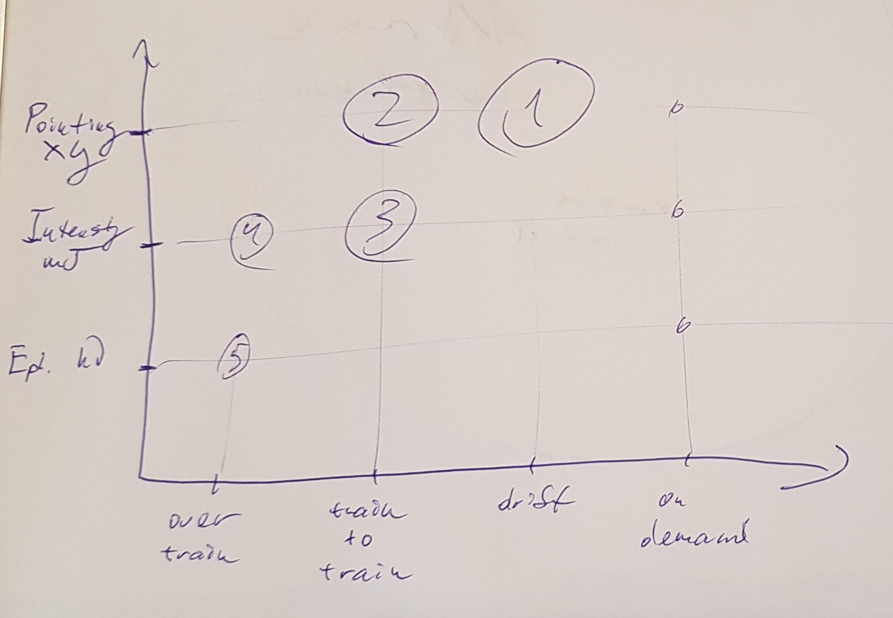
Top Nine issues concerning beam stability (1)
Photon beam pointing drifts (over minutes)
Improve diagnostics to identify the source
Photon beam pointing and electron orbit jitter (shot to shot)
Improve diagnostics to identify the source
Photon Intensity jitter (train to train)
For example: Detuning of 3.9 GHz module
Electron orbit / SASE2 kicker
Photon intensity variation over train
Electron orbit
Electron charge
Compression
Variation of photon energy (over train)
Correlate photon energy with electron energy
Improve availability of spectrometers

Slide 10
Top Nine issues concerning beam stability (2)
6. Pulse on demand stability
Use of pulse-picker to keep feedbacks running and heat-load constant
Disable automatic attenuation of BPMs
7. Injector laser pointing drift
Work in progress
8. Long term alignment drifts (SASE sections)
Realignment of undulator sections (BBA)
Realignment of photon beamline by MEA and correlate data with seasons
9. Electron charge jitter
Correlation with SASE to examine the relevance
10. 12 hour reproducibility of SASE properties
General remarks:
Continuous monitoring of tunnel conditions (air pressure, humidity, temperature, cooling water) to enable follow up on long term drifts will be beneficial (data partly available in Epics).
Proposed study:
Observe the influence of typical tuning activities on the relevant photon properties

Slide 11
Session 1: Stability Question 2 - StabInf (Bolko Beutner, Frederik Wolf-Fabris)
Which information should be on internal communication channels concerning stability?
Task: Sketch out a proposal what you would like to see on internal communication channels concerning the stability of the electron/photon beam, the overall facility, etc.
Internal communication channels are logbooks, Alfresco/Confluence, displays on software, status screen, white board in BKR etc … Focus on the most important topics. Which are the best suited communication channels?
Group work: Collect ideas from participants with flipchart or in any other way. If computers with internet are available, check out the current status. What are most urgent upgrades?
Take photos of the flipchart for the report writing later.
Report writing: Sum up your recommendations for enhancing the information on stability at the facility. What is most urgent to be implemented?

Slide 12
Session 1: Stability Question 2 - Required Data
Members: Bolko B.; F. Wolff-Fabris; Sara C.; Torsten L.; Thomas W.; Dirk L.;
We need to define in common agreement between accelerator and beamline groups what are the photon parameters defining stability, beam position (XGM, transmissive imager, ...), intensity, arrival time (?). These parameters should be available in the control system(s) including rolling averages and standard deviations (e.g. Doocs ML). This a prerequisite for possible photon- & e-beam slow feedbacks.(10Hz)
Parameters not directly measurable, like a radiation source point, beam angle, focus, ... might be defined and provided by a control system server to be directly available for BKR monitoring and tuning. (10Hz)
An urgent task is for the beamlines to define requirements for stability/instability on the above properties. We believe the beamlines have the tool to provide BKR with quantification for a threshold on stability issues: the BKR needs to have “values” that define stability from the beamlines. (available in control system for visualisation)
The accelerator/machine group can provide an expected “rock bottom” values for the optimum/best possible stability fluctuations – this should be well communicated to the beamlines.
Long term: A Task group on the instability has to address and define the correlation between e-beam and photon-beam stabilities in order to access the origin of the instabilities and offer mitigation strategies.

Slide 13
Session 1: Stability Question 2 - Communication
Stability requirement definition: The stability thresholds for the individual experiments have to be communicated to RC/Operators well in advance, for example during the Friday meeting. A good planning helps on setting up the machine for operational/user weeks – this information has to be available prior the start of the experiments.
Stability status screen in BKR: A live screen shall be available at the BKR with the current stability parameters from all the beamlines, displaying for example the beam position, focus and jitter from the experiments together with the actual requirements. This will help operators to visualize the current beam position as well as access effects to a beamline while tuning positions in other SASE beamlines.
Fast detection of instability source by operators (e.g. mirrors or electron orbit) can be improved by stability status screen
Meeting between Beamline and Accelerator operators: One has to communicate the actions and correlation between e-beam and photon-measurement between BKR and beamlines. For example, machine group can make a tutorial for the beamlines scientists on how “tough” is to tune the machine for changing the beam position (at least showing that there is no magical button to improve stability).

Slide 14
Session 1: Stability Question 3 - DefSTF (Shan, Maurizio, Nick)
How could a beam stability task force be defined?
Task: Sketch out a proposal for creation of a beam stability task force that would run about 1 year with the goal to analyze and improve the photon beam stability.
What should be the composition of this group? What should be (roughly) the mandate? Which meetings are required? What are other important aspects to consider?
Group work: Collect ideas from participants with flipchart or in any other way.
Take photos of the flipchart for the report writing later.
Report writing: Sum up your recommendations (e.g. to management) for creation of beam stability task force. Present your findings later in the meeting.

Slide 15
Mandate (possible themes/concepts) [1 / 2]
Identify, categorise and prioritise identified instabilities
Identify Figures of Merit / metrics to be used to clearly and unambiguously quantify the instabilities.
Identify means to measure metrics; in particular identify where additional monitoring (diagnostics, controls etc) are needed [-> HW+Sw].
Develop a mitigation strategy (plan) for the top-ranked instabilities [->TT-Stab] (identifying root cause, proposing corrective measures). These should include:
Most critical
Lowest lying fruit (i.e. possibly easier to get result)
Realistic
Provide forum for feedback from experiments [-> StabInf]
day-to-day experience

Slide 16
Mandate (possible themes/concepts) [2 / 2]
Plan, propose and organise use of dedicated beam time for stability studies.
Produce a written plan of action for review after initial org phase.
Provide coordination and communications forum for mitigation programmes.
Organise stability mini-workshop early in Org phase [-> PlanSTF]
Phased approach: [-> Plan STF]
Organisational and planning
Implementation
Close out

Slide 17
Composition of STF
Core team: ideally <= 10
Strong commitment needed (especially in org phase >=20%)
2 Joint chairs (Accelerator / Photon)
DESY
XFEL
1 Tech systems
1 Beam Dynamics
1 Instrumentation Department
6 Experiment
6 Experiment
6 Experiment
6 Experiment
6 Experiment
6 Experiment
Already 11 !

Slide 18
Meetings / Other issues
Meetings
Kick-off meeting / workshop [-> PlanSTF]
Core team meets regularly once per week
At least during org phase
Ad hoc (~ 1 month) specialised topic meeting with additional experts
One co-chair brief status report to other meetings (periodically).
Implementation phase meetings should be defined by task force.
More focused on coordinating activities reviewing results.
Final review meeting at end of task force mandate.
Other issues
Instabilities is a broad reaching issue --need to focus on realistically achievable goals. (Support from many groups likely to be needed.)
Expect dedicated beam time will be needed
STF scope: just identify issue and recommend actions? Or actually coordinate activities?
Feeling in group was the latter.
Support from management mandatory
Some identified programmes may exceed one year mandate.

Slide 19
Session 2: Stability Question 4 - Plan STF (Hans, Svitozar, Zuzana)
What could be a time plan for a stability task force ?
Task: Sketch out a possible time plan for a beam stability task force, that would run about one year.
What has to happen when, if at the end of the task force the photon beam stability should have increased significantly?
Group work: Collect ideas from participants that are important to setup a timeline with flipchart or in any other way. Take photos of the flipchart for the report writing later.
Report writing: Create a timeline for a stability task force and present the results in the final session (use computer, if required).

Slide 20
Timeline
STF should start with a kick-off meeting in early January; based on first input from Jork Workshop!
Review this timeline
Re-evaluation of top 9 stability issues
Confirm priority list, assess consequences of instabilities:
What are the Figures of Merit?
One time effort or continuous long(er) lasting activity?
Are tools to be developed to attack instability? Or are we already ready to start?
What can be done parasitically and where is dedicated beam time a must?
Discuss difference between well prepared studies and sometimes required ad-hoc actions
Develop individual plans for the top issues (in parallel?!) January/February
Do we have a strategy to address a particular instability?
Dedicated workshops or meetings
after identifying work package leaders and identification of additional experts required
Personnel & cost effort etc. -> reevaluate priorities (results / efforts)!
Schedules
Work out details wrt. tools needed
Arrange for an overall plan and discuss impact on operation schedule; report to Mgmt. and propose priorities for dedicated beamtime before end of February
(optionally) fix dedicated stability studies shifts over 2020, exact shift activities can be defined later.
????
Closeout. Report on stability improvements and tools developed in December

Slide 21
Session 3: Stability Question 5 - HW+SW - (Markus, Peter, Steffen)
What new hardware and software should be installed in the beam transport to improve beam stability?
Task: Make a list of hardware items that should be installed into the experiments and beam transports to monitor and enhance the beam stability. Do these installations require new software? Is there other software that could be developed or completed that would monitor or improve beam stability?
Beam stability means here that setup and experiments can be done more more efficiently and with higher accuracy.
Group work: You may split up the group to work independently on different topics.
Report writing: Sum up your recommendations present the results in the final session.

Slide 22
Hard+Software to improve beam stability
Hardware (slow)
Imager upgrade: Diamond screens e.g. upstream of distribution mirrors to enable beam position feedback
Additional imager upstream of distribution mirror with higher resolution to determine beam shape
XGMD in FXE branch: Measure absolute avg. X-ray power (in principle also fast data)
PBLM commissioning: Check suitability for position feedback
Software
Multi-topic availability of Karabo devices (cloning, e.g. BAM). Enable recording of more data sets simultaneously
DAQ Parameter filtering
Data correlation: Plot correlation of multiple Karabo data sets "live"
Karabo <-> DOOCS communication
Facility management data integration
Sparse data recording: Monitor beam "imagers" every n-th train
Hardware (fast)
MCP downstream of polarizer (in SCS): Pulse energy information
Diamond transmissive detector: Pulse position and energy information
XGM commissioning: Evaluate pulse resolved beam position
Backscatter detector for soft X-rays: Determine beam position
Backscatter detector in SA1&2: Upstream of all X-ray optics
THz Pulse Length Monitor (TPLM, THz streaking): Measurement of arrival time and pulse duration for hard+soft X-rays

Slide 23
Hard+Software to improve beam stability: Effort vs. Impact
Karabo < == > DOOCS
Interactive access to both worlds
Control and readback into both systems
Ad-hoc data exposure from the other side
Better data mining and correlation possibilities
New Imager types
Imager upgrades
Karabo cross-topic data sources
Backscatter detector for hard and soft X-rays
TPLM: THz streaking
Diamond transmissive detector
Sparse “fast” data (e.g. images) storage
DAQ parameter filtering (DAQ Pol.)
XGM for FXE branch
Impact
MCP downstream of polarizer (Intensity)
XGM commissioning
Facility management data integration
PBLM commissioning
Effort
Software
Hardware (10 Hz)
Hardware (pulse resolved)

Slide 24
Session 5: Stability Question 6 - FeedbAcc (Lars, Marc, Dirk)
Can one use signals derived from photon diagnostics to feedback to the accelerator?
Task: Find out, how and under which conditions signals from photon diagnostics could be used in the future to feedback to the orbit of the electron beam.
Which photon signals are the most relevant and promising? Is it technically possible to steer the pointing of the photon beam with orbit of the electron beam? On what time scales?
Group work: Participants exchange and discuss their experience and knowhow. The leaders will collect and summarize the information. Take photos of the flipchart (if used) for the report writing later.
Report writing: Sum up your findings and present the results in the final session

Slide 25
Can one use signals derived from photon diagnostics to feedback to the accelerator? - Yes
Procedure
Define interface location as close a possible to M1 but still upstream of it. Upstream pointing is fixed by the electrons, downstream pointing is fixed by the mirrors.
Define a absolute position zero at the interface (can be changed but not on an experiment by experiment basis)
Measures
Start of week setup: Use quad movers/air coils to align to absolute zero
Slow feedback: Use air coils to align to absolute zero (manually at shift change, optionally automatic)
Fast feedback: Use pulse resolved photon beam position in electron IBFB, experimental
Online measurement of pointing stability and displayed (optionally pulse resolved)
Relevant HW in front of M1
FEL imager, train resolved (ready, can be upgraded with Diamond)
Transmissive imager, train resolved (ready / upgrade with Diamond screen)
Backscatter monitor for hard x-ray lines, pulse resolved (missing)
Kicker in front of undulators, mini IBFB (optional)

Slide 26
Session 1: Communication Question 1 - TTcom - (Siegfried, Naresh, Liuba)
What are the Top Ten issues concerning communication at European XFEL?
Task: Compile a prioritized list and for each item a short explanation what is exactly meant.
Items on this list can be general or specific unsolved communication challenges, but also positive observations are allowed. If available, examples can be used to illustrate what is meant during the presentation later.
Gather material that people brought along. Use flipchart to collect ideas.
Take photos of the flipchart for the report writing later
If you change your mind during the workshop please update the list for the report and the presentation.
In final presentation you can e.g. present the results backwards like a ‘hit parade’ or any other style you like. The presentation can be only oral (preferred) or with computer.

Slide 27
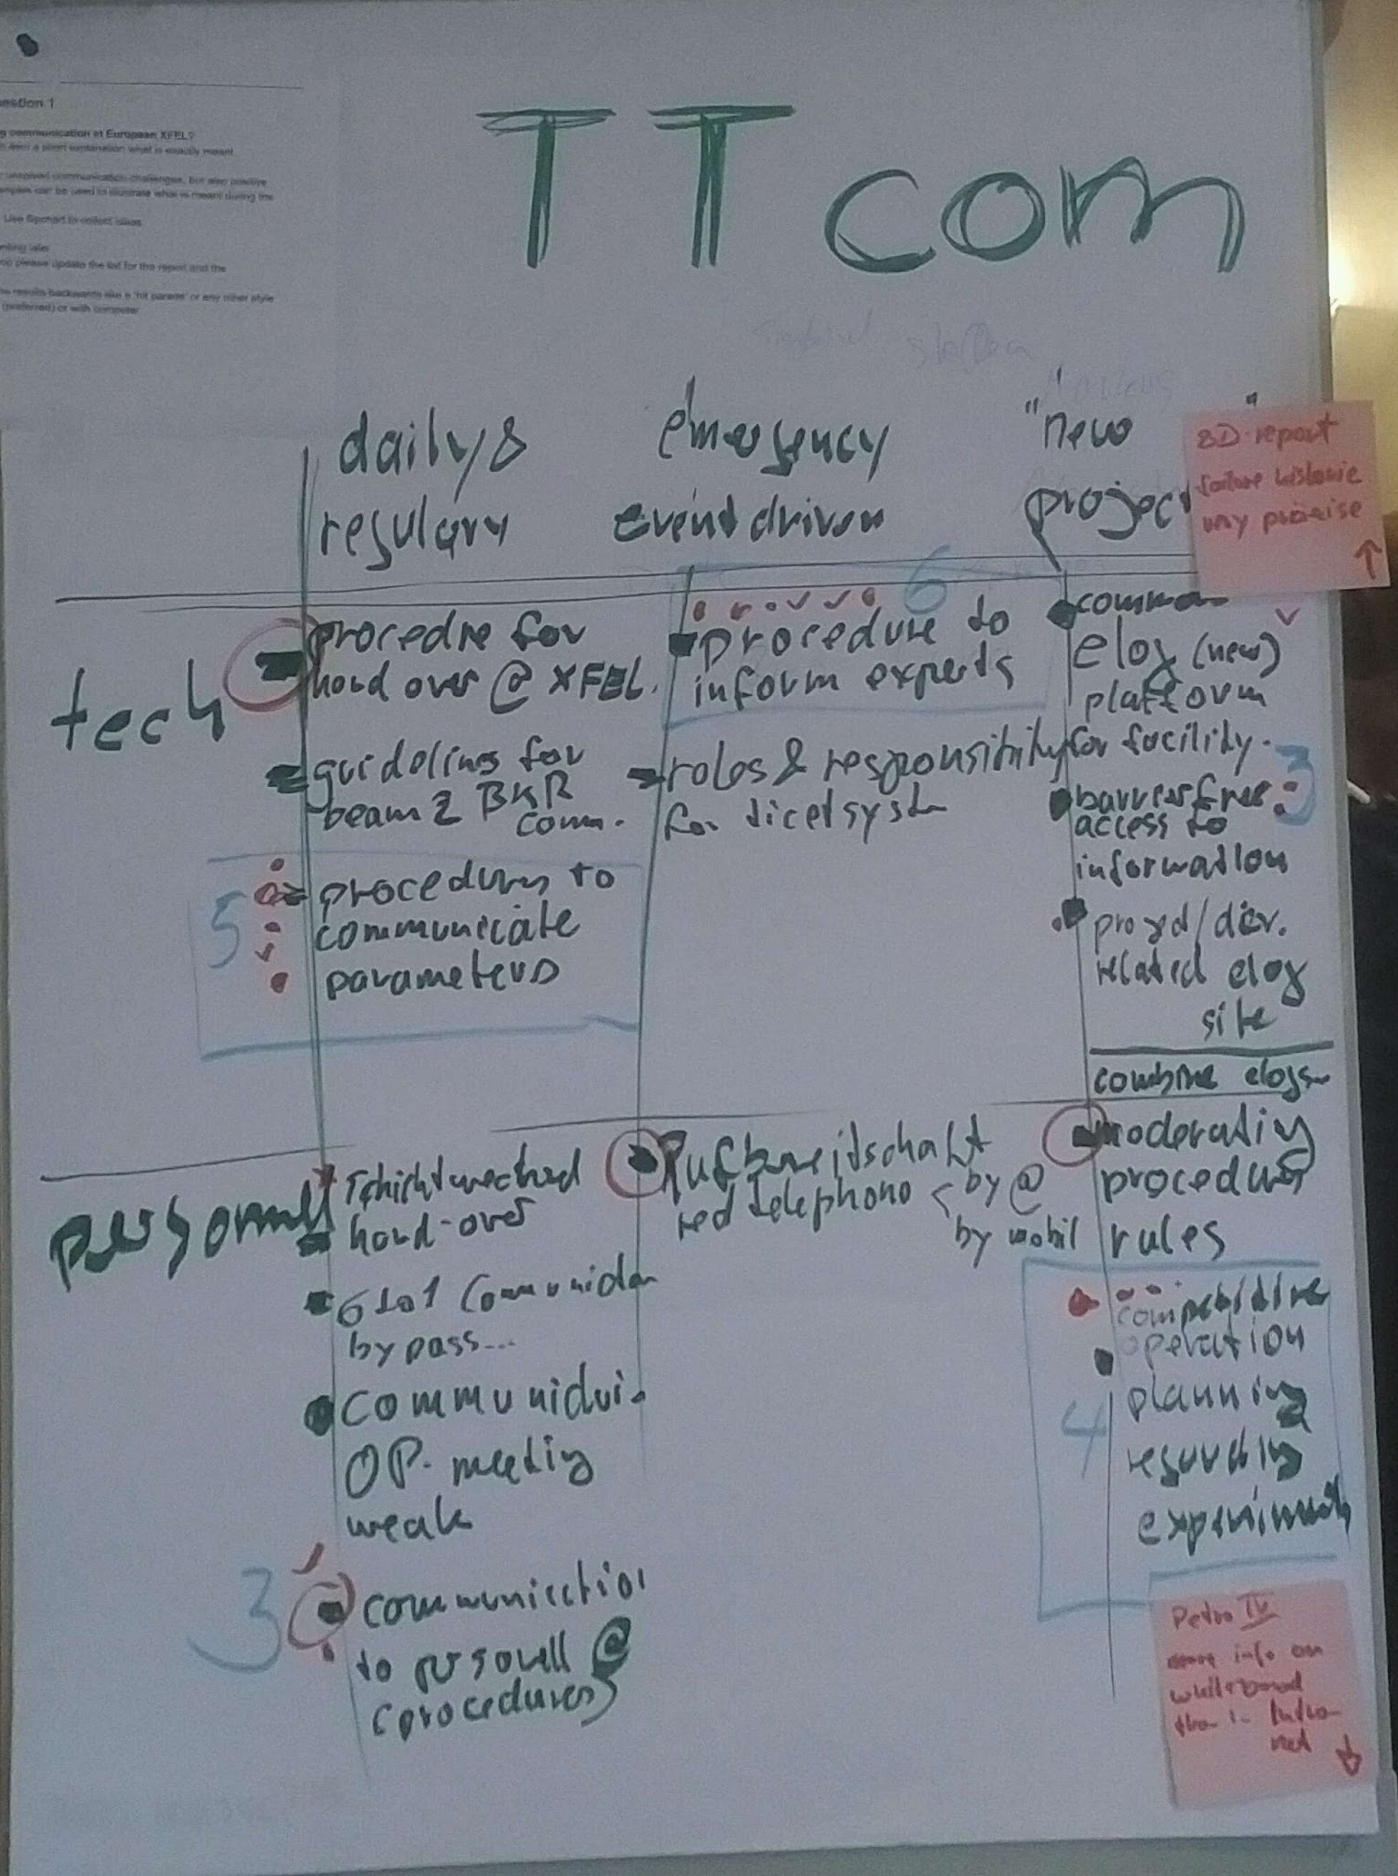
Session 1: Communication Question 1 - TTcom
Members: Siegfried, Naresh, Liuba, Matthias, Steffen, Dirk, Rico, Markus
Procedure to inform experts
Procedure to communicate machine parameters for the experiments
Competitive operation planning regarding the experiments
Communication to personnel (procedures)
Barrier-free access to info
Procedure for hand over @XFEL
Guidelines for BKR <--> experiments communication
Other issues identified
Roles and responsibilities for ticketing system
The common/single elogbook development to be used @XFEL for the whole facility
Moderating procedure rules
Improve communication at Beam and User operation meetings

Slide 28
S1 TTcom: emergency / event-driven communication issues
Procedure to inform experts (1)
Improve existing procedures in BKR, to get informed all experts in case of emergency
Don”t bypass the RUN Coordinators and the PRC
Define clear escalation pass
Proposal: Have some kind of interview evaluation to the involved people to get their ideas for improvements
Roles and responsibilities for ticketing system
RT and Redmine ticketing system
To get functional account for well-defined scopes (e.g. BPM experts list)
Procedures has to be defined clearly when should submitted ticket or calling OCD

Slide 29
S1 TTcom: Daily and regular communication issues
Proactive procedure(s) to communicate machine parameters for the experiments (2)
Positive experience: the beam parameters table under discussion at Friday meeting
Issues:
the parameters in the table correspond to user proposal a few months before the beamtime and have to be updated in accordance with recent experience
No competitive operation planning to optimize parallel operation of the user experiments
Communication to personnel (procedures) (4)
To get functional account for well-defined scopes
Procedure for hand over @XFEL (6)
We have a’ good practice’, with instruments calling to BKR at the end /beginning the shift
Issues : 6<-->1 communication, non-agreed wishes/requests, ...
Guidelines for BKR <--> experiments communication
Improve communication at Beam and User operation meetings
Issues to some extent were covered by Role play @S5
Change the time slot for User operation to Thursday afternoon?

Slide 30
S1 TTcom: New projects for communication improvement
Competitive operation planning regarding the experiments (3)
Interactive between DESY and XFEL on regular basis at least twice in week via meetings.
Barrier-free access to info (5)
To get more information regarding the running/current experimental conditions.
Web interface: to have barrier free access to information via web communication.
The common/single elogbook development to be used @XFEL for the whole facility
Need agree with common elog where all the information about the machine status and experimental conditions.
Moderating procedure rules
Moderator skills to lead groups/teams of XFEL and DESY in a structured way to deliver results.
Suggest: Having a microphone at BKR and having speaks at all instrument station and on experimental floor for announcement if the beamlost/tripped and giving updates of machine when beam will come back.

Slide 31
Session 2: Communication Question 2 - WebOP - (Thomas, Naresh)
What should be on the European XFEL web page concerning operation?
Task: Sketch out a proposal what the contents (topics, sequence of topics, subpages etc.) could be on the xfel.eu operations website. What is essential, what is optional. Which items require permanent, periodic or no updates?
Group work: Collect ideas from participants with flipchart or in any other way. If computers with internet are available, check out the already existing website and sites from other facilities. Sketch out a hierarchy or list of topics for the website. Take photos of the flipchart for the report writing later.
Report writing: Sum up the recommendations for enhancing the xfel.eu operations website (if required) and present the results in the final session (use computer, if required).

Slide 32
Contents for webpage XFEL.EU/operations
Essential content:
Non dynamic / static
experiment / Instrument description
Beam parameters, operation modes
Schedule
Periodic change
Proposals / PI names
Contact persons: PRC, RC…
Uptime statistics
Friday meeting agreed parameters
Machine operation parameters per run
Permanent update
Machine status (Status display)
Photon energy, rep. rate, pulse duration/charge, brilliance, e-beam energy
Optional content:
Public XGM display of SA1, SA2, SA3
Local contact per instrument per experiment
History parameters for each experiment
Webcamera viewing XFEL XHQ (like SACLA)
Useful links
“Active” plots: move mouse in intensity history and fluctuation graph
Calculator E-beam → E-photon min/max
AOB
Link to this website on main XFEL.EU webpage (actually it is hard to find)

Slide 33
Webpages of other facilities
SACLA:
List of proposals (approved / performed)
PI, institute, country, beamline, number of shifts
Links to
Monthly calendar
Beamline information
Webcam (weather)
Operation status
Operation mode
Active endstation / experiment
Rep. rate
Photon ernergy
Intensity fluctuations in 30 shots
LCLS:
Schedule
pdf. Calendar for each run
Proposal number + PI name + table with title of experiment
Status
Detailed overview of accelerator status
FLASH:
Reports and publications
Schedule by year
Schedule by week
User run: only wavelength, no title or PI
Studies: program and responsible person

Slide 34
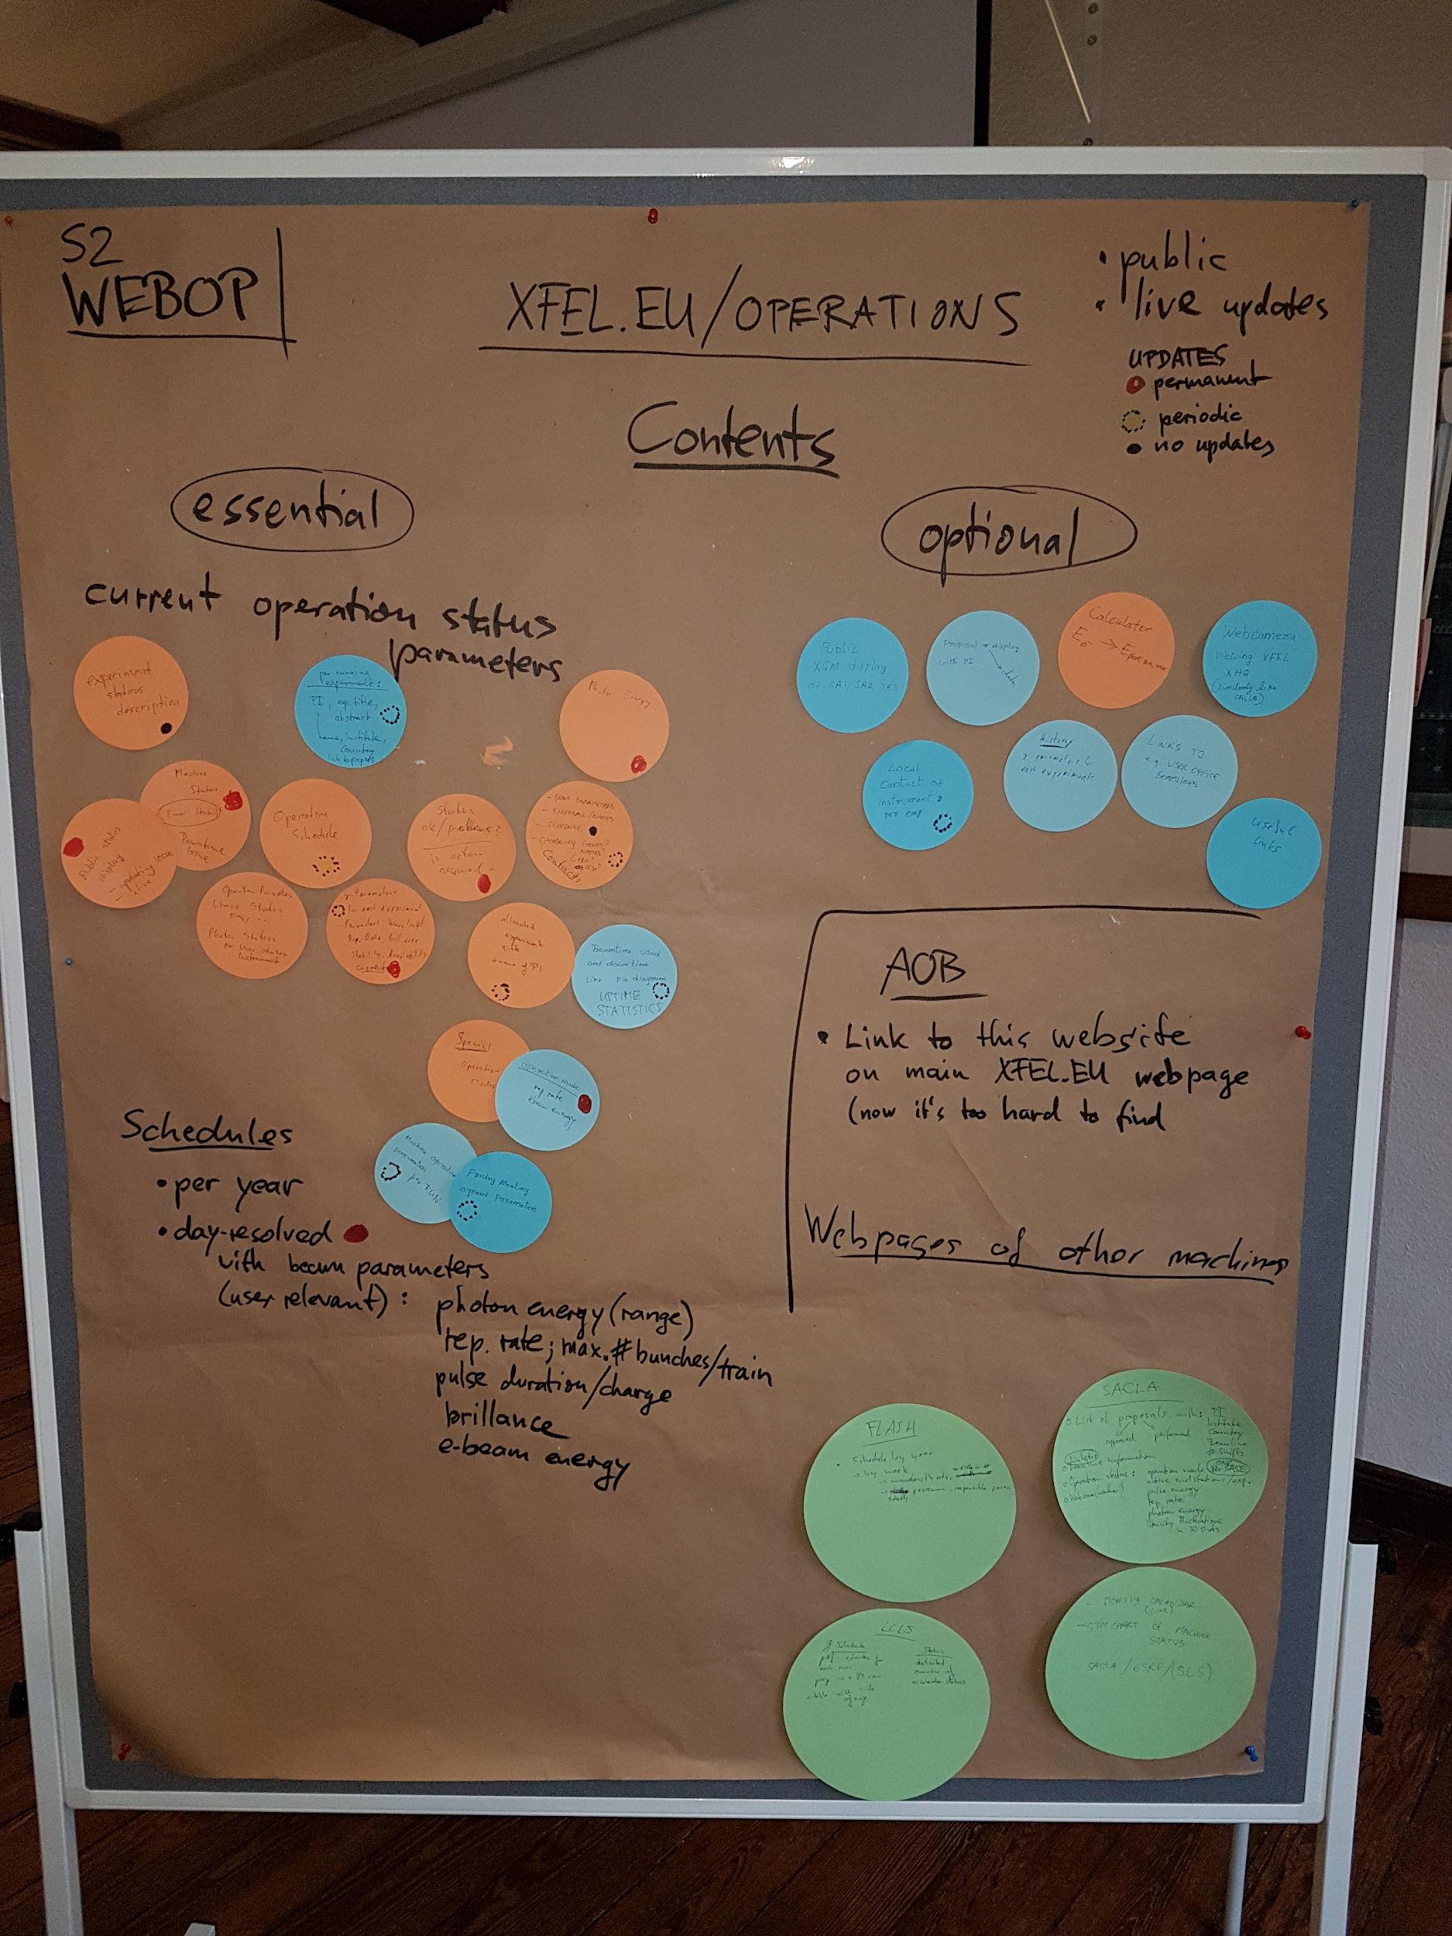
Screenshot/photos of flipcards:

Slide 35
Session 3: Communication Question 3 - ComBKR - (Matthias, Thomas)
How can we improve the communication between experiments and BKR?
Task: Collect ideas to improve the communication between BKR crew and instrument scientists in Schenefeld.
Group work: Collect ideas from participants with flipchart or in any other way. Take photos of the flipchart for the report writing later.
Report writing: Sum up your recommendations to improve communication and present the results in the final session (use computer, if required).

Slide 36
Session 3: Communication Question 3 - ComBKR - (Matthias, Thomas)
We do not have general/massive problems but a few things that can be improved:
More detailed shift handover within the BKR and/or instrument groups. Brief documentation.
Call the “other side” after shift change to say hello and get basic information or offer tuning time etc. (minimum 5 calls per day: 7 am, 8 am, 3 pm, 8 pm, 11 pm).
Call when major changes happen (beam not used, tuning necessary). Brief documentation.
Clear escalation rules necessary: When to call PRC, BKR, Robert?
FEL down procedure (wait at least 5 min. before calling. Downtime countdown? E-log info).
Technical solutions for better communication like chat, video link, pictures of colleagues.
E-log: common logbook or links between logbooks. Copy and paste at the end of the shift?
Improvement of “Friday-table” -> clear priorities (what is most important).
Visits between machine and experiment operators. Common trainings? Party or other social events?

Slide 37
Session 4: Communication Question 4 - RolePlay - (Dirk, Giuseppe, Sara, Nick, Siggi)
How can we improve the Friday’s Operations Meeting?
Task: Propose means to improve the Friday’s operations meeting. What info is essential, what can be shortened or omitted? Can we improve the format or the preparation of the ‘delivery requirements table’? Can we shorten the meeting to e.g. 45 or 30 minutes?
Role Play: ‘Friday’s Operations Meeting’: All 32 will participate. There will be an 1 hour preparation in a small group before the event. Total time of role play is 90 min; 30 min preparation inside groups + 45 min play + 15 min common analysis or buffer.
The idea is to play the Friday operations meeting. The roles in the play should be complementary to the roles in real life. Several sub-groups and roles will be defined during the 1 hour preparation. Sub-groups have to prepare their role during the 30 minutes preparation time.
Final report: Summarize your observations of the Role Play and eventually derive recommendations for enhancing the Friday’s operations meeting. Present summary in close-out session.

Slide 38
Improvements of Friday Operations Meeting
The role play reflected the operations meeting of the last months, summarizing what usually happens. The typical overall friendly atmosphere was met in the play even with exchanged roles.
The focus of the operations meeting should be on the finalization of the parameters of the upcoming week. The quality of the Table arriving to the Friday meeting needs to be improved.
Changes of the Table are driven by the Instruments.
The initial table should be coordinated and agreed with the machine to ensure feasibility and effectivity.
Instruments should present changes to the initial Table one week ahead of the Friday Meeting to XFEL Operation Group. XFEL Operation Group will check feasibility with the machine and moderate the consolidation of the Table before the Friday Meeting.
Condensed report of the operation Board and the present week should be part of the Operations Meeting.
Given the changes above the Operations Meetings could be limited to 30 min.
The present order of Friday meetings (Operation Board, Operations, User talks) could stay as it is. An alternative more user friendly but possibly with smaller audience could be to reverse the order to the meetings (User talks at 9 am, Operations 10 am, Operations Board).

Slide 39
Session 5: Communication Question 5 - CommTool - (Riko, Jan)
Contributors: Jan G., Riko W., Harald S., Thomas W., Martin D., Svitozar S., Winni D.
Which communication software tools can improve operational aspects?
Task: Find out, if it is possible for XFEL people to access Confluence and for DESY people to access Alfresco? Which information important for operational aspects can be found there today?
Which other tools could be useful (e.g. request trackers) for joint usage of XFEL and DESY people? Which existing tools (e.g. elogs more tightly connected) could be modified / updated to better support daily operation?
Group work: Participants exchange and discuss their experience and knowhow. If computers with internet are available one can check online. The two leaders will collect and summarize the information. Take photos of the flipchart (if used) for the report writing later.
Report writing: Sum up your recommendations to improve communication and present the results in the final session (use computer, if required).

Slide 40
Access to Alfresco for DESY and to Confluence for XFEL People
Situation Alfresco (Document Management with WIKI functionality):
Access to system with regular computer account (no special activation required but LDAP)
Access to specific sites needs authentication to that site
No public sites^{*)} available: DESY users always have to be granted access, and they don’t see the main EuXFEL page (site “European XFEL”) which is the navigation entry point
XFEL users have access to public sites independent of individual access rights
Other pages: users can be added via a “invitation mechanism”, access control available
Operation-relevant content: emergency phone lists operation documents as THE xls-table (PhotonDeliveryRequirementTable), shutdown plans... group specific pages → portal to EuXFEL documentation like operation manuals
Situation Confluence (WIKI System with document storage):
Access to system with regular computer account but activation (registry) is needed (licensing)
Public sites in confluence are available even without login
Non-public sites accessible by invitation
Operation-relevant content: Meetings & minutes, some documentation (mostly Linac), sort of internal web pages
^{*)} some sites are world wide visible

Slide 41
Improvement Recommendation to Alfresco / Confluence
Improvements Alfresco
Default access to all “XFEL public” pages to all DESY users that are involved in XFEL operation (e.g. via registry group or just all)
Improvements Confluence:
All XFEL operation involved people @XFEL.eu and @DESY should have “by default” access to the Confluence system (or just all)

Slide 42
Communication tools
Available tools at EuXFEL and DESY, sorted from highest to lowest “realtime intensity / interactivity”:
100% live (audio & video): CISCO meeting, skype (multiplex), (real meetings)
100% live (audio): PHONE calls (1-to-1)
Email (zimbra/outlook), FAX
Electronic logbooks: DESY eLOG (ttfinfo.desy.de), EuXFEL ELOG by PSI (in.xfel.eu/elog)
Task tracker: REDMINE (@EuXFEL, in testing at DESY), RT (@DESY)
Document handling, archiving, wiki, task : ALFRESCO, CONFLUENCE, ReadTheDocs, Sync&Share (DESYcloud), EDMS, GoogleDocs
Meetings&presentations: INDICO, doodle/terminplaner
Inventory Manager XIM

Slide 43
Live Document Editing
Situation:
Joint editing of documents becomes increasingly common and popular, e.g. meeting minutes, joint reports, other docs with sections in the responsibility of different people both @DESY and @XFEL.eu
Frequently is Google Docs
However, it’s against DESY regulations for usage for “official documents”
Request
Have proper “plugins” for the DESY Cloud / Sync & Share enabled to provide Office Functionality

Slide 44
CHATs
Situation:
currently only available in CISCO-meeting session, could use #slack, (Cisco chat app or Matrix as self-hosted solution)
benefits: documented/archived quick communication, quicker to use than elog, address directly some receiver, multiplex (in contrast to PHONE), chats can close gap between PHONE and ELOG, provides video conferencing
negative: additional effort (e.g. for operators), needs a policy, needs a clear hierarchy among comm tools
Actions:
A test of a CHAT functionality could be useful.
WD will set up a policy and a test chat communication: BKR ←→ Experiments ←→ RC/PRC
Evaluation after a few months, if this mode of communication is beneficial for operation.

Slide 45
Session 5: Communication Question 6 - DailyMeeting - (Torsten, Richard)
Is a daily operations meeting feasible?
Task: Find out, if a daily operations meeting could be useful.
An excerpt from the last SAC report:
To enhance communications, SAC considered the advantage of daily mandatory meeting between the users and accelerator staff to exchange information about success or failure and needs for the coming days. At other facilities such meetings have proven to be extremely effective. But on discussion, we learned about the role of a floor coordinator, responsible for the task of coordinating the three running instruments with the accelerator, already in place. SAC considers this should be sufficient communication, but requests that the system be announced to the users.
Group work: Discuss the statement of the SAC in the group. Could a daily meeting and under which boundary conditions? What shall Robert answer reply to this recommendation in the next SAC meeting? Take photos of the flipchart (if used) for the report writing later.
Report writing: Sum up your recommendations concerning the proposed meeting and present it in the closeout.

Slide 46
Daily Meeting accelerator / photons?
Recommendation from the SAC was somewhat vague but we extracted the following points:
Daily meetings at other facilities considered 'extremely effective'
Noted that in some facilities there is no direct user to accelerator contact and that where those meetings exist, the primary benefit is to give the machine coordinators, operators, instrument scientists and users some 'buy in' to the user experiment
Role of 'floor coordinator' already fulfills the role of coordinating the three concurrently operating instruments with the accelerator
This role is known as the Photon Run Coordinator (PRC) at XFEL
That users are informed of the existence of the PRC and their role
Currently XFEL users are generally not aware of who is the current PRC and their role in the communication channel between the instruments and accelerator

Slide 47
Daily meeting accelerator / photons?
We decided on a trial run of a daily meeting to evaluate its usefulness in enhancing communication
A meeting takes place at 8:30, DESY room 246, XFEL via cisco Due to potentially long travel times BKR-XFEL
Discussion primarily between PRC & RC. PRC can bring in instrument contacts where necessary for more complicated issues and also involve the experiment PIs if desired or requested. The meeting will always be open to any of the instrument contacts or PIs
Meeting does not take place on Fridays Due to overlap of contents with the already existing presentation of user experiments and operations meetings at XFEL
We also discussed a get together to enhance the team spirit between users, instrument scientists, accelerator run coordinators and operators
To take place at the XFEL campus at the beginning of the 'beam week'
Suggested time: Tuesday 4pm
Invited: Users (PIs +), Instrument Scientists, PRC, RC (From early shift), operators

Slide 48
Daily meeting accelerator / photons?
Additional discussion notes:
In order for the XFEL Photon Run Coordinator to effectively take on these new suggested communications efforts it would be beneficial for the role to be 'well defined'
People acting as PRCs should be given sufficient time for communication with the accelerator during the week whenever needed, both in person and digesting written material (elog etc.)
PRC also needs to have time available to keep an eye out on the activities at the instruments, initiating contact if needed
Instrument contacts (and PIs) are encouraged to visit BKR to meet the RCs and operators and to see what's going on

