Slide 1
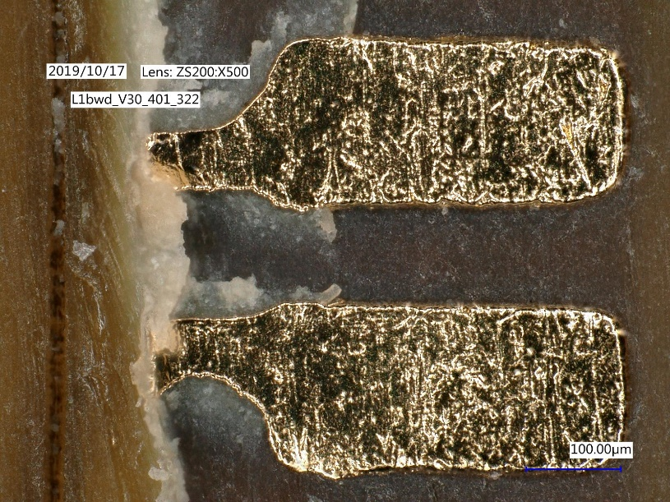
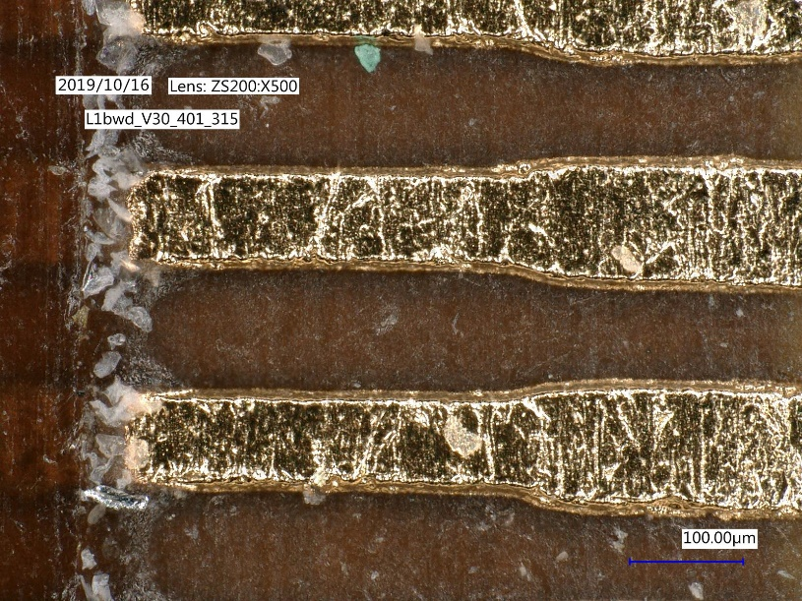
Components
Module & Ladder Assembly: Kapton tapes, jigs, boxes, auxilliary parts
Prepare for 12 inner ladders, 20 outer ladders (new components, no recycling)
Kaptons:
L1 fwd: 26
L1 bwd: 23
L2 fwd: 39
L2 bwd: 25
New gluing procedure
Clean pads
Glue remnants

Slide 2
Components
Patch panels: ~44 Panels assembled by PCS
Cable testing at MPP with manpower from LMU (Veronika Kratzer)
Cable tester still not working properly
Testing with module (recommended)?
- manpower*⁾
- need 4 ‚ginuea pig‘ modules (of each type)
- time
*⁾ Additonal manpower: Uli Leis (informatics engineer), but also needed for module testing
Emergency shutdown boards: 2 boards produced, under test
Jigs and Boxes: Survey by Tscharlie, missing components ordered or to be produced
(see next slide)
New gluing procedure

Slide 3
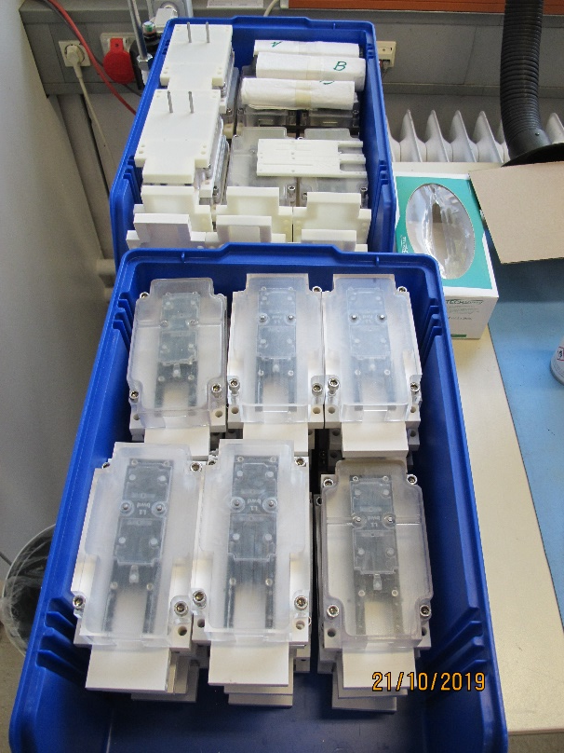
Component Survey
No immeadiate shortage
Missing components to be produced
(allready ordered, mostly 3D print)
In production

Slide 4
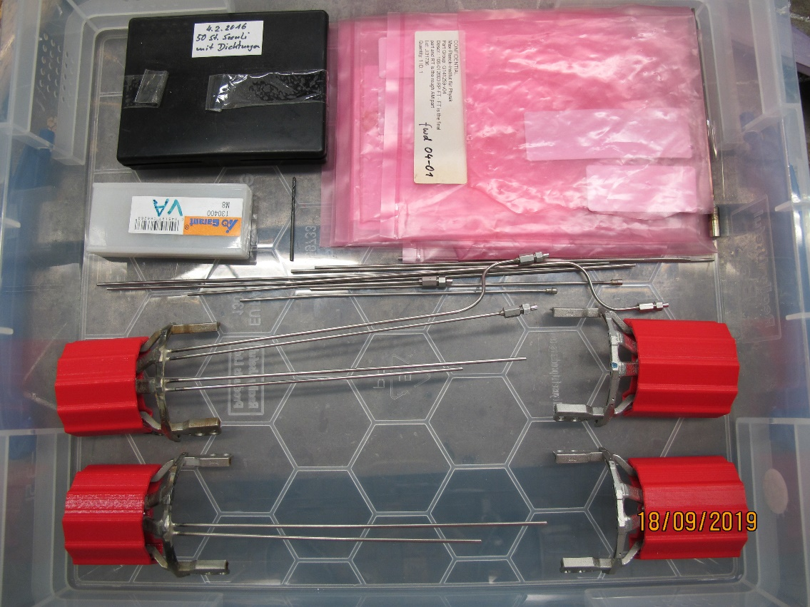
SCB
SCBs:
all 4 parts equipped with pipes
and tested
Next: assemble halfs using carbon tubes
tubes are available and coated
To be done: drilling of holes
Adhesive foil (from Laci)
=> Will test with ladder test setup

