Slide 1
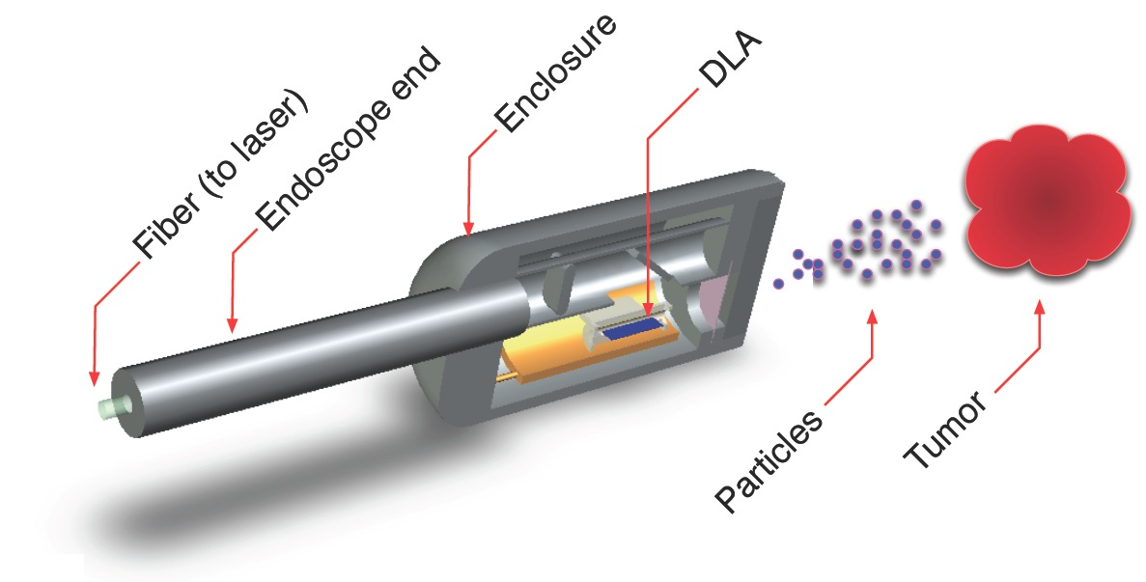

Applications for a Laser-Driven Accelerator on a Chip
R. J. England (SLAC, Stanford)
3rd Workshop on Applications of Dielectric Laser Accelerators
Boulder CO, March 10, 2020

Slide 2
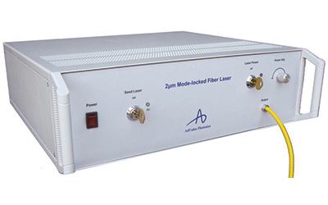
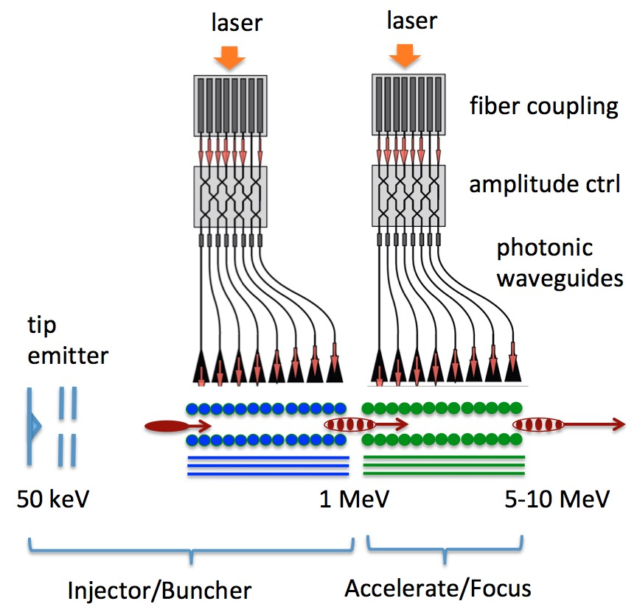
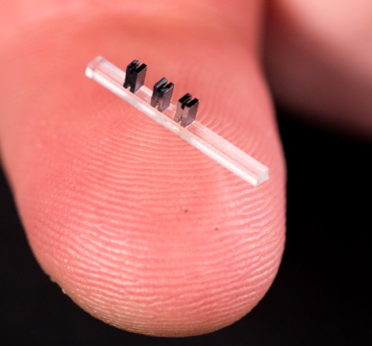
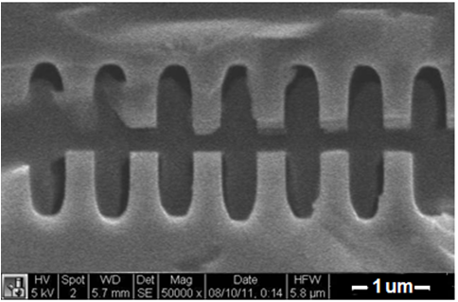
Dielectric Laser Accelerator (DLA) Concept:
Towards an “Accelerator on a Chip”
Modelocked Thulium Fiber Laser (λ = 2µm, 10µJ, $300k)
Required lasers are MHz rep rate, low pulse energy, wallplug efficiency ~ 30%
Dielectric materials can withstand GV/m
fields and kilowatts of average power
Can be mass produced using techniques of the integrated circuit industy.
gradient
SEM images of DLA prototypes tested at SLAC
3 cm
fused silica
silicon
DLA research aims to produce ultracompact nanofabricated devices for particle acceleration, powered by efficient solid-state lasers.

Slide 3
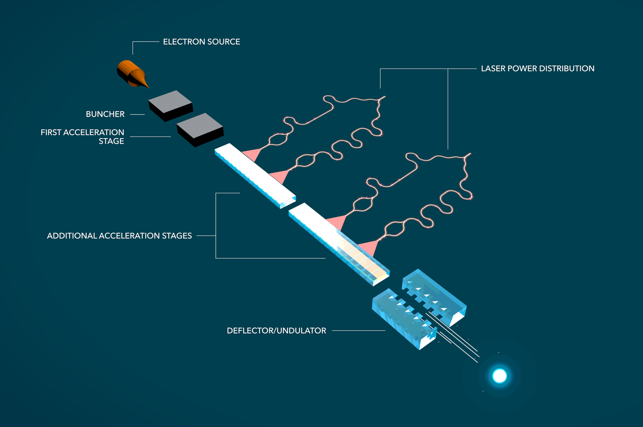
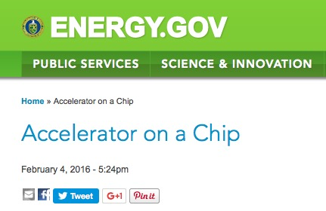
Moore Foundation has Funded a 5-Year
Accelerator on a Chip International Program (ACHIP)
Moore Foundation “Accelerator on a Chip” Program (started Dec 2015)
$13.5M / 5 years
6 universities, 3 partner labs
1 industry partner
(DOE Web Feature 2015)
Goals of ACHIP:
(1) An MeV class benchtop DLA accelerator in 5 years.
(2) Transverse dynamics (focusing, deflection, undulators, diagnostics)
3
The ACHIP program has been extended by Moore Foundation for an additional 2 years, continuing through 2022.

Slide 4


ACHIP Institutional Organization
Executive Committee:
R. L. Byer (Stanford), P. Hommelhoff (FAU), R. J. England (SLAC), R. Assmann (DESY), R. Ischebeck (PSI)
Sub-Relativistic DLA experiments
Stanford: Harris, Solgaard
Erlangen: Hommelhoff
Structures
Stanford: Harris, Solgaard, Byer
Erlangen: Hommelhoff
Electron source
UCLA: Musumeci
Erlangen: Hommelhoff
Stanford: Harris, Solgaard
System integration
(Core DLA groups)
Stanford: Byer, Harris, Solgaard
Erlangen: Hommelhoff
Simulations
Tech-X: Cowan
U Darmstadt: Boine-Frankenheim
Light Coupling
Stanford: Fan, Vučković
Associated Scientific Collaborators
Yenchieh Huang (Tsinghua)
Evgenya Simakov (Los Alamos)
Zhirong Huang (SLAC)
Kazu Koyama (Tokyo U)
Relativistic DLA experiments
SLAC: England
DESY/UnivHH: Assmann, Kaertner, Hartl
PSI/EPFL: Ischebeck, Rivkin
Industrial affiliate Hamamatsu Corp. Japan (joined June 2017)
Program start: Dec. 2015
ACHIP Scientific Advisory Board:
Chan Joshi (UCLA), Tor Raubenheimer (SLAC), Reinhard Brinkmann (DESY)

Slide 5
ACHIP Technical Group Organization
Executive Committee:
R. L. Byer (Stanford), P. Hommelhoff (FAU), R. J. England (SLAC), R. Assmann (DESY), R. Ischebeck (PSI)
TG 1: Injector
K. Leedle (Stanford)
N. Schönenberger (FAU)
TG 5: Radiation Generation and Applications
Yen-Chieh Huang (NTHU TW)
Zhirong Huang (SLAC)
TG 2: Relativistic Structures & Facilities
R. J. England (SLAC)
R. Assmann (DESY)
R. Ischebeck (PSI)
TG 6: Integration
R. J. England (SLAC)
P. Hommelhoff (FAU)
P. Musumeci (UCLA)
TG 4: Simulation and Beam Dynamics
U. Niedermayer (Darmstadt)
B. Cowan (Tech-X)
TG 3: Laser Sources & Coupling
J. Vučković (Stanford)
F. Kaertner (Hamburg)
I. Hartl (DESY)

Slide 6
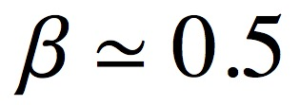
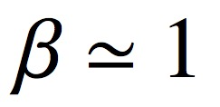
Concept for 1 MeV “Shoebox” Accelerator (1 Year)
A single bunching/acceleration/focusing stage driven by a tilted laser pulse.
special “banana” shaped pulse needed for group velocity match
tip emitter +
electrostatic
lens
Pulse Front Tilted Laser
...
50-100 keV
Longitudinal Focus
Transverse Focus
Emitter
Buncher
DLA Linac with APF Focus + Velocity Taper
1.3 cm

Slide 7
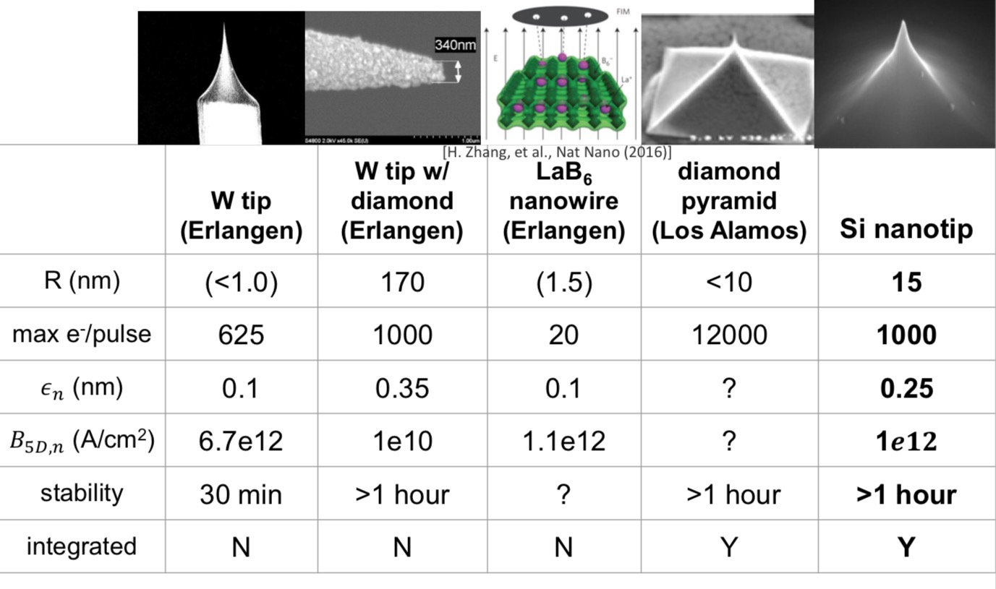
High Brightness Photocathodes Tested Under the ACHIP Program...
A. Ceballos, DLA Applications Workshop, March 26 (2019)

Slide 8
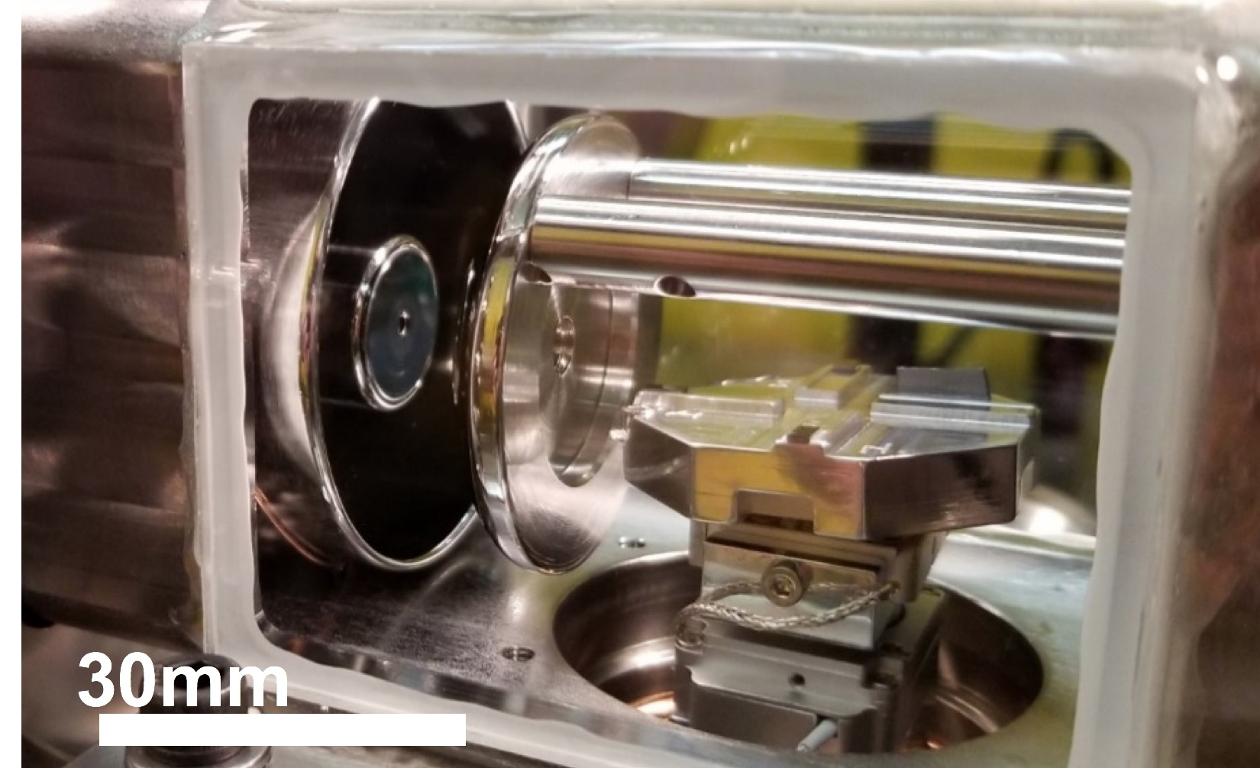
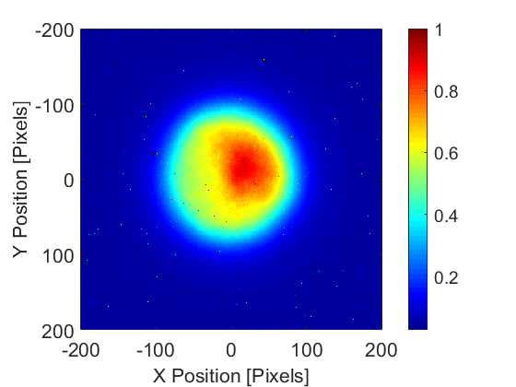
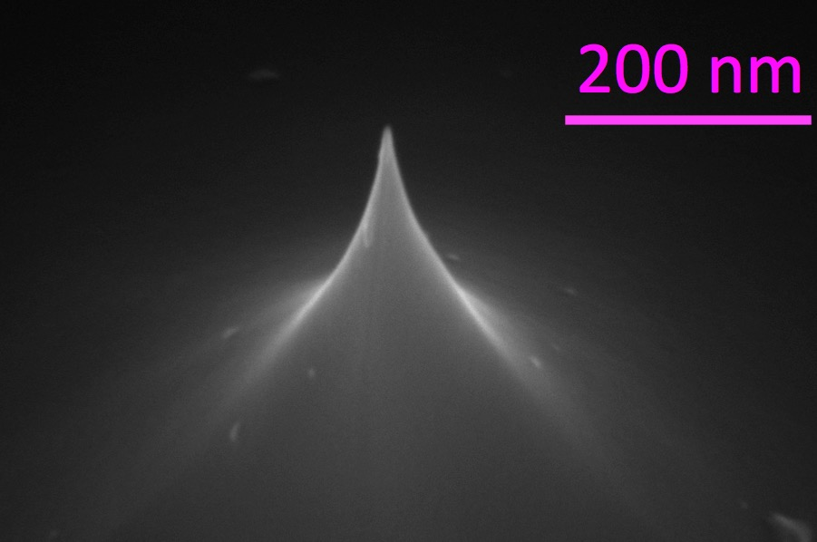
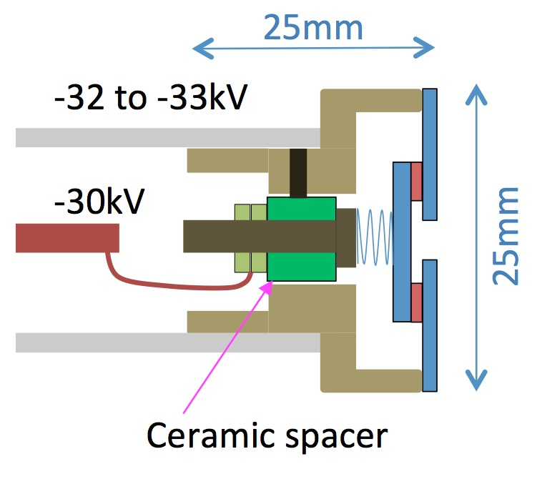
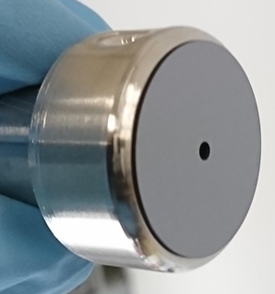
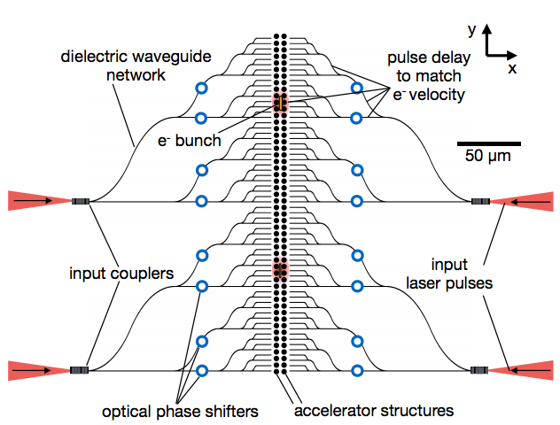
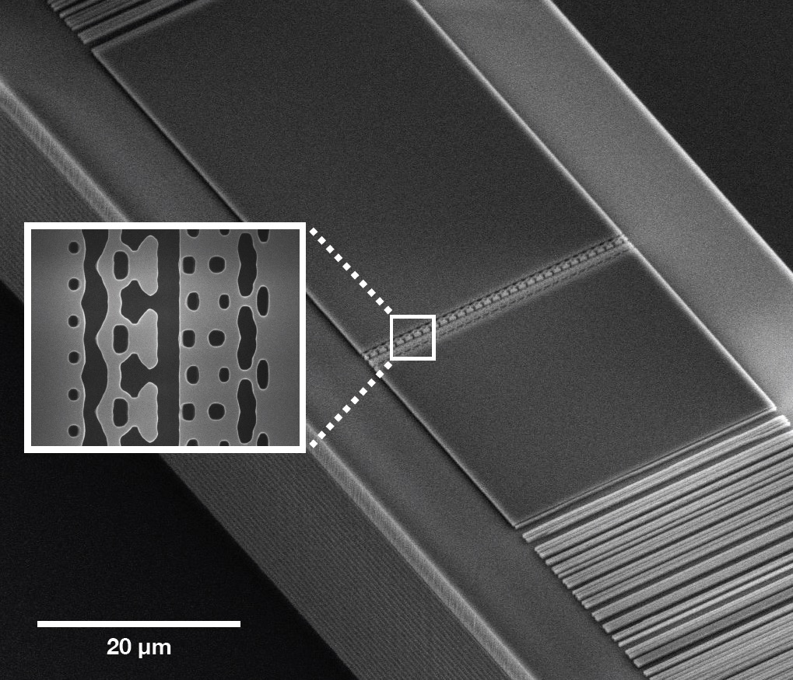
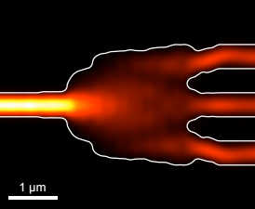
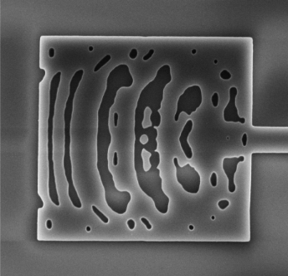
A compact prototype “shoebox” test system is now operating at Stanford University – goal of 1 MeV energy
Stanford “glassbox” test system
compact electron gun
w/electrostatic lens
96keV
Si tip emitter
3000 e-/pulse,100 kHz rep
0.2 nm emittance
A. Ceballos, Stanford
30mm
compact e- gun
optimized DLA components via inverse design
splitters
waveguide coupled DLA
couplers
e-
courtesy T. Hirano (Hamamatsu, visiting scientist at Stanford University)
8
T. Hughes, et al, Phys. Rev. Appl. 9, 054017 (2018)
N. Sapra, et al.,
Science 367, 79 (2019)

Slide 9
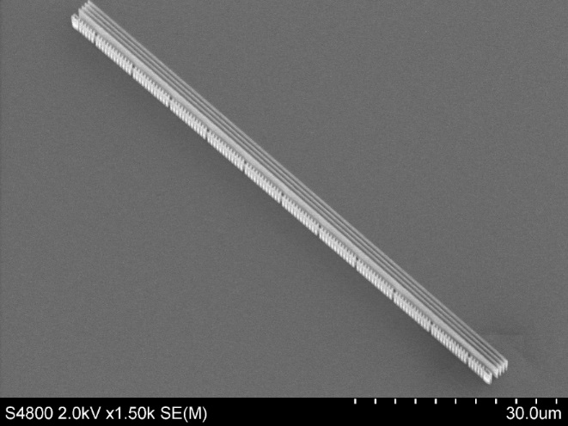
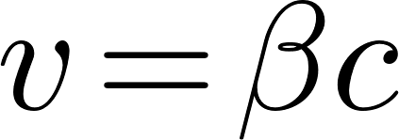
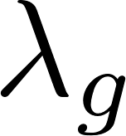

Sub-relativistic Structures with Laser-Driven Focusing Have Been Recently Fabricated for Experimental Tests
Laser
y
x
z
s
Laser
Hommelhoff Group, FAU Erlangen, Germany
Niedermayer, et al., PRL 121, 214801 (2018)
First APF structure optimized for 2000 nm laser wave length and 26.478 keV electron beam Structure length required pulse front tilted (PFT) laser pulses
Structure is only for guiding as a proof-of-principle
Goal is to see a maximum laser ON/OFF contrast of 2.5:1
Additionally the contrast should scale with incident laser power

Slide 10
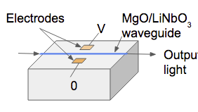


Multistage Waveguide Network Design for a Dielectric Laser accelerator
couplers
splitters
phase shifters
T. Hughes, et al. “On-Chip Laser Power Delivery System for Dielectric Laser Accelerators,”
Phys. Rev. Appl. 9, 054017 (2018)
• Design Study of Integrated Multi-Stage DLA Network
• Realistic Component Parameters
• Adjoint Variable (“Inverse Design”) Based Structure Optimizations

Slide 11
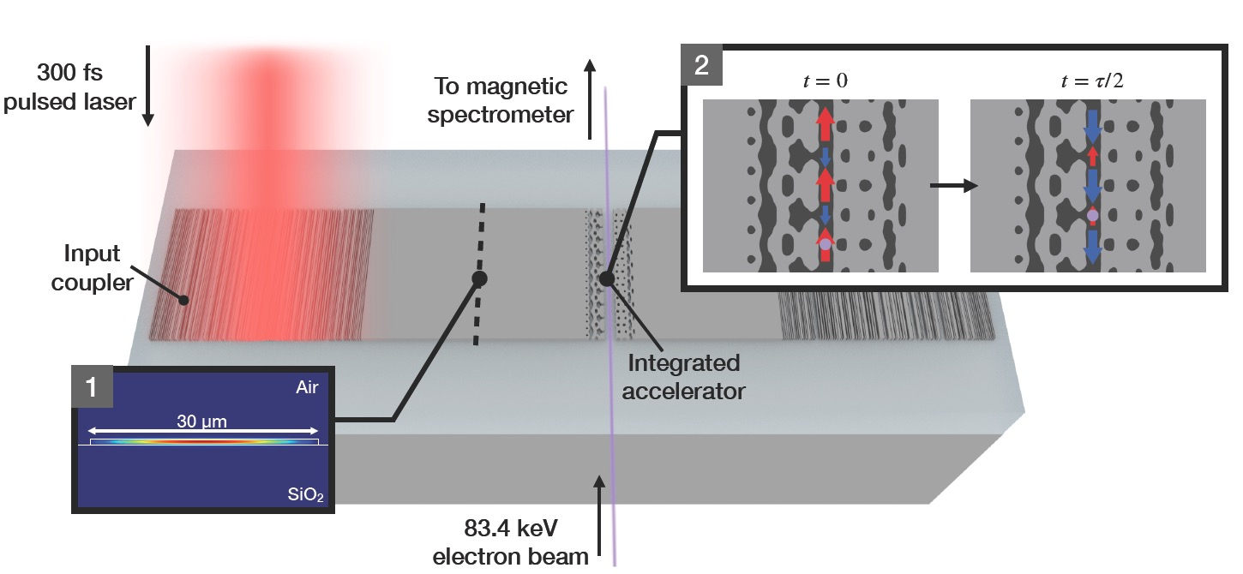
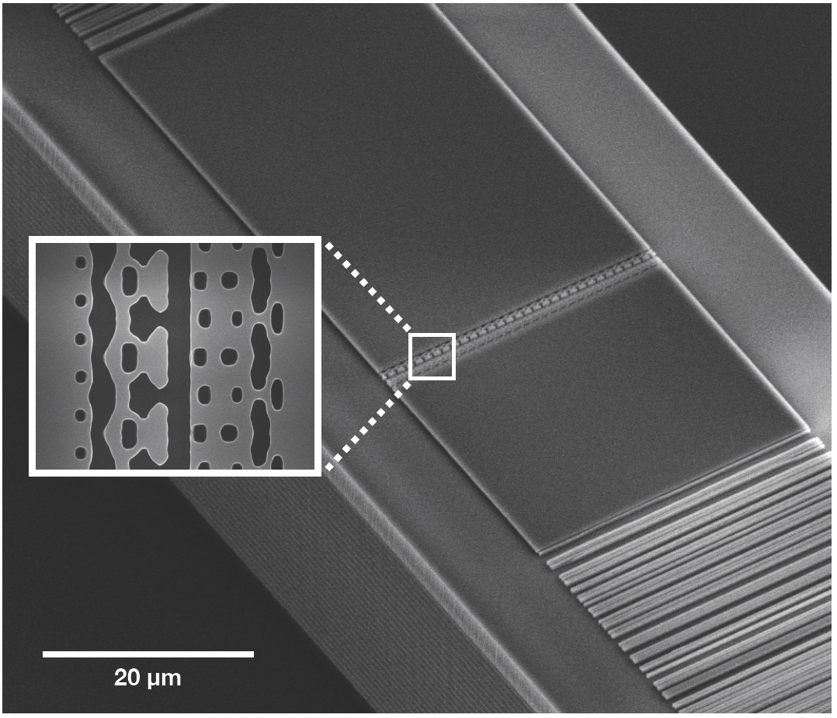
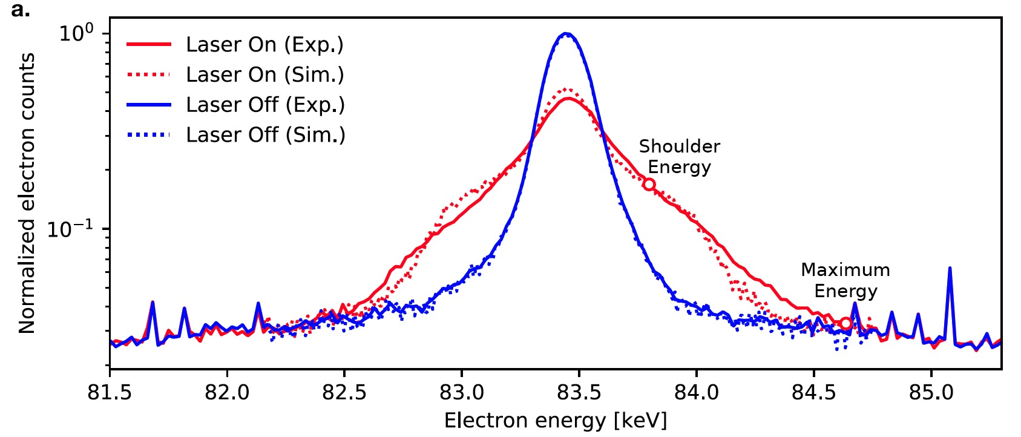
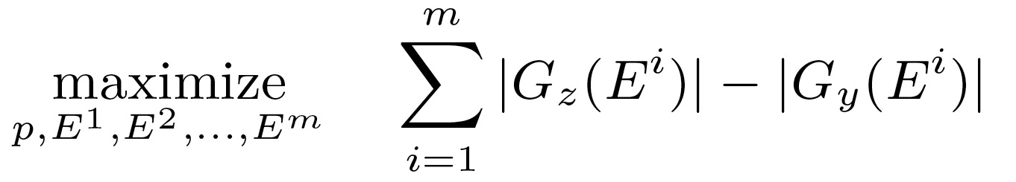
Demonstration of a waveguide-coupled DLA produced using inverse design optimization
• First demonstration of acceleration in a waveguide-coupled DLA
• Acceleration of 1.2 keV over 30 µm (gradient of 40.3 MeV/m)
• Illustrates utility of inverse design methods to optimize over unique parameter constraints
N. Sapra, et al., “On-chip laser driven particle acceleration through inverse design,” Science 367, 79 (2019)

Slide 12
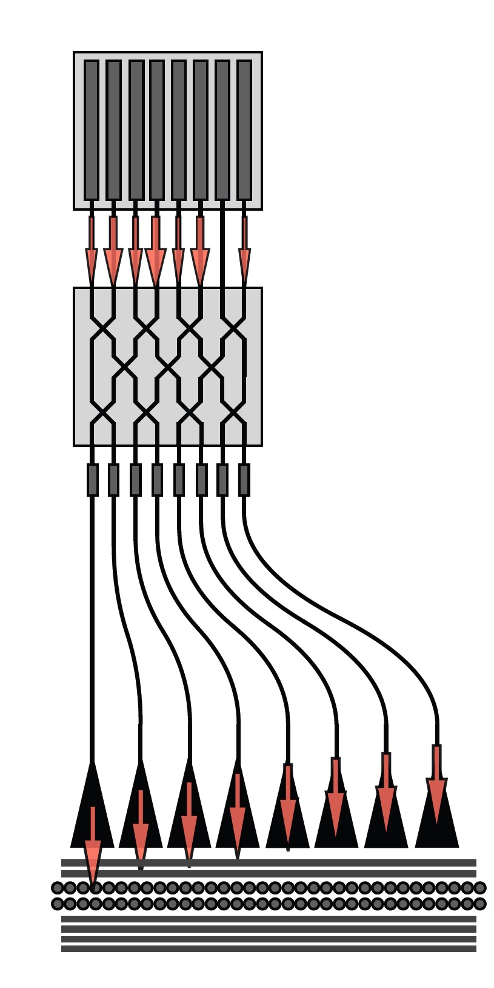
Concept for Injector + Multistage Accelerator (2-5 Year)
Thulium Fiber
Laser (2µm)
Master Clock
Master Oscillator
CEP phase locked network
…
Oscillator 0
Oscillator 1
Oscillator 2
Oscillator 3
Oscillator N
…
...
silicon
fused silica
50 keV 1 MeV 5-10 MeV
Injector/Buncher
MZI Controlled DLA Linac with APF Focusing
12

Slide 13
Shoebox Demonstration System
Parameters (1 vs. 2-3 Year Time Scale)
Parameter | Units | Near Term (1 Year) | Longer Term (2-3 Years)
Final Electron Kinetic Energy | MeV | 1 | 6
Charge Per Laser Pulse | e- | 10 | 300
Laser Rep Rate | MHz | 0.1 | 50
Electron Beam Size (X/Y) | µm | 0.05 / 1.00 | 0.05 / 1.00
Geographical Gradient | MeV/m | 100 | > 200
Total Accelerator Length | cm | 1 | 3
Electron Beam Power | µW | 1 | 3000
Values represent conservative estimates (as of March 2019) and not ultimate limitation on the technology.

Slide 14

What are DLA’s Unique Capabilities?
“Create a matrixed list or table of all DLA related applications that have been proposed or discussed so far, both near and long-term, including industrial, scientific, and medical. Please evaluate each application in terms of area of interest (light source, HEP, industry, medicine, security, etc.), feasibility (is DLA a good match?), time scale (near-term vs. long-term), and degree to which it leverages DLA's unique capabilities.”
Features of a DLA Accelerator:
• Compactness: x10⁻² longitudinal, x10⁻⁴ transverse
• Efficiency: solid state lasers (> 30% wall-plug)
• Bunch Format: fC charge at MHz rep rates
• Attosecond Time Scale: intrinsic optical bunching
• Uniquely enabled by DLA?

Slide 15
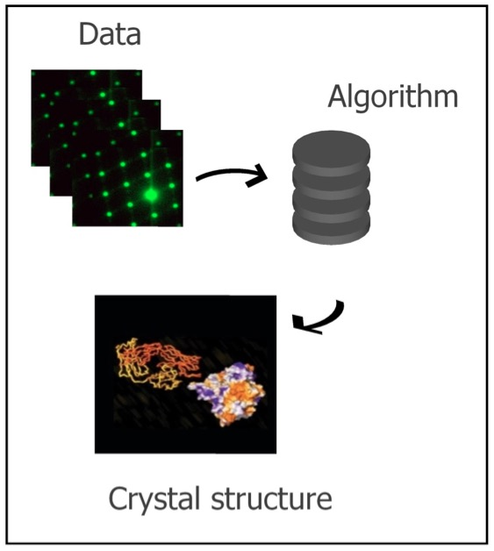
Applications Identified by the March 2019 DLA Applications 1-Day Workshop
potential areas of industry interest
Biomedicine industry
-- Radiation therapy
Semiconductor industry
-- low-power EUV for mask/wafer
inspection/calibration
potential areas of scientific interest
Nano- or micro-beam for radiobiology and radiation chemistry
Ultrafast electron diffraction, X-ray pulses at sub-fs time scales

Slide 16
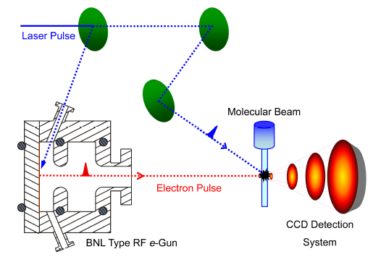
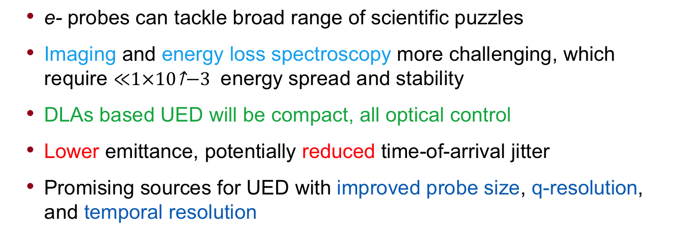
High-Brightness DLA Beams for Ultrafast Electron Diffraction – Renkai Li (SLAC, Tsing Hua U., Beijing)
Typical UED beam parameters
Parameters | Values
rep. rate | SS - 180 Hz
beam energy | 2 - 4 MeV
bunch charge | 10⁴-10⁶
emittance | 2 - 20 nm
bunch length | <50 fs rms
  e- probes can tackle broad range of scientific puzzles
  Imaging and energy loss spectroscopy more challenging, which require energy spread and stability
  DLAs based UED will be compact, all optical control
  Lower emittance, potentially reduced time-of-arrival jitter
  Promising sources for UED with improved probe size, q-resolution, and temporal resolution

Slide 17
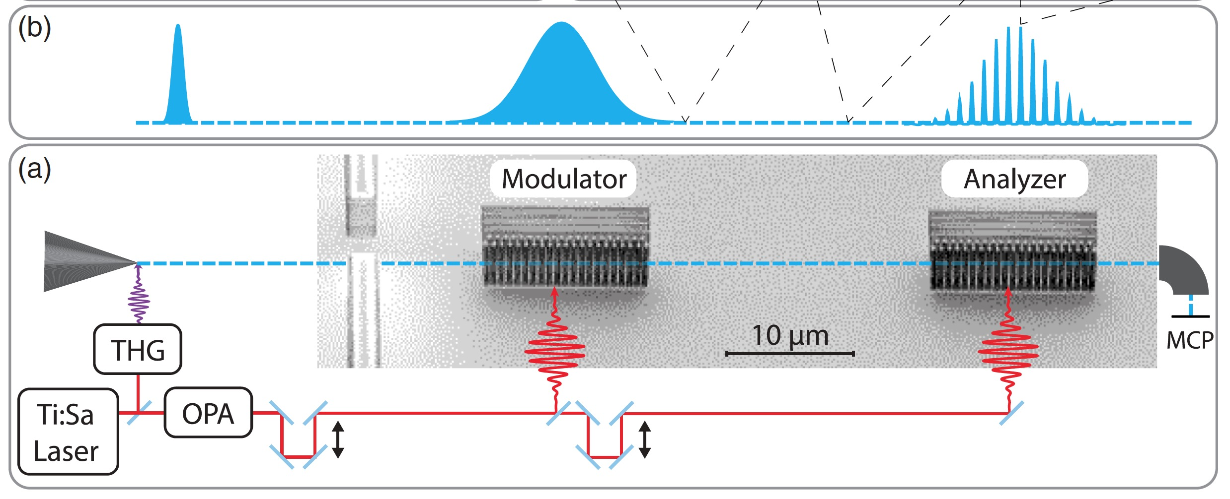
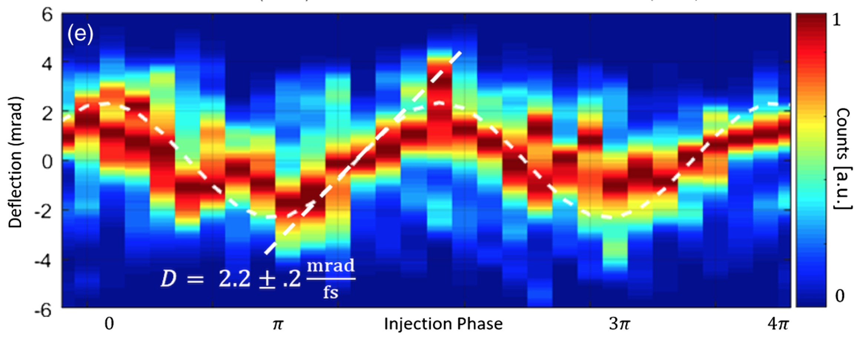
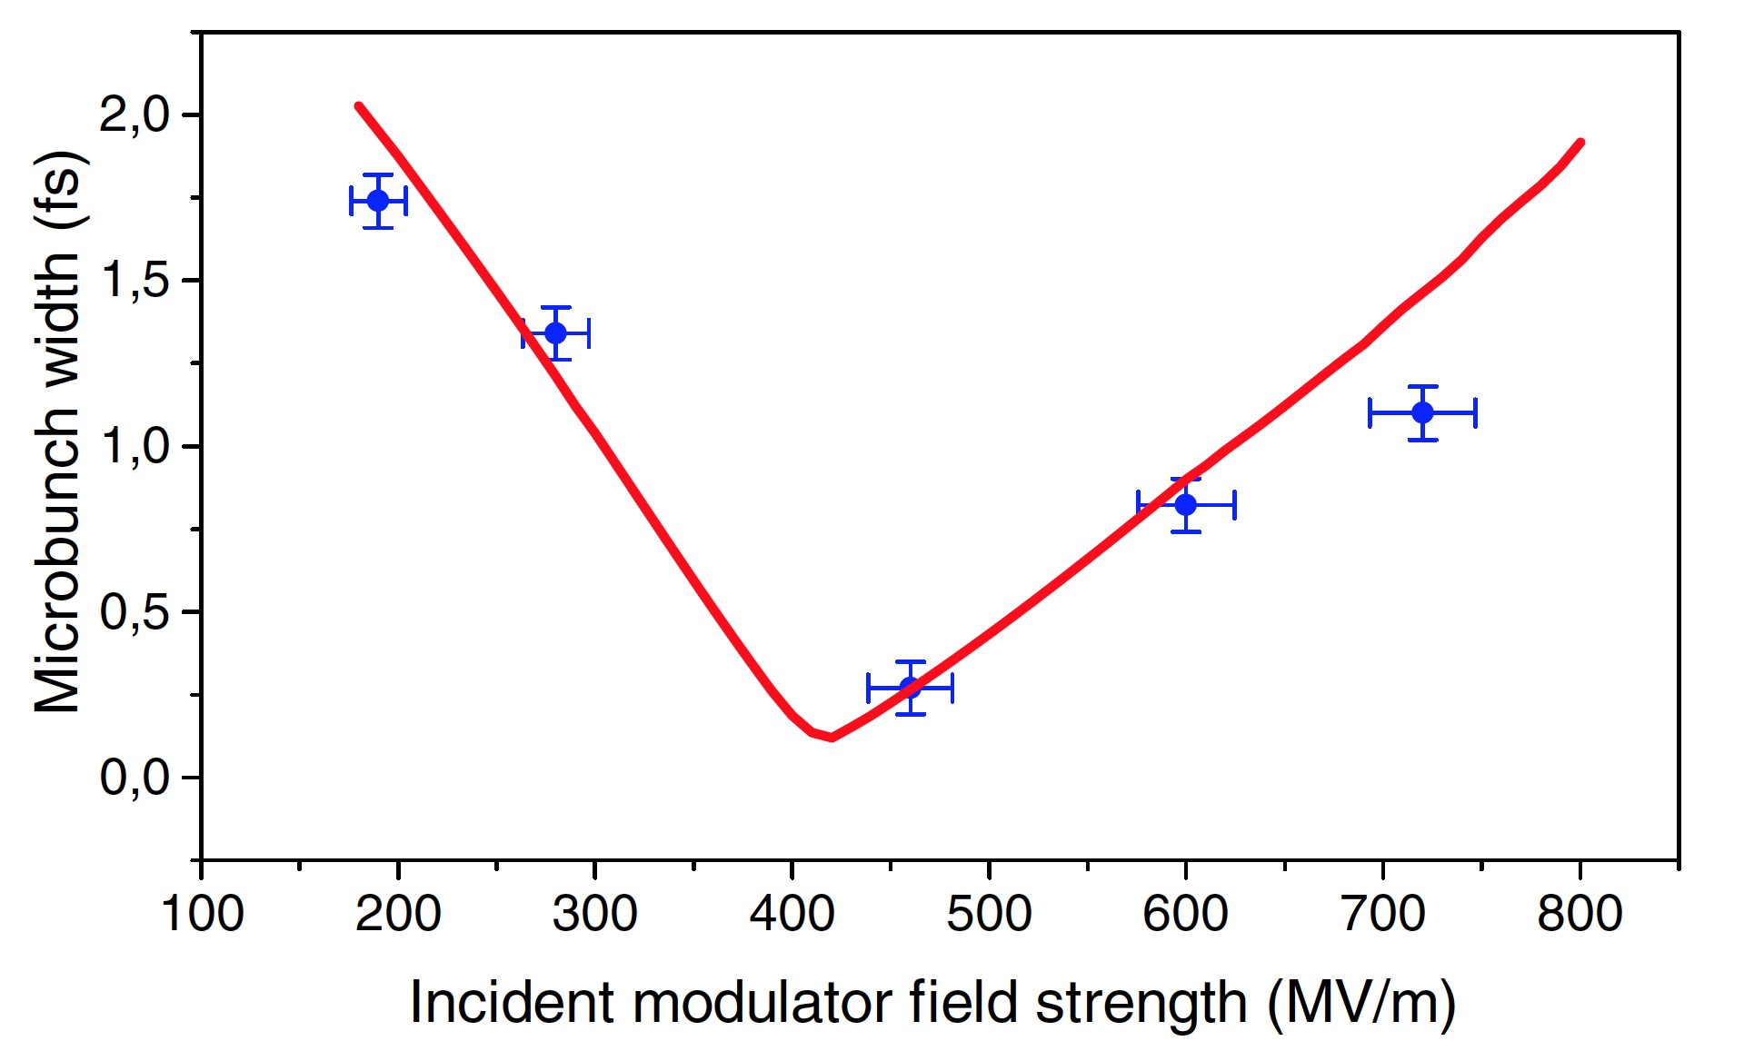
Optical structures naturally have sub-fs time scales and favor high repetition rate operation
DLA's attosecond bunch structure raises the possibility of making attosecond radiation pulses
D. Black, et al. PRL 123, 264802 (2019)
Shönenberger, et al., PRL 123, 264803 (2019)

Slide 18
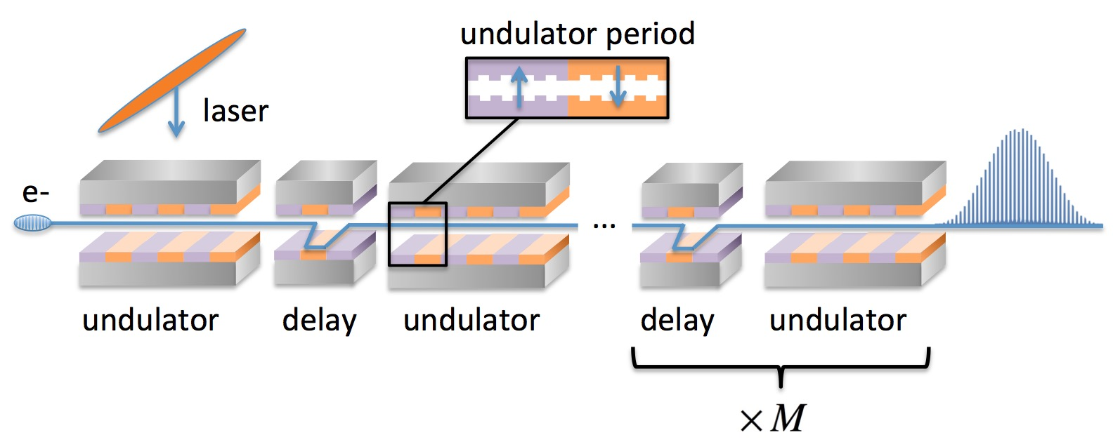
EUV Attosecond Frequency Comb
Modelocking scheme proposed could enable attosecond radiation pulses
(R. J. England, Z. Huang, FLS 2018)
Parameter | Unit | Value
Beam Energy | MeV | 40
Microbunch Charge | fC | 10
Undulator Period | µm | 250
Number of periods / Delay Modules | # | 10 / 100
EUV Photon Energy | eV | 50
Radiated Pulse Energy | nJ | 100

Slide 19
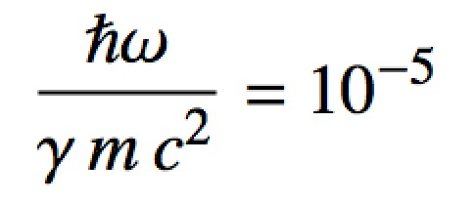
DLA X-ray FEL Strawman Parameter Table
Parameter | Units | Value
Ebeam Energy | GeV | 1.056
Microbunch Charge | fC | 0.5
Bunches per Train |  | 150
Rep Rate | MHz | 100
Normalized Emittance | nm | 0.87
Laser Wavelength | µm | 2
Laser Pulse Duration | ps | 1
Undulator Period | mm | 0.9
Equivalent Undulator B | T | 1.6
Undulator K |  | 0.14
Pierce Parameter |  | 2.29E-04
Undulator Length | m | 0.9
Photon Energy | keV | 11.5
Gain Length | m | 0.18
Photons per Bunch |  | 6.6E+04
Photon Flux | photons/sec | 9.9E+14
Brightness | SBU* | 1.05E+21
A DLA X-ray source would be in or near the Quantum FEL regime:
* 1 “SBU” = ph/s/mm²/mrad²/0.1%BW

Slide 20
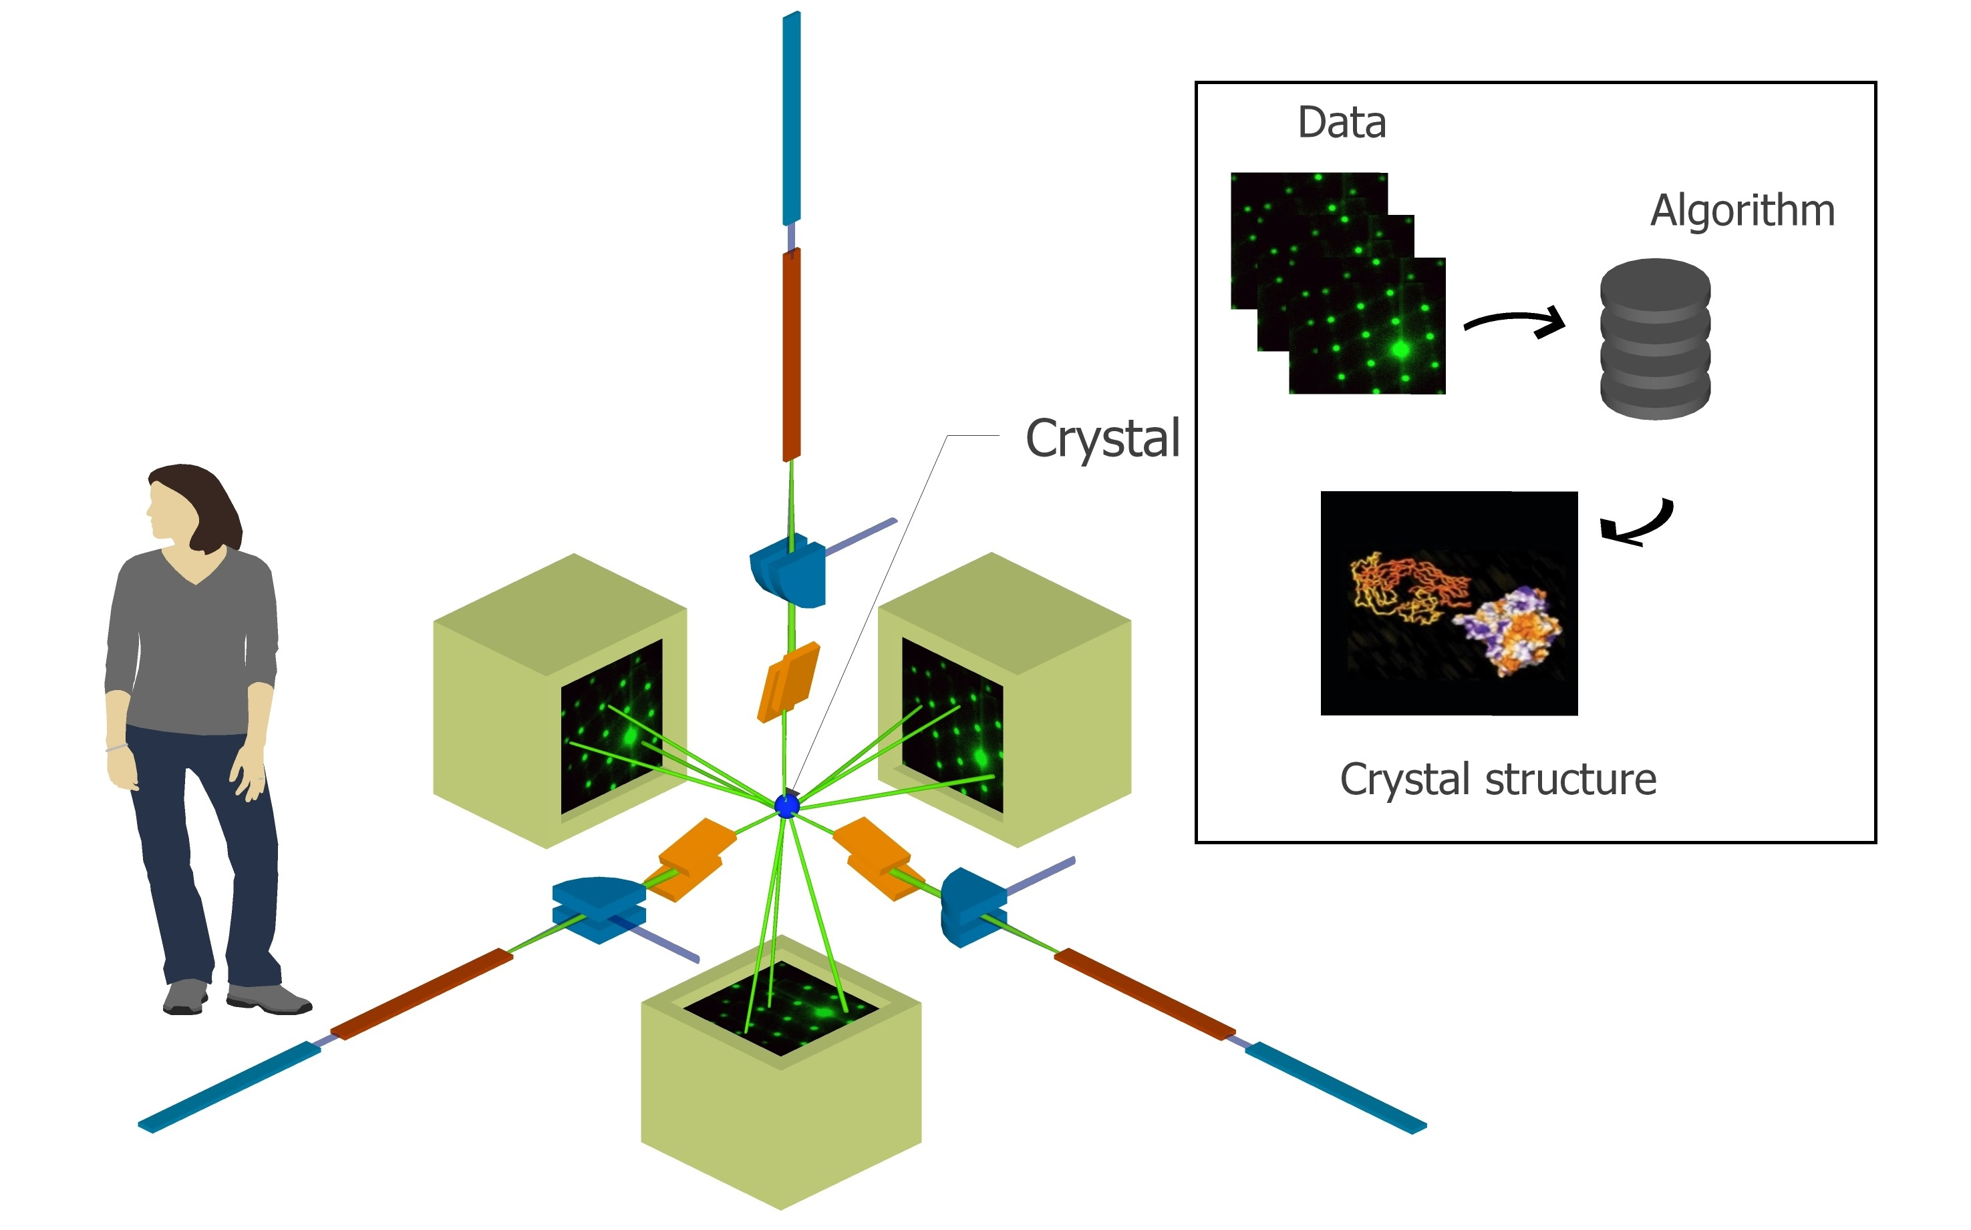
A miniaturized attosecond XFEL could enable revolutionary new science capabilities.
• Improved access for universities
• Ultrafast (attosec) pulses
molecular movies
atomic physics
• Inexpensive solid state devices
• Portable security scanners
Concept for multi-axis ultrafast tomography with DLA based XFELs (K. Wootton)

Slide 21
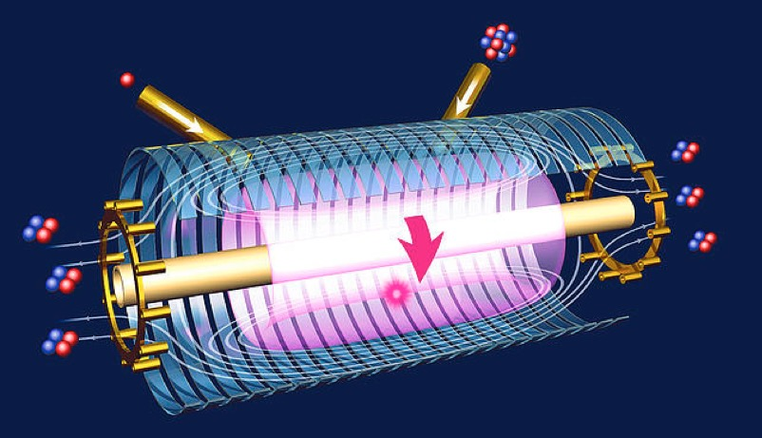
What about protons or ions?
Commercialization of Nuclear Fusion Summit (CNFS) – SLAC, 2017
Motivation
Desired Delivery Parameters (c/o: Dr. M. Thompson, Tri-Alpha)
Parameter | Value
Proton Energy | 15 keV to 1 MeV
Beam power | 1 MW
Beam Brightness | low / unimportant
Reduce size/cost for colliding beam fusion reactor (CBFR).
Possible uses for plasma diagnostic measurements of ion temperature, plasma density with lower beam powers.
Preliminary Estimated Source Requirements
Parameter | Value
Proton Energy | > 10 MeV desired
Size | Compact (< 1 meter)
Emittance | << 1 µm
Beam format | Pulsed, laser synced, high rep rate (MHz)
• In principle DLA can accelerate heavier charged particles.
• Existing tabletop p+ sources not suitable for a final device, but may be useful for demonstration tests; feasibility studies needed.
• Demonstration experiments would be interesting with suitable test facilities.

Slide 22
Applications Timeline
AB Recommendation #11: A clear picture/diagram should be developed showing the timeline for different DLA applications and the most important beam parameters
Application | Field | Time-Scale | Kinetic Energy | Species | Beam Power
Radiobiology | Science | 5 yrs | 100 keV to 5 MeV | e- | 5 mW
UED/UEM Source | Science | 5 yrs | 1-5 MeV | e- | 10 to 50 µW
Catheterized Electron Source | Medical | 5 yrs | 1 to 10 MeV | e- | 1-3 mW
Compton X-ray Source | Medical | 5-10 yrs | 10 to 60 MeV | e- | 20 to 60 mW
Low-power EUV | Industry | 5-10 yrs | 10 to 100 MeV | e- | 0.5 W
Proton/Hadron Therapy | Medical | 10-20 yrs | 70 to 250 MeV | p+ | 3-400 mW
Compact XFEL | Science | 10-20 yrs | 1 GeV | e- | 1.5 kW
Multi-Axis Tomography | Science | 10-20 yrs | 1 GeV | e- | 1.5 kW
Colliding Beam Fusion | Industry | 20+ yrs | 15 keV to 1 MeV | p+ | 1 MW
Linear Collider | HEP | 20+ yrs | 1 to 10 TeV | e-/e+ | 10 to 200 MW

Slide 23
3rd Workshop on Applications of Dielectric Laser Accelerators
Date: Tues March 10, 2020
Satellite meeting of the March ACHIP collaboration meeting.
Room reservations made at the Boulderado Hotel.
Proposed session topics: Biomedical, Attosecond science, UED/UEM, and Industrial EUV
Workshop charge: to develop performance requirements and R&D roadmap for a DLA based source in consultation with experts in relevant fields.
Due to reduced attendance on account of coronavirus, we will augment this workshop with a follow-up teleconference in the next few weeks. This will allow international colleagues to more easily contribute.

Slide 24
Proposed Charge Questions for Each Application
What characteristics of the DLA approach make it attractive for this application area?
Are there new capabilities that would be uniquely enabled (i.e. which could not be done with a conventional accelerator system)?
What are the minimum required accelerator performance parameters for useful application of the technology?
What are the primary R&D challenges and time scale to achieve needed performace?
Google doc created at the following link to facilitate group editing:
https://docs.google.com/document/d/1pq4UM53rHdNySY4I0W1OLuavIJPqctJIrq5sWg3ZVX4/edit?usp=sharing

Slide 25
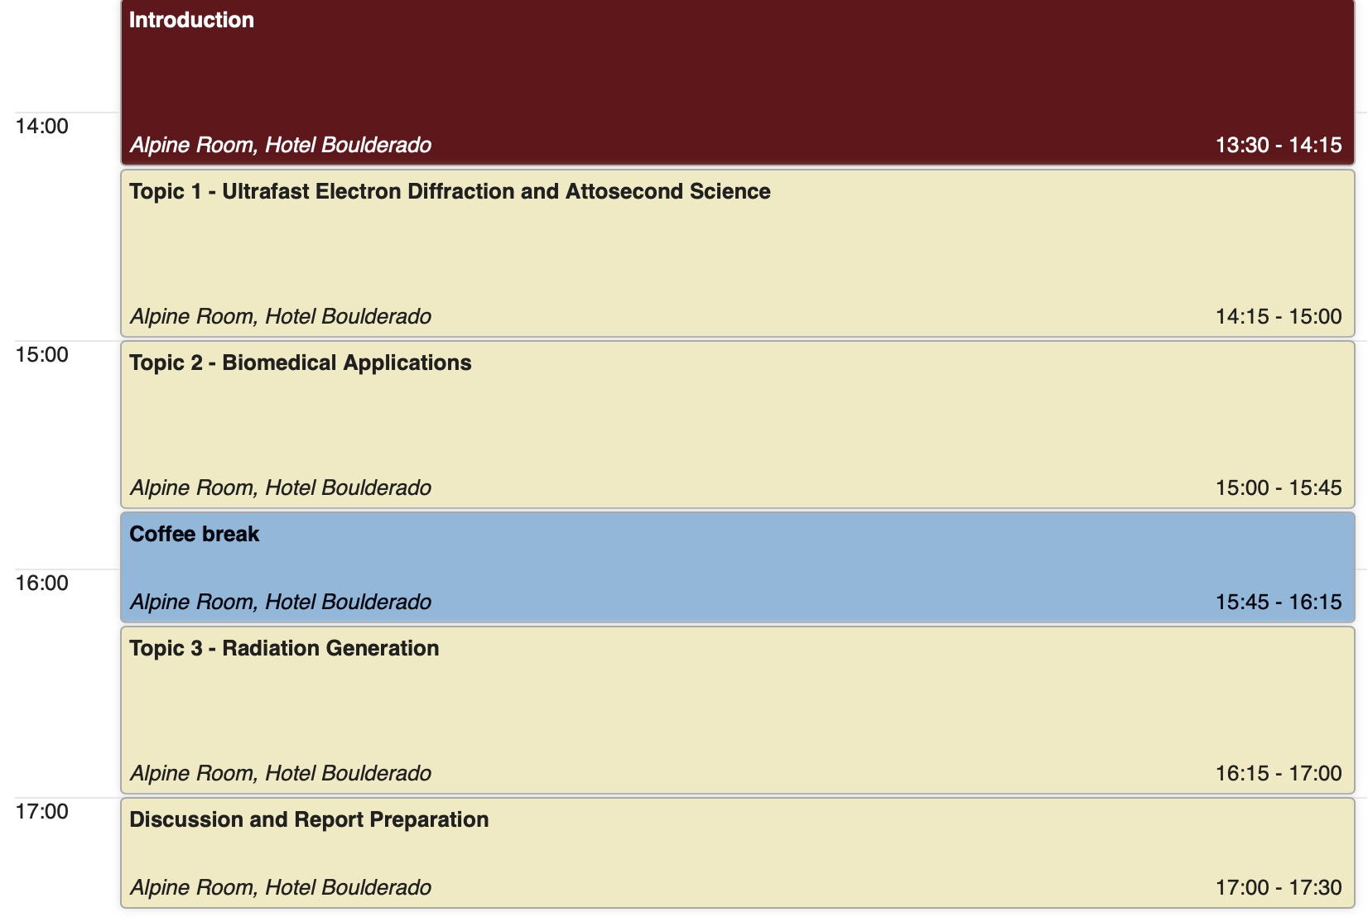
Schedule for Today

Slide 26
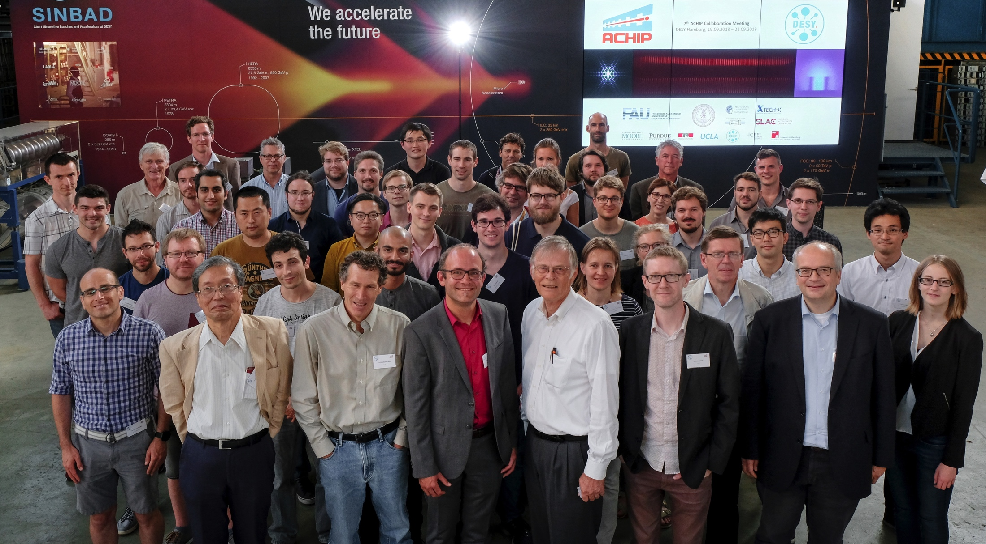
Thank you!
Group photo, ACHIP collaboration meeting at DESY, Hamburg, Germany, Sept 19-21, 2018.
contact: england@slac.stanford.edu
http://achip.stanford.edu
http://slac.stanford.edu/dla
Special thanks to K. Leedle, Z. Huang, Y-C. Huang, T. Hirano, U. Niedermayer for contributions of slides.

