Slide 1
The WIMP is DEAd!
Long Live the WIMP!
Dan Hooper – Fermilab and the University of Chicago
Particle and Astroparticle Physics Colloquium, DESY Hamburg
February 11, 2020

Slide 2
The Origin of the WIMP
Dan Hooper – The WIMP is Dead! Long Live the WIMP!
Historically, a huge fraction of the papers on particle dark matter have focused on WIMPs – they have dominated the dark matter landscape
This started with massive Standard Model neutrinos: Gershtein & Zeldovich, 1966 Cowsik & McClelland, 1972 Szalay & Marx, 1976 P. Hut, 1977 Lee & Weinberg, 1977 Sato & Kobayashi, 1977 Dicus, Kolb & Teplitz, 1977
And then expanded to other candidates, including supersymmetric particles: P. Hut, 1977, Pagels & Primack 1982, Weinberg & Goldberg 1983 Ellis, Hagelin, Nanopoulos, Olive & Srednicki, 1983
By the late 1980s, it was widely appreciated that these specific candidates were but a few examples of a broader class of “WIMPs”
For a history of dark matter, see Bertone and Hooper, arXiv:1605.04909
(Coined by Turner and Steigman in 1984, but meaning has since evolved)

Slide 3
The Case for the WIMP
Dan Hooper – The WIMP is Dead! Long Live the WIMP!
To simplify the discussion, lets make two well-motivated assumptions:
1) Standard expansion history in the early universe (radiation dominated)
2) The dark matter was in thermal equilibrium (at some point in time)
The abundance of dark matter that emerges from the Big Bang depends on the dark matter’s mass and couplings
A thermal relic with very small couplings will exceed the measured dark matter density, while one with very large couplings will constitute only a small fraction of the dark matter – to accommodate the measured abundance, something comparable to the weak force is required
Under these well-motivated assumptions, viable dark matter candidates must fall within a mass range of ~10 MeV to ~100 TeV
From this perspective, dark matter candidates with weak-scale masses and interactions – “WIMPs” – are particularly well motivated
This argument has also played a significant role in guiding our experimental program

Slide 4
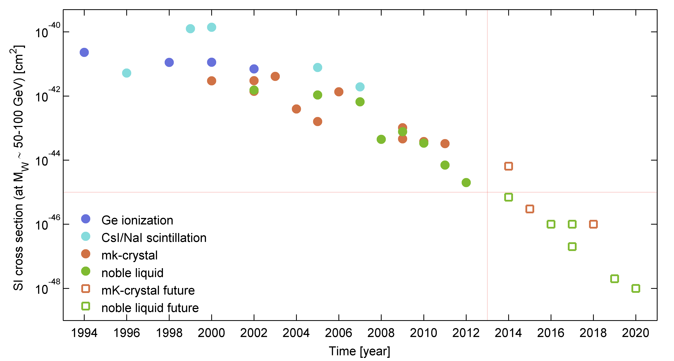
The Fall of the WIMP?
Dan Hooper – The WIMP is Dead! Long Live the WIMP!
The thermal relic abundance calculation provided us with a collection of well-motivated benchmarks and experimental targets
Many of our most attractive WIMP candidates were expected to fall within the reach of planned direct detection and accelerator experiments
Over the past two decades, direct detection experiments have performed better than we had any right to expect, improving in sensitivity at a rate faster than Moore’s Law – and yet no WIMPs have appeared
The LHC has performed beautifully, and yet no signs of dark matter (or any other BSM physics) have been discovered

Slide 5
So, is the WIMP Paradigm Dead?
Dan Hooper – The WIMP is Dead! Long Live the WIMP!

Slide 6
So, is the WIMP Paradigm Dead?
Dan Hooper – The WIMP is Dead! Long Live the WIMP!
No.
Despite the very stringent constraints that have been placed on the nature of dark matter, there remain many viable options for WIMP model building

Slide 7
An (Incomplete) List of Ways to Reconcile WIMP Dark Matter With All Current Constraints:
Dan Hooper – The WIMP is Dead! Long Live the WIMP!

Slide 8
An (Incomplete) List of Ways to Reconcile WIMP Dark Matter With All Current Constraints:
Dan Hooper – The WIMP is Dead! Long Live the WIMP!
Common Theme: Mechanisms that deplete the dark matter abundance in the early universe without leading to large elastic scattering rates with nuclei or large annihilation rates in the universe today
Unsuppressed Suppressed
X
SM
X
X
X
SM
N
N

Slide 9
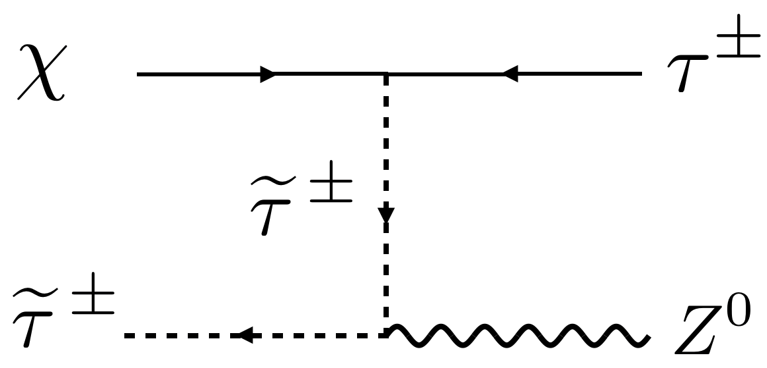
An (Incomplete) List of Ways to Reconcile WIMP Dark Matter With All Current Constraints:
Dan Hooper – The WIMP is Dead! Long Live the WIMP!
1) Co-annihilations between the dark matter and another state
Griest, Seckel (1991)

Slide 10
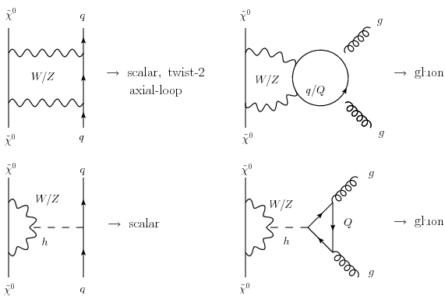
An (Incomplete) List of Ways to Reconcile WIMP Dark Matter With All Current Constraints:
Dan Hooper – The WIMP is Dead! Long Live the WIMP!
1) Co-annihilations between the dark matter and another state
2) Annihilations to W, Z and/or Higgs bosons; scattering with nuclei only through highly suppressed loop diagrams
Hisano, et al., arXiv:1007.2601, 1104.0228, 1504.00915; Hill, Solon, arXiv:1309.4092, 1409.8290; Berlin, DH, McDermott, arXiv:1508.05390

Slide 11
An (Incomplete) List of Ways to Reconcile WIMP Dark Matter With All Current Constraints:
Dan Hooper – The WIMP is Dead! Long Live the WIMP!
1) Co-annihilations between the dark matter and another state
2) Annihilations to W, Z and/or Higgs bosons; scattering with nuclei only through highly suppressed loop diagrams
3) Interactions which suppress elastic scattering with nuclei by powers of velocity or momentum

Slide 12
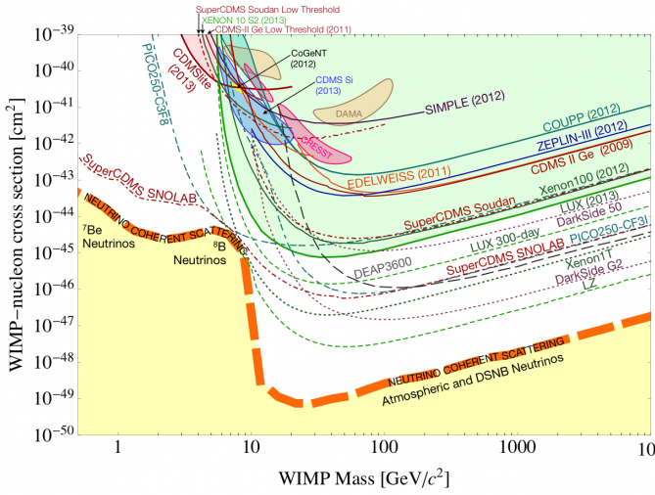
An (Incomplete) List of Ways to Reconcile WIMP Dark Matter With All Current Constraints:
Dan Hooper – The WIMP is Dead! Long Live the WIMP!
1) Co-annihilations between the dark matter and another state
2) Annihilations to W, Z and/or Higgs bosons; scattering with nuclei only through highly suppressed loop diagrams
3) Interactions which suppress elastic scattering with nuclei by powers of velocity or momentum
4) Dark matter that is lighter than a few GeV (evading direct constraints)

Slide 13
An (Incomplete) List of Ways to Reconcile WIMP Dark Matter With All Current Constraints:
Dan Hooper – The WIMP is Dead! Long Live the WIMP!
1) Co-annihilations between the dark matter and another state
2) Annihilations to W, Z and/or Higgs bosons; scattering with nuclei only through highly suppressed loop diagrams
3) Interactions which suppress elastic scattering with nuclei by powers of velocity or momentum
4) Dark matter that is lighter than a few GeV (evading direct constraints)
5) Departures from radiation domination in the early universe (early matter domination; late-time reheating, etc.) which result in the depletion of the dark matter’s relic abundance

Slide 14
An (Incomplete) List of Ways to Reconcile WIMP Dark Matter With All Current Constraints:
Dan Hooper – The WIMP is Dead! Long Live the WIMP!
1) Co-annihilations between the dark matter and another state
2) Annihilations to W, Z and/or Higgs bosons; scattering with nuclei only through highly suppressed loop diagrams
3) Interactions which suppress elastic scattering with nuclei by powers of velocity or momentum
4) Dark matter that is lighter than a few GeV (evading direct constraints)
5) Departures from radiation domination in the early universe (early matter domination; late-time reheating, etc.) which result in the depletion of the dark matter’s relic abundance
6) The dark matter annihilates into unstable non-Standard Model states (ie. hidden sector models)

Slide 15
An (Incomplete) List of Ways to Reconcile WIMP Dark Matter With All Current Constraints:
Dan Hooper – The WIMP is Dead! Long Live the WIMP!
1) Co-annihilations between the dark matter and another state
2) Annihilations to W, Z and/or Higgs bosons; scattering with nuclei only through highly suppressed loop diagrams
3) Interactions which suppress elastic scattering with nuclei by powers of velocity or momentum
4) Dark matter that is lighter than a few GeV (evading direct constraints)
5) Departures from radiation domination in the early universe (early matter domination; late-time reheating, etc.) which result in the depletion of the dark matter’s relic abundance
6) The dark matter annihilates into unstable non-Standard Model states (ie. hidden sector models)

Slide 16
Dark Matter Within a Hidden Sector
Dan Hooper – The WIMP is Dead! Long Live the WIMP!
Lets hypothesize that the dark matter is one of several particle species within a hidden sector, which is entirely uncharged under the Standard Model
Even without any direct couplings between these two sectors, small “portal” interactions could connect them
Standard
Model
Hidden
Sector
Portal

Slide 17
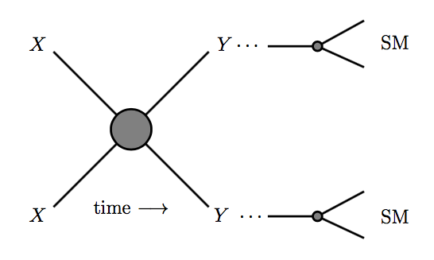
Dark Matter Within a Hidden Sector
Dan Hooper – The WIMP is Dead! Long Live the WIMP!
The dark matter, X, freezes-out of thermal equilibrium entirely within its own hidden sector (annihilating to produce lighter particles within the hidden sector, Y)
These lighter hidden sector particles then decay through portal interactions into Standard Model particles
Dark matter annihilates within the hidden sector…
…and then those hidden sector annihilation products decay through portal interactions

Slide 18
Dark Matter Within a Hidden Sector
Dan Hooper – The WIMP is Dead! Long Live the WIMP!
Hidden sector dark matter models offer a number of attractive features:
1) Relic abundance is easily accommodated; similar to ordinary WIMPs
2) Elastic scattering with nuclei is highly suppressed
3) Production at colliders is highly suppressed
4) Simple model building possibilities, including the three renormalizable “portal” interactions: the vector portal, Higgs portal, and lepton portal

Slide 19
Prospects Moving Forward?
Dan Hooper – The WIMP is Dead! Long Live the WIMP!
I’ve just described many ways in which the dark matter’s detection prospects can be almost arbitrarily suppressed
Does this mean that efforts to detect dark matter particles could be doomed from the start?

Slide 20
An (Incomplete) List of Ways to Reconcile WIMP Dark Matter With All Current Constraints:
Dan Hooper – The WIMP is Dead! Long Live the WIMP!
1) Co-annihilations between the dark matter and another state
2) Annihilations to W, Z and/or Higgs bosons; scattering with nuclei only through highly suppressed loop diagrams
3) Interaction which suppress elastic scattering with nuclei by powers of velocity or momentum
4) Dark matter that is lighter than a few GeV (evading direct constraints)
5) Departures from radiation domination in the early universe (early matter domination; late-time reheating, etc.) which result in the depletion of the dark matter’s relic abundance
6) The dark matter annihilates to unstable non-Standard Model states (ie. hidden sector models)

Slide 21
An (Incomplete) List of Ways to Reconcile WIMP Dark Matter With All Current Constraints:
Dan Hooper – The WIMP is Dead! Long Live the WIMP!
1) Co-annihilations between the dark matter and another state
2) Annihilations to W, Z and/or Higgs bosons; scattering with nuclei only through highly suppressed loop diagrams
3) Interaction which suppress elastic scattering with nuclei by powers of velocity or momentum
4) Dark matter that is lighter than a few GeV (evading direct constraints)
5) Departures from radiation domination in the early universe (early matter domination; late-time reheating, etc.) which result in the depletion of the dark matter’s relic abundance
6) The dark matter annihilates to unstable non-Standard Model states (ie. hidden sector models)
Although potentially invisible to both underground detectors and colliders, many of these scenarios are testable with indirect searches
In this sense, the lack of such signals has strengthened the motivation for gamma-ray and cosmic-ray searches for dark matter

Slide 22

The Motivation for Indirect Searches
Dan Hooper – The WIMP is Dead! Long Live the WIMP!
To account for the observed dark matter abundance, a thermal relic must have an annihilation cross section (at freeze-out) of σv~2x10⁻²⁶ cm³/s
Although many model-dependent factors can cause the dark matter to possess a somewhat lower or higher annihilation cross section today, most models predict current annihilation rates that are within an order of magnitude or so of this estimate
Indirect detection experiments that are sensitive to dark matter annihilating at approximately this rate will be able to test a significant fraction of WIMP models
Fermi
AMS-02

Slide 23
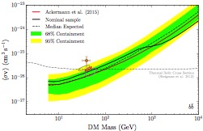
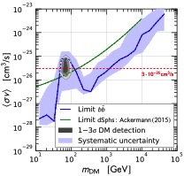
Recent Constraints from Indirect Detection
Dan Hooper – The WIMP is Dead! Long Live the WIMP!
A variety of gamma-ray strategies (GC, dwarfs, IGRB, etc.) as well as cosmic-ray antiproton and positron measurements from AMS, are sensitive to dark matter with the annihilation cross section predicted for a simple thermal relic, for masses up to ~100 GeV
This program is not a fishing expedition, but is testing a wide range of well-motivated dark matter models – we are testing the WIMP paradigm!
Bergstrom, et al, arXiv:1306.3983
Fermi Collaboration,
arXiv:1611.03184
Cuoco, et al., arXiv:1610.03071
Cui, et al. arXiv:1610.03840

Slide 24
The Galactic Center Gamma-Ray Excess
Dan Hooper – The WIMP is Dead! Long Live the WIMP!
A bright and highly statistically significant excess of gamma-rays has been observed from the region surrounding the Galactic Center
This signal is difficult to explain with astrophysical sources or mechanisms, but is very much like the signal predicted from annihilating dark matter
Among other references, see:
DH, Goodenough (2009, 2010)
DH, Linden (2011)
Abazajian, Kaplinghat (2012)
Gordon, Macias (2013)
Daylan, et al. (2014)
Calore, Cholis, Weniger (2014)
Murgia, et al. (2015)
Ackermann et al. (2017)

Slide 25
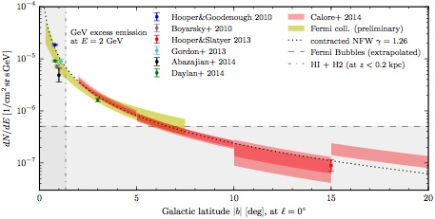
Dan Hooper – The WIMP is Dead! Long Live the WIMP!
Morphology
The GeV excess exhibits approximate spherical symmetry about the Galactic Center (axis ratios within ~20% of unity), with a flux that falls as ~r ^{-2.4} out to at least ~10°
If interpreted as annihilating dark matter, this implies ρ_{DM} ~ r ^{-1.2} out to at least ~1.5 kpc, similar to and only slightly steeper than the canonical NFW profile
Unlike stellar populations, we expect dark matter annihilation products to exhibit approximate spherical symmetry (see, for example, Bernal, Necib and Slatyer, arXiv:1606.00433)
Calore, Cholis, Weniger (2014) Daylan, et al. (2014)

Slide 26
Dan Hooper – The WIMP is Dead! Long Live the WIMP!
Spectrum
The spectrum of the excess is well fit by a ~20-65 GeV particle annihilating to quarks or gluons (and also by a wide range of of hidden sector dark matter models)
The shape of the spectrum appears to be uniform across the Inner Galaxy
Calore, Cholis, Weniger; Calore, Cholis, McCabe, Weinger (2014);
Escudero, Witte, DH, arXiv:1709.07002

Slide 27
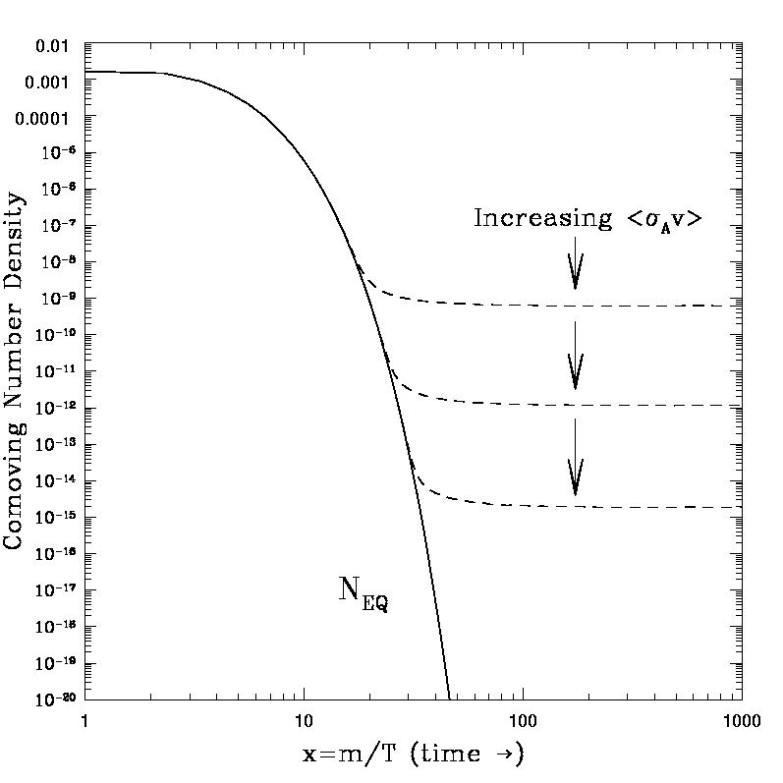
Dan Hooper – The WIMP is Dead! Long Live the WIMP!
Intensity
To normalize the observed excess, the dark matter particles must annihilate with a cross section of σv ~ 10⁻²⁶ cm³/s
This is approximately equal to the value of the cross section that is required to generate the measured dark matter abundance through thermal freeze-out in the early universe

Slide 28
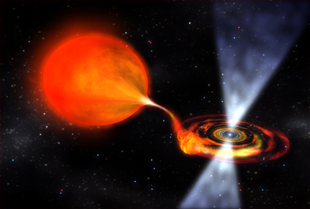
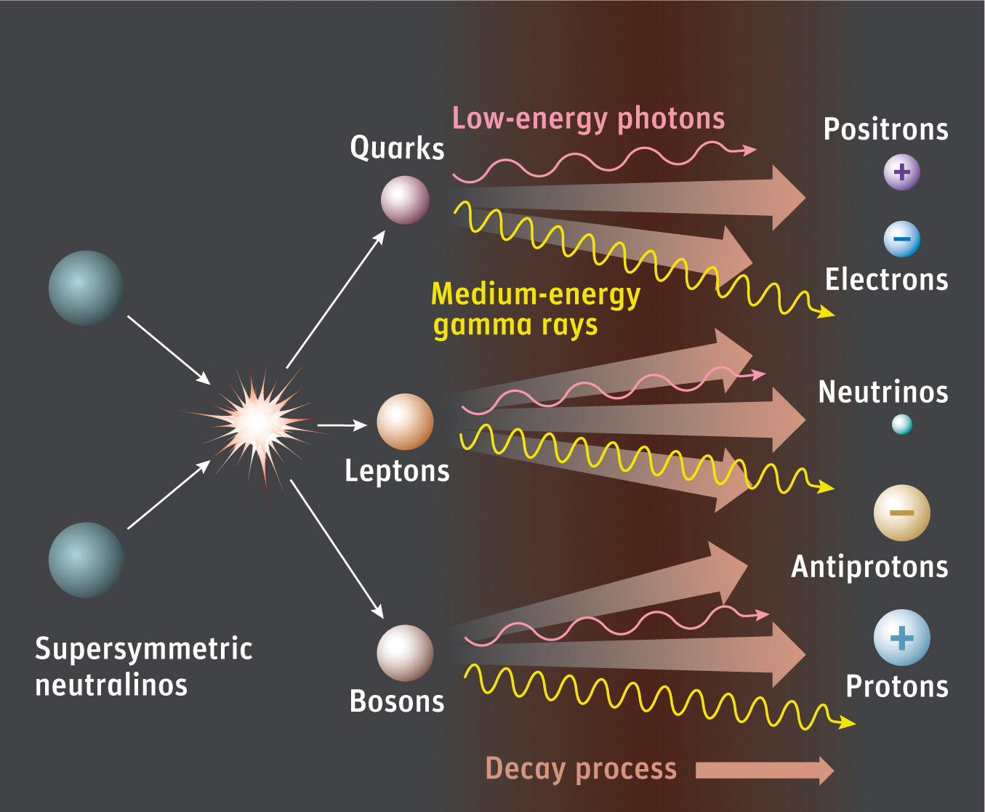
What Produces the Excess?
Dan Hooper – The WIMP is Dead! Long Live the WIMP!
A large population of centrally located millisecond pulsars?
Annihilating dark matter?

Slide 29
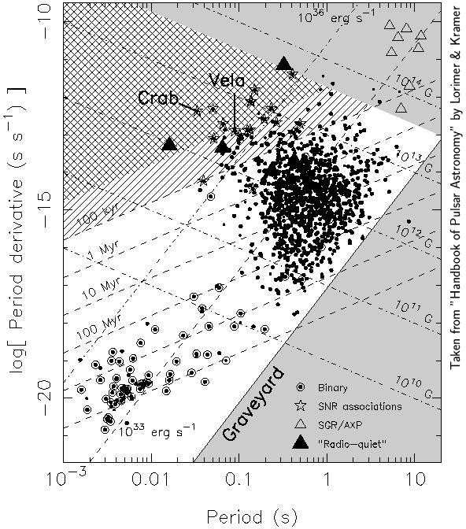
Millisecond Pulsars
Dan Hooper – The WIMP is Dead! Long Live the WIMP!
Pulsars are rapidly spinning neutron stars, which gradually convert their rotational kinetic energy into radio and gamma-ray emission
Typical pulsars exhibit periods on the order of ~1 second and slow down and become faint over ~10⁶ -10⁸ years
Accretion from a companion star can “spin-up” a dead pulsar to periods as fast as ~1.5 ms
Such millisecond pulsars have low magnetic fields (~10⁸-10⁹ G) and thus spin down much more gradually, remaining bright for >10⁹ years
It seems plausible that large numbers of MSPs could exist near the Galactic Center

Slide 30
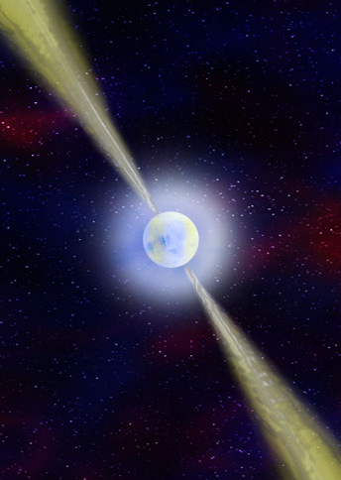
Millisecond Pulsars and The Galactic Center Gamma-Ray Excess
Dan Hooper – The WIMP is Dead! Long Live the WIMP!
Arguments in Favor of Pulsars:
Pulsars are known to exist
The gamma-ray spectrum of observed pulsars
Small-scale power in the gamma-ray emission from the Inner Galaxy
Small-scale power
Arguments Against Pulsars:
The lack of pulsars detected in the Inner Galaxy
The measured luminosity function of gamma-ray pulsars
The lack of low-mass X-ray binaries in the Inner Galaxy
in the gamma-ray emission from the Inner Galaxy

Slide 31
Millisecond Pulsars and The Galactic Center Gamma-Ray Excess
Dan Hooper – The WIMP is Dead! Long Live the WIMP!
Arguments in Favor of Pulsars:
The gamma-ray spectrum of observed pulsars
Pulsars are known to exist
Small-scale power in the gamma-ray emission from the Inner Galaxy
Small-scale power
Arguments Against Pulsars:
The lack of pulsars detected in the Inner Galaxy
The measured luminosity function of gamma-ray pulsars
The lack of low-mass X-ray binaries in the Inner Galaxy
in the gamma-ray emission from the Inner Galaxy

Slide 32
Millisecond Pulsars and The Galactic Center Gamma-Ray Excess
Dan Hooper – The WIMP is Dead! Long Live the WIMP!
Arguments in Favor of Pulsars:
The gamma-ray spectrum of observed pulsars
Pulsars are known to exist
Small-scale power in the gamma-ray emission from the Inner Galaxy
Small-scale power
Arguments Against Pulsars:
The lack of pulsars detected in the Inner Galaxy
The measured luminosity function of gamma-ray pulsars
The lack of low-mass X-ray binaries in the Inner Galaxy
in the gamma-ray emission from the Inner Galaxy

Slide 33
Millisecond Pulsars and The Galactic Center Gamma-Ray Excess
Dan Hooper – The WIMP is Dead! Long Live the WIMP!
Arguments in Favor of Pulsars:
The gamma-ray spectrum of observed pulsars
Pulsars are known to exist
Small-scale power in the gamma-ray emission from the Inner Galaxy
Small-scale power
Arguments Against Pulsars:
The lack of pulsars detected in the Inner Galaxy
The measured luminosity function of gamma-ray pulsars
The lack of low-mass X-ray binaries in the Inner Galaxy
in the gamma-ray emission from the Inner Galaxy

Slide 34
Gamma-Ray Bright MSPs in The Inner Galaxy?
Dan Hooper – The WIMP is Dead! Long Live the WIMP!
To be clear, known (ie. resolved) gamma-ray point sources do not appreciably contribute to the Galactic Center Excess; masking the pulsar candidate sources contained in various catalogs does not impact the characteristics of the excess
Bartels, DH, Linden, Mishra-Sharma, Rodd, Safdi, Slatyer, arXiv:1710.10266

Slide 35
Millisecond Pulsars and The Galactic Center Gamma-Ray Excess
Dan Hooper – The WIMP is Dead! Long Live the WIMP!
Arguments in Favor of Pulsars:
The gamma-ray spectrum of observed pulsars
Pulsars are known to exist
Small-scale power in the gamma-ray emission from the Inner Galaxy
Small-scale power
Arguments Against Pulsars:
The lack of pulsars detected in the Inner Galaxy
The measured luminosity function of gamma-ray pulsars
The lack of low-mass X-ray binaries in the Inner Galaxy
in the gamma-ray emission from the Inner Galaxy

Slide 36
Small Scale Power Among Inner Galaxy 𝛄-Rays
Dan Hooper – The WIMP is Dead! Long Live the WIMP!
In 2015, two groups found that the ~GeV photons from the direction of the Inner Galaxy are more clustered than predicted from smooth backgrounds, suggesting that the GeV excess might be generated by a population of unresolved point sources
Lee et al. used a non-Poissonian template technique to show that the photon distribution within ~10° of the Galactic Center (masking within 2° of the Galactic Plane) is clumpy, potentially indicative of an unresolved point source population
Bartels et al. reach a qualitatively similar conclusion employing a wavelet technique
Small-scale power in the gamma-ray emission from the Inner Galaxy
Lee, Lisanti, Safdi, Slatyer, Xue, arXiv:1506.05124
Bartels, Krishnamurthy, Weniger, arXiv:1506.05104

Slide 37
Dan Hooper – The WIMP is Dead! Long Live the WIMP!
Small Scale Power Among Inner Galaxy 𝛄-Rays
A typical Fermi Inner Galaxy analysis might include the following spatial templates: 1) Galactic diffuse emission 2) Fermi Bubbles 3) Isotropic background 4) Known point sources 5) Dark matter annihilation products (generalized NFW²)
Lee et al. then add a number of non-Poissonian templates to model the distribution of unresolved point sources: 5) Isotropically distributed point sources 6) Disk-correlated point sources 7) NFW² correlated point sources
Lee, Lisanti, Safdi, Slatyer, Xue, arXiv:1506.05124

Slide 38
Dan Hooper – The WIMP is Dead! Long Live the WIMP!
Small Scale Power Among Inner Galaxy 𝛄-Rays
Excess-Like Population
Disk-Like Population
(1.9-11.9 GeV)
Lee, Lisanti, Safdi, Slatyer, Xue, arXiv:1506.05124

Slide 39
Dan Hooper – The WIMP is Dead! Long Live the WIMP!
Small Scale Power Among Inner Galaxy 𝛄-Rays
Excess-Like Population
Disk-Like Population
Approximate
Fermi
Detection Threshold
(1.9-11.9 GeV)
Bottom Line: A population of ~10³ points sources with luminosities near Fermi’s detection threshold could potentially account for the GeV Excess

Slide 40
Evidence For Unresolved Point Sources?
Dan Hooper – The WIMP is Dead! Long Live the WIMP!
It is difficult to tell whether these clustered gamma-rays result from unresolved sources, or from backgrounds that are less smooth than are being modeled

Slide 41
Evidence For Unresolved Point Sources?
Dan Hooper – The WIMP is Dead! Long Live the WIMP!
It is difficult to tell whether these clustered gamma-rays result from unresolved sources, or from backgrounds that are less smooth than are being modeled
Observed
Smooth and well-modeled background
Flux
Point source dominated excess signal
Direction

Slide 42
Evidence For Unresolved Point Sources?
Dan Hooper – The WIMP is Dead! Long Live the WIMP!
It is difficult to tell whether these clustered gamma-rays result from unresolved sources, or from backgrounds that are less smooth than are being modeled
Observed
Observed
Smooth and well-modeled background
Poorly-modeled background, including points sources or other small scale structure (gas)
Flux
Flux
Point source dominated excess signal
Smooth (dark matter) dominated excess signal
Direction
Direction

Slide 43
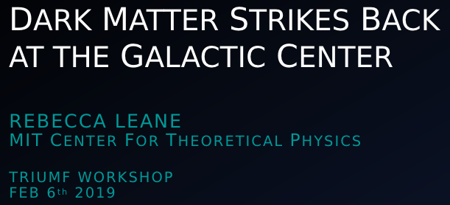
Dan Hooper – The WIMP is Dead! Long Live the WIMP!
See Leane and Slatyer, arXiv:1904.08430

Slide 44
Dan Hooper – The WIMP is Dead! Long Live the WIMP!
See Leane and Slatyer, arXiv:1904.08430
Evidence for NFW² Distributed Point Sources
Evidence against any significant amount of dark matter annihilation
To what extent could inadequate templates be biasing these results?

Slide 45
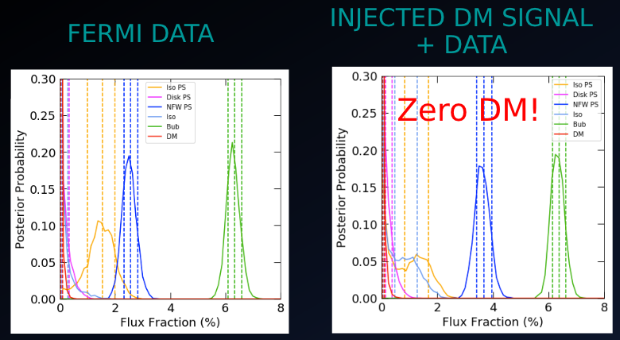
Dan Hooper – The WIMP is Dead! Long Live the WIMP!
See Leane and Slatyer, arXiv:1904.08430
Here is the result that Leane and Slatyer get using the same procedure as Lee et al.
To test the reliability of this result, they then add to the Fermi data a (smooth) dark matter-like signal

Slide 46
Dan Hooper – The WIMP is Dead! Long Live the WIMP!
See Leane and Slatyer, arXiv:1904.08430

Slide 47
Dan Hooper – The WIMP is Dead! Long Live the WIMP!
See Leane and Slatyer, arXiv:1904.08430
Despite having just added a dark matter-like signal to the data, the fit does not ascribe any of it to the dark matter template

Slide 48
Dan Hooper – The WIMP is Dead! Long Live the WIMP!
See Leane and Slatyer, arXiv:1904.08430
Despite having just added a dark matter-like signal to the data, the fit does not ascribe any of it to the dark matter template
Instead, the fit identifies the injected dark matter-like signal as originating from point sources

Slide 49
Dan Hooper – The WIMP is Dead! Long Live the WIMP!
See Leane and Slatyer, arXiv:1904.08430
What happens if an even larger dark matter-like signal is added to the data?

Slide 50
Dan Hooper – The WIMP is Dead! Long Live the WIMP!
See Leane and Slatyer, arXiv:1904.08430
Even very bright dark matter-like signals are misattributed to the point source templates! (up to an order of magnitude larger than the intensity of the excess)

Slide 51
Dan Hooper – The WIMP is Dead! Long Live the WIMP!
See Leane and Slatyer, arXiv:1904.08430
Bottom Line:
The non-Poissonian template fit misattributes the dark matter-like signal to point sources, clearly demonstrating that the templates being used are not adequate to describe the data, strongly biasing the results of the fit
This method does not provide evidence for point sources over a dark matter interpretation of the excess

Slide 52
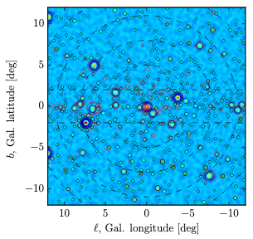
Wavelet Analyses and GC Point Sources
Dan Hooper – The WIMP is Dead! Long Live the WIMP!
In 2015, Bartels et al. used a wavelet-based technique to identify what they called “strong support” for a millisecond pulsar interpretation of the gamma-ray excess
Bartels, Krishnamurthy, Weniger, arXiv:1506.05104

Slide 53
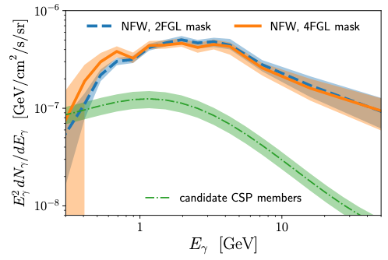
Wavelet Analyses and GC Point Sources
Dan Hooper – The WIMP is Dead! Long Live the WIMP!
In 2015, Bartels et al. used a wavelet-based technique to identify what they called “strong support” for a millisecond pulsar interpretation of the gamma-ray excess
Recently, Zhong, McDermott, Cholis and Fox revisited this method, utilizing an updated gamma-ray source catalog (4FGL vs 3FGL)
When using the 3FGL, Zhong et al. are able to reproduce the results of Bartels et al.
After accounting for the sources in the 4FGL, however, Zhong et al. find no evidence that the excess is produced by pulsars or other point sources
Bartels, Krishnamurthy, Weniger, arXiv:1506.05104
Zhong, McDermott, Cholis, Fox, arXiv:1911.12369

Slide 54
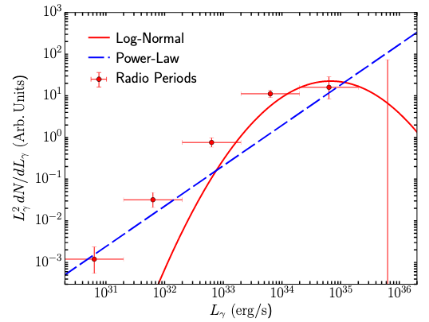
Strong Tension with Pulsar Interpretations
Dan Hooper – The WIMP is Dead! Long Live the WIMP!
Furthermore, the wavelet technique can be used to place stringent constraints on the luminosity function of any point source population that could potentially be responsible for the Galactic Center excess
Observed populations of millisecond pulsars (in the disk and in globular clusters) have luminosity functions that peak in the range of L²dN/dL ~ 10³⁴-10³⁵ erg/s
If modeled as a power-law, dN/dL ~L^{-𝛂}, such observations favor 𝛂~1.2-1.5 (for L_{max}~10³⁵ erg/s)
𝛂~1.2-1.5
Observed Pulsar
Populations
Zhong, McDermott, Cholis, Fox, arXiv:1911.12369

Slide 55
Strong Tension with Pulsar Interpretations
Dan Hooper – The WIMP is Dead! Long Live the WIMP!
Furthermore, the wavelet technique can be used to place stringent constraints on the luminosity function of any point source population that could potentially be responsible for the Galactic Center excess
Observed populations of millisecond pulsars (in the disk and in globular clusters) have luminosity functions that peak in the range of L²dN/dL ~ 10³⁴-10³⁵ erg/s
If modeled as a power-law, dN/dL ~L^{-𝛂}, such observations favor 𝛂~1.2-1.5 (for L_{max}~10³⁵ erg/s)
In contrast, the results of Zhong et al. constrain 𝛂 > 1.9, in strong contrast to observed pulsar populations
Put another way, to explain the GC excess without dark matter would require ~3x10⁶ pulsars with L>10²⁹ erg/s
No proposed pulsar population models predict anything close to so many pulsars in the Inner Galaxy
Wavelet Constraint
𝛂~1.8-2.0
𝛂~1.2-1.5
Observed Pulsar
Populations
Zhong, McDermott, Cholis, Fox, arXiv:1911.12369

Slide 56
If the Galactic Center Excess is the result of annihilating dark matter, where else would we expect to see evidence of this process?
Dan Hooper – The WIMP is Dead! Long Live the WIMP!

Slide 57
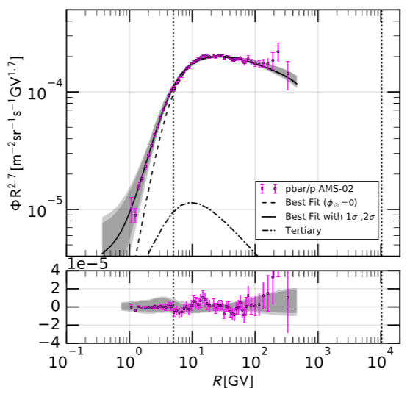
The Cosmic-Ray Antiproton Excess
Dan Hooper – The WIMP is Dead! Long Live the WIMP!
An excess of cosmic-ray antiprotons was pointed out in 2016 by two independent groups (Cuoco, Krämer, Korsmeier and Cui, Yuan, Tsai, Fan)
Both papers identified a small, but statistically significant excess (~4.5𝛔)
These papers made it clear that out-of-the-box GALPROP models could not explain the antiproton spectrum measured by AMS
Well fit by a ~40-70 GeV WIMP with a ~10⁻²⁶ cm³/s cross section
Cuoco et al., arXiv:1610.03071
Cui et al., arXiv:1610.03840

Slide 58
It’s All About the Systematics
Dan Hooper – The WIMP is Dead! Long Live the WIMP!
The 2016 papers on the AMS antiproton excess received relatively little attention (roughly ~100 citations each), somewhat surprising for such a highly statistically significant and important result
The skepticism of the community was the result of (perhaps reasonable) concerns pertaining to the difficult to quantify systematic uncertainties associated with:
1) Cosmic-ray injection and transport in the ISM
2) The antiproton production cross section
3) The impact of the solar wind (solar modulation)
Previous work had explored a wide range of injection/transport models, finding that such variations seem to be unable to account for the observed excess (Cuoco et al.,1610.03071, Cui et al., 1610.03840)

Slide 59
The Cosmic-Ray Antiproton Excess
Dan Hooper – The WIMP is Dead! Long Live the WIMP!
Even after allowing for large systematic uncertainties associated with the antiproton production cross section and solar modulation, we find that the excess persists
The fit consistently prefers a contribution from annihilating dark matter, at a level never less than 3.3𝝈
Cholis, DH and Linden, arXiv:1903.02549;
see also, Cuoco et al. arXiv:1903.01472

Slide 60
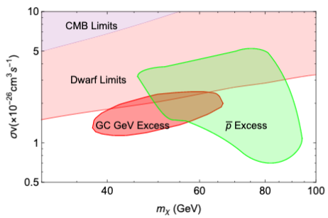
Implications For Dark Matter
Dan Hooper – The WIMP is Dead! Long Live the WIMP!
Marginalizing over all of the free parameters in our fit, we find that the antiproton excess could potentially be generated by ~45-95 GeV dark matter particles with a cross section of 𝛔v ~(0.7-5)x10⁻²⁶ cm³/s (for annihilations to bb)
For m_{X}~ 50-70 GeV and 𝛔v ~(1.4-2.4)x10⁻²⁶ cm³/s, we can simultaneously account for the gamma-ray and antiproton excesses
→
XX bb

Slide 61
What’s Next?
Dan Hooper – The WIMP is Dead! Long Live the WIMP!

Slide 62
Fermi Observations of Dwarf Galaxies
Dan Hooper – The WIMP is Dead! Long Live the WIMP!
Current Fermi dwarf constraints are based on stacks of dwarf galaxy candidates, aided by recent discoveries by DES and other surveys
At this time, these constraints are compatible with dark matter interpretations of the Galactic Center excess
That being said, if the Galactic Center signal is produced by annihilating dark matter, we should expect gamma rays to be detected from dwarfs soon
Region favored by the 𝛾, anti-p excesses
Fermi Collaboration, arXiv:1611.03184 (see also 1503.02641)

Slide 63
The plot I see in my dreams…
Dan Hooper – The WIMP is Dead! Long Live the WIMP!
Pre-Preliminary
(made up!)
Recticulum II
Tucana III
Willman 1
Measured Gamma-Ray Flux
Coma Berenices
Segue I
Ursa Major II
J-factor
(proportional to the predicted annihilation signal)

Slide 64
Summary
Dan Hooper – The WIMP is Dead! Long Live the WIMP!
Direct detection experiments have improved in sensitivity at an exponential rate over the past 15 years, and have ruled out many well-motivated dark matter models; many others will be explored over the next decade
The LHC is our most comprehensive tool to explore the TeV-scale; many different analyses and search strategies are of relevance to dark matter
Indirect searches using gamma rays and cosmic rays are currently testing the range of annihilation cross sections that are predicted for a thermal relic, for masses up to ~100 GeV
These experiments are collectively testing the WIMP paradigm

Slide 65
Summary
Dan Hooper – The WIMP is Dead! Long Live the WIMP!
Direct detection experiments have improved in sensitivity at an exponential rate over the past 15 years, and have ruled out many well-motivated dark matter models; many others will be explored over the next decade
The LHC is our most comprehensive tool to explore the TeV-scale; many different analyses and search strategies are of relevance to dark matter
Indirect searches using gamma rays and cosmic rays are currently testing the range of annihilation cross sections that are predicted for a thermal relic, for masses up to ~100 GeV
These experiments are collectively testing the WIMP paradigm
Although the WIMP is far from dead, the lack of a clear discovery has redirected the field and has lead to an explosion in beyond-WIMP model building
The Galactic Center’s GeV excess remains compelling: highly statistically significant, robust, extended, spherical, and cannot be explained with known or proposed astrophysics; future gamma-ray observations of dwarf galaxies and measurements of antimatter in the cosmic ray spectrum will provide critical tests to establish the origin of this signal

Slide 66


