Slide 1
Beam Optics and Emittance
Bolko Beutner
21.01.2020
Notes:
How to edit the title slide
Upper area: Title of your talk, max. 2 rows of the defined size (55 pt)
Lower area (subtitle): Conference/meeting/workshop, location, date,
your name and affiliation, max. 4 rows of the defined size (32 pt)
Change the partner logos or add others in the last row.

Slide 2
Introduction

Slide 3
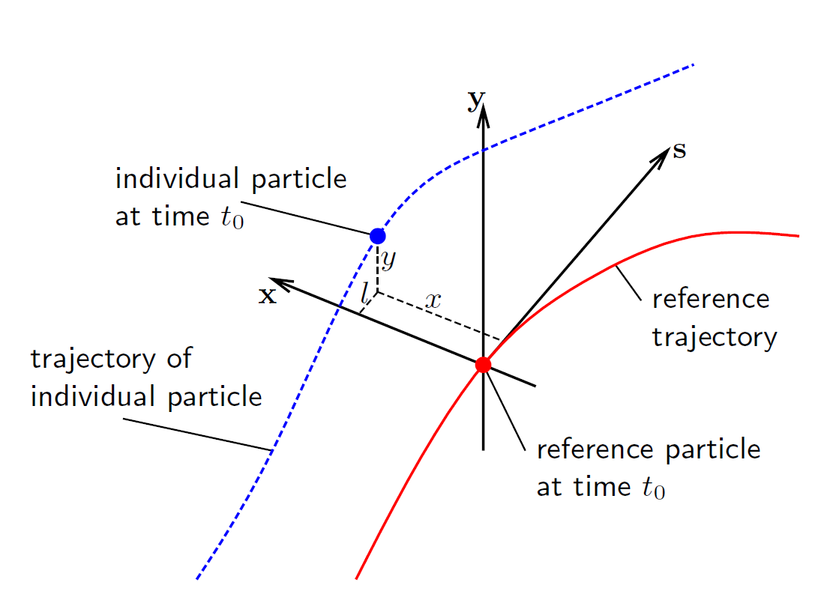

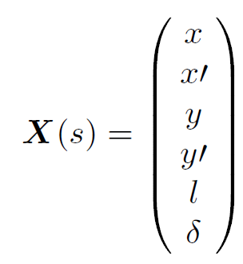
Beam Dynamics Coordinates
horizontal phase space
Co-moving coordinate system with respect
to design trajectory (right-handed-system
at XFEL)
Phase space is generated between distance and angle to the design orbit in each plane

Slide 4
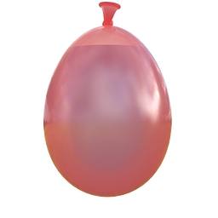
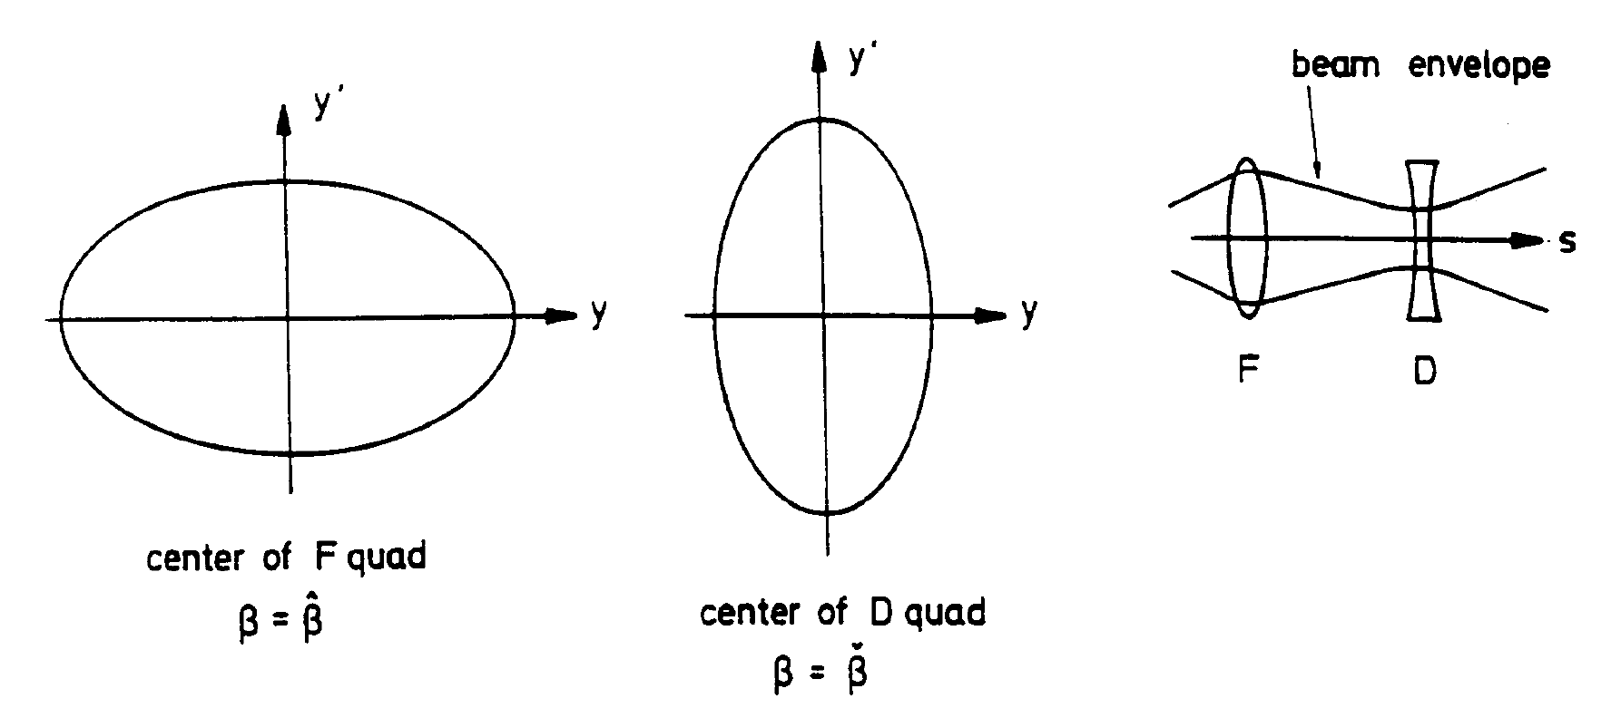
Emittance
Area covered by particles in phase space is
called emittance
We can assume an elliptical distribution
Emittance is conserved in linear optics
(Liouville’s theorem)
=> beam behaves like an incompressible liquid
=> focusing the beam will increase its
divergence
Small beams with little divergence as required
for SASE lead to small emittance requirements

Slide 5

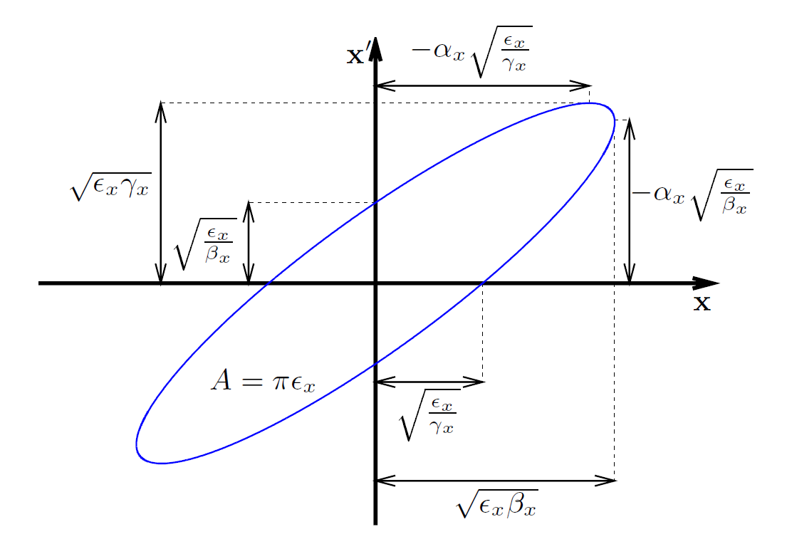
Beam Optics
While the area is conserved the orientation of the phase space ellipse is not
Beam orientation is measured with the “twiss” parameters
“slope” of such ellipses are a signature of convergent or divergent beams
A beam which does not have the same orientations
is called “mismatched” (with respect to design optics)
even if the emittance is the same
smaller emittance and no mismatch
same emittance with mismatch

Slide 6
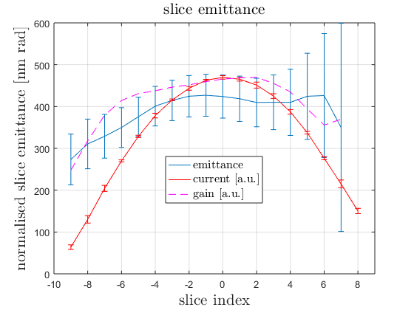
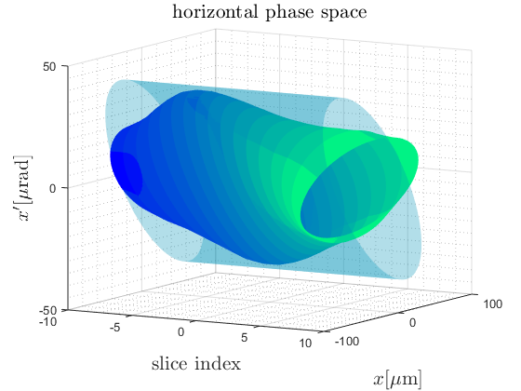
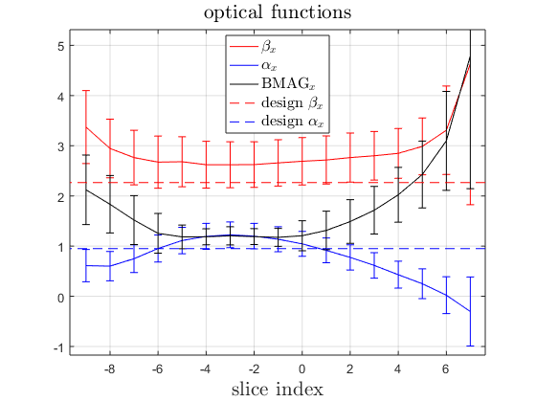
Slice Emittance
FEL Process acts in a “slice” much shorter then the bunch length
Projected emittance would underestimate the phase space density of each slice
Longitudinal resolved measurements using a transverse deflecting structure (TDS)

Slide 7
Measurements

Slide 8
Principle of Optics Measurements
momentum
position

Slide 9
Principle of Optics Measurements
normalised
momentum
normalised
position

Slide 10
Principle of Optics Measurements
normalised
momentum
normalised
position
beam size

Slide 11
Principle of Optics Measurements
normalised
momentum
normalised
position

Slide 12
Principle of Optics Measurements
normalised
momentum
Phase Advance
normalised
position

Slide 13
Principle of Optics Measurements
normalised
momentum
normalised
position

Slide 14
Principle of Optics Measurements
normalised
momentum
normalised
position

Slide 15
Principle of Optics Measurements
normalised
momentum
normalised
position

Slide 16
Principle of Optics Measurements
normalised
momentum
normalised
position

Slide 17
Principle of Optics Measurements
normalised
momentum
normalised
position

Slide 18
Principle of Optics Measurements
normalised
momentum
normalised
position

Slide 19
Principle of Optics Measurements
normalised
momentum
normalised
position

Slide 20
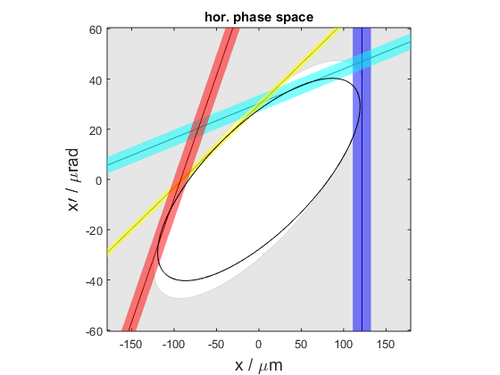
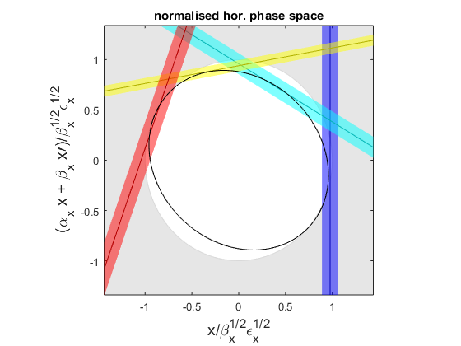
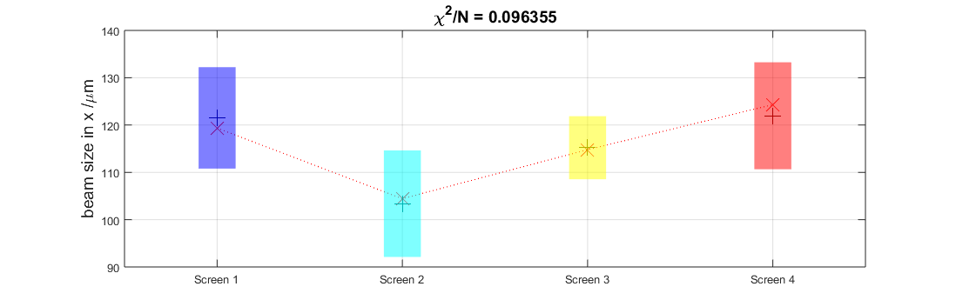
Measurement Fit Summary
Different visualizations of the fit are displayed to judge measurement quality
The design (white) and measured (black) ellipse should agree
Measured ellipse (black) should touch all beam size measurement lines (colors)
In normalised phase space the ellipse should be a circle

Slide 21
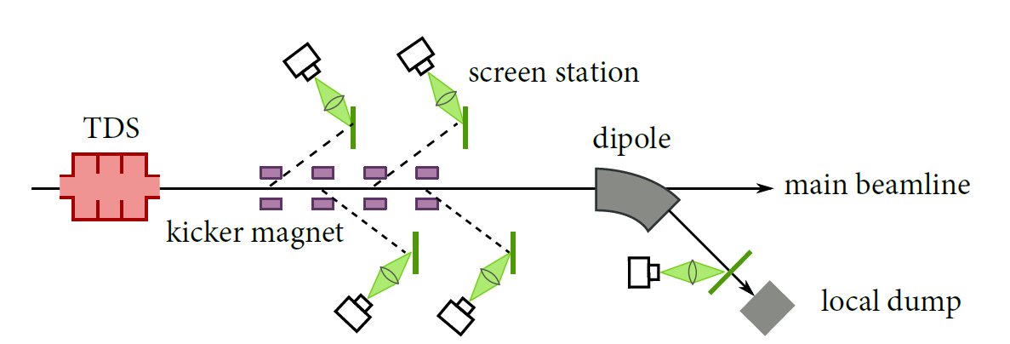
Optics-/Emittance Measurements
Optics and Emittance is determined from beam size measurements:
Beam moments are determined at a reference point using either:
  one screen while varying the quadrupole settings
  at multiple positions along a constant lattice (FODO)
Slice resolved measurements in combination with a transverse deflecting RF-structure (TDS)
Screen
Quadrupole
reference point

Slide 22
Matching

Slide 23
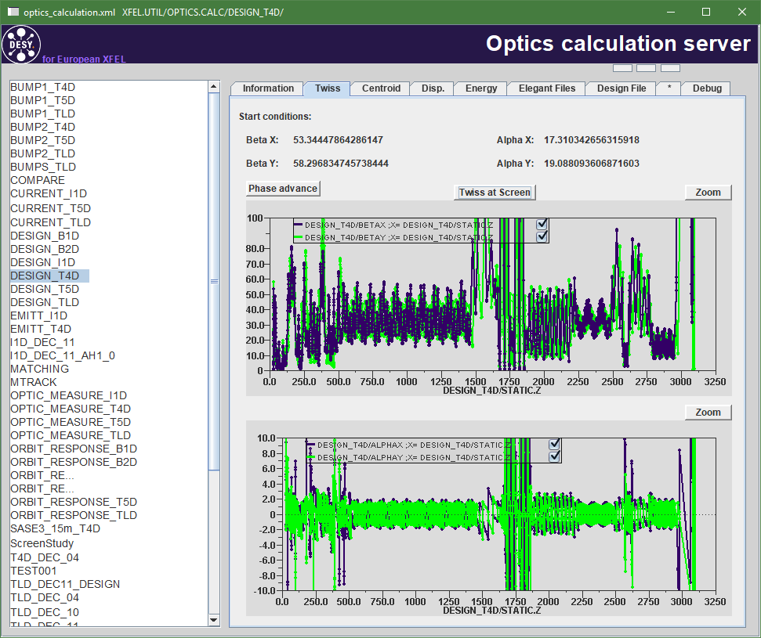
Design Optics
Optics is designed for optimal beam transport, efficient collimation, FEL output power, …
Optics initial condition (after A1) determine the beam optics in the whole machine (different in storage rings)
Deviations in the initial conditions or lattice inaccuracies have to be adjusted by matching quadrupoles

Slide 24
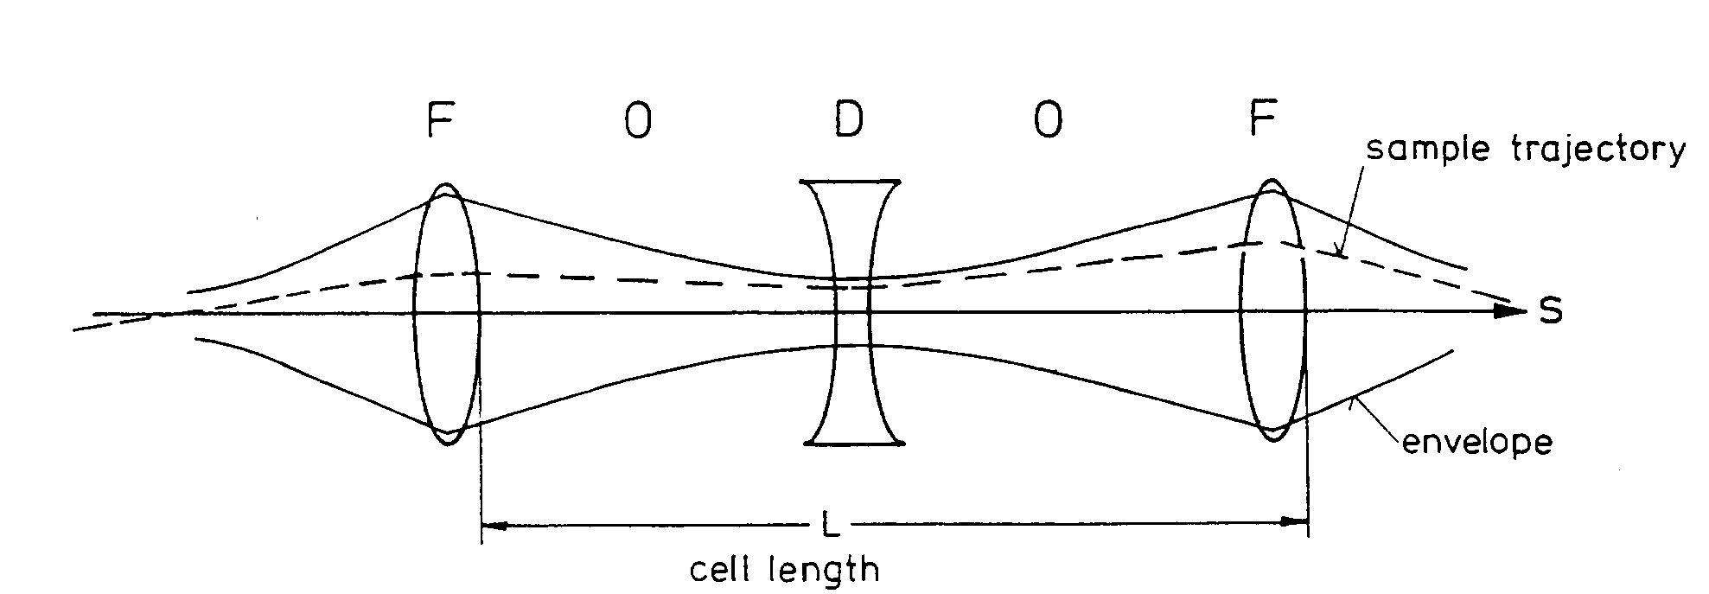
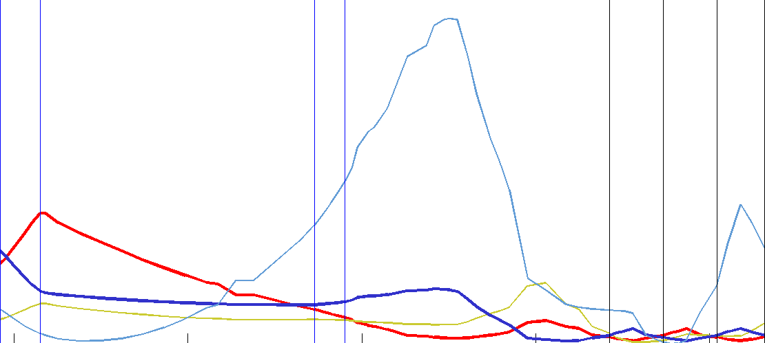
Design Optics
Design optics in the Diagnostic Sections are defined by the periodic FODO lattice
  Unique periodic solution
Example: XFEL Injector
  Quads QI.55.I1, QI.57.I1,
  and QI.59.I1 (same strength as QI.55.I1) define the periodic solution
  Upstream quads match the beam from gun section to the periodic solution
  Downstream quads are set assuming the periodic solution as a start e.g. transport to the I1D dump.
Matching
FODO

Slide 25
Optics Matching
Screen
Quadrupole
reference point
matching quads
A mismatched beam at a reference point can be “matched” by tuning upstream quads
Results from a optics measurement are used from a matching tool to calculate a quad setup
Another measurement is required to confirm improved BMAG
Iterate until desired mismatch is reached (better than 1.1)

Slide 26
Matching or NOT Matching?
In standard operation we typically load a file from a previous SASE run. Therefore we can assume the configuration of the matching quads is correct if the gun is set correctly (otherwise SASE performance would be poor).
Set machine (injector) on-crest (zero chirp and zero curvature) and energize the quads correctly
If a file is loaded try to match without changing the quads – assuming the quads are set correctly before
  vary gun phase
  vary main solenoid
Try matching with quads if gun phase and solenoid do not improve matching

Slide 27
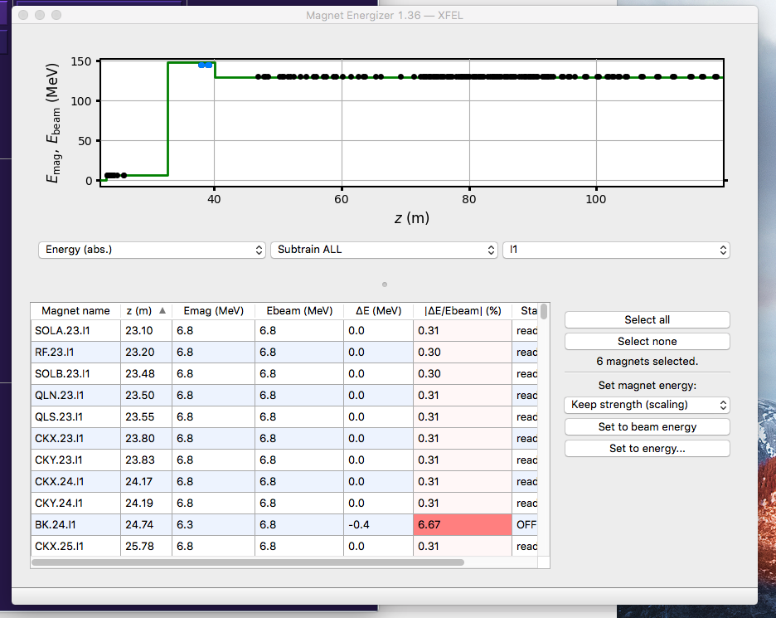
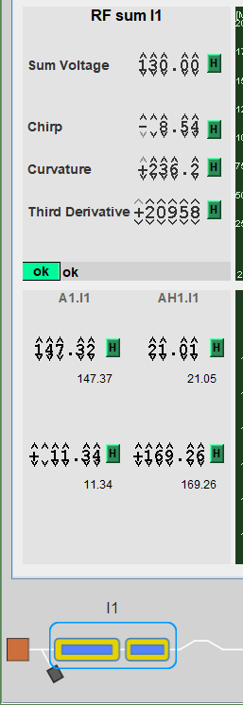
Energizing of injector cold quads
If matching with the quads is done on-crest the magnets between A1 and AH1 need to be:
energized correctly for on-crest (chirp, curvature and third derivative equal zero) energy profile before matching
energized again after matching and setup of off-crest compression parameters

Slide 28
Tools at XFEL

Slide 29
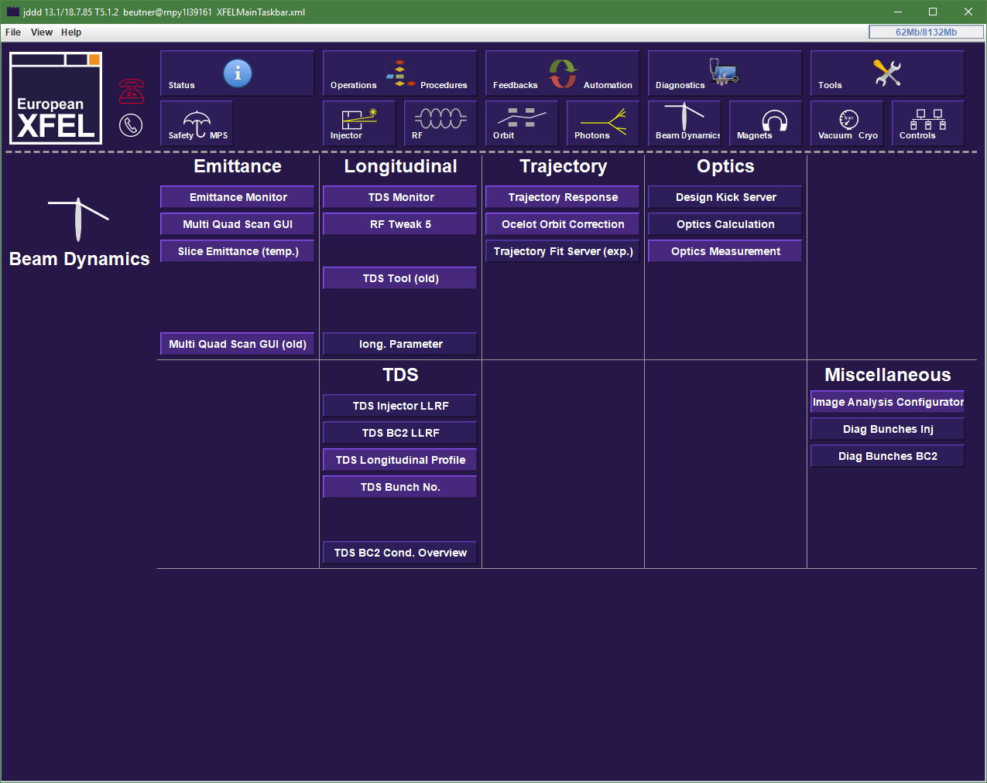
XFEL Tools

Slide 30
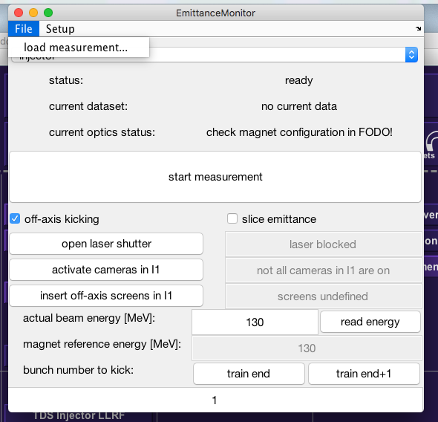
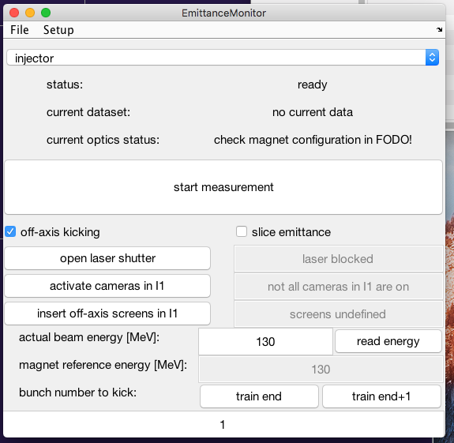
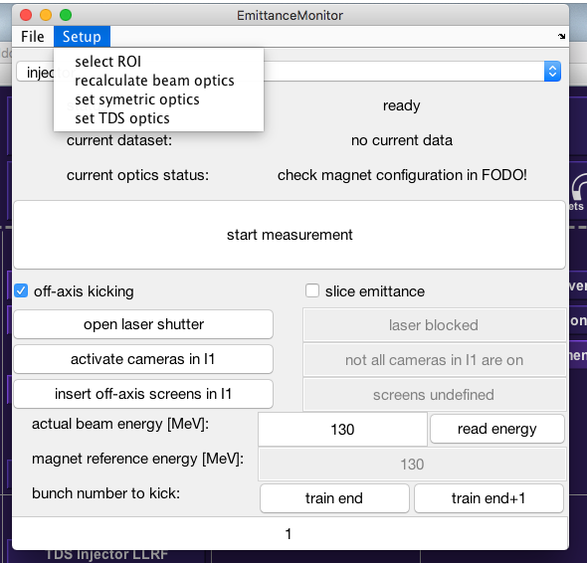
Emittance Monitor Tool
Unified Emittance and Optics Tool:
  Projected Emittance
  Slice Emittance (not in B1)
  on-axis measurements
  off-axis (presently only in I1)
  Optics Matching
  Can load old measurement data
  If kickers for off-axis screens are
  used a bunch number can be
  selected

Slide 31
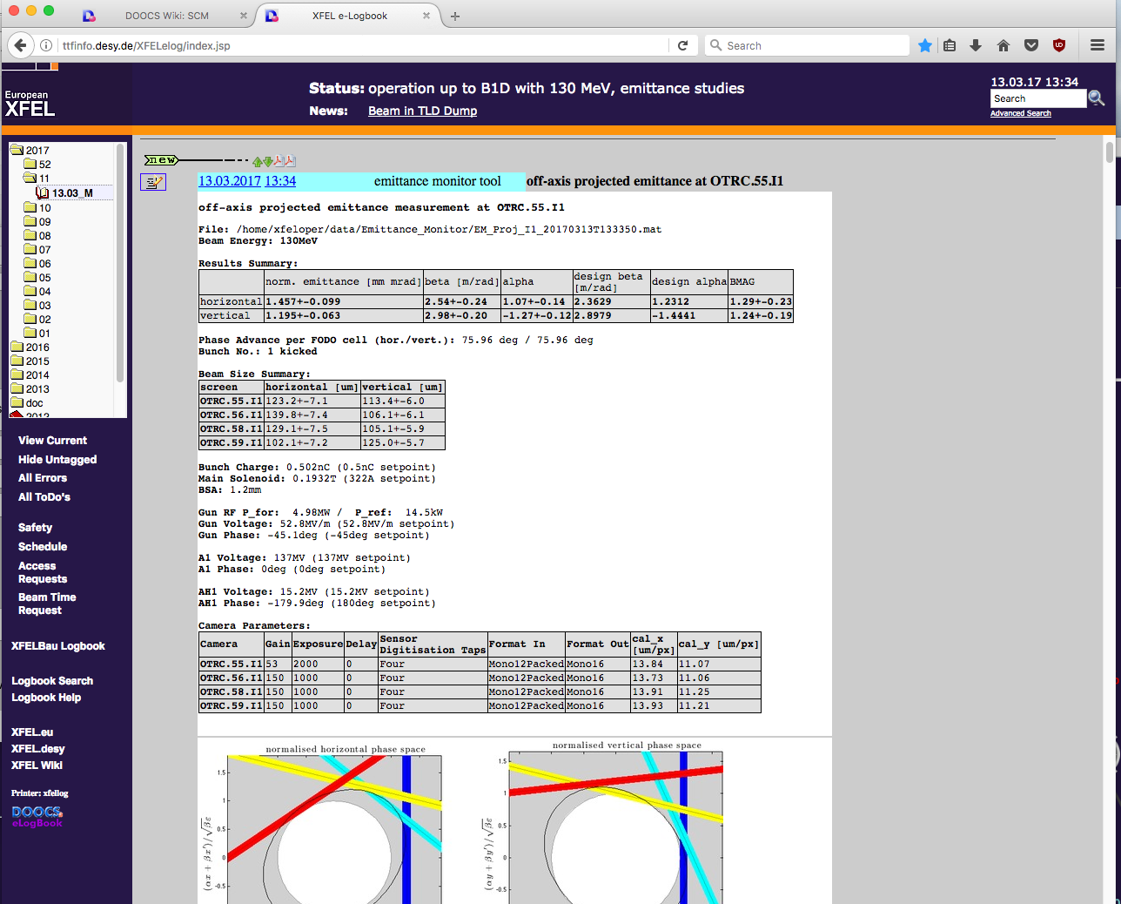
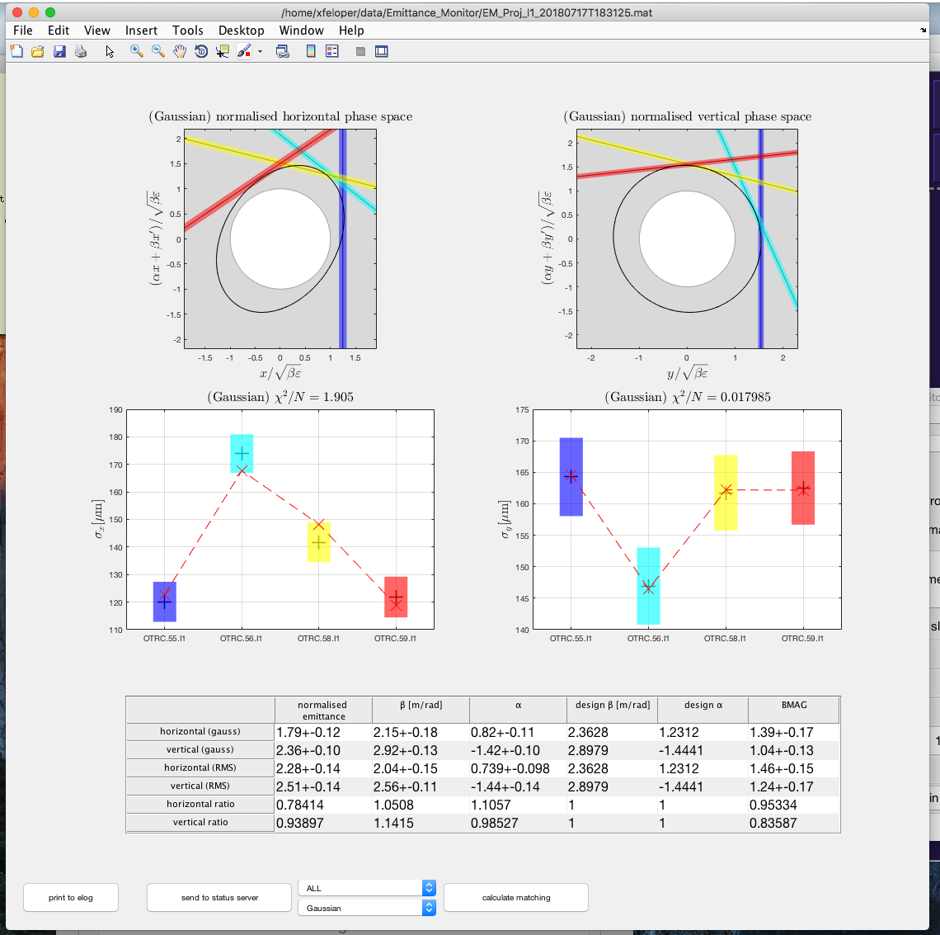
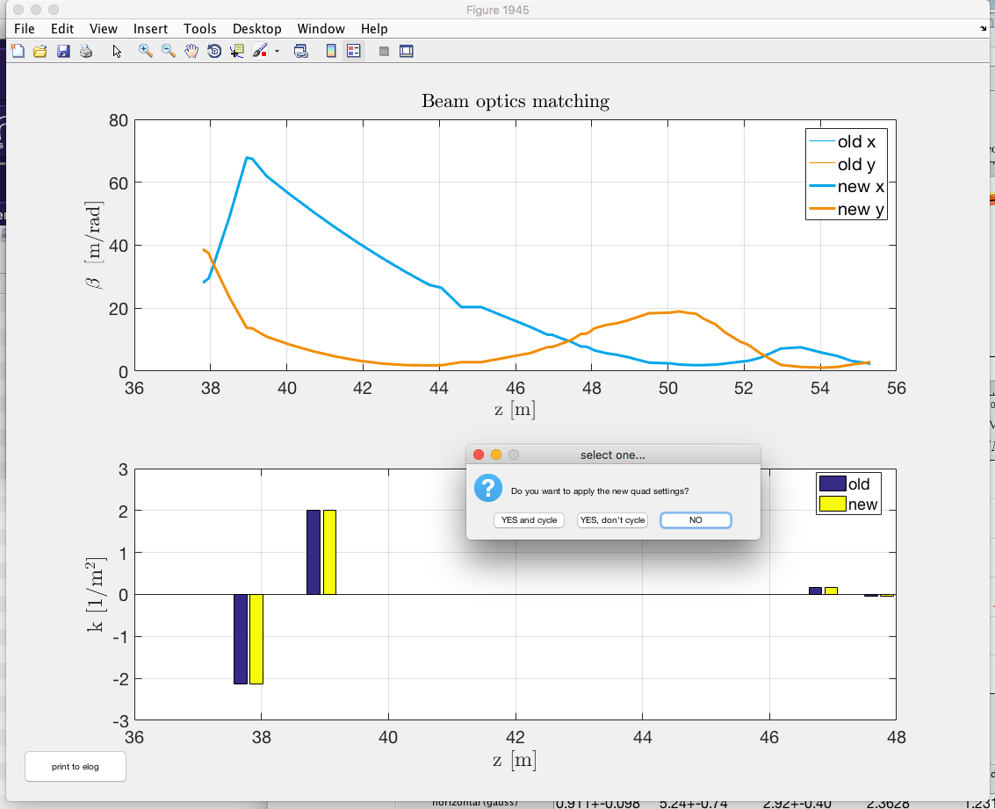
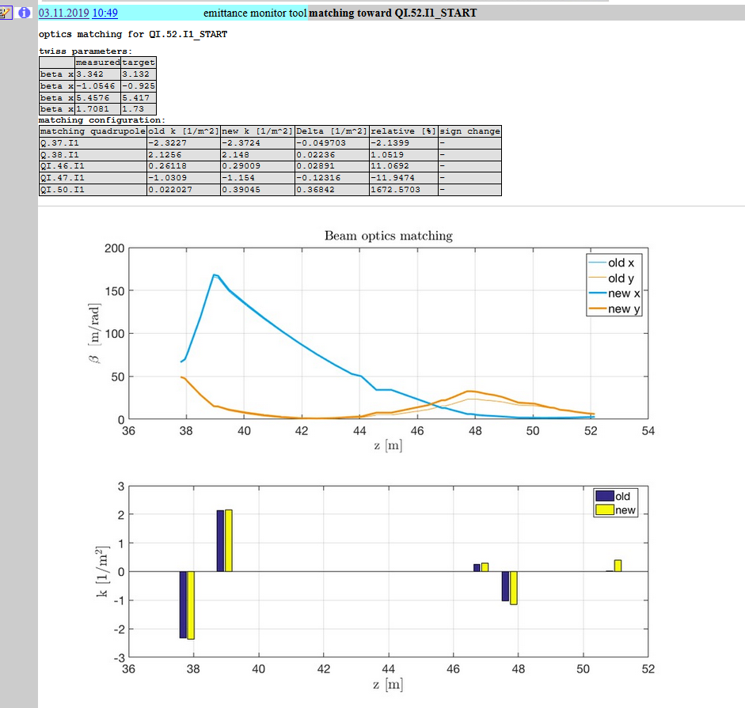
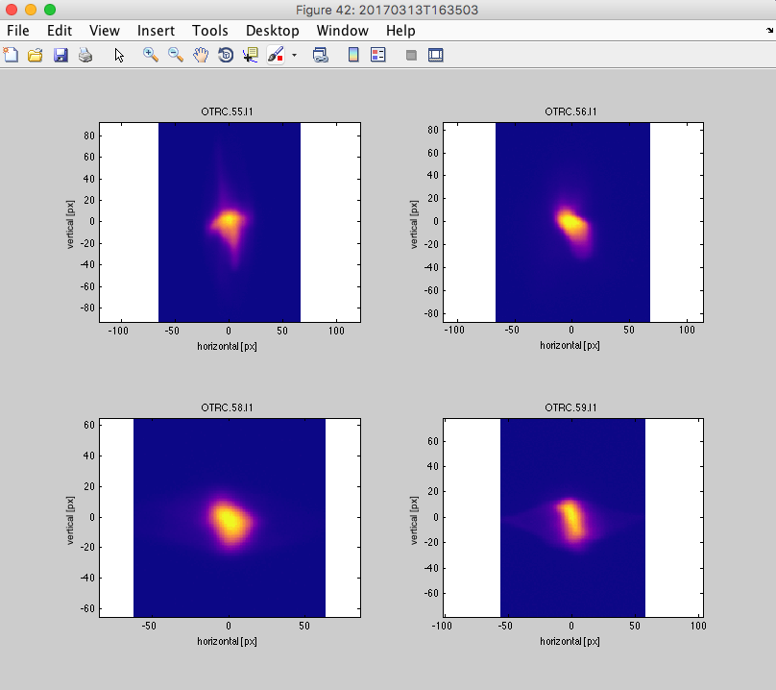
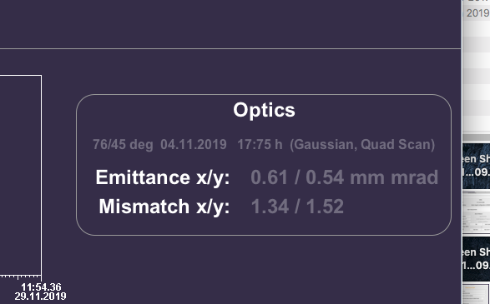
Measurement Summary

Slide 32
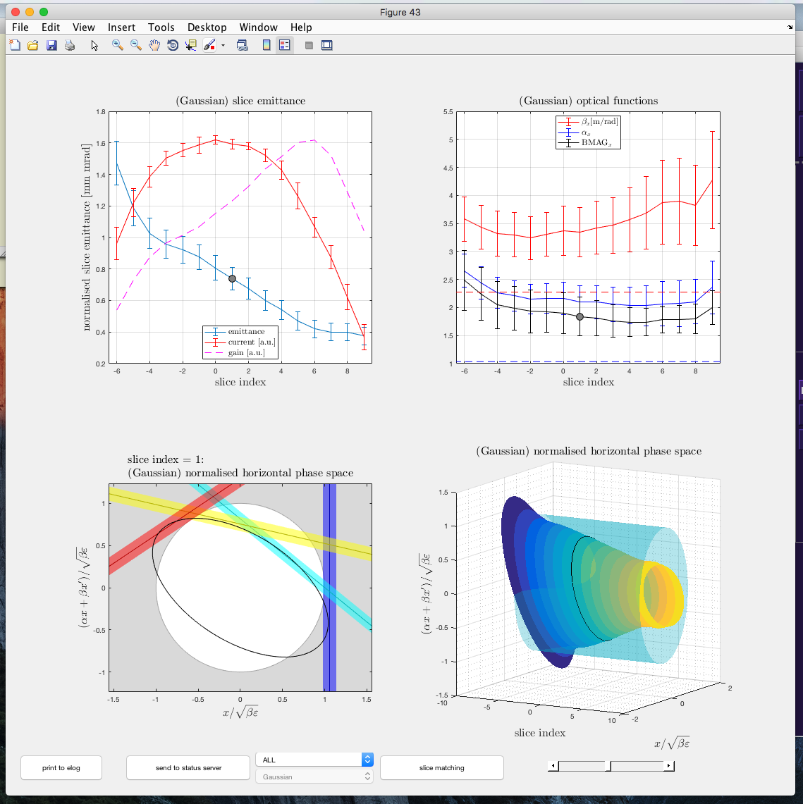
Slice Emittance
Using the TDS slice emittance
can be measured
TDS needs to be in operation
  set TDS phase and voltage
TDS optics (76/45) deg has to be
set in machine
(use design kick server to set)

Slide 33
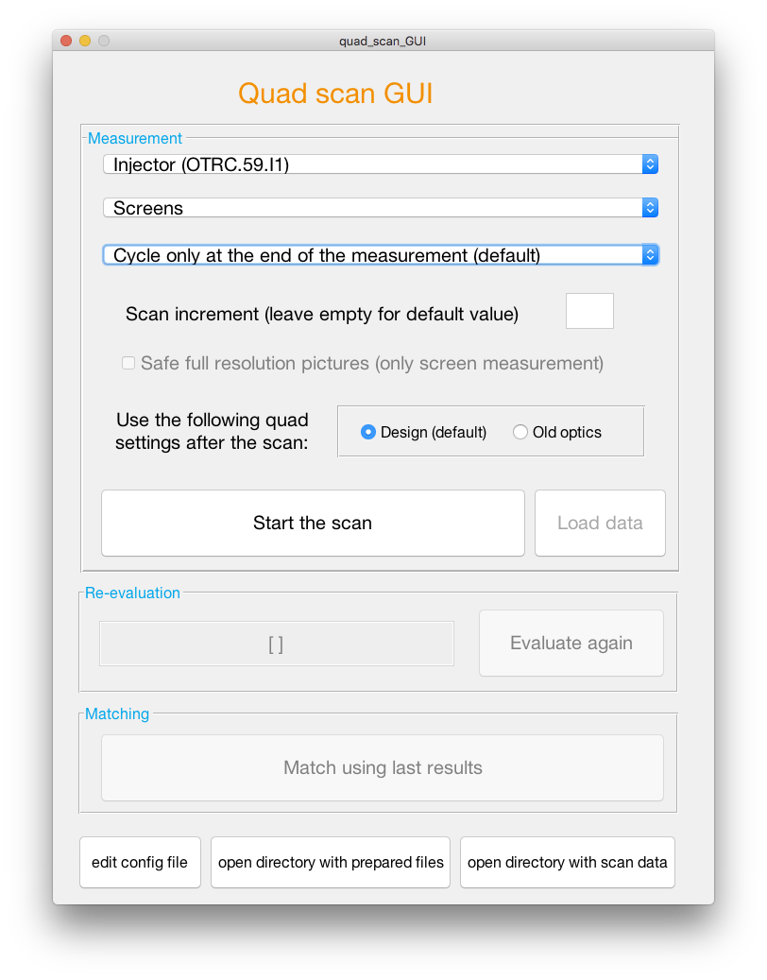
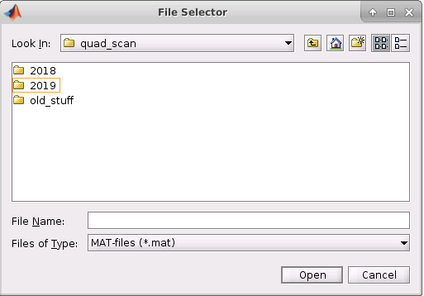
Multi Quad Scan GUI
Select a beamline section
Increment: only every nth step of the measurement will be taken.
Select the measurement device: Screens or wires? The default device is automatically set for each beamline section.
Chose beam optics after measurement: either design values or beam optics used before the measurement.
Select the preferred cycling procedure.
New button: load and plot old measurements. Opens a file selector GUI.
Start the scan
It is necessary to change matching quads, wire scan detectors or something else? Press ‘edit config file’.
Access to the prepared quad scan files.
Access to all quad scan measurement data.

Slide 34
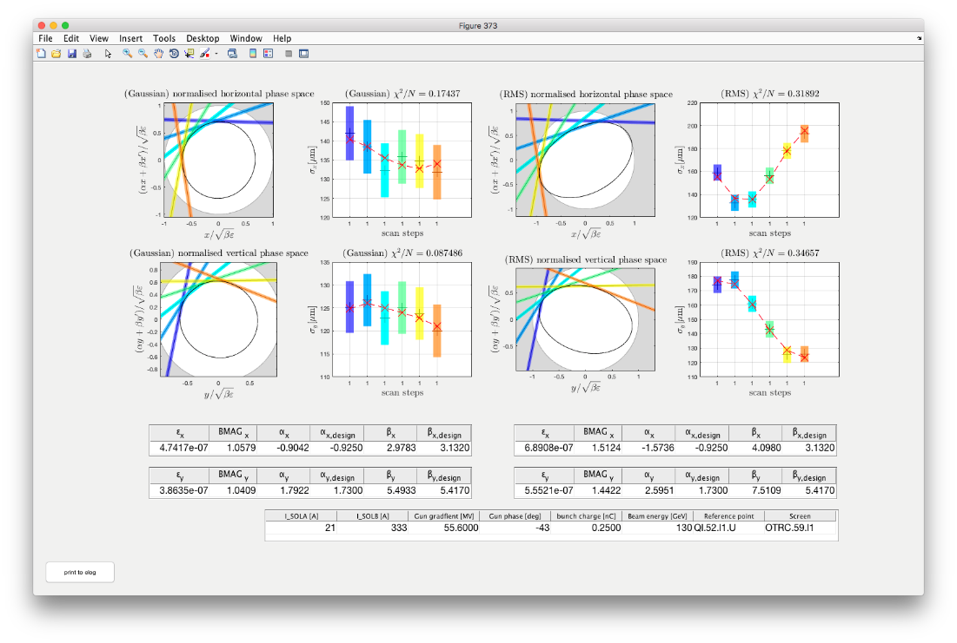
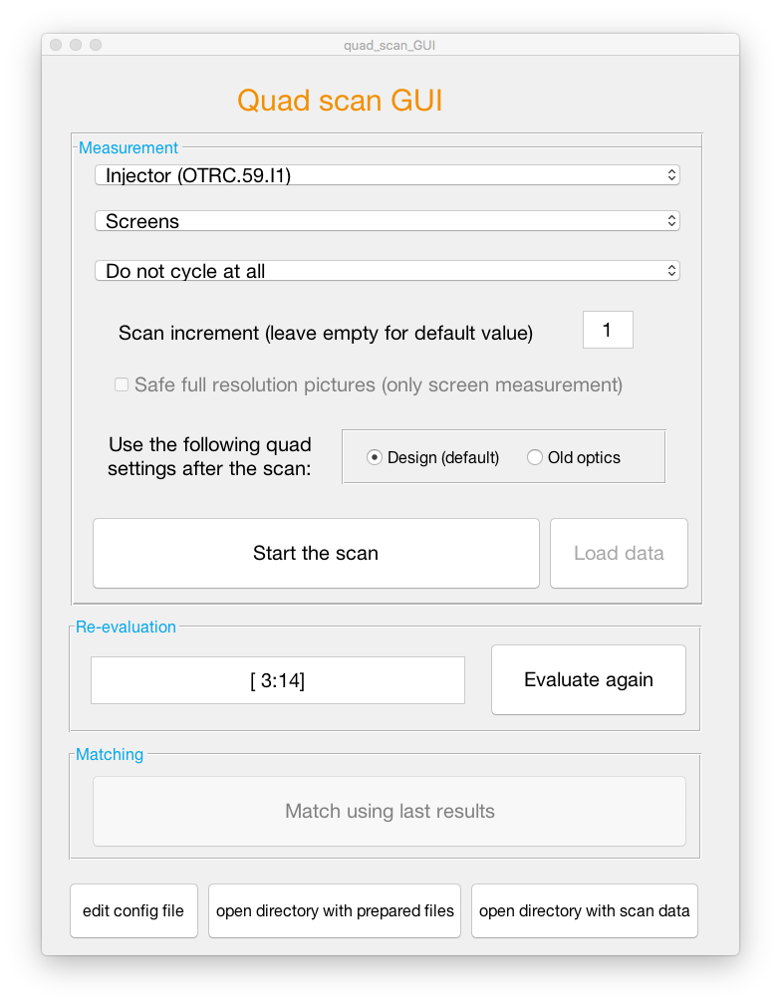
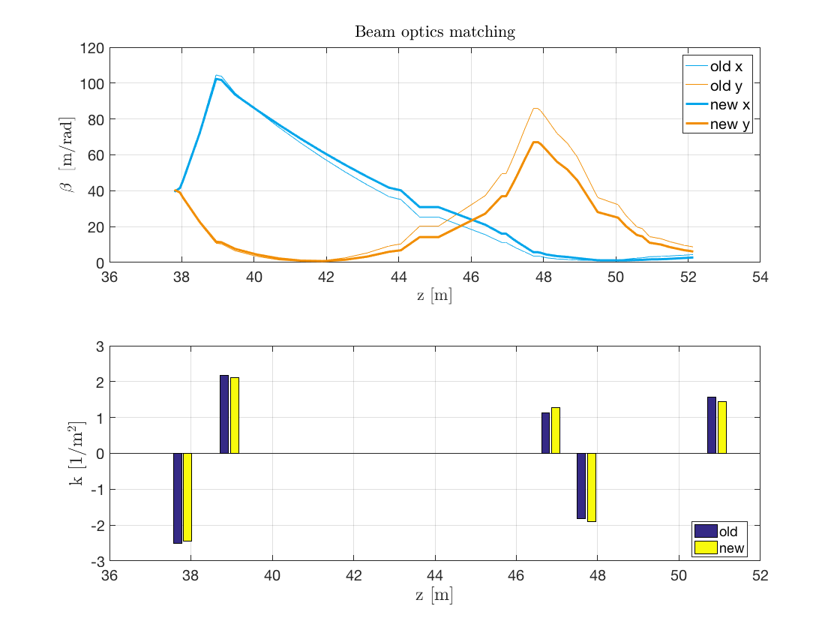
Measurement results for quad scans with screens
Well know measurement presentation after a quadrupole scan using screen as measurement devices.
The matching routine uses either the last measurement or the last re-evaluation of the measurement data.
Match using last results
Typical result after matching calculation. This plot is only shown if the algorithm found a solution.

Slide 35
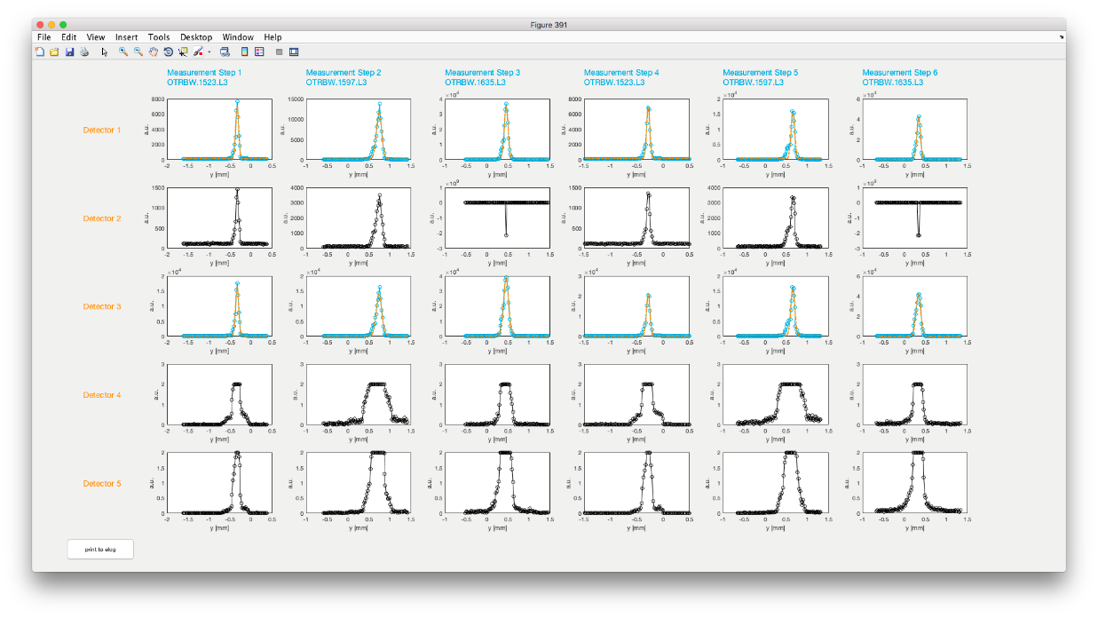
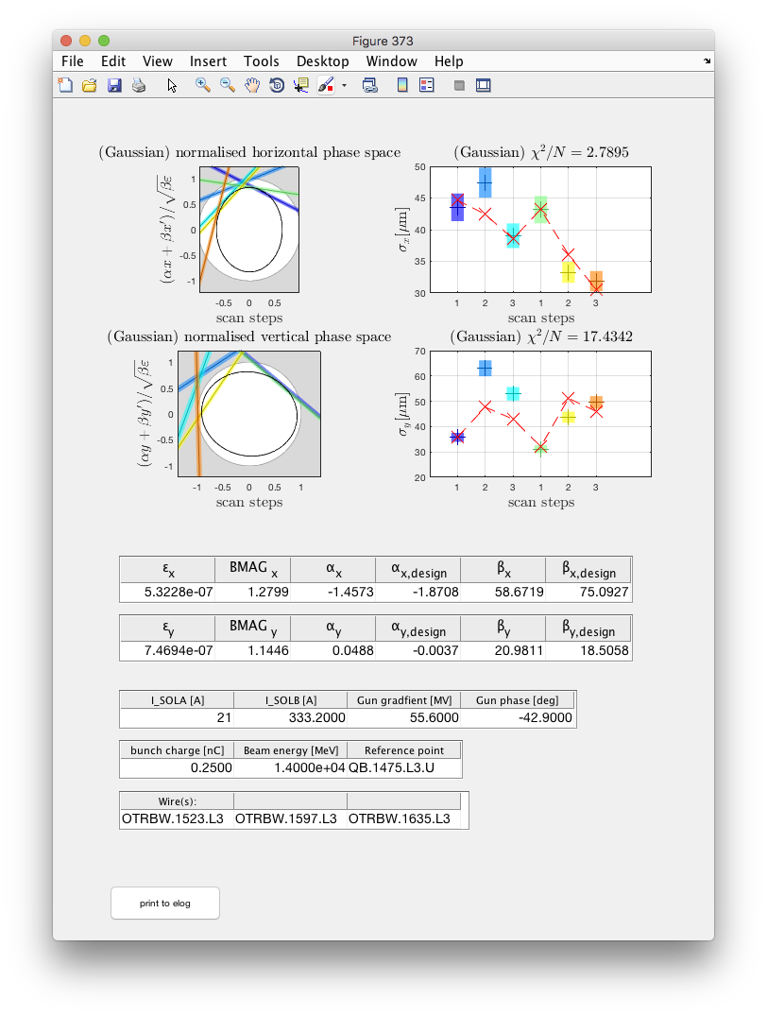
Measurement results for quad scans with wires
Signals from all wires and for all measurement steps
<- Detectors ->
<- Measurement steps ->
Blue intensity traces indicate that the data from the respective detector is used for the evaluation.
Thus, saturated signals should be presented in black, which means they are not considered in the evaluation.
The upper plot is shown twice, one plot for each plane.
Normalized phase spaces and beam sizes as well crucial scan parameters from the measurement.

Slide 36
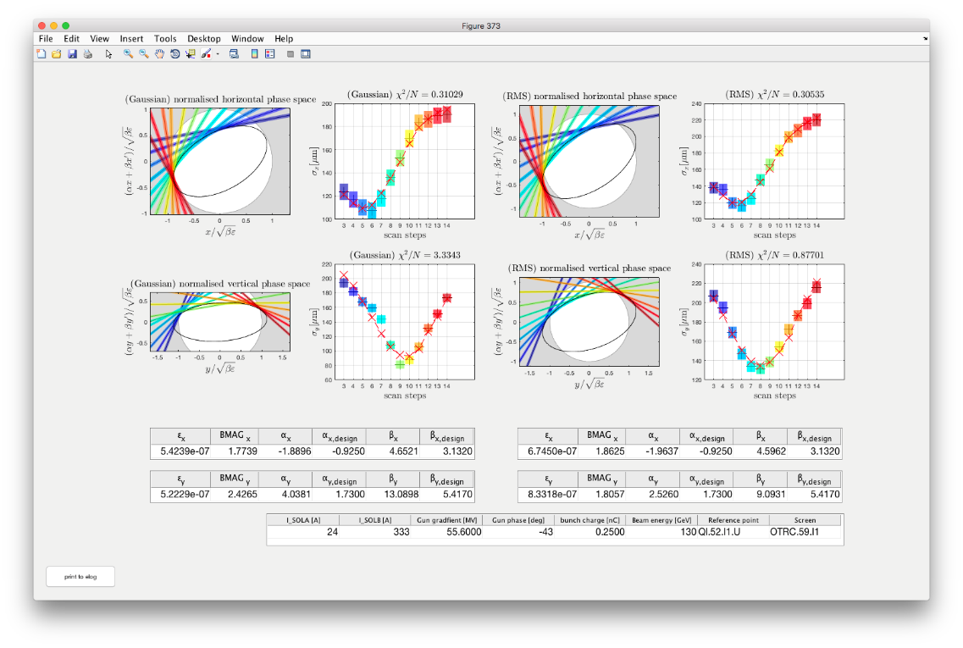
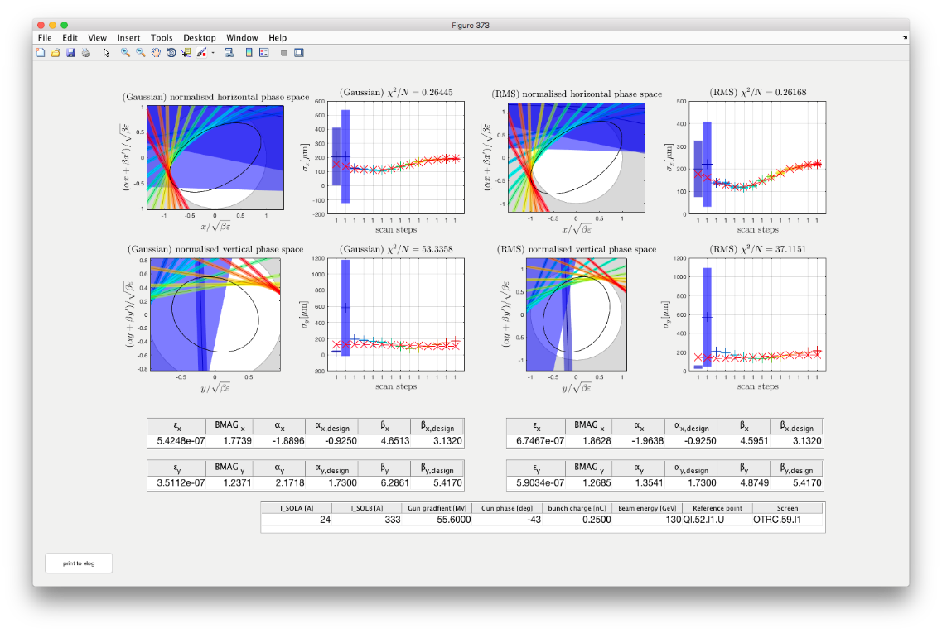
Deselecting single measurements
It is possible to evaluate only a selection of the taken data steps.
Write all step numbers that should into that field and press ‘Evaluate again’.
You can use MATLAB type vector definitions like [3:7] = [3 4 5 6 7].
Be careful with the deselection of measurement steps and with the following evaluation of the data!
This functionality must only be used to deselect measurements steps that went clearly wrong (e.g. no beam).
It must not be used to deselect ‘unwanted’ measurement steps to improve e.g. emittance size or beam optics matching!
The first two measurement steps were taken steps without beam.
After deselecting the first two measurement steps

Slide 37
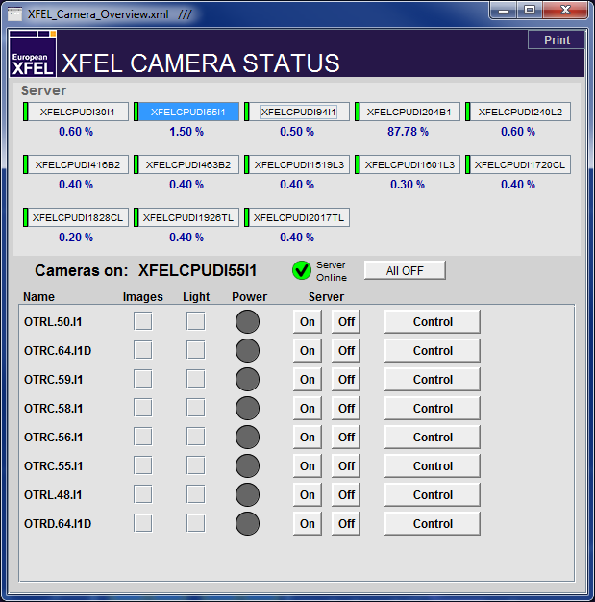
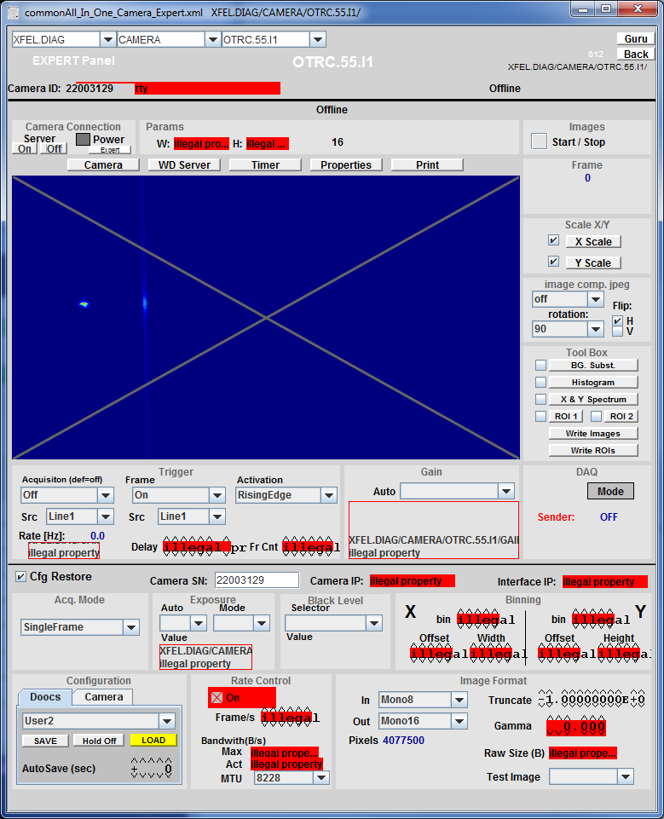
Camera Server Issues
Check CPU load
Only the 4 cameras in the section
should be powered
Deactivate image acquisition

Slide 38

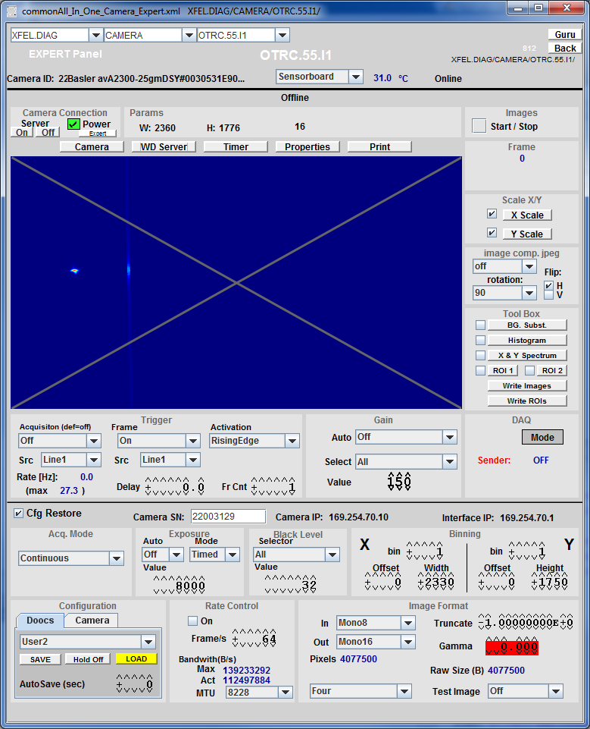
Camera (Server) Startup

Slide 39
Camera Default Values
Default Values of cameras are set
if Emittance Monitor is used to
activate them
Proper settings:
  IN: Mono12Packed
  OUT: Mono16
  Truncate: -1
  Exposure: maximum 1000
  Acquisition: off
  Frame: on
  “Tool Box” checkboxes: off

Slide 40
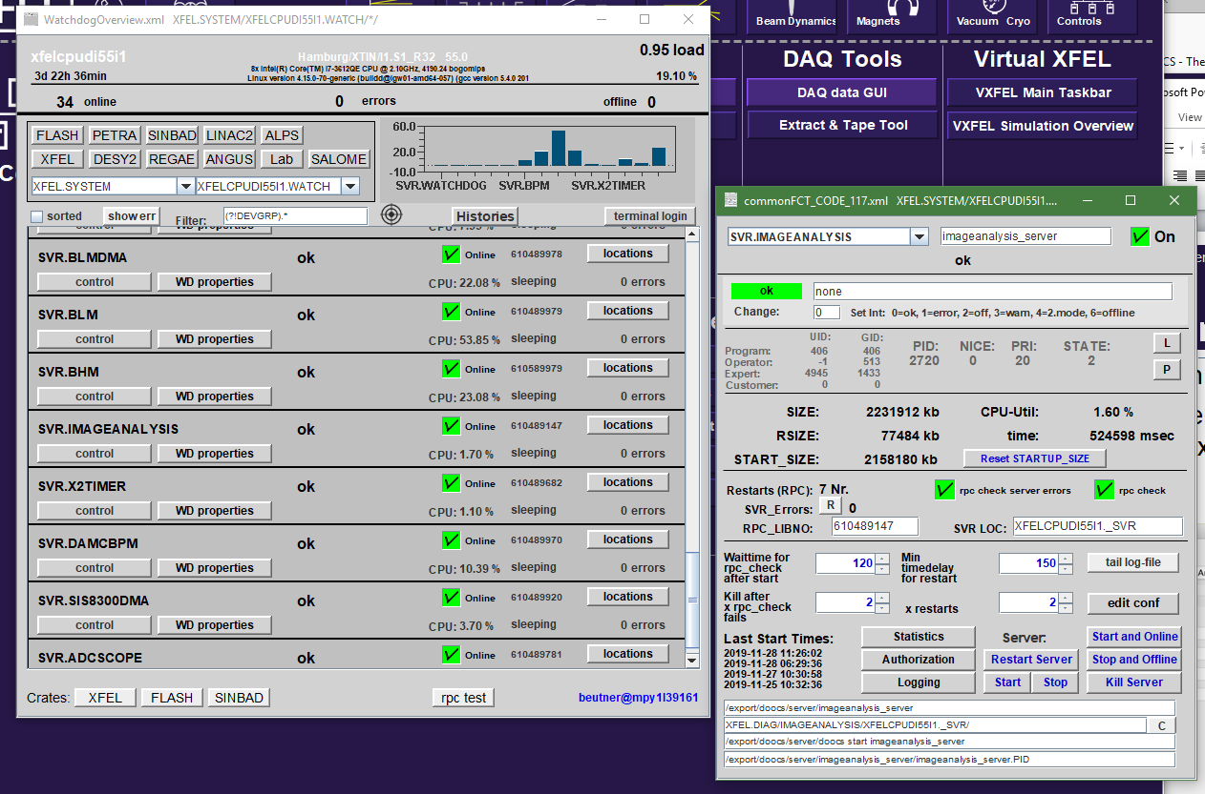
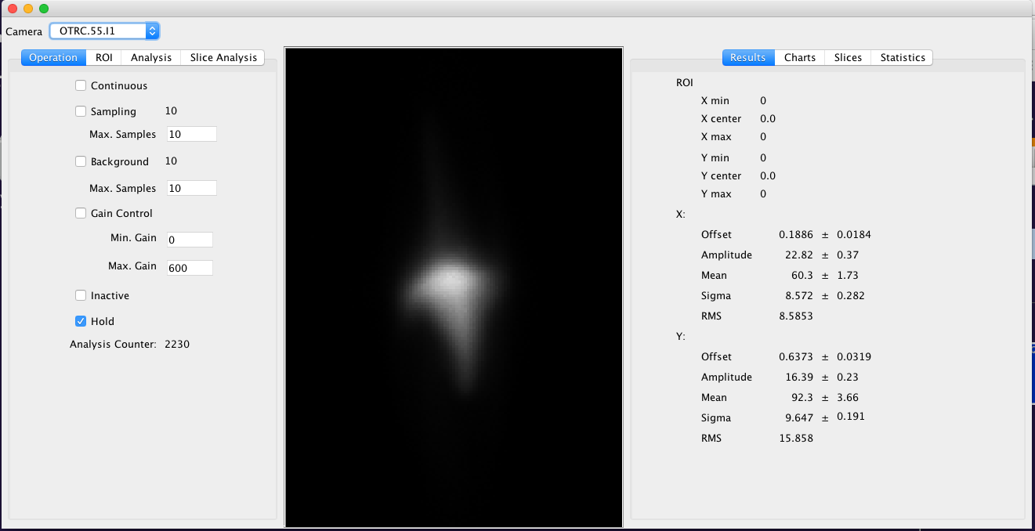
Image Analysis Server Expert Tool
Check if you can see images updating in “Continuous” mode
In case of problems => restart image analysis server via the Doocs watchdog (call expert RC, BB, J. Wilgen, or any controls person with permission)

Slide 41
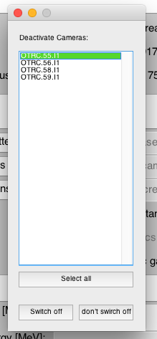
Camera Lifetime
Cameras die fast!
  On average each camera was
  exchanged once during the injector run
  Deactivate cameras every time you
  don’t need them for a foreseeable time
  Emittance Monitor Tools gives a list off
  all activated emittance cameras at
  shutdown and offers to close them
  Do it….

Slide 42
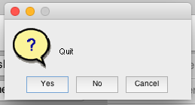

Slide 43
Thank You for Your Attention…
Literature:
M. Minty and F. Zimmermann, “Measurements and control of charged particle beams”,
Springer, Berlin, Heidelberg, New York, 2003.
F. Loehl, “Measurements of the Transverse Emittance at the VUV-FEL”,
DESY-THESIS 2005-014, TESLA-FEL 2005-03
J. Rossbach and P. Schmueser, “Basic Course on Accelerator Optics”

Slide 44
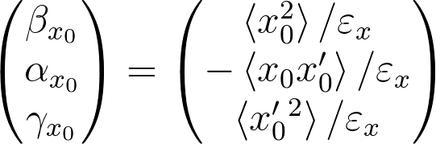

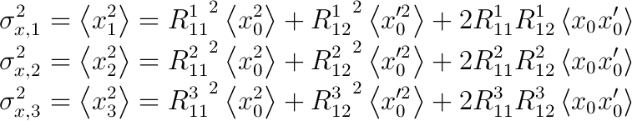
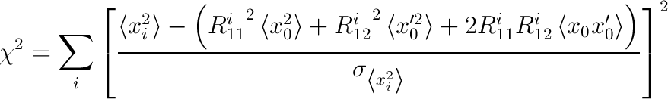
Measurement Theory
Beam size at point i as a function of initial beam moments:
From the beam moments emittance (and twiss parameters) are determined:
In an ideal measurement three data points are sufficient:
In a real measurement more
then three data points are taken and
the beam moments are determined
by a least square fit:
unknowns to be determined by the measurement
determined by diagnostics (screens / Image Analysis Server/ wire-scanner)
provided by beam dynamics (Optics Server)

Slide 45
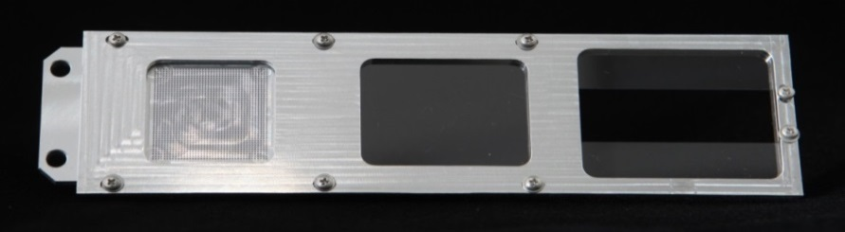
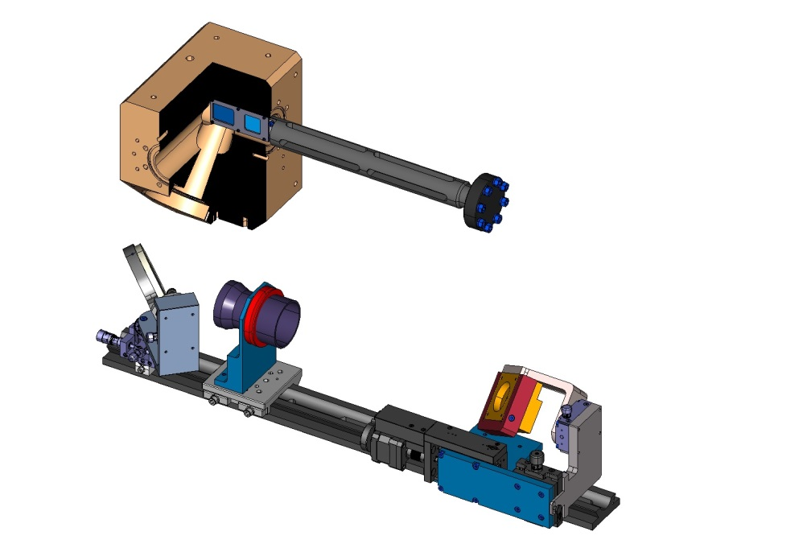
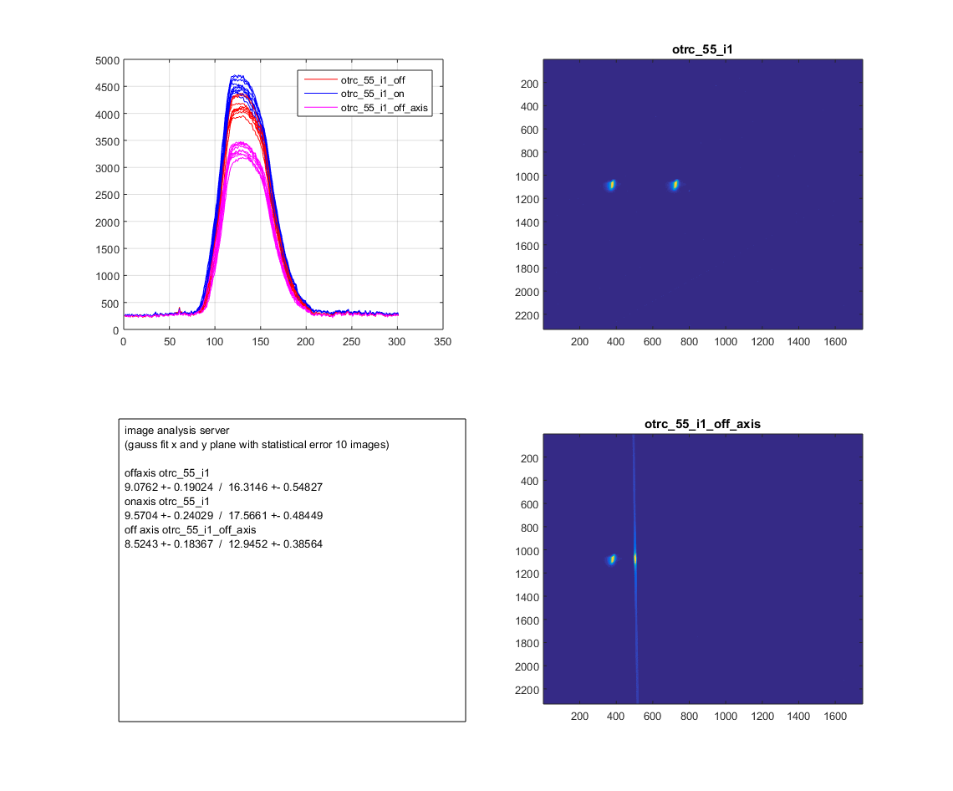







Screen Station for European XFEL
monitor setup
dot grid target(spot Ø .50mm)
BEAM
f = 180mm for 1:1
200µm thick LYSO screen (on-axis)
f = 120mm for 1:2
2 half 200µm thick LYSO screens (off-axis)
Optical Axis
FLASH II installation
Example: 2 bunch operation second bunch is kicked
Optics Axis
optical Resolution
BEAM
on-axis screen
off-axis screen
Scheimpflug observation geometry
10.5 μm average resolution
(dot → optical „step“ function)
Slide thanks to G. Kube
Ch. Wiebers et al. Proceedings of IBIC2013, Oxford, UK

Slide 46

Tool at Start-up

Slide 47
Problems
Screens Inserted correctly / Cameras activated / …
  Use buttons on the tool
Is the Orbit good?
  Check if beam is on screen?
  In case of off-axis measurement try on-axis
  or start kickers manually
Are the magnets properly set?
  Strength and magnet energy
  => check phase advance
        projected emittance: (76/76) deg
        slice emittance: (76/45) deg
Are the cameras working properly?
Is the Image Analysis Server in operation?
  ROI configuration?

Slide 48
Orbit Problems
Area of off-axis screens is smaller
  Make sure the kicked beam
  hits them
Screens in B1 and B2 are of the same
size but the imaging on the chip is 1:1
(factor 2 in each plane compared to I1)
  Field-of-view is 2.54 cm in diagonal
  If beam is not visible insert screen in question and move beam with orbit correctors
B1 and B2
field-of-view
I1
field-of-view

Slide 49

Energy Setup

Slide 50

Manual Setting of energy

Slide 51



FODO Configurations
I1 from 55 to 59m (horizontal kick)
  Projected: (76/76) deg
    Gen. kick = (-0.8382, +0.8382, -0.8382) rad/m
  Slice: (76/45) deg
    Gen. kick = (-0.6271, +0.7792, -0.6271) rad/m
B1 from 219 to 226m (vert. kick)
  Projected: (76/76) deg
    Gen. kick = (+0.6769, -0. 6769, +0. 6769) rad/m
B2 from 444 to 459m (vert. kick)
  Projected: (76/76) deg
    Gen. kick = (+0.3310, -0.3310, +0.3310) rad/m
If phase advance values are not correct check magnets and energy – and recalculate optics model in tool!

Slide 52

Optics Options

Slide 53


ROI Configuration Tool

Slide 54



On-Axis Projected Measurements
Most reliable
Takes more time than other methods (~ 5 minutes)
Does not require kickers or TDS systems operational
Only first bunch
Should be the first choice for startup after shutdown etc.

Slide 55





Off-Axis Projected Measurements
Use of kickers allows for much faster measurements (about 20s)
Orbit and optics mismatch
needs to be good
Allows for measurements of
other than the first bunch
Make sure that the energy
chirp is removed
Main tool for tuning of
projected emittance

Slide 56


Slice Emittance Measurements

Slide 57


Combined Tool Results

Slide 58


Slide 59


Measurement errors
A mismatched beam (with respect to design optics) is not only bad because of the resulting unknown beam transport – a mismatched beam makes the measurement itself unreliable
If the beam is well matched in a periodic measurement lattice statistic beam size errors contribute with equal weights and partially compensate each other
Do not trust measurements with mismatch higher than BMAG = 2
Beam should be
matched to
BMAG < 1.1
rms error
deviation
failed fits

