Slide 1
XFEL-Gun Operator Training
F.Brinker
Notes:
How to edit the title slide
Upper area: Title of your talk, max. 2 rows of the defined size (55 pt)
Lower area (subtitle): Conference/meeting/workshop, location, date, your name and affiliation, max. 4 rows of the defined size (32 pt)
Change the partner logos or add others in the last row.

Slide 2
Content
Cathode
Interlock systems
Multi Pactoring
Temperature regulation
FSM and Ramp Up procedure

Slide 3
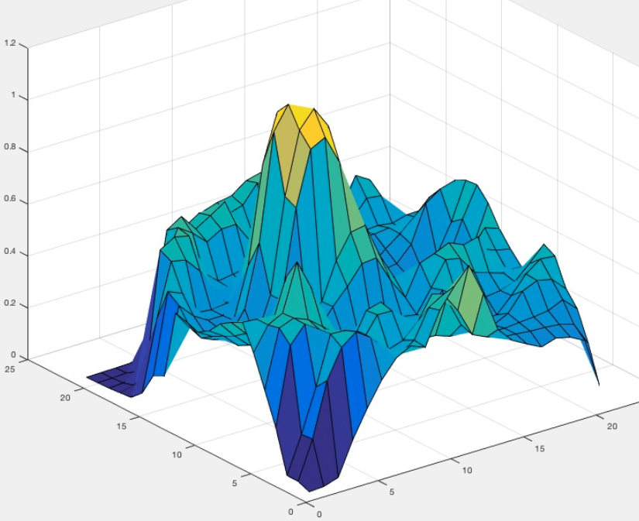
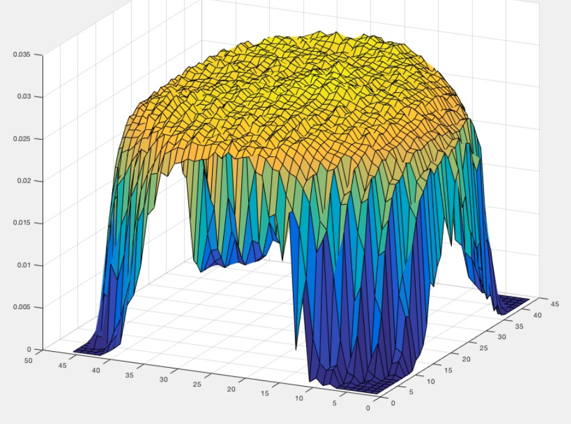
Cathode exchange January 2020, Why?
Messung der Quanteneffizent = wieviele Electronen werden pro Laser Photon freigesetzt
5 mm

Slide 4
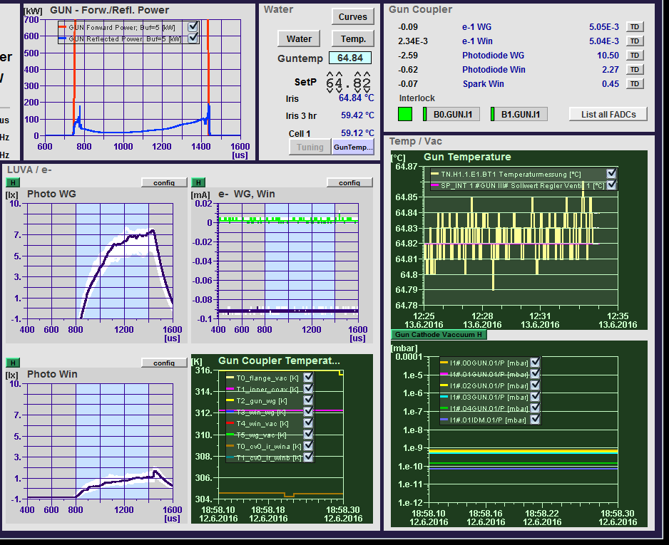
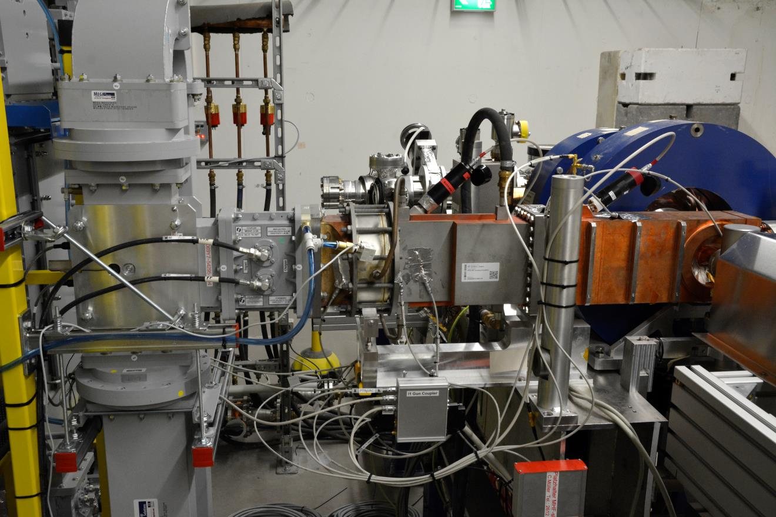
Gun signals and interlocks
RF measurement

Slide 5
Gun signals and interlocks
Light and electron detection

Slide 6
Gun signals and interlocks
Temperatures

Slide 7
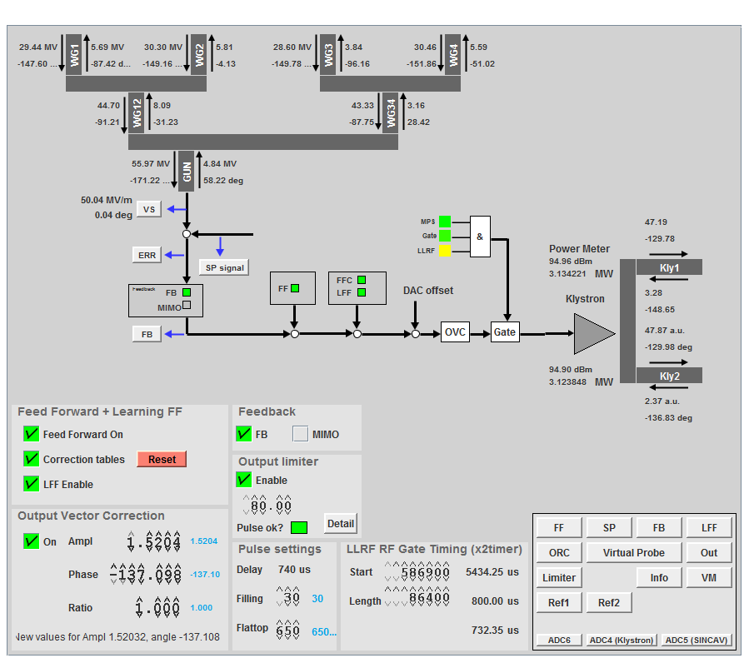
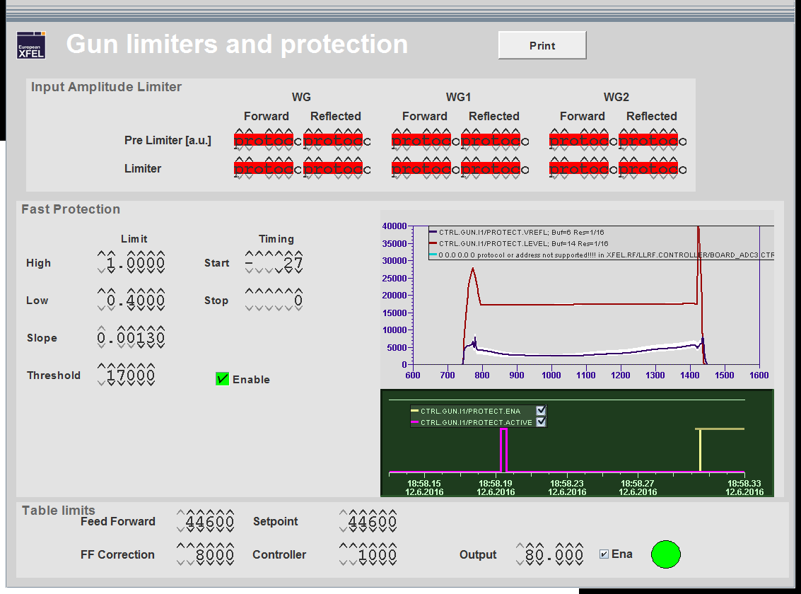
Limits of fast protection

Slide 8
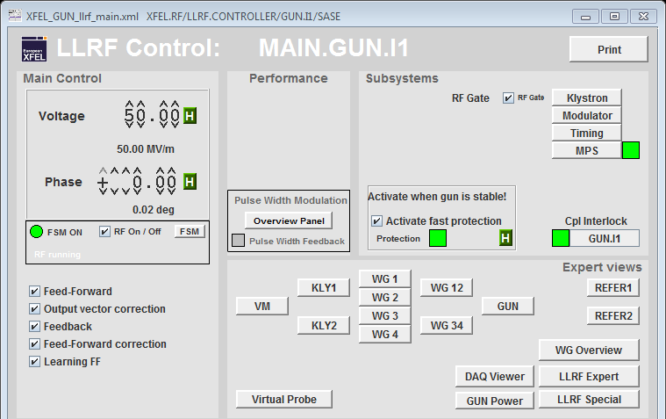
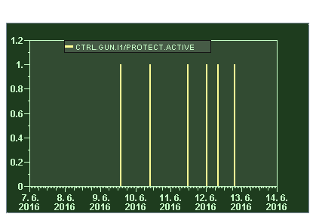
LLRF fast protection – looking at the reflected power

Slide 9
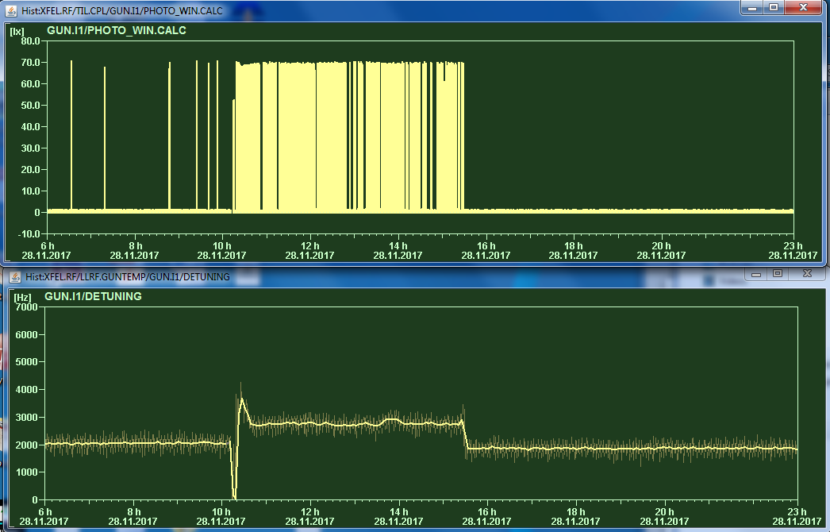
Strong temperature ( detuning ) dependance of light emission
Below 2200 Hz
Much less activity.
200Hz = 0.01°C!

Slide 10
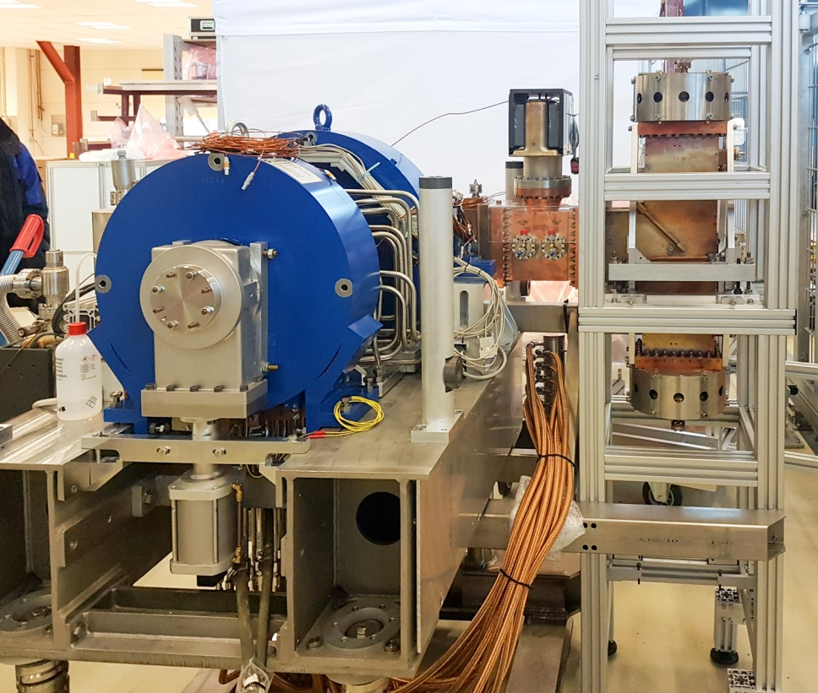
December 2017: Exchange of the gun
December 2017 the gun has been exchanged with the Gun 4.6, which has been conditioned at PITZ
The two guns are identical beside a different cathode spring design ( watchband reloaded at 4.6 )
The goal is to have two identical guns available which proved to deliver beams for SASE
It turned out that the Thales window easily produced multi pactoring with rapid raise of vacuum pressure
Could not get rid of this also after longer conditioning

Slide 11
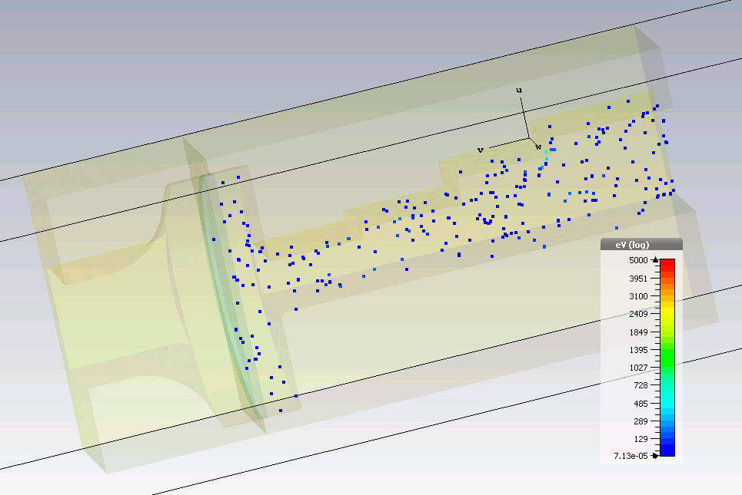
Run Simulation
t = 0.05 ns
n = 1,000
The electrons are distributed pseudo randomly in space at the beginning

Slide 12
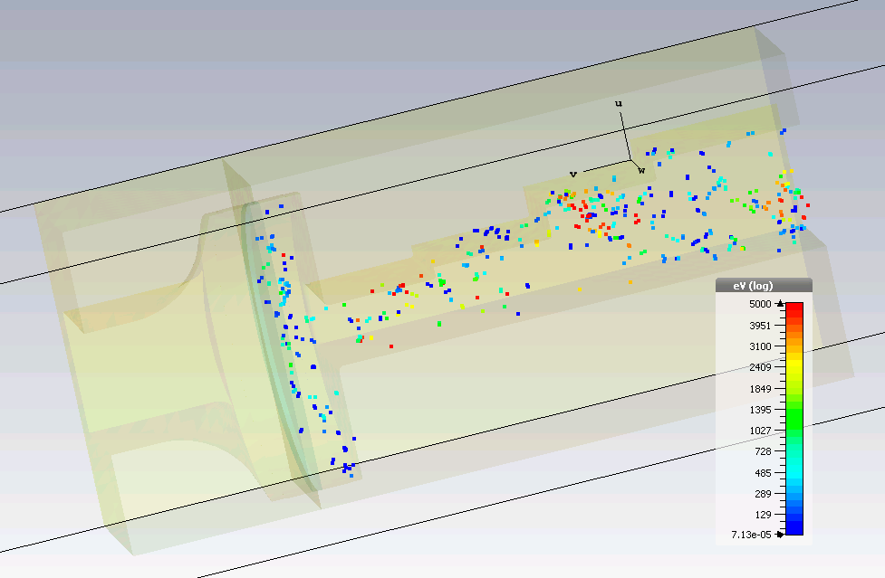
Run Simulation
t = 2 ns
n = 1,008
Electric field accelerate the electrons
Power = 6.98 MW

Slide 13
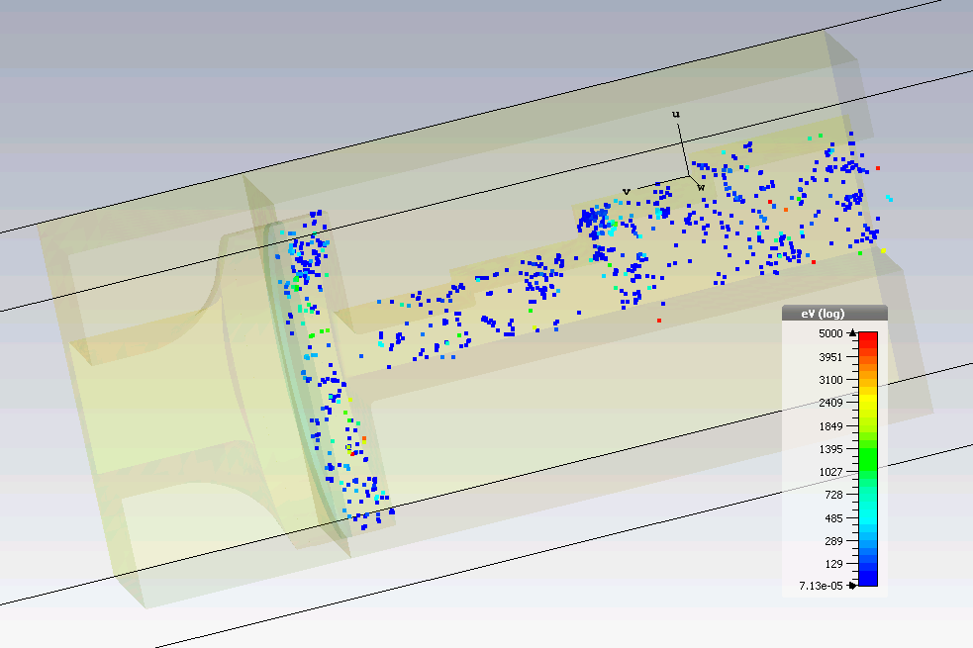
Run Simulation
t = 10 ns
n = 1,942
Number of electrons doubles

Slide 14
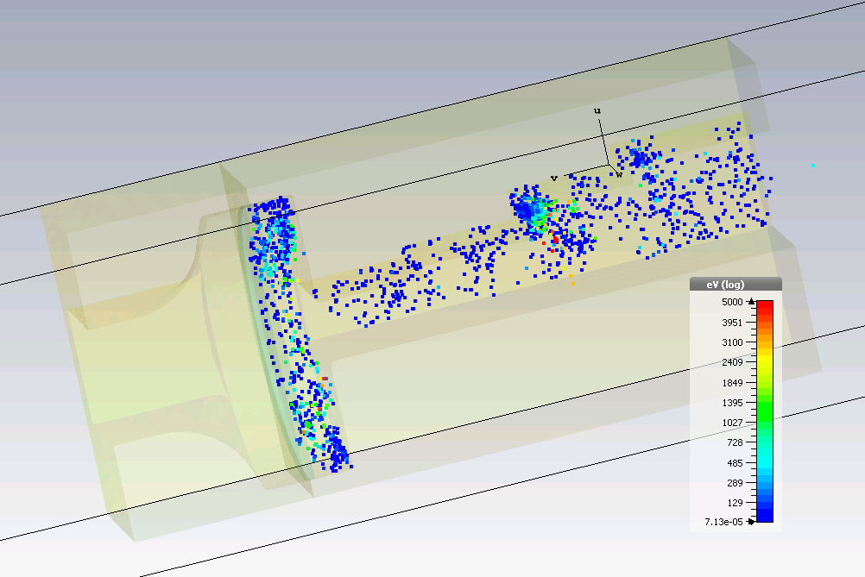
Run Simulation
t = 20 ns
n = 3,983
Number of electrons doubles again

Slide 15
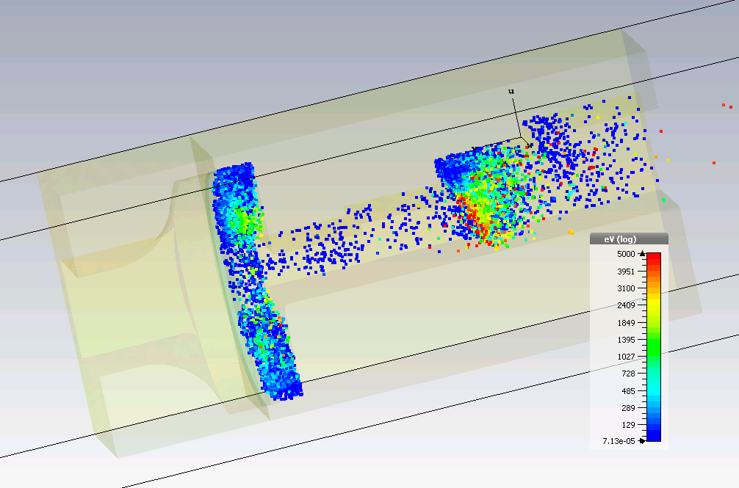
Run Simulation
t = 40 ns
n = 56,413
Number of electrons increase faster
Electrons are concentrate in some parts
Important: were the electrons are concentrate depends on the applied power

Slide 16
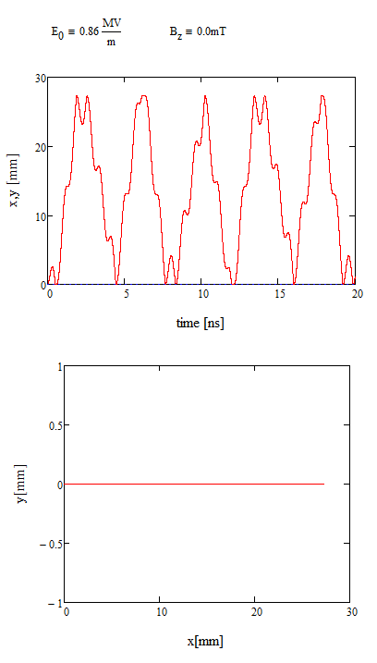
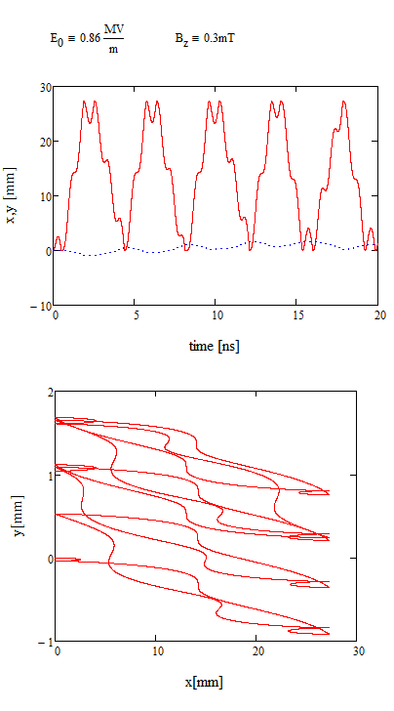
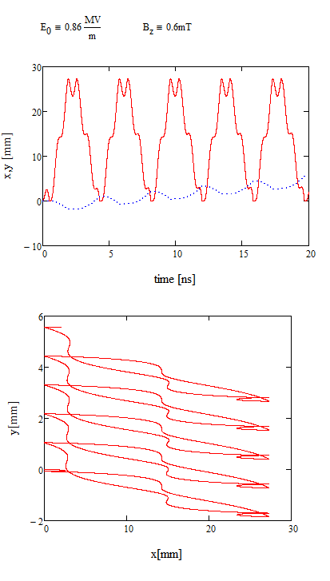
Qualitative calculation of multipacting between copper and ceramic with magnetic field
Bz = 0 mT
Bz = 0.3 mT
Bz = 0.6 mT
E field
copper
ceramic

Slide 17
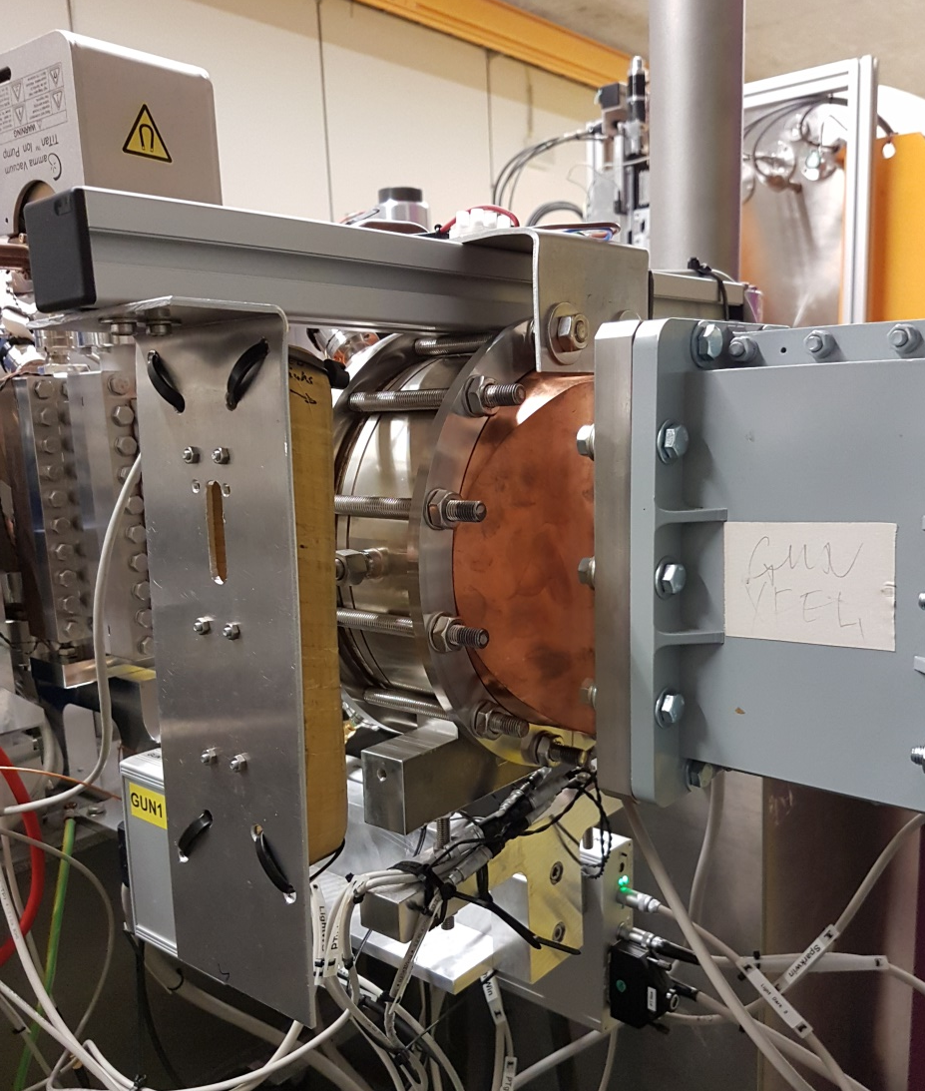
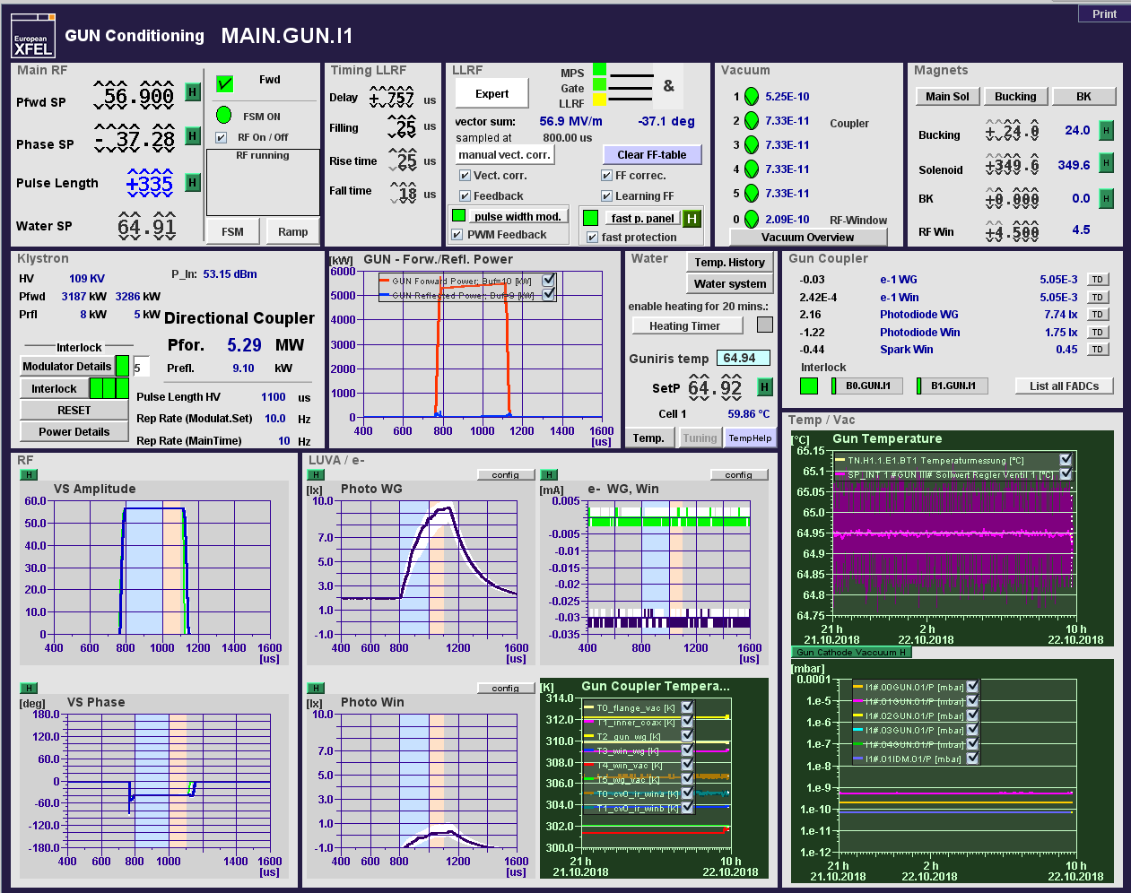
Preliminary installation of air coils at the gun vacuum window – successful suppression of MP
5A ~ 1mT

Slide 18
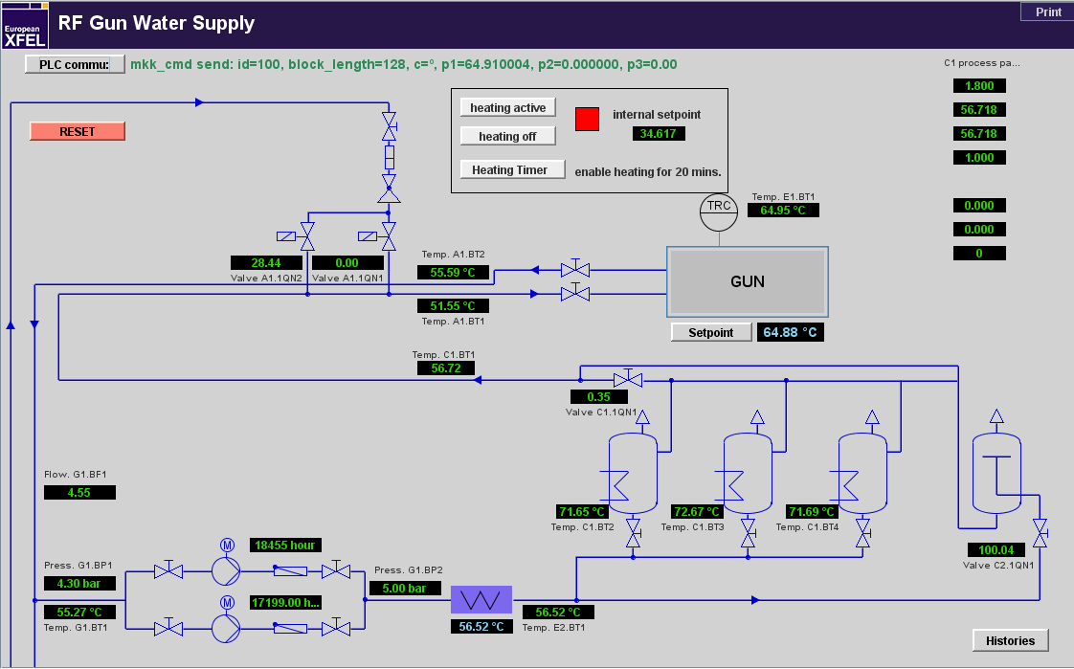
Water temperature regulation – gun operation
Precise,fast temperature regulation by adding cold water

Slide 19
Water temperature regulation – heating up for some time
64.6 C
Valve : open
Valve : closed

Slide 20
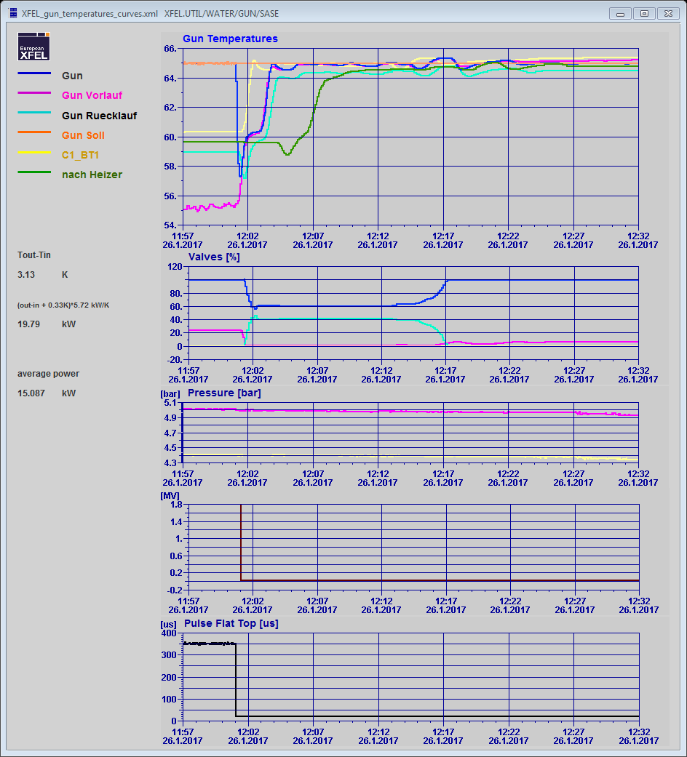
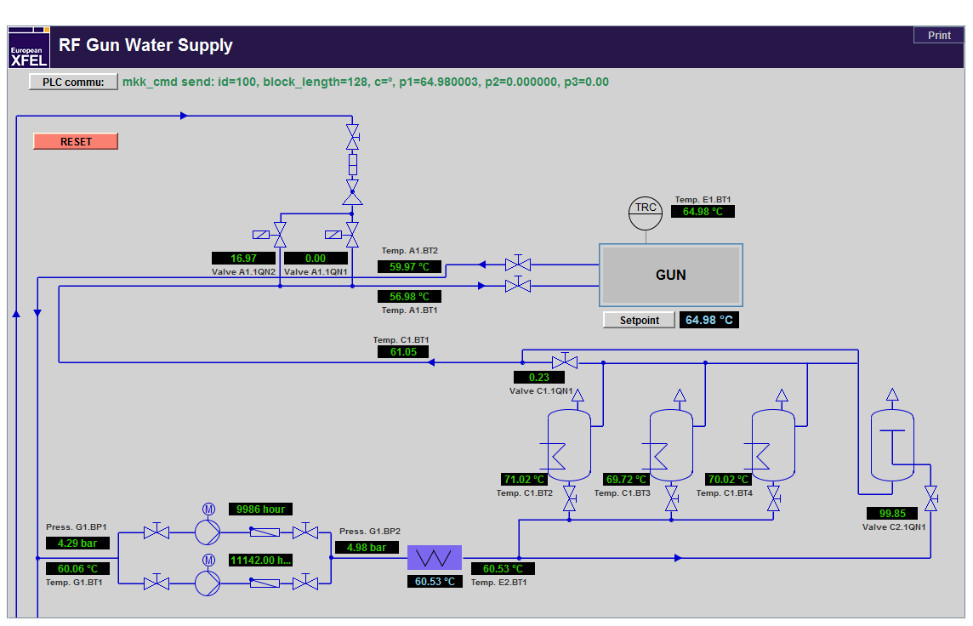
Heating up by adding hot water from the tanks

Slide 21
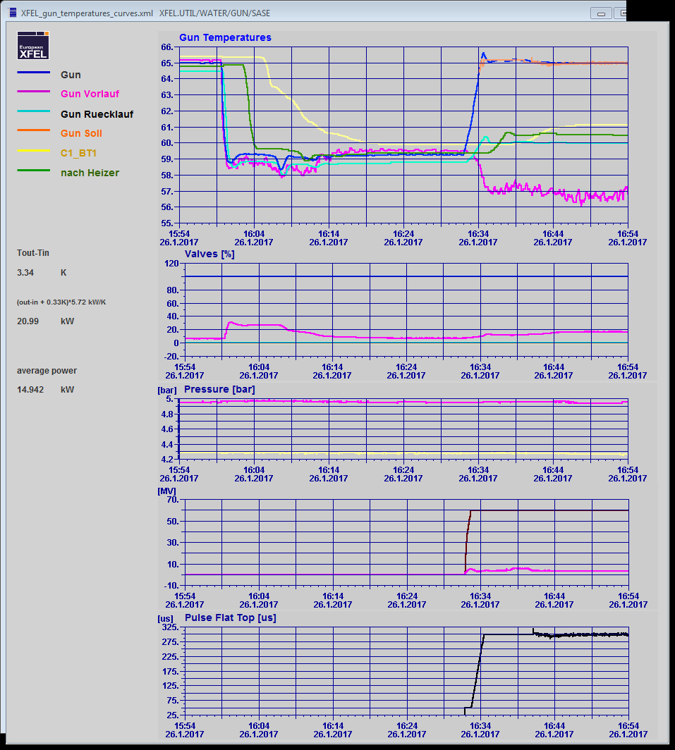
Cooling down with cold water

Slide 22
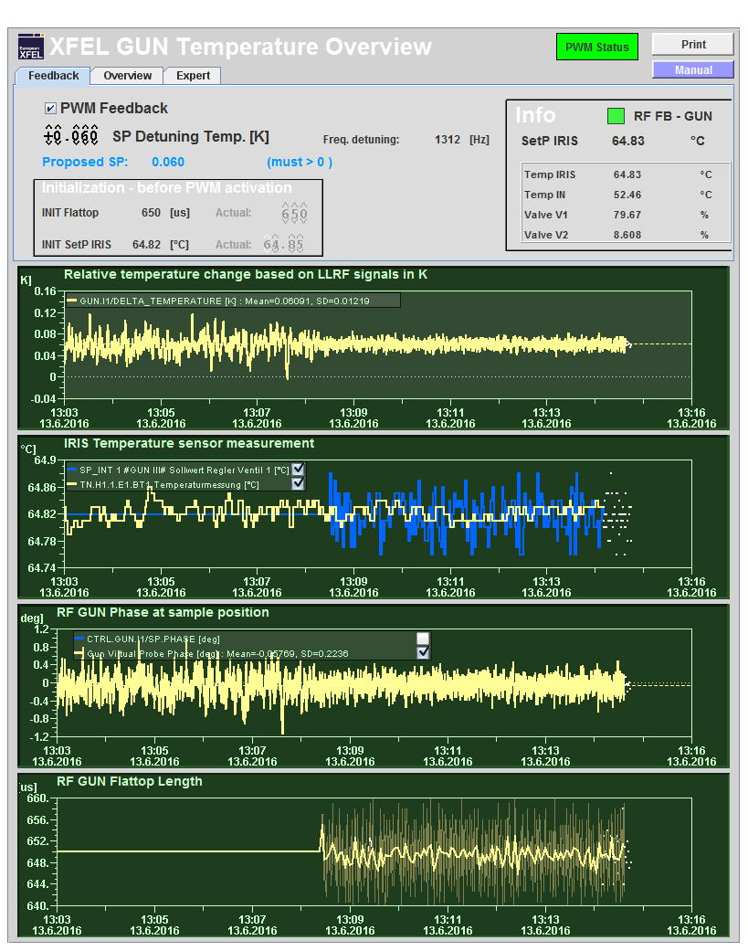
Pulse width modulation
Fast measurement of gun temperature/detuning (0.1sec vs. 7 sec)
compensate temperature deviations with the RF pulse width
Compensate for cooling water drifts after ramp

Slide 23
Fast Gun Ramp Up – by FSM Typically the parameters are taken from the last run!
1) FSM On
2) Choose targets: gradient and pulse width
Estimation for the start temperature
Only for new parameters!
3) Set start temperature and wait until it’s reached (~0.2 C )
4) Start ramp by switching FSM RF On
FSM messages

Slide 24
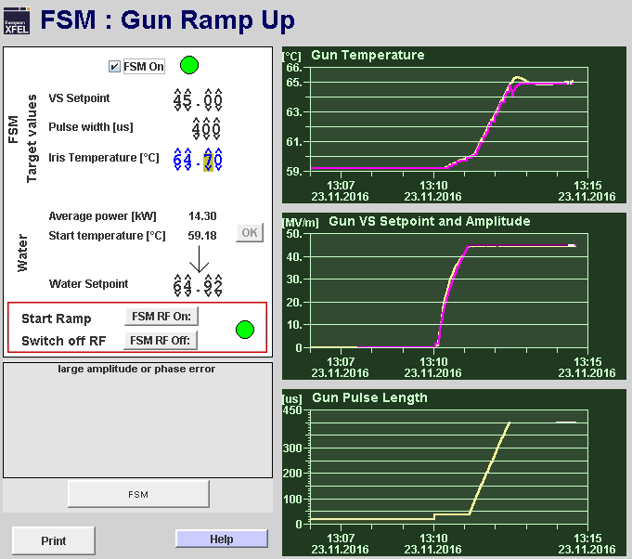
Fast Gun Ramp Up – by FSM
The FSM sets the Gun frequency on the actual resonance frequency defined by the temperature
Gradient and pulse length are ramped up
The temperature set point tracks the actual temperature which rises with RF power
The frequency is kept on resonance to avoid reflections
After reaching the target values, the FSM is waiting for the temperature to stabilize before setting the frequency to nominal.
The pulse width modulation is started to compensate for temperature drifts
When Set points for amplitude and phase are close to the measured values the feedback and learning feed forward are started. From now on the gun parameters can be changed by hand as usual
“RF off “ switches the gun off – the temperature setpoint follows the actual temperature, therefore we end up already with the correct starting point to come back with the same parameters

