Slide 1
The Next Generation
Material Structures
for
SRF Technologies
M. Eng. A. Özdem Sezgin, Dr. –Ing. Michael Vogel
Prof. Dr. rer. nat. habil. Xin Jiang
LOT
Fak. IV, Department Maschinenbau
University of Siegen
^{14.02.2020}
^{Hamburg}
SIS Multilayer Structures for Applications in SRF Technology (SMART)

Slide 2
Project
Systematic investigations of surface properties of novel materials – formed by coating of mono- or multi-layers of varying: Composition (e.g., Nb, Nb(Ti)N, Nb₃Sn, AlN, etc.) Thickness (multilayer S-I-S).
KEY CHALLENGES
Materials: | Stoichiometric films with low defect density for high crystalline quality.
Coating Processes: | Up-scaling capacity.
Optimization studies to determine feasible deposition parameters: Cathode Power, Gas pressure, Target/substrate materials, Substrate temperature, Substrate bias, Process gas.

Slide 3
Initial Objectives
Obtaining high-quality thin films (TFs) by controling the TF structures through: * TF Thickness, * TF Composition, * TF Uniformity.
Witness samples (Si – Nb, NbN ) for initial studies of Stoichiometry, Crystallography, ((Morphology)).

Slide 4
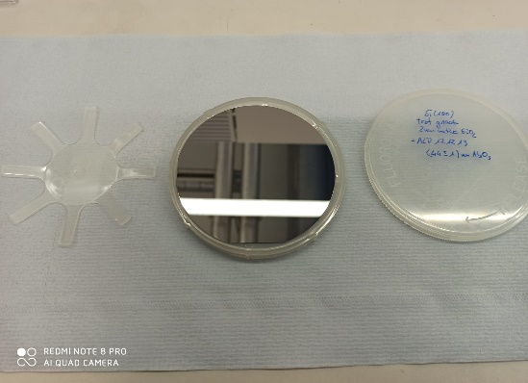
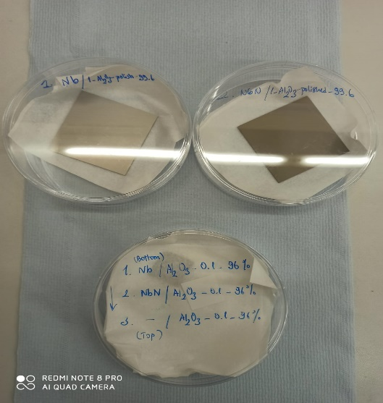
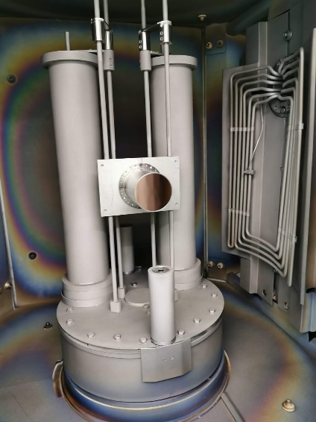
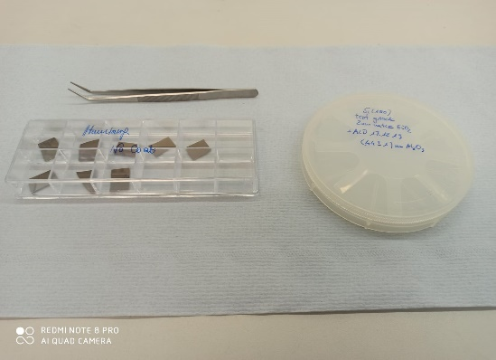
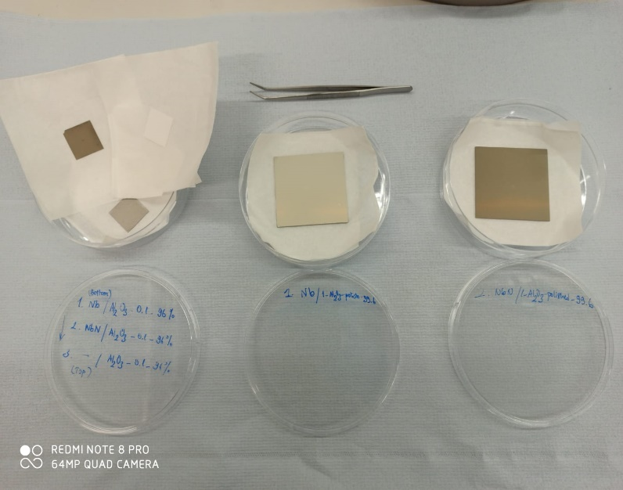
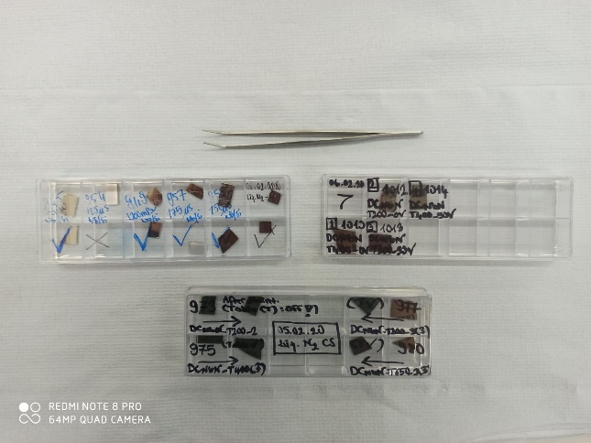
Materials & Infrastructures
Nb
NbN
Target: Nb (RRR300)
(100*88*10mm³)
ALD –Al2O3
(44nm) / Si<100>
Wf ~ Hamburg
Cleaved
Wf
Al2O3
Goodfellow
(25*25*0.1mm³)
Purity: 96%
Al2O3
Goodfellow
(60*60*1mm³)
Purity: 99.6%
CC800 - DCMS
Coated
substrates

Slide 5
Experiments
Process | Substrate Temperature T [ºC] | Process Gas Pressure p[mPa] | Process Gas | Process Gas Mass Flow Rate [sccm] | Cathode Power [W] | Substrate Bias [V] | Coating Time t_{c} [min]
1. 964 | 650 | 1200 | Ar / N₂ | 500 / 43 | 400 | 0 | 30
2. 970 | 200 | 1200 | Ar / N₂ | 500 / 43 | 400 | 0 | 30
3. 973 | 200 | 1200 | Ar / N₂ | 500 / 43 | 400 | 0 | 30
4. 975 | 400 | 1200 | Ar / N₂ | 500 / 43 | 400 | 0 | 30
5. 977 | 200 | 1200 | Ar / N₂ | 500 / 43 | 400 | 0 | 30
6. 980 | 650 | 1200 | Ar / N₂ | 500 / 43 | 400 | 0 | 30
7. 990 | 715 | 1200 | Ar / N₂ | 500 / 43 | 400 | 0 | 30
8. 994 | 715 | 1200 | Ar / N₂ | 500 / 43 | 60 | 0 | 240
9. 1012 | 200 | 1200 | Ar / N2 | 500 / 42 | 60 | 0 | 240
10. 1010 | 400 | 1200 | Ar / N2 | 500 / 43 | 60 | 0 | 240
11. 1013 | 200 | 1200 | Ar / N2 | 500 / 43 | 60 | 50 | 240
12. 1014 | 400 | 1200 | Ar / N2 | 500 / 43 | 60 | 50 | 240

Slide 6
Material Characterizations
XRD | Phase analysis
SEM / EDX | Thickness Composition

Slide 7
Results
Cross section (CS) - ALD-Al2O3-Si
Thickness (Th)=44.67nm

Slide 8
SEM – CS Images
DC-NbN
T200-400W-0V
NbN
977
Al2O3
Si
NbN
Al2O3

Slide 9
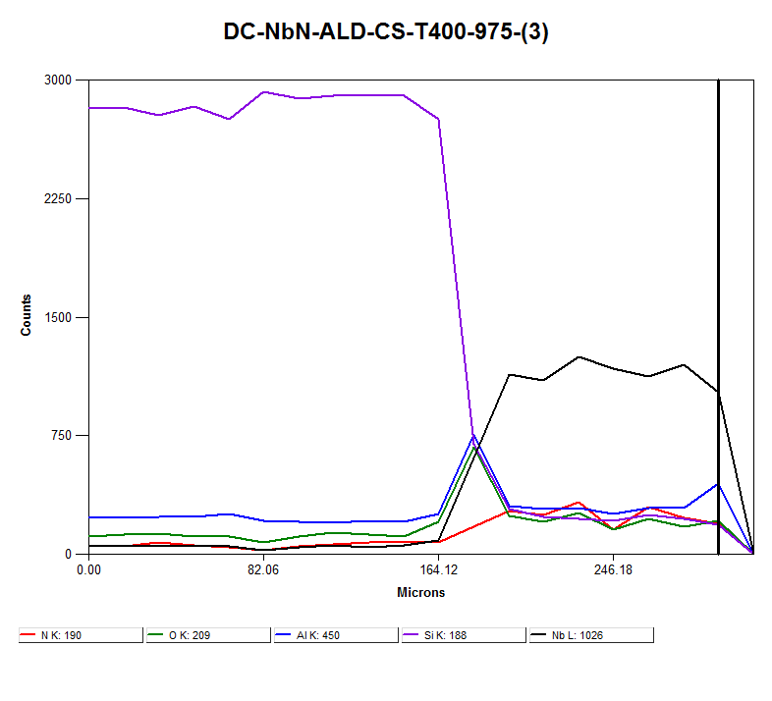
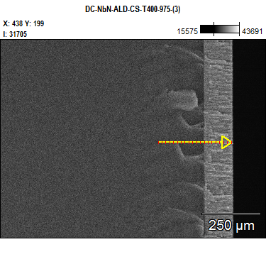
EDX – CS Analysis
975

Slide 10
SEM – Surface (S)
980 – T650
975 – T400
977 – T200

Slide 11
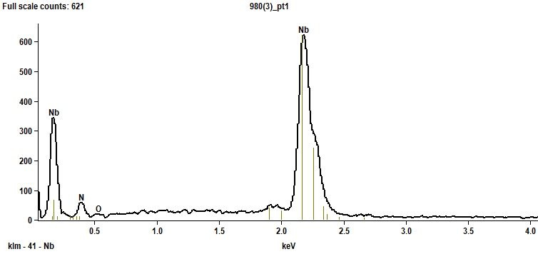
SEM / EDX
DC-NbN-T650-400W-0V
980
A. Özdem Sezgin, 12.02.2020

Slide 12
SEM – Thickness Analysis
T=200 [ºC]
Th=1.315 μm
T=400 [ºC]
Th=1.226 μm
977
975
T=650 [ºC]
Th=1.170 μm
T ➔ Thickness
980

Slide 13
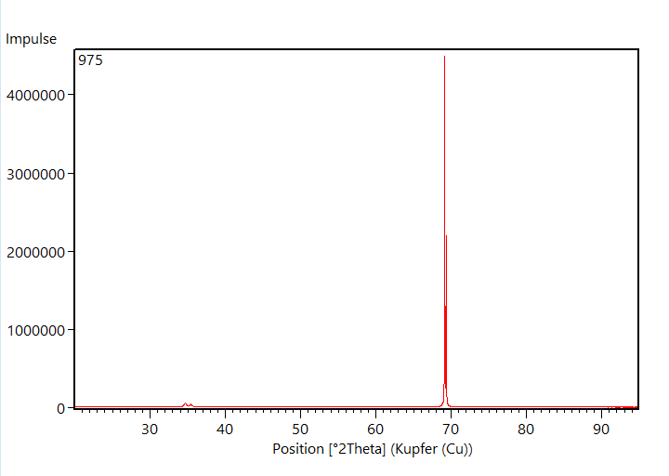
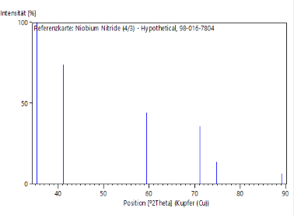
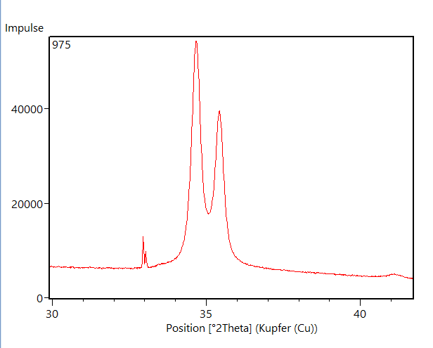
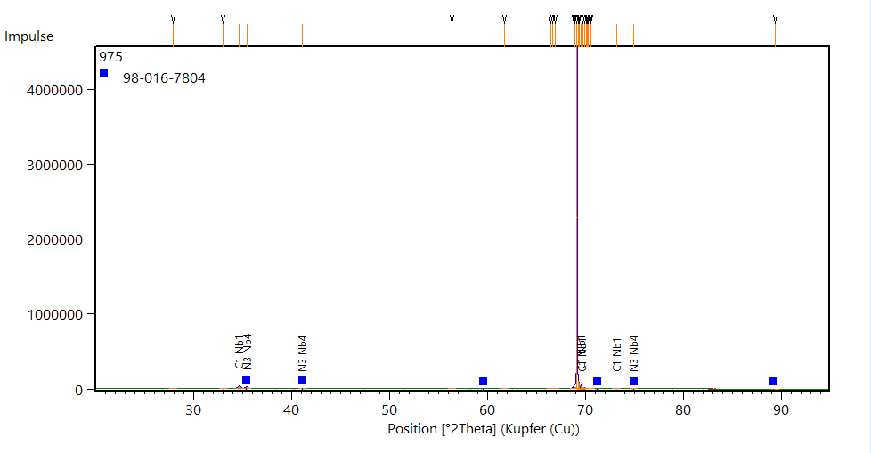
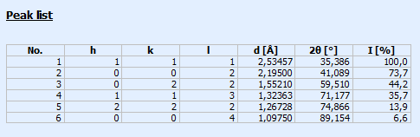
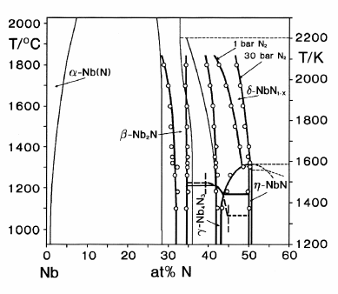
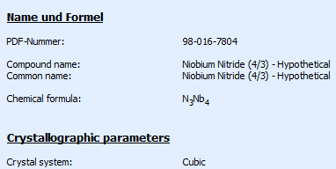
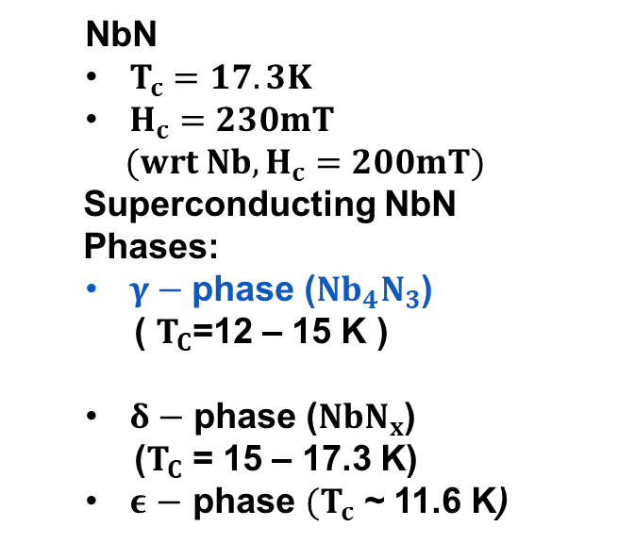
XRD
  NbN
  $T_{c}=17.3K$
  $H_{c}=230mT$
  $(wrt Nb,H_{c}=200mT)$
  Superconducting NbN
  Phases:
  $γ−$phase ($Nb_{4}N_{3}$)
  ( $T_{C}$=12 – 15 K )
  $δ−$ phase ($NbN_{x}$)
  ($T_{C}$ = 15 – 17.3 K)
  $ε$ $−$ phase $(T_{c}$ ~ 11.6 K)
Si (100)
Nb4N3(111)

Slide 14
Future Work
Further elaboration of the thin films with various materials characterization techniques (e.g.,TEM, AFM, STM, SIMS, etc.), Working on Nb substrates - provided by Hamburg team, Target geometry and composition screening (e.g., NbxSny, Nb target with Sn plugs, Nb and Sn individual targets), Utilizing different PVD methods (DCMS, RFMS, HiPIMS), Multilayered TF studies - incorporating insulating layer (e.g., AlN) (to pave the way to SIS structures).

Slide 15
Acknowledgements
Apart from the invaluable guidance and on point constant feedback from my supervisors, I do appreciate each and every member of LOT for their extensive support. I also would like to acknowledge my colleague Stewart Leith for fruitful discussions and the exchange of information along with Thorsten Staedler, Petra auf dem Brinke from LOT and Markus Hartmann from LWF for AFM, SEM / EDX and XRD measurement introductions, respectively.

Slide 16
THANK YOU
FOR
YOUR ATTENTION !

