Slide 1
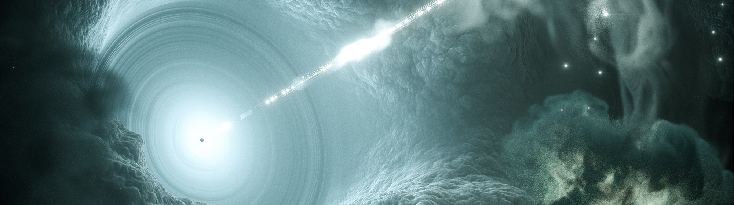
Astroparticle Physics
A rapidly developing field of research
Christian Stegmann, 7.2.2020

Slide 2
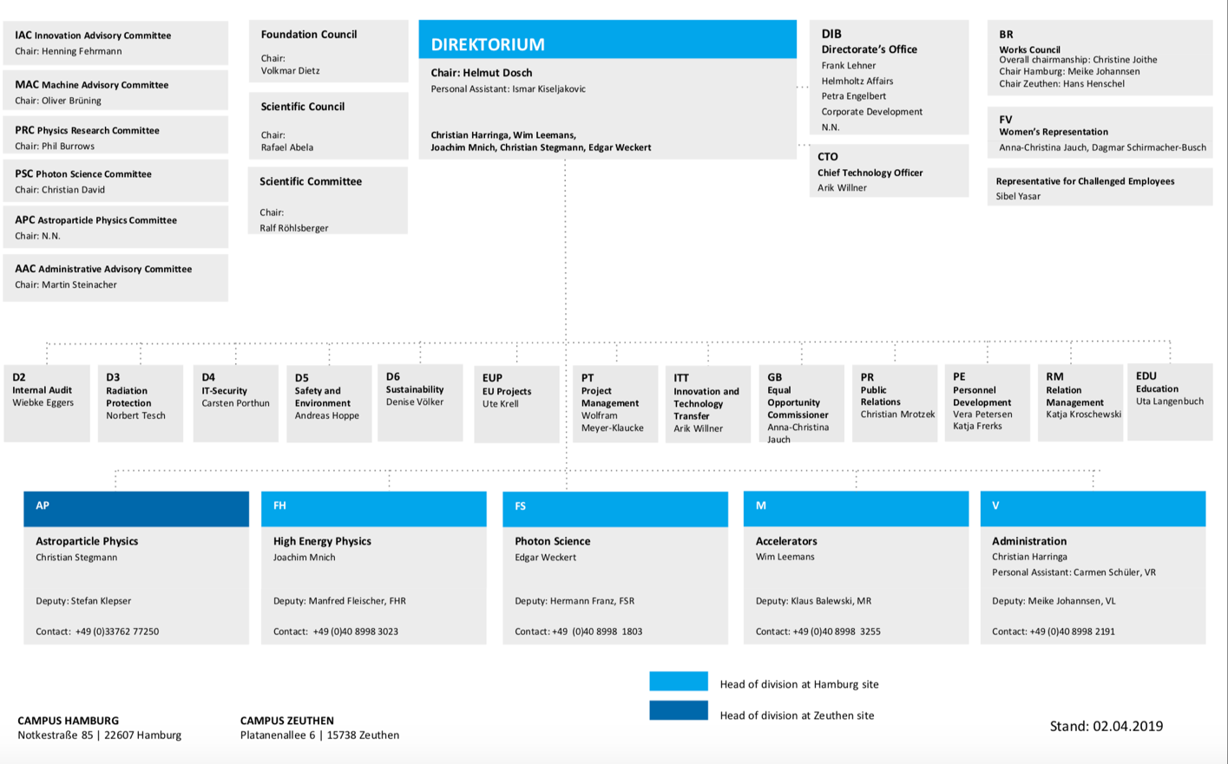
The AP Research Division is in place and working

Slide 3
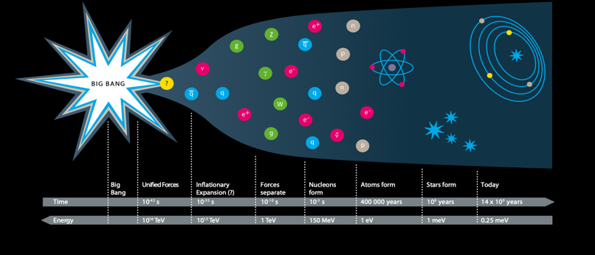
We want to understand the high-energy Universe and ist constituents
Gamma-ray astronomy
A broad but coordinated research program with observatories (and in laboratories)
– a growing field of science
Strong interplay between experiments and theory
Received a short but clear PoF IV recommendation:
„Continue with the ambitious posture of the Helmholtz programm“
Neutrino astronomy
Multi-messenger view of the cosmos
High-energy Universe today
Cosmic rays
Understand the role of neutrinos in the Universe
Gravitational waves
Search for new physics and Dark Matter

Slide 4

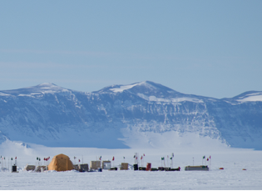
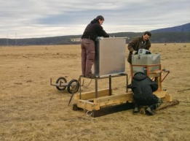



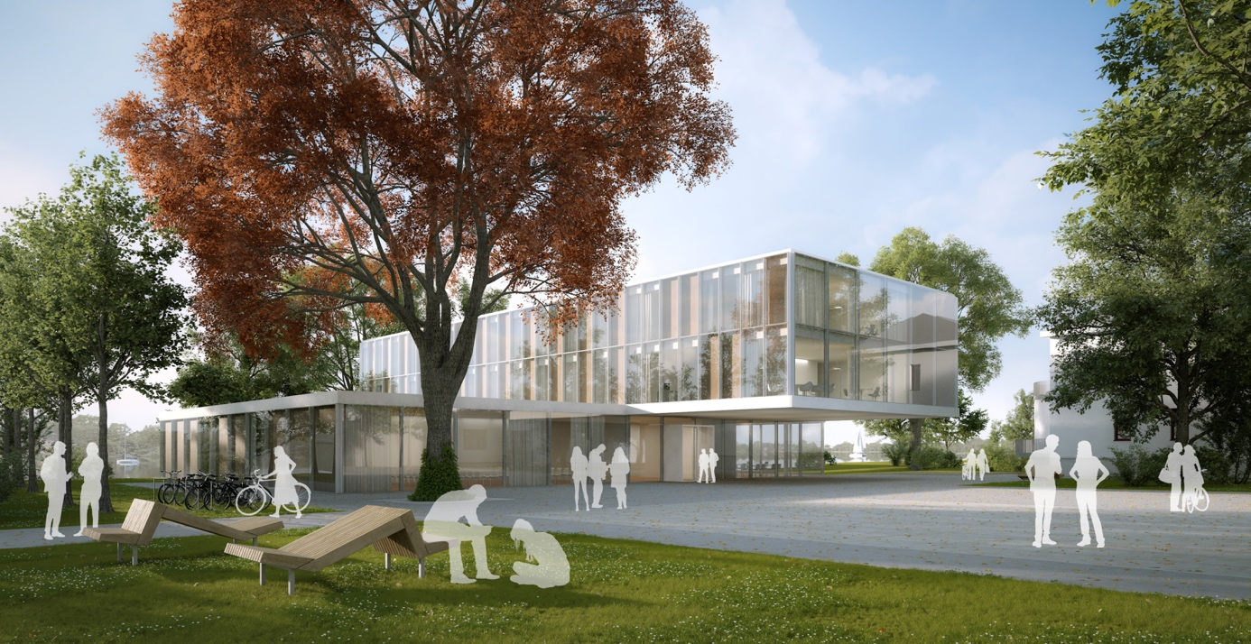

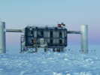
INFRASTRUCTURES & COOPERATIONS
ULTRASAT
 | High-energy Universe | Neutrino properties | Dark Matter
CTA
IceCube
(Gravitational Waves)
Theory
We are members in large international collaborations operating instruments
at remote places
RNO
TAIGA
VERITAS
MAGIC
CTA
CTA
H.E.S.S.
IceCube
CTA Science Data Management Center in Zeuthen

Slide 5
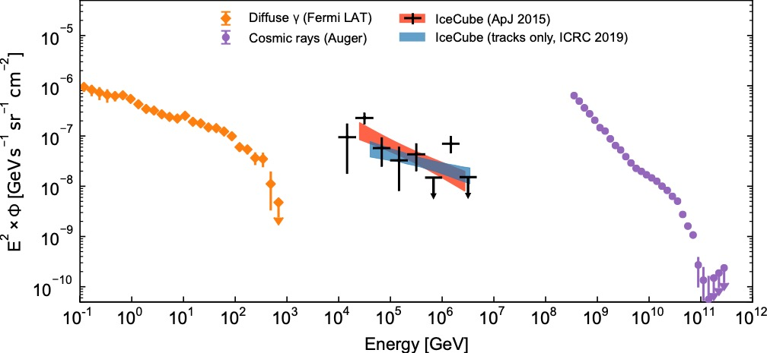
We want to understand cosmic environments
Energy flux of cosmic messengers
gamma rays
neutrinos
cosmic rays
Markus Ackermann, DESY
CTA
Gen2
Fermi
IceCube
Auger

Slide 6
γ
Gamma rays
ν
Neutrinos
Multimessenger
Astronomie
DESY
DESY/KIT
GW
Gravitational Waves
p
Cosmic rays
KIT

Slide 7
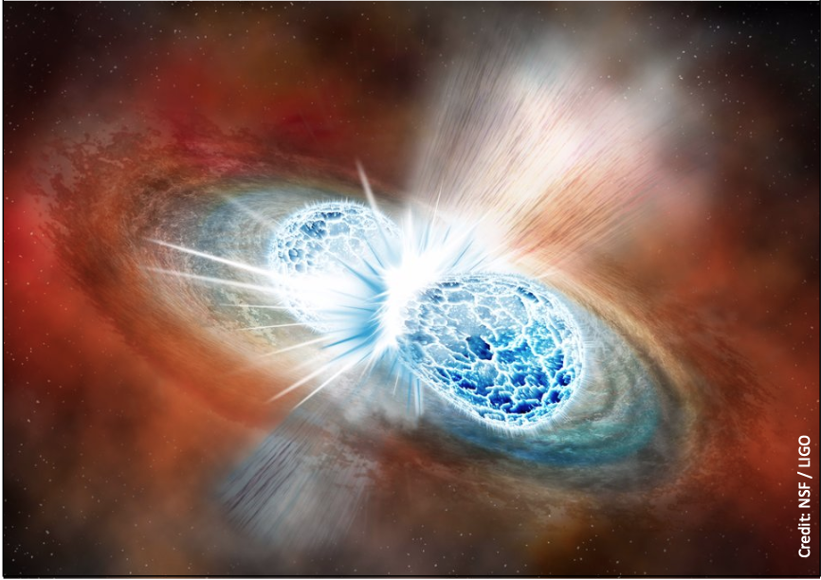
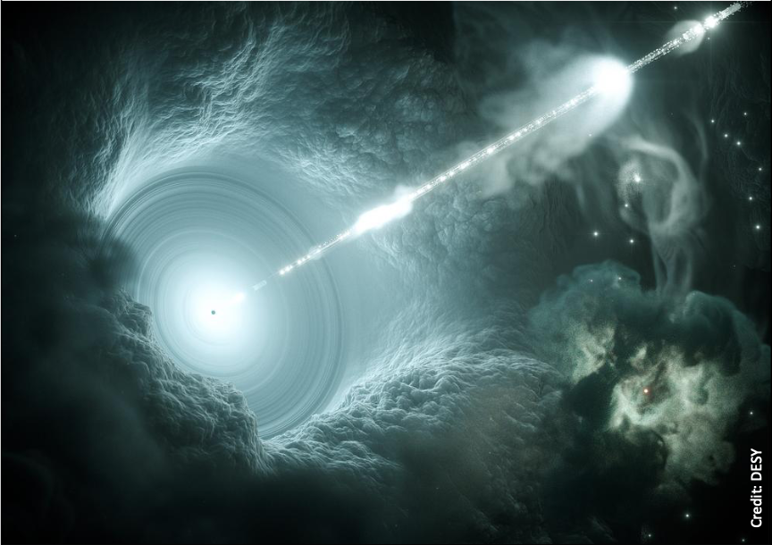
The Birth of Multimessenger Astronomy
Highlight 1: Neutron star merger
How: Gravitational waves + optical + x-rays + ...
Observed by more than 70 observatories
Highlight 2: The first source of cosmic neutrinos
How: Neutrinos + Gamma rays
Observed by 16 observatories

Slide 8
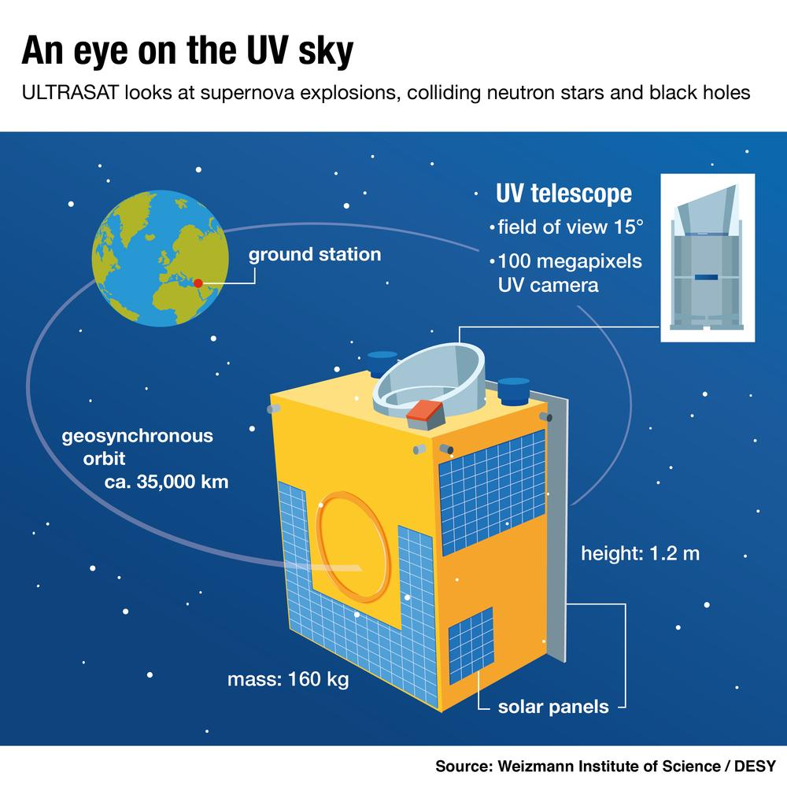
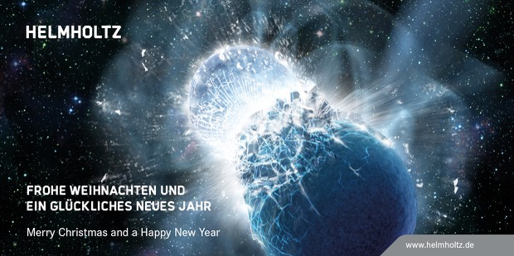
We want to study celestial objects in all channels
Transient multi-messenger astronomy
Artist image of the neutron star merger GW170817:
Gravitational Wave Astronomy
Needs national initiative to organize German contribution.
We are actively participating.
Gravitational wave follow-up observations with ULTRASAT
Advance and run multi-messenger realtime analysis center

Slide 9
Particle Physics
Photon Science
Astroparticle Physics
Accelerator Physics
Berlin-Brandenburg
Hamburg

Slide 10

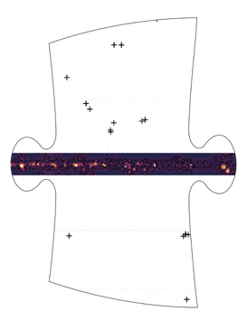
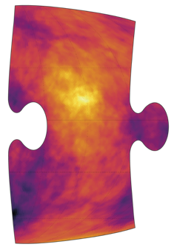
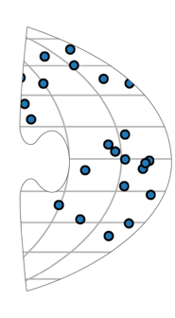

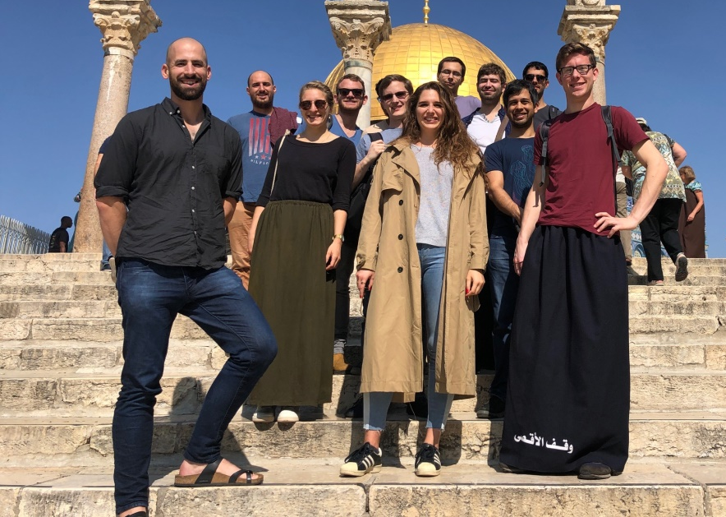
We see the Cosmos as never before
Our emerging view of the high-energy Universe today:
gamma rays
neutrinos
very-high-energy
gamma-rays
cosmic rays
Within the next decade: We make decisive steps towards a coherent picture of the Universe

