Slide 1
XFEL Operator Training
Low Level Radio Frequency (LLRF)
Julien Branlard, for the LLRF team

Slide 2
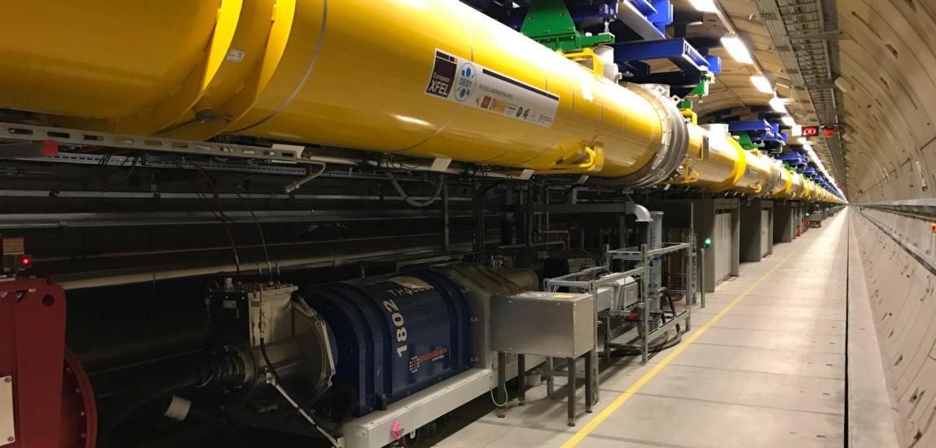
Contents
Introduction
What an operator should know
Exceptional cases and how to react

Slide 3
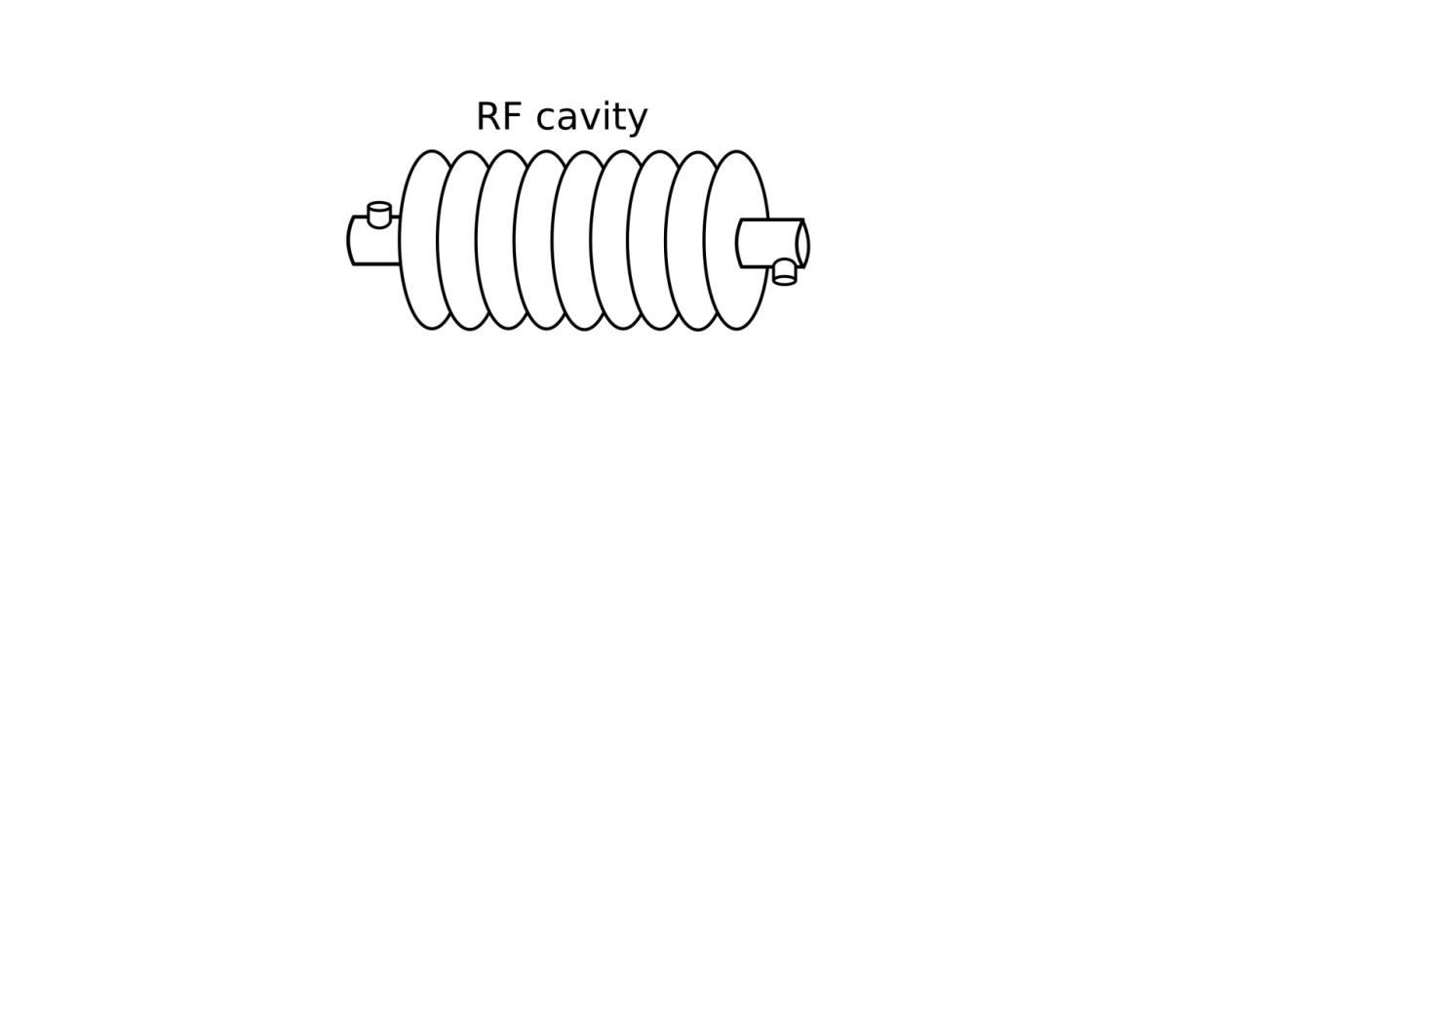
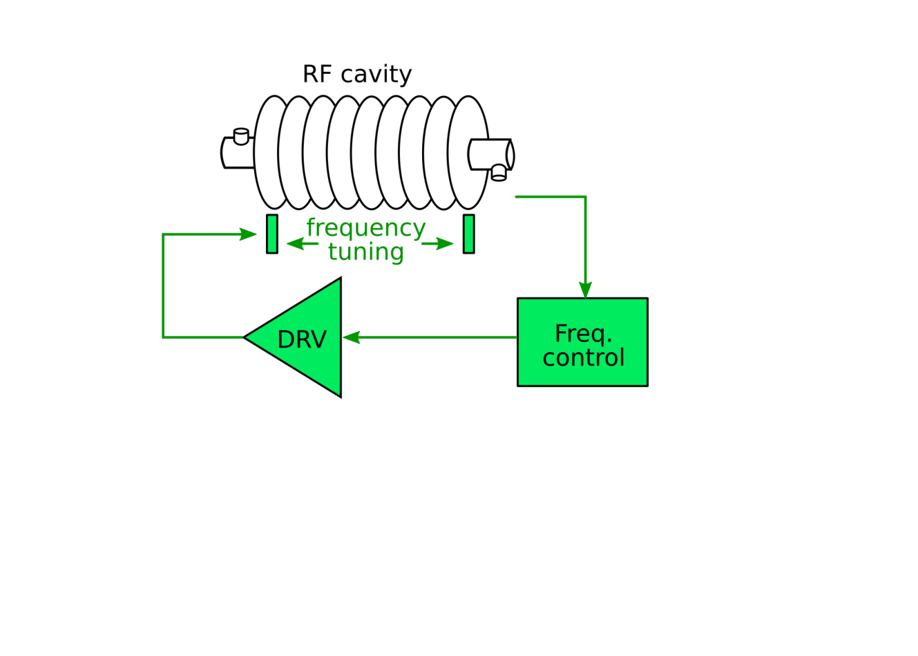
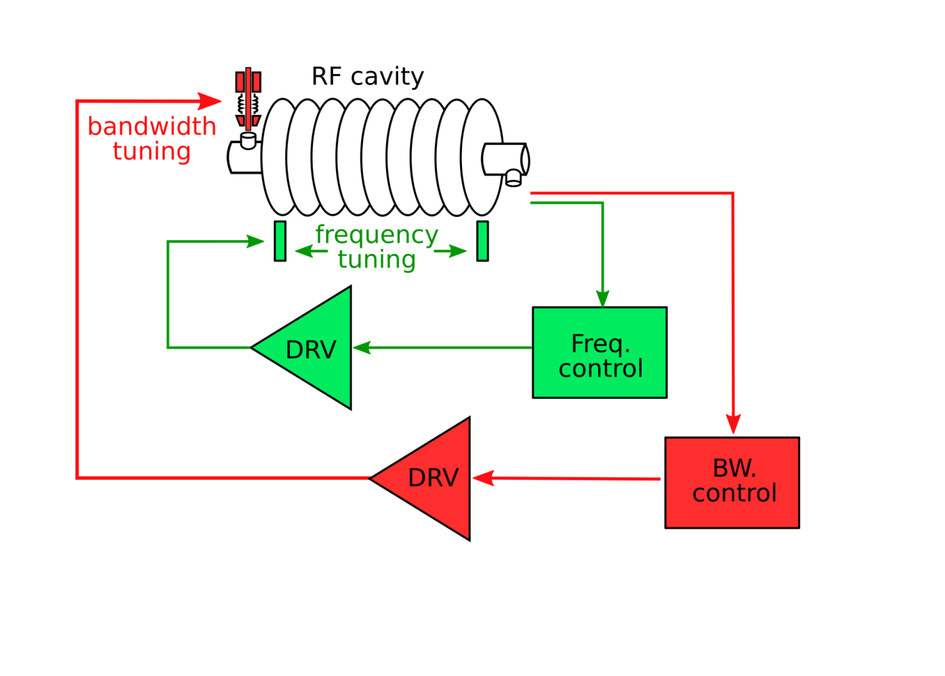
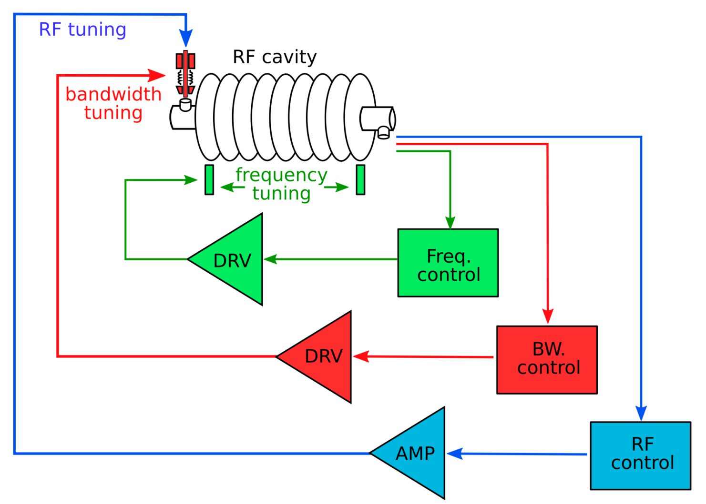
Introduction
LLRF and RF operations
Low Level Radio Frequency
Our task: digital control of accelerating fields inside the cavities
Normal conducting gun 1.3 GHz
Super conducting cavities 1.3 GHz and 3.9 GHz (AH1)
Other tasks often labelled as LLRF
Frequency control (cavity tuning)
Bandwidth adjustments (Q_{L})
Quench detection
Trip recovery

Slide 4
Introduction
LLRF Systems
Where are we involved?
In every RF station
30 LLRF systems
TDS-INJ
TDS-BC2
reserved for tests

Slide 5
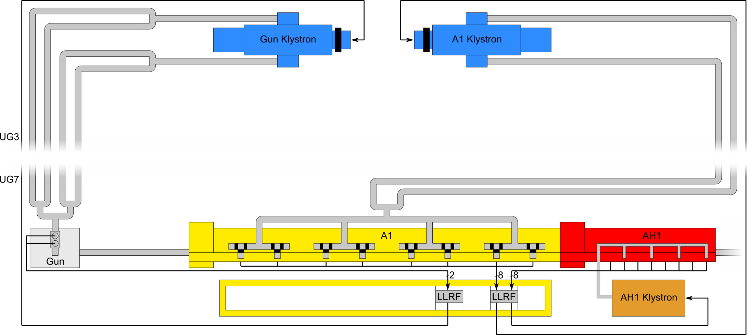
Introduction
LLRF Systems
RF Stations in the injector

Slide 6
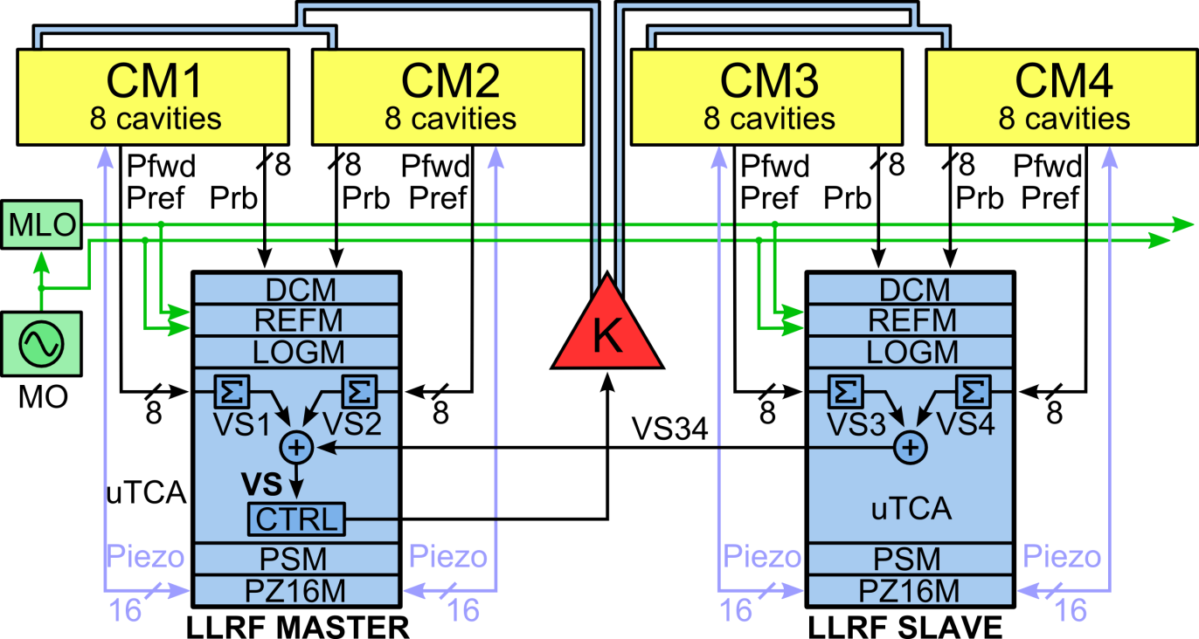
Introduction : LLRF Station Overview
XTL RF station: semi-distributed LLRF system
DCM
Drift Compensation Module
REFM
RF Reference Module
LOGM
Local Oscillator Generation Module
PSM
Power Supply Module
PZ16M
Piezo Driver Module

Slide 7
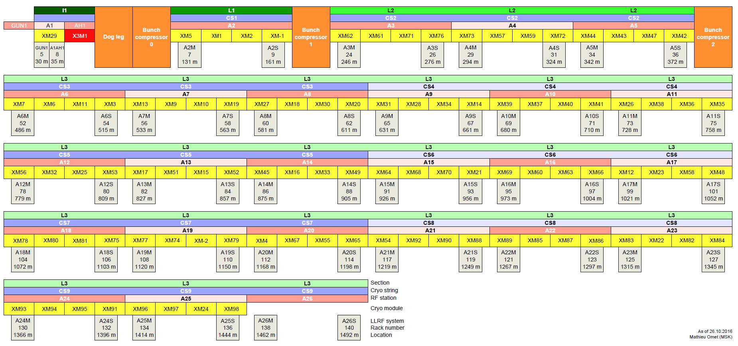
Introduction : LLRF Station Overview

Slide 8
What an operator should know
LLRF tasks of the XFEL operator:
Turn an RF station ON / OFF
Adjust the vector-sum voltage / phase
Tune cavities, if necessary
Adjust output vector correction and ratio, if necessary
Set a certain phase as on-crest phase

Slide 9
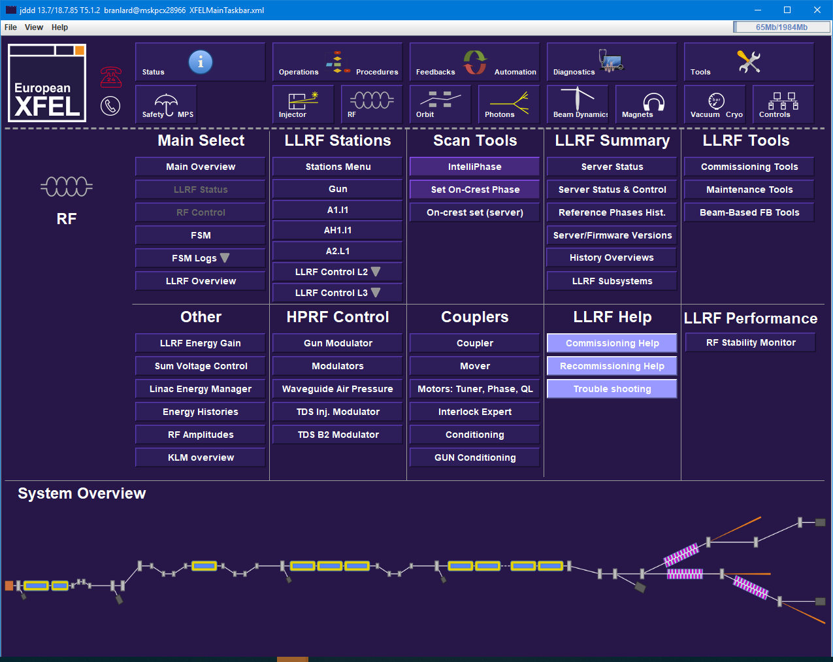
What an operator should know
Check amplitude and phase set point, RF control settings and flat tops

Slide 10
What an operator should know
Check waveform profiles (open loop, glitches, etc…
i.e. deviation from set point)

Slide 11
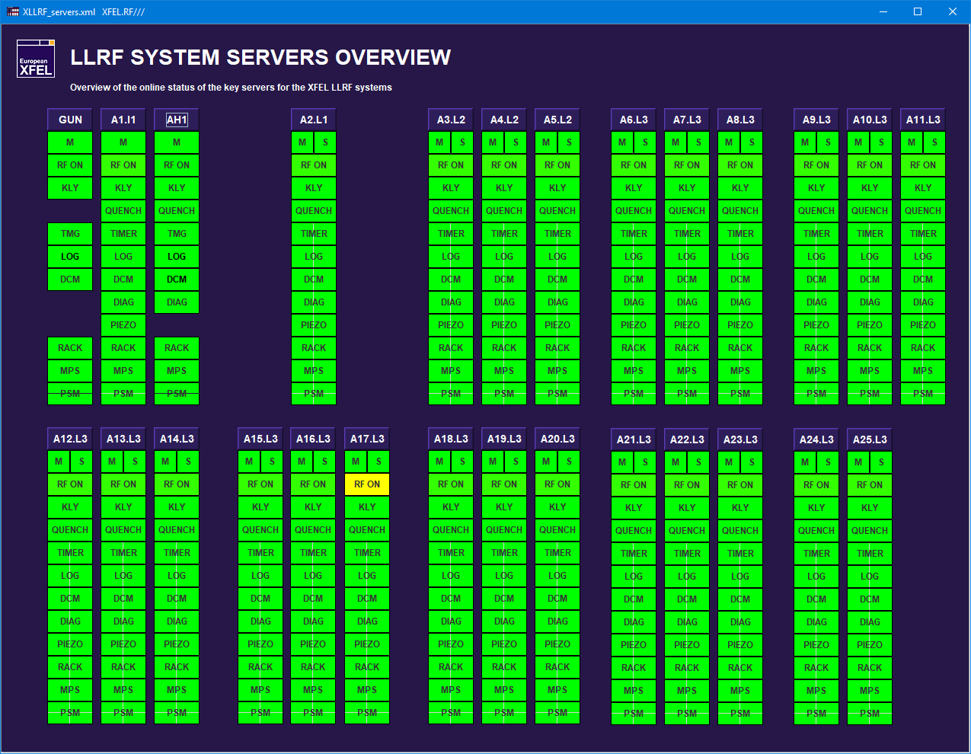
What an operator should know
Check for server failures (all should be green!)
Good way to catch a “zombie” station
A17 shifted OFF beam

Slide 12
What an operator should know
Navigate to the main LLRF panel of a particular RF station: INJ, L1, L2, L3

Slide 13
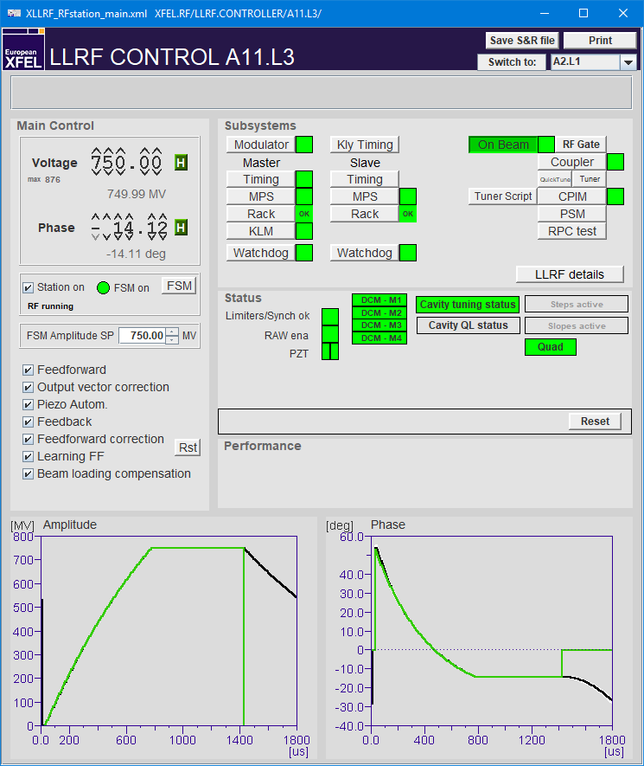
What an operator should know
Voltage setpoint
Phase setpoint
NEW: Cavity tuning indicator
(should be green)
Ramp station with FSM
Check for ON,
FSM should be green
FSM recovery voltage
Quench notifications
RAMP-DOWN
NEW: drift compensation module (DCM)
NEW: piezo
ALL these settings should be enabled*
* exception gun
Not green:
OK for operation but drifts are not compensated
Not green:
OK for operation but piezo automation is not working
RAMP-UP
elog entry → LLRF
elog entry → LLRF

Slide 14
What an operator should know
Not green:
Might lead to RF pulse cuts
NEW:
Steps active (yellow) : i.e. different flat tops
elog entry → LLRF
NEW:
Slopes active (yellow) : i.e. RF slope across the flat top
RAW ena should always be GREEN
Debug mode only
NEW:
Error message area
(does NOT auto clear so it could be “old” news)
Not green:
Piezo driver has problems or is switched off
elog entry → LLRF

Slide 15
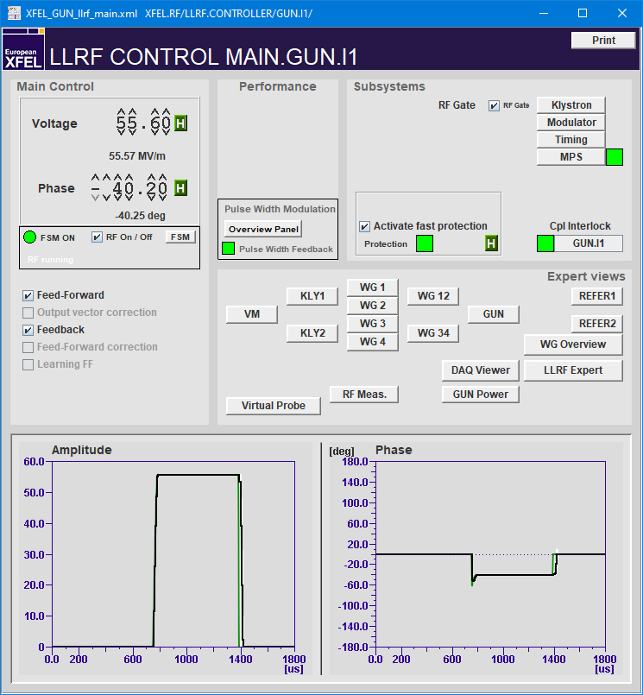
What an operator should know
Special case GUN
Note that for the gun, the following features are greyed out and should stay disabled:
Output vector correction
Feed-forward correction
Learning FF

Slide 16
What an operator should know
Drive with FF only (i.e. open loop) no feedback trying to minimize error between signal and set point
Linear scaling of amplitude and phase drive to minimize error
Enables cavity tuning using piezos, (including Lorentz force detuning)
Drive with FB (closed loop)
Applies small corrections to FF to compensate for systematic errors
Learns from pulse to pulse to adapt these small corrections
Re-initialize what has been learn so far (i.e. start from empty correction)
Applies small correction to the drive to compensate for the presence of beam (i.e. scales with beam parameters)

Slide 17
What an operator should know
Changing RF amplitude set point
YES
Change is less than 100 MeV ?
NO
Do it in closed loop
Do it in open loop
Dial in new SP
Open the loop and adjust SP
NO
After adjustment limiters are triggering ?
YES
Adjust OVC amplitude and ratio
Note:
Changing SP phase does not require so much care, but should be also done progressively (i.e. steps of 10 deg.)
Revert to previous SP and try in open loop
Check tuning and adjust OVC phase
Close the loop
Done

Slide 18
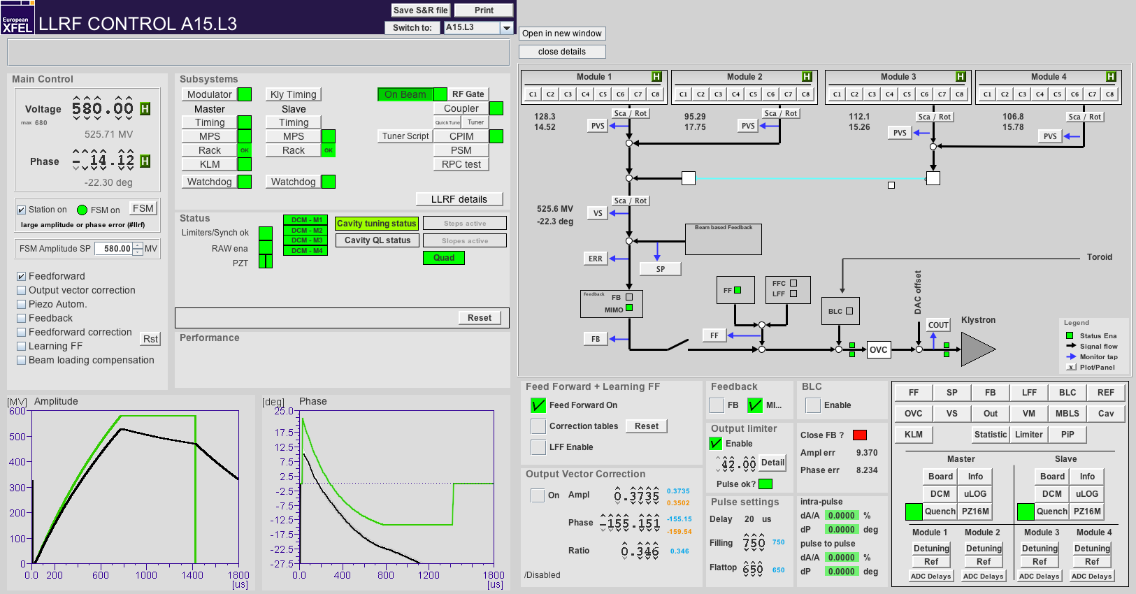
What an operator should know
Changing RF amplitude set point in open loop (1/4)

Slide 19
What an operator should know
Changing RF amplitude set point in open loop (2/4)

Slide 20
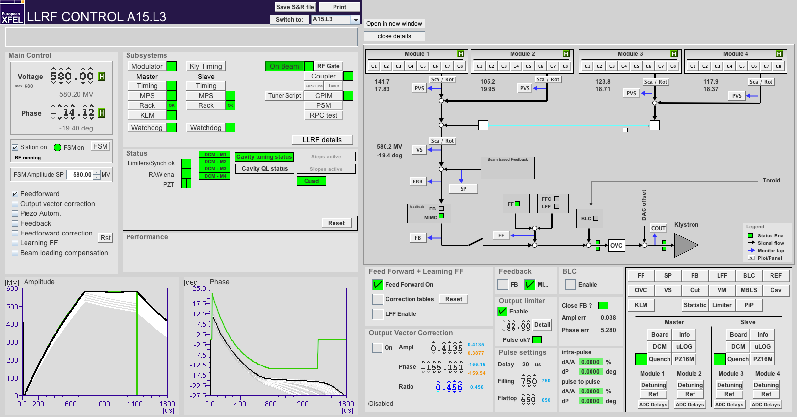
What an operator should know
Changing RF amplitude set point in open loop (3/4)

Slide 21
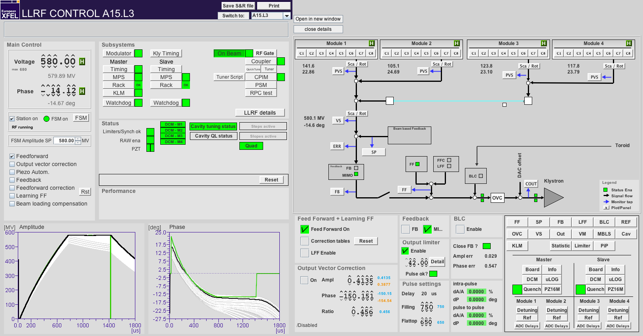
What an operator should know
Changing RF amplitude set point in open loop (4/4)

Slide 22
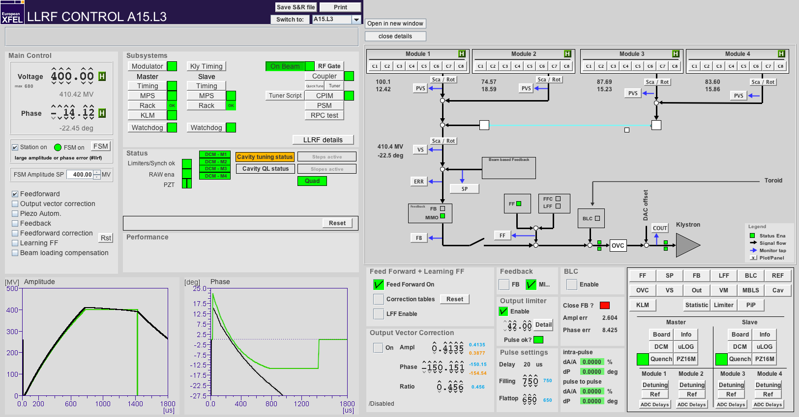
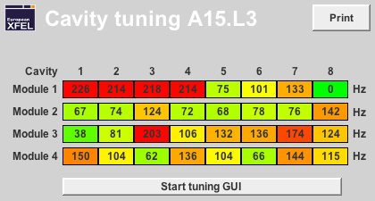
What an operator should know
Tuning cavities (1/2)

Slide 23
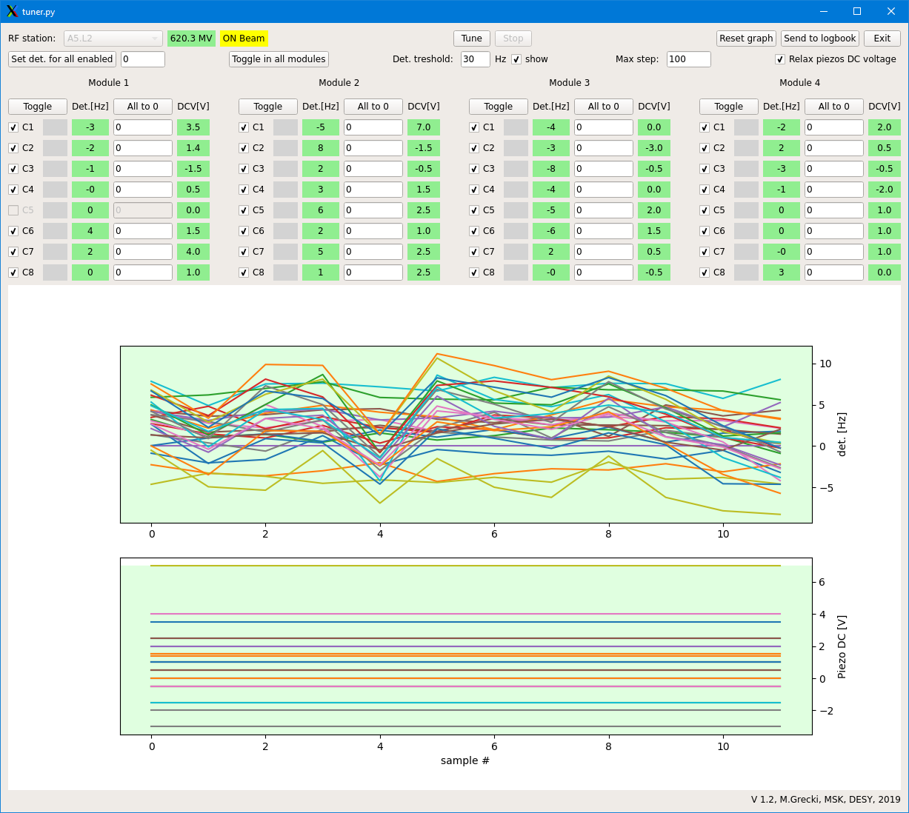
What an operator should know
Click “Tune”
Tuning cavities (2/2)
New interface
Shows tuning [Hz] and piezo DC bias [V]
both should converge to 0
“relax piezo DC voltage” is enabled by default
Some cavities should NOT be tuned (greyed out)
Cavity detuning [Hz]
Some error message may pop up
You can choose to ignore once or twice but if problem persists, call expert
Piezo voltage (DC bias [V])

Slide 24
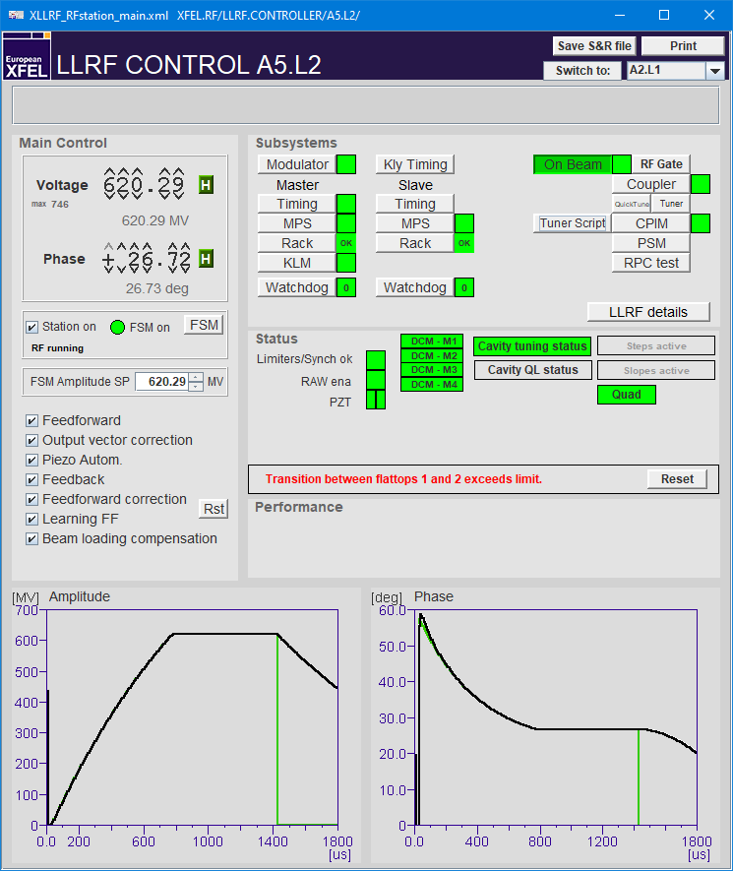
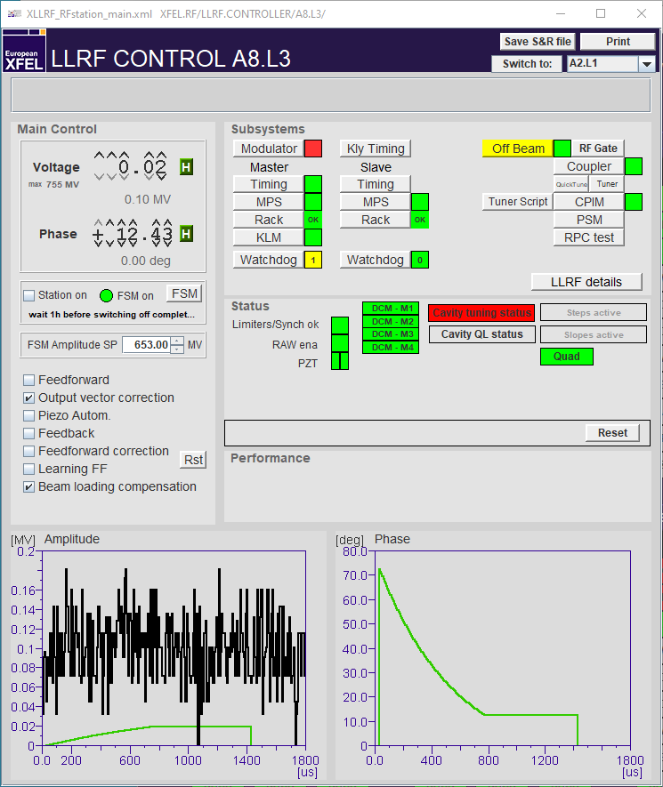
What an operator should know
Error messages
Error message area:
Currently only used for multi-flat top settings but might be extended in the future
The error message latches. First try to reset, if persists, call LLRF expert
Sum of server errors should be 0 (green)
If not, elog entry to LLRF

Slide 25
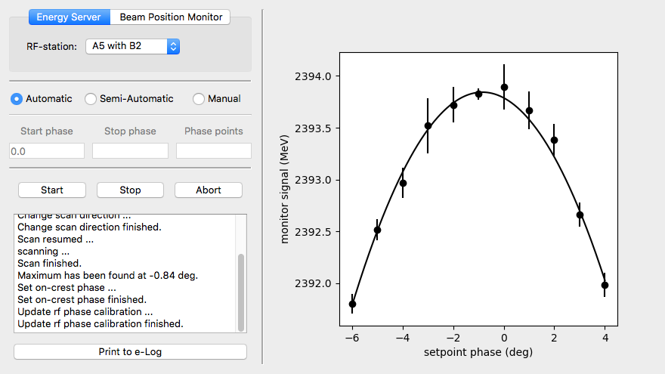
What an operator should know
Setting the on-crest phase
The phase at which the max energy is measured is defined as on crest phase and corresponds to the “new” 0 phase setting in the LLRF controller

Slide 26
What an operator should know
RF station color code
Actually not LLRF but belongs to RF operation
Station UP
Station DOWN
Station TRIPPED
Note:
Sometimes, the color indicator on the main display shows yellow/red instead of green,
➔ Simply disable / re-enable FSM to force a status refresh
Station UP FSM is ON
Station DOWN
FSM is ON
Station DOWN
FSM is ON
FSM ON
Station UP
FSM is OFF
FSM OFF
Station OFF beam
Station ON beam

Slide 27
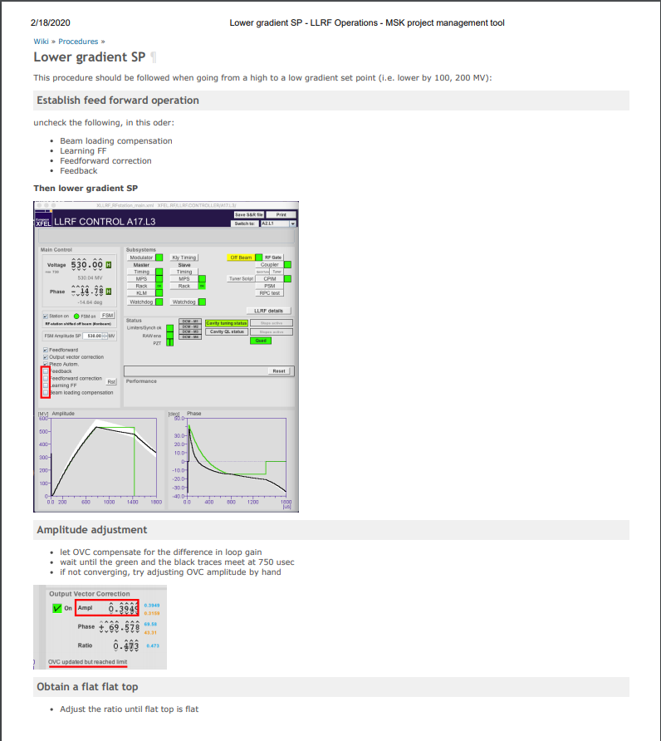
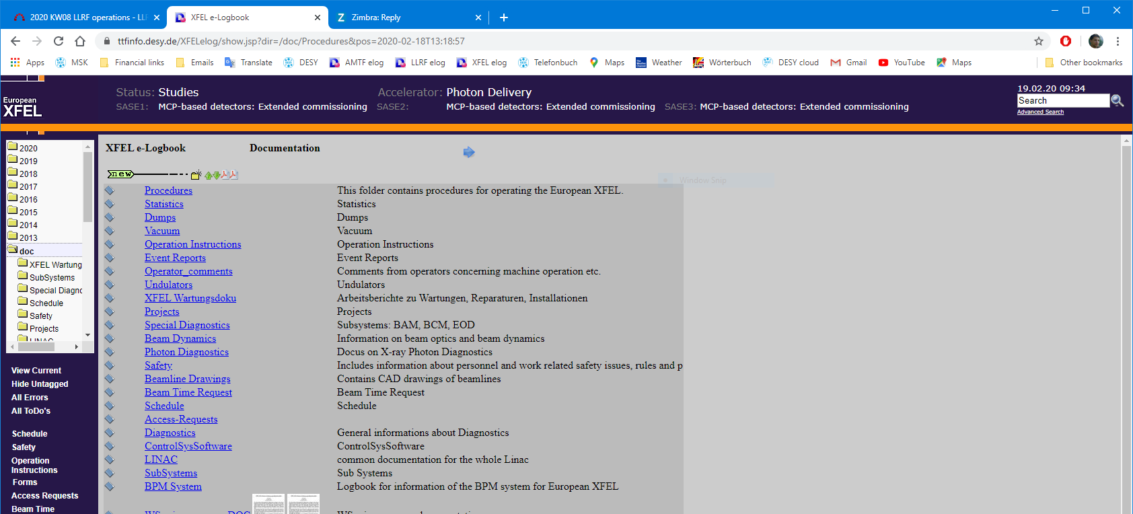
What an operator should know
Procedures

Slide 28
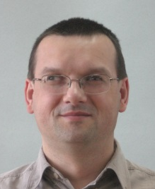
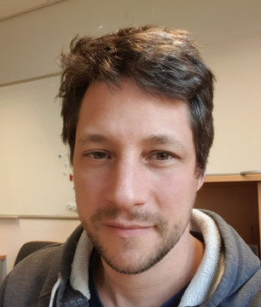
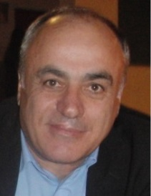
LLRF on-call service
LLRF on-call 5588
8 experts, 24/7
llrf-expert@desy.de
Send log book entry to LLRF expert list
PLEASE, PLEASE, PLEASE:
Write your name / initials
Use the Tag fields (at least Location)
Christian
Julien
Mariusz
Martin
Matthias
Sven
Uros
Valeri

Slide 29
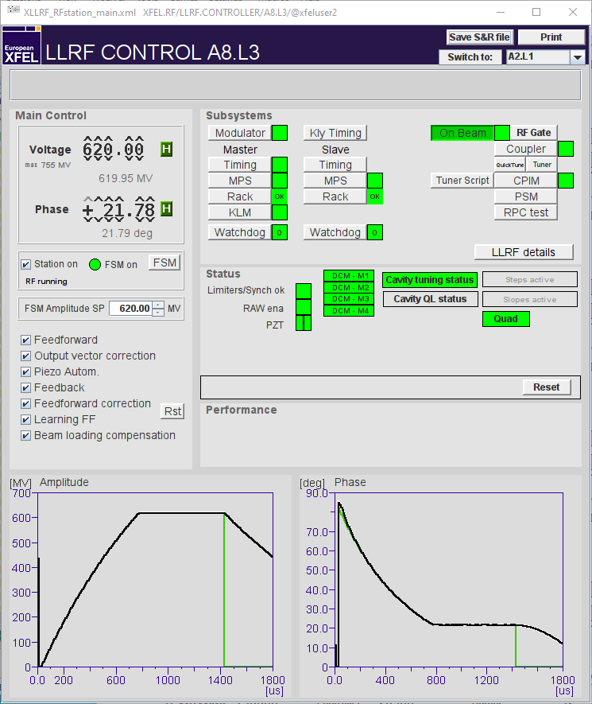
Exceptional cases and how to react
Pulse cuts due to gradient limiters
Note:
Pulse cuts are displayed on the main panel (limiter / KLM)
The beam is cut if the RF pulse is cut
What to do:
Document in log book and send to LLRF
Lower the gradient if possible
Limiter indicator is red
3. If you want, you can check what is the limiting factor
(see next 2 slides)
RF pulse is shorter

Slide 30
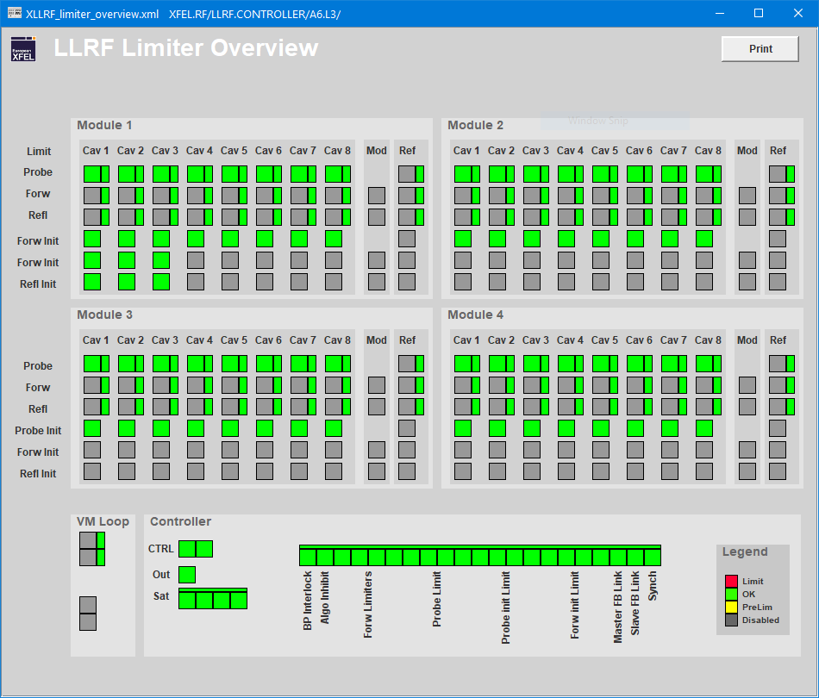
Exceptional cases and how to react
Pulse cuts due to gradient limiters
RF pulse is shorter
Check if a specific cavity is the reason for the cut

Slide 31
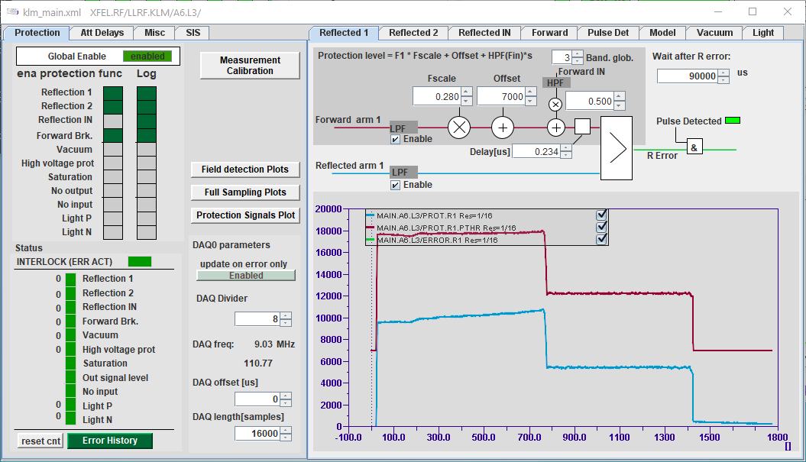
Exceptional cases and how to react
Pulse cuts due to gradient limiters
8
If all cavity limiters are green, the cut probably comes from the Klystron Lifetime Management (KLM) system.
In any case,
Document in log book and send to LLRF
Lower the gradient if possible
RF pulse is shorter

Slide 32
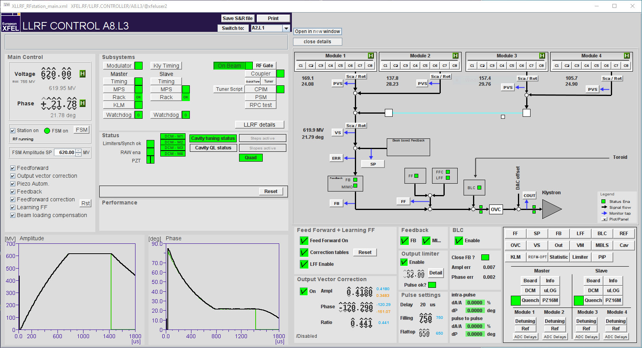
Exceptional cases and how to react
Limiter is red (but no cut)
What to do:
Document in log book and send to LLRF
Lower the gradient if possible
If this output limiter is red:
SP is too high
or
2. LLRF drive parameters need to be rechecked

Slide 33
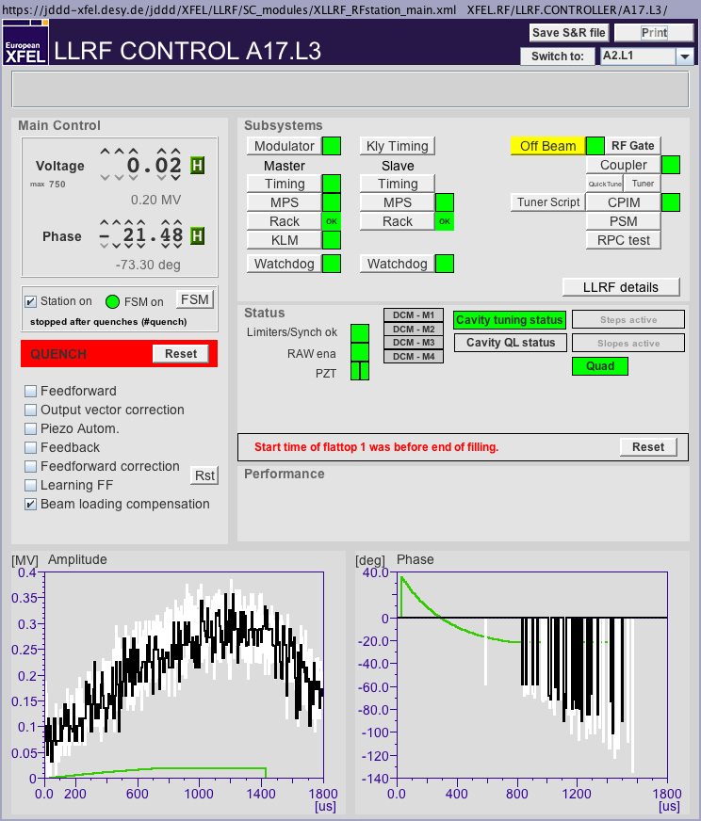
Exceptional cases and how to react
Note:
Place the quench panel instead of the main panel in the log book (more information)
What to do:
Document in log book and send to LLRF
Reset and let the FSM recover
Cavity quench (1/2)
QUENCH

Slide 34
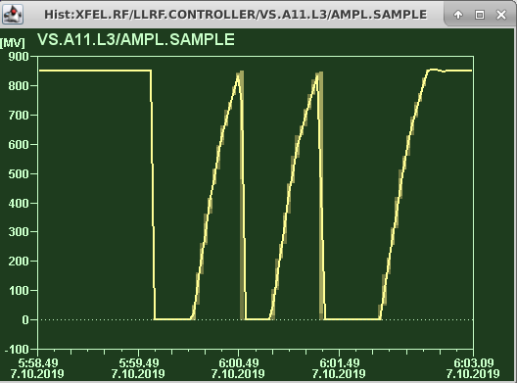
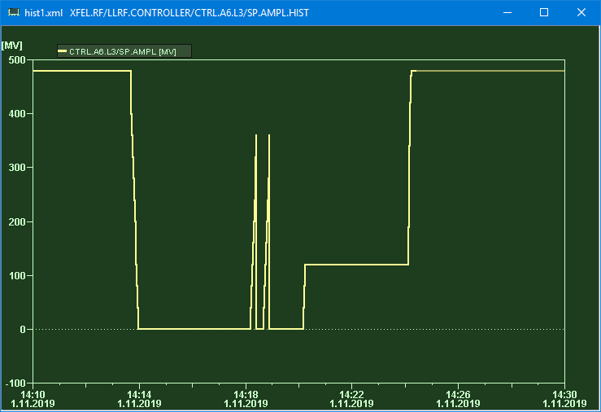
Exceptional cases and how to react
Cavity quench (2/2)
Repetitive quenches
Problem description:
The FSM tries to recover a station after a quench, ramps up to the same gradient and quenches again
After 3 tries, the FSM gives up
What you can try
Lower the recovery gradient in the FSM window (-10 MV ?)
Quench during ramp up
Problem description
(After a quench) the RF station trips due to quenches taking place at a much lower gradient
Chances are the Q_{L} computation got corrupted during the quench, hence corrupting the quench detection mechanism
What you can try
Disable the FSM, ramp up the station slowly (i.e. 10 MV steps) by hand, and re-enable the FSM

Slide 35
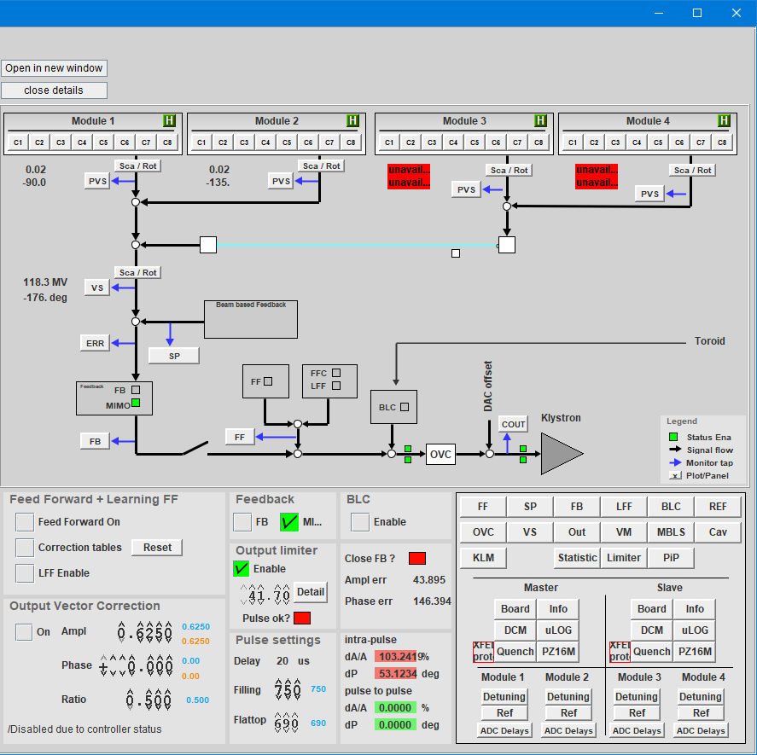
Exceptional case and how to react
“Zombie” station
The llrfCtrl server is not responsive
Chances are the hardware is still working
BUT
Likely the quench detection is no longer working
What to do:
Document in log book and send to LLRF
Agree with LLRF on-call and run coordinator when best to recover the station
MASTER (and / or) SLAVE “zombied”
SLAVE “zombied”

Slide 36
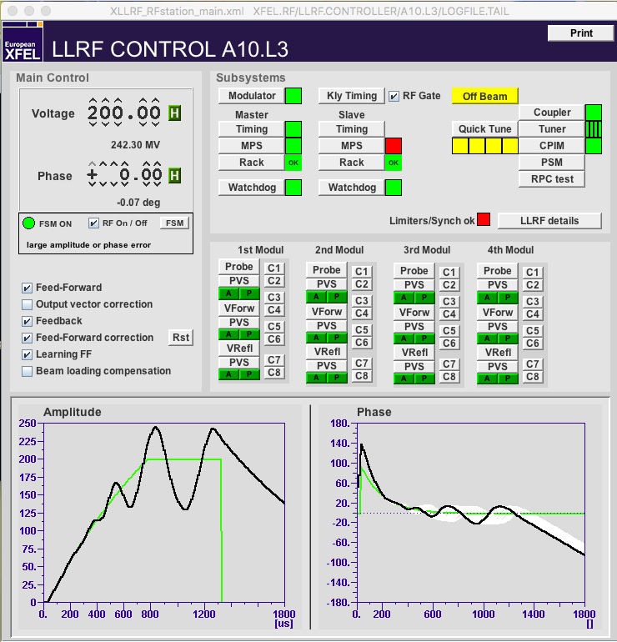
Summary
LLRF tasks of the XFEL operator:
Turn an RF station ON / OFF
Adjust the vector-sum voltage / phase
Tune cavities, if necessary
Adjust output vector correction and ratio, if necessary
Set a certain phase as on-crest phase
Special cases
Pulse cut
Limiter notification
Quench
Zombie stations
Document (elog) what you find not normal
Please include your name and tag the entry. Thank you!

Slide 37
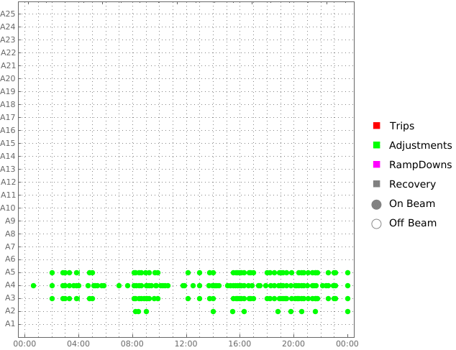
Thank you
Julien Branlard
MSK
julien.branlard@desy.de
1599

