Slide 1
Status of the BPM and BLM systems for the SASE3-Variable Polarization Project
Dirk Lipka and Thomas Wamsat, MDI, DESY Hamburg
BPM
Overview
Requirements
Rack modifications
Status
BLM

Slide 2
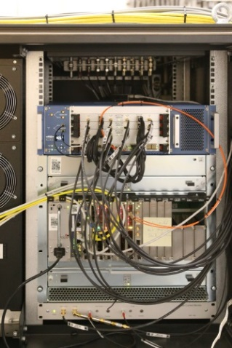
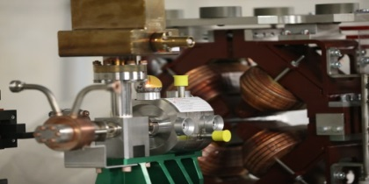
Overview for BPM
Necessary components:
Cavity BPM in undulator intersection
Modular BPM Electronics (MBUs) from PSI
µTCA crate with free ports of DAMC02 and timing card

Slide 3
Requirements for BPM system
4 BPM monitors connected to the Front-end electronics
2 MBUs installed in racks with water cooling for higher temperature stability (<0.6°C)
Synchronization signal from LLRF for both MBUs
Connection of MBUs to µTCA crate with DAMC02 and timing card via fibers for data transfer and timing
Connection of MBUs to MPS card in a µTCA crate
2 network ports for each MBU

Slide 4
Rack modifications
Diagnostics rack at 2943m needs to be removed: content are 1 µTCA, 1 MBU and network distribution
2 new diagnostics racks on roof for µTCA and MBU and a small box for network proposed to serve for SASE3 again; this needs to be done in summer shutdown (infrastructure: water, power, SAVE, network)
~2937m
Air cooling
~2944m
Water cooling
~2951m
Water cooling
~2955m
Water cooling
2 new diagnostics rack for VP project installation in addition

Slide 5
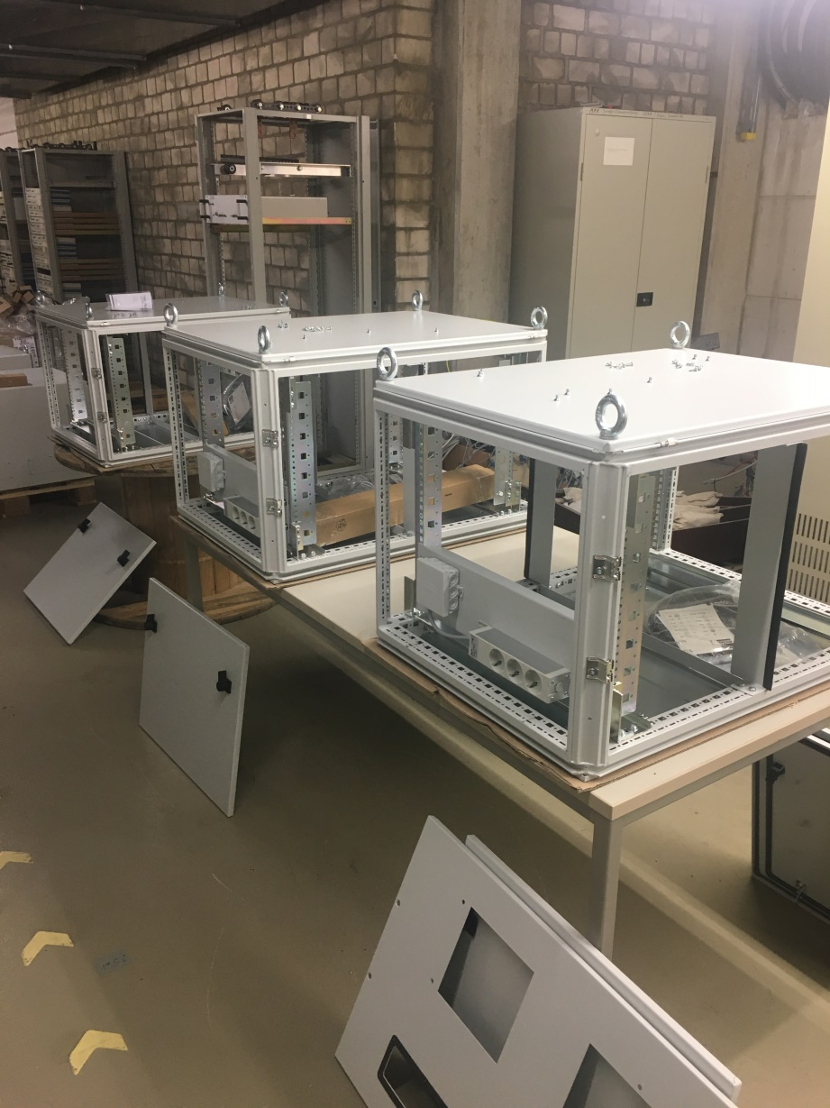
Status of BPM system
Cavity BPM mechanics available from the series production for E-XFEL
MBUs are ordered and expected April 2020
Racks are available and in preparation
Infrastructure for racks discussed, coordination by MKK: need modifications of
water distribution,
SAVE system, needs to be checked
network distribution
Cabling: elongate cable and cable tray

Slide 6
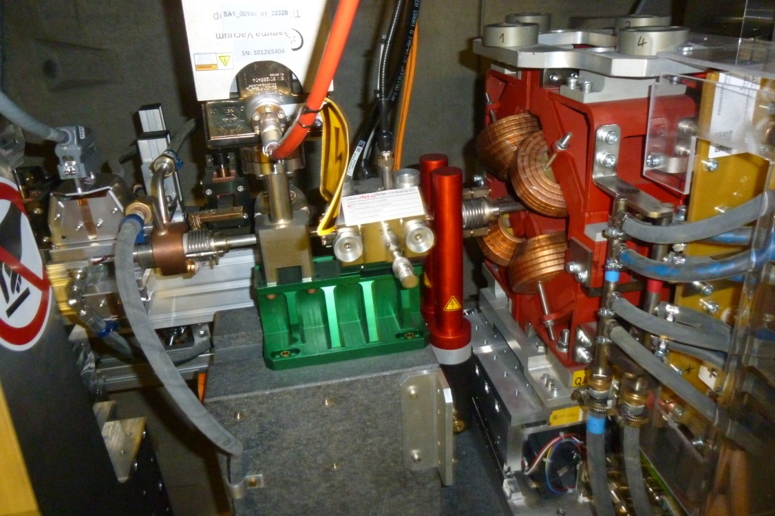
Beam Loss Monitors in SASE3 Afterburner
No new MTCA crate necessary, BLMs will be connected to a Rack where diagnostic crates with BLMs are already installed:
XTD4_SA3.R004_R01 @2943m
→ Will be shifted to 2937m
Same intersection like in undulators will be used, BLMs can be installed likewise
All needed parts already in stock
Costs 2.5k€/BLM, 20k€ total (including cables, mechanics)

