Slide 1
Status of the undulator vacuum chamber design
Daniele La Civita
Mechanical Engineering Group
February 20th, 2020.

Slide 2
Technical specifications
General aspects
Derived from meeting and discussions
2m long with two supporting points (plus optional “corrections” point in the middle)
  Upstream: movable in horizontal and vertical direction, fixed along the beam
  Downstream: movable in horizontal and vertical direction, free (flexure) along beam direction
  Adjustment range: +/-5mm with 150µm resolution
  Central support to correct possible twist
Undulator has remote alignment system and small magnet-to-chamber clearance: chamber moves with the undulator (supports and alignment system are mounted on the structure)
Material: Aluminium alloy: EN AW-6060T6 (AlMgSiT6)
  Non-magnetic material
  Good for extrusion and can be welded (CF flanges)

Slide 3
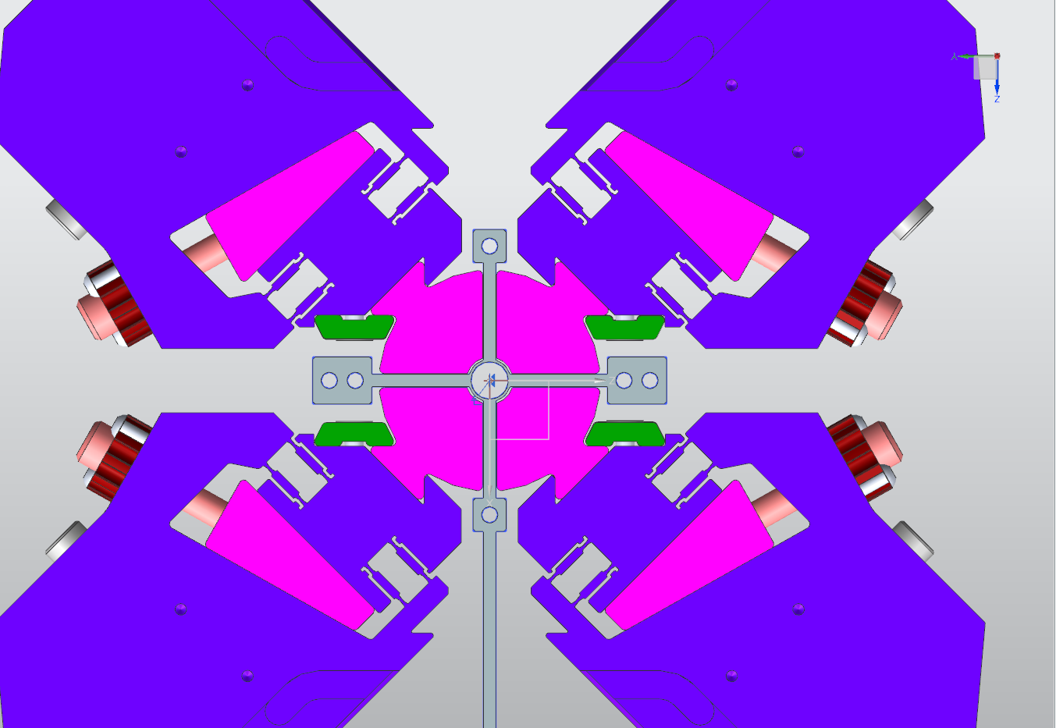
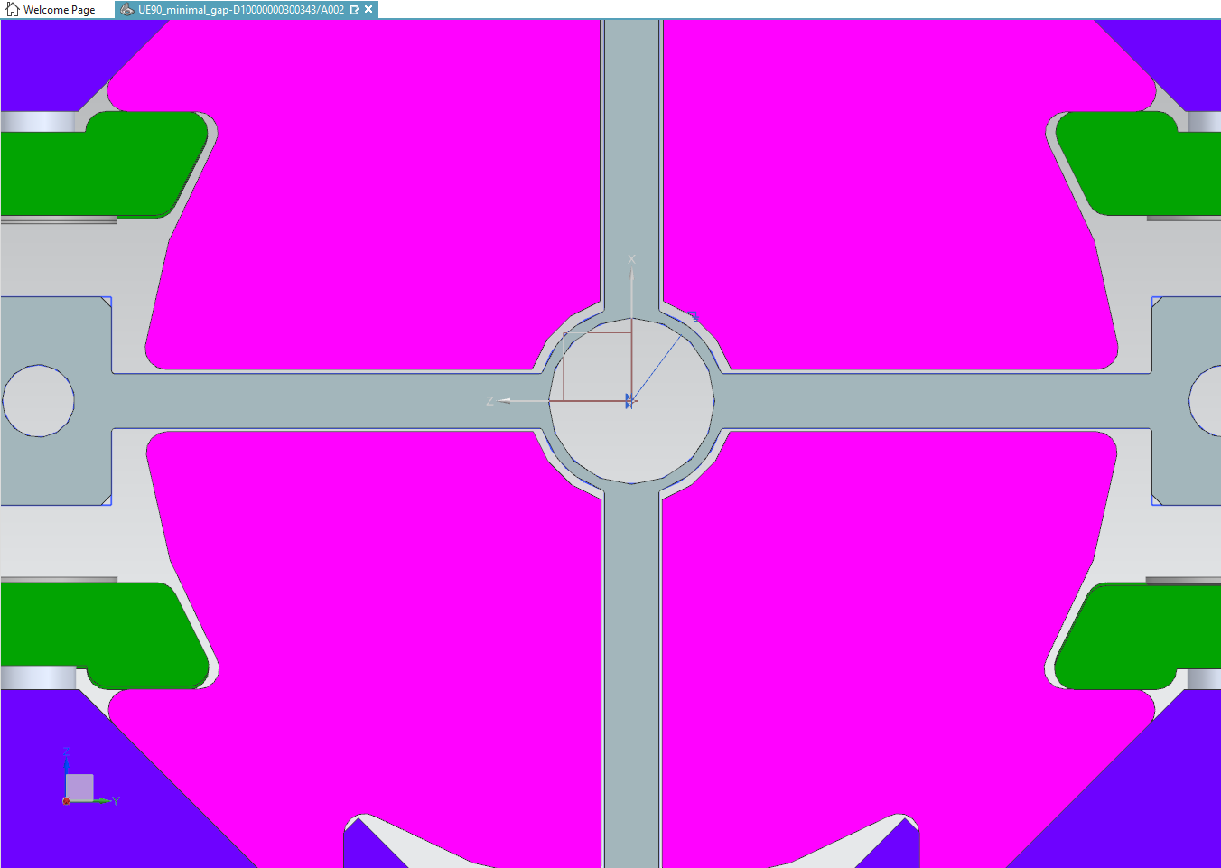
Technical specifications
Main dimension considerations
External diameter 9mm (present thinking)
  0.3mm clearance in radius on the central part
    ∅10mm min nominal gap
    +/-0.2mm shimming adjustment (∅ 9.6mm)
    Straightness tolerance to be considered
  0.6mm on the “straight” magnet faces
    Twist tolerance to be taken into account
  Gravity sag to be taken into account
    Less than 100µm
Internal diameter defined by:
  Mechanical aspects (static and buckling) ≈ 0.5mm
  Fabrication aspects (good extrusion)
  e-beam aspects
Roughness of internal chamber: 0.5

Slide 4
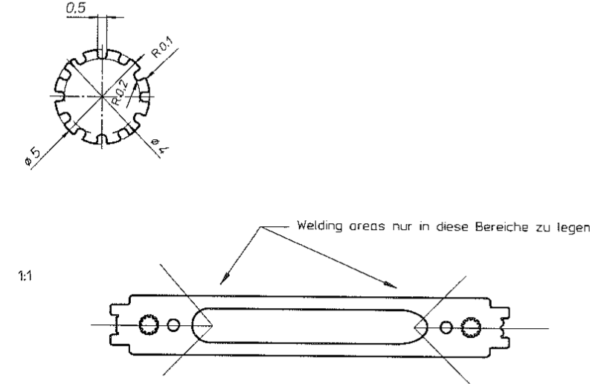
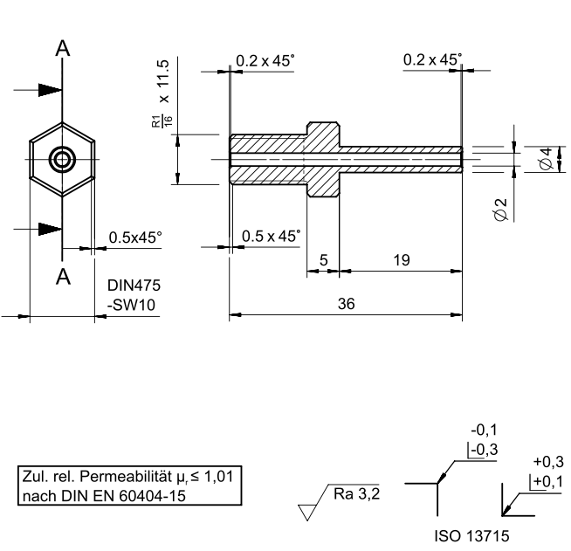
Technical specifications
Interfaces
Two water channels to dissipate 7 W*m
  Flow of 1.5m/s in 5mm diameter holes (special internal shape under discussion)
  Connectors already in use at DESY
  Special water for aluminium
    Independent circuit
    Temperature stability??
Water pipes connected to the undulator
  No additional load on the chamber
  Undulator moves -> pipes move
5mm holes for the coils at 6.5mm from water
Is the absorber part of the system? (moves together)

Slide 5
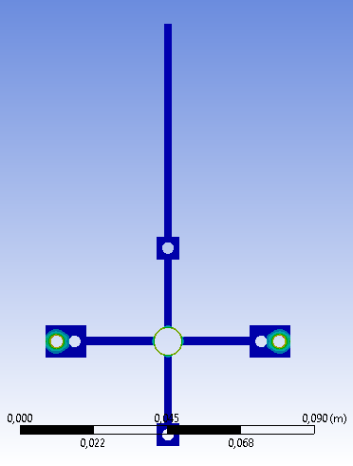
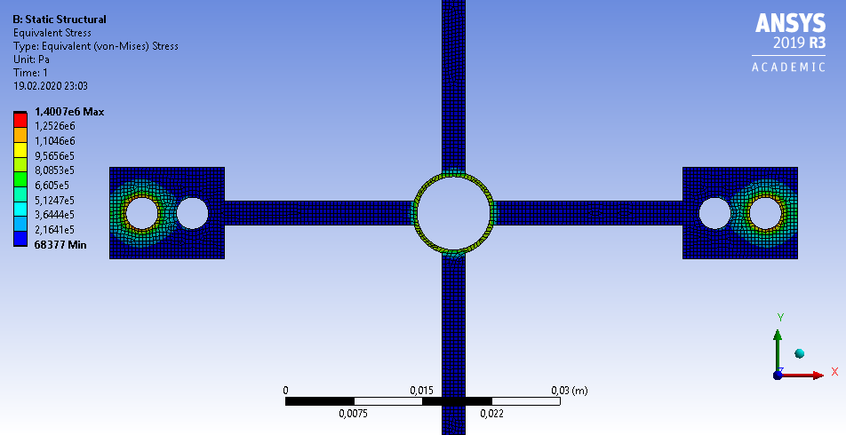
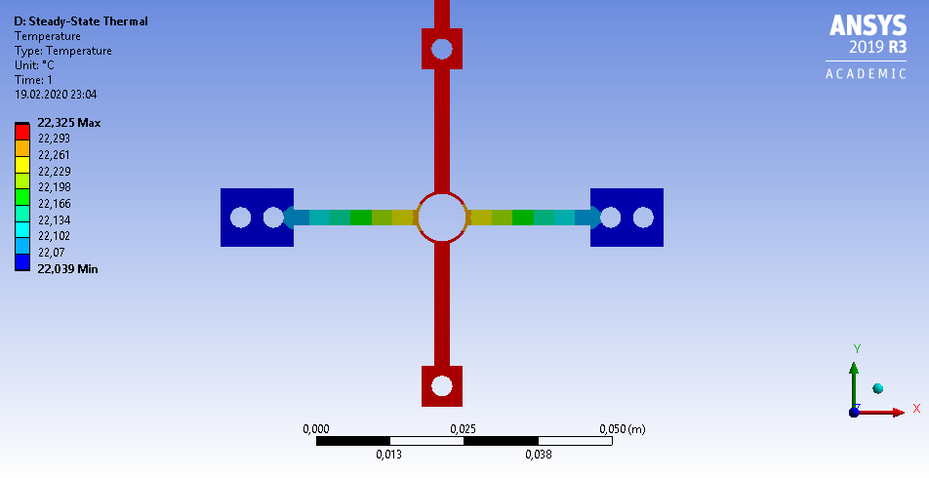
Preliminary geometry and FEA validation
Thermal simulations (DeltaT ≈ 0.4K)
Buckling and static pressure effects (max stress ≈ 1.5MPa)
  Vac inside, 1bar outside, 6 bar water
Gravity sag with two supports within 100µm

Slide 6












Before MIFA

Slide 7
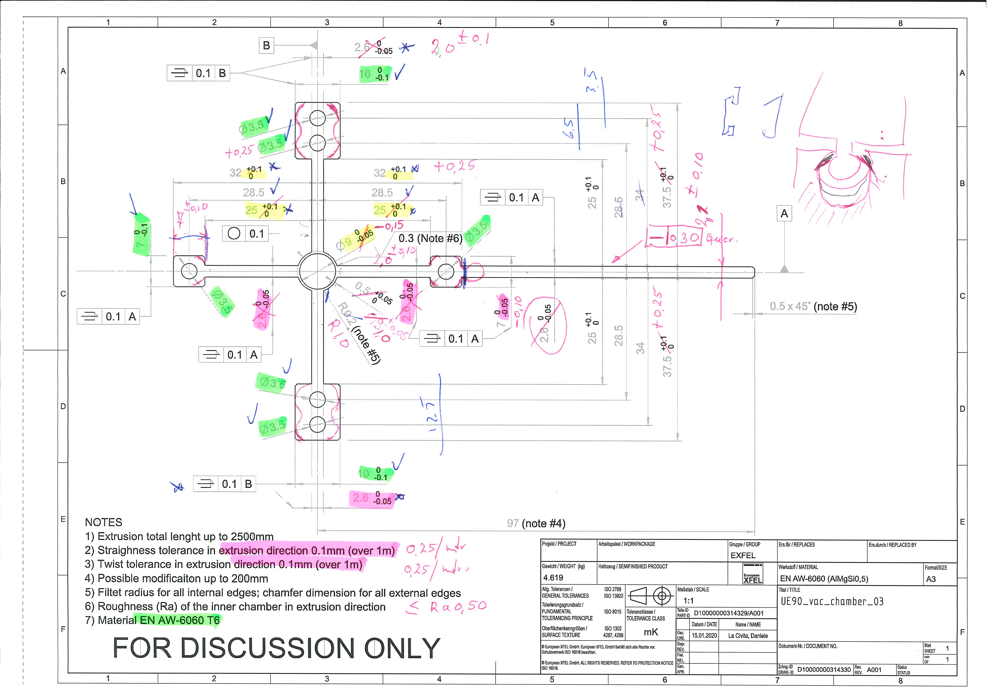
After MIFA
Not single part
Chamber wall thickness
Roghness
Twist / Straightness

Slide 8
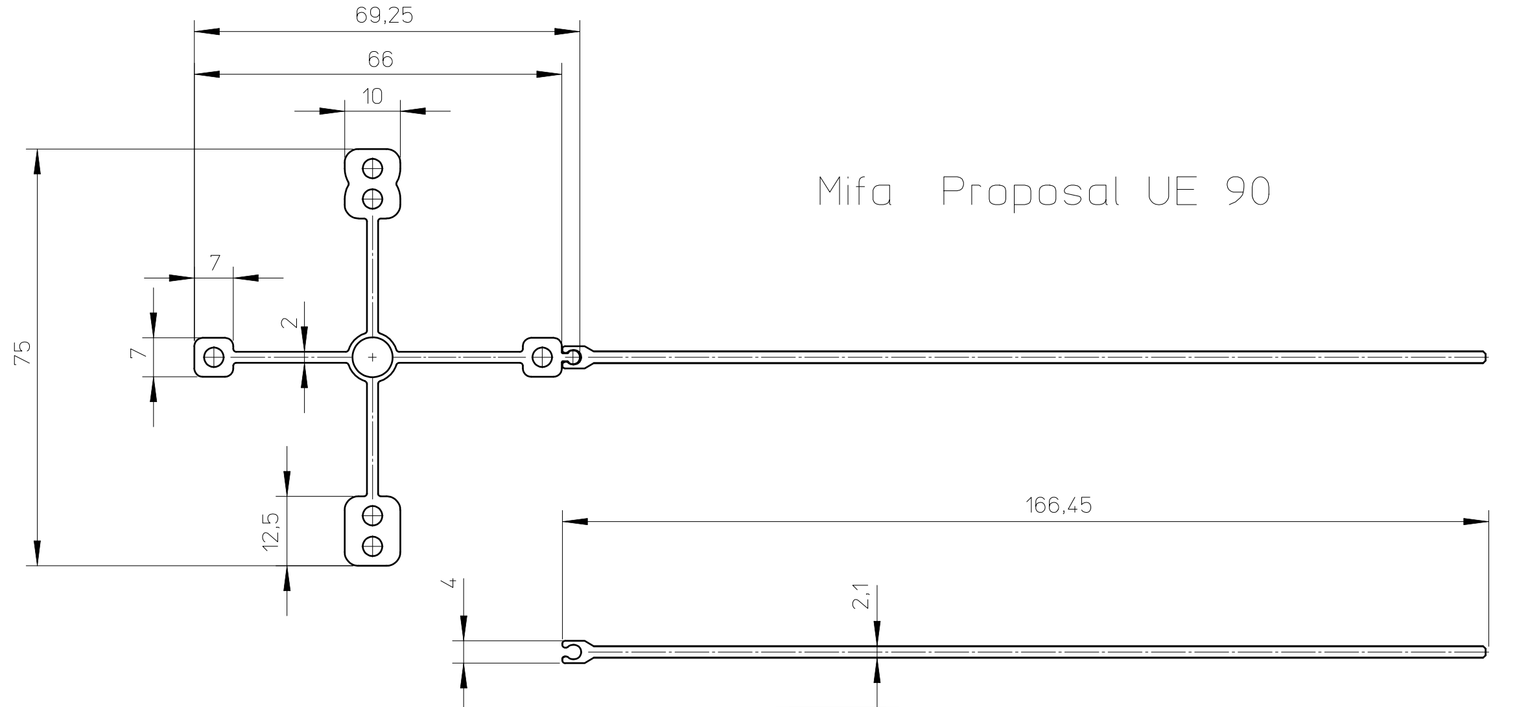
MIFA proposal

Slide 9
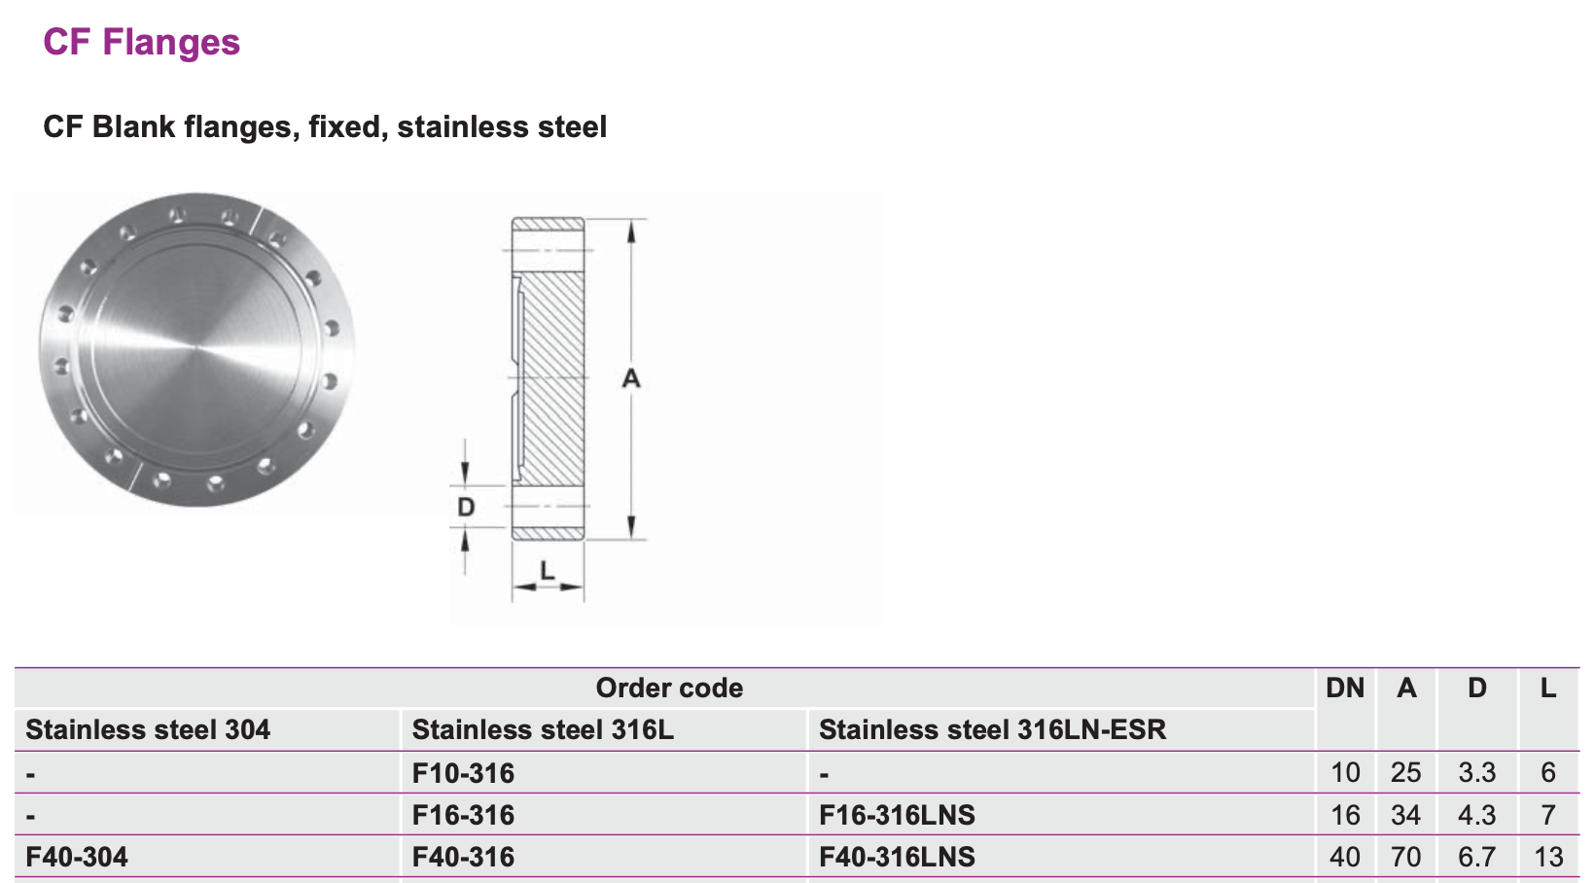
Chamber general aspects and considerations
Chamber has to be installed with the undulator sliding along the beam direction
  Max gap is 30mm: CF10 or custom flange has to be used
Strong interaction is needed with:
  DESY MVS + MEA2
  MIFA
Additional “T groove” on the side for:
  Temperature sensors
  Interface to intermediate support
Alignment procedure / strategy to be defined
We are out of machine spec for roughness (+ oxide)
  300nm roughness or 550nm including oxide layer

Slide 10
Next steps
Design progress meeting (Unsys+ME+MVS) at the end of March
  MIFA visit follow-up
  Interfaces with MVS
Design of chamber and alignment system ready for July 2020
  Design review needed
12 weeks for extrusion at MIFA
Prototype testing and (hopefully) design validation
Production
  Extrusion
  Welding
  Vacuum conditioning

Slide 11
Backup slides

Slide 12
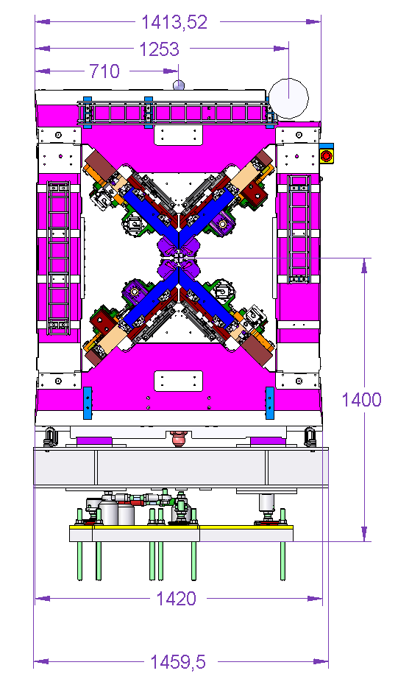
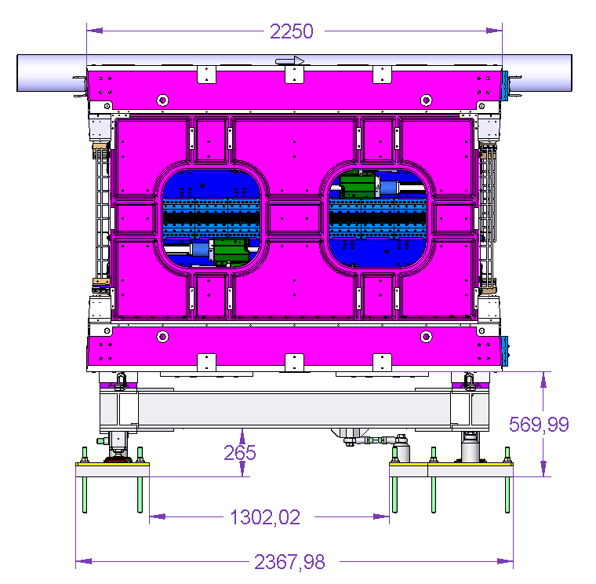
Und design
(from generic archive)

Slide 13
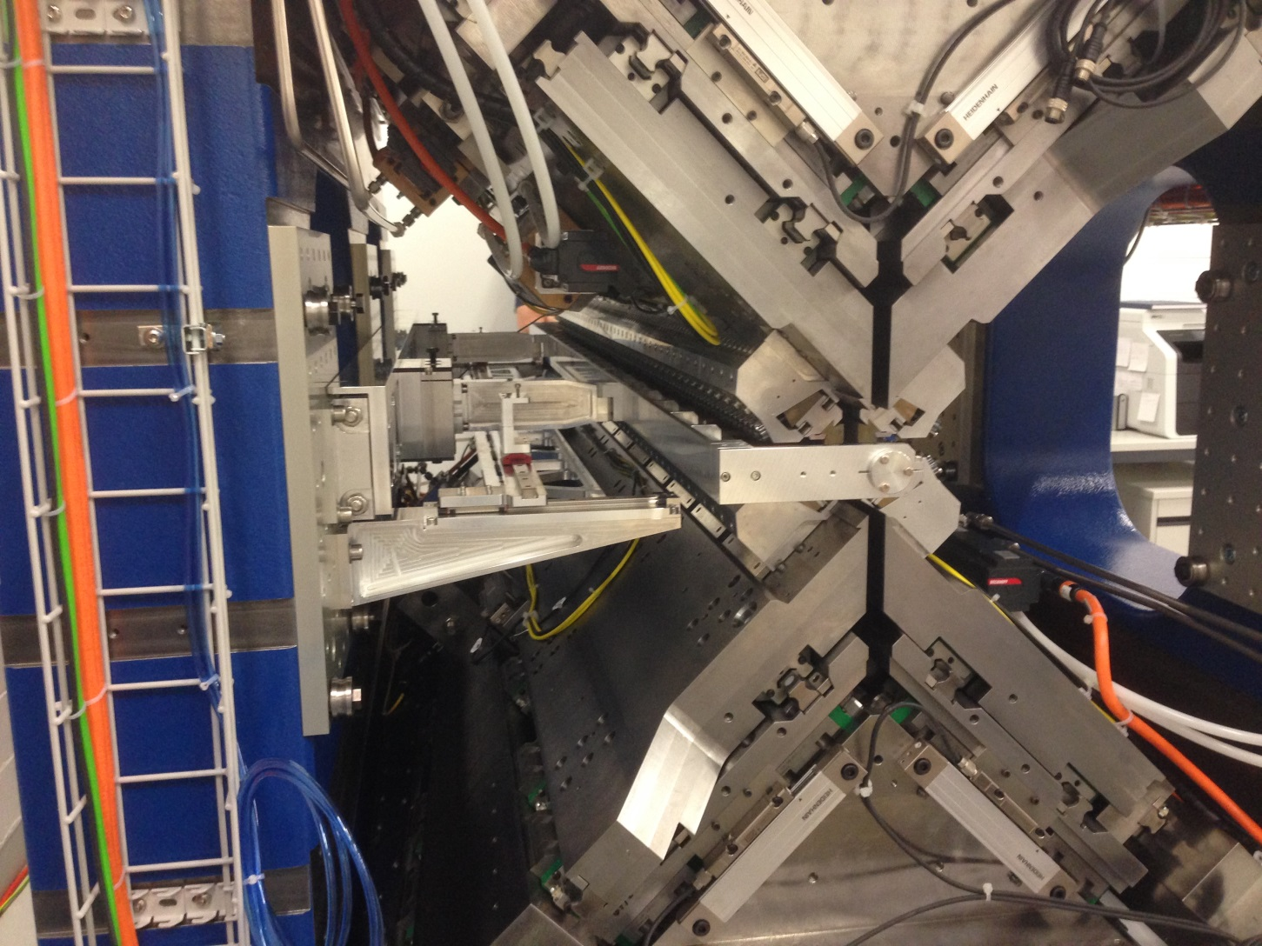
PSI “problematic” chamber

