Slide 1
Status of the SLRS Alignment system for SASE3
Johannes Prenting
Notes:
How to edit the title slide
Upper area: Title of your talk, max. 2 rows of the defined size (55 pt)
Lower area (subtitle): Conference/meeting/workshop, location, date, your name and affiliation, max. 4 rows of the defined size (32 pt)
Change the partner logos or add others in the last row.

Slide 2
Status of the SLRS Alignment system for SASE3
In the wintershutdown 2019/2020 the SLRS für SASE3 was moved as preparation for the redesign of the undulator section and due to the modification of the PKG
Following conditions were given:
There will be no space for maintenance behind the moved PKG
There will be no space for maintenance behind the Undulators to be placed
Flanges for the SLRS have to be placed in between the respective undulators
There is a target chamber (MK11.3), not equipped with targets momentarily that has to be removed.
SLRS had to be completed before the moving of the PKG
SLRS does not need to be completed and functional in 2020

Slide 3
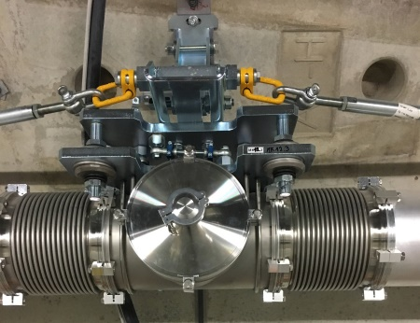
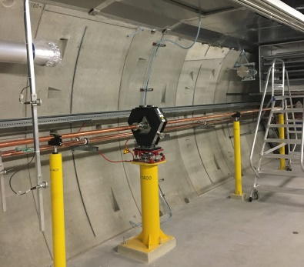
Status of the SLRS Alignment system for SASE3
Conducted actions
Actual aligned position of the SLRS was determined by precise laser tracker measurements (2 days)
SLRS was taken out of operation and vented
target chamber MK11.3 and neighbouring pipes ( 3 sections of 7.7[m] each) were removed (1d)
Two pipe sections with a total length of 15m were mounted in a position that covers the complete length of the PKG (1d)
The upstream flange of the SLRS in front of the PKG was installed at a given position marked in the tunnel

Slide 4
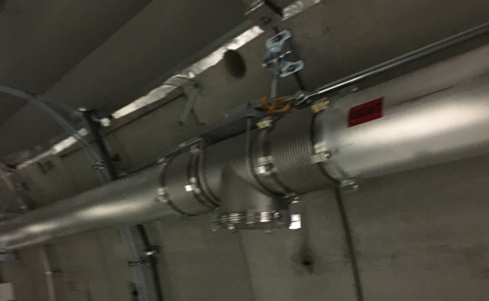
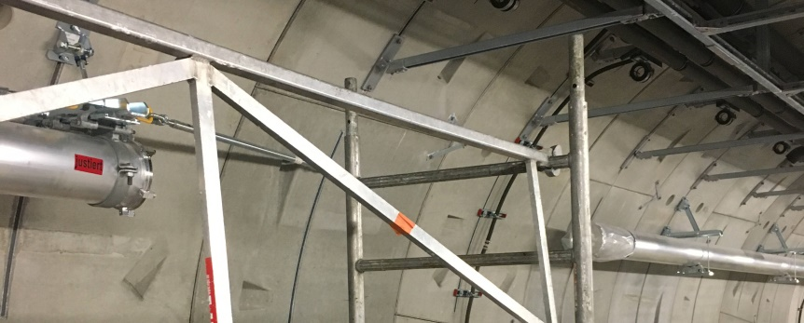
Status of the SLRS Alignment system for SASE3
Conducted actions (2)
Three brackets of the SLRS pipe system behind the new position of the PKG have been shortened
A fixed-point bracket was removed and mounted at a different position. The fixed-point has been replaced by a floating-point bracket (smaller)
A target chamber at a position behind installations was rotated 90°to avoid collisions
All components of the SLRS have been aligned to the SLRS straight that was determined before (2d)
The newly installed pipe section (behind the PKG) has been leak tested (1d)
Distances between existing pipes have been determined to enable the fabrication of the needed new pipe sections.
Total working time: 7d
floating-point brackets
fixed-point bracket

Slide 5
Status of the SLRS Alignment system for SASE3
Remaining actions to get SLRS into operation again:
Fabricate new pipe sections
Install new pipe sections and align new pipe sections to the SLRS straight
Leak test of the completed system
Design new targets for new target chamber positions (if needed)
Reinstall laser section (has been taken out earlier for different reasons)
Align laser section and chambers
Install calibration targets, execute calibration measurements
Individual process for every target chamber
Reinstall measuring targets
…
Add online functionality to the SLRS SASE3
Install plug sockets for network connections
Add remote control for the laser section and camera section

Slide 6
Status of the SLRS Alignment system for SASE3
Thank you for your attention.

Slide 7
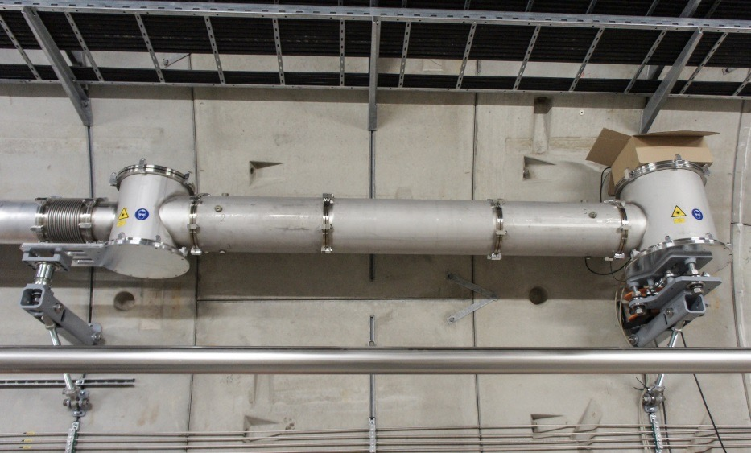
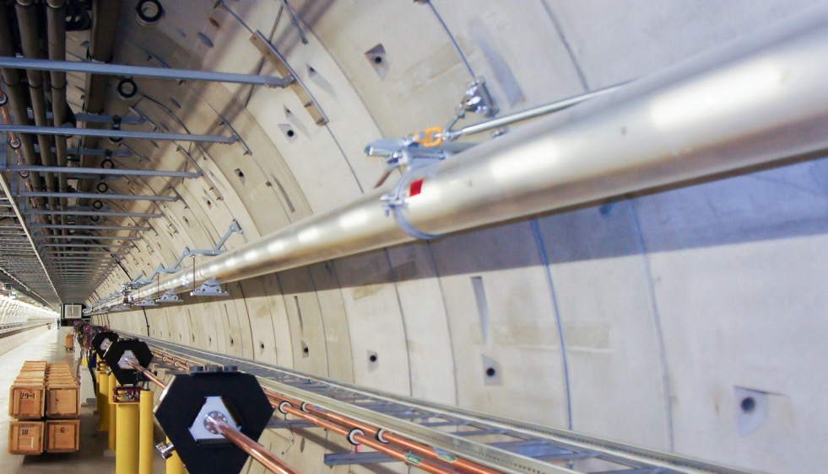
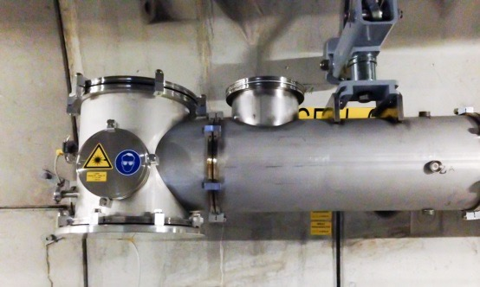
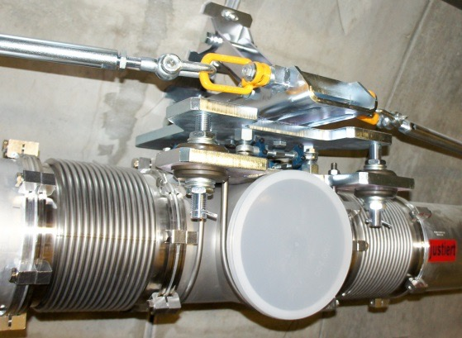
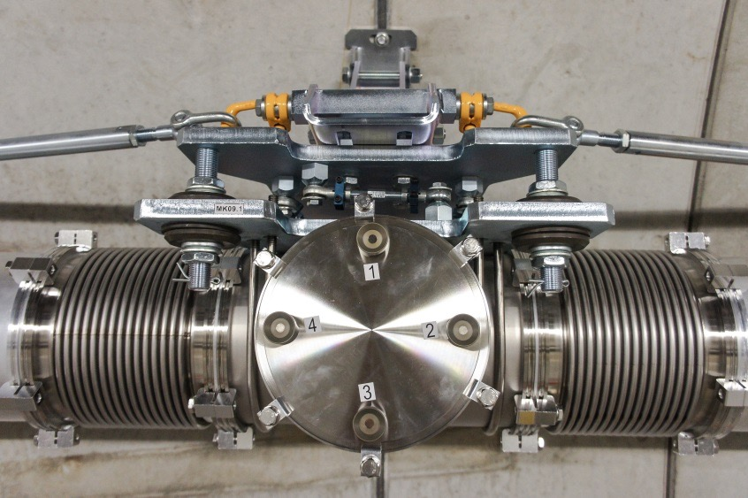
Bonus material: system setup
housing for laser, aperture, lens
camera housing
SLRS@SASE1, 482m
Tee piece connector & bellows
Actual setup:
Aluminum pipes, 7.73m/3.87m long, 200mm diameter. Supports are placed every 3 to 4.5m with fixed point and floating point fixing.
special housings for (laser, aperture, lenses) and (lenses & camera)
Tee piece connector with bellows, every 24m, every 2nd is
equipped with adapted measurement targets (aka target boxes)
blue laser (wavelength = 405nm) allows for small targets and provides fine interference patterns
revised plano convex lenses for minimal spherical aberration
GigE-Camera with 2048x2048 pix. resolution
Oerlikon/Leybold Trivac D 65 B Vacuum pumps
target box

Slide 8
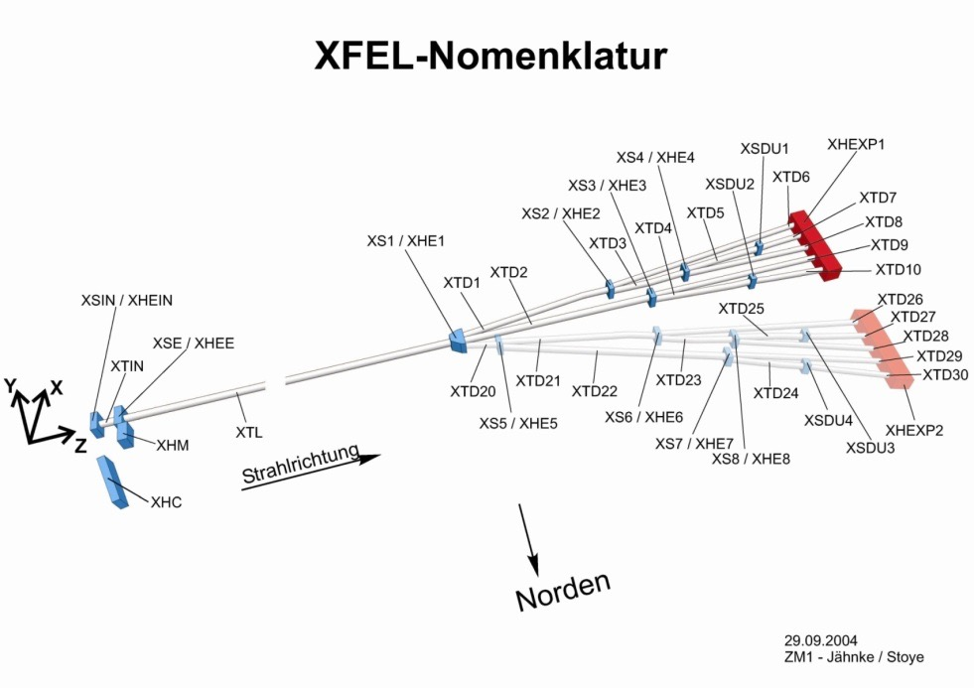
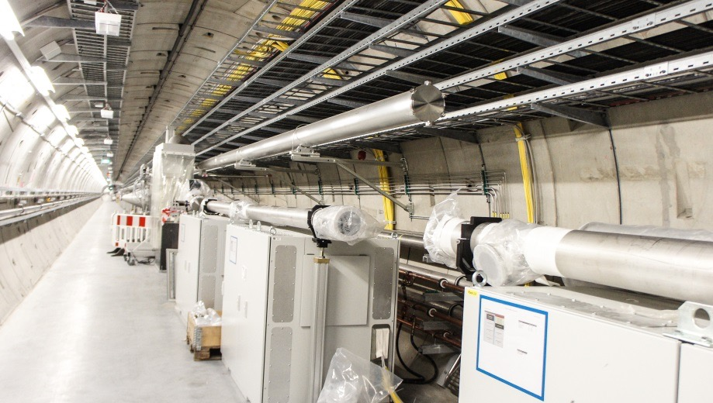
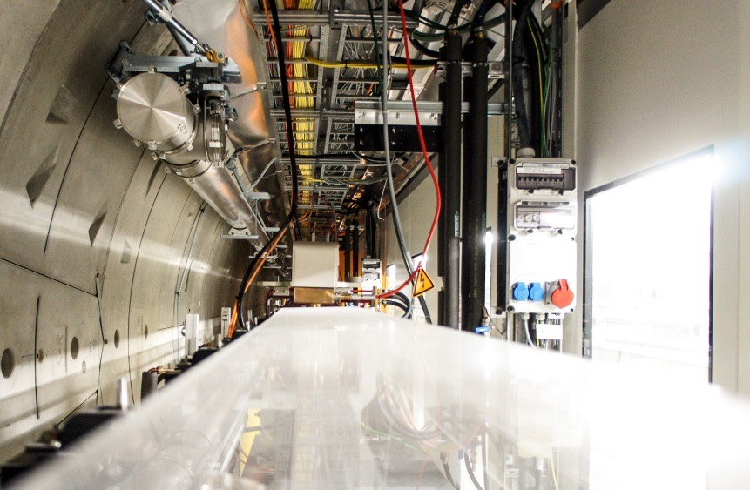
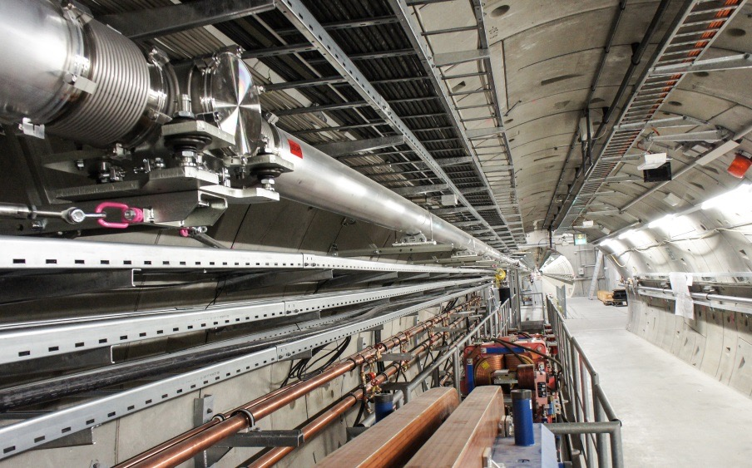
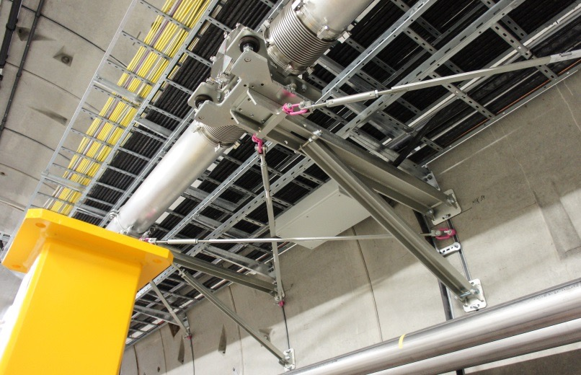
Bonus material: system setup
Distribution of SLR-Systems in XFEL Tunnels
Distribution of SLRS systems in the XFEL
First SLRS operational @ SASE1, XTD2
Second SLRS operational @ SASE3, XTD4 & XTD10
Third SLRS operational as online system @ SASE2, XTD1 & XTD6
SASE2: 530m
SASE3: 434m
SASE1: 482m
crossing the dump shaft XSDU2
begin of SLRS @ SASE3, XTD4
end section @ XTD10
strut section to minimize movements

