Slide 1
Hypothesis Testing
Terascale reduced online Statistics School July 6-10, 2020
Olaf Behnke (DESY)
1

Slide 2
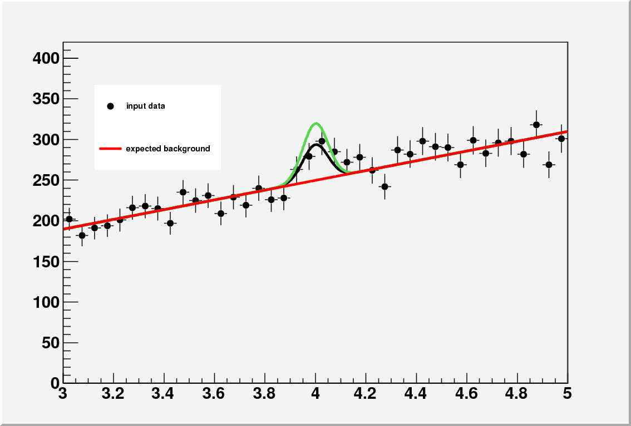

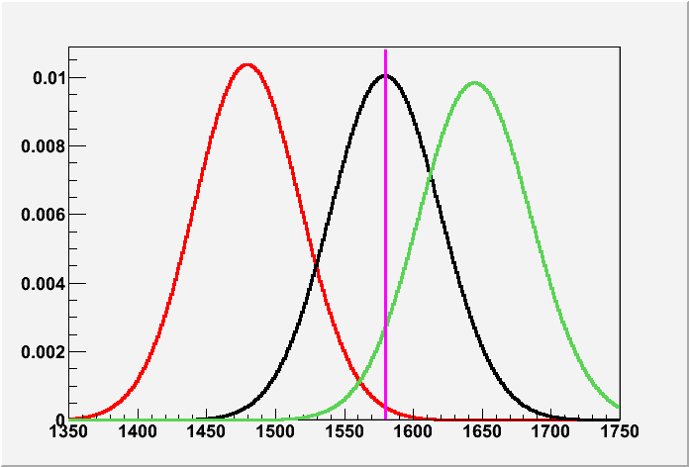
Lecture intro
Is there a signal or not?
H₀ = b only
H₁ = b + μS; μ>0
Test statistics: event count n
in signal region
Outline:
Basics with 2 gaussians
Tests of H₀ only (Goodness-of-Fit)
L(H₁)/L(H₀) based tests:
  - H1 = add background pars
  - H1 = there is a signal
n=1578
b=1480
μ=0
μ=98
μ=163 UL 95% C.L.
n
2

Slide 3
Recommended Literature
“Data Analysis in High Energy Physics” (OB, K. Kroeninger,
G. Schott and T. Schoerner-Sadenius), Wiley-VCH
Excellent statistics books from various authors:
  Fred James
  Roger Barlow
  Glen Cowan
  Louis Lyons
Not to forget these two most concise up-to-date articles:
PDG reviews of Probability and Statistics (G. Cowan) www.pdg.lbl.gov/2020/reviews/rpp2020-rev-probability.pdf
www.pdg.lbl.gov/2020/reviews/rpp2020-rev-statistics.pdf
3

Slide 4
Hypothesis testing
1. Basics
4

Slide 5
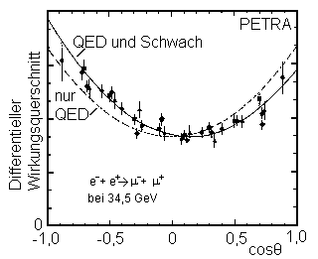
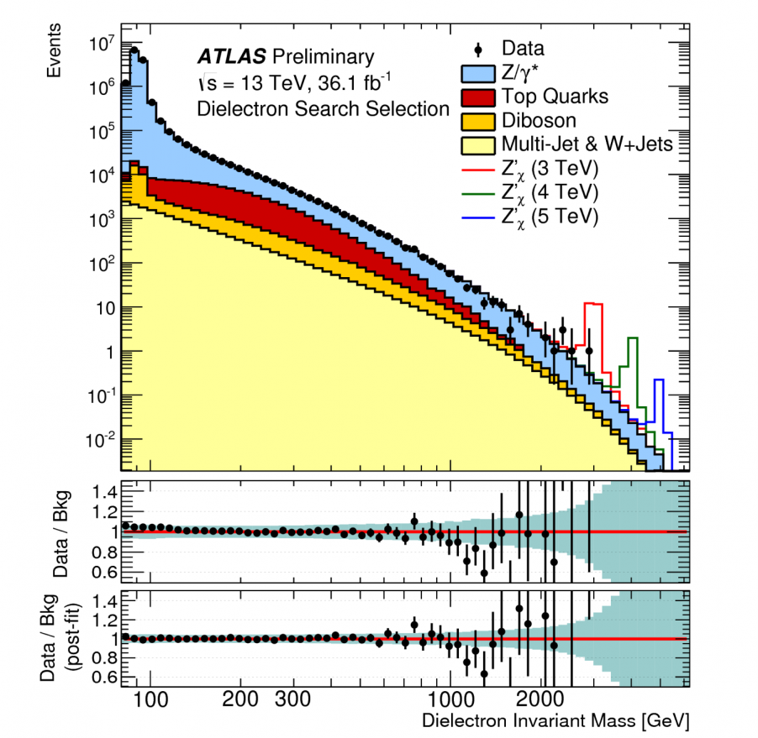
Hypothesis types in HEP
Distribution shapes
Total rates
ATLAS-CONF-2016-045
New Z’ resonance increases e+e- rate
The Standard Model predicts both shapes and rates!
Simple (= completely fixed) hypotheses: Photon has spin 1
Composite hypotheses: e.g. depend on a parameters, H(θ): Rates depend on proton PDFs, coupling α_{s}
5

Slide 6
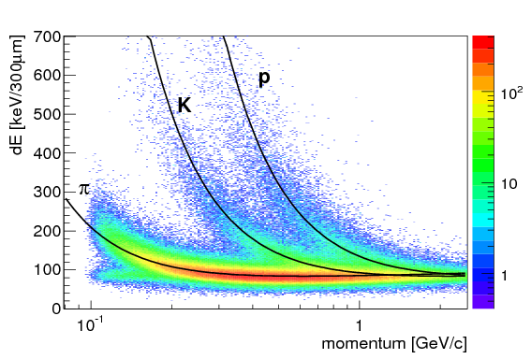
Test statistics
To distinguish between two (or more) hypotheses → define for n observations x_{i} a test statistics t(x₁,x₂,..,x_{n})
Example dE/dX measurement in ALICE ITC
Task: identify a particle: pion (H₀) or kaon (H₁)? (for p~400 MeV)
t = (x – <x(π)>)/σ , where x = measured dE/dX value
6

Slide 7
Test statistics
To distinguish between two (or more) hypotheses → define for n observations x_{i} a test statistics t(x₁,x₂,..,x_{n})
Example dE/dX measurement in ALICE ITC
Task: identify a particle: pion (H₀) or kaon (H₁)? (for p~400 MeV)
Simplify:Assume t to follow gaussian
(in reality Landau!)
t = (x – <x(π)>)/σ , where x = measured dE/dX value
7

Slide 8
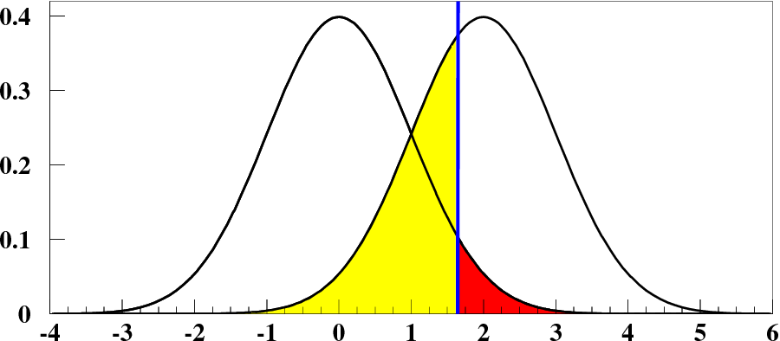
Basic test recipe
H₀ True (π)
H₁ True (K)
frequency
1−β
1−α =95%
α =5%
β
Retain H₀
t_{c}
Reject H₀
t
Define critical value t_{c} before observation: if t>t_{c} then reject H₀
Type I error: reject H₀ although true: P(t>t_{c}|H₀)=α “size of test”
Type II error: fail to reject H₀ while H₁ true: P(t<t_{c}|H₁) = β 1-β = “Power of test”
8

Slide 9
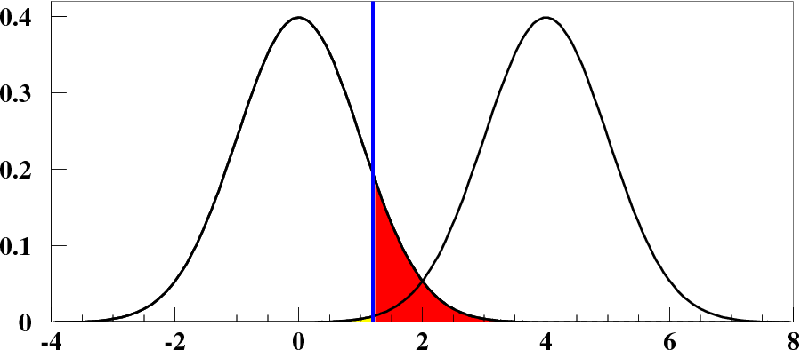
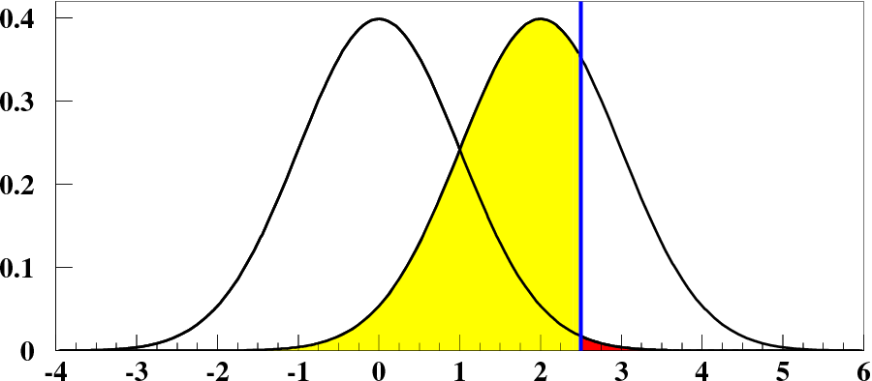
Importance of type I and II errors
Test airplane wing steering relay quality
Good relays
Faulty relays
Where would you place the cut t_{c}?
frequency
β
α
t_{c}
Quality evaluation
CMS lepton trigger
Signal fires
Background fires
frequency
β
α
t_{c}
Threshold
9

Slide 10
Importance of type I and II errors
Test airplane wing steering relay quality
Good relays
Faulty relays
frequency
Small β saves lives!
β
α
t_{c}
Quality evaluation
CMS lepton trigger
Signal fires
Background fires
frequency
β
α
t_{c}
Threshold
10

Slide 11
Importance of type I and II errors
Test airplane wing steering relay quality
Good relays
Faulty relays
frequency
Small β saves lives!
β
α
t_{c}
Quality evaluation
CMS lepton trigger
Signal fires
Background fires
Where would you place the cut t_{c}?
frequency
β
α
t_{c}
Threshold
11

Slide 12
Importance of type I and II errors
Test airplane wing steering relay quality
Good relays
Faulty relays
frequency
Small β saves lives!
β
α
Quality evaluation
CMS lepton trigger
Signal fires
Background fires
Small α ensures good signal acceptance
frequency
β
α
α = 5% common choice for model testing in science
Threshold
12

Slide 13
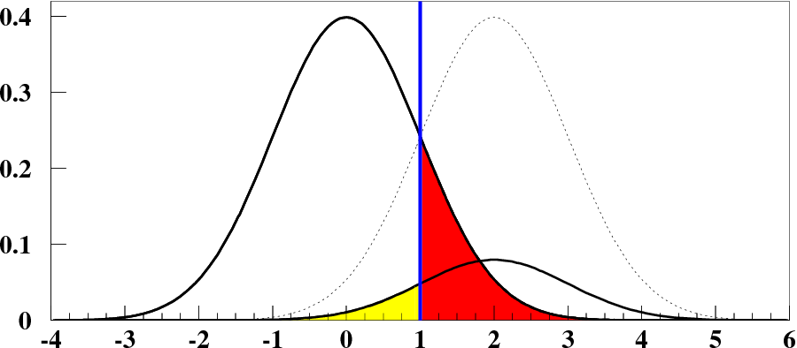
For rates: intrinsic frequencies matter
In pp collisions: ~5 times more pions produced than kaons
Pions
5 times smaller β
Kaons
t_{c}
t
Apply cut t_{c}=1 (in the middle of two gaussians), chance to really select a pion?
Bayes theorem
$$P\left( pion \right| t<t_{c }) = \frac{P\left(t<t_{c}\right|pion)π(pion)}{ P\left(t<t_{c} | pion\right)π\left(pion\right)+P\left(t<t_{c}\right|kaon)π\left(kaon\right)}$$
13

Slide 14
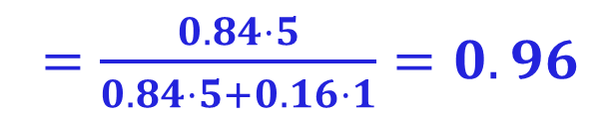
For rates: intrinsic frequencies matter
In pp collisions: ~5 times more pions produced than kaons
Pions
5 times smaller β
Kaons
t_{c}
t
Apply cut t_{c}=1 (in the middle of two gaussians), chance to really select a pion?
Bayes theorem
$$P\left( pion \right| t<t_{c }) = \frac{P\left(t<t_{c}\right|pion)π(pion)}{ P\left(t<t_{c} | pion\right)π\left(pion\right)+P\left(t<t_{c}\right|kaon)π\left(kaon\right)}$$
$=\frac{0.84⋅5}{0.84⋅5+0.16⋅1}=0.96$
14

Slide 15
p-value
H₀ True (π)
H₁ True (K)
Observed value
t_{obs} =3.5
1−β
1−α =95%
α =5%
β
p = area
Retain H0
t_{c}
Reject H0
t
p = P(t>t_{obs}|H₀)
p values specify observed significance level (random variable) here: 3.5 σ effect
If p<α reject H₀
15

Slide 16
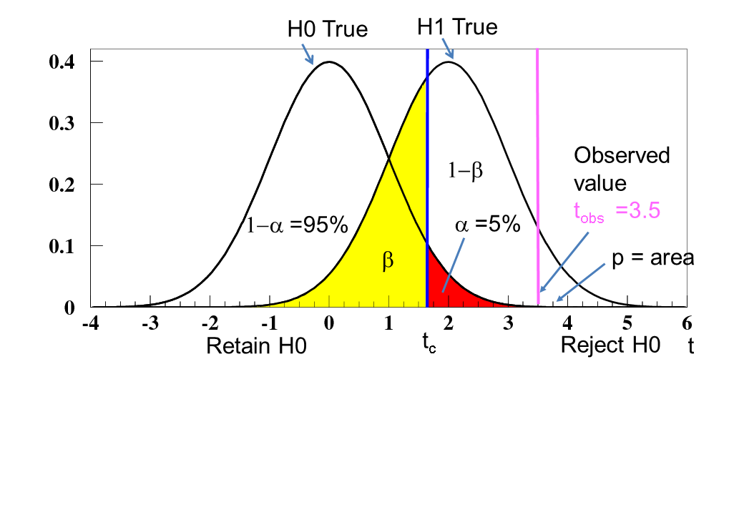
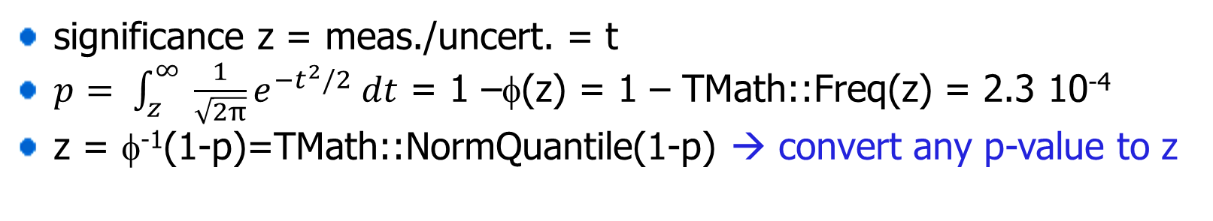
p-value
For our gaussian reference example:
Gaussian z score: “3.5 sigma”
significance z = meas./uncert. = t
$p= \int_{z}^{∞}{ \frac{1}{\sqrt{2π}}e^{−t^{2}/2} dt}$ = 1 –φ(z) = 1 – TMath::Freq(z) = 2.3 10⁻⁴
z = φ⁻¹(1-p)=TMath::NormQuantile(1-p) → convert any p-value to z
16

Slide 17
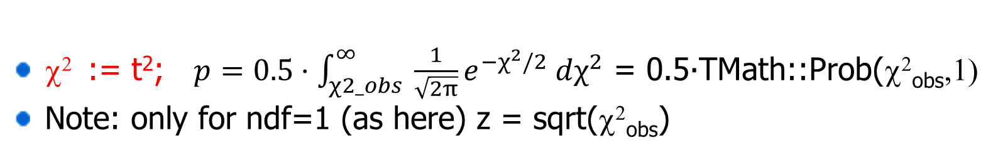
p-value
For our gaussian reference example:
Gaussian z score: “3.5 sigma”
significance z = meas./uncert. = t
$p= \int_{z}^{∞}{ \frac{1}{\sqrt{2π}}e^{−t^{2}/2} dt}$ = 1 –φ(z) = 1 – TMath::Freq(z) = 2.3 10⁻⁴
z = φ⁻¹(1-p)=TMath::NormQuantile(1-p) → convert any p-value to z
χ² := t²; $p=0.5⋅\int_{χ2_obs}^{∞}{ \frac{1}{\sqrt{2π}}e^{−χ^{2}/2} dχ^{2}}$ = 0.5∙TMath::Prob(χ²_{obs},1)
Note: only for ndf=1 (as here) z = sqrt(χ²_{obs})
17

Slide 18
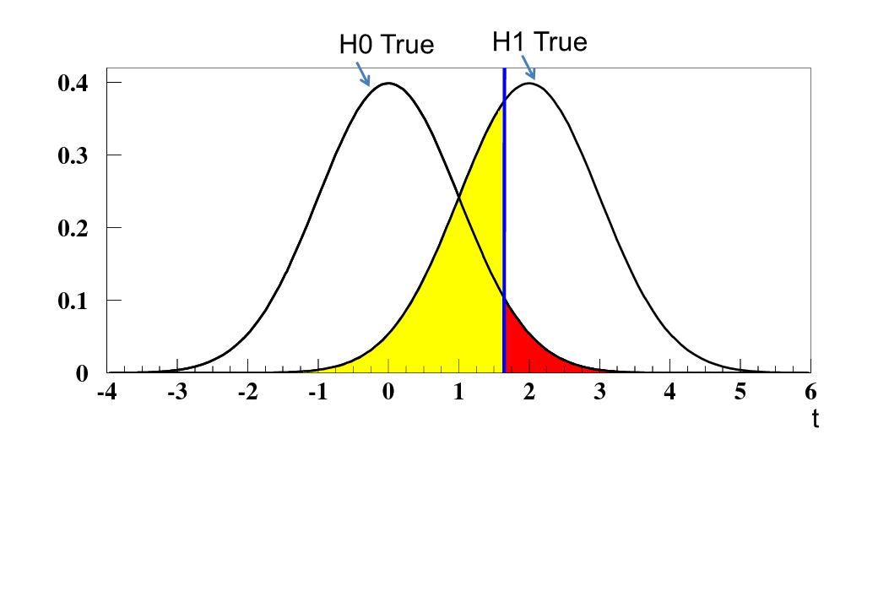
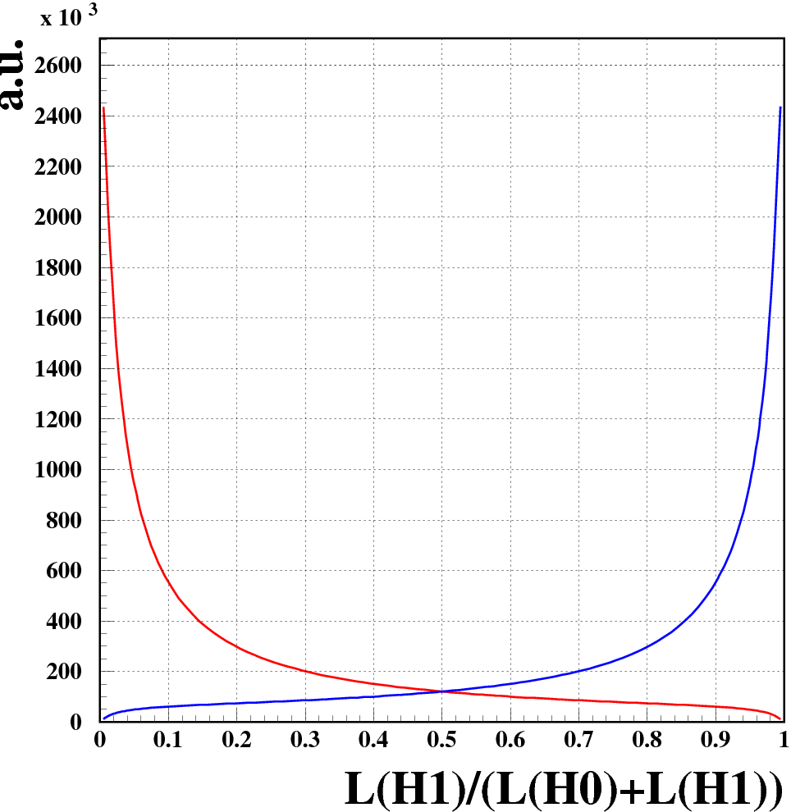


Neyman Pearson Lemma (J. Neyman, E. Pearson, 1933)
Likelihood ratio L(H₁)/L(H₀) provides for given α test with smallest β
Distribution of
L(H₁)/[L(H₀)+L(H₁)]
H₀
H₁
L(H₀) =
90% H₀
90% H₁
L(H₁) =
For equal mix of pions (H₀) and Kaons (H₁):
→ Likelihood ratio directly proportional to relative contributions → optimal test statistics for signal vs background separation
18

Slide 19
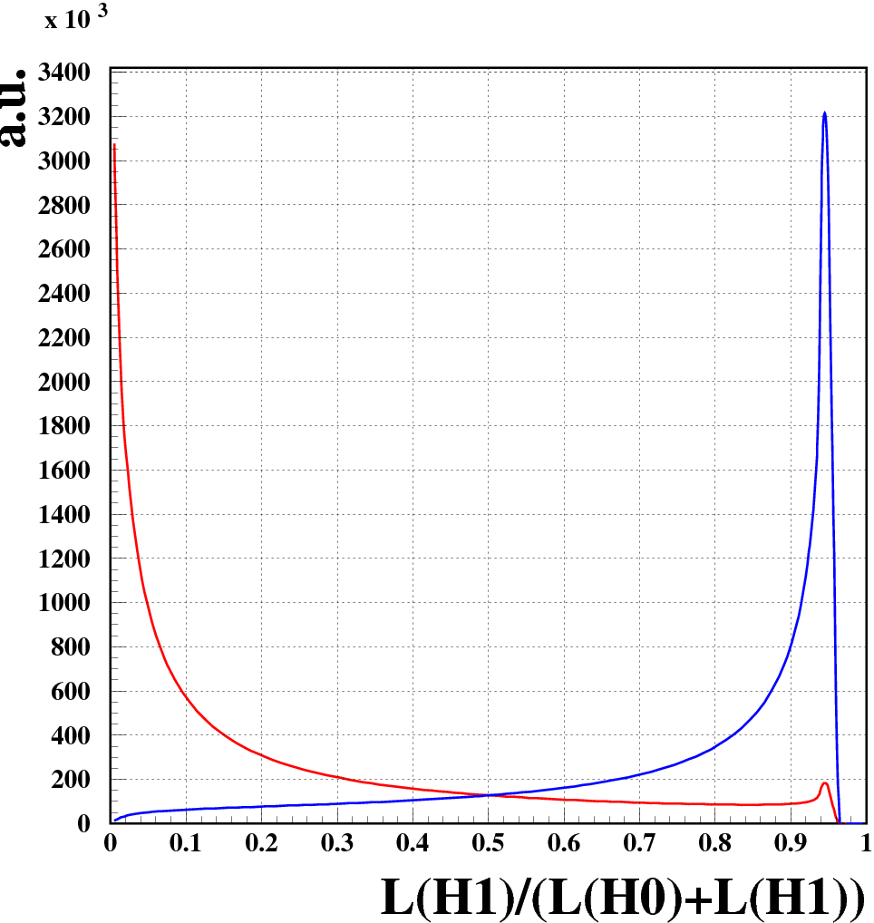
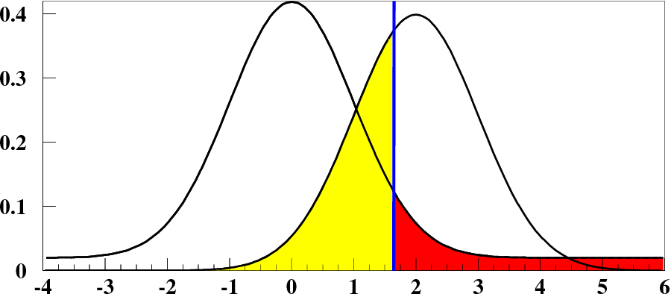
Likelihood ratio with a flat tail for t(H₀)
H₀ True
H₁ True
Distribution of
L(H₁)/[L(H₀)+L(H₁)]
t
H₀
H₁
L(H₀) = +0.02
90% H₀
90% H₁
L(H₁) =
For equal mix of pions (H₀) and Kaons (H₁):
→ Likelihood ratio directly proportional to relative contributions → optimal test statistics! better than cut t<t_{c} for original t
19

Slide 20
Testing more than 2 hypotheses (π,K,p,D, etc.)
A particle was measured with dE/dX = 510
The H(K) vs H(π) test ruled out the pion hypothesis
What to
conclude?
20

Slide 21
Testing more than 2 hypotheses (π,K,p,D, etc.)
A particle was measured with dE/dX = 510
The H(K) vs H(π) test ruled out the pion hypothesis
What to
conclude?
A H(p) vs H(K) test rules out the K hypothesis!
Can never verify hypotheses, only exclude, unless one has excluded all other possible hypos (Sherlock Holmes)
21

Slide 22
Hypothesis testing
2. GOF tests
22

Slide 23
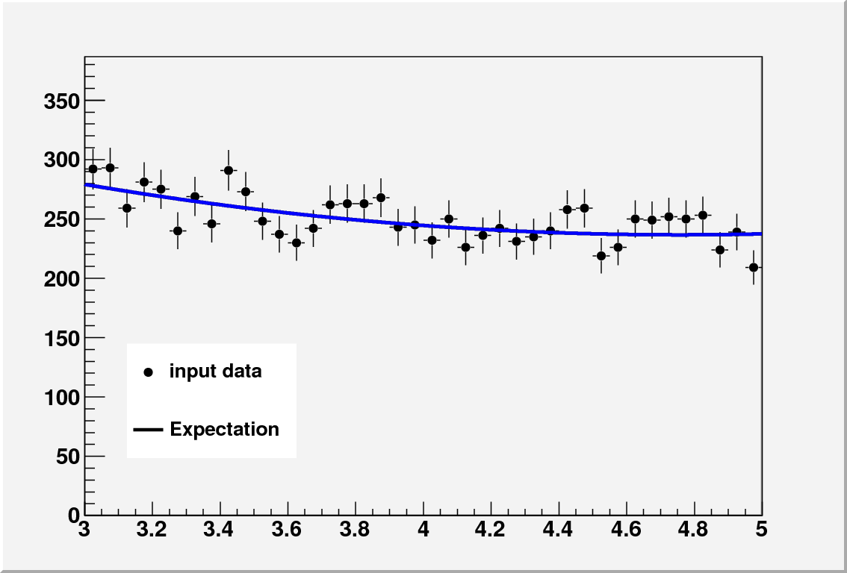

Goodness-Of-Fit Tests
Basic question: how well does H₀ describe the data?
n_{i}
For GOF tests with binned data:
compare observed event numbers n_{i} with expectation values f_{i}
f
→ Since no H₁ specified → many different GOF tests possible
23

Slide 24
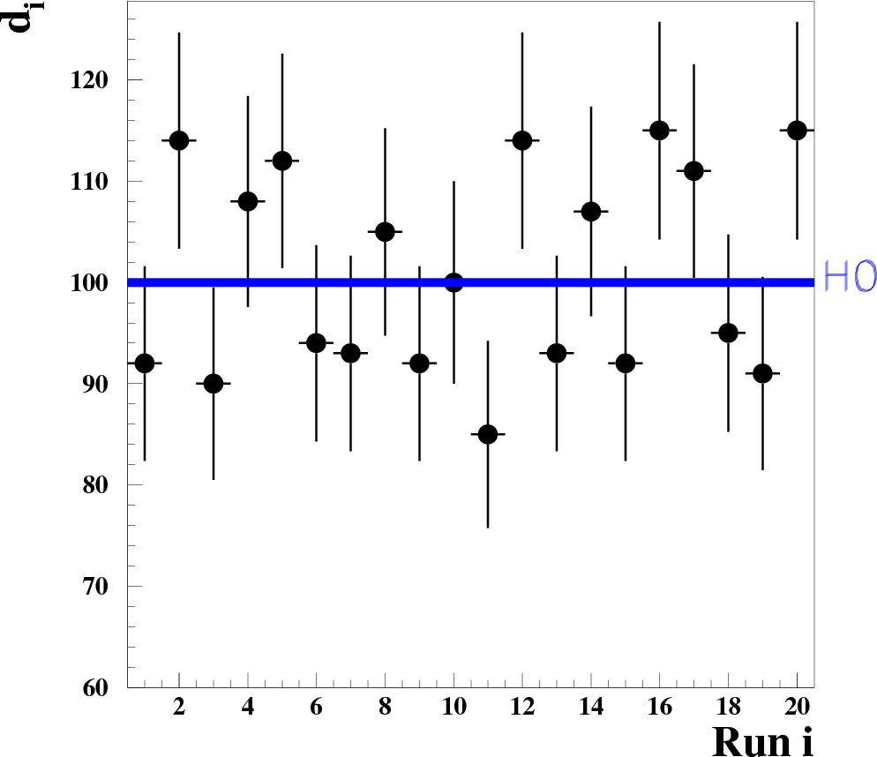
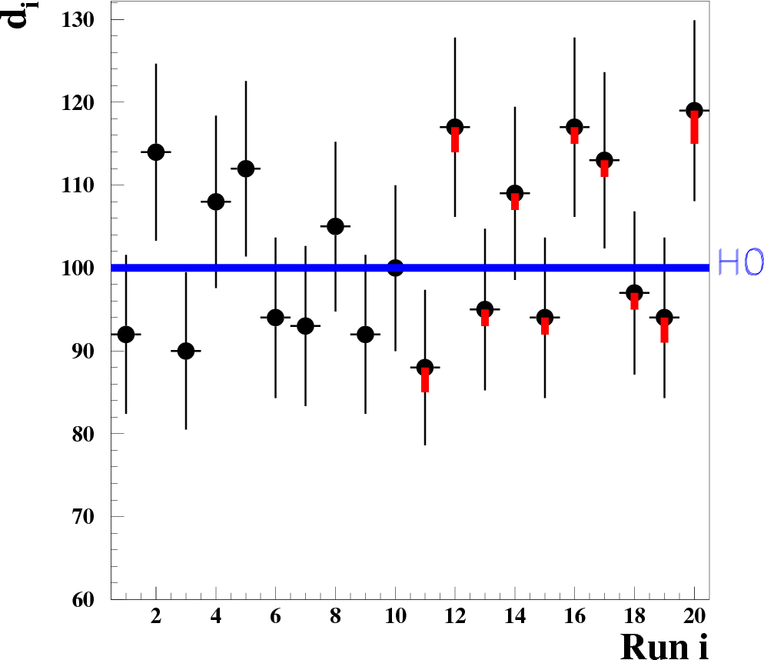

Goodness-Of-Fit Test – χ² tests
correlated +shifts
χ² = 20.1
χ² = 24.2
χ² throws away all sign and order info → not very sensitive to correlated shifts in a certain region.
→ apply further GOF tests to check all data/model facets!
Note: p-values for χ²: TMath::Prob(χ²_{obs},ndf)
24

Slide 25
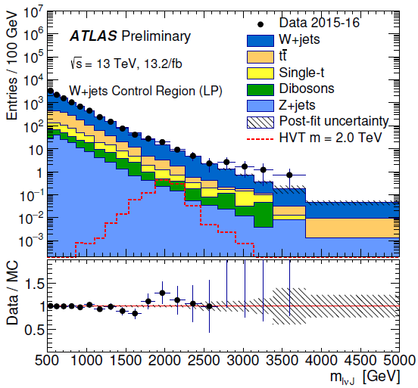
Goodness-Of-Fit Tests in ATLAS and CMS searches
ATLAS-CONF-2016-062
Diboson resonance
“Good agreement is observed
(optical inspection of pulls) between the data and the background prediction”
25

Slide 26
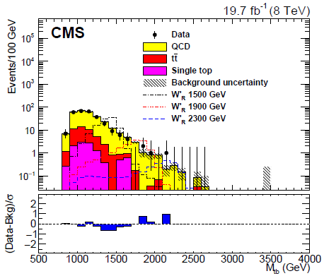
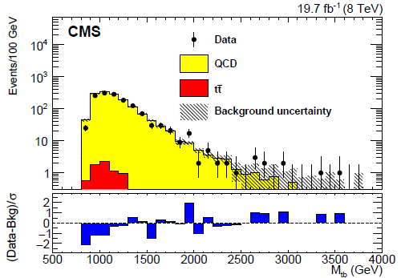
Goodness-Of-Fit Tests in ATLAS and CMS searches
W’ → tb
arXiv:1509.06051v2
“This test (optical inspection) shows good agreement ”
“Good agreement (optical inspection) between data and expectation from SM”
→ Optical inspection of bin-wise pulls is fine but should do also global tests as discussed in the following slides!
26

Slide 27
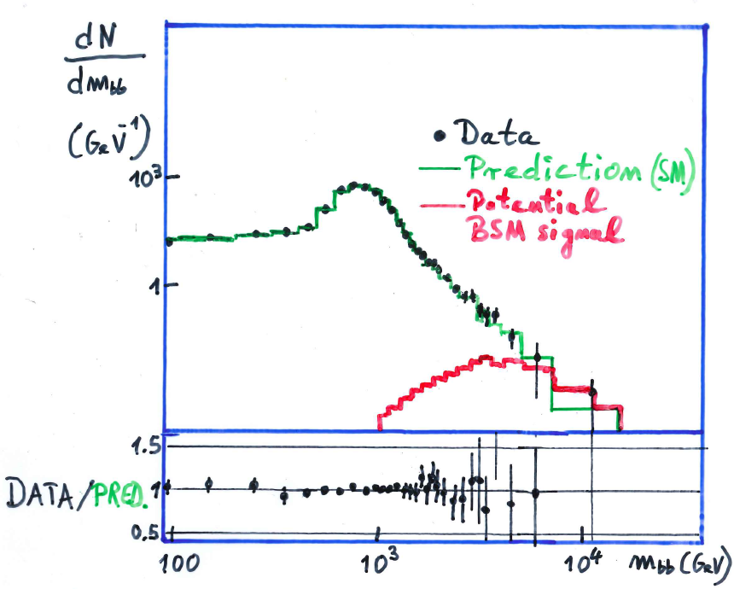

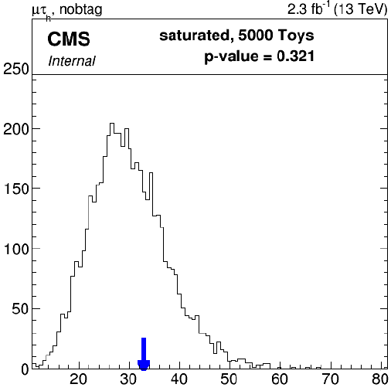
GOF-tests: exemplary analysis
Hypothetical pp data@100 TeV
Likelihood ratio improved χ² test
S. Baker & R.D. Cousins,
NIM 221 (1984) 437
Saturated model
Analysed with CMS combine tool
Test result ok
27

Slide 28


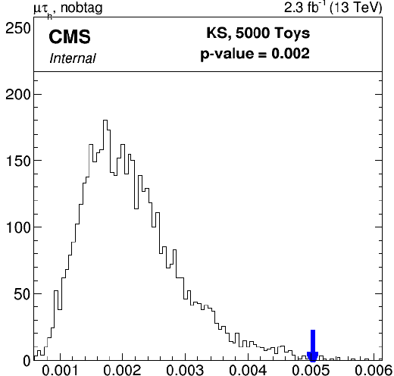
GOF-tests: exemplary analysis
Hypothetical pp data@100 TeV
Kolgomorov-Smirnov test
Analysed with CMS combine tool
correlated shift?
Test result bad!
28

Slide 29
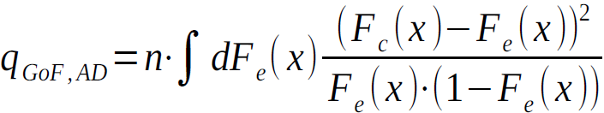
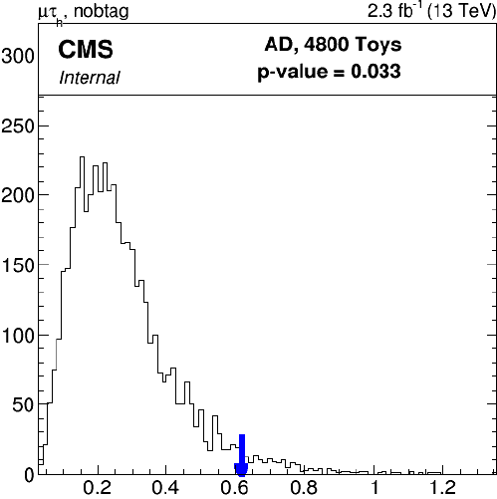
GOF-tests: exemplary analysis
Hypothetical pp data@100 TeV
Anderson-Darling test
Analysed with CMS combine tool
correlated shift?
Test result bad!
29

Slide 30

Summary of GOF tests
Most important:
Perform GOF tests through various analysis stages:
Control plots (!)
Signal Extraction (!!)
Comparisons to theory (!!)
essential for understanding/control of analysis results and theory!
Apply ≥ two different tests, e.g and K.S.
30

Slide 31
Hypothesis testing
3. L(H₁)/L(H₀) based tests
1) H₁: add more background pars
2) H₁: there is a signal
31

Slide 32
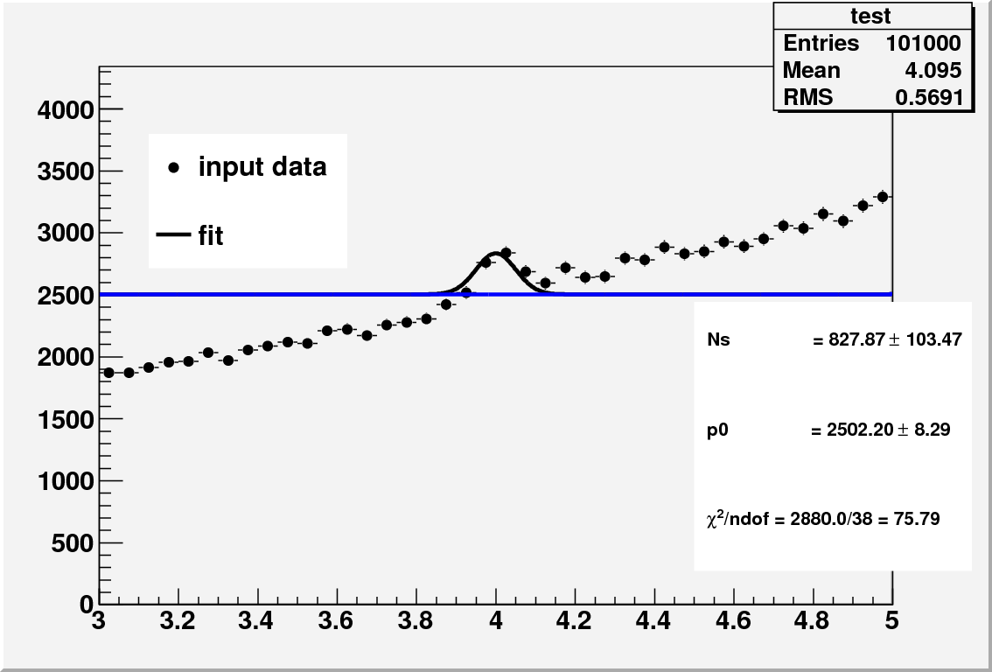


#of background fit pars – How many are needed?
Fit function:
gauss+p0
= 2880
→ Very poor fit: TMath::Prob(2880,38) = 0.
32

Slide 33
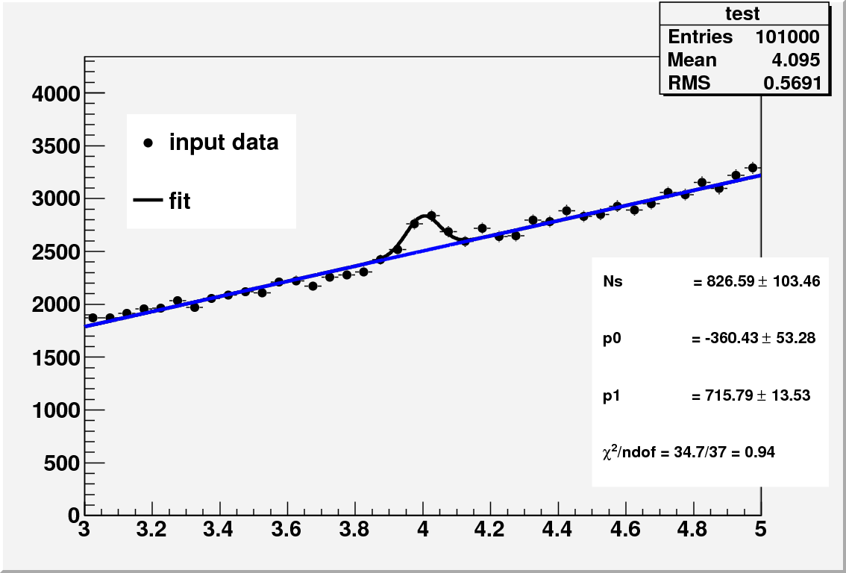
#of background fit pars
Fit function:
gauss+p1
= 34.7
→ Reasonable TMath::Prob(34.7,37) = 0.58
Should we stop here?
33

Slide 34
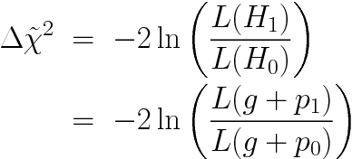
#of background fit pars
Fit function:
gauss+p1
= 34.7
= -2845.3
→ Reasonable TMath::Prob(34.7,37) = 0.58
Should we stop here?
34

Slide 35
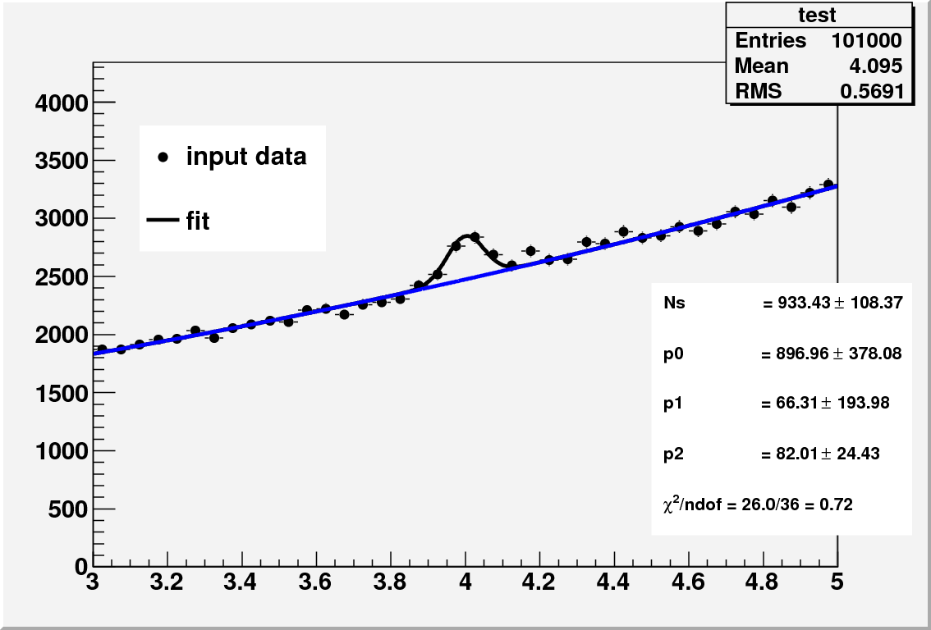
#of background fit pars
Fit function:
gauss+p2
= 26.0
Δ
= -8.7
Should we stop here?
→ Reasonable TMath::Prob(26.0,36) = 0.89
35

Slide 36
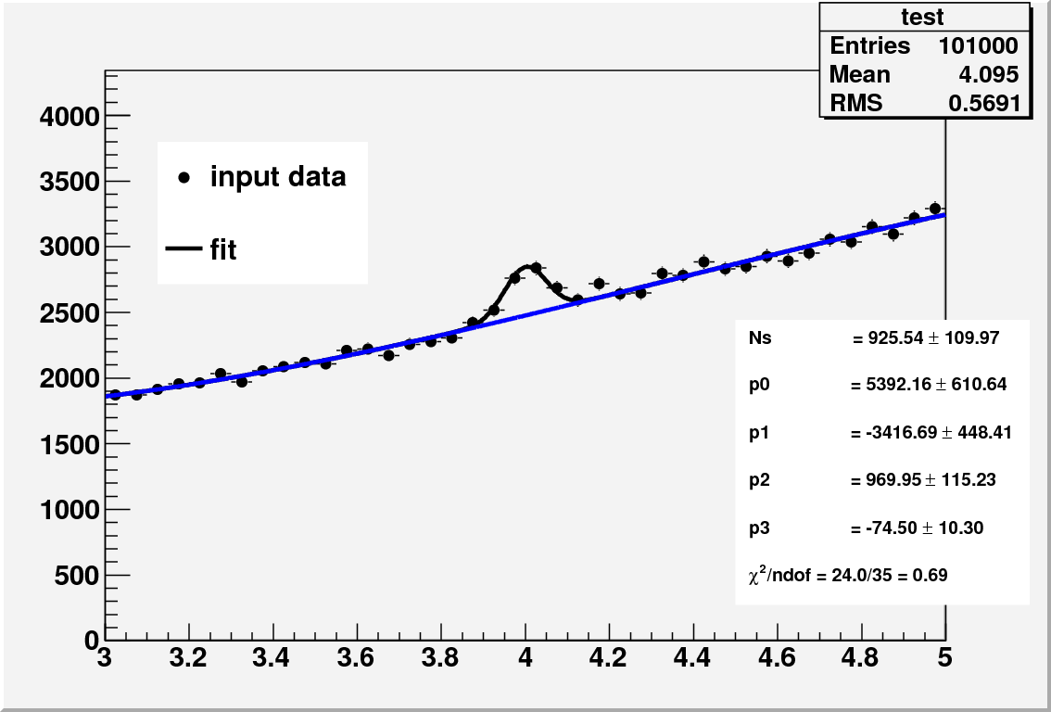
#of background fit pars
Fit function:
gauss+p3
= 24.0
Δ
= -2.0
Lets stop here ☺
→ Reasonable TMath::Prob(24.0,35) = 0.92
36

Slide 37
#of background fit pars
g+p0
= 2880
See also: www.pd.infn.it/~dorigo/rolkelrvsftest.pdf
g+p1
= 34.7
Δ
= -2845.3
g+p2
= 26.0
Δ
= -8.7
g+p3
= 24.0
Δ
= -2.0
When to stop adding further parameters?
H₀ Hypo: Additional parameter not needed (= zero)
If H₀ correct then according to Wilks’ theorem: –Δ should
follow χ² function with ndf=1 (in asymptotic regime of large n)
TMath::Prob(8.7,1) = 0.003 → g+p2 favoured over g+p1
Tmath::Prob(2.0,1) = 0.15 → g+p3 not favoured over g+p2
37

Slide 38
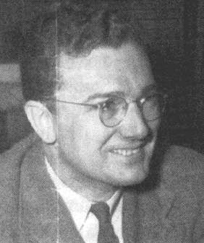
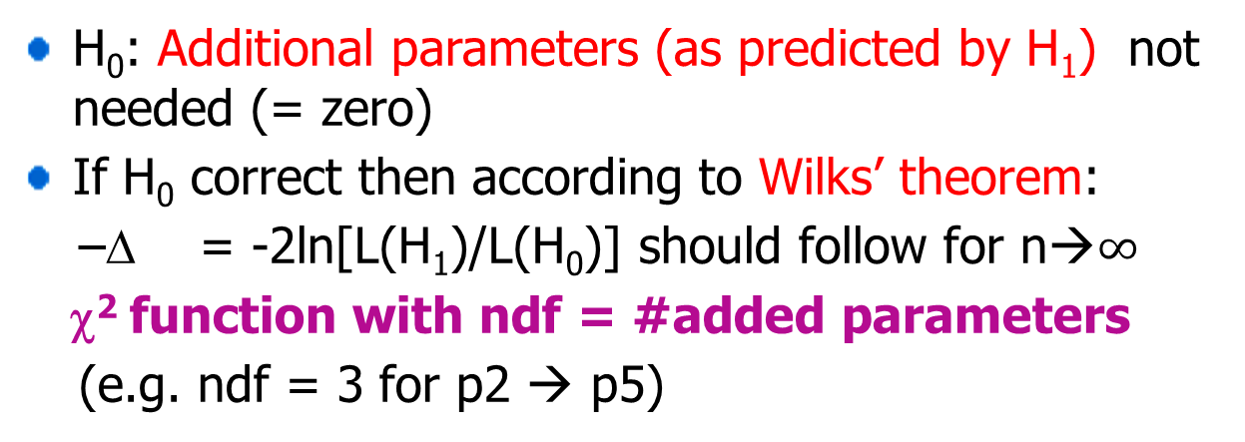
Wilks’ theorem
Samuel S. Wilks
(1906-1964)
H₀: Additional parameters (as predicted by H₁) not needed (= zero)
If H₀ correct then according to Wilks’ theorem:
–Δ = -2ln[L(H₁)/L(H₀)] should follow for n→$∞$
χ² function with ndf = #added parameters
(e.g. ndf = 3 for p2 → p5)
Wilks’ theorem only applies for nested hypotheses:
H₀: 1st order polynomial → H₁: 2nd order polynomial
H₀: 1st order polynomial → H₁: a∙exp(bx+cx²)
Pol2
Pol3
38

Slide 39

Optimal background parametrisation - Summary
Stop adding parameters k → k+1 when
.
.
Another test for vs
Fisher F-test
39

Slide 40
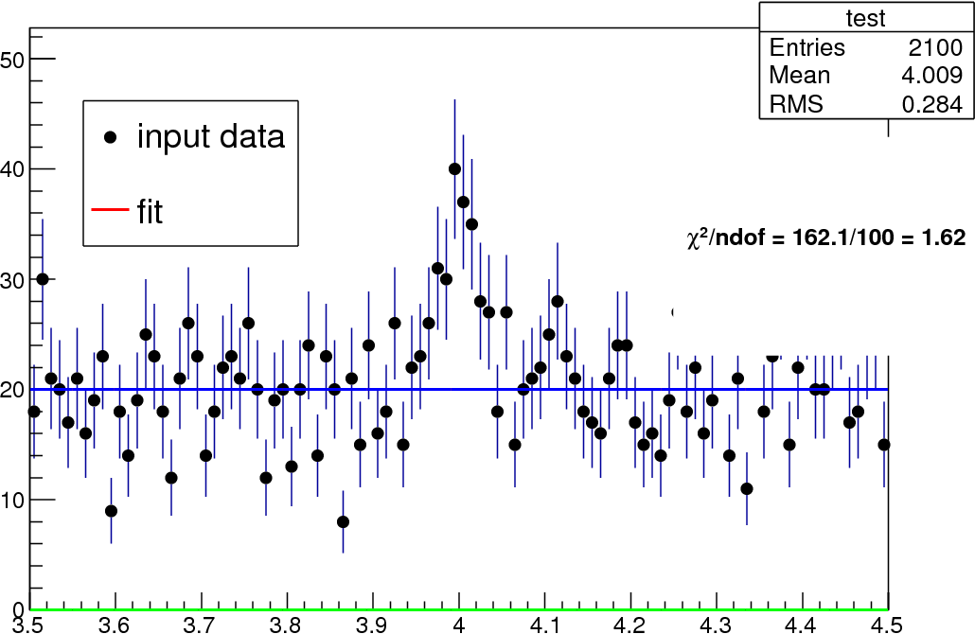
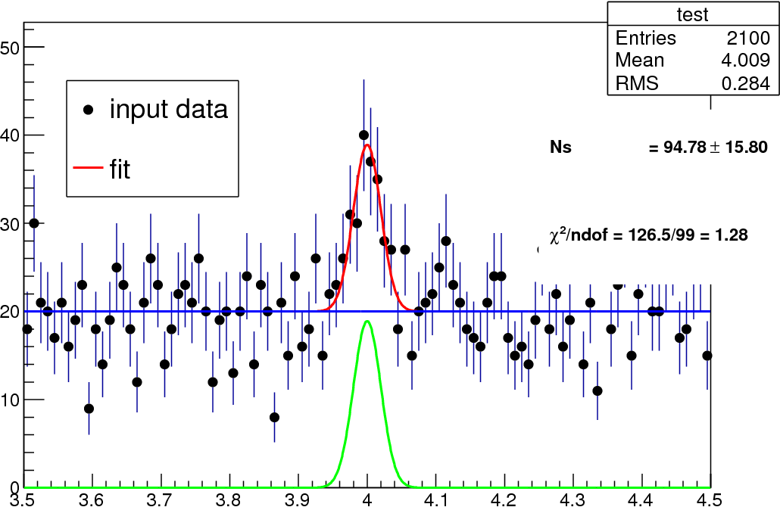


Peak significance
Assumptions: Known background, signal position + width and ~asympotics (large n)
H₀
H₁
According to Wilks’ theorem get local signal significance from
= -51 (for above case)
-Δ should follow χ² distribution with 1 ndf if H₀ correct
= 7.1 is the gaussian z-score, p-value: 5∙10⁻¹³
The bible: “Asymptotic formulae for likelihood-based tests of new physics”
G. Cowan, K. Cranmer, E. Gross, O. Vitells, arXiv:1007.1727
40

Slide 41
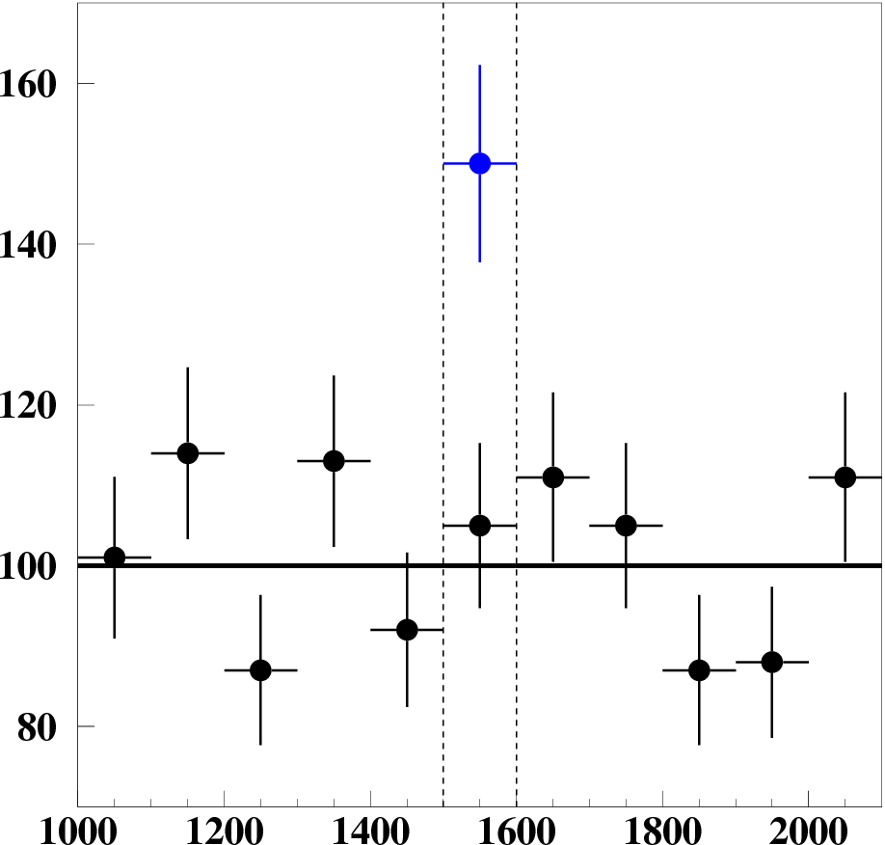
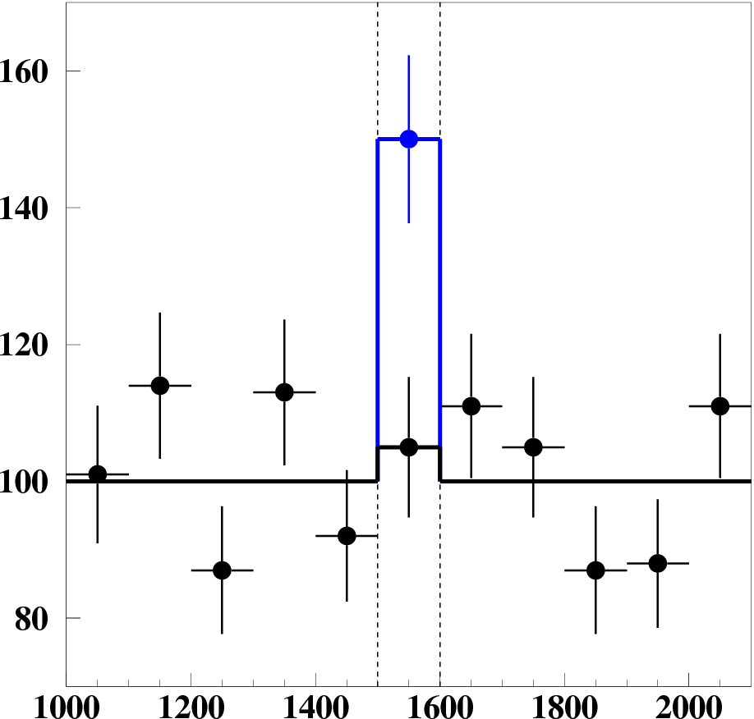
Signal significance for (Gauss. approx.)
Signal case
χ²_{bin} = 16.7
χ²_{bin} = 0.
Background case
χ²_{bin} = 0.3
χ²_{bin} = 0.0
H₀ = b
H₁ = s+b
Define Δχ² := χ²(H₁)-χ²(H₀); Background case: -Δχ² should follow χ² distribution with 1 dof (Wilk’s theorem)
p-value for b fluctuation: TMath::Prob(-Δχ²,1)/2 = 2∙10⁻⁵ for signal case
is the Gaussian z-score: → 4.1 for signal case
41

Slide 42
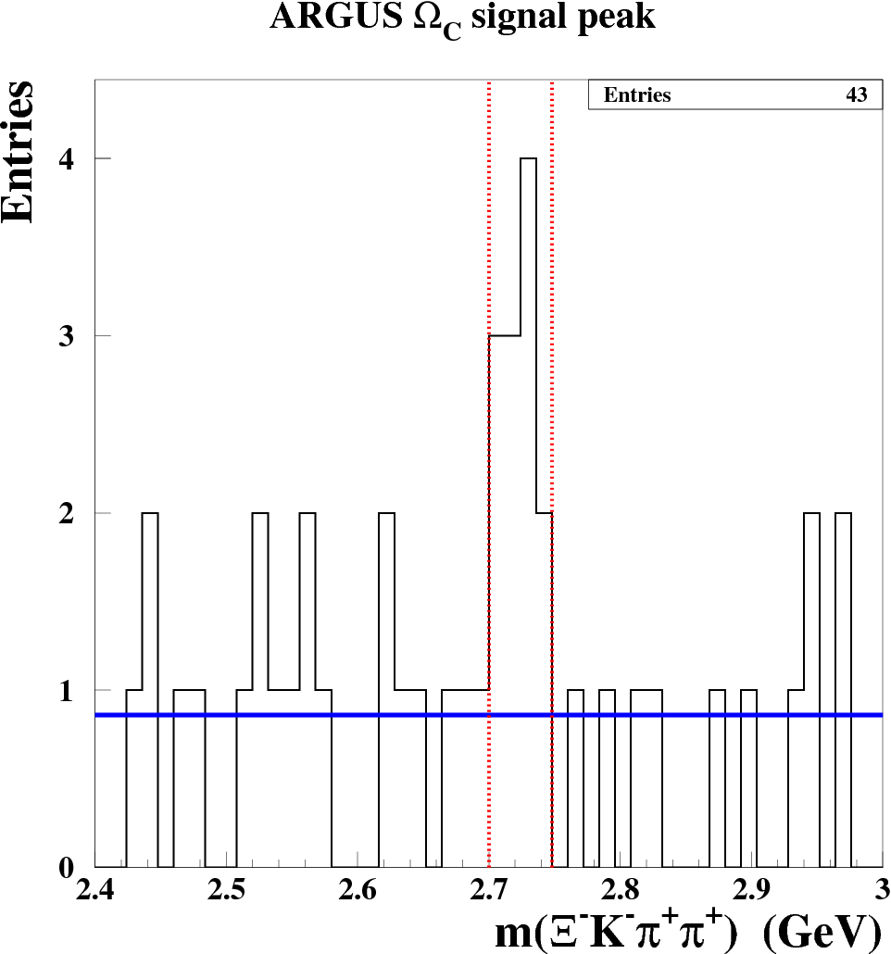
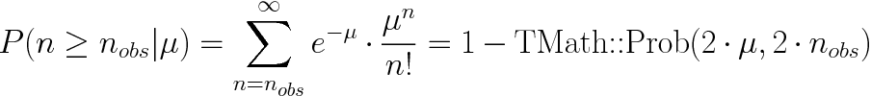
Exercise: Argus peak significance
In four signal bins in total 12 events are counted while expecting 4∙0.86 =3.44 background events
Calculate the probability for a Poisson distribution with μ=3.44 to observe ≥12 events → 1-TMath::Prob(6.88,24) = 2.5 10⁻⁴
Extra: How would results change if the expected background per bin would be 0.67 (as estimated from the side-bands)? → 1-TMath::Prob(5.39,24) = 2.6 10⁻⁵
Signal region
PL B 288 (367)
Hint:
42

Slide 43
Hypothesis testing summary:
Hypothesis tests are an essential tool to test and reject models
→ we do (try) this all the time with the Standard Model
Last big success in 2012:
  Reject hypo: there is NOT a new 125 GeV particle produced @LHC
  No proof of the SM Higgs boson! In many other theories (e.g. SUSY variants) a 125 GeV particle can exist
  Einstein: “A thousand scientists can’t prove me right but one can prove me wrong”
Likelhood ratios L(H₁)/L(H₀) → most powerful for hypothesis testing
H₁
H₀
Check in your analyses if H0
describes data in control-regions
→ Do GOF tests ( , K.S.)
43

Slide 44
Backup slides
44

Slide 45

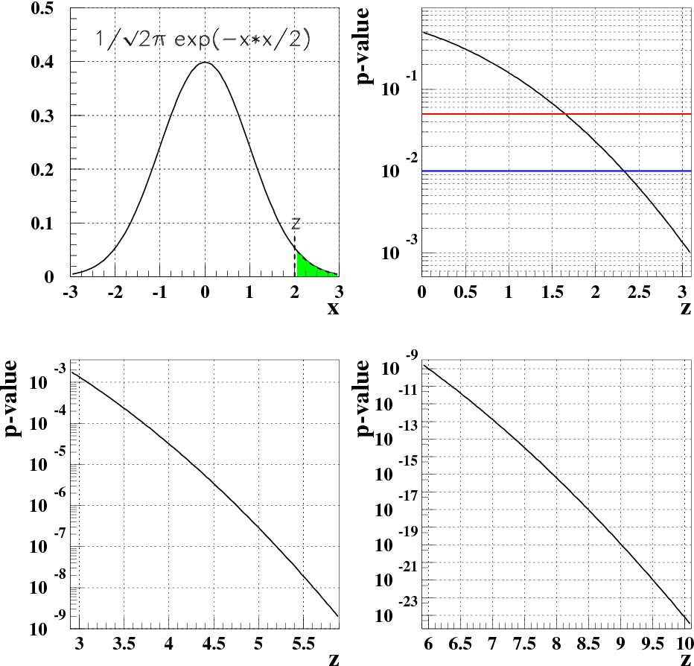

p-values vs significance z
Gaussian 1-sided tail probability
p = 10⁻⁹
→ corresponds to z=6
6σ
45

Slide 46

Combination of independent p values
Fisher formula for combining two observed p values p1’ and p2’
  Order combined p according to p1∙p2
  p = P(p1∙p2<p1’∙p2’) = p1’∙p2’∙(1 – ln p1’∙p2’)
Different ranking/mapping of several p-values to combined one possible, see “Annotated bibliography of some papers on combining significances or p-values”, R.D. Cousins, arXiv:0705.2209
46

Slide 47
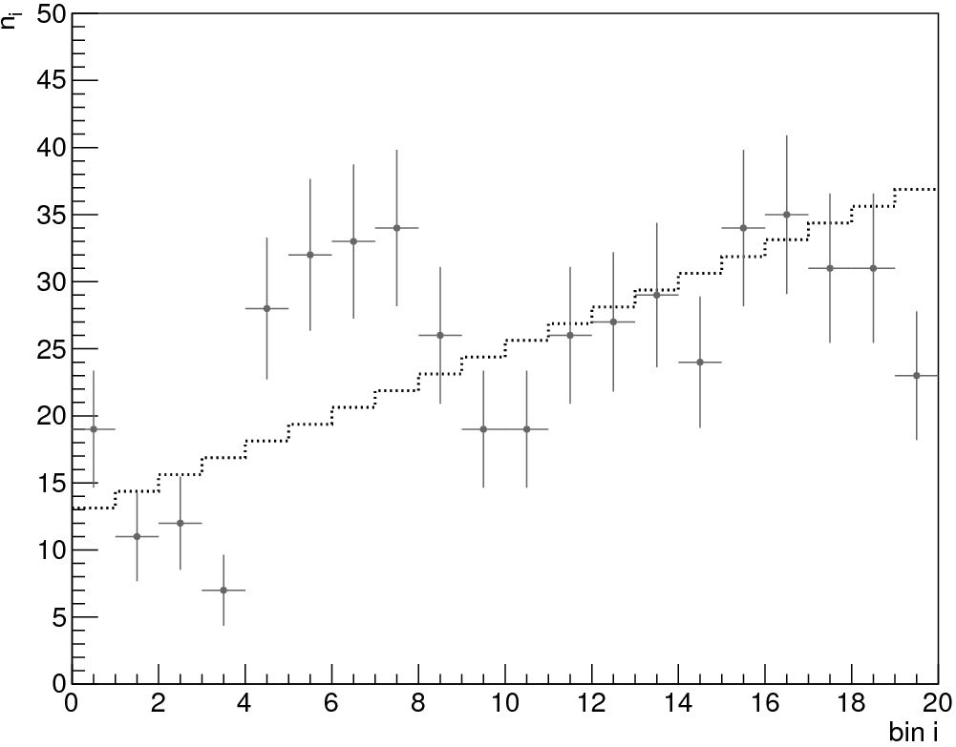



Goodness of Fit - Run test
Idea: count runs = regions with same sign of deviation
Example from “Data Analysis in High Energy Physics” Wiley-VCH
Edited by O.B., K. Kroeninger, G. Schott, T. Schoerner-Sadenius
r = #runs
N₊ = #bins data>model
N_ = #bins data<model
r should follow Binomial statist.
Approximate
Significance
Runs
Here: r=6, E(r)=10.6±2.1
→ p-value = ?
→ Easy to do test!
47

Slide 48
Goodness of Fit - Run test
Idea: count runs = regions with same sign of deviation
Example from “Data Analysis in High Energy Physics” Wiley-VCH
Edited by O.B., K. Kroeninger, G. Schott, T. Schoerner-Sadenius
r = #runs
N₊ = #bins data>model
N_ = #bins data<model
r should follow Binomial statist.
Approximate
Significance
Runs
Here: r=6, E(r)=10.6±2.1
→ p-value = 0.0285
→ Easy to do test!
48

Slide 49
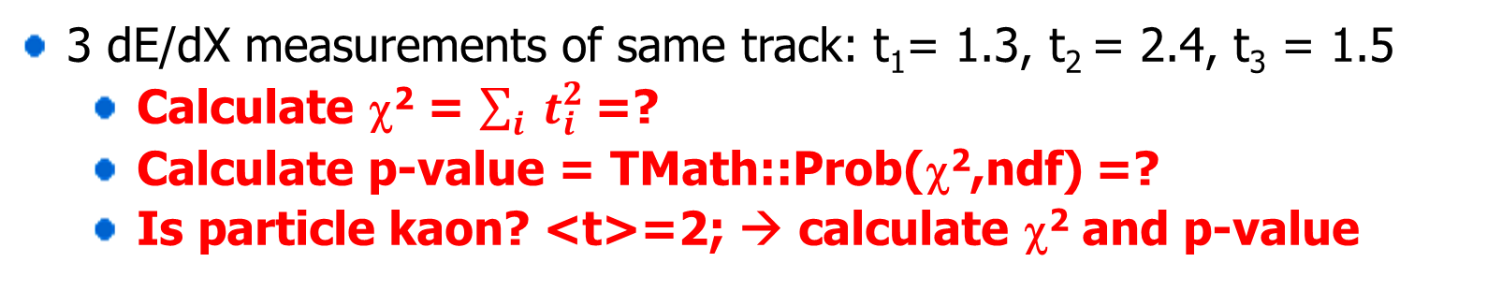
χ² GOF-test exercise: 3 dE/dX measurements
π
K
x=dE/dX
t = [x – <x(π)>]/σ
Distributions for single dE/dX meas.
t
3 dE/dX measurements of same track: t₁= 1.3, t₂ = 2.4, t₃ = 1.5
  Calculate χ² = $\sum_{i}{ t_{i}^{2}}$ =?
  Calculate p-value = TMath::Prob(χ²,ndf) =?
  Is particle kaon? <t>=2; → calculate χ² and p-value
49

Slide 50
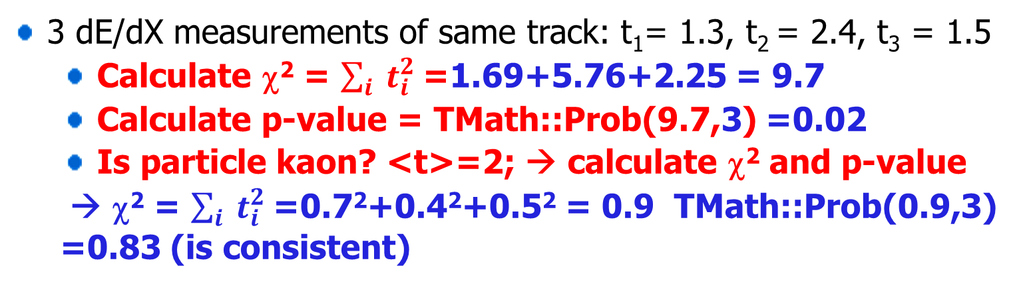
χ² GOF-test exercise: 3 dE/dX measurements
π
K
x=dE/dX
t = [x – <x(π)>]/σ
Distributions for single dE/dX meas.
t
3 dE/dX measurements of same track: t₁= 1.3, t₂ = 2.4, t₃ = 1.5
  Calculate χ² = $\sum_{i}{ t_{i}^{2}}$ =1.69+5.76+2.25 = 9.7
  Calculate p-value = TMath::Prob(9.7,3) =0.02
  Is particle kaon? <t>=2; → calculate χ² and p-value
  → χ² = $\sum_{i}{ t_{i}^{2}}$ =0.7²+0.4²+0.5² = 0.9 TMath::Prob(0.9,3) =0.83 (is consistent)
50

Slide 51

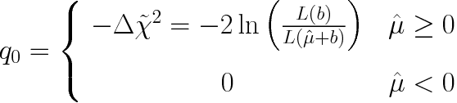
L-ratio based significance for event count n given b
Max. L →
LHC test statistics for discovery: arXiv:1007.1727
with signal n~s+b :
= 2[-s+(s+b)∙ln(1+s/b)]
for s«b: ≈2s²/b→ z=√q₀~s/√b
=

Slide 52
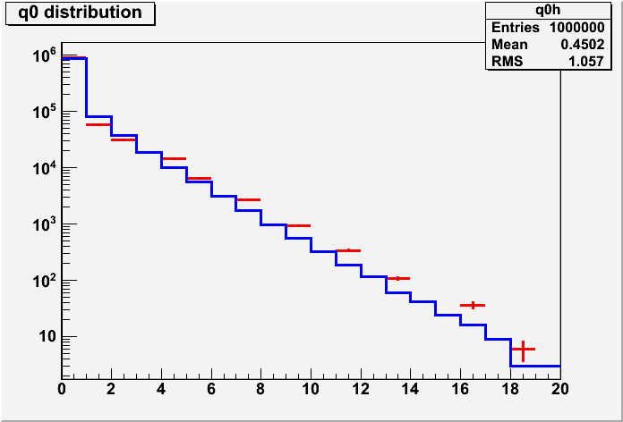
L-ratio based significance for event count n given b
Max. L →
LHC test statistics for discovery: arXiv:1007.1727
= 2[b-n +n∙ln(n/b)]
=
Toy experiments
Ex: b=4.8
(no signal)
Compare to χ² distr. (ndf=1)
52

Slide 53
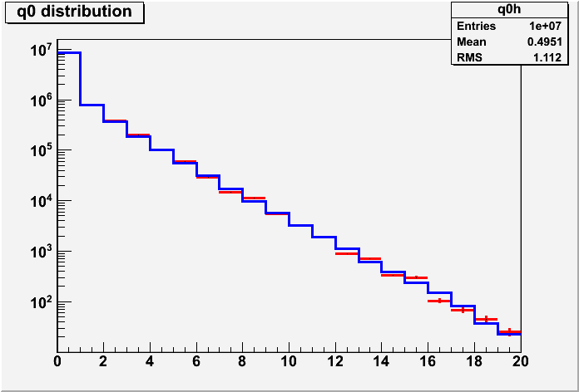
L-ratio based significance for event count n given b
Max. L →
LHC test statistics for discovery: arXiv:1007.1727
= 2[b-n +n∙ln(n/b)]
=
Toy experiments
Ex: b=600.8
(no signal)
→ Asymptotics at work
Compare to χ²
distr. (ndf=1)
Significance z = sqrt(q₀)
53

Slide 54
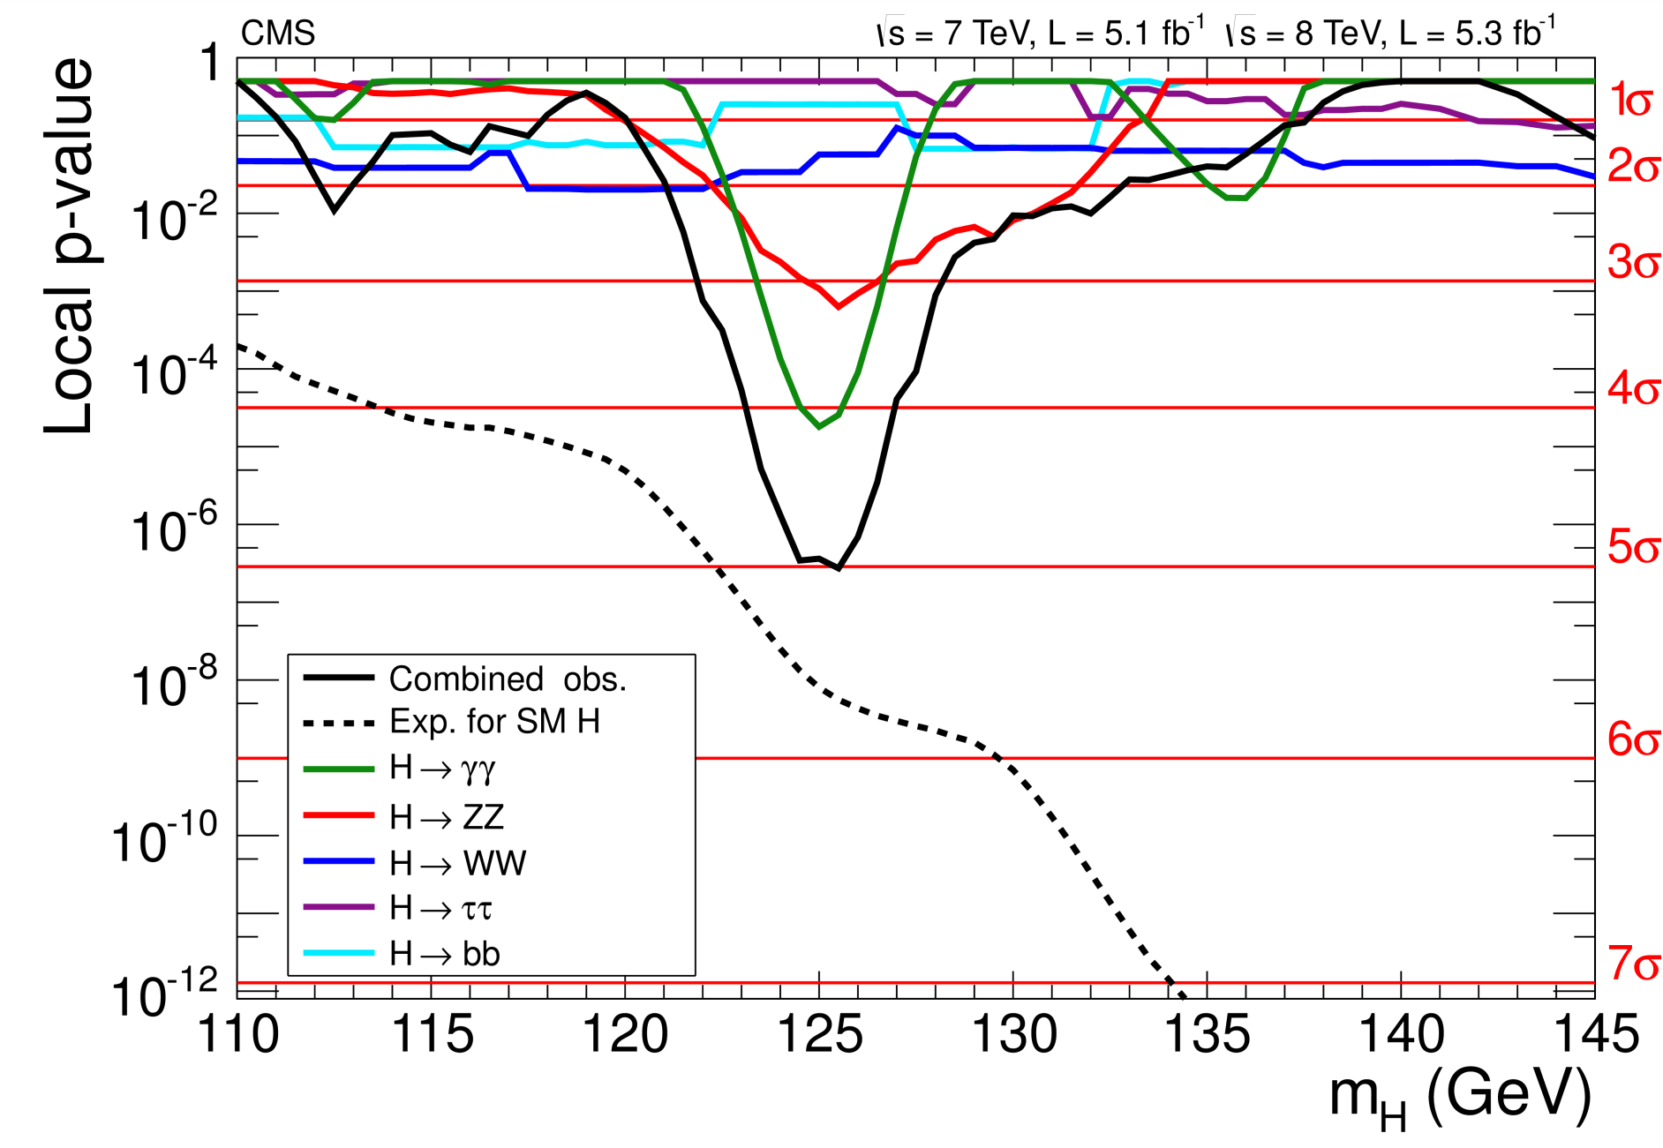
Local p-values: example Higgs discovery
CMS-HIG-12-028
54

Slide 55

Look Elsewhere Effect
© Louis Lyons
Probability of upward background fluctuation
at that place = local p-value
‘anywhere’ = global p-value
Global p > Local p
Where is `anywhere’?
Any location in this histogram in sensible range
Also in histogram produced with different cuts, binning, etc.
c) Also in other plausible histograms for this analysis
Also in other searches in this PHYSICS group (e.g. SUSY at CMS)
In any search in this experiment (e.g. CMS)
In all CERN expts (e.g. LHC expts + NA62 + OPERA + ASACUSA + ….)
In all HEP expts
INFORMAL CONSENSUS:
Quote local p, and global p according to a) above. Explain which global p
55

Slide 56
How many σ for discovery? Judge yourself for … cases
Apply subconscious Bayes factor p(H₁|x)/p(H₀|x) * LEE * Worries about Systematics
SEARCH | SURPRISE | IMPACT | LEE | SYSTEMATICS | No. σ
Higgs search | Medium | Very high | M | Medium | 5
Single top | No | Low | No | No | 3
SUSY | … | … | … | … | …
B_{s} oscillations | Medium/Low | Medium | Δm | No | 4
Neutrino osc | Medium | High | sin²2ϑ, Δm² | No | 4
B_{s}→ μ μ | No | Low/Medium | No | Medium | 3
Pentaquark | … | … | … | … | …
(g-2)_{μ} anom | Yes | High | No | Yes | 4
H spin ≠ 0 | … | … | … | … | .
4th gen q, l, ν | … | … | … | … | .
Dark energy | Yes | Very high | Strength | Yes | 5
Grav Waves | No | High | Enormous | Yes | 8
© Louis Lyons
56

Slide 57
How many σ for discovery?
© Louis Lyons
Apply subconscious Bayes factor p(H₁|x)/p(H₀|x) * LEE * Worries about Systematics
SEARCH | SURPRISE | IMPACT | LEE | SYSTEMATICS | No. σ
Higgs search | Medium | Very high | M | Medium | 5
Single top | No | Low | No | No | 3
SUSY | Yes | Very high | Very large | Yes | 7
B_{s} oscillations | Medium/Low | Medium | Δm | No | 4
Neutrino osc | Medium | High | sin²2ϑ, Δm² | No | 4
B_{s}→ μ μ | No | Low/Medium | No | Medium | 3
Pentaquark | Yes | High/V. high | M, decay mode | Medium | 7
(g-2)_{μ} anom | Yes | High | No | Yes | 4
H spin ≠ 0 | Yes | High | No | Medium | 5
4th gen q, l, ν | Yes | High | M, mode | No | 6
Dark energy | Yes | Very high | Strength | Yes | 5
Grav Waves | No | High | Enormous | Yes | 8
57

Slide 58
Look Elsewhere effect useful papers
“Trial factors for the look elsewhere effect in high energy physics” Ofer Vitells, Eilam Gross, physics arXiv:1005.1891
“Estimating the significance of a signal in a multi-dimensional search” Ofer Vitells, Eilam Gross, astro-ph arXiv:1105.4355
58

