Slide 1
Low-Loss Tuning Issues from the 9mA Run
Nicholas Walker
Workshop on Linac Operation with Long Bunch Trains
February 23rd, 2010

Slide 2
Introduction
In lieu of having anything quantitative and useful to say (i.e. analysis results)…
I will instead try and gives some “words of wisdom”.
Mostly obvious statements (not rocket science)
But will hopefully stimulate some discussion…
An in particular, lead to some clearly defined analysis of the existing DAQ data we can do

Slide 3
Some comments associated with “loss free tuning”
“Cruel and unusual punishment”
“Would not ask my worst enemy to do this job”
“Frustrating beyond belief”
“Soul destroying”
“I’m going mad…”
“I don’t know what to try (next)…”
“It got better…but I don’t know what I did!”
“It got worse…but I can’t see what changed”
…
Achieving loss-free transmission of high-powered beams is the key to achieving ‘routine’ operation.

Slide 4
What do we mean by “loss free”?
“Loss free” should actually be “trip free”
“No signal” on the BLMs means “beam losses too small to measure” – but not necessarily zero!
  i.e. signals are “in the noise”
Setting-up long bunch trains necessitates ramping-up the beam power (total charge) and therefore...
Step-wise approach to increasing the power is mandatory.
  Trip free @ 100 bunches: integrated losses = 10nC (<15nC)
  Increasing to ~150 bunches trips the machine (again)
As power increases, “tuning” requires ever more delicate adjustment and in general becomes more challenging
  We tend to always live on the “cliff edge” with little margin.

Slide 5
The Basic Problem

Slide 6
The Basic Problem
Physical acceptance
Energy
Transverse
Trajectory (orbit)
Optics / matching
Misalignments

Slide 7
The Basic Problem
Beam related
emittance
energy spread
tails/halo
Power
Dark Current

Slide 8
The Basic Problem
Lattice adjustment and energy matching
Aperture must be large enough to transport beam and/or DC cleanly
Injector set-up

Slide 9
The Basic Problem
Damage thresholds
(Failure mode analysis)
BLM/TPS calibration
Logic (Philosophy)

Slide 10
The Basic Problem
How well these themes are controlled will define how difficult your job is

Slide 11
Observations on Loss Free Tuning
Empirical approach
  Not algorithmic / procedural (in general)
Common “knobs” used
  Steering (orbit) – normally first line of attack
    Attempts to steer “lost particles” away from limiting aperture
    Includes dipole magnets in bypass
    Tuned ‘loss free’ orbit not zero BPM readings
  RF parameters (“putting the phase ‘back on crest’”)
    Adjusting energy and energy spread
  Quads (adjusting optics / beta-beats)
  Dispersion measurements / corrections
    Did reducing dispersion in bypass help the losses?
  Gun phase & solenoid setting
    Initial emittance (beam core)
    Talks also to dark current
Experience counts!

Slide 12
Recovering Loss Free configuration
Loss free ‘gold configuration’ was quite often lost after interruption
Nominal restoration of observable machine parameters still resulted in high losses
What were we not observing, or what changed that we didn’t restore?
Note again, in long bunch-train mode we are much more sensitive to 1% or less effects

Slide 13
What can we learn from the DAQ?
Basic approach is to search for meaningful correlations
Look at specific periods when trip rates where high and find correlated ‘parameters and/or other signals’
  E.g. energy, BPM readings, toroid
Optics and orbit modelling
  Potentially enough data in DAQ to do beam-based alignment (dispersion free alignment)
Attempt to include ‘set-points’ in analysis
  What was being tuned during period observed
  Distribution of trip signals
  Again look for correlations (model independent analysis?)
Evidence of ‘tuning on the wrong signal’
  Being fooled in the control room about which signal to concentrate on
  (we are only human)

Slide 14
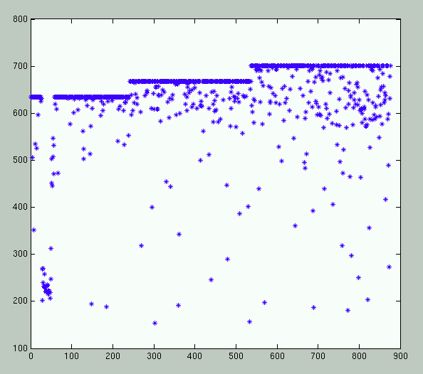
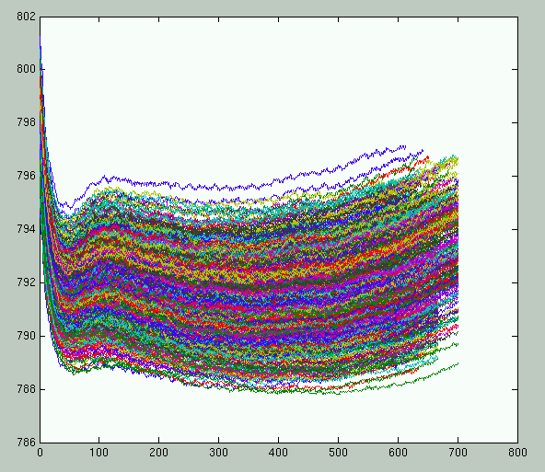
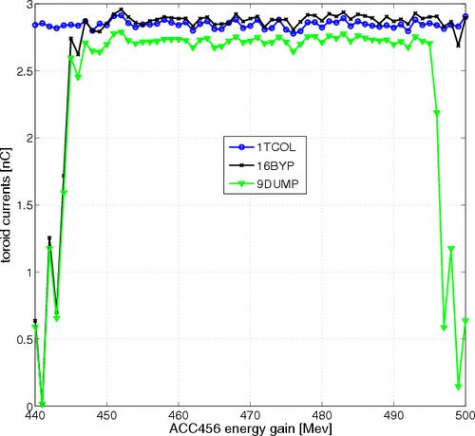
Looking at the DAQ data
20.09.2009 22:16 +5 minutes
3MHz running
Number of bunches (÷3)
No obvious ‘energy aperture’ effect

Slide 15
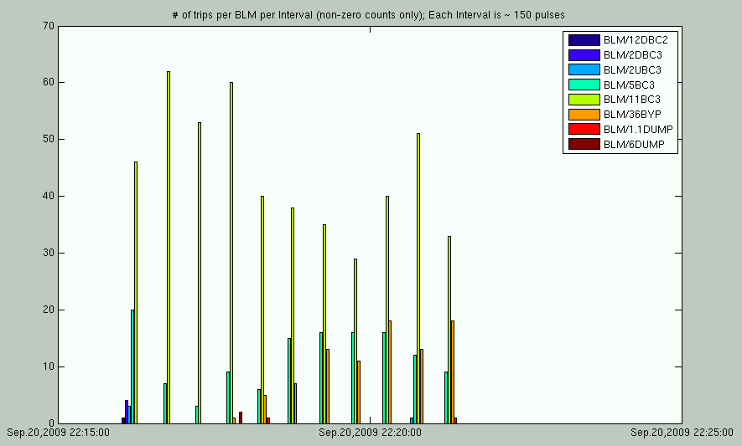
Trip statistics
30 second bins

Slide 16
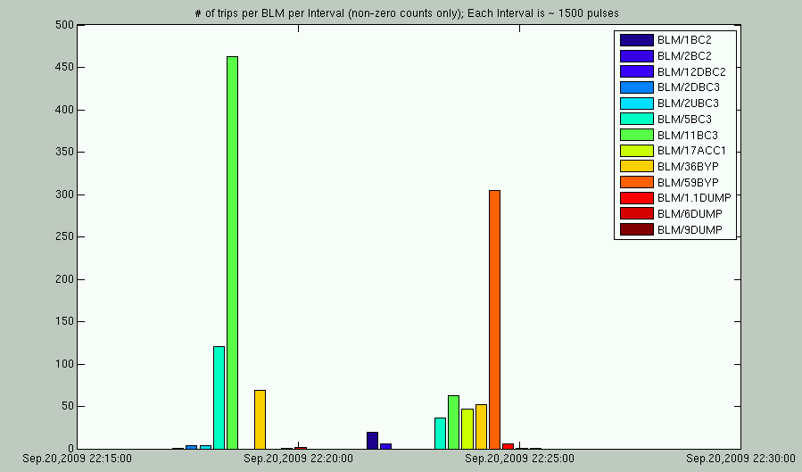
Longer time scale
Loss situation has changed
Likely to be ‘no simply model’

