Slide 1
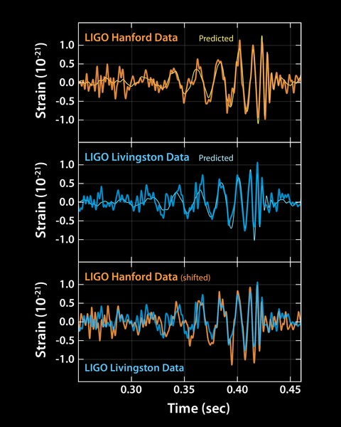
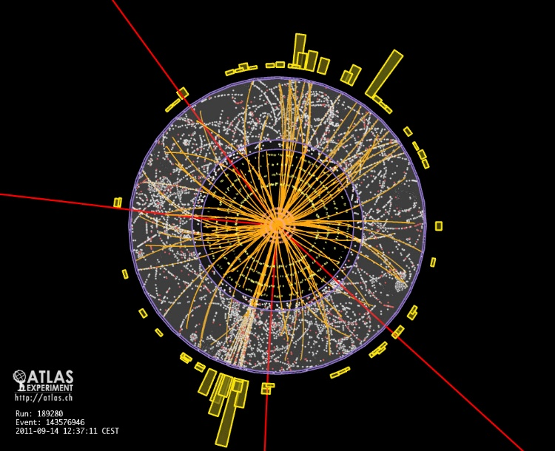
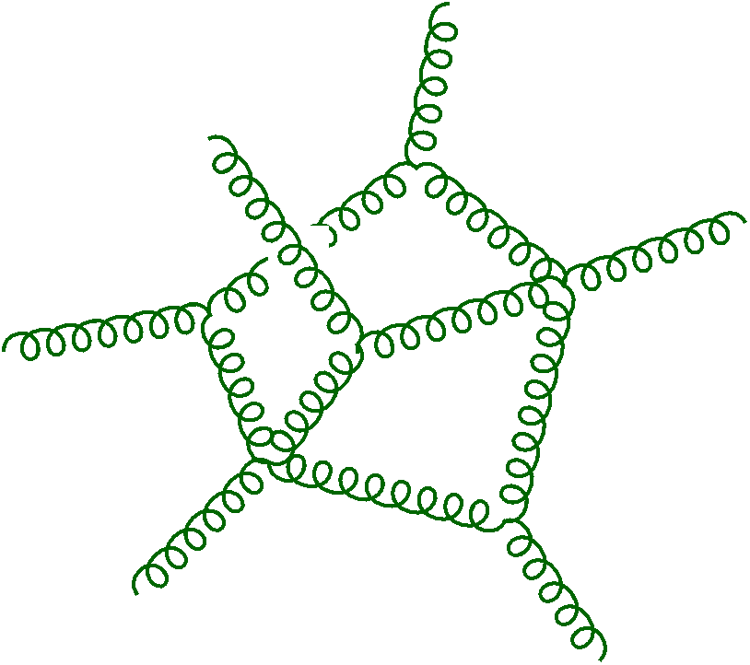


Scattering Amplitudes from LHC to LIGO and Beyond
Lance Dixon
“Quantum Universe” Colloquium
DESY and University of Hamburg
23 June 2020

Slide 2
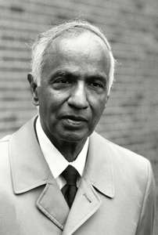
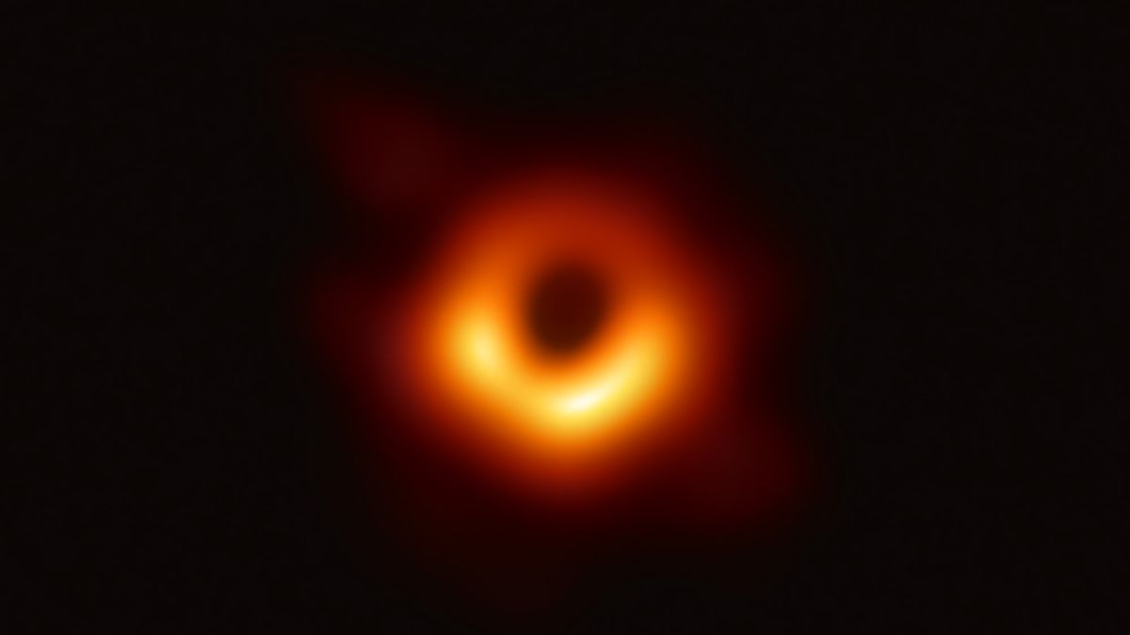
“The black holes of nature are
the most perfect macroscopic
objects there are in the universe:
the only elements in their construction
are our concepts of space and time.”
- S. Chandrasekhar (1979)
Event Horizon Telescope
(2019)

Slide 3
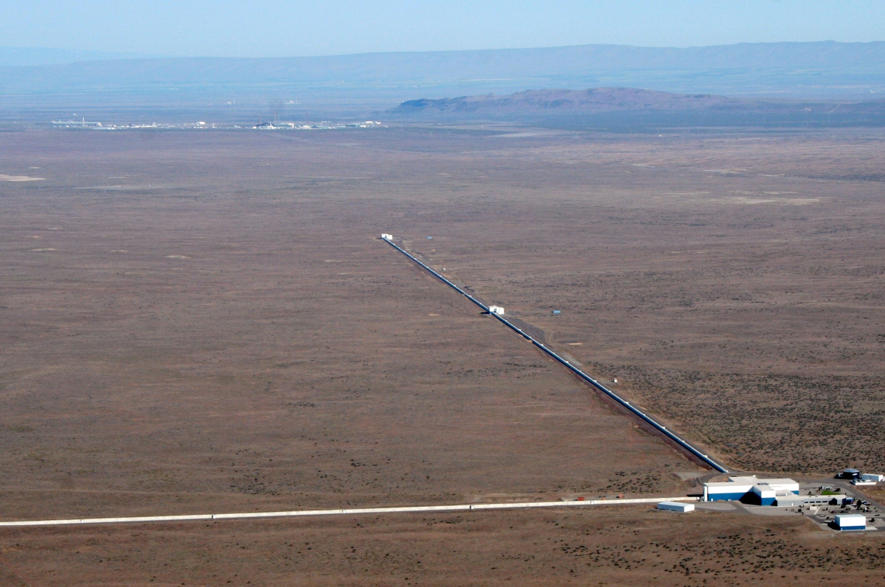
Where most black holes have been “seen”
LIGO, Hanford, WA; also LIGO, Livingston, LA; VIRGO, near Pisa

Slide 4
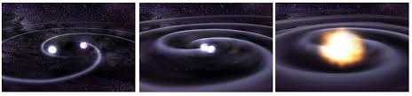
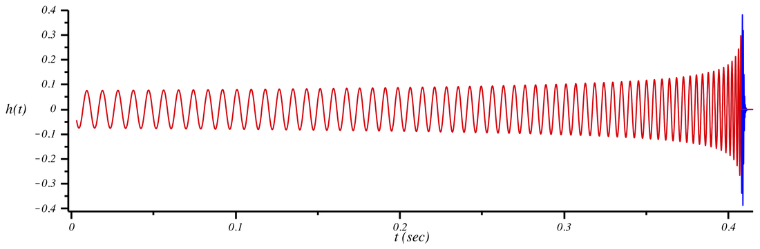
Binary inspiral

Slide 5
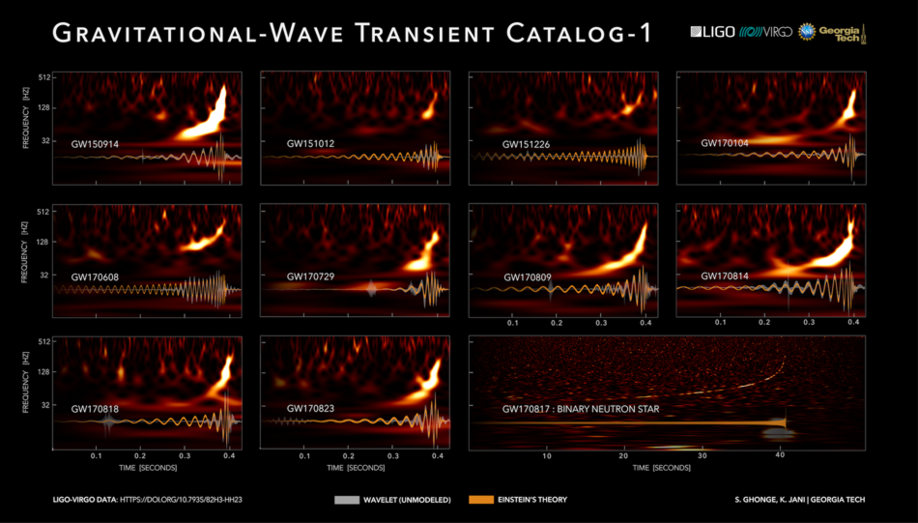
Some events (many more on tape)

Slide 6
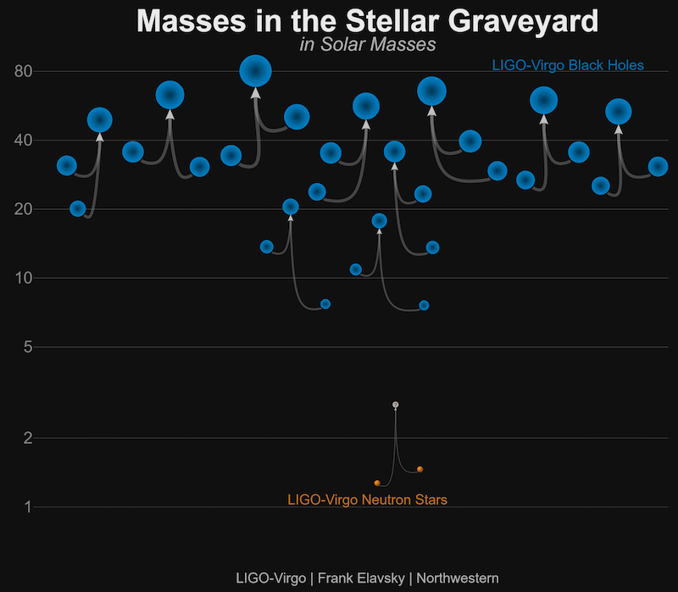

Slide 7
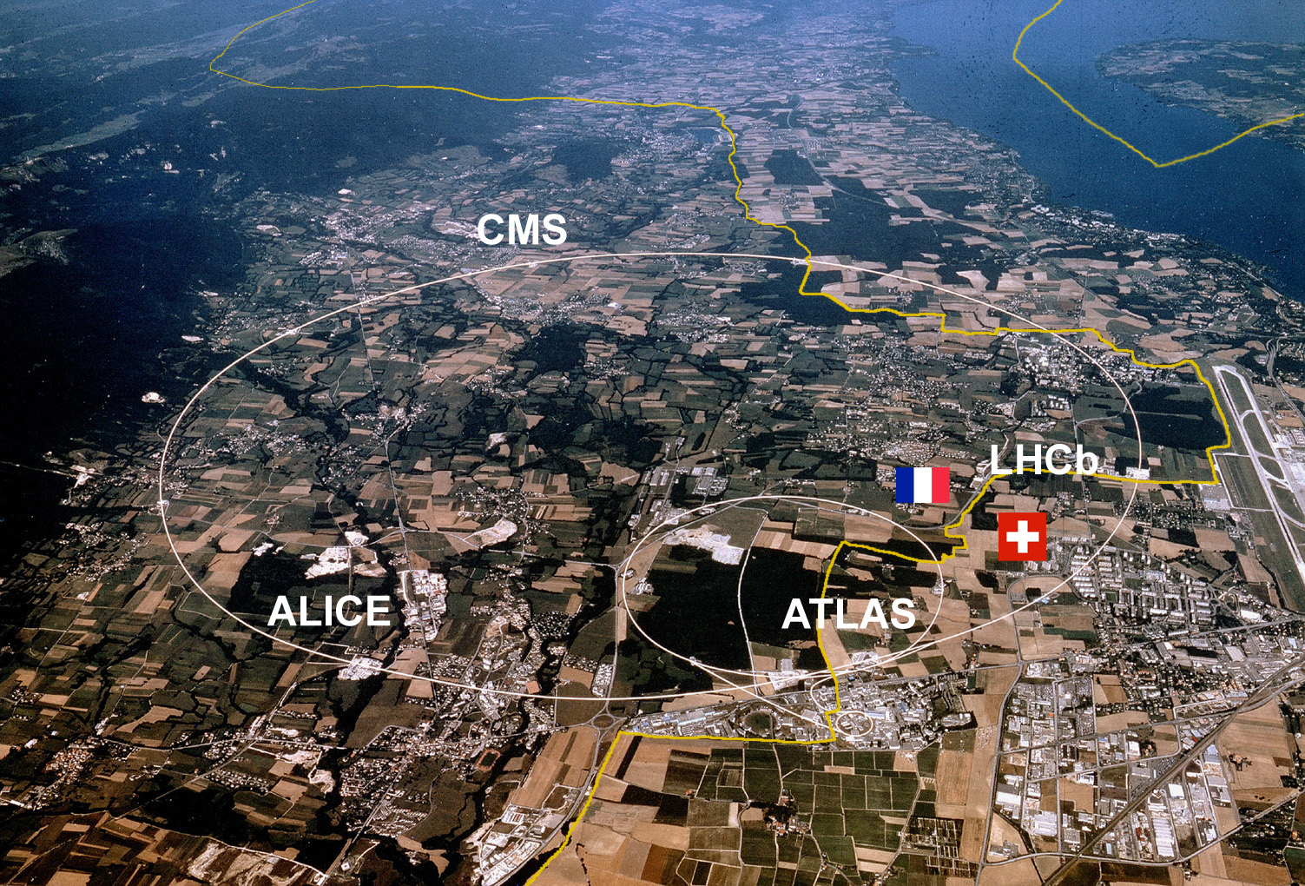
LHC, Geneva: Probing matter at the shortest distances

Slide 8

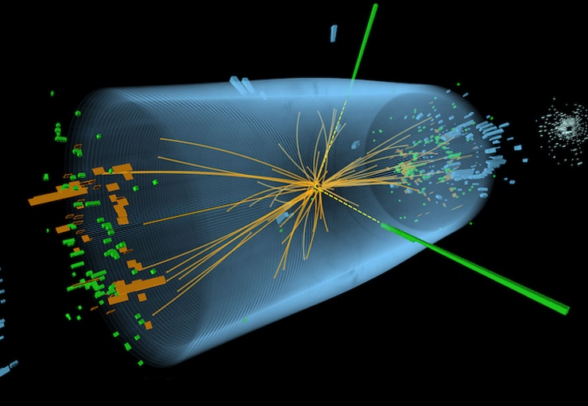
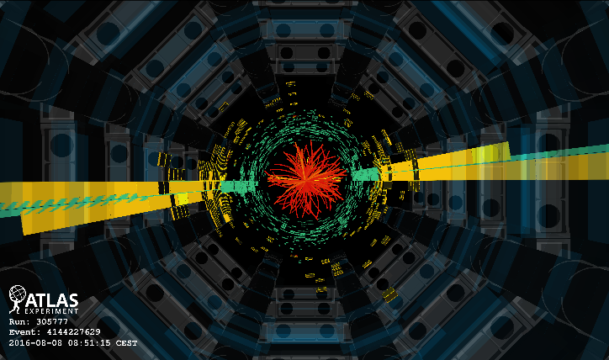
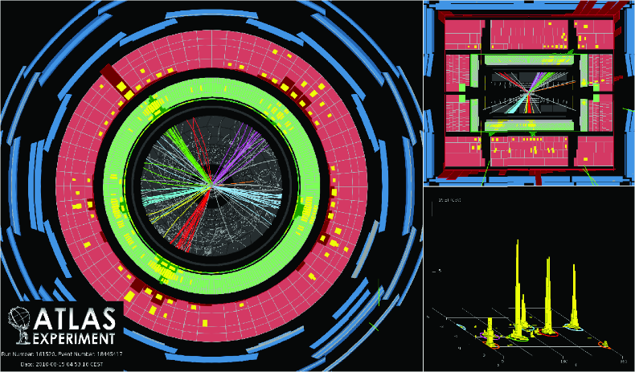
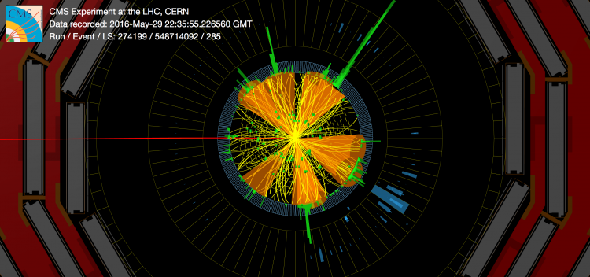




A few events, out of trillions
$pp→{2 jets }^{}$
13 TeV $m_{jj}=8 TeV$
CMS $H→γγ$
$$H→{μ^{+}μ^{−}μ}^{+}μ^{−}$$
6 jets
$t\overline{t}t\overline{t}$

Slide 9
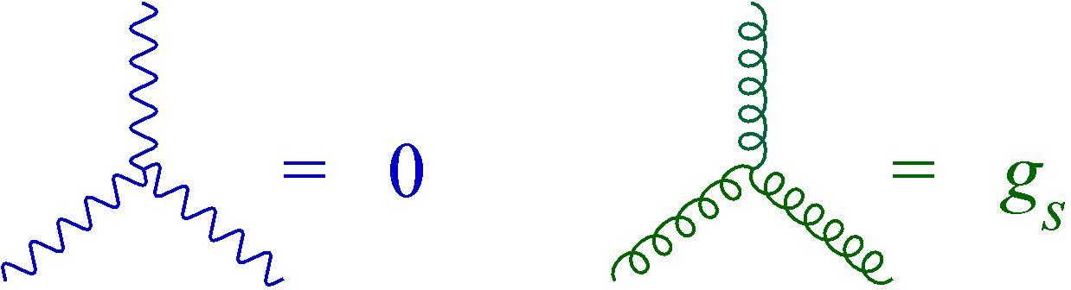
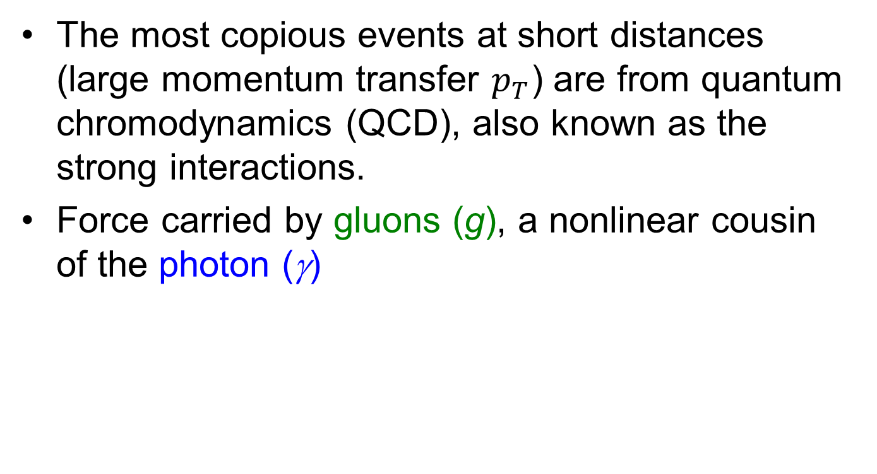

At the heart of the LHC
The most copious events at short distances (large momentum transfer $p_{T}$) are from quantum chromodynamics (QCD), also known as the strong interactions.
Force carried by gluons (g), a nonlinear cousin of the photon (γ)
$=\sqrt{α_{s}}$
γ
g

Slide 10
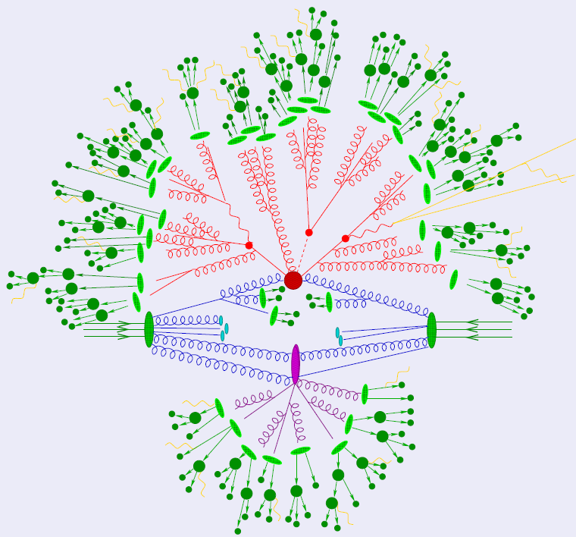
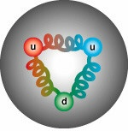
Typical
LHC event
hadronic
jets
nonlinearities small,
perturbatively
calculable
proton
proton
Particle Data Group
F. Krauss
confining

Slide 11
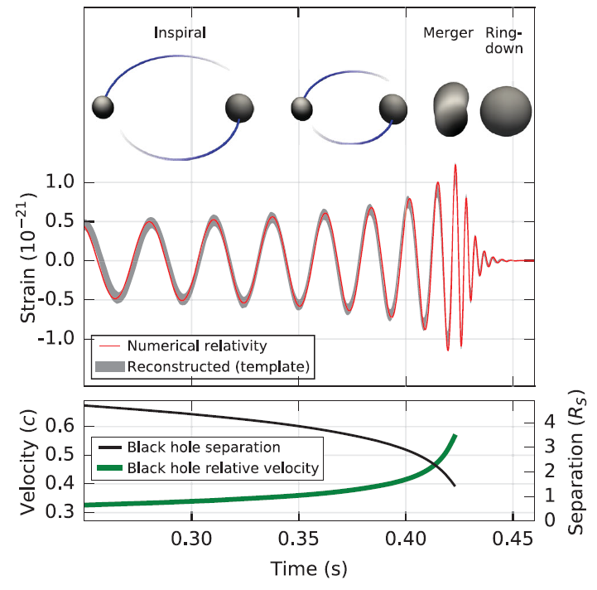
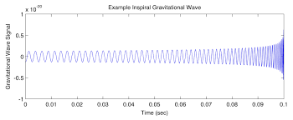
Typical LIGO Event
nonlinearities small,
perturbatively
calculable
quasi-normal
modes
NS-NS mergers @ LIGO/VIRGO/...
or BH’s @ LISA
many, many cycles
in perturbative regime
→ phase of orbit can be measured
very precisely
numerical relativity

Slide 12

Scattering amplitudes
“The most perfect microscopic structures in the universe”
Where the “rubber meets the road” between quantum field theory and experiment
Amplitudes for quantum chromodynamics (QCD) dominate collisions at LHC
Smooth functions of the external kinematic variables and essentially nothing else

Slide 13
Both shrouded in mystery
Black holes often shrouded in gas and dust (which makes it possible to “see” them electromagnetically)
Quarks and gluons scattering in QCD are shrouded by confinement: bound within the initial protons, and emerge as collimated jets of hadrons in the final state.

Slide 14
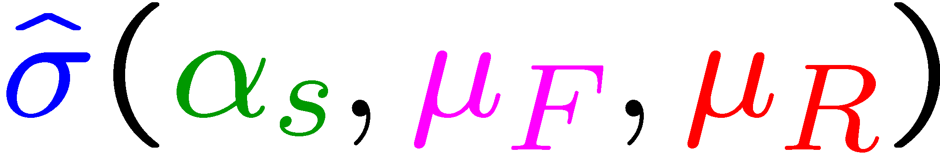
QCD Factorization & Parton Model
At short distances, quarks and gluons (partons) in proton are almost free. Sampled “one at a time”
“typical” infrared safe final state
The “femto-universe”
size = factorization scale μ_{F}
(“arbitrary”)
Parton distribution
functions
(from experiment)
Short-distance cross section
predictable using perturbative QCD
Renorm. scale
(“arbitrary”)

Slide 15

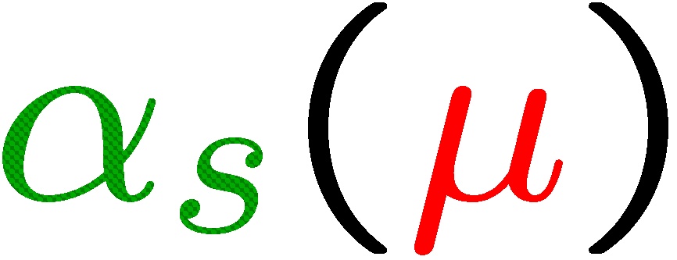

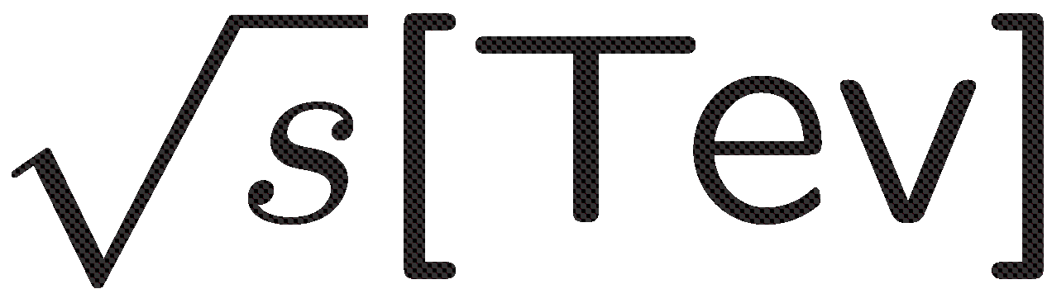
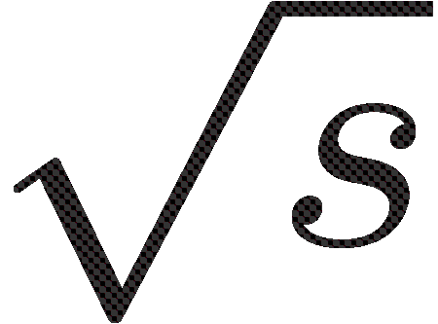
Perturbative Short-Distance Cross Section
LO
NLO
NNLO
50
Leading-order (LO) predictions qualitative:
poor convergence
of expansion in
Uncertainty bands from varying
Anastasiou, Duhr, Dulat,
Herzog, Mistlberger, 1503.06056
20
Example: Higgs gluon fusion
cross section vs.
LHC CM energy
8
13
14
LO → NNNLO
→ factor of 2.7 increase!

Slide 16


Short-distance cross sections built out of scattering amplitudes,
S-matrix elements

Slide 17
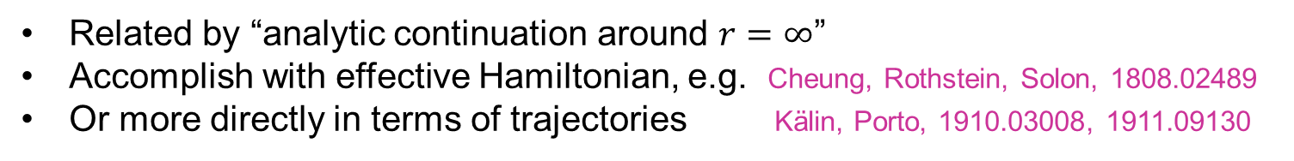
Black hole scattering vs. inspiral
Related by “analytic continuation around $r=∞$”
Accomplish with effective Hamiltonian, e.g. Cheung, Rothstein, Solon, 1808.02489
Or more directly in terms of trajectories Kälin, Porto, 1910.03008, 1911.09130

Slide 18
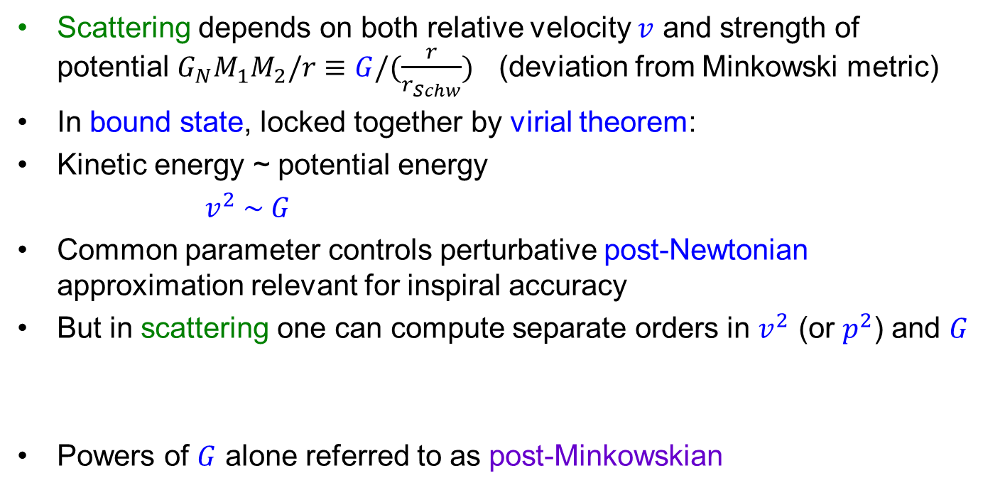
Spinless black hole example
Scattering depends on both relative velocity $v$ and strength of potential $G_{N}M_{1}M_{2}/r≡G/(\frac{r}{r_{Schw}})$ (deviation from Minkowski metric)
In bound state, locked together by virial theorem:
Kinetic energy ~ potential energy
$v^{2} \sim G$
Common parameter controls perturbative post-Newtonian approximation relevant for inspiral accuracy
But in scattering one can compute separate orders in $v^{2}$ (or $p^{2}$) and $G$
Powers of $G$ alone referred to as post-Minkowskian

Slide 19
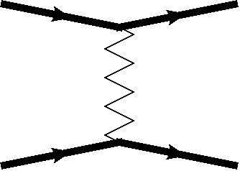
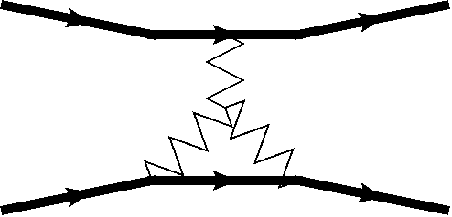
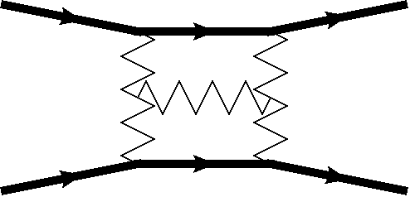
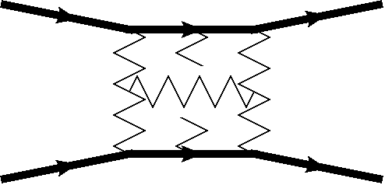
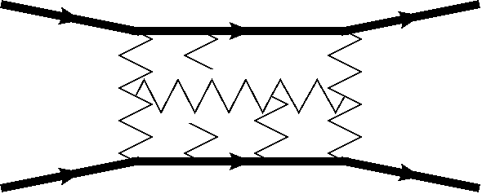
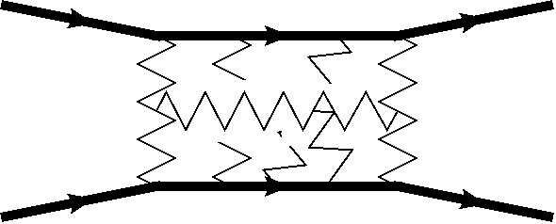

Double expansion of spinless conservative Hamiltonian
1972
-1985
2001
2014
1687
1938
0PN
1PN
2PN
3PN
4PN
5PN
$$\left( 1+v^{2}+v^{4}+v^{6}+v^{8}+v^{10}+v^{12}+…\right) G$$
$( 1 +v^{2}+v^{4}+v^{6} +{ v}^{8 } +{ v}^{10 }+…){ G}^{2}$
$\left( 1 +v^{2}+v^{4} +v^{6} +{ v}^{8 } +…\right) G^{3}$
$\left( 1 +{ v}^{2} +{ v}^{4} +{ v}^{6} +…\right)$ $G^{4}$
$\left( 1 +{ v}^{2} +{ v}^{4} +…\right)$ $G^{5}$
$\left( 1 +{ v}^{2} +…\right)$ $G^{6}$
1PM
1956
2PM
1960
3PM
2019
4PM
2019-2020
5PM
almost
6PM
2019
Many contributed to these advances, for PN notably T. Damour and collaborators

Slide 20


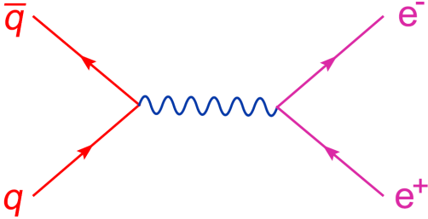
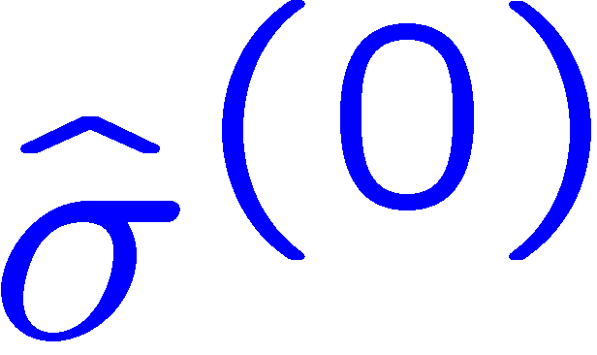
QCD at LHC:
LO = Trees
LO cross section uses only Feynman diagrams with no closed loops – tree diagrams.
Here’s a very simple one:
Z
LO
Although there are many kinds of trees,
some harder than others,
“textbook” methods often suffice

Slide 21
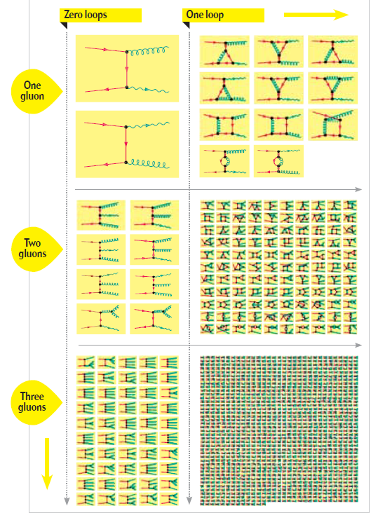
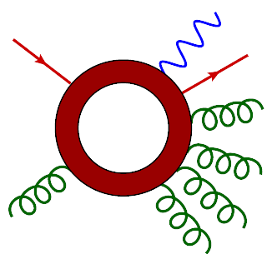
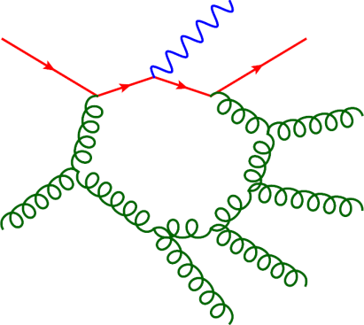
NLO needs 1 loop first quantum corrections
Challenging in QCD if many legs – depends on many variables
_
qq → W + n gluons
=
+ 256,264 more

Slide 22
“NLO QCD revolution”
Gavin Salam (2012)

Slide 23
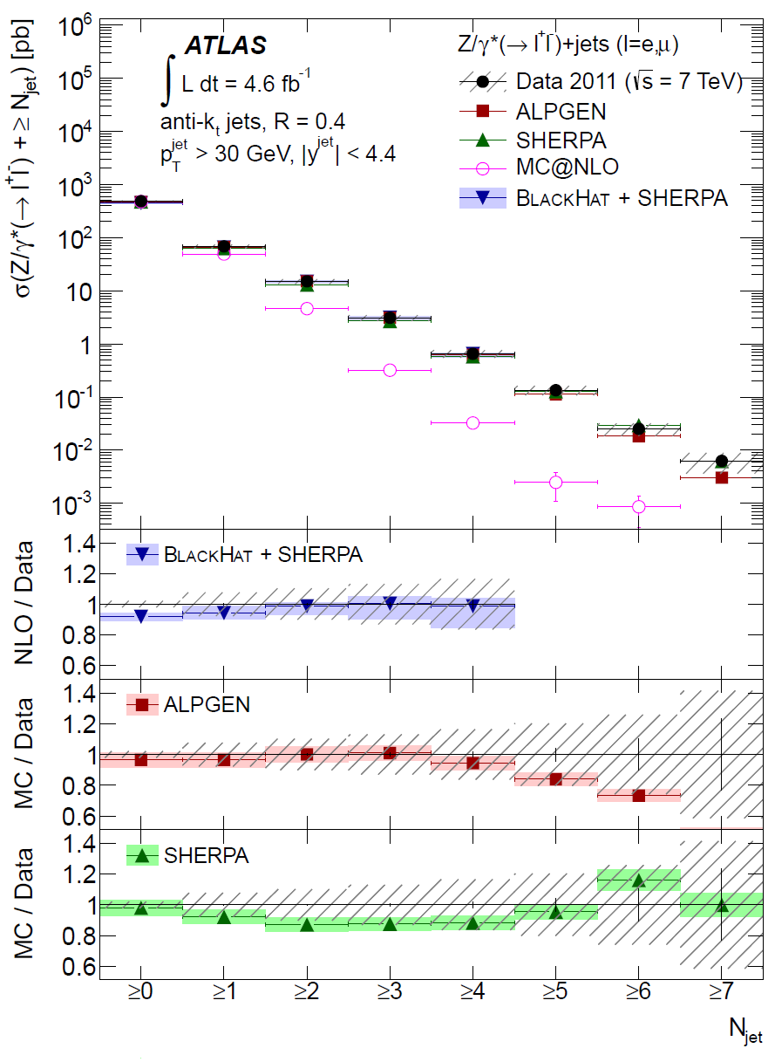
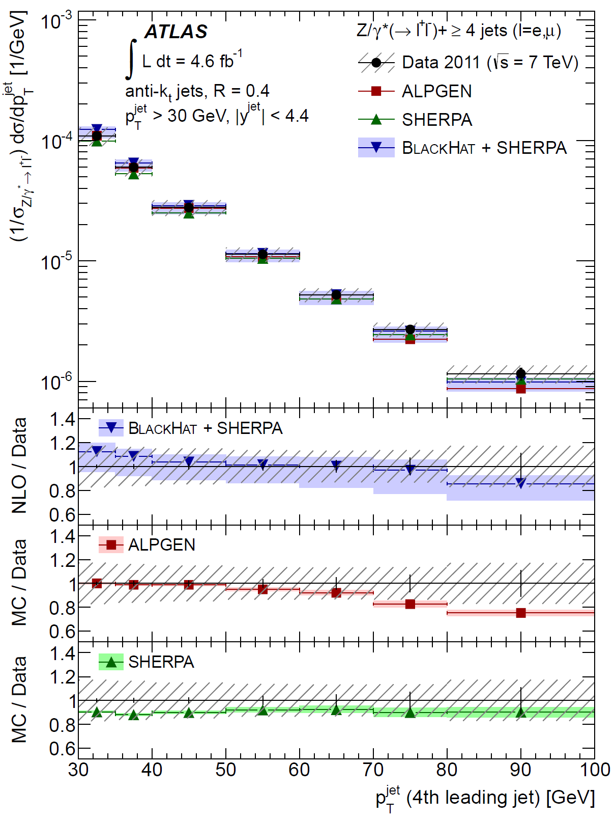
NLO pp → Z + 1,2,3,4 jets vs. ATLAS 2011 data
ATLAS 1304.7098
BH+S:
1108.2229

Slide 24
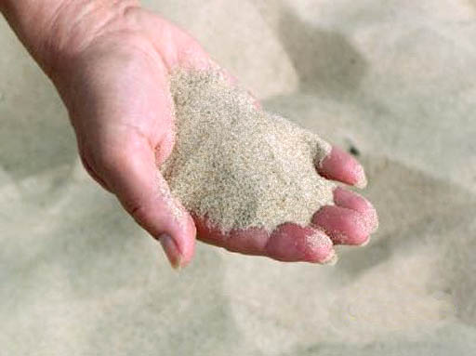
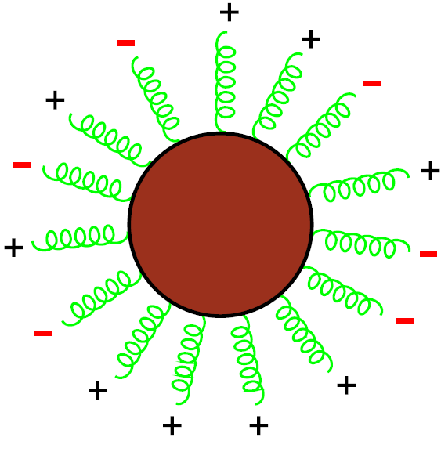
Revolution made possible by new perspective on particle scattering:
“On-shell” Methods, or
Granularity vs. Fluidity

Slide 25


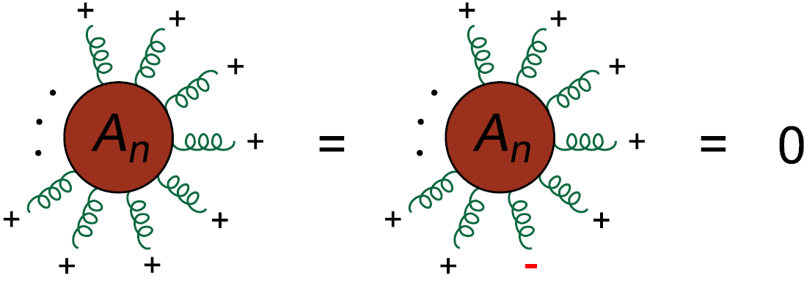
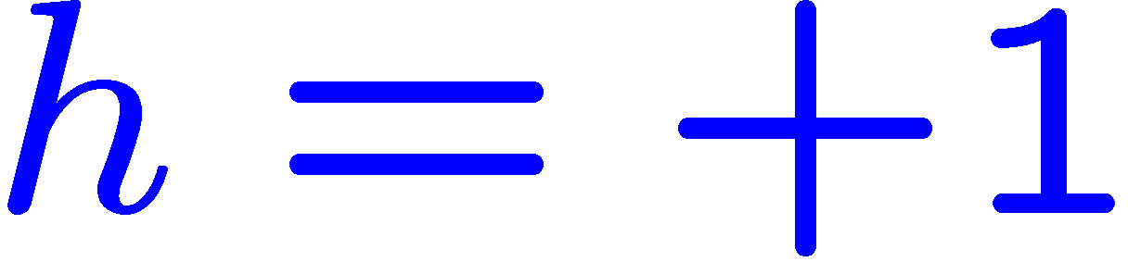
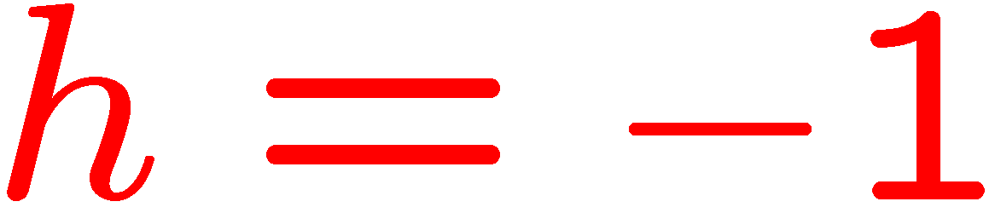
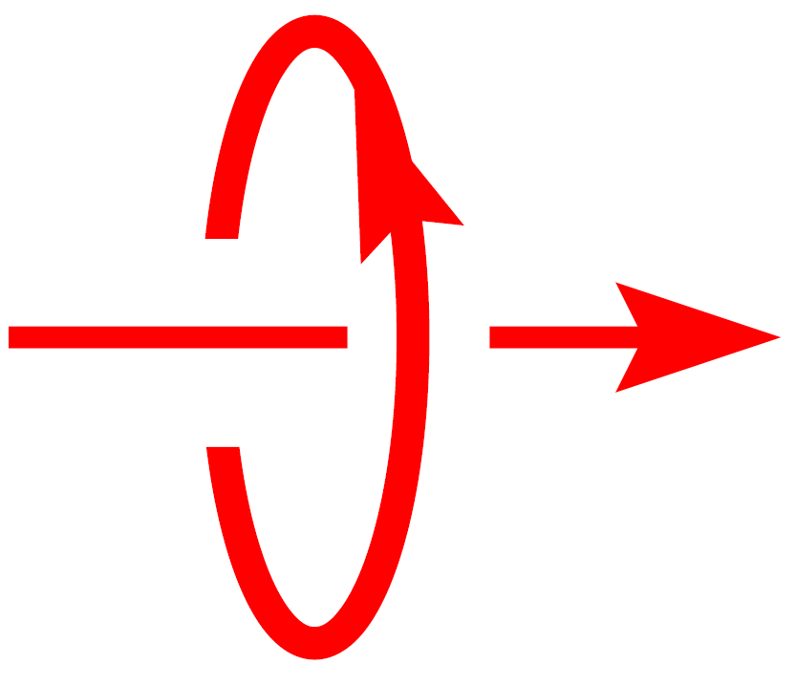
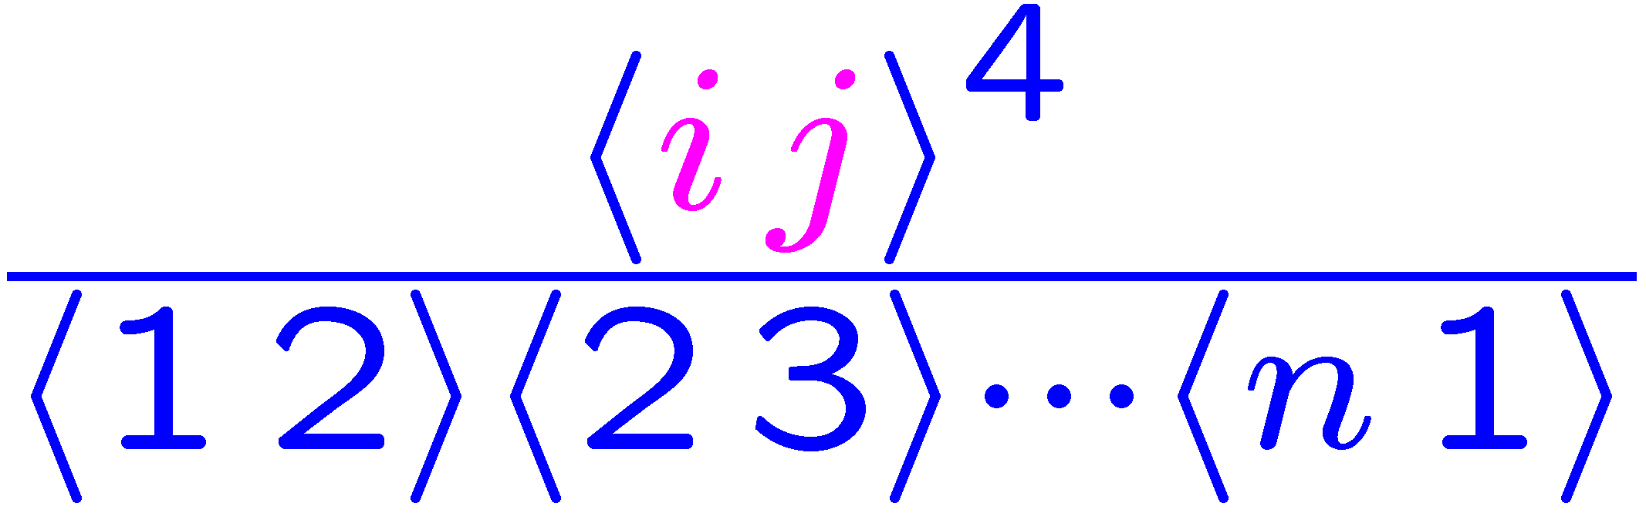
QCD Tree Amplitudes
Many tree-level helicity amplitudes vanish or are very simple.
Much simpler than individual Feynman diagrams!
Analyticity/unitarity
makes it possible
to recycle this
simplicity into
loop amplitudes
Parke-Taylor formula (1986)

Slide 26
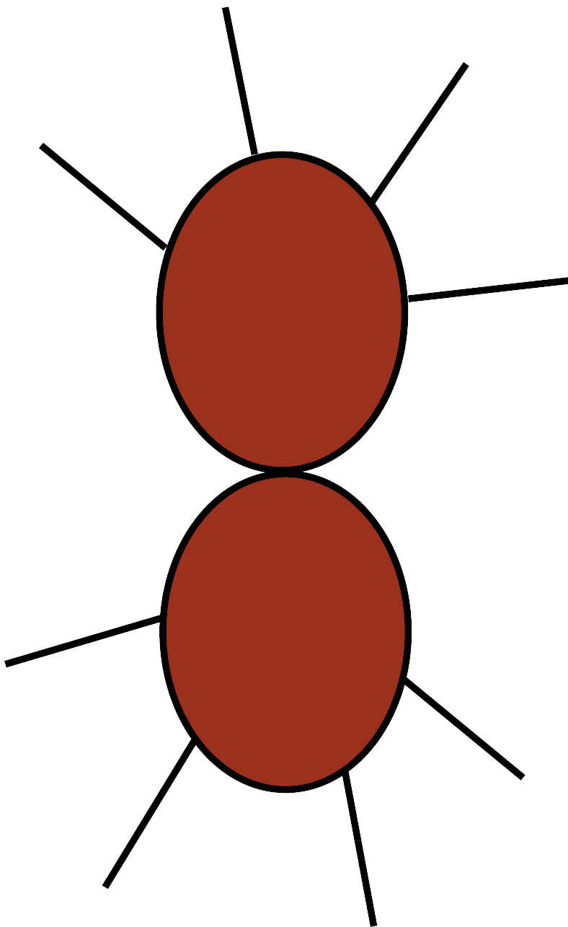
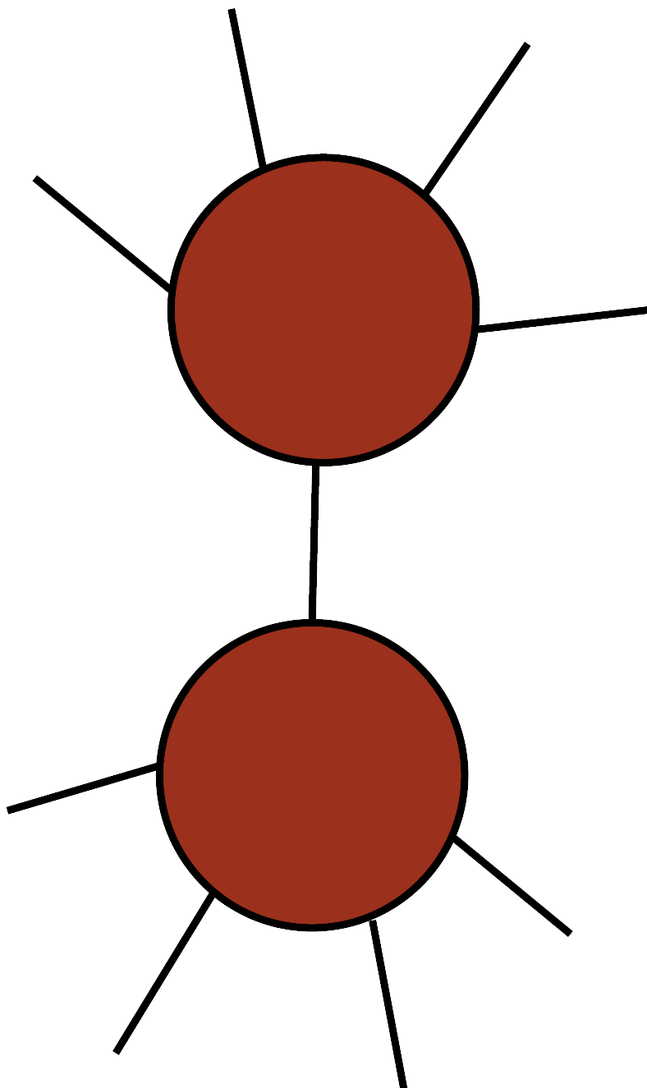


Recycling “Fluid” Amplitudes
Amplitudes fall apart into simpler ones in special limits
– pole information
Picture leads directly to
BCFW (on-shell) recursion relations:
Reconstruct amplitude from poles in
complex plane, where intermediate particle
is on shell, and amplitude factorizes into
product of 2 simpler amplitudes with
fewer external legs
Britto, Cachazo, Feng, Witten, hep-th/0501052
Trees recycled into trees

Slide 27

All Gluon Tree Amplitudes Built From:
In contrast to Feynman vertices,
it’s on-shell, completely physical
On-shell recursion → very compact analytic formulae, fast numerical implementation.
Can do same sort of thing at loop level.

Slide 28

Branch cut information →
Generalized Unitarity (One-loop Fluidity)
Ordinary unitarity:
put 2 particles on shell,
with real momenta
Generalized unitarity:
put 3 or 4 particles on shell,
complex momenta
Trees recycled into loops!

Slide 29



What does all this have to do with black holes?
Orbiting black holes obey General Relativity:
$$S_{EH}= \int{d^{4}x \sqrt{g}} R$$
Gluons scatter according to
Yang-Mills theory
$${ S}_{YM} = \int{d^{4}x }F_{μν}^{a}F^{μν,a}$$

Slide 30


Both theories contain massless particles
Graviton is a traceless symmetric tensor → helicity $±2$
Gluon helicity $±1$
like photon

Slide 31





Gedanken calculation
Graviton scattering amplitudes $𝓜_{n}$
Could compute Feynman rules from
${ S}_{EH} =−\frac{2}{κ^{2}}\int{d^{4}x \sqrt{g}} R(g_{μν})$
by expanding metric around Minkowski space,
$g_{μν}=η_{μν}+κh_{μν}$, $κ=\sqrt{32πG_{N}}$
But action contains inverse metric,
leading to incredibly complicated
Feynman vertices of arbitrary multiplicity
While Yang-Mills → 3- and 4-gluon vertices only
Feynman rules not the way to go
$$ℳ_{n}$$

Slide 32





“On-shell” methods
Ignore Lagrangians and Feynman rules, construct on-shell scattering amplitudes using causality and analyticity
Basic on-shell amplitude, exposing
theory’s nonlinearity, is 3-point amplitude
For all massless particles, complex momenta needed to realize it nonsingularly:
$$s_{ab}≡{\left(k_{a}+k_{b}\right)}^{2}=k_{c}^{2}=0$$
→ All 3 vectors parallel, if $k_{a,b,c}$ all real
$$k_{b}$$
$$k_{a}$$
$$k_{c}$$

Slide 33

3-point amplitudes (cont.)
Complex 3-point kinematics: no free parameters, like scattering angles
3-point amplitudes completely dictated by
External helicities
Overall energy scaling (dimension of coupling)
For YM, $g_{s}$ dimensionless and helicity $±1$, find:
$𝒜_{3}^{YM}\left(1^{+},2^{+},3^{+}\right)=𝒜_{3}^{YM}\left(1^{−},2^{−},3^{−}\right)=0$
$$𝒜_{3}^{YM}\left(1^{−},2^{−},3^{+}\right)=g_{s} \frac{{<12>}^{3}}{<23><31>}{ f}^{a_{1}a_{2}a_{3}}$$
$<ab>$ are inner products of Weyl spinors, would be $\sqrt{s_{ab}}$ if momenta were real
color
factor

Slide 34

3-point graviton amplitude
For gravity, ${κ∝\frac{1}{M_{Planck}}}_{}$has dimension $−1$ and graviton helicity $±2$, together dictate:
$ℳ_{3}^{grav}\left(1^{++},2^{++},3^{++}\right)=ℳ_{3}^{grav}\left(1^{−−},2^{−−},3^{−−}\right)=0$
$ℳ_{3}^{grav}\left(1^{−−},2^{−−},3^{++}\right)=\frac{κ}{2} \frac{{<12>}^{3}}{<23><31>}$ $∝{\left[𝒜_{3}^{YM}\right]}^{2}$
Note: $<ab> ∝energy$. 1 more $<ab>$ compensates $κ$
In summary: 1+1=2, Lorentz symmetry, and dimension of 3-point couplings
→ Gravity = YM²
2

Slide 35

Beyond 3-point tree
BCFW recursion relations work for gravity as well as gauge theory.
Uniquely determine n-point tree amplitude $ℳ_{n}$, given $ℳ_{3}$. (Higher-point Feynman vertices all linked to 3-point vertex by gauge symmetry.)
Suggests that in general
${ ℳ}_{n}$ ~ $A_{n}⨂A_{n}^{′}$
Relations actually known much earlier from string theory (KLT)

Slide 36

Other theories lurking in background

Slide 37




KLT relations
Kawai, Lewellen, Tye (1985)
1-dimensional string sweeps out a 2-dimensional world-sheet
open → with boundary (disk) closed → no boundary (sphere)
$A_{n}^{open} \sim \int{dx_{a} f(x_{b,}k_{b})}$
$ℳ_{n}^{closed} \sim \iint{dz_{a}d{\overline{z}}_{a} |f(z_{b,}k_{b})|^{2}}$
deform integral contours, take low energy limit,
ignore couplings and color factors
…

Slide 38

KLT relations (cont.)
Machine for building any graviton tree amplitude from simpler gauge theory ones.
Can also get massless external scalars, by dimensional reduction or supersymmetry, make them massive by giving them momentum in a 5th dimension (Kaluza-Klein):
$k^{μ}=(E,\vec{k},k_{5})$
$k^{2}=0= E^{2}−{\vec{k}}^{2}−k_{5}^{2}$ $→ mass= k_{5}$
Massive scalar ~ spinless black hole!

Slide 39
Quantum supergravity
Unitarity → construct loop amplitudes from tree amplitudes
KLT relations → (super)gravity trees from (super)YM trees
Three-loop example:
Determine at what loop (if ever?) various supergravities have ultraviolet divergences
For example, find that N=8 SUGRA is finite through 5 loops!
Z. Bern et al., 9802162, 0702112, 0808.4112, 0905.2326, 1201.5366, 1708.06807, 1804.09311
These calculations would be impossible using Feynman diagrams

Slide 40


Another approach – the double copy
Bern, Carrasco, Johansson (2008,2010)
Can always write a gauge theory amplitude in terms of cubic graphs:
$n_{i}$ are not unique, can be shifted around. Remarkably, can (usually) be chosen to obey a set of 3-term identities
kinematic
factor
color
factor
symmetry factor
scalar propagator
for each edge in $Γ$

Slide 41

Double copy (cont.)
Color factors $C_{i}$for these triplets of graphs,
obey a Jacobi identity ($f^{…}$ $f^{…}=f^{…}$ $f^{…}+f^{…}$ $f^{…}$)
$$C_{i}=C_{j}{+ C}_{k}$$
Also require $n_{i}=n_{j}{+ n}_{k}$
for every such triplet.

Slide 42



Double copy (cont.)
Then the gravity amplitude is the literal square of the YM amplitude:
Machine for building graviton loop amplitudes from simpler gauge theory ones
${\left(n_{i}\right)}^{2}$
$ℳ_{m}^{(L)}$
${\left(\frac{κ}{2}\right)}^{m−2+2L}$

Slide 43

Loops contain classical pieces
Especially if particles move slowly, lots of time for multiple exchanges of virtual gravitons, to build up smooth classical trajectory.
+
+
…

Slide 44


But not all loop diagrams are classical
E.g. black holes don’t annihilate
in this regime
graviton vacuum is pure quantum
Black holes never
get very far off shell

Slide 45
Classical restrictions compatible with on-shell methods
3PM computation Bern, Cheung, Roiban, Shen, Solon, 1901.04424, 1908.01493

Slide 46
One of first contributions of “amplitudes” to LIGO physics
1972
-1985
2001
2014
1687
1938
0PN
1PN
2PN
3PN
4PN
5PN
$$\left( 1+v^{2}+v^{4}+v^{6}+v^{8}+v^{10}+v^{12}+…\right) G$$
$( 1 +v^{2}+v^{4}+v^{6} +{ v}^{8 } +{ v}^{10 }+…){ G}^{2}$
$\left( 1 +v^{2}+v^{4} +v^{6} +{ v}^{8 } +…\right) G^{3}$
$\left( 1 +{ v}^{2} +{ v}^{4} +{ v}^{6} +…\right)$ $G^{4}$
$\left( 1 +{ v}^{2} +{ v}^{4} +…\right)$ $G^{5}$
$\left( 1 +{ v}^{2} +…\right)$ $G^{6}$
1PM
1956
2PM
1960
3PM
2019
4PM
2019-2020
5PM
almost
6PM
2019
Many contributed to these advances, for PN notably T. Damour and collaborators

Slide 47


Spin and tidal effects also computable within similar framework
Bern, Luna, Roiban, Shen, Zeng, 2005.03071
Cheung, Solon, 2006.06665
operator(s) encoding
multipole moments of
neutron star
analogous to $HF_{μν}F^{μν}+…$
operator(s) encoding
couplings of gluons to
Higgs boson at LHC

Slide 48

Effective one-body approach
Inspired by properties of
bound states in QFT.
Interpolates information
from various sources,
including PN and PM
expansions, test particle
limit $m_{1}≪ m_{2}$, and
numerical relativity results.
Provides accurate
gravitational wave templates
very close in, faster than NR,
allowing many combinations
of initial masses and spins.
Buonanno, Damour, 9811091
Buonanno, Satyaprakash, 1410.7832

Slide 49


EOB matched to different PN/PM orders
Antonelli, Buonanno, Steinhoff, van de Meent, Vines, 1901.07102
Adding more PN and PM orders improves EOB performance, but
it also depends strongly on matching scheme, $PS vs. \tilde{PS}$
binding energy
numerical relativity
angular frequency

Slide 50

Conclusions
At the heart of the LHC is the “square root” of the fundamental nonlinearity of General Relativity
One can combine this information with on-shell methods, originally developed to improve QCD predictions for LHC, and study supergravities to high quantum loop order
Similar methods just now beginning to bear fruit for the classical problem of binary inspiral, relevant for LIGO, VIRGO, and future gravitational wave detectors!
Bright future ahead for higher precision waveforms, thanks to modern understanding of particle scattering in gauge theory and gravity.

Slide 51

Thanks for your attention!

Slide 52
Extra slides

Slide 53


NNLO QCD revolution still in progress
G. Salam, LHCP 2016
All 2 → 1 or 2 → 2 processes (still, in 2020),
except for one 2 → 3 process, $γγγ$
Chawdry, Czakon, Mitov, Poncelet, 1911.00479

Slide 54

New Physics Example: Supersymmetry
Symmetry between fermions (matter) and bosons (forces)
Very elegant, solves hierarchy problem
Lightest supersymmetric particle (LSP) can be dark matter
Cornucopia of new elementary particles at LHC.
spin 1
spin 0
spin 1/2
spin 0
spin 1/2

Slide 55

Classic SUSY dark matter signature
Heavy colored particles decay rapidly to stable
Weakly Interacting Massive Particle (WIMP = LSP)
plus jets
→ Missing transverse energy
MET + 4 jets

Slide 56
Not background free:
happens in Standard Model too
◊ ν ν
MET + 4 jets from pp → Z + 4 jets,
Z → neutrinos
Neutrinos escape detector.
Irreducible background.
Plus there are many reducible backgrounds
from W + jets, tt + jets, ...
Precision theory (typically NLO) can help with this,
usually when embedded in parton shower Monte Carlos

Slide 57
From searches to measurements
No convincing evidence for SUSY, or any other direct production of new particles.
Also look for deviations in rates for Standard Model processes, especially involving the brand-new Higgs boson.
Measurements are hard, take a while to perform.
More precise theory typically needed.

Slide 58

2019
Precision theory,
from NLO to NNLO
and even NNNLO
required here!
even 3 electroweak
vector bosons seen

Slide 59
Many Automated Programs for One-Loop QCD
Blackhat: Berger, Bern, LD, Diana, Febres Cordero, Forde, Gleisberg, Höche, Ita, Kosower, Maître, Ozeren, 0803.4180, 0808.0941, 0907.1984, 1004.1659, 1009.2338…
+ Sherpa → NLO W,Z + 3,4,5 jets pure QCD 4 jets
CutTools: Ossola, Papadopolous, Pittau, 0711.3596
NLO WWW, WWZ, ... Binoth+OPP, 0804.0350
NLO ttbb, tt + 2 jets,…
Bevilacqua, Czakon, Papadopoulos, Pittau, Worek, 0907.4723; 1002.4009
MadLoop: Hirschi, Frederix, Frixione, Garzelli, Maltoni, Pittau 1103.0621
HELAC-NLO: Bevilacqua et al, 1110.1499
_ _ _
Rocket: Giele, Zanderighi, 0805.2152
Ellis, Giele, Kunszt, Melnikov, Zanderighi, 0810.2762
NLO W + 3 jets Ellis, Melnikov, Zanderighi, 0901.4101, 0906.1445
W⁺W± + 2 jets Melia, Melnikov, Rontsch, Zanderighi, 1007.5313, 1104.2327
SAMURAI → GoSAM: Mastrolia, Ossola, Reiter, Tramontano, 1006.0710,…
NGluon: Badger, Biedermann, Uwer, 1011.2900,…
OpenLoops: Cascioli, Maierhofer, Pozzorini, 1111.5206,...

Slide 60

On to two loops
State-of-art currently stuck at 2 → 2
– with a couple of 2 → 3 exceptions
Why? In part because 2 loop multiscale integrals are typically very hard
All 1 loop integrals with external legs in D=4 are reducible to scalar box integrals + simpler
combinations of
+ simpler
Brown-Feynman (1952), Melrose (1965), Passarino-Veltman (1979), van Neerven-Vermaseren (1984), Bern, LD, Kosower (1992)

Slide 61


First 2 loop 2 → 3 amplitudes
All massless partons (or photons) in large N_{c} (planar) limit for QCD gauge group SU(3) → SU(N_{c}):
$gg→ggg, qg→qgg, q\overline{q}→q\overline{q}g, …$
Gehrmann, Henn, Lo Presti, 1511.05409;
Badger, Brønnum-Hansen, Hartanto, Peraro, 1712.02229, 1811.11699;
Abreu, Dormans, Febres Cordero, Ita, Page, Zeng, Sotnikov,
1712.03946, 1812.04586, 1904.00945
More work needed to compute NNLO cross section for pp → 3 jets
And $q\overline{q}→γγγ$
– already with NNLO cross section
for pp → $γγγ$ !
Chawdhry, Czakon, Mitov, Poncelet, 1911.00479

Slide 62
The “QCD for LHC” revolution
Many important hadron collider processes have been computed at NLO and NNLO in the past decade (even 2 → 1 at NNNLO), well beyond what was previously thought possible
Required a new understanding of scattering amplitudes, at a formal level, as well as efficient, stable implementation
Many people contributed to this progress
Parallel progress in understanding supersymmetric gauge & gravity theories
Revolution far from over; e.g. NNLO 2 → 3+ awaits!

