Slide 1
EPR for HO / HCAL
What do we need:
Ashraf: EPR during PhD, 4months – 2 months for writing ➔ 2 months
Lucas: 6 months authorship EPR – project outside EPR can be negotiated, if connected with upgrade
Dirk: has 4 months from alignment code from CPU → GPU
Kerstin: looking for an easy task without knowledge of CMSSW
New GK Student: 6 months authorship EPR or upgrade
Potentially a HAICU student: 6 months authorship or upgrade

Slide 2
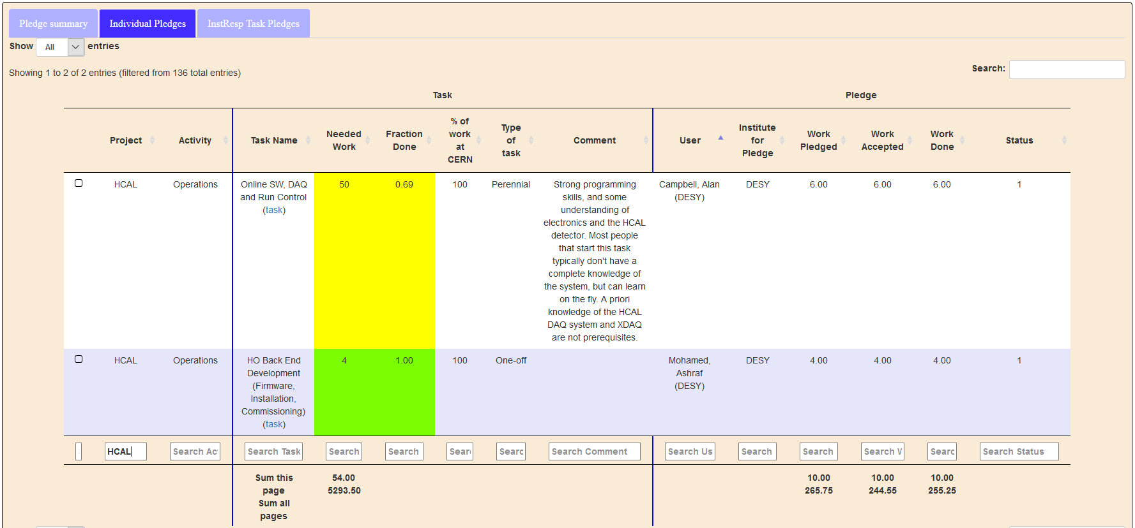
EPR in 2019
https://icms.cern.ch/epr/showInstitute/DESY
Ashraf and Alan in HCAL

Slide 3
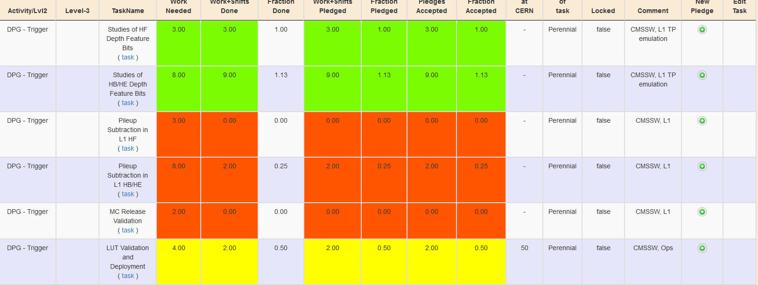
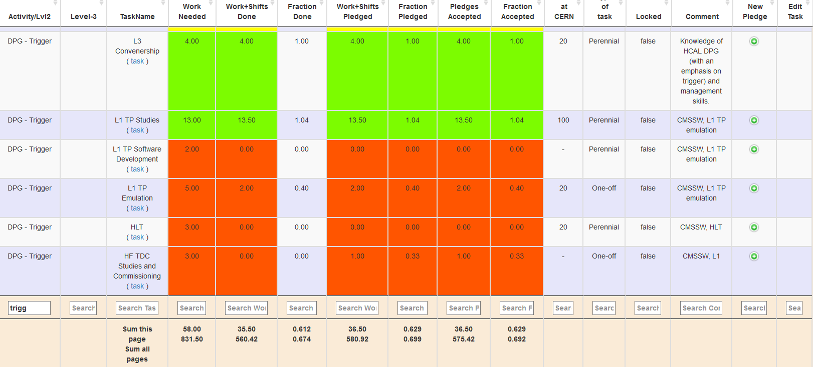
EPR in 2019
https://icms.cern.ch/epr/showProjectTasks/141
HCAL DPG-Trigger-Tasks

Slide 4
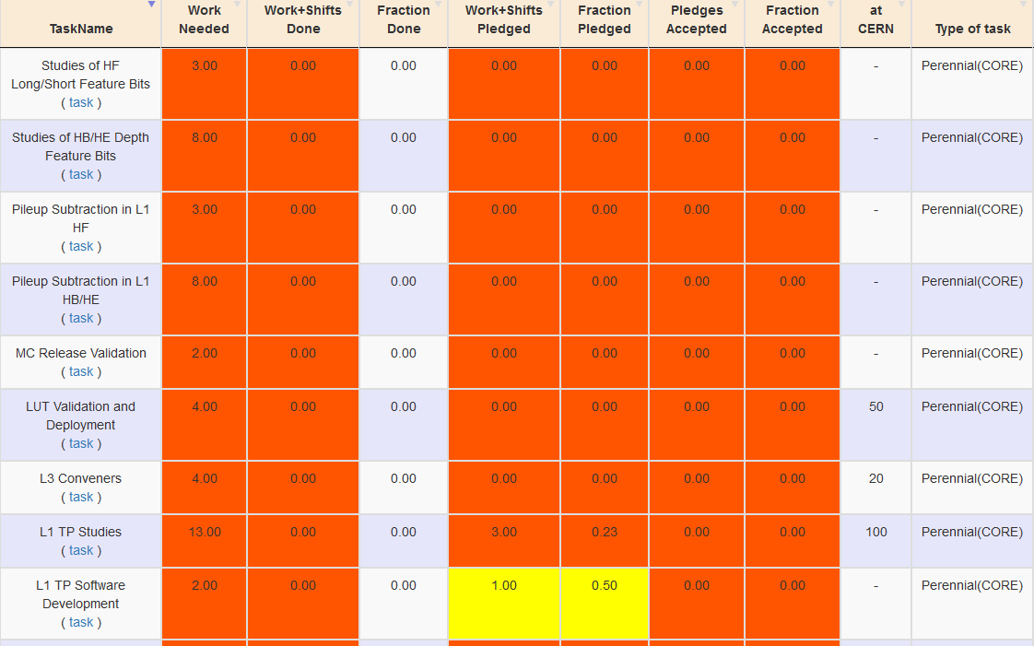
EPR in 2020
https://icms.cern.ch/epr/showProjectTasks/141
Lucas HO 6m? Depth, timing, muon isolation….
HCAL DPG-Trigger-Tasks
GK ?
KB ?
At CERN????
?
?

Slide 5
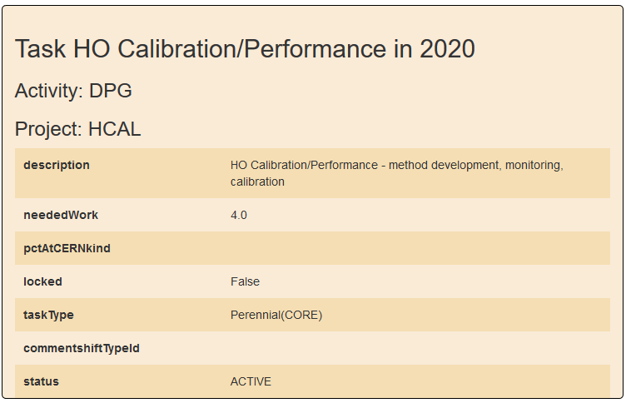
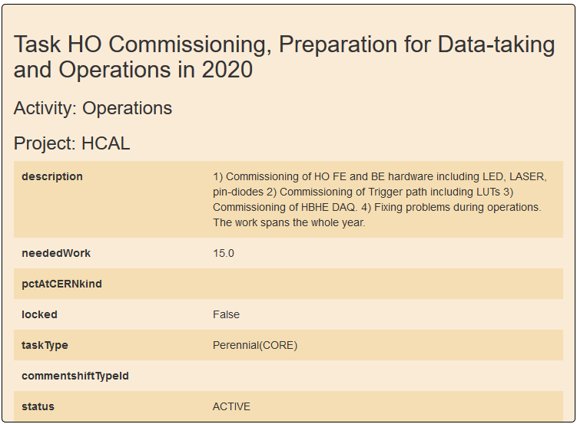
Other HCAL Tasks ?
HO specific tasks
https://icms.cern.ch/epr/showProjectTasks/160
HO Calibration/Performance 4 months
HO Commissioning, Preparation for Data-taking and Operations 15 months …. @ CERN !
What about L1 EPR ?

Slide 6
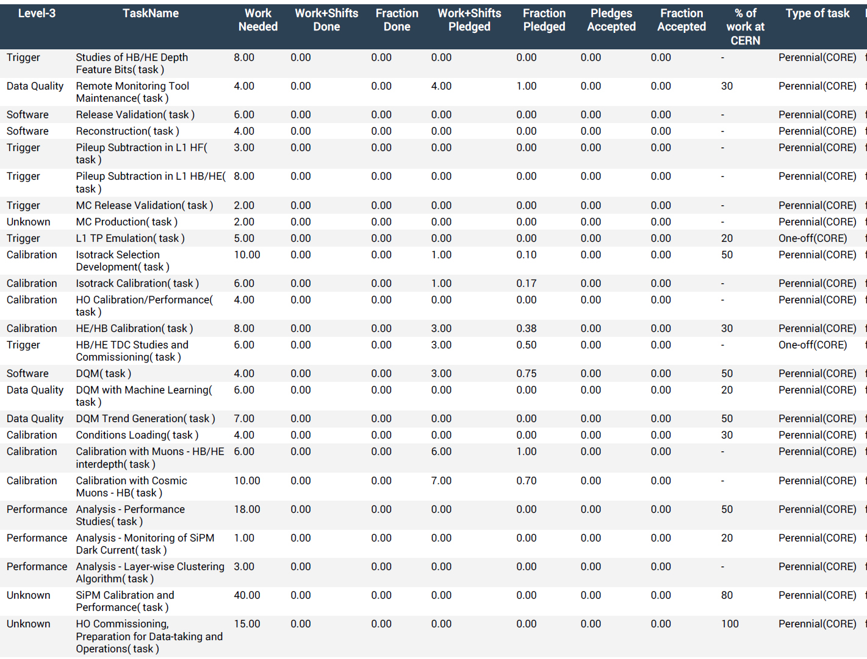
Other HCAL Tasks ?
_{Calibration…. Shifts…..}
HO Calibration/ Performance 4 months
HO Commissioning, Preparation for Data-taking and Operations 16 months
https://icms.cern.ch/epr/showProjectTasks/160

