Slide 1
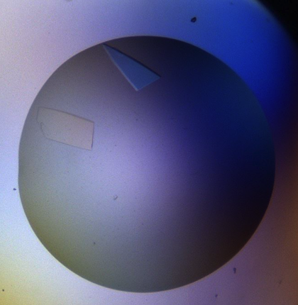
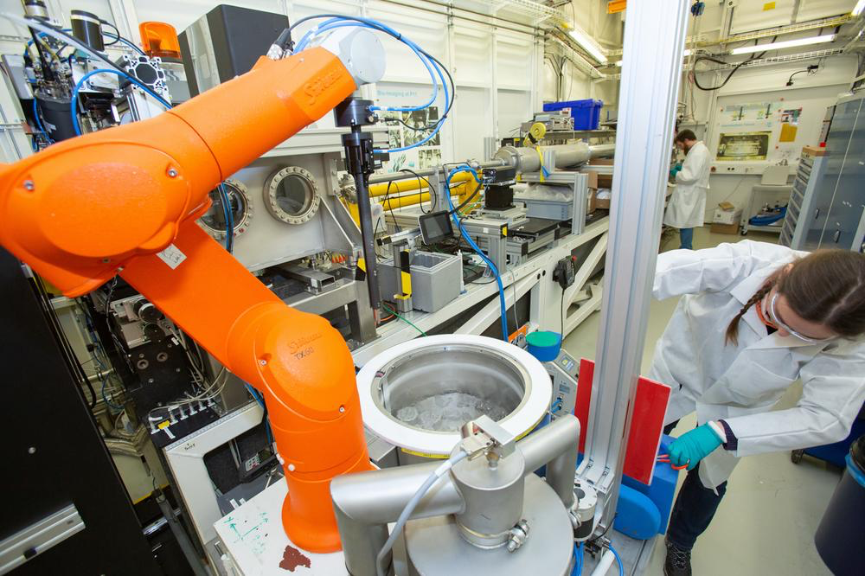
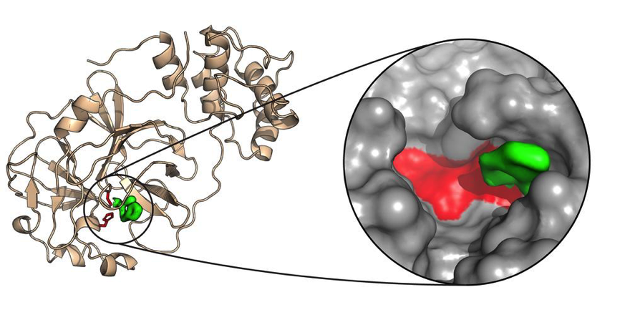
High-throughput X-ray compound screening against SARS-CoV2 at DESY
Alke Meents
CFEL-BMX

Slide 2
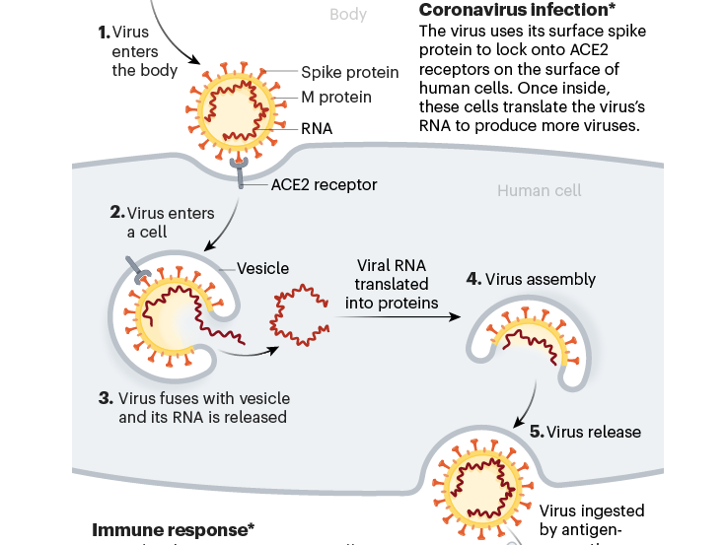
SARS-CoV2 infection process
Inhibition of ‘virus entry”
Inhibition of ‘virus replication’
Profile of a killer: the complex biology powering the coronavirus pandemic. Nature, May 2020

Slide 3
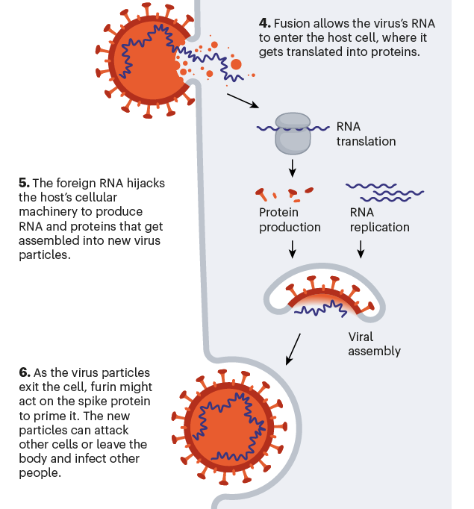
SARS-CoV2 replication in cells
Viral-RNA
Ribosome
Protein production
Non-structural proteins (30)
Polyprotein rep1a
Polyprotein rep1b
-> cut into 16 proteins
(important for replication:
Including: Mpro, PLPro,RNA Polymerase)
RNA replication
Structural proteins (4)
Spike, Membrane, Envelop, Nucleocapsid
Profile of a killer: the complex biology powering the coronavirus pandemic. Nature, May 2020

Slide 4
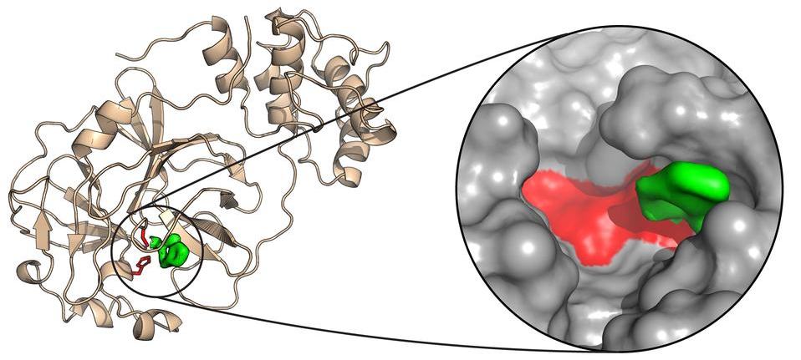
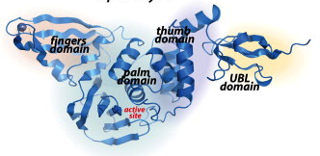
3 target proteins selected for screening
SARS-CoV2 Main protease
viral cystein protease
34 kDa
11 x cleavage of rep1A and rep1B
SARS-CoV2 Papain-like protease
viral cystein protease
36 kDa (protease domain)
3 x cleavage of rep1A and rep1B
Blocks host immune response (de-ubiquitinase)
Y. M. Báez-Santos et al., Antiviral Research, Volume 115, 2015, 21-38,
TMPRSS2
human serine protease
located on cell surface
54 Kda
Important for virus activation during entry / release
cleavage of Spike protein
Structure not known yet ….

Slide 5
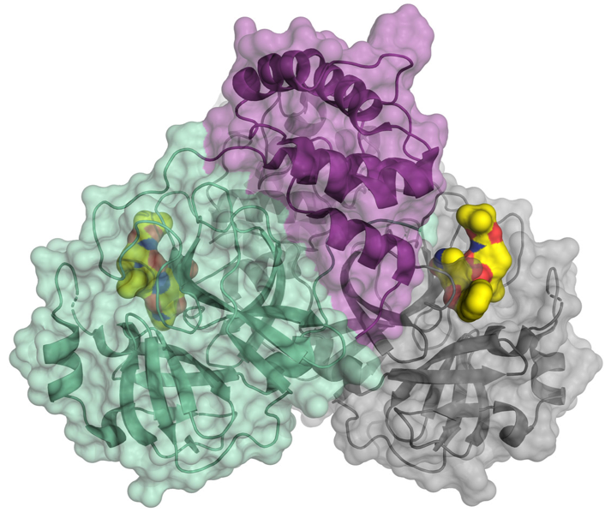
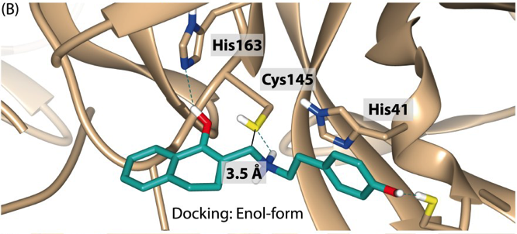
Conventional process of ‘structure based drug design’
Determination of the protein (apo-) structure
with X-ray crystallography or cryo-EM.
Identification of binding sites / pockets with X-ray fragment screening or computational methods
Postulation of ‘lead structure’ binding to the protein by computational methods
Optimization
Chemical Synthesis and binding assays to test biological activity
L. Zhang et al. Science 24 Apr 2020:
Vol. 368, Issue 6489, pp. 409-412
Improvement of lead compounds by chemical modification
Biologically active drug target for clinical studies – binding confirmed by X-ray or EM structure

Slide 6
X-ray centered ‘structure based drug design’
Determination of the protein (apo-) structure
with X-ray crystallography or cryo-EM.
High throughput X-ray screening of large compound libraries
Binding assays to test biological activity
Optimization
Improvement of lead compounds by chemical modification
L. Zhang et al. Science 24 Apr 2020:
Vol. 368, Issue 6489, pp. 409-412
X-ray confirmation of binding
Biologically active drug target for clinical studies

Slide 7
Hamburg SARS-CoV2 screening project
Idea: High-throughput screening of a 5700 compound re-purposing library against three
SARS-Cov2 relevant target proteins in < 6 months with X-ray crystallography
Fraunhofer IME
Compound library
> 80 contributors
Further partners:
- EuXFEL
- Heinrich Pette Inst.
- HZB
- University of Hannover
- SLAC / Caltech
WP2 UHH
Protein production and co- crystallization
WP1 UHH In-silico pre-selection of compounds and priorization
WP3 DESY High-throughput X-ray crystal screening
WP4 UL Protein activity assays of hits
WP5 BNITM
Virus cell culture experiments
Experimental workflow
Feedback from experiment

Slide 8
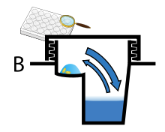
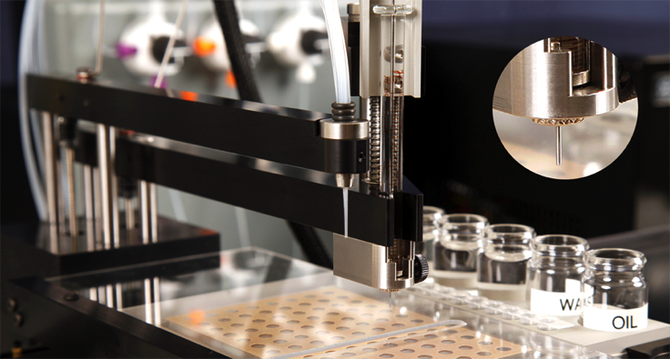
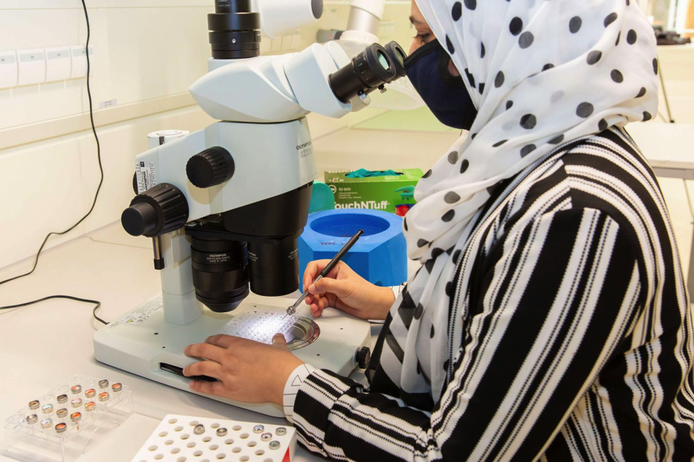
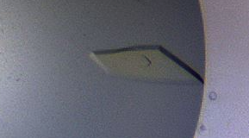
Co-crystallization experiments
Sitting drop vapor diffusion
Seeding for reproducible crystallization
96 well plates (with 96 different compounds)
Automatic pipetting with ORYX (~8 minutes per plate)
Manual crystal harvesting (most time consuming)

Slide 9
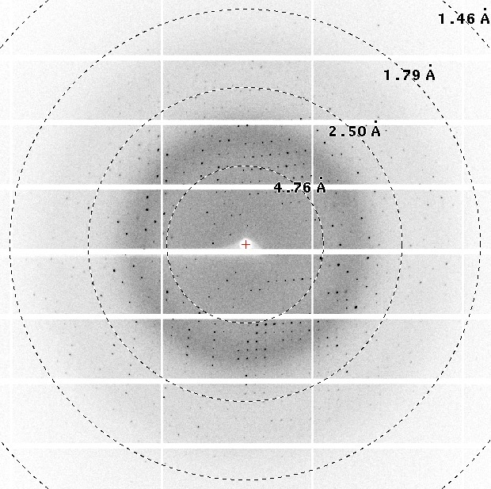
X-ray data collection at P11
Exclusive use for ~3 weeks
Fully remote operation
Robotic sample exchange (20 sec.)
~450 samples measured per day
(~3 minutes per dataset)
Diffraction pattern from SARS-CoV2 main protease crystal

Slide 10
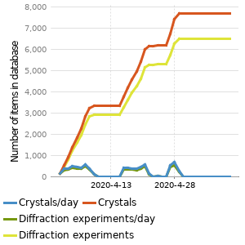
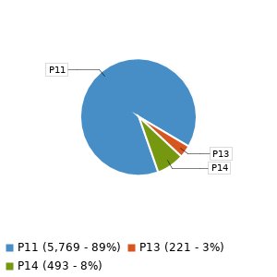
Results data collection
Number of crystals: 7697
Number of unique compounds: 4035
Unique targets: SARS-CoV-2 Main Protease
Number of diffraction data sets marked as success: 6506

Slide 11
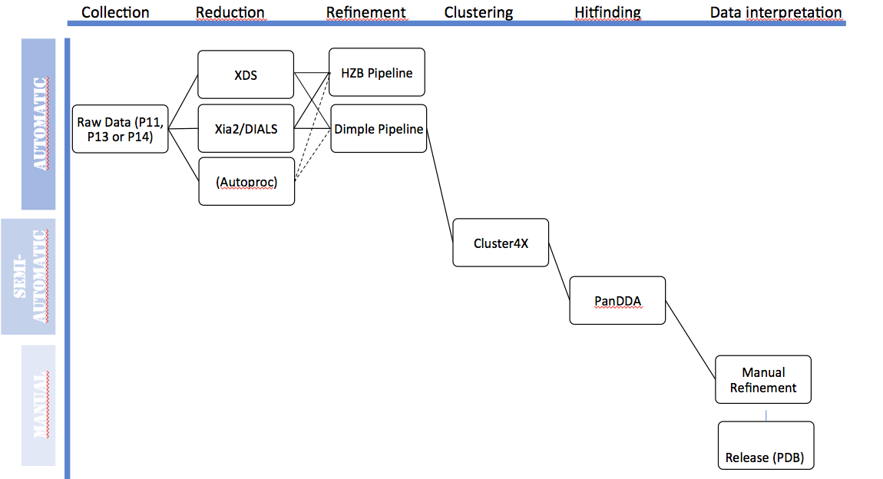
Data processing pipeline of DESY’s Maxwell cluster

Slide 12
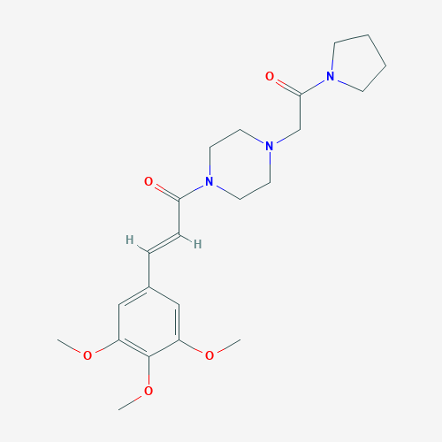
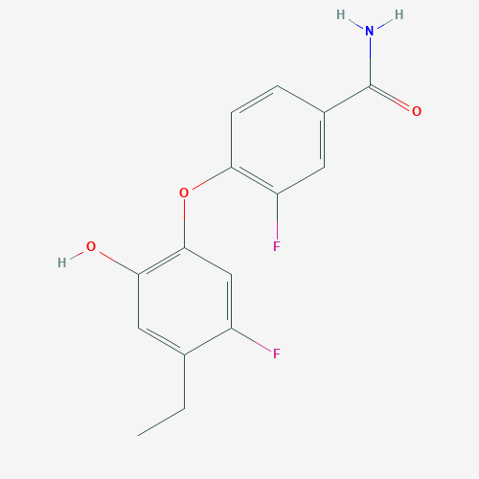
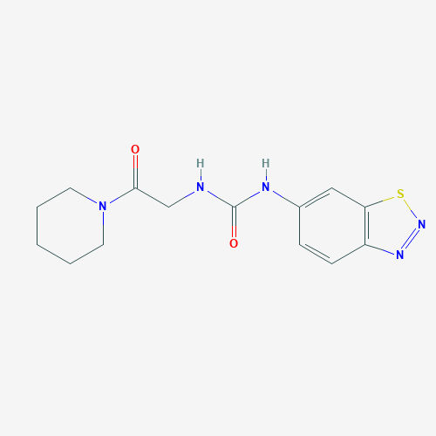
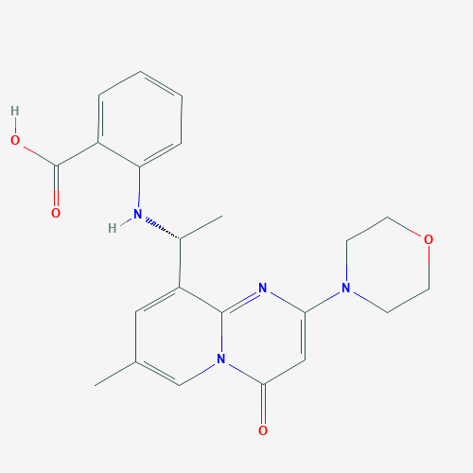
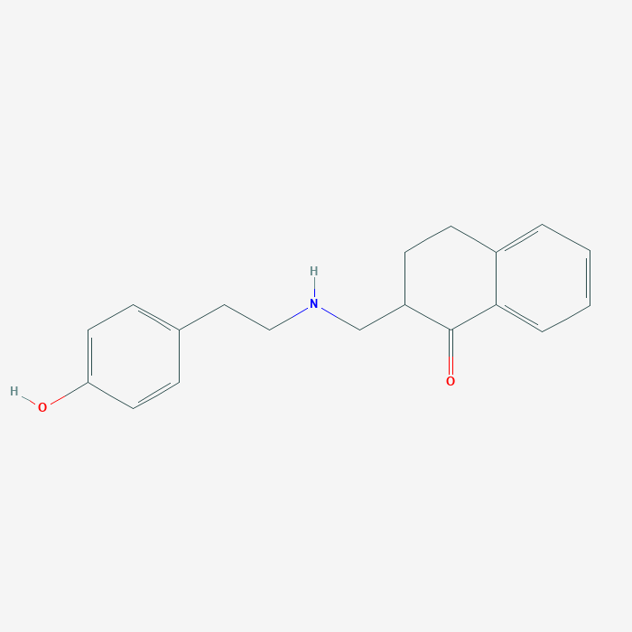
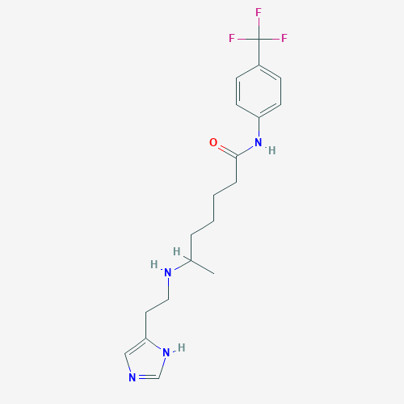
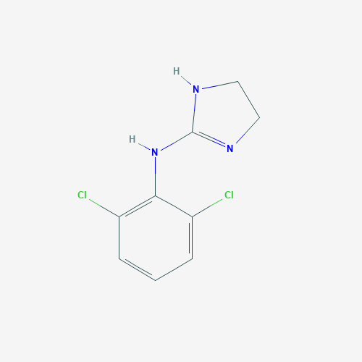
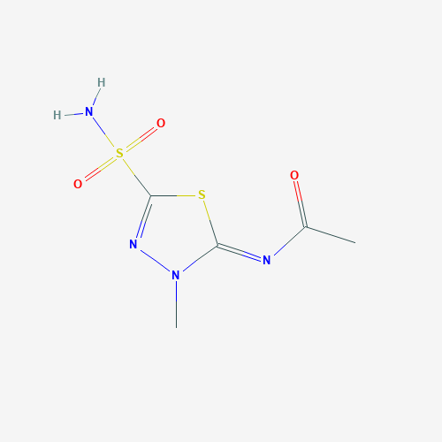
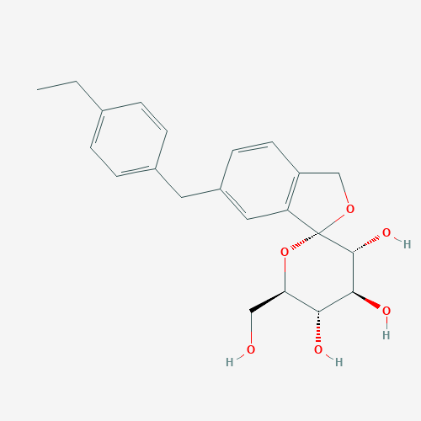
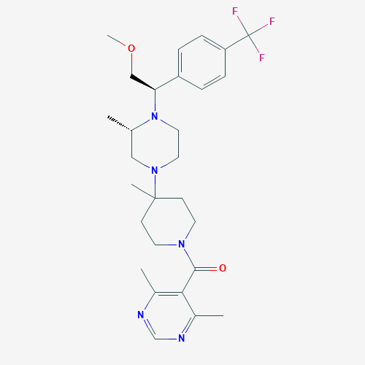
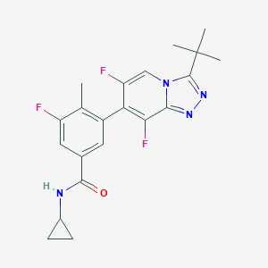
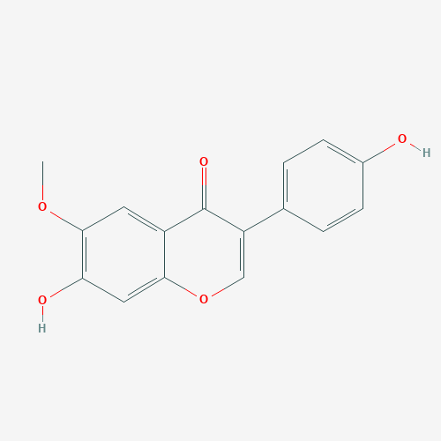
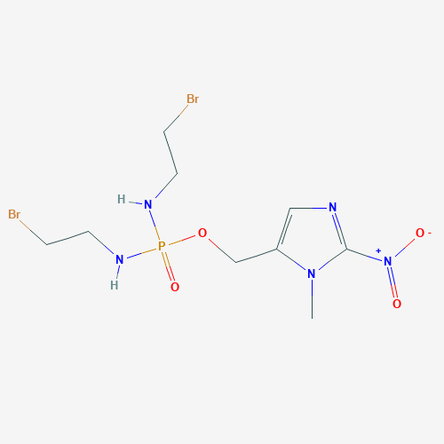
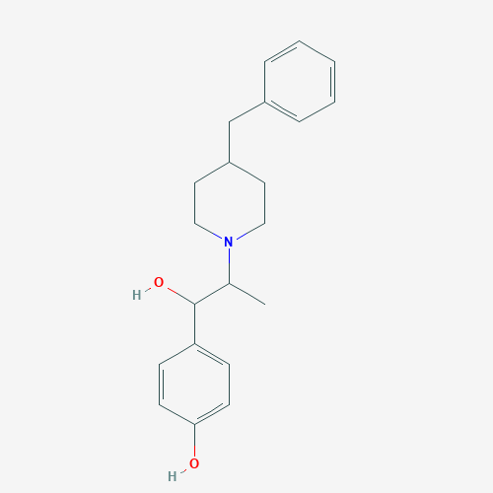
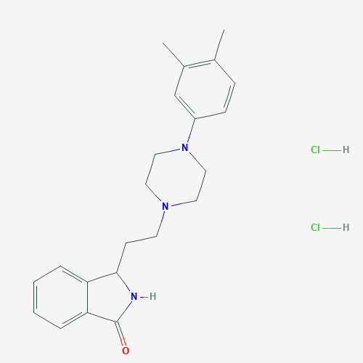
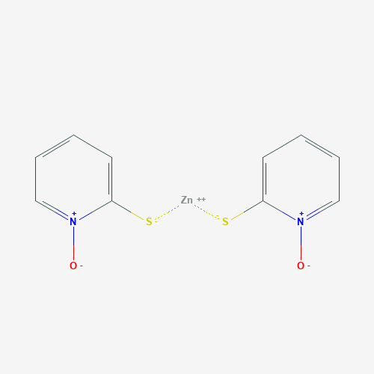
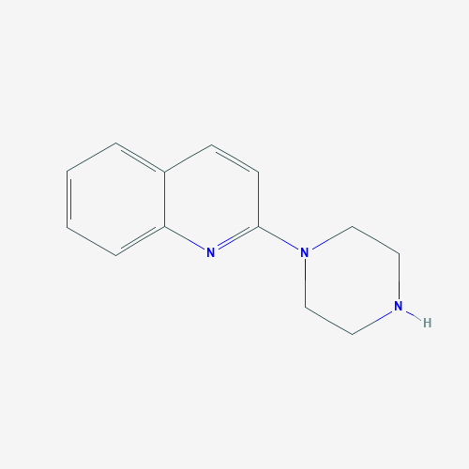
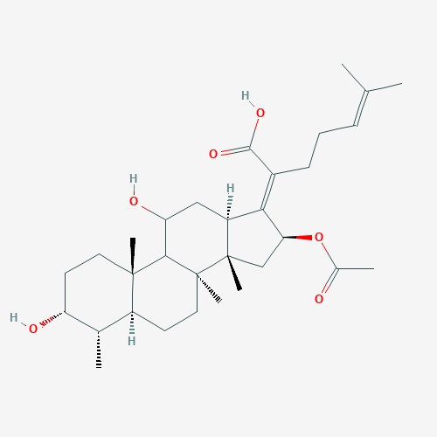
So far: 18 compounds binding to MPro
Cinepazide
MUT056399
UNC2327
AZD6482
HEAT
HTMT
Clonidine
Methazolamide
Tofogliflozin
Vicriviroc
AL8697
Glycitein
Evofosfamide
Ifenprodil
PD168568
Zinc Pyrithione
Quipazine
Fusidic Acid

Slide 13
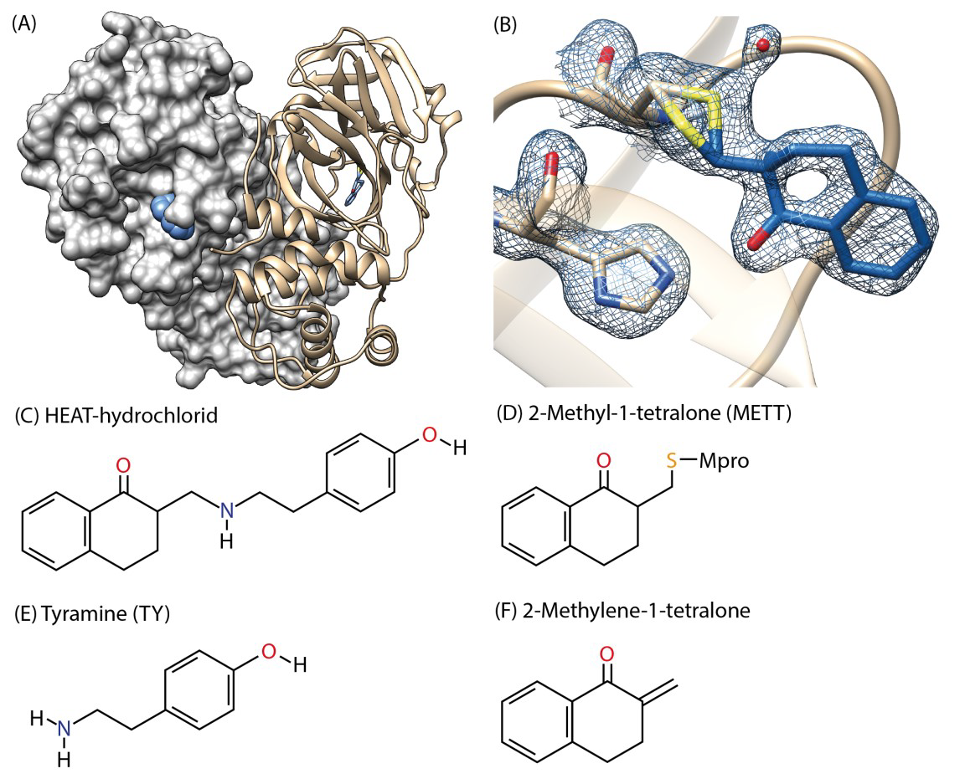
Currently most promising hit: HEAT (BE-2254)

Slide 14
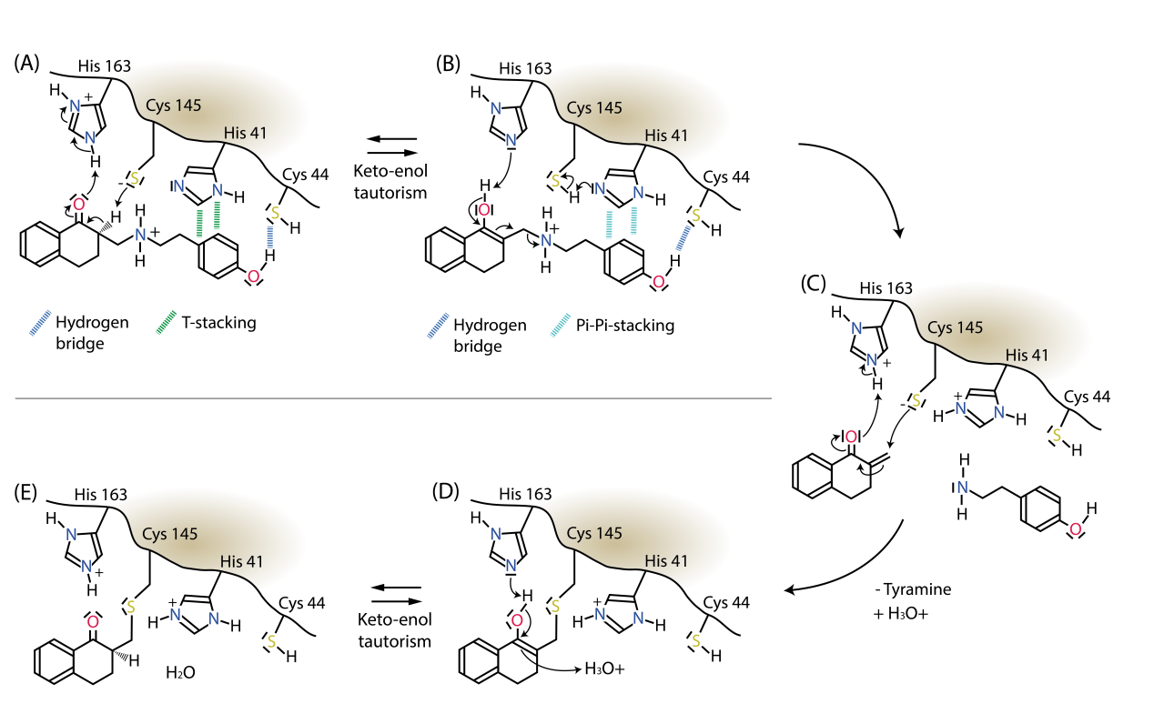
Proposed HEAT reaction mechaism

Slide 15
Hamburg Corona-project time line
17.3.2020 | Initial idea, selection of 3 target proteins
20.3.2020 | Project partners agree on project plan
24.3.2020 | MPro protein and Plasmid received from UL
27.3.2020 | MPro Protein production and co-crystallization with compounds established
31.3.2020 | Start of X-ray screening experiments at PETRA III beamline P11: about 450 dataset collected per day / remote operation. Setup of data processing and data evaluation pipeline
9.4.2020 | ~ 3000 datasets collected from ~2100 compounds
15.4.2020 | First hits identified (Easter egg’s)
17.4.2020 | Supporting experiments: MassSpec and activity measurements
23.4.2020 | Screening campaign on Mpro finished: ~ 6000 datsets from ~ 4000 different compounds, 18 hits identified
28.4.2020 | Release of first pdb entry
4.5.2020 | Preprint of first hit available on bioRxiv

Slide 16
Next steps
Main Protease:
Testing of biological activity of the hits from X-ray screening
Further characterization with additional X-ray, MasSpec, NMR, …
Chemical modification of very promising hits, entering the optimization cycle
…
Papain-like Protease / TMPRSS2
Reliable protein production
Optimization of crystallization conditions
X-ray comound screeening ...
....

Slide 17
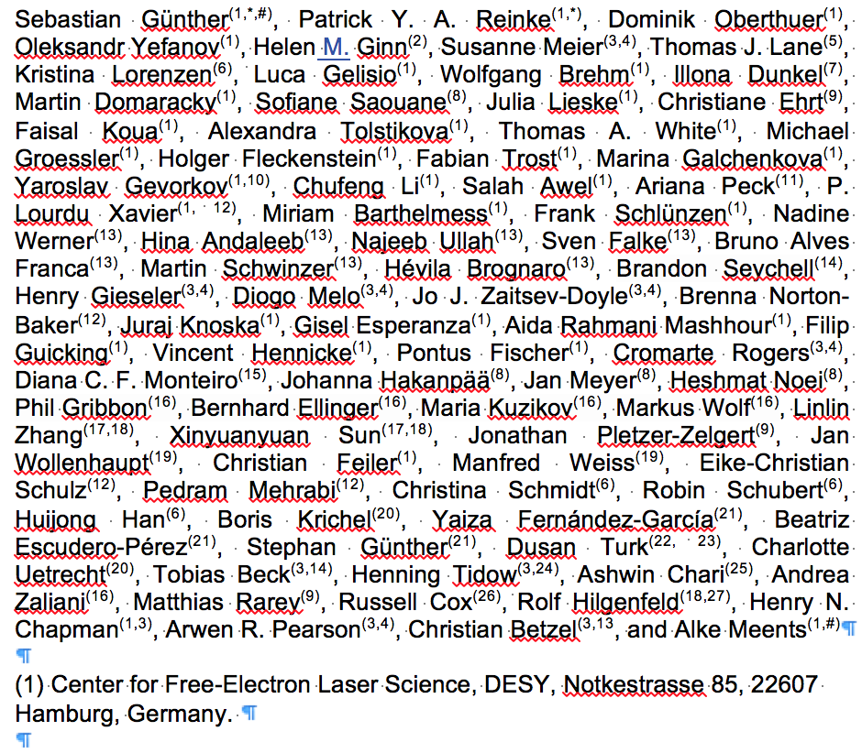
People involved & Thanks to ….
Special Thanks to DESY machine group for PETRA III operation and all other DESY groups supporting the project.

