Slide 1
ML Enhanced Control of Particle Accelerators
Andrei Ivanov
Hamburg, 11.05.2020

Slide 2
Overwiew
01 ML in Particle Accelerators Control
02 ML-based orbit correction
03 ML-based physics recovering
2

Slide 3
ML related problems
forecasting
surrogate models
one-short learning
3

Slide 4
We focus on one-short learning of dynamical systems
forecasting
surrogate models
one-short learning
4

Slide 5
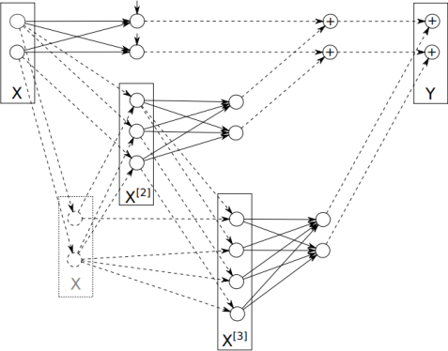
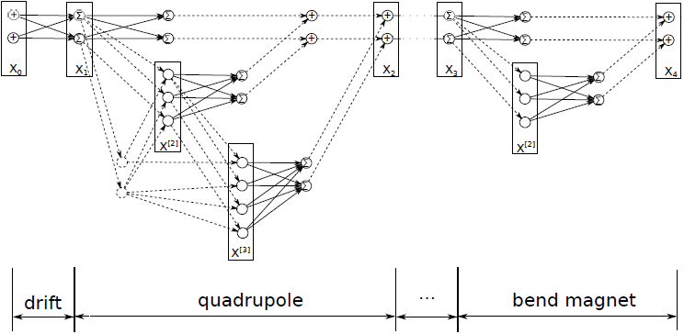
From Taylor maps to Neural Networks
Taylor map as a polynomial neuron
Instead of tuning ODEs one can fit weights directly
…
5

Slide 6
Theoretical Model: MAD file, OCELOT…
Magnet strengths
Converter:
strength → current, current limits
ML Model: TensorFlow
Beam trajectory
Post processing:
calibration
Magnets currents:
get(), set()
BPMs
Currents
Raw data
Real accelerator
6

Slide 7
ML-based orbit correction
7

Slide 8
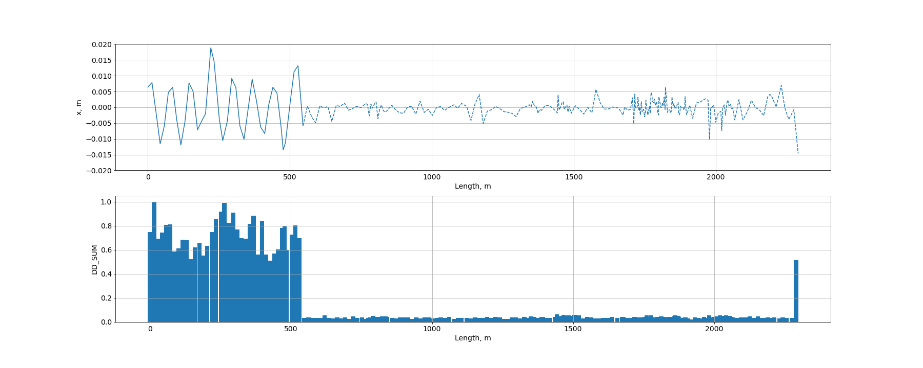
First run
because of lots of imperfection in the real magnets, the beam initially is not accumulated in the ring
8

Slide 9
First run
because of lots of imperfection in the real magnets, the beam initially is not accumulated in the ring
control (actuators)
9

Slide 10
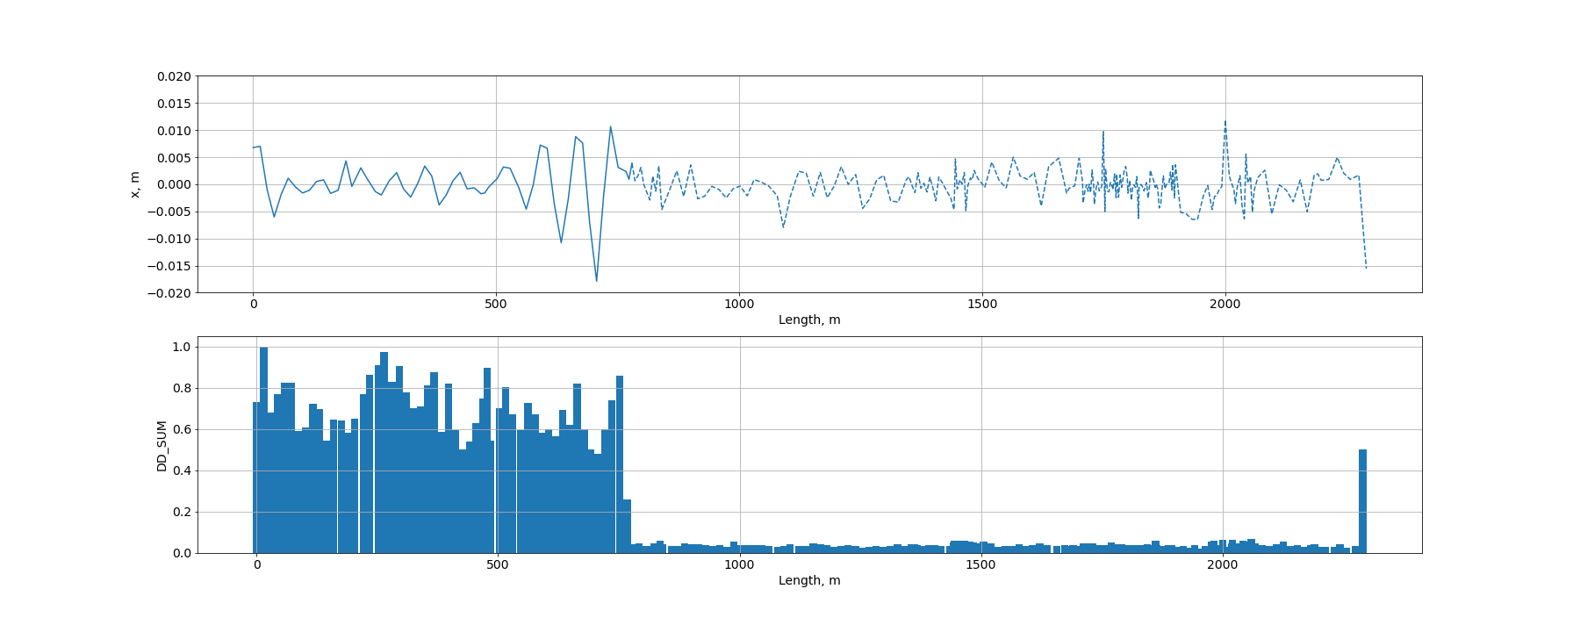
Second run
because of lots of imperfection in the real magnets, the beam initially is not accumulated in the ring
10

Slide 11
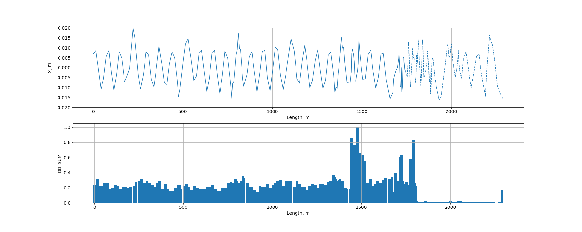
Beam accumulation
because of lots of imperfection in the real magnets, the beam initially is not accumulated in the ring
11

Slide 12
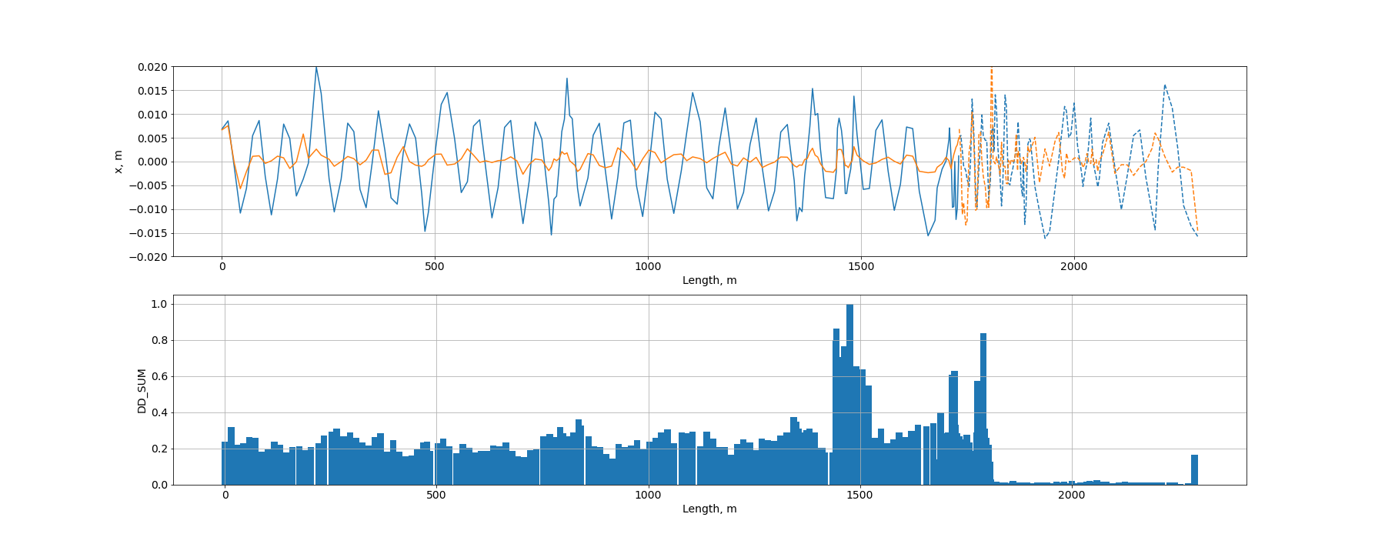
Orbit correction
predictive model results strengths of the corrector magnets that results decreasing of the orbit displacement
12

Slide 13
ML-based physics recovering
13

Slide 14
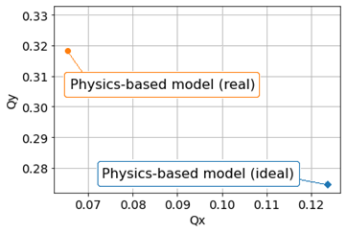
TM-PNN for one-short learning
physics recovering from limited data
Theoretical one-turn beam trajectory (orange line) and measured trajectory (blue line):
Optics imperfections were introduced in a controlled way by detuning the strength of one quadrupole magnet by 20%.
The beam in the storage ring was injected and kicked out after one turn, and the one-turn trajectory measured. The TM-PNN initialized on the PETRA III lattice, fine-tuned with one turn data.
14

Slide 15
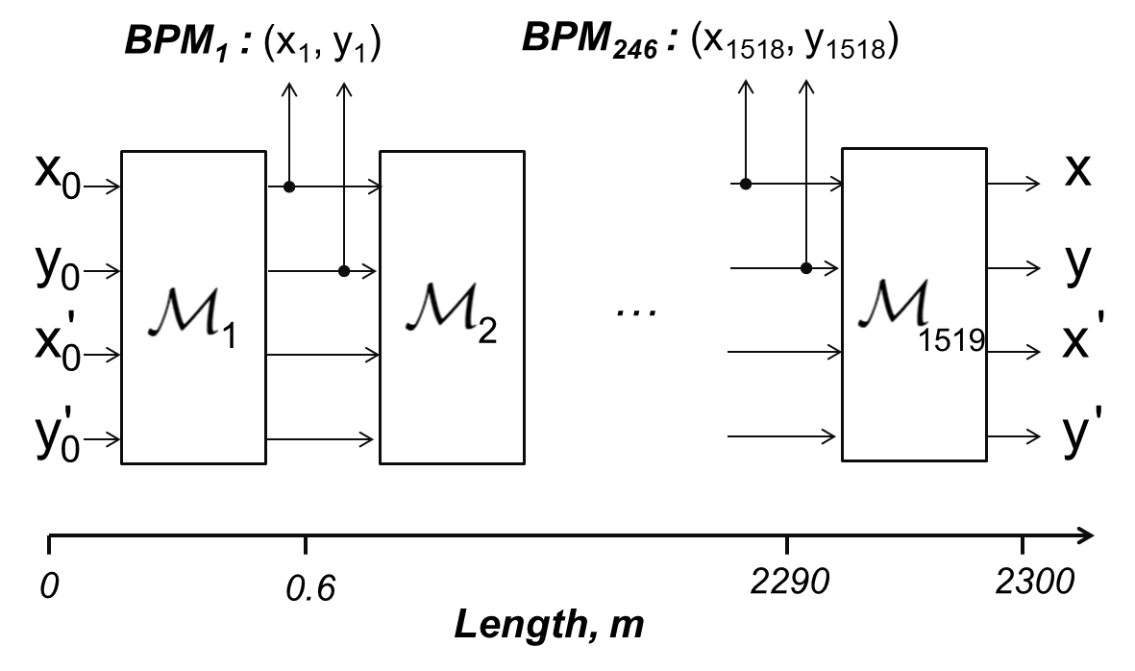
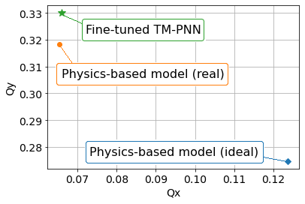
TM-PNN for one-short learning
physics recovering from limited data
Theoretical one-turn beam trajectory (orange line) and measured trajectory (blue line):
15

Slide 16
TM-PNN for one-short learning
physics recovering from limited data
X0
prediction
X1
X2
first turn (training data)
second turn
To estimate main frequencies one has to predict dynamics of ~500 turns with unseen initial conditions
16

Slide 17
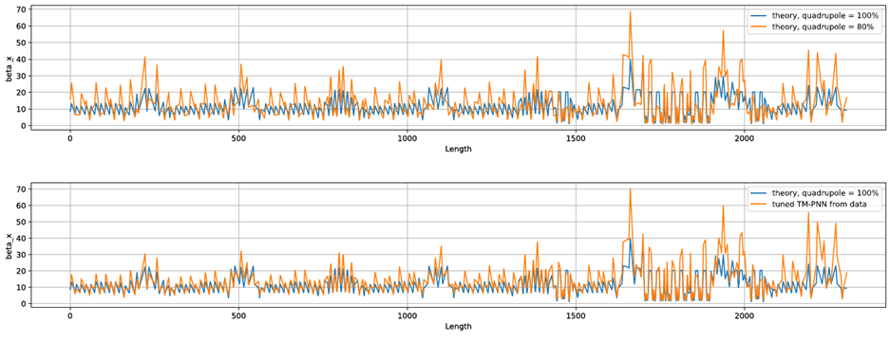
Input data (one-turn beam trajectory):
Ideal Lattice
True Imperfected Lattice
(2) tuned NN based on Taylor maps
17

Slide 18
Input data (one-turn beam trajectory):
Ideal Lattice
True Imperfected Lattice
(2) tuned NN based on Taylor maps
18

Slide 19
Result
It is demonstrated in practice that the proposed NN architecture works for
Orbit correction
Physics recovering from limited observations:
tunes (main frequencies)
beta-functions
Open question: Accuracy vs Data Amount
19

Slide 20
Thank you
Andrei Ivanov
MPY
andrei.ivanov@desy.de

