Slide 1
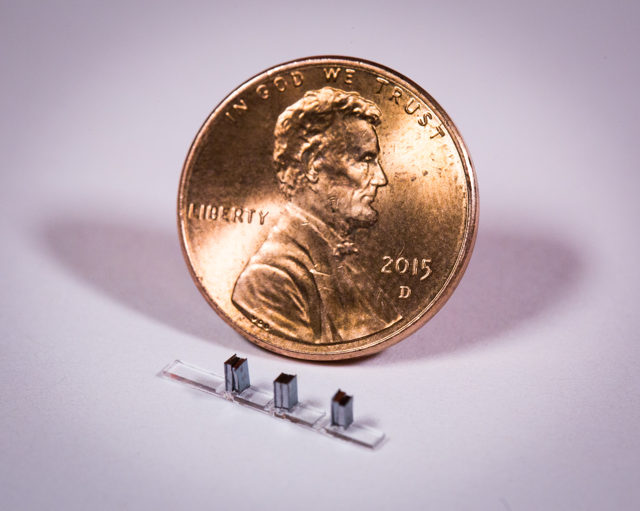



Applications of Dielectric Laser Accelerators
Overview and Meeting Agenda
R. J. England (SLAC)
Zoom Teleconference
June 23, 2020
8am – 11am US Pacific Time

Slide 2
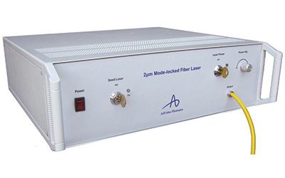
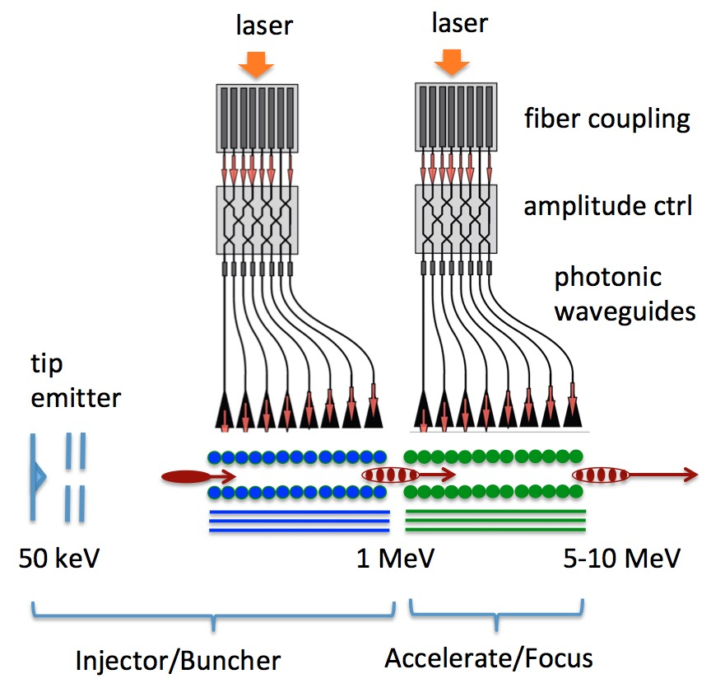
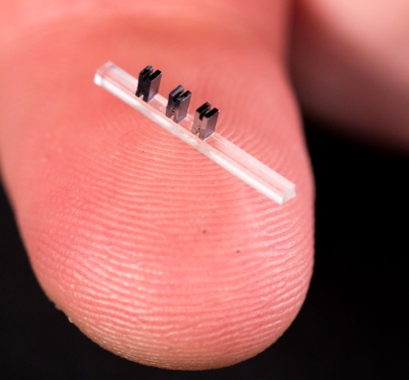
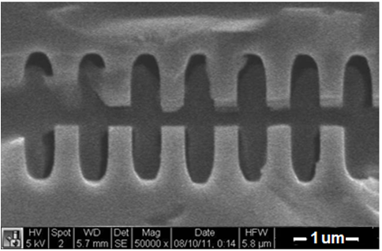
Dielectric Laser Accelerator (DLA) Concept:
Towards an “Accelerator on a Chip”
Modelocked Thulium Fiber Laser (λ = 2µm, 10µJ, $300k)
Required lasers are MHz rep rate, low pulse energy, wallplug efficiency ~ 30%
Dielectric materials can withstand GV/m
fields and kilowatts of average power
Can be mass produced using techniques of the integrated circuit industy.
gradient
SEM images of DLA prototypes tested at SLAC
3 cm
fused silica
silicon
DLA research aims to produce ultracompact nanofabricated devices for particle acceleration, powered by efficient solid-state lasers.

Slide 3
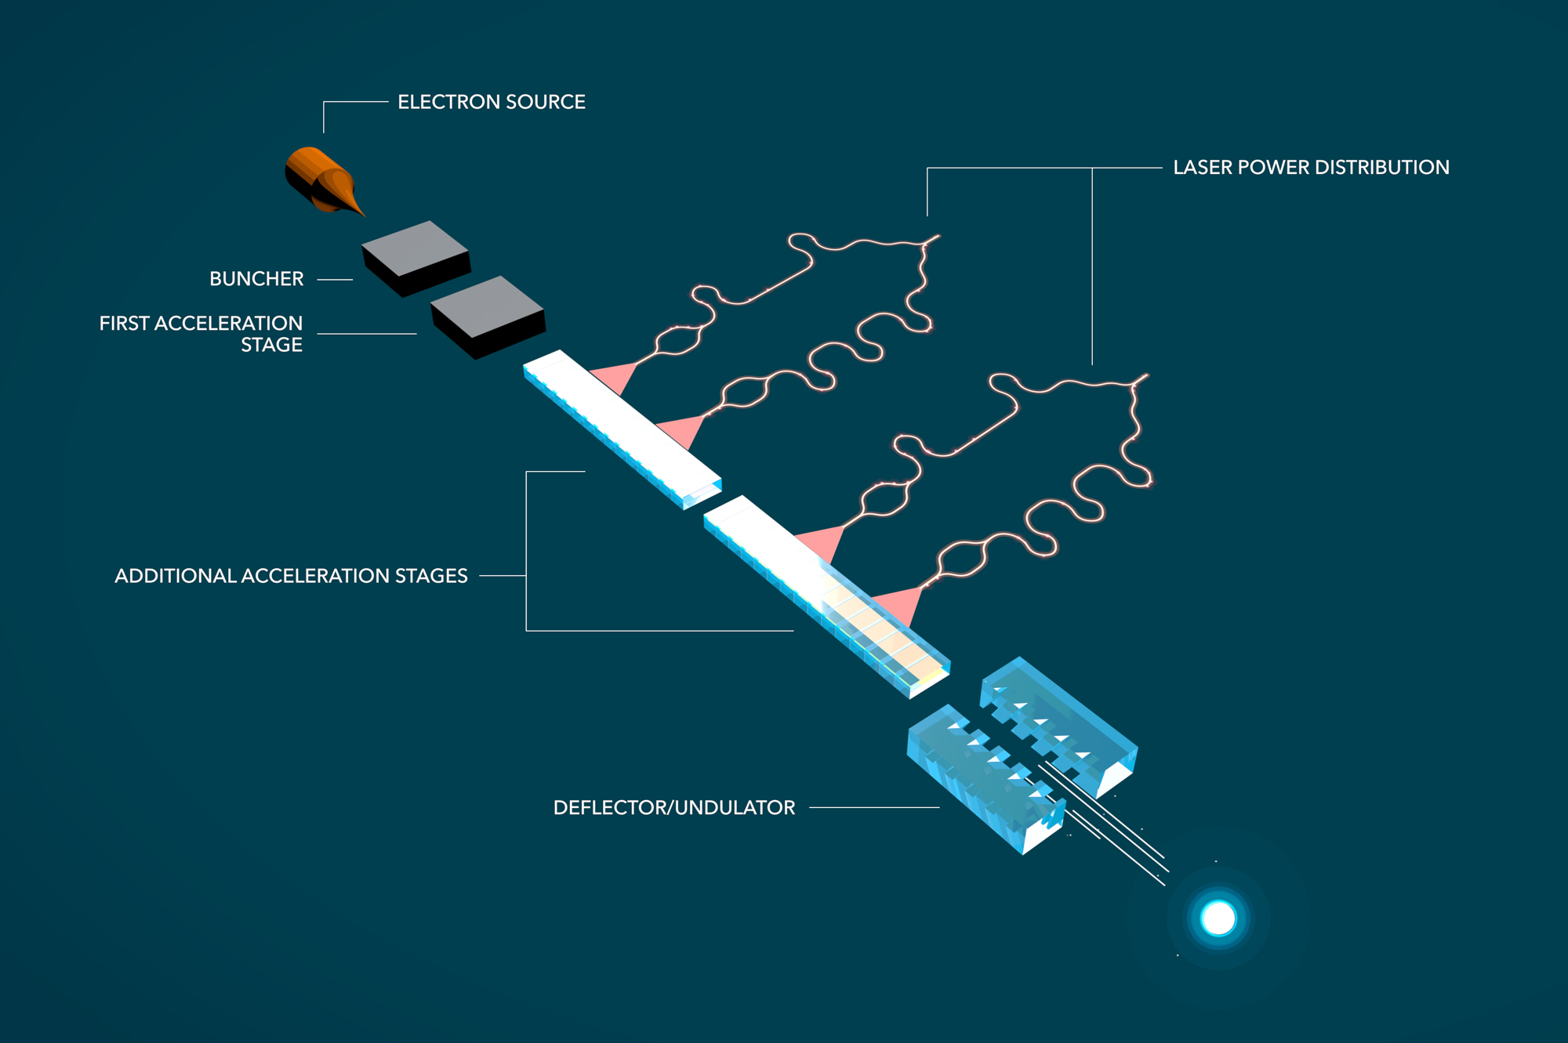
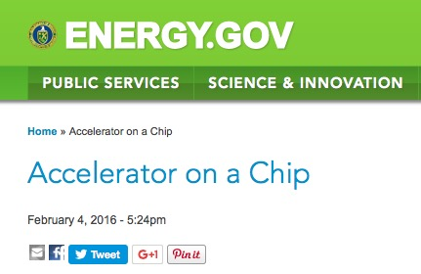
A 5-Year initiative in DLA was funded by the Gordon and Betty Moore Foundation (2015 – 2020)
Moore Foundation “Accelerator on a Chip” Program (started Dec 2015)
Recent 2-Year Continuation Approved through 2022
$13.5M / 5 years
6 universities, 3 partner labs
1 industry partner
(DOE Web Feature 2015)
Goals of ACHIP:
(1) An MeV class benchtop DLA accelerator in 5 years.
(2) Transverse dynamics (focusing, deflection, undulators, diagnostics)
3
Encouraged by recent rapid progress in DLA, Moore Foundation funded an international program in this area as part of its mission to advance basic science.
Notes:
The Moore Foundation, created by Gordon Moore of Intel and the namesake of Moore’s Law, is a philanthropic organization that funds high-risk high-payoff scientific research. After the recommendation in 2015 by the DOE Accelerator R&D Subpanel that DLA funding in the US be reduced, the Moore Foundation approached us with the idea of starting an international collaboration in this area, and funded a program for $13.5M over 5 years, led by Stanford University. The goals of this program are to develop a compact DLA accelerator on a tabletop in 5 years, and also to study the transverse dynamics for applications such as radiation generation.
Explain what the Moore Foundation is!

Slide 4


ACHIP Technical Group Organization
Executive Committee:
R. L. Byer (Stanford), P. Hommelhoff (FAU), R. J. England (SLAC), R. Assmann (DESY), R. Ischebeck (PSI)
TG 1: Injector
K. Leedle (Stanford)
N. Schönenberger (FAU)
TG 5: Radiation Generation and Applications
R. J. England (SLAC)
Yen-Chieh Huang (NTHU TW)
Zhirong Huang (SLAC)
TG 2: Relativistic Structures & Facilities
R. J. England (SLAC)
R. Assmann (DESY)
R. Ischebeck (PSI)
TG 6: Integration
R. J. England (SLAC)
P. Hommelhoff (FAU)
P. Musumeci (UCLA)
TG 4: Simulation and Beam Dynamics
U. Niedermayer (Darmstadt)
B. Cowan (Tech-X)
TG 3: Laser Sources & Coupling
J. Vučković (Stanford)
F. Kaertner (Hamburg)
I. Hartl (DESY)

Slide 5
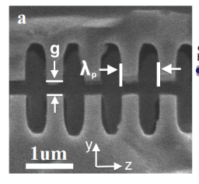
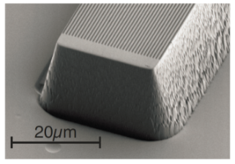
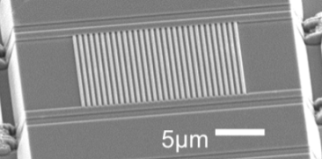
Comparison of DLA Acceleration Experiments
 | SLAC & UCLA | Hommelhoff Erlangen | Si Single Grating | Si Dual Pillars
Electron Energy | 8 MeV | 30 keV | 96.3 keV | 86.5keV
Relativistic β | 0.998 | 0.33 | 0.54 | 0.52
Laser Energy | 150 µJ | 160 nJ | 5.2 nJ | 3.0 nJ
Pulse Length | 40 fs | 110 fs | 130 fs | 130 fs
Interaction Length | ~20 µm | 11 µm | 5.6 µm | 5.6 µm
Peak Laser Field | 8 GV/m | 2.85 GV/m | 1.65 GV/m | ~1.1 GV/m
Max Energy Gain | 315 keV | 0.275 keV | 1.22 keV | 2.05 keV
Max Acc Gradient | 0.85 GV/m | 25 MeV/m | 220 MeV/m | 370 MeV/m
G_{max}/E_{p} | ~0.18 | ~0.01 | ~0.13 | ~0.4

Slide 6
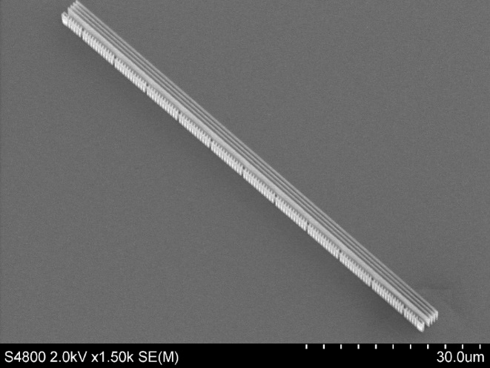
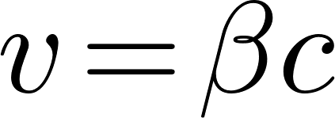
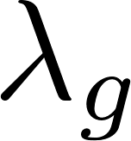

Sub-relativistic Structures with Laser-Driven Focusing Have Been Recently Fabricated for Experimental Tests
Laser
y
x
z
s
Laser
Hommelhoff Group, FAU Erlangen, Germany
Niedermayer, et al., PRL 121, 214801 (2018)
First APF structure optimized for 2000 nm laser wave length and 26.478 keV electron beam Structure length required pulse front tilted (PFT) laser pulses
Structure is only for guiding as a proof-of-principle
Goal is to see a maximum laser ON/OFF contrast of 2.5:1
Additionally the contrast should scale with incident laser power

Slide 7
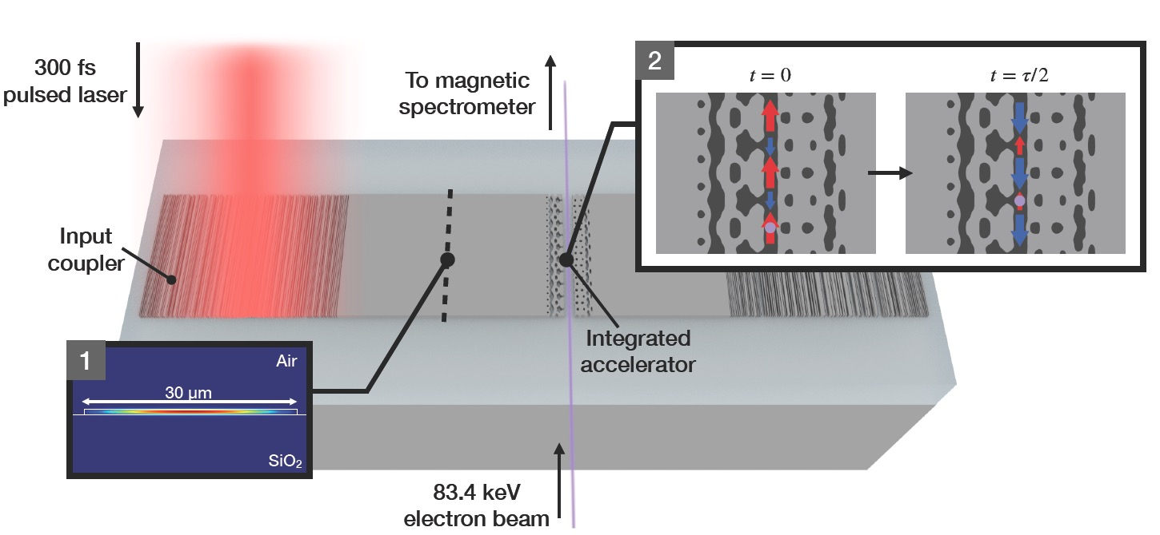
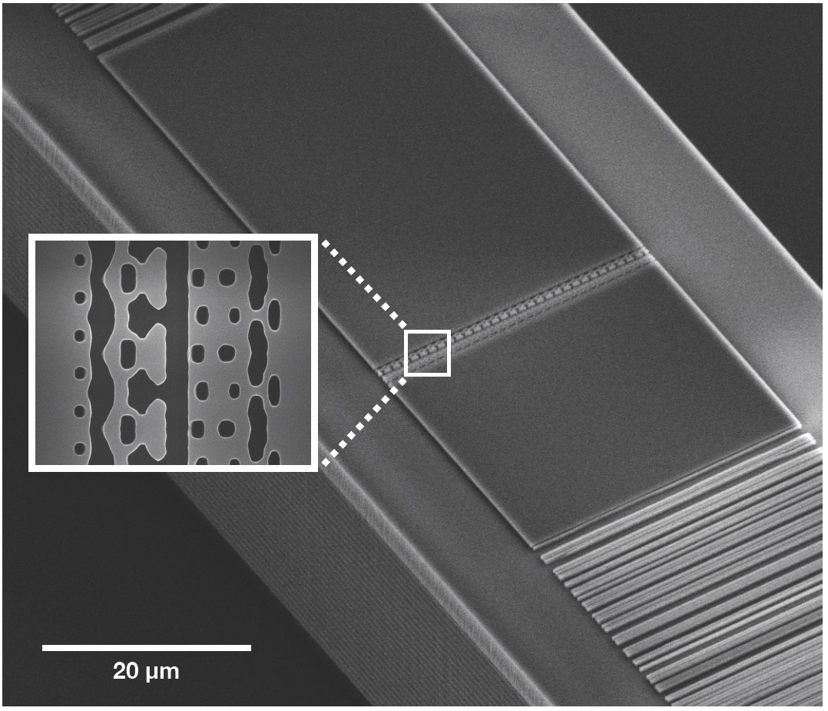
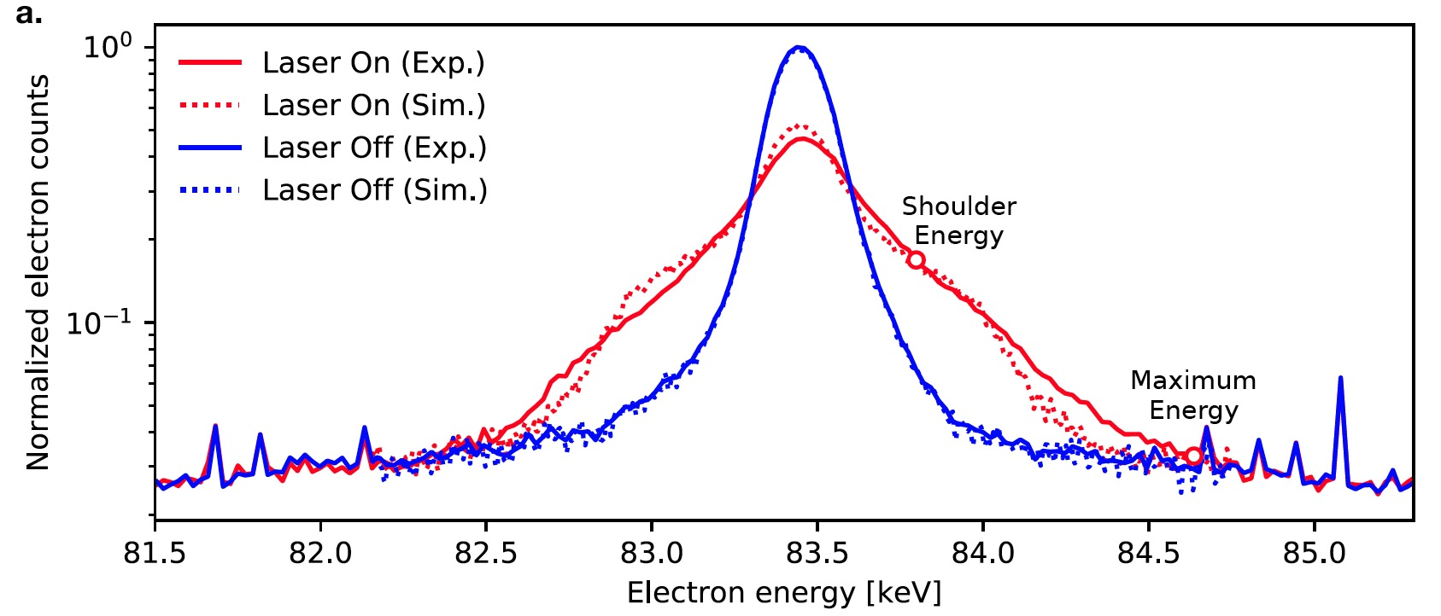
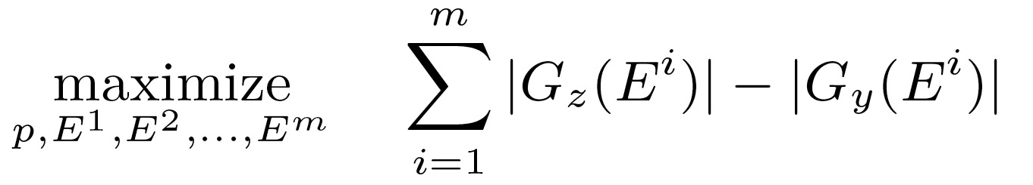
First demonstration of a waveguide-coupled DLA produced using inverse design optimization
• First demonstration of acceleration in a waveguide-coupled DLA
• Acceleration of 1.2 keV over 30 µm (gradient of 40.3 MeV/m)
• Illustrates utility of inverse design methods to optimize over unique parameter constraints
N. Sapra, et al., “On-chip laser driven particle acceleration through inverse design,” Science 367 (6473), 79 (2020)

Slide 8
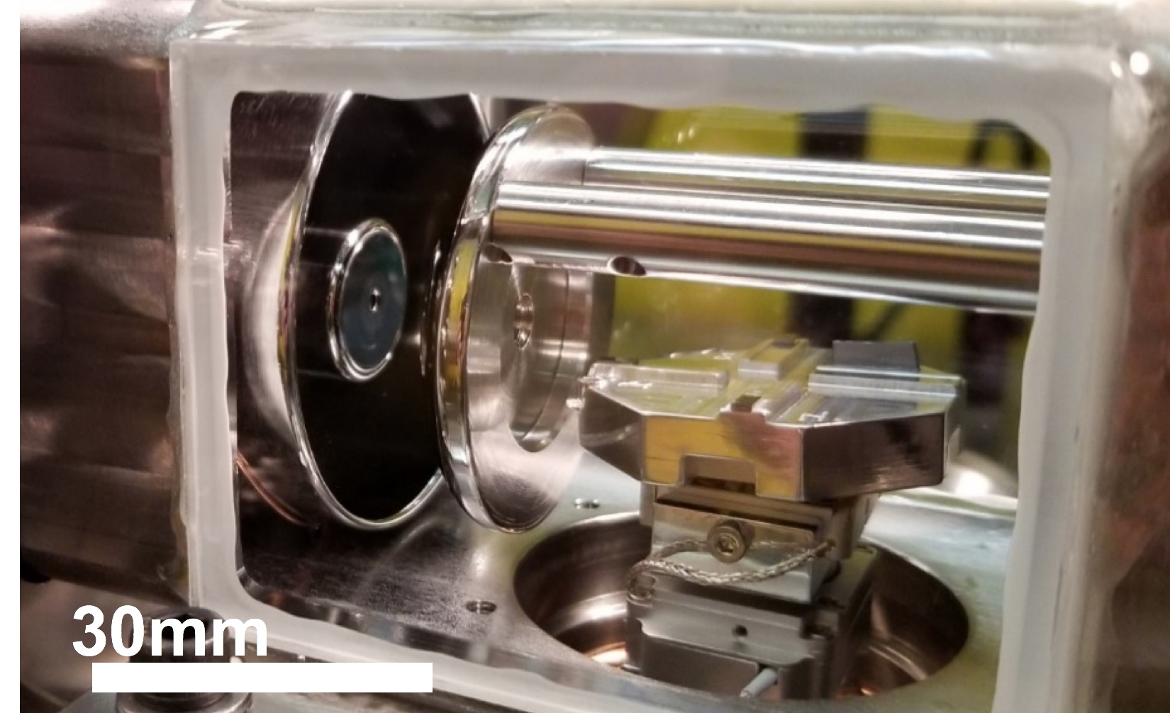
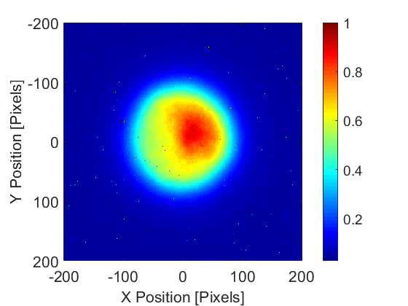
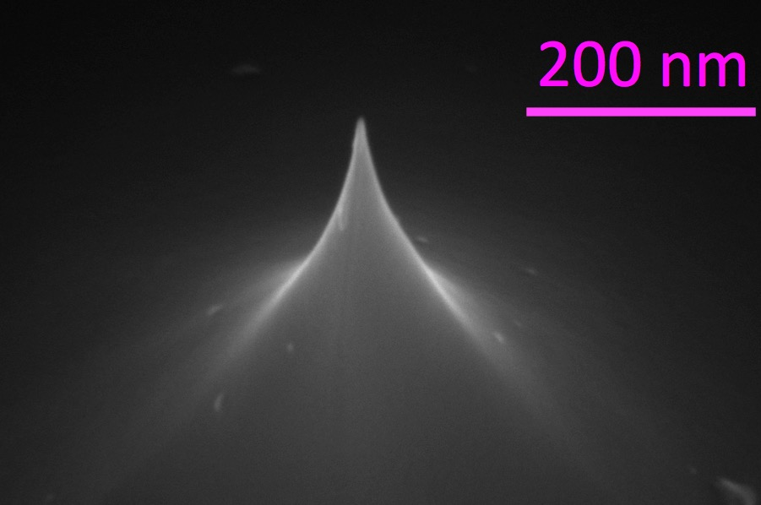
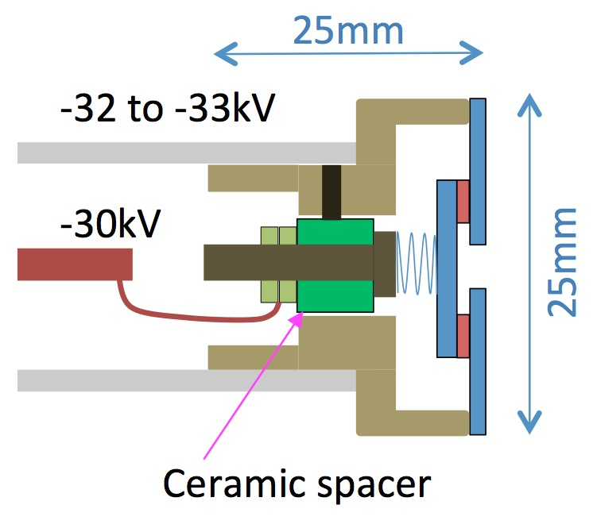
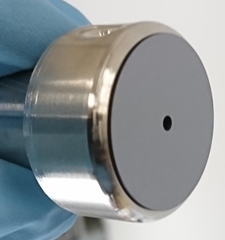
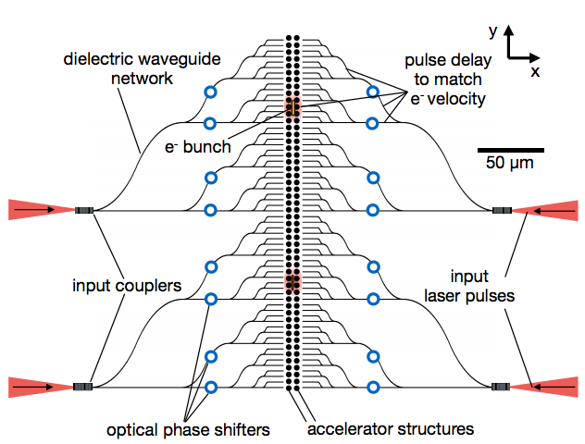
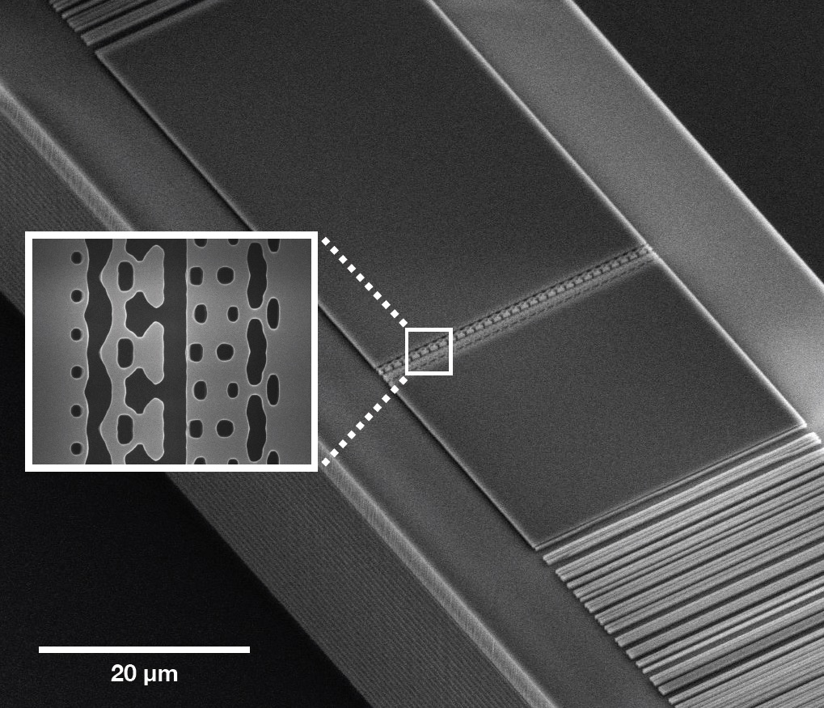
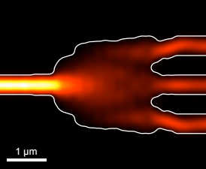
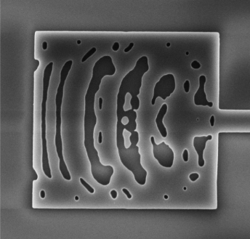
The components for an integrated 1 MeV tabletop accelerator are coming together
Stanford “glassbox” test system
compact electron gun
w/electrostatic lens
96keV
Si tip emitter
3000 e-/pulse,100 kHz rep
0.2 nm emittance
A. Ceballos, Stanford
30mm
compact e- gun
optimized DLA components via inverse design
splitters
waveguide coupled DLA
couplers
e-
courtesy T. Hirano (Hamamatsu, visiting scientist at Stanford University)
T. Hughes, et al, Phys. Rev. Appl. 9, 054017 (2018)
N. Sapra, et al., Science (2019)

Slide 9
Anticipated Shoebox Demonstration System
Parameters (1 vs. 2-3 Year Time Scale)
Parameter | Units | Near Term (1 Year) | Longer Term (2-3 Years)
Final Electron Kinetic Energy | MeV | 1 | 6
Charge Per Laser Pulse | e- | 10 | 300
Laser Rep Rate | MHz | ≤ 1 | 50
Electron Beam Size (X/Y) | µm | 0.05 / 1.00 | 0.05 / 1.00
Geographical Gradient | MeV/m | 100 | > 200
Total Accelerator Length | cm | 1 | 3
Electron Beam Power | µW | 1 | 3000
Values represent conservative near-term estimates, not theroretical or practical limitations on the technology.

Slide 10

What are DLA’s Unique Capabilities?
“Create a matrixed list or table of all DLA related applications that have been proposed or discussed so far, both near and long-term, including industrial, scientific, and medical. Please evaluate each application in terms of area of interest (light source, HEP, industry, medicine, security, etc.), feasibility (is DLA a good match?), time scale (near-term vs. long-term), and degree to which it leverages DLA's unique capabilities.”
Features of a DLA Accelerator:
• Compactness: x10⁻² longitudinal, x10⁻⁴ transverse
• Efficiency: solid state lasers (> 30% wall-plug)
• Bunch Format: fC charge at MHz rep rates
• Attosecond Time Scale: intrinsic optical bunching
• Uniquely enabled by DLA?

Slide 11
Various Potential Applications Under Consideration
AB Recommendation #11: A clear picture/diagram should be developed showing the timeline for different DLA applications and the most important beam parameters
Application | Field | Time-Scale | Kinetic Energy | Species | Beam Power
Radiobiology | Science | 5 yrs | 100 keV to 5 MeV | e- | 5 mW
UED/UEM Source | Science | 5 yrs | 1-5 MeV | e- | 10 to 50 µW
Catheterized Electron Source | Medical | 5 yrs | 1 to 10 MeV | e- | 1-3 mW
Compton X-ray Source | Medical | 5-10 yrs | 10 to 60 MeV | e- | 20 to 60 mW
Low-power EUV | Industry | 5-10 yrs | 10 to 100 MeV | e- | 0.5 W
Proton/Hadron Therapy | Medical | 10-20 yrs | 70 to 250 MeV | p+ | 3-400 mW
Compact XFEL | Science | 10-20 yrs | 1 GeV | e- | 1.5 kW
Multi-Axis Tomography | Science | 10-20 yrs | 1 GeV | e- | 1.5 kW
Colliding Beam Fusion | Industry | 20+ yrs | 15 keV to 1 MeV | p+ | 1 MW
Linear Collider | HEP | 20+ yrs | 1 to 10 TeV | e-/e+ | 10 to 200 MW

Slide 12
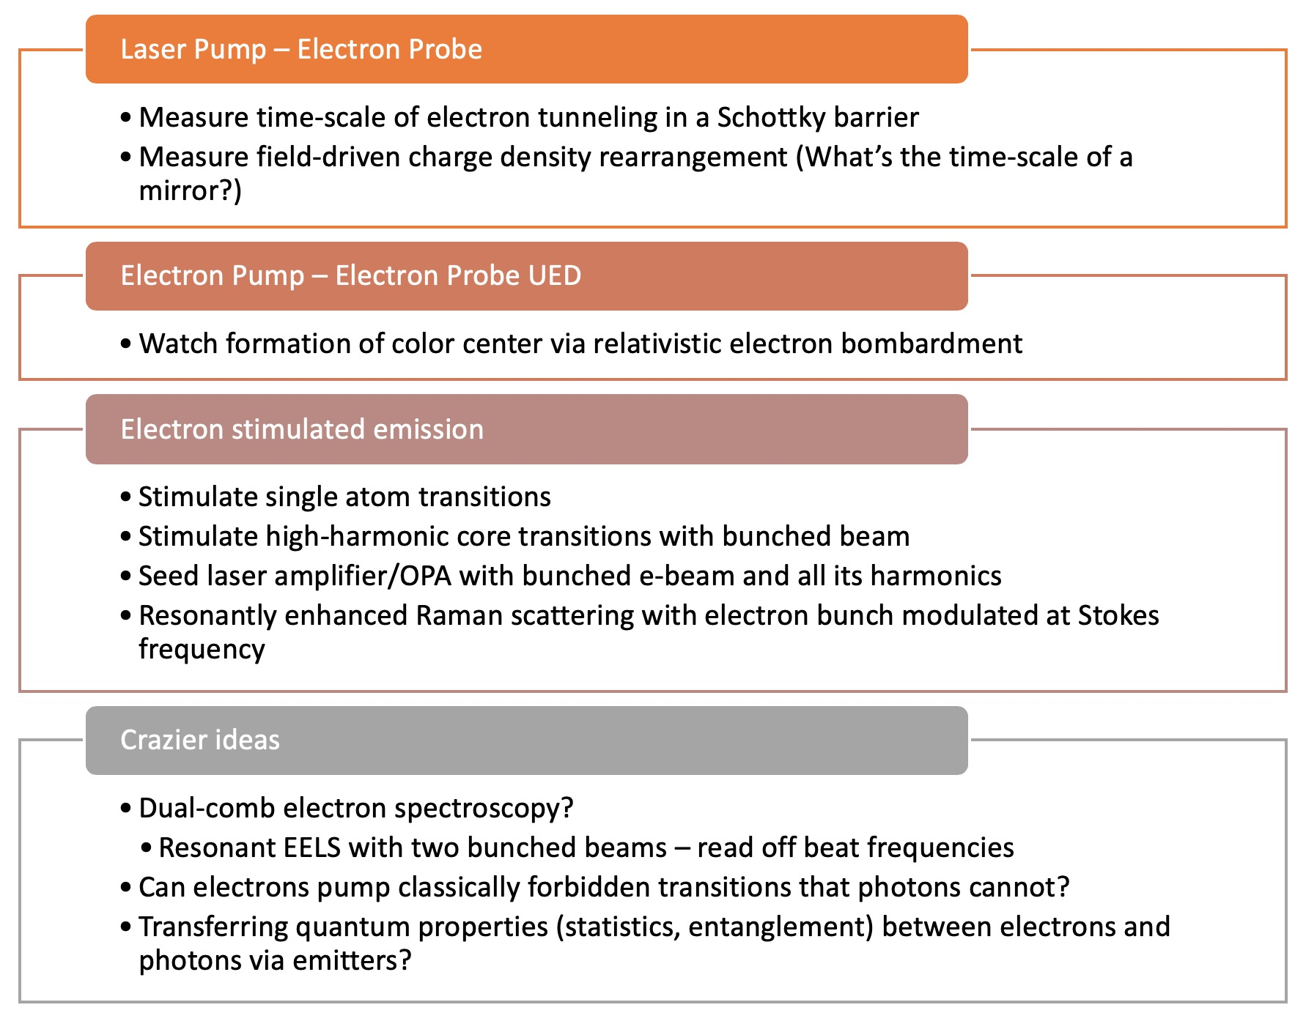
Possible Electron Diffraction and Attosecond Science Experiments (Dylan Black, Stanford)

Slide 13

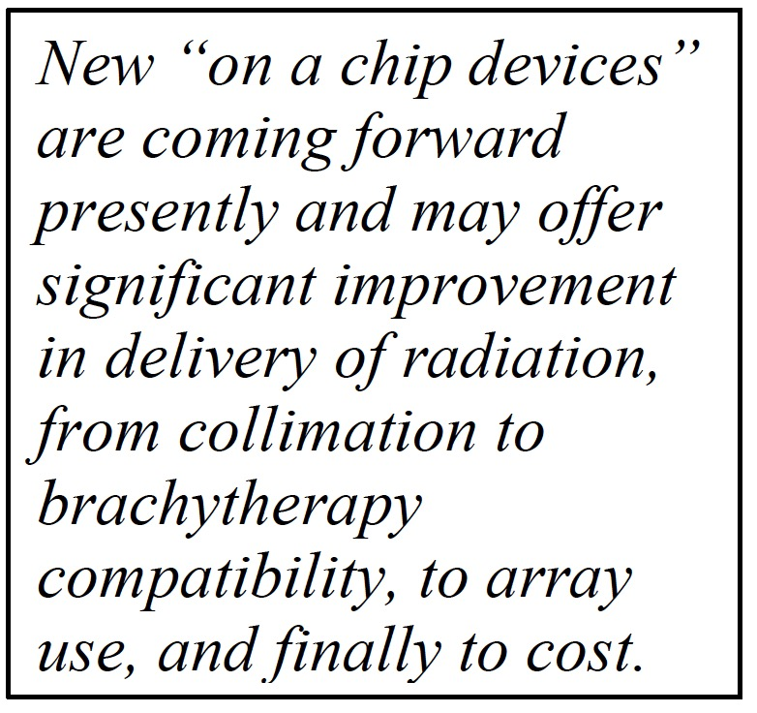
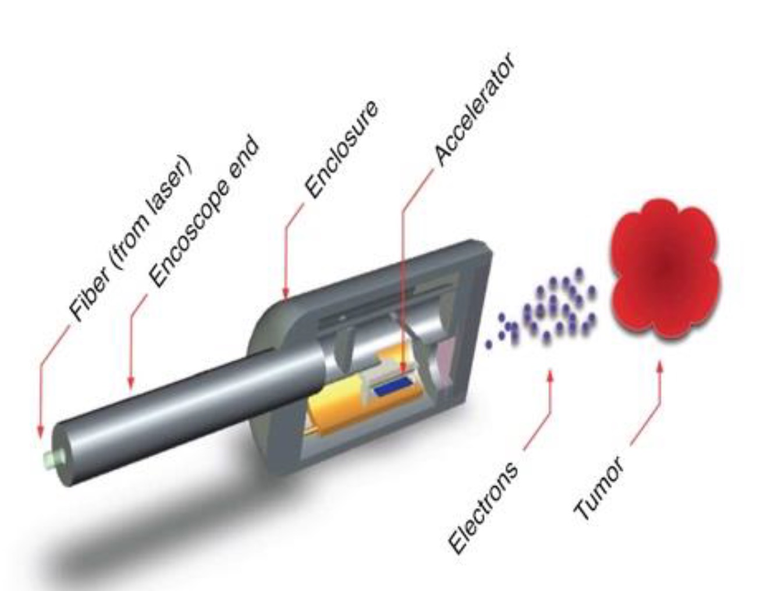
Medical Applications Highlighted by Recent DOE Basic Research Needs Report

Slide 14
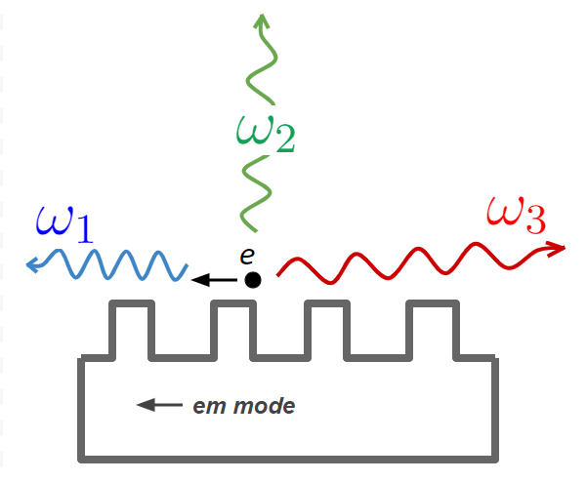
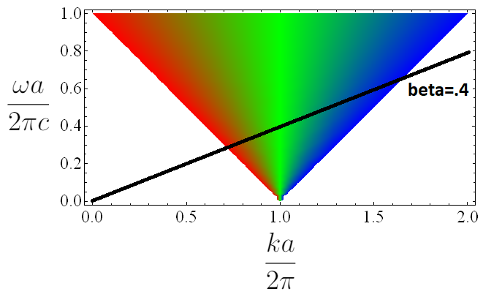
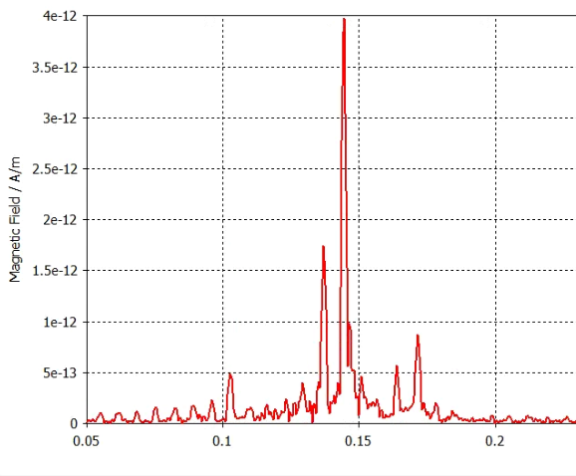
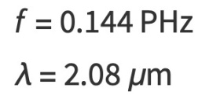
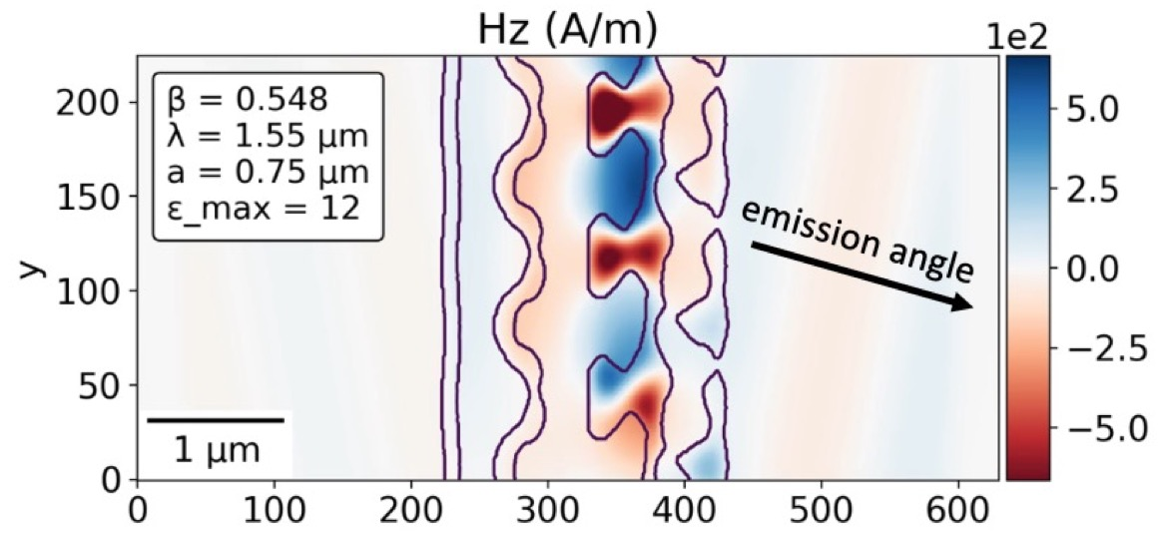
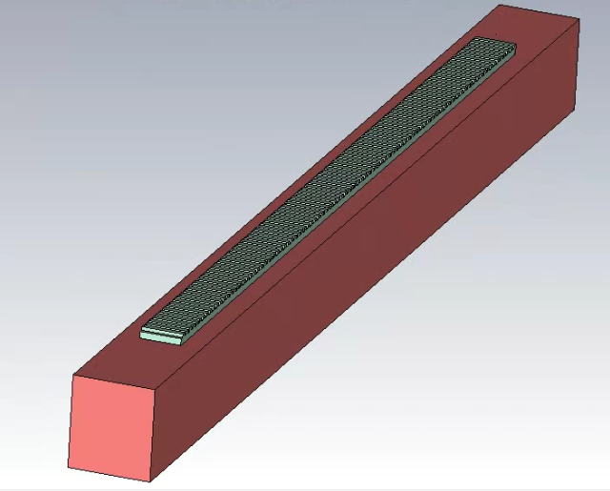
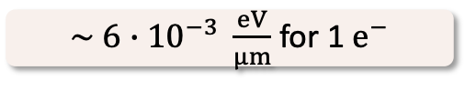
Photonic mode structure vs. Smith–Purcell
(A. Szczepkowicz, Wroclaw Univ.)
color legend:
radiation
forward
perpendicular
backward
Cherenkov Mode Mediated Coherent Smith Purcell
Resonant (20x) Enhancement of Radiation through Inverse Design
4
3
2
Magnetic Field (pA/m)
1
0
0.05 0.10 0.15 0.20
f (PHz)
53.6 keV
thin silicon grating on SiO2 substrate
$\sim 6∙{10}^{−3} \frac{eV}{μm}$ for 1 $e^{−}$
e-
(Y-C. Huang, NTHU)
(Urs Haussler, FAU Erlangen)

Slide 15
Proposed Charge Questions for Each Topic Area
What characteristics of the DLA approach make it attractive for this application area?
Are there new capabilities that would be uniquely enabled (i.e. which could not be done with a conventional accelerator system)?
What are the minimum required accelerator performance parameters for useful application of the technology?
What are the primary R&D challenges and time scale to achieve needed performace?
Google doc created at the following link to facilitate group editing:
https://docs.google.com/document/d/1pq4UM53rHdNySY4I0W1OLuavIJPqctJIrq5sWg3ZVX4/edit?usp=sharing

Slide 16
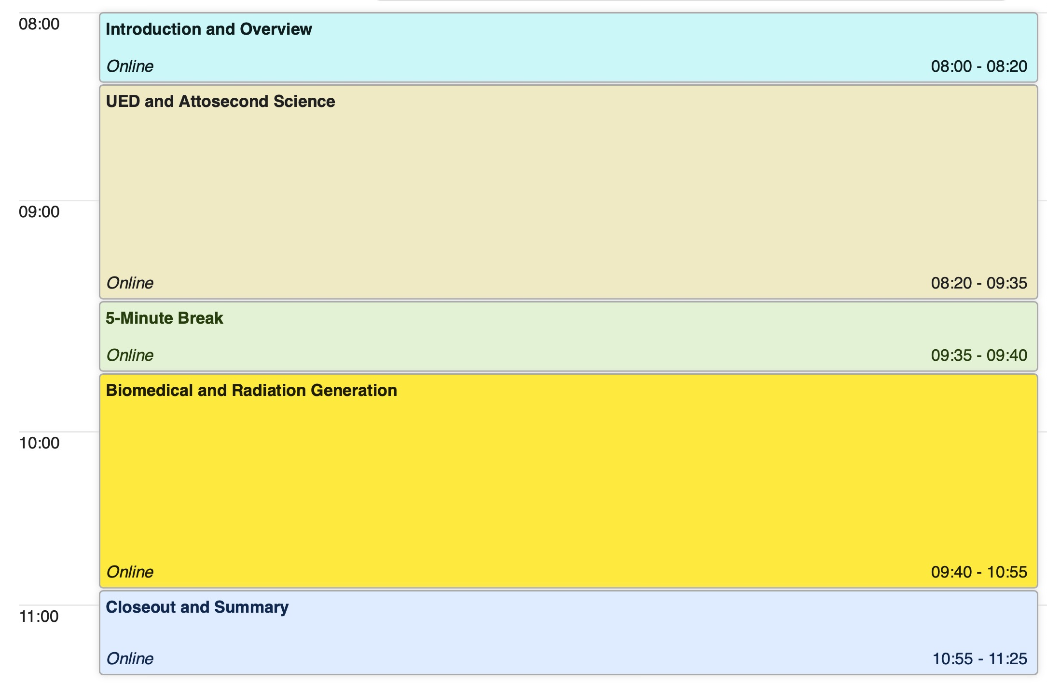
Schedule for Today’s Meeting

Slide 17
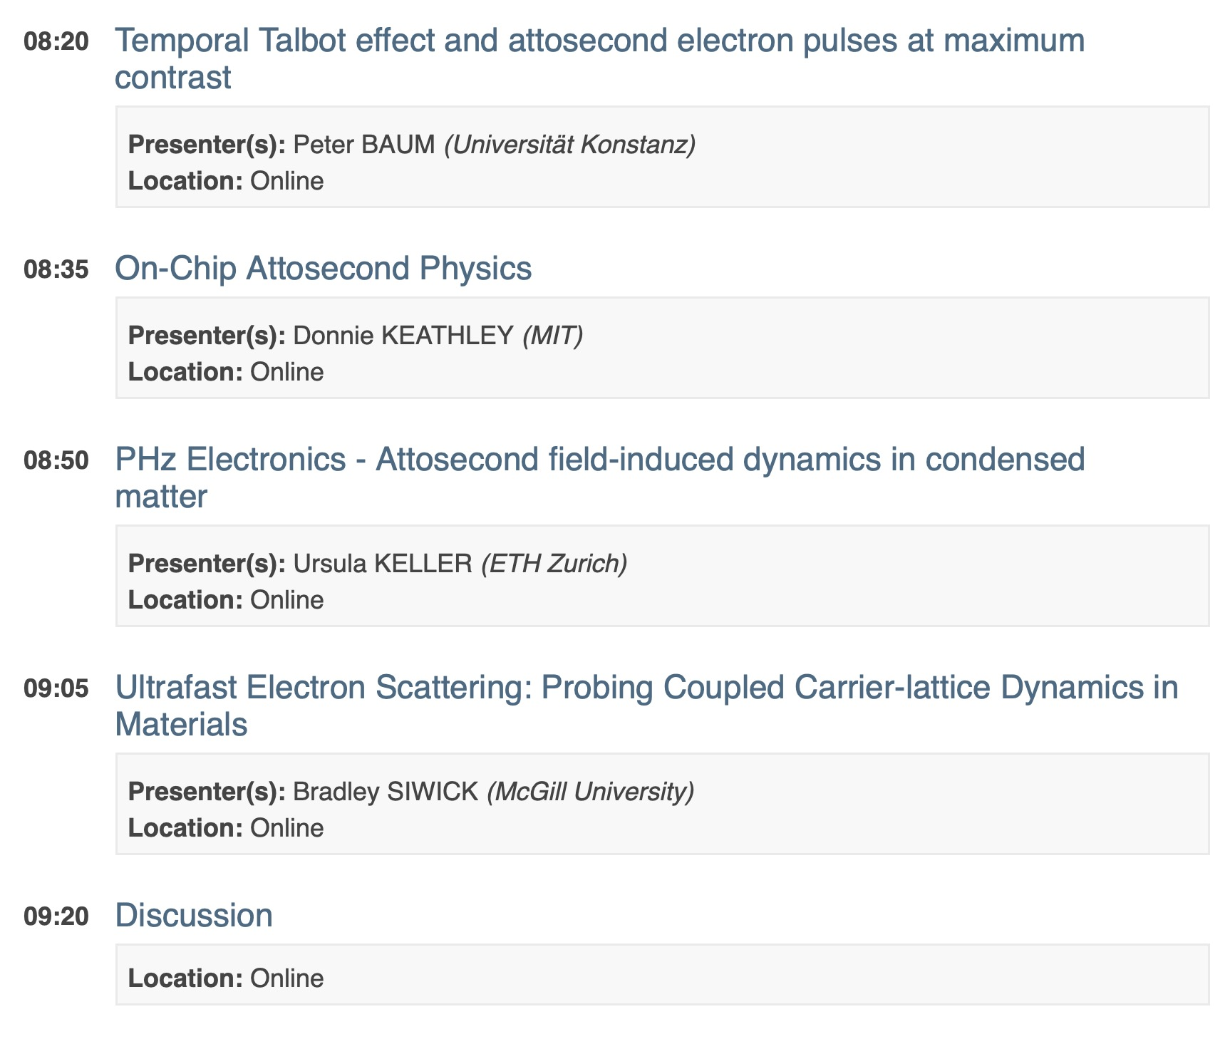
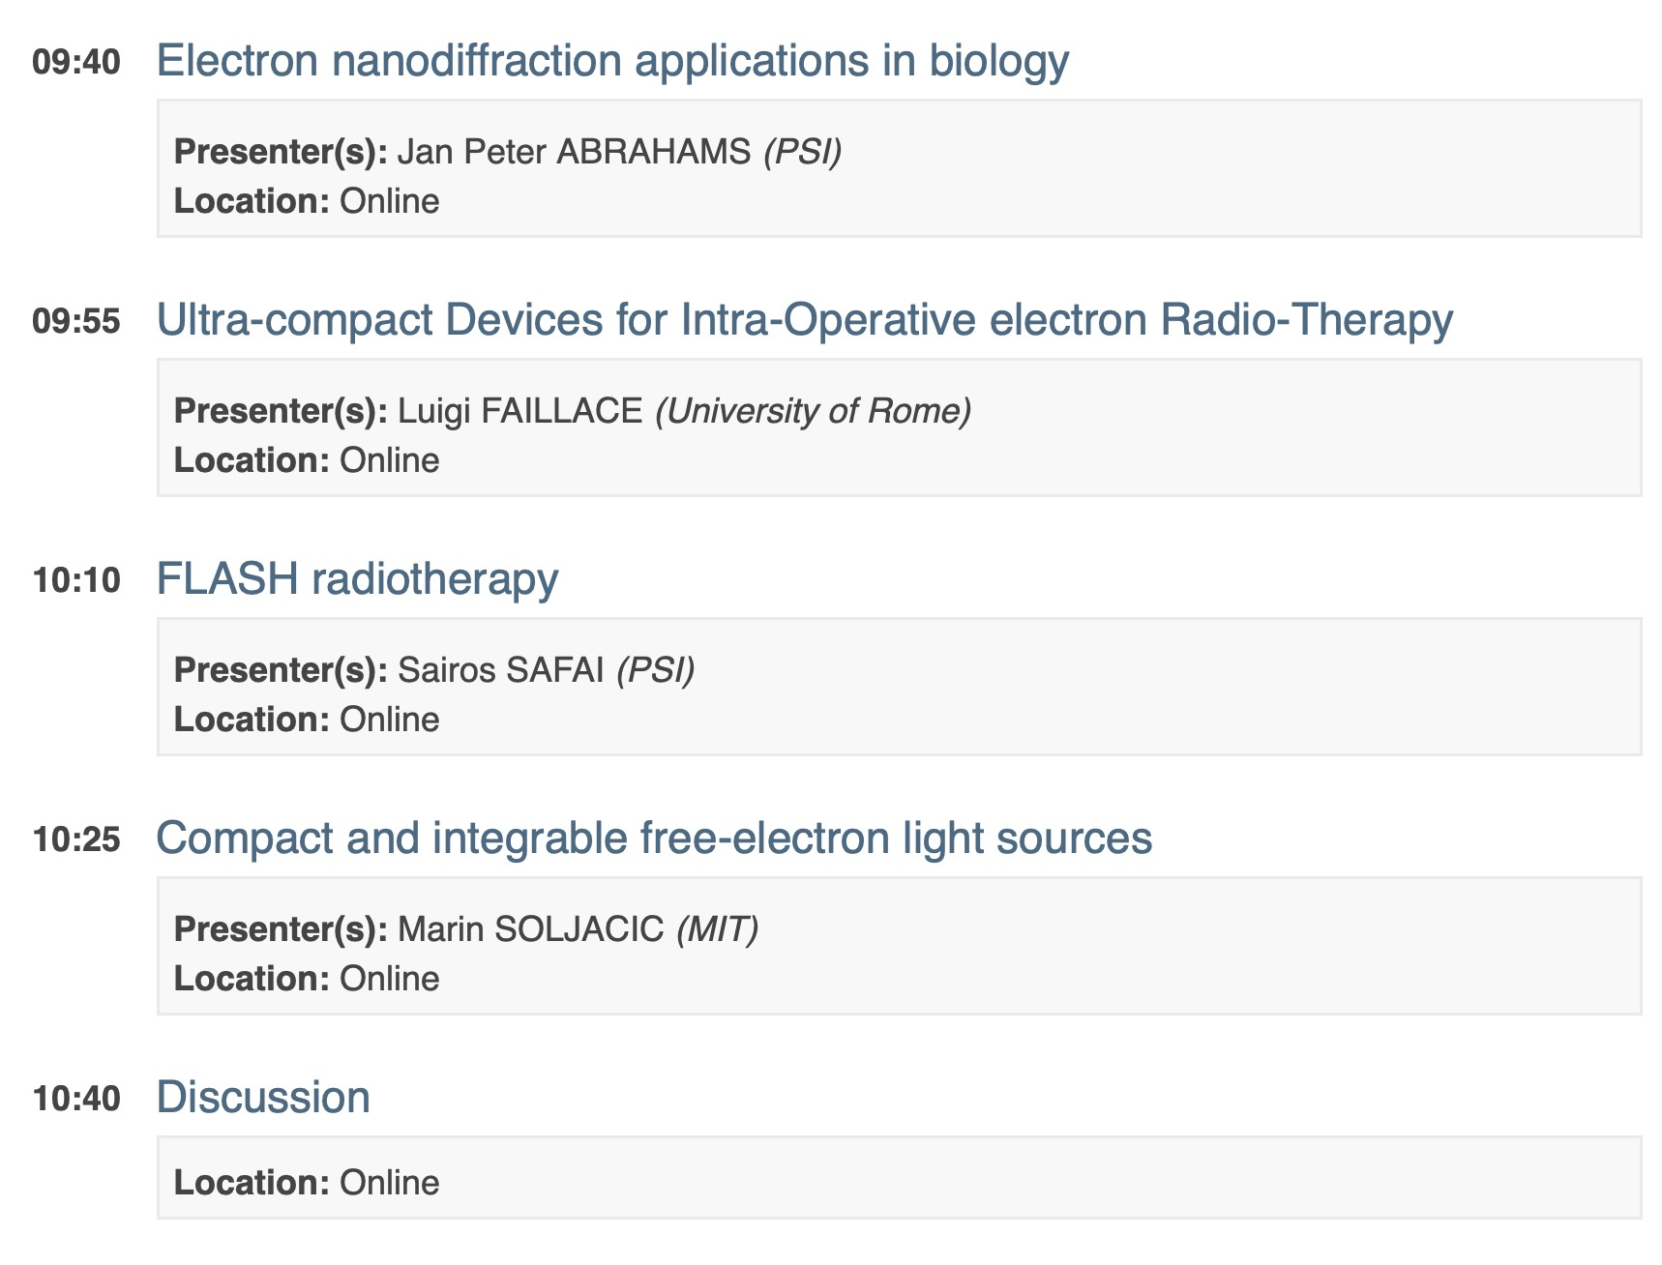
Session Organization
Session 1:
Attosecond science, UED/UEM
Session 2:
Biomedical, Radiation Generation
For the sake of time, we have consolidated the 3 topic areas into two back-to-back sessions. To allow time for questions and discussion, we ask that presenters please observe the 10 minute time limit. We also ask that presenters please upload their slides or send by email to be archived.

