Slide 1
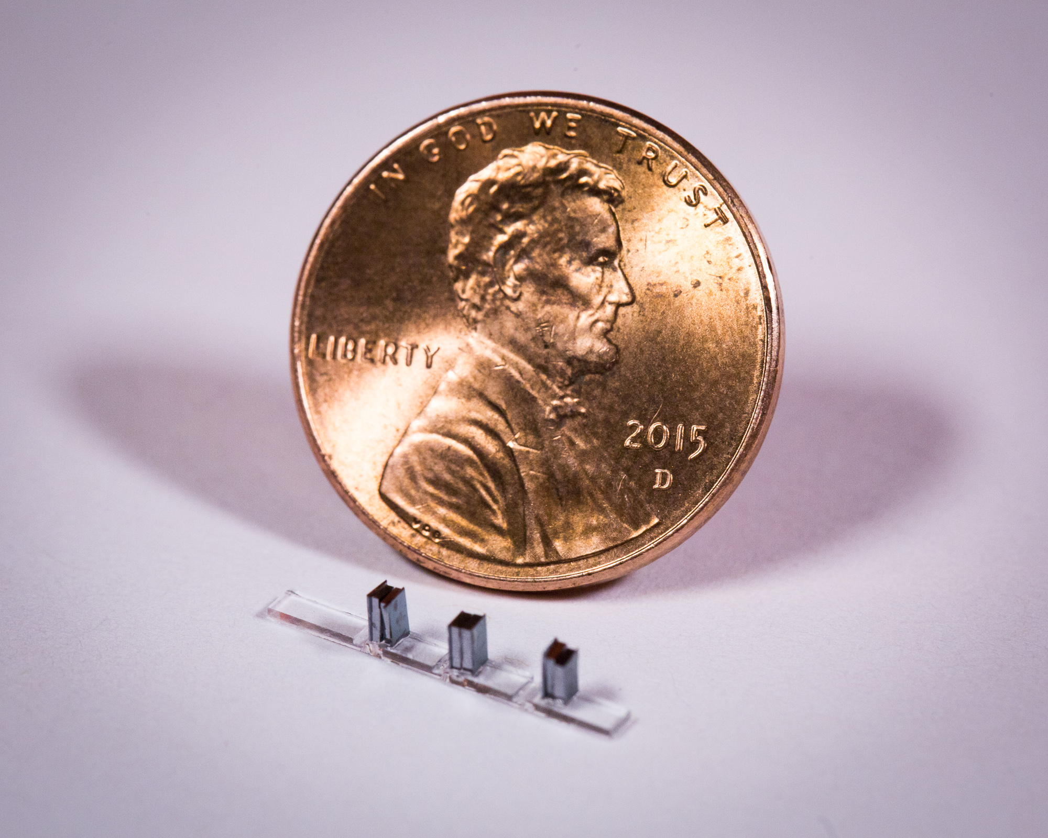
Applications of Dielectric Laser Accelerators Closeout Discussion and Summary R. J. England (SLAC) Zoom Teleconference June 23, 2020 8am – 11am US Pacific Time

Slide 2
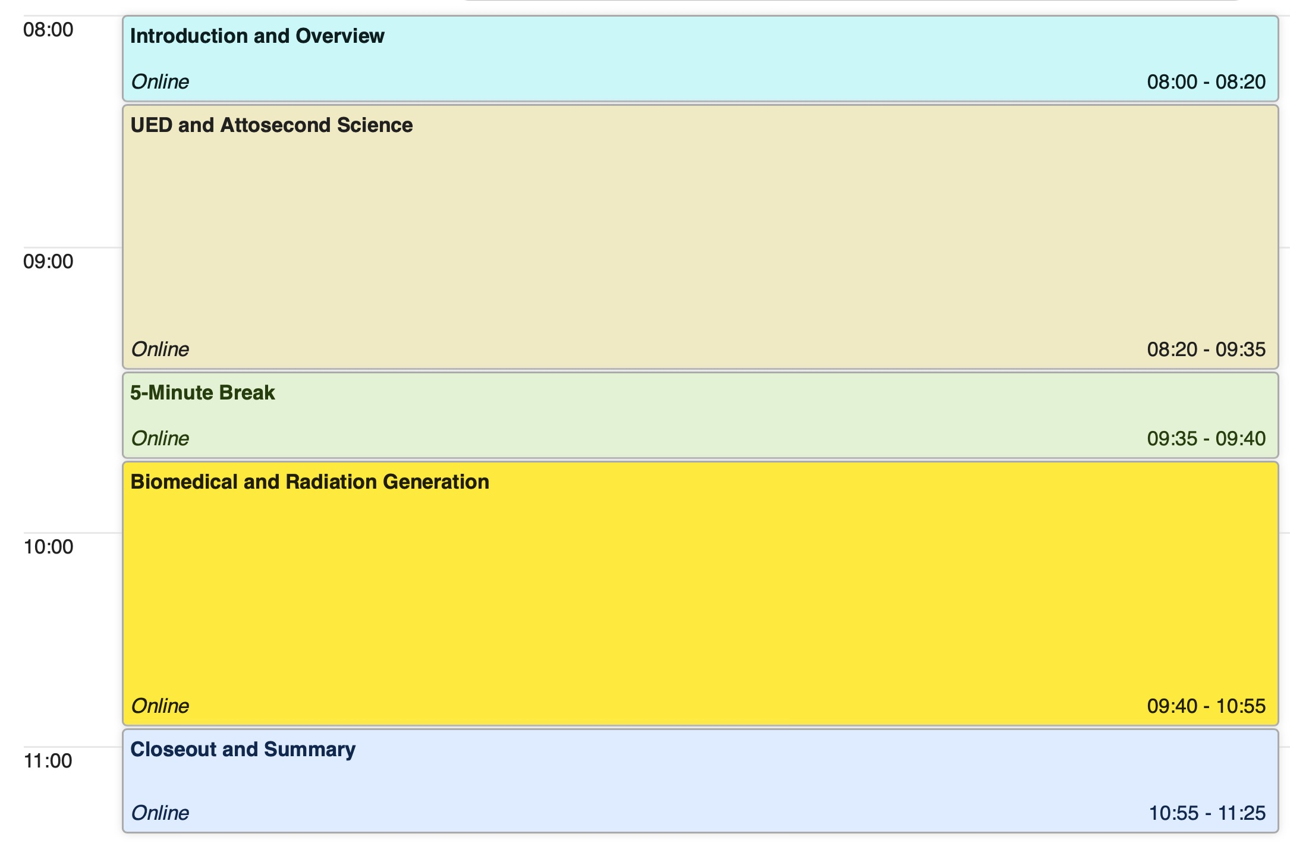
Schedule for Today’s Meeting

Slide 3
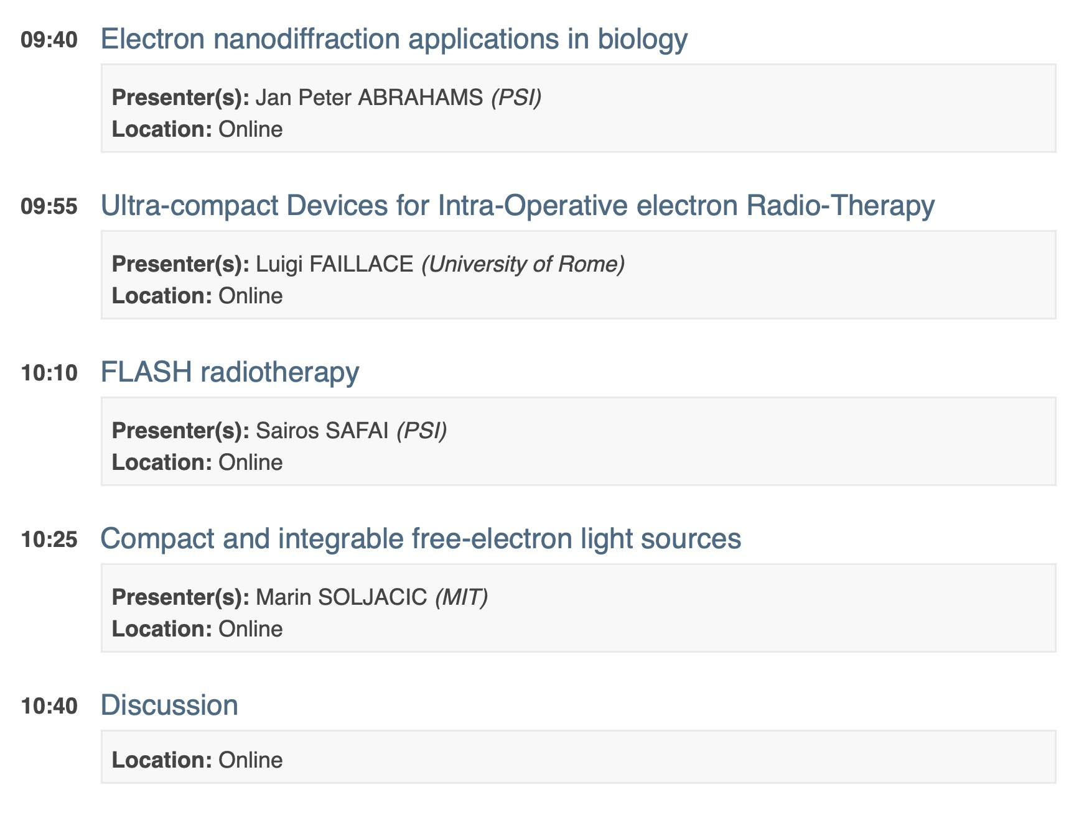
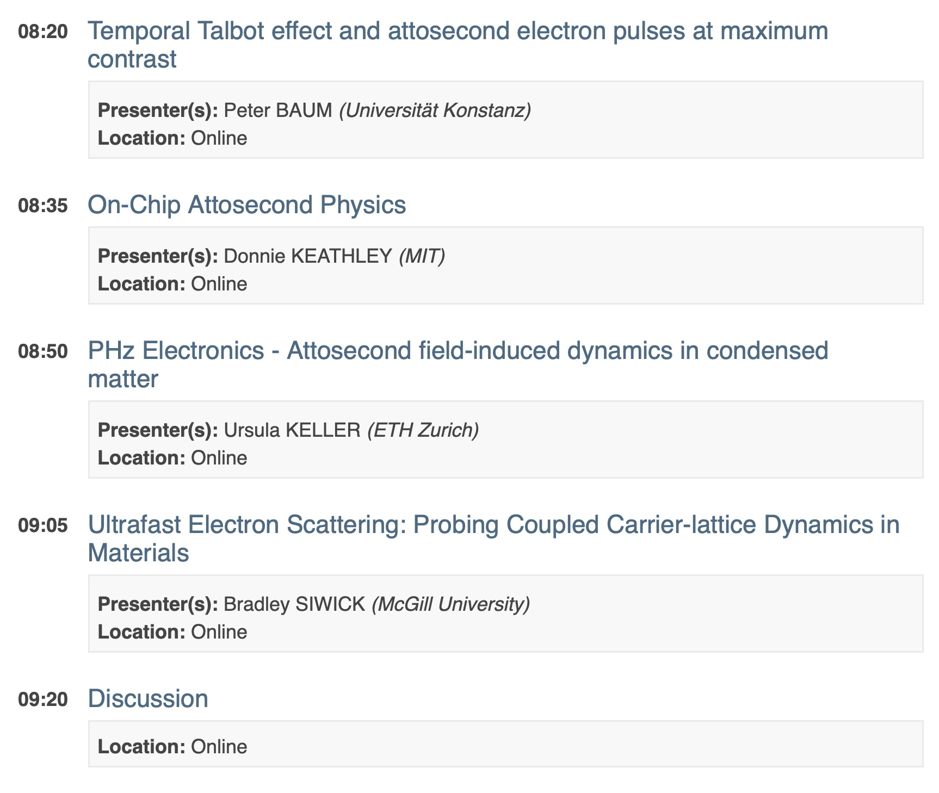
Session Organization
Session 1:
Attosecond science, UED/UEM
Session 2:
Biomedical, Radiation Generation
For the sake of time, we have consolidated the 3 topic areas into two back-to-back sessions. To allow time for questions and discussion, we ask that presenters please observe the 10 minute time limit. We also ask that presenters please upload their slides or send by email to be archived.

Slide 4
Proposed Charge Questions for Each Topic Area
What characteristics of the DLA approach make it attractive for this application area?
Are there new capabilities that would be uniquely enabled (i.e. which could not be done with a conventional accelerator system)?
What are the minimum required accelerator performance parameters for useful application of the technology?
What are the primary R&D challenges and time scale to achieve needed performace?
Google doc created at the following link to facilitate group editing:
https://docs.google.com/document/d/1pq4UM53rHdNySY4I0W1OLuavIJPqctJIrq5sWg3ZVX4/edit?usp=sharing

Slide 5
Charge Questions Topic Area 1: UED and Attosecond Science
What characteristics of the DLA approach make it attractive for this application area? Synchronization with external laser and attosecond bunch format. Possible to include the photoelectron source (integrated)? Possibility to outrun space charge?
Are there new capabilities that would be uniquely enabled (i.e. which could not be done with a conventional accelerator system)? Attosecond synchronization.
What are the minimum required accelerator performance parameters for useful application of the technology? In stroboscopic mode few e- per pulse / 60-100 keV < 100 KHz rep-rate (otherwise sample heats from pump). In single shot mode 1E4 e- per pulse in < 100 fs. Electrons per pulse is an important figure of merit: 1e6 is great, 10 is very difficult.
What are the primary R&D challenges and time scale to achieve needed performace? Single shot mode not matched to DLA. Application space needs further clarification.

Slide 6
Charge Questions Topic Area 2: Radiobiology Dosimetry
What characteristics of the DLA approach make it attractive for this application area? Compact size, endoscopic delivery, inexpensive, replaceable.
Are there new capabilities that would be uniquely enabled (i.e. which could not be done with a conventional accelerator system)? Prospect for field deployable, portability, access to underserved areas.
What are the minimum required accelerator performance parameters for useful application of the technology? Energy 1-10 MeV, few hundred e- per laser pulse, MHz rep rates, microbeams, scannable or raster deflection.
What are the primary R&D challenges and time scale to achieve needed performace? Need nanoamp beam currents, fC bunches, improved efficiency. 1-3 years to benchtop demonstration. 100 ms is max duration for FLASH effect; time structure matters somewhat; 8-12 Gy in 1.8us

Slide 7
Charge Questions Topic Area 3: Smith Purcell Radiation
What characteristics of the DLA approach make it attractive for this application area? Compatibility with integrated photonics, wavelength tunability.
Are there new capabilities that would be uniquely enabled (i.e. which could not be done with a conventional accelerator system)? Potential is for compactness and integration with photonic circuits to enable greater complexity.
What are the minimum required accelerator performance parameters for useful application of the technology? Need µA currents or 100nm-level particle confinement to achieve mW-level radiated power. UV or soft X-ray on chip would be interesting; MeV with similar beam quality to TEM would be of interest; soft to hard x-rays (requires very low emittance)
What are the primary R&D challenges and time scale to achieve needed performace? Need electron guiding and high-Q structures. Pre-bunched beam could lead to further coherent enhancement. Stimulated emission? 1-3 Year time scale for POC of integrated device. Could we have train of short bunches with only 1 electron per bunch? Beam duration (or bunch spacing) matched to the Q of the structure. Would coupling to an external structure with high optical Q help? Combine resonances from FP and distributed feedback (Bragg resonance) – high cavity Q.

