Slide 1
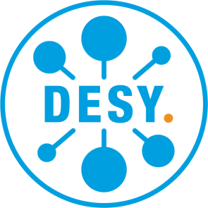
Bio-medical imaging
Small animal imaging at PETRA III
Directorate‘s decision
Pilot experiments at PETRA III
Legal context and processes of the animal experiments
DESY as a perfect ecosystem
Summary and Outlook
June 5th, 2020
Arik Willner, CTO

Slide 2
Bio-medical imaging
Directorate‘s decision

Slide 3
Directorate‘s Decision
Directorate approved first steps towards using PETRA
for animal experiments
First pilot project with two pillars is approved and in preparation
Workshops and interviews are organized for checking the needs of the community
Contact to LEAPS partners with in-vivo beamlines
Discussions with federal Government about DESY‘s contribution to the post-Corona time
Notes:
-> this is initiated by researchers of the different mentioned research institutes, science ciooperation
-> via the Corona fast track access

Slide 4
Directorate‘s Decision
Check list:
Convincing case and scientific motivation?
Strong consortium of excellent people and
institutes?
High societal impact?
Technical Visibility at PETRAIII?
Full approval of experiments by authorities?
Directorate approved first steps towards using PETRA
for animal experiments
First pilot project with two pillars is approved and in preparation
Workshops and interviews are organized for checking the needs of the community
Contact to LEAPS partners with in-vivo beamlines
Discussions with federal Government about DESY‘s contribution to the post-Corona time
Notes:
-> this is initiated by researchers of the different mentioned research institutes, science ciooperation
-> via the Corona fast track access

Slide 5
Bio-medical imaging
Pilot experiments at PETRA III

Slide 6
The initiating case for in-vivo developments
Excellent science with high impact on people‘s life
Prof. Dr. med. Samuel Huber
Clinic Director
Heisenberg-Professorship for immune regulation
Head of „Molekulare Gastroenterologie und Immunologie“ (Molecular gastroentology and immunology)
Medical Specialist for Internal Medicine and Gastroenterology
Notes:
Here you can see the share of different areas where Synchrotron radiation can be used for experiments.
Health and life sciences are already today the largest field of research

Slide 7
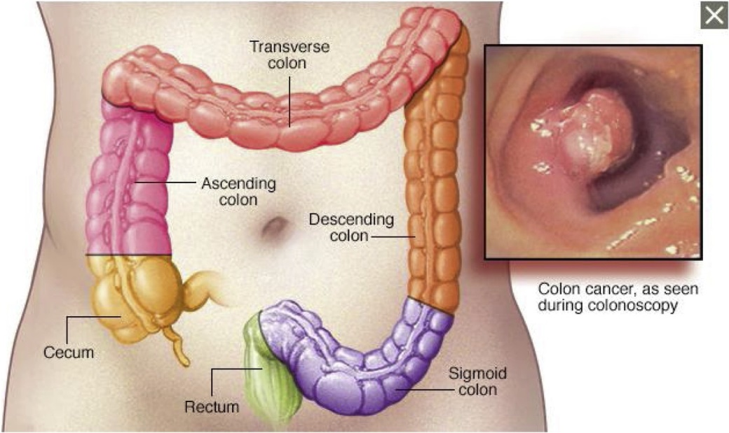
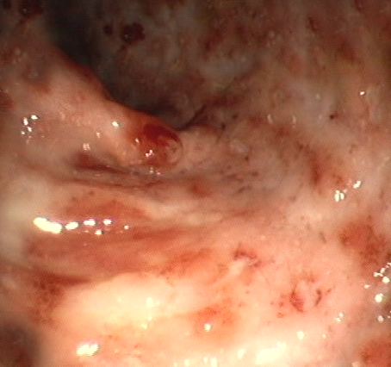
The initiating case for in-vivo
Excellent science with high impact on people‘s life
Inflammatory Bowel Disease
Colorectal Cancer
About 2 millions in EU (1/200)
Chronic disease
No curative treatment available
Third most cancer world-wide
Fourth most cause for cancer death
Incidence: 0.5 million/year (EU)
Mortality: 200 x 10³ per year (EU)
Notes:
Here you can see the share of different areas where Synchrotron radiation can be used for experiments.
Health and life sciences are already today the largest field of research

Slide 8
The topical case in-vivo
Pandemic infection SARS-CoV-2 with high impact on
people‘s daily life and the world‘s economy
Infection mechanisms are not clear
Localization of infection
Multi-organ effect
Sleeping virus?
Immunity?
Causes of death
No treatment, vaccine or curative drug availabe to this date
Notes:
-> this is initiated by researchers of the different mentioned research institutes, science ciooperation
-> via the Corona fast track access

Slide 9
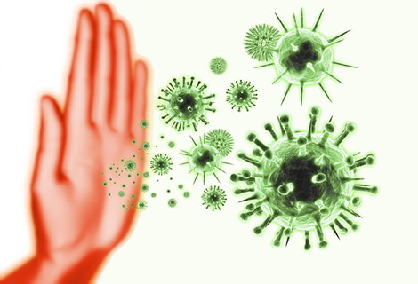
How can DESY help?
PETRA III reveals the answer of the immune system
Crohn’s Desease and Covid-19:
CD is caused by bad T-cells of immune system
Most deaths of Covid-19 caused by overreaction of immune system
Tracking T-cells (as driver of the immune system) in living mice => Deep understanding of CD mechanisms and infection process of Covid-19!
Long-term goal is to manipulate the molecular mechanisms
to cure the deseases!
P21: Beamline, where the pilot in-vivo imaging experiments will take place
DESY NanoLAb
Notes:
Entscheidung des DIR Anfang Januar für einen Pilotversuch.
Verantwortliche Abwägung aller Argumente für und gegen medizinische Kleintierbildgebung
3. Details zu dem Pilotversuch, was, wie und warum untersucht wird folgen von Samuel Huber (UKE) direkt im Anschluss
DESY Mission:
Wir erforschen auf höchstem internationalen Niveau die grundlegenden Zusammenhänge von Struktur und Funktion der Materie und schaffen damit die notwendige Wissensbasis zur Lösung der großen und drängenden Fragen von Gesellschaft
Mit DESYs Synchrotronstrahlungsquelle PETRA III stehen die technischen Möglichkeiten für solche medizinischen Untersuchungen zur Verfügung. Die gewonnenen Ergebnisse können helfen, neue Therapien und Medikamente für bisher unheilbare Krankheiten zu entwickeln.

Slide 10
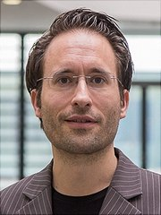
In-Vivo tracking of molecules
Using the method of X-Ray Fluoriscence (XFI)
Problem: No possibility to track non-invasive and in-vivo drugs or different types of immune cells so far
New development:
Labeled molecules or cells (labeled with GNPs or iodine) irradiated with synchrotron radiation shine via Fluoriscence. Background issue solved!
New XFI approach enables:
Exact localization and temporal tracking of drug molecules and immune cells in the body
Follow even several different molecules in-vivo with one mouse
High potential for immune reactions, infection research and drug development
Prof. Dr. Florian Grüner,
University of Hamburg
„Scientific Reports“, 2018; DOI: 10.1038/s41598-018-34925-3
Notes:
Florian Grüner
Finanzierung Hamburg Innovation
Publikation
Branche: Life Science / medizintechnik
Hier steht ein patentiertes Verfahren dahinter

Slide 11
The pilot project I
In-vivo tracking of T-cells for CD research
With a decision in January 2020 the directorate agreed to a pilot trial for small animal imaging at DESY‘s PETRA III.
First Goal: Establishing and verification of the x-ray fluorescence (XFI) in-vivo method with several diffrent T-Cells
Ultimate Goal: understand bowel deseases (Morbus Crohn, Colitis ulcerosa und colon cancer) and the impact of drugs
What: spatio-temporal tracking good and bad T-cells in a reaction of the immune system
P21: Beamline, where the pilot in-vivo imaging experiments will take place
DESY NanoLAb
Notes:
Entscheidung des DIR Anfang Januar für einen Pilotversuch.
Verantwortliche Abwägung aller Argumente für und gegen medizinische Kleintierbildgebung
3. Details zu dem Pilotversuch, was, wie und warum untersucht wird folgen von Samuel Huber (UKE) direkt im Anschluss
DESY Mission:
Wir erforschen auf höchstem internationalen Niveau die grundlegenden Zusammenhänge von Struktur und Funktion der Materie und schaffen damit die notwendige Wissensbasis zur Lösung der großen und drängenden Fragen von Gesellschaft
Mit DESYs Synchrotronstrahlungsquelle PETRA III stehen die technischen Möglichkeiten für solche medizinischen Untersuchungen zur Verfügung. Die gewonnenen Ergebnisse können helfen, neue Therapien und Medikamente für bisher unheilbare Krankheiten zu entwickeln.

Slide 12
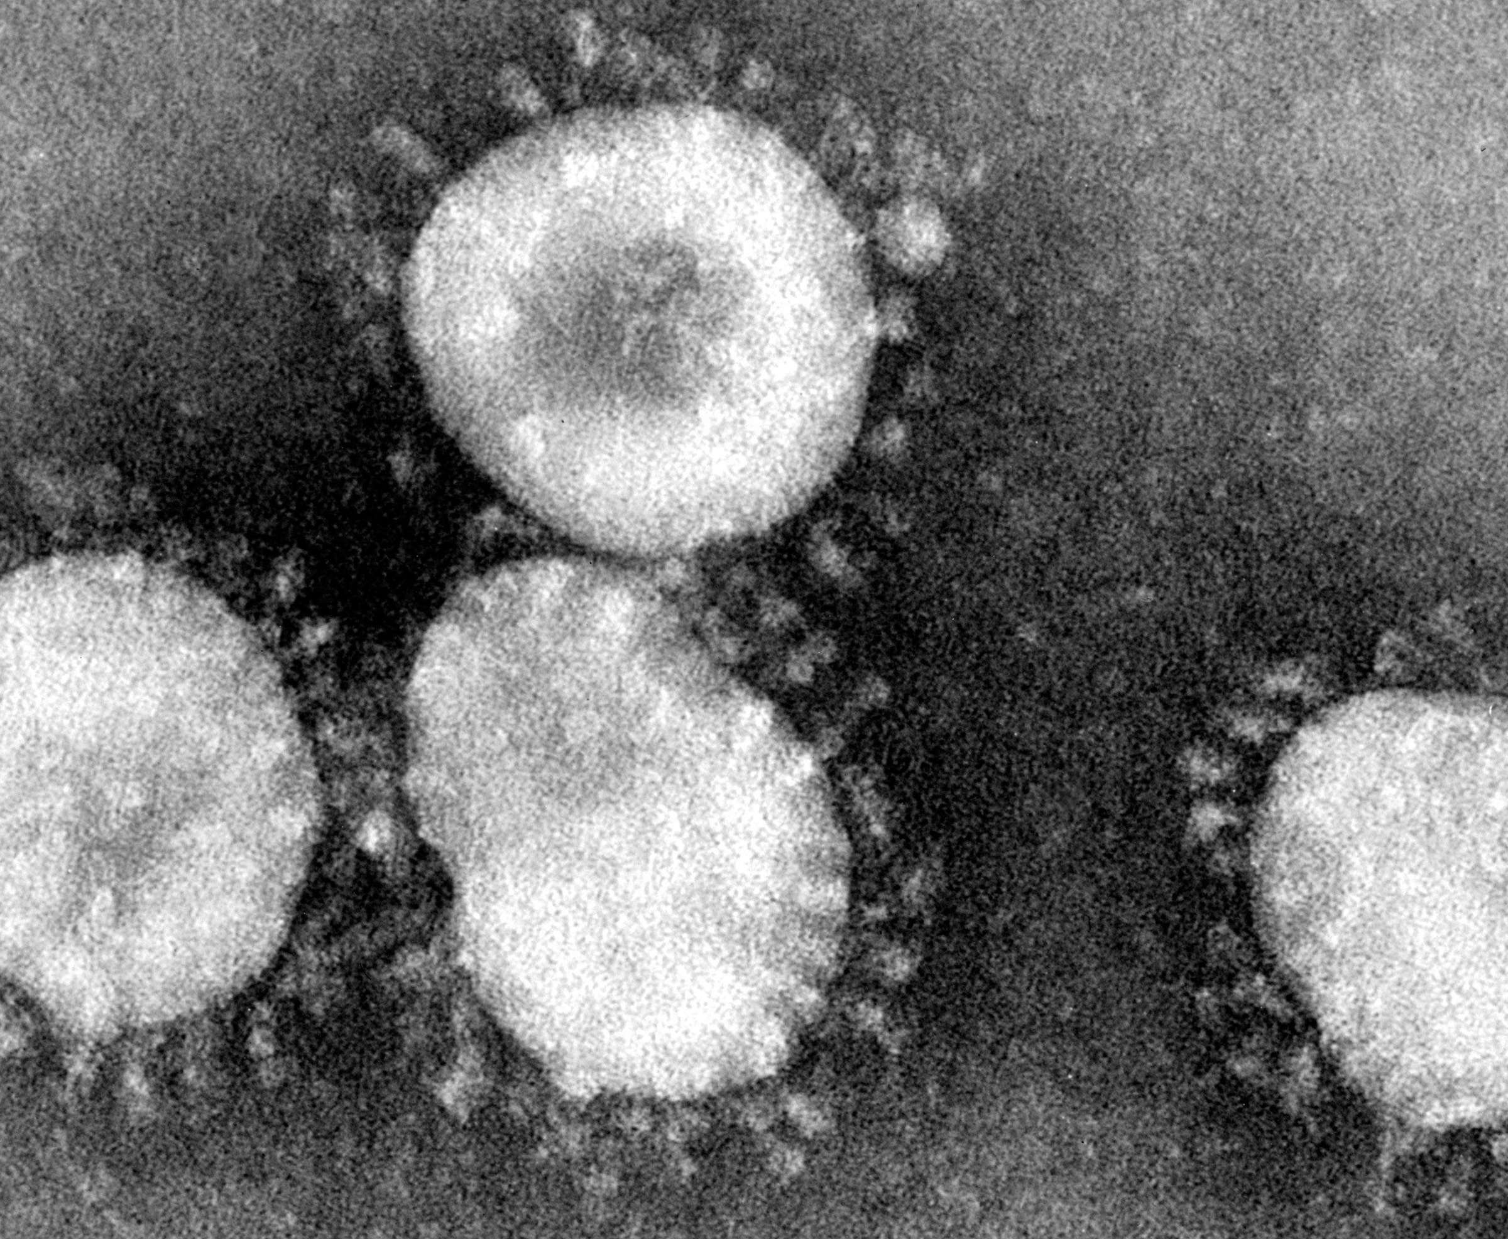
The pilot project II
In-vivo tracking of T-cells for Covid-19 as a second pillar
The experiment has developed in the context of the fast track access in regard to Corona-related research at DESY.
High interest of experts due to lack of data for Covid-19
Pre-studies approved by directorate
Safety issues are currently under discussion, then final approval of DIR
Goal: Demonstration of tracking multiple T-Cells as a reaction of Sars-CoV-2 infection
What: spatio-temporal tracking T-cells in a reaction of the immune system
Notes:
Entscheidung des DIR Anfang Januar für einen Pilotversuch.
Verantwortliche Abwägung aller Argumente für und gegen medizinische Kleintierbildgebung
3. Details zu dem Pilotversuch, was, wie und warum untersucht wird folgen von Samuel Huber (UKE) direkt im Anschluss
DESY Mission:
Wir erforschen auf höchstem internationalen Niveau die grundlegenden Zusammenhänge von Struktur und Funktion der Materie und schaffen damit die notwendige Wissensbasis zur Lösung der großen und drängenden Fragen von Gesellschaft
Mit DESYs Synchrotronstrahlungsquelle PETRA III stehen die technischen Möglichkeiten für solche medizinischen Untersuchungen zur Verfügung. Die gewonnenen Ergebnisse können helfen, neue Therapien und Medikamente für bisher unheilbare Krankheiten zu entwickeln.

Slide 13
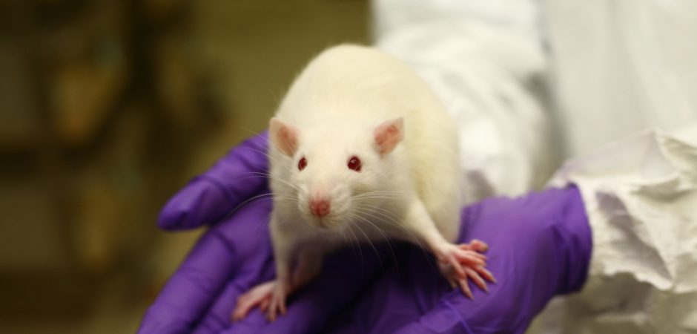
Good to know
Animal Welfare is a key element
Important facts:
No animal will die from synchrotron radiation! In advance calculated dose deposited in the mouse are far below threshold.
As part of the pilots, medical experts will do detailed analysis of radiation impact.
Authorities rank the measurement(s) at PETRA III as an experiment with low impact on the animals
Reduce: Not only the scientist gain information they would never get in the lab, they also need much less animals for their trails!
Compared to lab-based trials the usage of PETRA III
will reduce the # of animals by a factor defined by
the # of temporal steps!
DESY only provides the beam, no DESY staff is
directly involved in the experiment.
Notes:
The 75% is an estimate by Samuel Huber -> each case and experimental setting will have a different number when it comes to the possibilities in reducing animals in experimentation.

Slide 14
Bio-medical imaging
Legal context of animal experiments and processes

Slide 15
Animal Experiments today
Ongoing discussion and evolving standpoints in the society: Never just black or white
We can do with animals whatever we want
Humans and animals have the same status
Notes:
Spectrum with different standpoints
Today the legislative framework in Germany is somewhere in the middle ground when it comes to experiments with animals (as so many other topics in DE)
Very different perception on the different animals. In Hamburg the scandal last year at the LPT lab, which – apparenty very clearly - mistreated animals such as cats and dogs caused a rather substantial and legitimate outrage
Additional aspects, which very much shaped our perception today:
Grundsätze für Versuche am Menschen erstmals im Nürnberger Kodex 1947
Contergan Skandal, 1950er
Deklaration von Helsinki, 1964:
„Medizinische Forschung am Menschen muss den allgemein anerkannten wissenschaftlichen Grundsätzen entsprechen sowie auf einer gründlichen Kenntnis der wissenschaftlichen Literatur, anderen relevanten Informationsquellen, ausreichenden Laborversuchen und, sofern angemessen, auf Tierversuchen basieren. Auf das Wohl der Versuchstiere muss Rücksicht genommen werden.“ (Rev. Oktober 2013)
Tierschutzgesetz, 1972
Art. 20a GG:
„Der Staat schützt auch in Verantwortung für die künftigen Generationen die natürlichen Lebensgrundlagen und die Tiere im Rahmen der verfassungsmäßigen Ordnung durch die Gesetzgebung und nach Maßgabe von Gesetz und Recht durch die vollziehende Gewalt und die Rechtsprechung.

Slide 16
3Rs
Guiding Principles for Research with Animals
Replace: the use of animals with alternative techniques, or avoid the use of animals altogether.
Reduce: the number of animals used to a minimum, to obtain information from fewer animals or more information from the same number of animals
Refine: the way experiments are carried out, to make sure animals suffer as little as possible
„Responsibility“ towards human and animal life is emerging as the R #4.
A guiding principle in responsible research with animals: Drive the development of (new) alternatives, ensure replicability, transparency, responsibility towards society
Notes:
Good science and good animal welfare go hand in hand. If an animal is suffering stress or pain it could affect the results of the research. So it makes good scientific sense to house animals in the best possible conditions and make sure they get the best possible care from skilled and experienced carers.

Slide 17
Legislative Framework
Animal Protection is a national objective
Legislative texts: 2010/63/EU, TierSchG, TierSchVersV, VTMO
EU DIRECTIVE 2010-63 has been implemented in German law in 2013.
Different to some other countries in Germany the approval process for animal experiments has been with the local authorities, never with bodies or commissions within the research institutes.
Additional Context in the “Grundgesetz“ (German Constitution)
Art. 2(2) GG, 1949:
„Jeder hat das Recht auf Leben und körperliche Unversehrtheit.“ -> Right to physical integrity
Art. 5 (3) GG, 1949:
„Kunst und Wissenschaft, Forschung und Lehre sind frei.“ -> freedom for art and science, research and teaching
Notes:
Additional amendments to the German „Tierschutzgesetz“/ animal protection law passed in 2013 are expected to be passed by the „Deutscher Bundestag“ in 2021. As requested by the EU commisssion. Experts predict slight procedural changes
Rules and definitions are strict, for example animal exoeriments are only allowed when they are proven to be essential! This goes for fundamental research

Slide 18
Animal experiments: When is it allowed?
Medical Applications
Legislative Framework Sets Limits
Which Animals?
Applicable for: Vertebrates, Cephalopods, Decapods (or their genotype)
Does not apply to: (painfree) euthanization of these animals
ÜBERARBEITUNG MAIKE
Basic Research
Drug Development
Identification of hazardous materials for the environment
Development of cosmetics, detergents, products with tobacco
Safety assessments
Development of and testing of any arms

Slide 19
Animal experiments: Statistics in Germany
Type of animals used in experiments
In 2018, in Germany appr. 2.1 Mio. animals were used for animal experiments.
In Hamburg, 260.000 animals were used for trials. About 200.000 at UKE, others at HPI, BNITM and Evotec SE. (Not all of them for experiments, also for the development of mouse models)

Slide 20
Defined Approval Process for Every Experiment
Approval by Local Authorities Only and Always a Case-by-case Decision
Local Administration: Approval
Executes
Application
Scientist
Project
Approval
Approval Process
Appointment
Consultation
Consults
Controls
Controls
Animal Experiment
Committe on Animal Welfare
Local Administration
Animal Welfare Officer
Notes:
Animal Welfare Committees: Tierschutzkommission: Members are from different backgrounds: - experts from animal welfare organisations, veterinarians, biomedical scientific background (fundamental research), medical doctors, liberal arts scolars (e.g. ethics)…
The application / proposal for an experiment needs to prove the folloowing: no alternative methods for addressing the research question.
Animal welfare officers are most often veterinarians by training. every lab / clinic etc. conducting experiments needs between one and several employees to fulfill the role (depending on size).
For an experiment to gain approval a researcher calculates today between 9 months to a year. All applications need to be precise and are only submitted after revisions by the animal welfare officer. For example a fairly exact number of animals need to be calculated, which requires detailed planning.
Animal welfare officer / Tierschutzbeauftragter / important role in a lab:
veterinarian, medical doctor or biologists by training:
not subjected to instructions (as for the radiation protection at DESY)
Key contact between scientists and the local authorities: both can address the animal welfare officer with questions.
Consults researchers during the whole process in writing the application,
cooperation with veterinarians by the local authorities,
controls animal care/ breeding etc. within the lab.

Slide 21
Defined Approval Process for Every Experiment
Approval by Local Authorities Only and Always a Case-by-case Decision
Animal Welfare Officer
Local authorities advised by
Animal welfare committee
At least 1/3 of members nominated by animal protection associations
Rest of members are experts, medical doctors and scientists
Usually, the authorities follow the statement of the committee
Notes:
Animal Welfare Committees: Tierschutzkommission: Members are from different backgrounds: - experts from animal welfare organisations, veterinarians, biomedical scientific background (fundamental research), medical doctors, liberal arts scolars (e.g. ethics)…
The application / proposal for an experiment needs to prove the folloowing: no alternative methods for addressing the research question.
Animal welfare officers are most often veterinarians by training. every lab / clinic etc. conducting experiments needs between one and several employees to fulfill the role (depending on size).
For an experiment to gain approval a researcher calculates today between 9 months to a year. All applications need to be precise and are only submitted after revisions by the animal welfare officer. For example a fairly exact number of animals need to be calculated, which requires detailed planning.
Animal welfare officer / Tierschutzbeauftragter / important role in a lab:
veterinarian, medical doctor or biologists by training:
not subjected to instructions (as for the radiation protection at DESY)
Key contact between scientists and the local authorities: both can address the animal welfare officer with questions.
Consults researchers during the whole process in writing the application,
cooperation with veterinarians by the local authorities,
controls animal care/ breeding etc. within the lab.

Slide 22
Defined Approval Process for Every Experiment
Approval by Local Authorities has a high quality in terms of balancing
Quelle: Tierversuche verstehen e.V.
With the approval of the authorities, all the detailed and ethical relevant questions are answered!!!
- This procedure is valid for every experiment (scientific or industrial) -
Notes:
Animal Welfare Committees: Tierschutzkommission: Members are from different backgrounds: - experts from animal welfare organisations, veterinarians, biomedical scientific background (fundamental research), medical doctors, liberal arts scolars (e.g. ethics)…
The application / proposal for an experiment needs to prove the folloowing: no alternative methods for addressing the research question.
Animal welfare officers are most often veterinarians by training. every lab / clinic etc. conducting experiments needs between one and several employees to fulfill the role (depending on size).
For an experiment to gain approval a researcher calculates today between 9 months to a year. All applications need to be precise and are only submitted after revisions by the animal welfare officer. For example a fairly exact number of animals need to be calculated, which requires detailed planning.
Animal welfare officer / Tierschutzbeauftragter / important role in a lab:
veterinarian, medical doctor or biologists by training:
not subjected to instructions (as for the radiation protection at DESY)
Key contact between scientists and the local authorities: both can address the animal welfare officer with questions.
Consults researchers during the whole process in writing the application,
cooperation with veterinarians by the local authorities,
controls animal care/ breeding etc. within the lab.

Slide 23
Control during the Experiment
The PI is legally responsible that al conditions are as approved by authorities
Specific Animal Welfare Officer
For each project
Has the right to interrupt and even stop the experiment
Notes:
Animal Welfare Committees: Tierschutzkommission: Members are from different backgrounds: - experts from animal welfare organisations, veterinarians, biomedical scientific background (fundamental research), medical doctors, liberal arts scolars (e.g. ethics)…
The application / proposal for an experiment needs to prove the folloowing: no alternative methods for addressing the research question.
Animal welfare officers are most often veterinarians by training. every lab / clinic etc. conducting experiments needs between one and several employees to fulfill the role (depending on size).
For an experiment to gain approval a researcher calculates today between 9 months to a year. All applications need to be precise and are only submitted after revisions by the animal welfare officer. For example a fairly exact number of animals need to be calculated, which requires detailed planning.
Animal welfare officer / Tierschutzbeauftragter / important role in a lab:
veterinarian, medical doctor or biologists by training:
not subjected to instructions (as for the radiation protection at DESY)
Key contact between scientists and the local authorities: both can address the animal welfare officer with questions.
Consults researchers during the whole process in writing the application,
cooperation with veterinarians by the local authorities,
controls animal care/ breeding etc. within the lab.

Slide 24
Bio-medical imaging
DESY as a perfect ecosystem

Slide 25
Snychrotron Radiation and Health Research
Research areas at PETRA III (2019)
3 % Transport und Aerospace
13 % Enabling Technologies
30 % Health and Life Sciences
15 % Earth and Environment
22% Energy
17 % Key Technologies
Notes:
Here you can see the share of different areas where Synchrotron radiation can be used for experiments.
Health and life sciences are already today the largest field of research

Slide 26
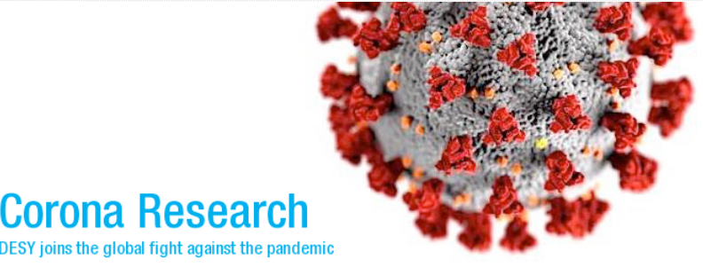
Recent and dynamic research field: SARS-CoV-2
X-ray screenings of proteins
Taking medicine the right way
Computing power for Corona research
Qick testing of virus infection
In preparation: in-vivo imaging with BNTIM and UKE
More info: https://www.desy.de/news/corona_research/index_eng.html
Notes:
Here you can see the share of different areas where Synchrotron radiation can be used for experiments.
Health and life sciences are already today the largest field of research
Impressive example is the screening with the team of Alke Meents

Slide 27
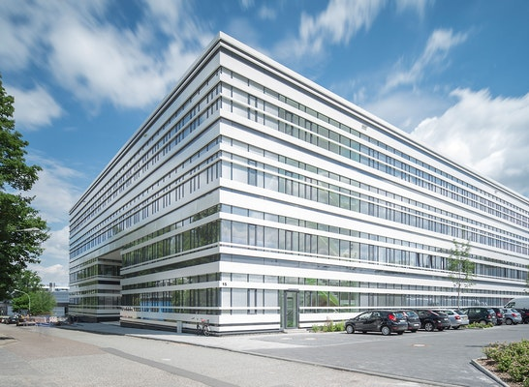
DESY as a dynamic ecosystem for Health R&D
Strong partners strengthen the ability to make an impact in medical research and develepment
Strong partners in
Nothern Germany
CSSB as reasearch hub for infection-
related aspects
Notes:
Here you can see the share of different areas where Synchrotron radiation can be used for experiments.
Health and life sciences are already today the largest field of research

Slide 28
DESY as world-leading accelerator lab
DESY‘s mission is to development new methods and technologies to support high impact research
New accelerator technologies
as core mission
Maximizing usage of accelerator-based
sources for the good of the society
FLASH
Continuously increase the user base of our technologies
Being the driver for new methods
Being a test bed for new methods and technologies
Bringing people together for new cases
Generating new cases from DESY‘s research portfolio
PETRA III
XFEL
FLASH2020
PETRA IV
CW XFEL?
Compact Sources
Notes:
Here you can see the share of different areas where Synchrotron radiation can be used for experiments.
Health and life sciences are already today the largest field of research

Slide 29
Practice at other synchrotron light sources
Other synchrotrons conducting in-vivo imaging experiments together with partners
Full programme
incl. infrastructure (transport, accomodation)
ID17- Biomedical Beamline
experiments in-vitro or in-vivo in two endstations (PC)
Close collaboration with university hospital
experiments for several years
long-term programs collaboration with the main hospital of Trieste
ongoing long-term clinical study on human patients plans to expand the programme (Elettra 2.0)
The Imaging and Medical beamline (IMBL) for in-vivo imaging of small animals
longitudinal studies to be undertaken that may reduce the number of animals used for biomedical research purposes
SwissFEL & SLS: occasional animal experiments
e.g. isolating isotopes for radiopharmacy research
Network of clinical partners (e.g. hospitals) and partner companies (e.g. pharmaceutical industry)
Not yet in place but, biomedical imaging experiments based on the mouse model are in planning
Currently collaboration with other facilities
Notes:
ESRF: Full Programme including animal house for transit and long stay, ID17- Biomedical Beamline: https://www.esrf.eu/UsersAndScience/Experiments/CBS/ID17
Applications: : Examples of applications include preclinical radiation therapy, radiation biology studies using monochromatic beams, preclinical brain microsurgery, in-vitro phase contrast imaging (mammography, cartilage studies, etc.), functional imaging: bronchography (large volume or time resolved), and paleontology studies using 3D high-resolution imaging of samples requiring a wide beam (skulls, bones, etc.).
Australian Synchrotron:
https://www.ansto.gov.au/user-access/instruments/australian-synchrotron-beamlines/imaging-and-medical#content-introduction--2
http://archive.synchrotron.org.au/31-australian-synchrotron/imbl/809-preparation-for-animal-experiments
Info: Diamond does not currently allow any experiments to be performed on any live animals, though tissue taken from animals can be studied. However, there is a new institute - The Rosalind Franklin Institute (https://www.rfi.ac.uk/ ) - being set up alongside Diamond to facilitate the development of new techniques applied to medicine

Slide 30
Bio-medical imaging
Summary and Outlook

Slide 31
Directorate‘s Decision
Check list:
Convincing case and scientific motivation?
Strong consortium of excellent people and
institutes?
High societal impact?
Technical Visibility at PETRAIII?
Full approval of experiments by authorities?
Directorate approved first steps towards using PETRA
for animal experiments
First pilot project with two pillars is approved and in preparation
Workshops and interviews are organized for checking the needs of the community
Contact to LEAPS partners with in-vivo beamlines
Discussions with federal Government about DESY‘s contribution to the post-Corona time
Strategy for PETRA IV
*
*Valid for the CD project pillar, Covid-19 is in preparation
Also for future in-vivo experiments the Directorate
will be the decision level.
Notes:
-> this is initiated by researchers of the different mentioned research institutes, science ciooperation
-> via the Corona fast track access

Slide 32
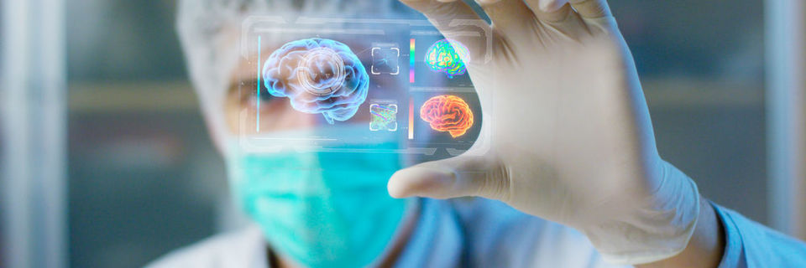
Outlook: DESY with a high impact due to animal experiments
Support to fight back infections and to reduce and replace animal experiments
In a crisis like we have right now: TIME IS A FACTOR!
Big bottle neck: Development of a decent mouse model
Key is the early detection of immune response
Setting up a program together with partners
Using a synchrotron in combination with the current methods can support the mission of the 3R
Reduce (non-invasiv methods)
Replace (support comparison trails for alternatives)
Refine
Setting up a program together with partners
Notes:
Good science and good animal welfare go hand in hand. If an animal is suffering stress or pain it could affect the results of the research. So it makes good scientific sense to house animals in the best possible conditions and make sure they get the best possible care from skilled and experienced carers.

Slide 33
3Rs
Guiding Principles for Research with Animals
Replace: the use of animals with alternative techniques, or avoid the use of animals altogether.
Reduce: the number of animals used to a minimum, to obtain information from fewer animals or more information from the same number of animals
Refine: the way experiments are carried out, to make sure animals suffer as little as possible
„Responsibility“ towards human and animal life is emerging as the R #4.
A guiding prínciple in responsible research with animals: Drive the development of (new) alternatives, ensure Reproduzierbarkeit, Translation, Transparenz, Verantwortung gegenüber der Gesellschaft
Notes:
Good science and good animal welfare go hand in hand. If an animal is suffering stress or pain it could affect the results of the research. So it makes good scientific sense to house animals in the best possible conditions and make sure they get the best possible care from skilled and experienced carers.

Slide 34
Questions & Answers
More information will follow soon
?
!
A detailed document with answers to your questions will follow by the end of this month. In English and German.
In the meantime you can get directly in touch:
Arik Willner
Tel.- 4888
arik.willner@desy.de
With thanks to the initiative of Germany‘s research organisations “Tierversuche verstehen“ for information and images.

