Slide 1
Notes:
Slide 1: Company Logo Full Page
Before you start editing the slides of your talk change to the Master Slide view:
Microsoft Office :Menu: View > Slide Master;
Macintosh – View > Master > Slide Master
Edit the following items:
On the Slide Master (first master slide) – lower area
a) On the left Delete the text and write the title of the event/Conference, Location
b) On the right delete the text and write the name and surname of the speaker and the date (day, month , year)
Close Master View

Slide 2

Synchronization needs for future seeding in FL1
E. Allaria
Notes:
Slide 2: Title of the Presentation
Before you start editing the slides of your talk change to the Master Slide view:
Microsoft Office :Menu: View > Slide Master;
Macintosh – View > Master > Slide Master
Edit the following items:
On the Slide Master (first master slide) – lower area
a) On the left Delete the text and write the title of the event/Conference, Location
b) On the right delete the text and write the name and surname of the speaker and the date (day, month , year)
Close Master View
To start adding slides insert a new slide and select a Layout:
For Title & Subtitle
For text with bullet points
For Text
For Picture, graphs, visuals
Two columns
Blank

Slide 3
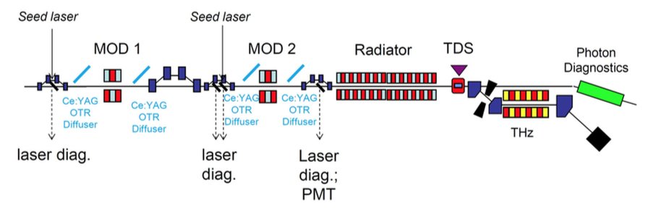
FLASH 2020+
The FLASH upgrade program considers the conversion of FL1 to a seeded FEL in the 60nm – 4 nm.
Current design relies on EEHG and APPLE III undulators for polarization control.
Seeding has different requirements than SASE and new hardware is needed.
Seeding on FL1 need to be compatible with SASE and advanced operational modes of FL2.

Slide 4
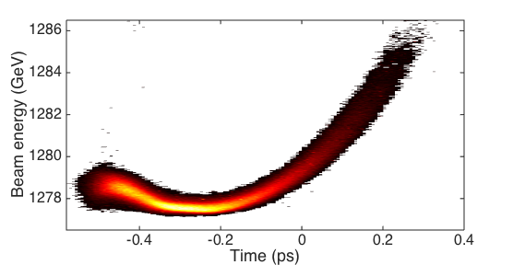
Electron beam for seeded FELs
Current spikes are not suitable for seeded FELs.
Low energy spread and flat phase space are required for seeding.
Electron beam optimization is different than for a SASE FEL.
Moderate compression is used.
Only electrons interacting with the laser participate to the FEL emission.
Phase space nonlinearities may counteract the benefits of the seed.
Electron beam parameters
 | FERMI | FLASH
Charge | 700 | 250 | pC
Peak current | ~700 | 500 | A
Energy | 1.0 - 1.5 | 0.7 - 1.3 | GeV
Energy spread | ~150 | 150 | keV
Energy chirp | ~3 | ~8 | MeV
Emittance | 1 | 0.6 | mm mrad
Size (rms) | ~100 |  | μm
FERMI e-beam phase space.

Slide 5

E-beam timing jitter
A short seed is used to initiated the FEL process.
Only seeded electrons produce FEL.
Seed
FEL
Independently on the e-beam arrival time FEL timing is determined by the seed laser.
Seeded FEL are not affected by e-beam timing jitter

Slide 6
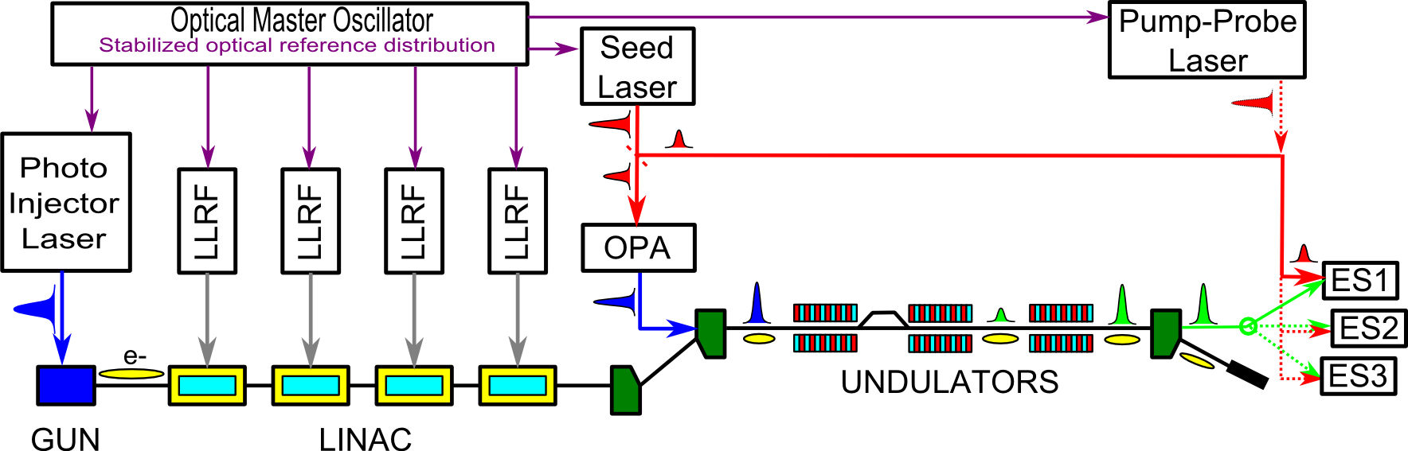
SYNCHRONIZATION ASPECTS
TiS
Amp
EOS
MUST HAVE
Low phase noise Timing Ref distribution with drift compensation: stabilized fibre link based
Seed Laser&Pump-probe laser:
Low phase noise mode-locked oscillator(s) with optical locking (BOCC based) to the
timing Ref
Timing drift stabilization of Regen Amplifiers
GOOD TO HAVE
Seed Beam transport drift stabilization
Timing tool at experimental stations in case of sub-5 fs Pump-Probe resolution request
Courtesy of M. Danailov (Elettra)

Slide 7
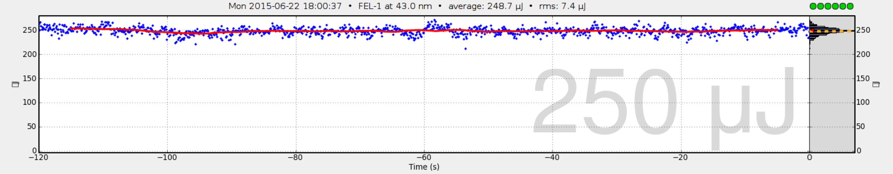
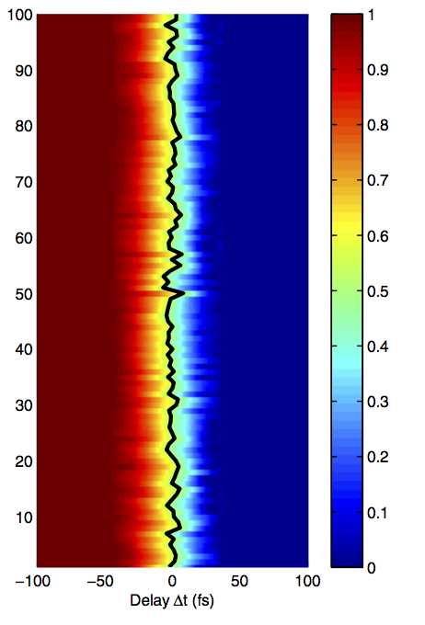
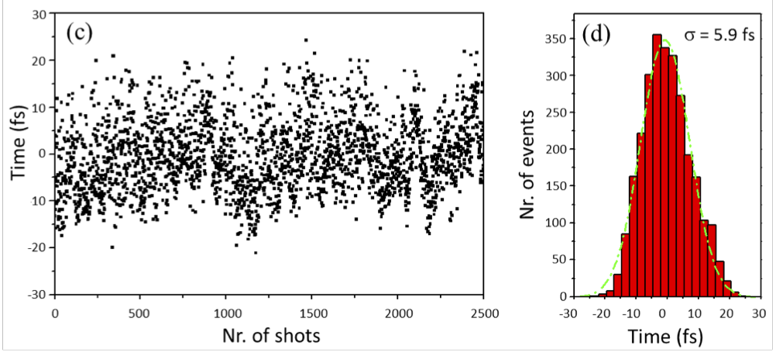
Energy stability and temporal jitter
Energy per pulse fluctuations typical 10-15% rms on FEL-1
FEL-1 saturated @43 nm
3% rms
Thanks to the the seeding, the temporal jitter of the FEL is very low.
2.2 fs from P. Finetti et al. Phys. Rev. X 7, 021043 (2017)
Temporal jitter < 6 fs
M. Danailov et al. Optics Express, Vol. 22, Issue 11, 12869 (2014)

Slide 8
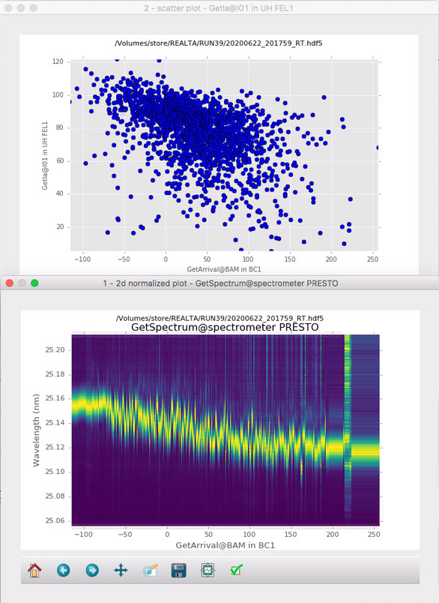
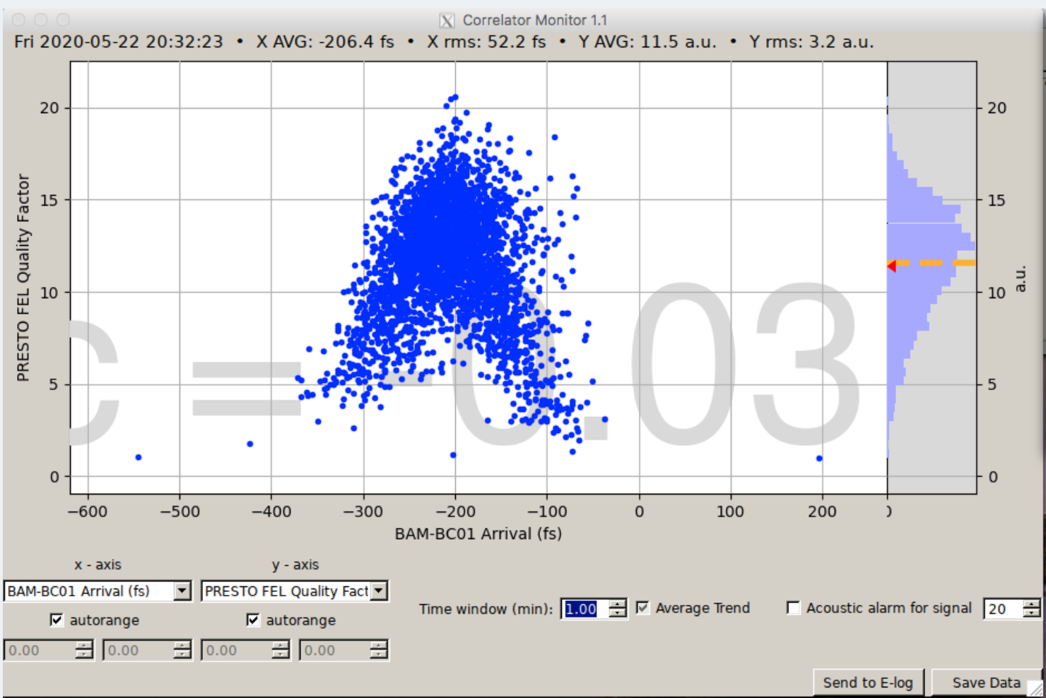
But …
e-beam timing jitter results in seeding electrons with different properties.
It affects FEL efficiency
It affects FEL quality

Slide 9
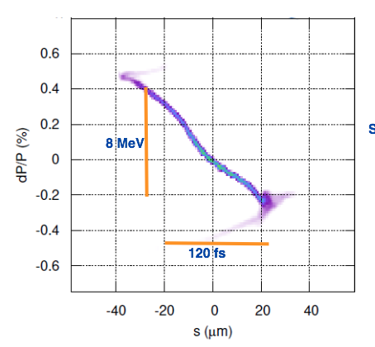
FLASH e-beam
FLASH linac cavities does not suffer from strong wakefields as FERMI:
No quadratic chirp
High linear chirp
Local energy chirp ~ 80keV/fs.
With 10 fs timing jitter, energy of seeded electron will change by about 10⁻³ significantly affecting the FEL gain.
Higher order chirp will affect spectrum quality and stability.

Slide 10
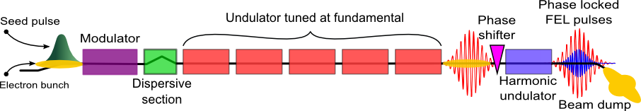
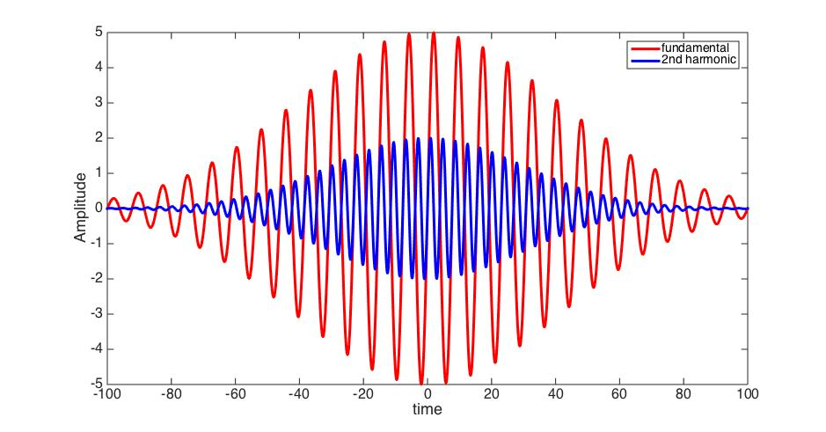
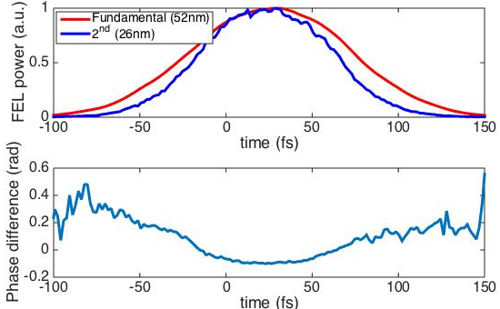
Advanced modes: Coherent control
With longitudinal coherent pulses one can produce pulses with a controlled phase difference.
GINGER simulations
The simplest possibility relies on the generation of a second harmonic pulse phase locked to the main pulse.

Slide 11
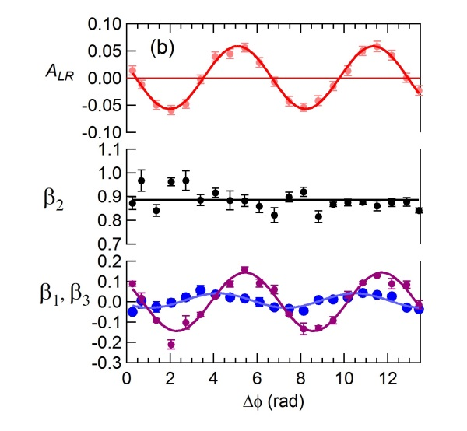
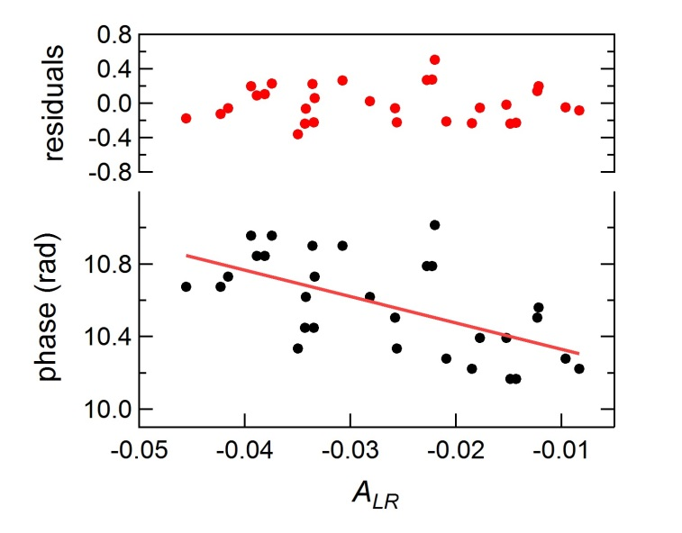
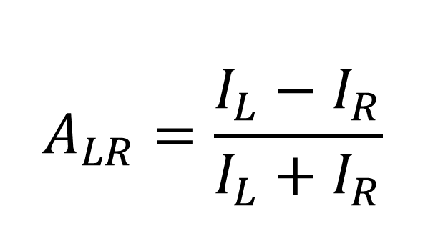
Phase control limit
The asymmetry A_{LR} of electron distribution shows clear oscillations are present, with a period 2π rad or 105 as.
At the maximum sensitivity position results indicates a resolution of 3.1 as
This is also affected by fluctuations related to timing jitter.
K. Prince, et al. Nature Photon. 10, 176–179 (2016)

Slide 12
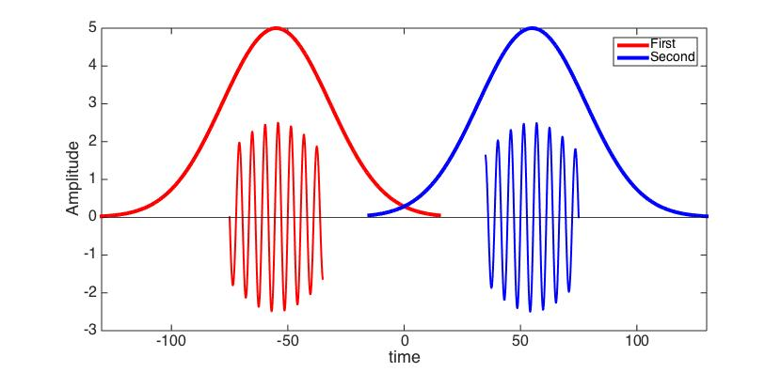
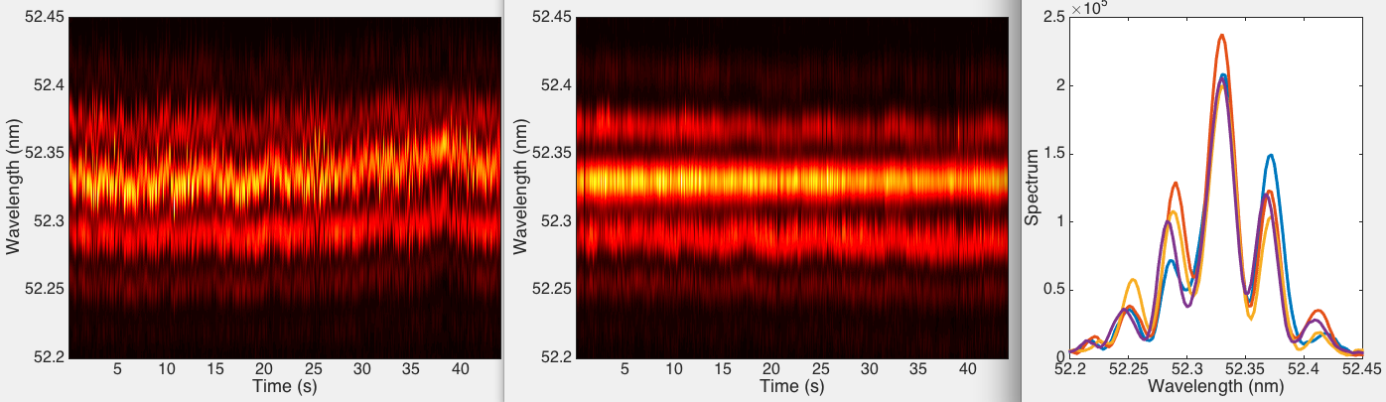

Phase-locked FEL pulses
Twin seed pulses
Twin FEL pulses
Laser pulse
τ
Dispersive section
modulator
radiator
τ
spectrometer
e⁻ beam
µ-controled
birefringent plate
to beamlines
Twin seed-e⁻ beam interaction
τ
1/τ
ΔΦ
Δφ
τ
Δϕ_{SEED}
With two seed lasers one can control and change the relative time between two FEL pulses. For coherent pulses, a fine tuning allows to control the relative phase between the two FEL pulses.
Interference between two coherent and phase-locked pulses is evident in the spectral domain.
D. Gauthier et al., Phys. Rev. Lett. 116, 024801 (2016)

Slide 13
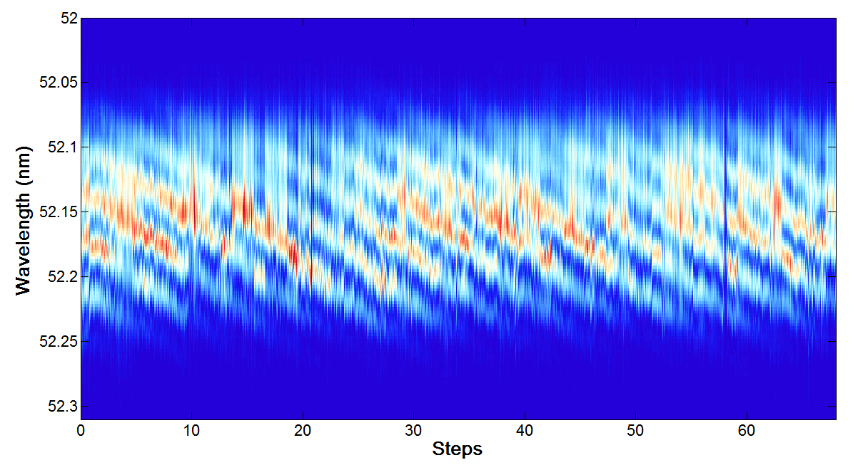
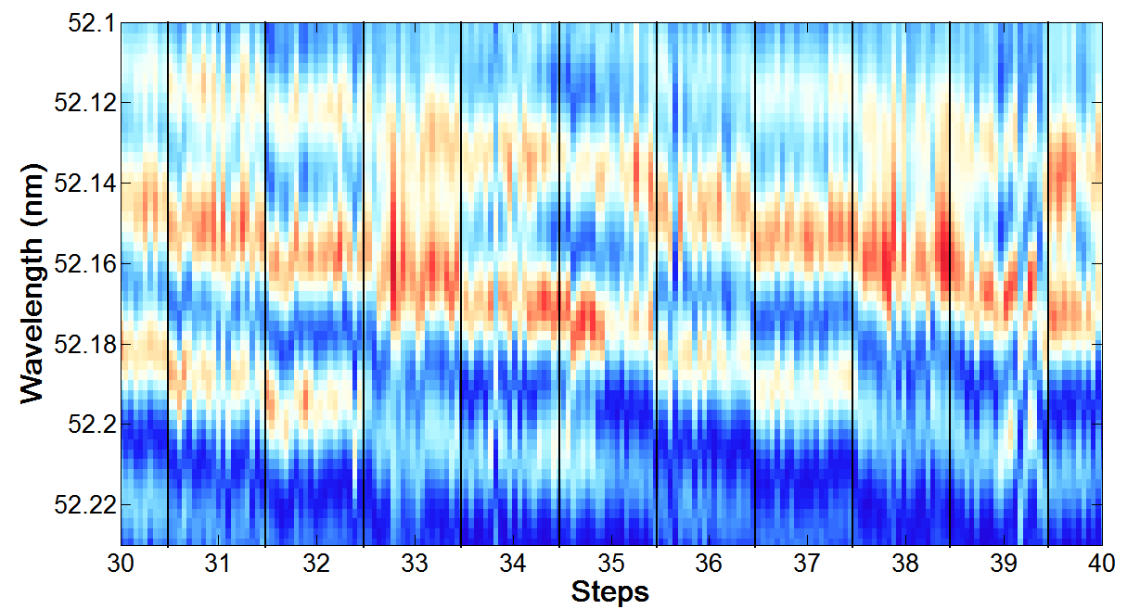
FEL phase-locking control
Relative phase between the seed pulses with changed with Δϕ_{seed} ~ 12º@260nm
corresponding to changes of the phase between FEL pulses by Δϕ_{FEL} ~ 60º@52nm
Interferogram
This correspond to a control with ~ 30 as resolution.
ΔΦ_{FEL} = 2π
Δϕ_{SEED} (a.u.)
Fringe instability is associated to wavelength jitter of the spectral envelope and is correlated with electron bunch compression monitor.
Zoom of the central part
Higher resolution to ~ as requires a better control of the electron beam phase space and reduced timing jitter

Slide 14
Conclusions
Seeded FEL is less demanding in terms of e-beam timing jitter if only considering synchronization of FEL to a pump&probe laser.
Advanced FEL operation modes ask for better synchronization between e-beam and seed laser.
Long term drifts can usually be properly compensated as long as one has proper signal to monitor.

Slide 15
Notes:
Last Slide 1: Thanks to the audience

Slide 16
16
Notes:
Last Slide 2: Aerial Photo of Elettra

