Slide 1
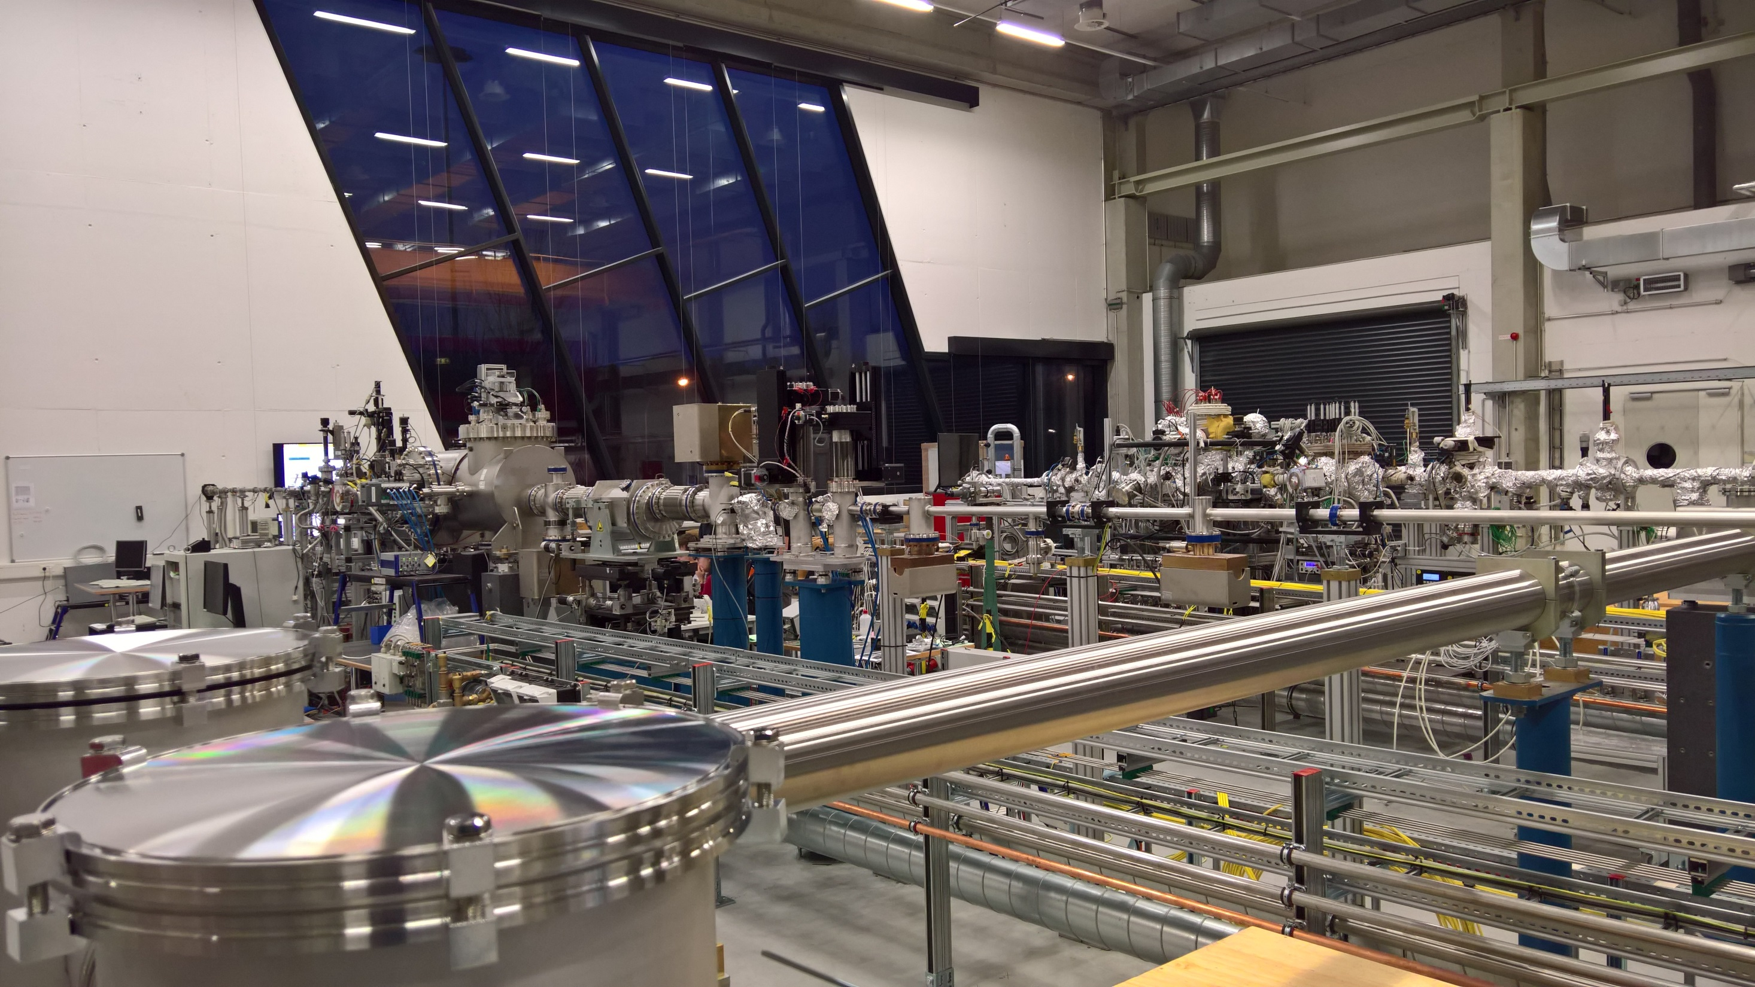
XUV-Photon Arrival Diagnostics: status and plans
Stefan Düsterer
For the arrival time team: Ch. Gerth, B. Manschwetus, J. Müller, S. Schulz, K. Tiedtke, S. Toleikis, …
And the THz streaking team: I. Bermudez, R. Ivanov, …
Mini-Workshop on Synchronization for FLASH2020+, 25.6.2020

Slide 2
Outline
XUV arrival time measurements
Different methods
THz streaking
“Plasma switch”
others
Limits
Plans for next steps
Future Ideas

Slide 3
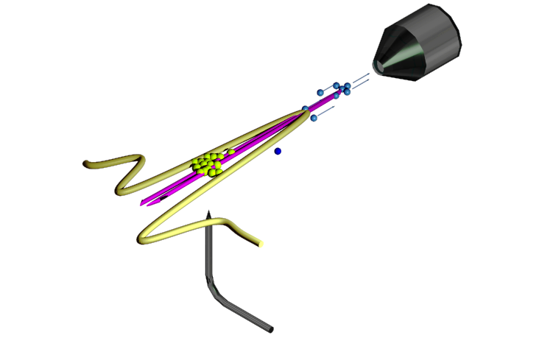
THz streaking setup
At FL21
Optically synched Oscillator
(1030 nm Origami)
10 Hz Regenerative amplifier
4 mJ, ~ 1ps
( >>100 m amplification path)
THz production
THz
XUV
photoelectron
Single-cycle
THz pulse
Electron TOF
spectrometer
R. Ivanov, et al. J. Synchrotron Rad. 25, 26-31 (2018)
R. Ivanov, et al. J. Phys. B, accepted (2020)
sample
Soft X-ray
Gas jet

Slide 4
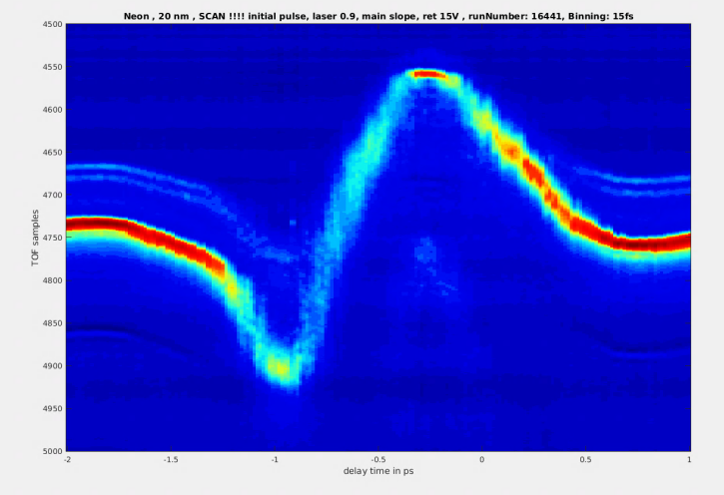
THz Streaking principle
Single pulse resolved measurement
Scalable to high repetition rates (~100 kHz)
(almost) non-invasive
online monitoring
E_{kin}
Streaking trace
Photoelectron
spectrum
XUV pulse
time
Nat. Photonics 3, 523 (2009), Nat. Photonics 6, 852 (2012)

Slide 5
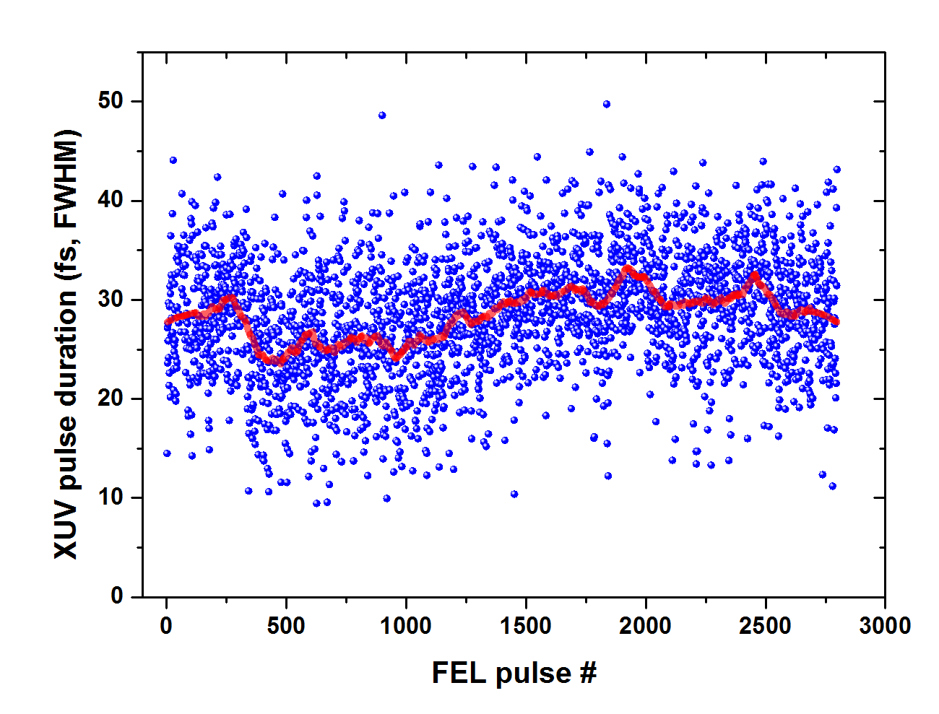
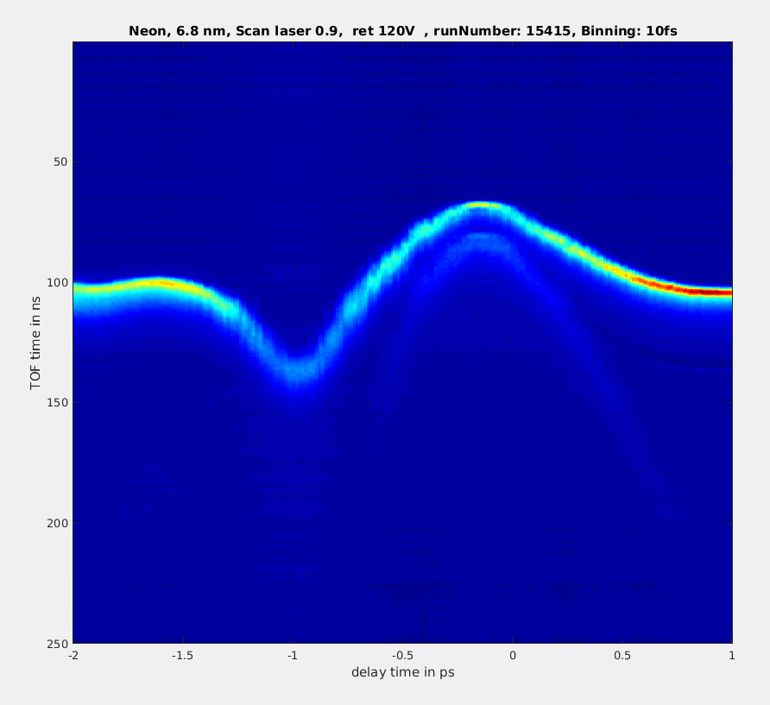
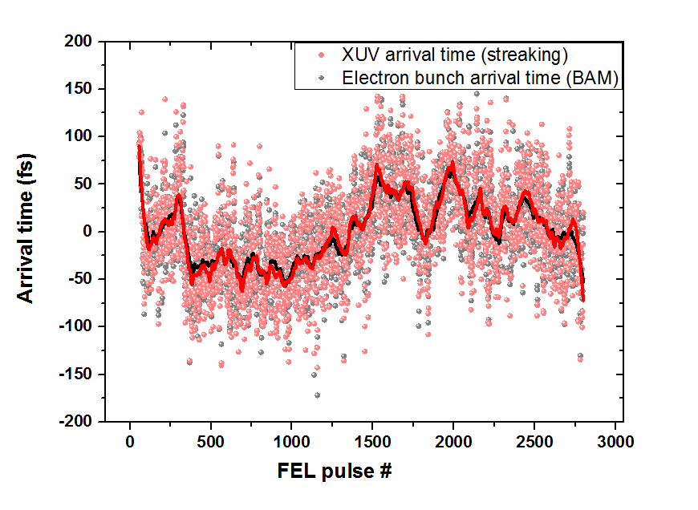
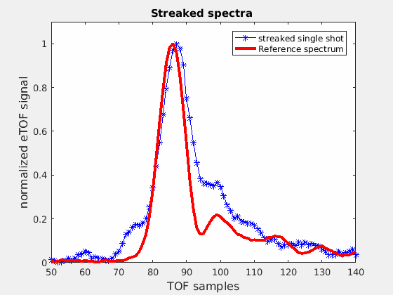
THz Streaking - observables
Single shot XUV pulse duration
Streaking raw data
(delay scan)
TOF trace
-1.5ps 0 ps 1.5ps
Arrival
time
Laser delay

Slide 6
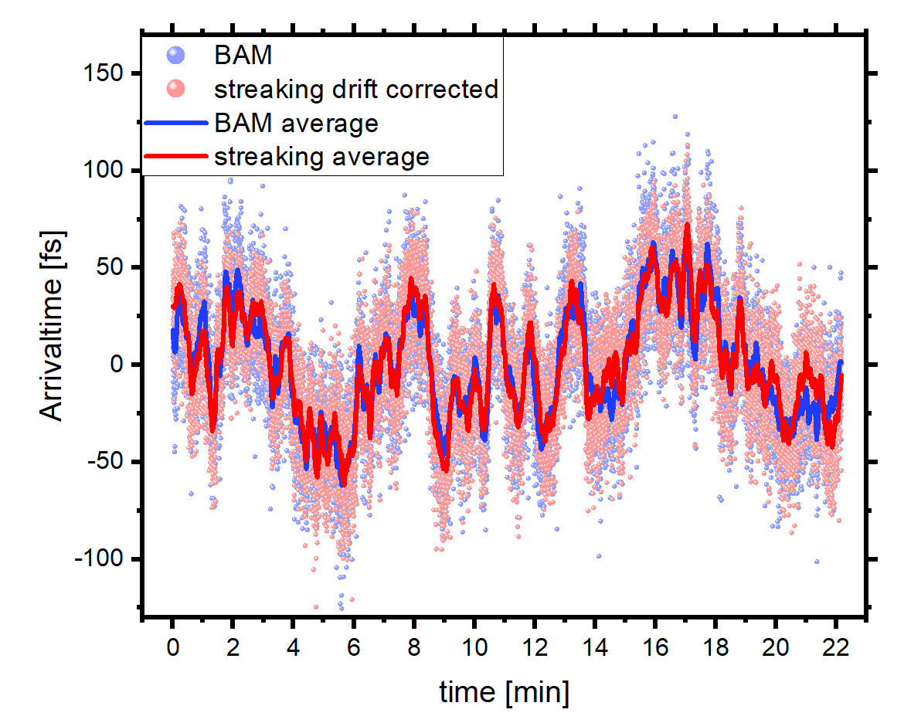
THz streaking: Arrival time measurements
Correlation width < 30 fs FWHM !
Measuring electron bunch arrival time 200 m away from the experiment
Comparing to streaking laser vs XUV pulse

Slide 7
THz-streaking: Uncertainties / Limits
Slow drifts:
Short term
Fitting error: ~ 1-2 fs
Wavelength fluctuations: ~2-4 fs
Long term (minutes)
Drifts in the laser amplifier ~ 100 fs
In general: calibration of the streaking ~ 10% ??
-> Measure reference spectrum
-> cross correlator
will be quite challenging for > 1 ps pulses ☹
Frequency components
-> get more experience with setup …

Slide 8
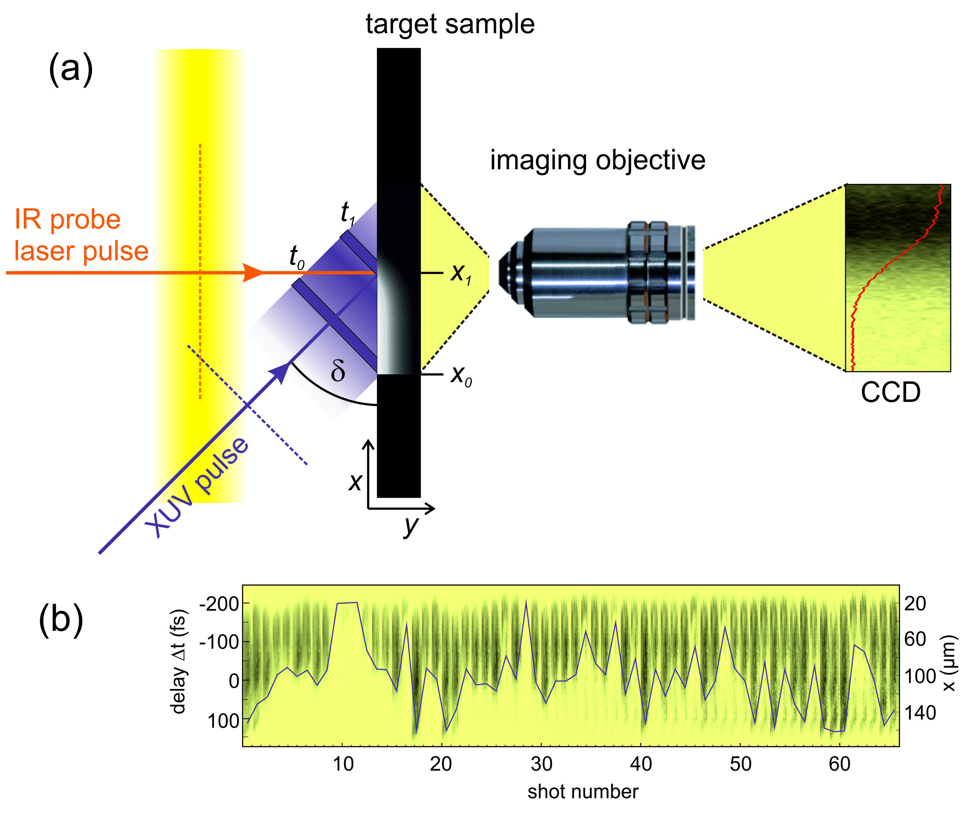
Plasma switch scheme
“spatial encoding”
“spectral encoding”
Glass target
CCD
Laser @ 800 nm, 40 fs
(probe)
FEL @ 8 keV, 40 fs
(pump)
Plasma shadow
Shadowgraphy technique where we optically image (e.g. 800 nm) a high free electron density created by an intense XUV/X-ray FEL pulse
Used at FLASH [1-4] and extended at LCLS to 8 keV [5]
Development of an FEL pulse arrival tool
[1] C. Gahl, et al., Nature Photonics 2, 165 (2008)
[2] T. Maltezopoulos, et al. New J. Phys. 10, 033026 (2008).
More papers at : https://confluence.desy.de/display/FLASHUSER/FLASH+beamlines+and+instruments+references
[3] M. Harmand et al., JINST 7, P08007 (2012) [4] R. Riedel et al., Nature Comm. 4, 1731 (2013)
[5] M. Harmand et al., Nature Phot. 7, 215 (2013)

Slide 9
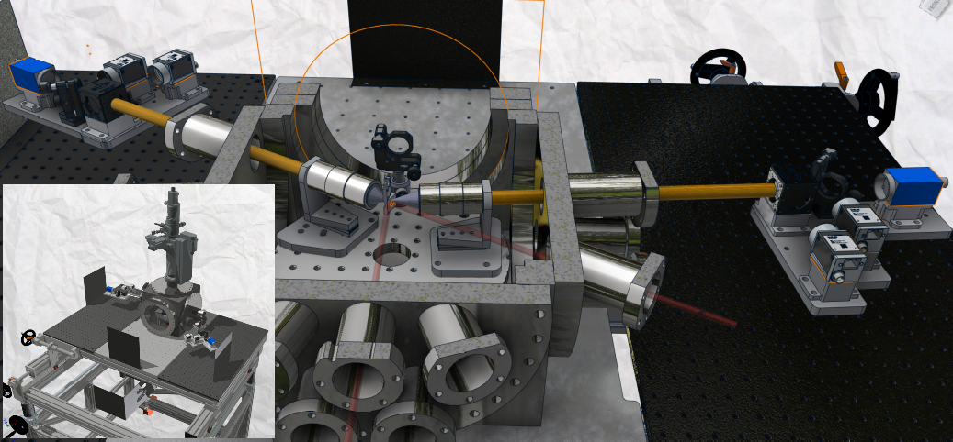
XUV-PUMA Setup
Transmission
Reflection
FEL
Probe Laser

Slide 10
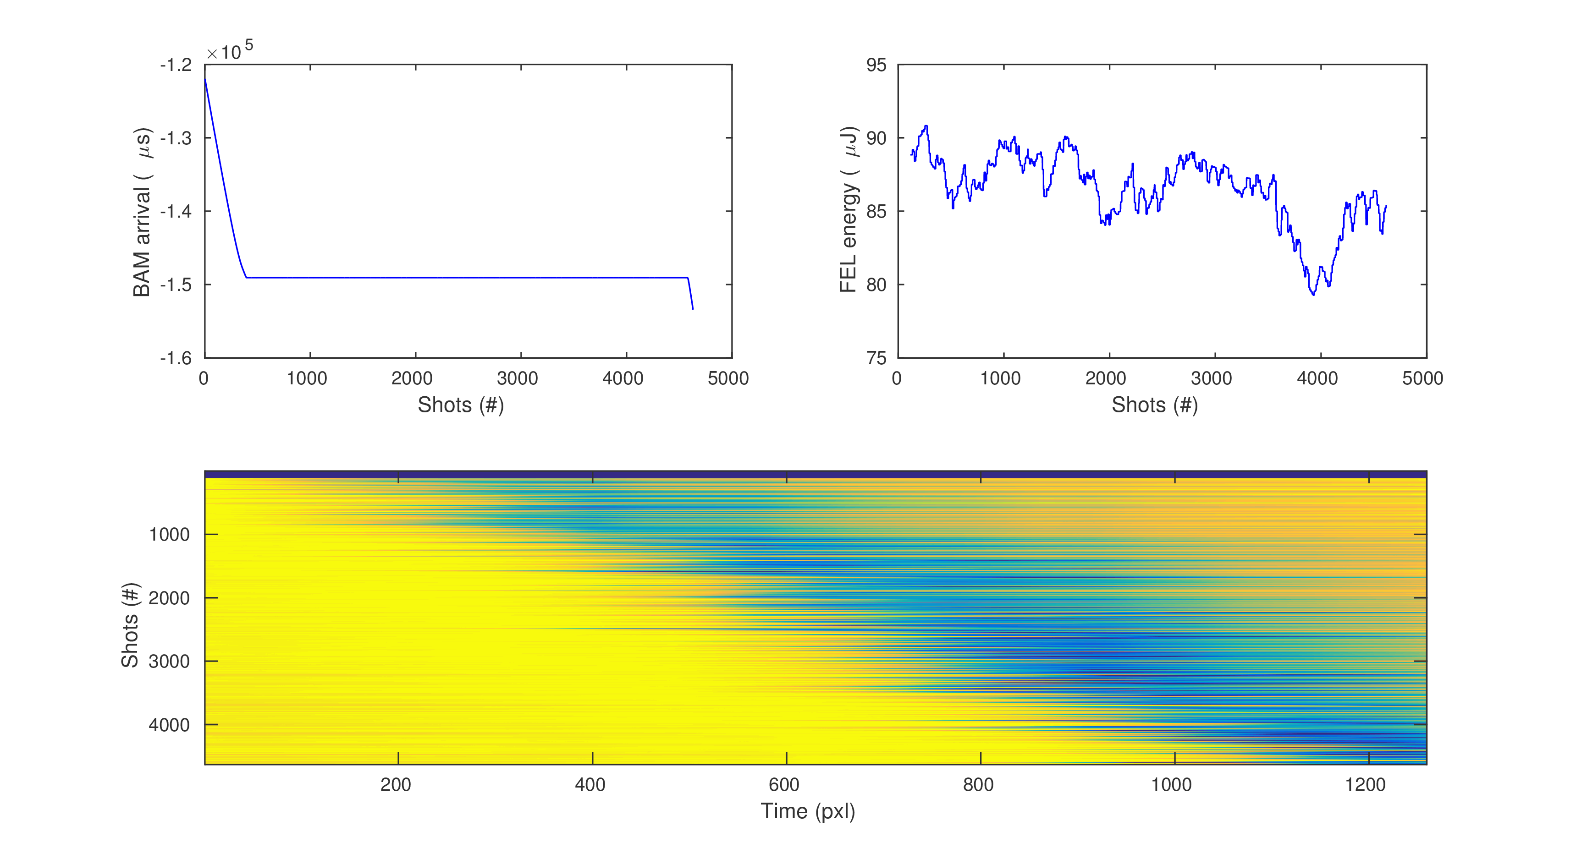
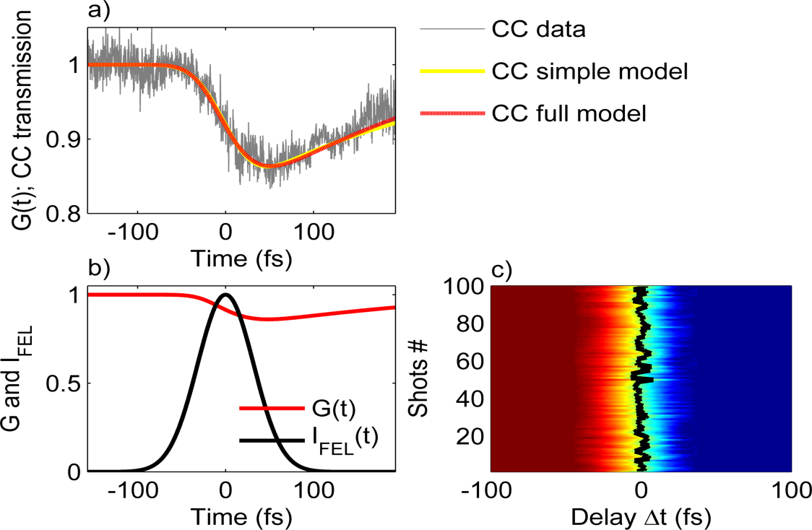
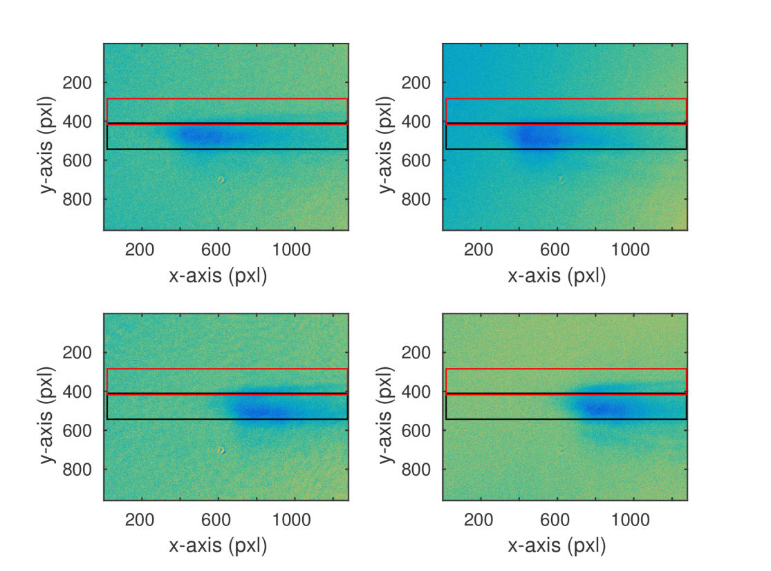
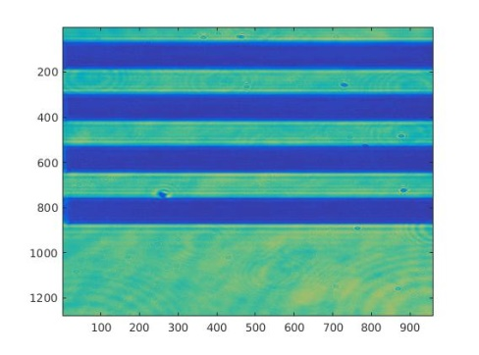
Plasma switch: first results at FLASH2
Preliminary data analysis from the April 2019 in-house experiment (11005874) at FL24
Run #28365 – drifting FEL!?
P. Finetti et al. PRX 7, 021043 (2017)
FEL wavelength: 26.2 nm NOPA: 630 nm, 32.7 fs
Pulse duration: 74.9 fs
Jitter: 2.2 fs (rms)
Calibration target

Slide 11
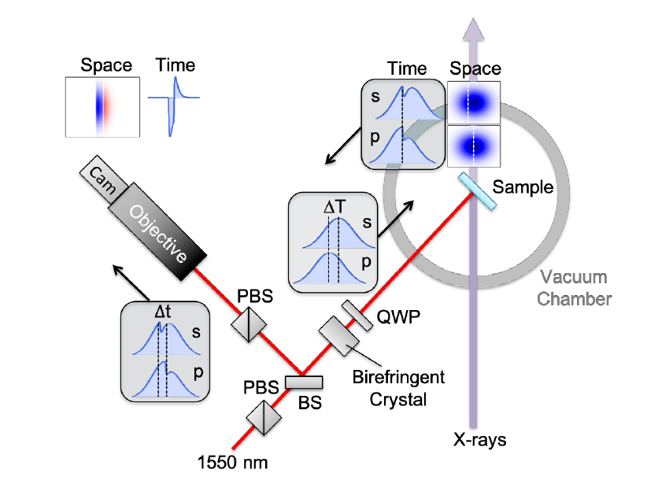
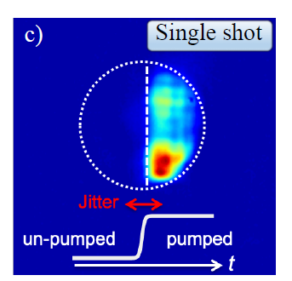
New plasma switch approach @ LCLS
Interferometric approach
Needed much lower X-ray intensity !!
5-10 times improvement in sensitivity (20 and 230 μJ/cm² (at 500 eV) works)
CLEO 2019 / SF3I.7.

Slide 12
Other methods
As far as we know …
Sidebands as quality monitor -> can only be used to get an idea how good the synch is (no sorting possible)
Balanced detection of sidebands (proposal for FL26) -> very challenging realization
“Optical afterburner @ THz undulator” – using optical part that coincides with XUV SASE -> so far only preliminary results

Slide 13
Comparison of methods
THz streaking
+ time resolution of few fs (< 5fs)
+ works for essentially all XUV wavelength (~ 30 eV to x-rays)
+ needs only ~ 1 µJ XUV
+ detection (TOF) works for 100 kHz (possibly even MHz)
+ delivers pulse duration (actually main task of the setup)
- Needs ~ 1 mJ optical pulse energy -> not feasible with Pump-probe laser (Using part of the OPCPA pump ???)
- needs XUV focus (part of the XUV beam has to be scraped of – tested at FL21)
- not easy to scale THz production to 100 kHz (or even 1 MHz …)
Plasma switch
+ time resolution of few fs (<< 5fs) (and delivers some idea about the pulse duration)
+ detection works at 1 MHz (shown at EXFEL: Sato et al Optica 7 (6), 716 (2020))
+ needs only few nJ of optical laser -> can be used parasitically
+ rather simple setup (compared to THz streaking)
+ well established method at LCLS
- target material absorbs XUV – no transparent target
- current techniques: needs lots of XUV (> 50 µJ) AND focus -> refocusing of XUV beam after transparent experiment
- current techniques: has to work close to damage threshold in the XUV (x-ray is much more relaxed)
Other methods
- no experience

Slide 14
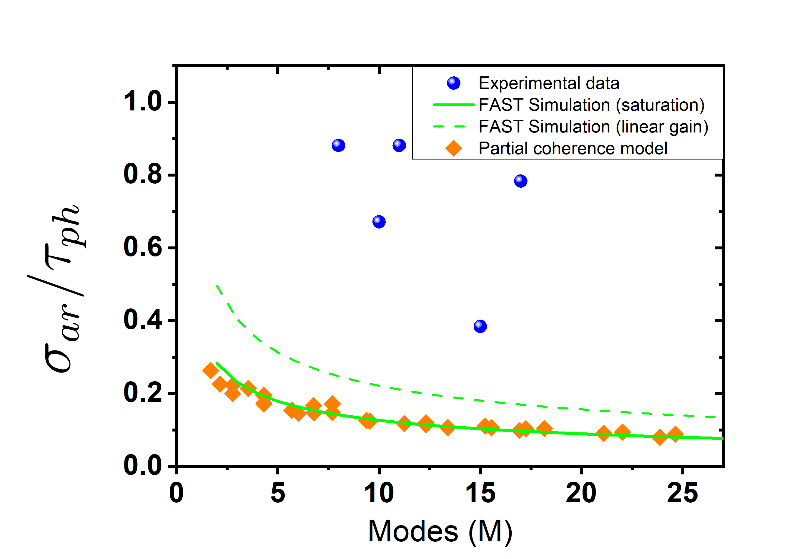
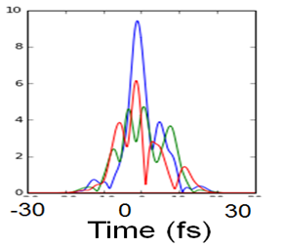
Arrival time: Theoretical limits
Relative fluctuations of the CoM of the arrival time
σ_{ar} = std( T_{XUV}-T_{BAM})
Typically still factor 5 from limit …
but for optimized cases already remarkably close
SASE induced arrival time fluctuations
Oct 2019:
Τ_{ph} =50 fs rms (120 fs (FWHM))
σ_{ph} =17 fs rms
Bermudez et al, in preparation / Simulations by M. Yurkov

Slide 15
Plans for next steps
Finding critical components
Cross-correlation between PP laser (FL2) and optical master oscillator
-> Noras talk
Identify Pump-probe laser induced jitter / drifts
Cross-correlation between XUV (FL2) and optical master oscillator (1550 nm – Plasma switch)
Compare to BAM: test precision of BAM to master timing
Test to what precision BAM could be used to sort the timing for user experiments
Test new concepts to get away from XUV damage threshold
Cross-correlation between XUV (FL2) and THz streaking laser
THz streaking is permanent setup – frequent tests for different FEL settings
Use for dedicated timing shifts – test different synch settings / fast feedbacks …
Test precision BAM –XUV timing (e.g. FLASH 2 BAM …)
Cross-correlation between XUV (FL2) and PP laser (FL2) (~ 800 nm – Plasma switch)
Test time resolution for user experiments
Investigate options for XUV online arrival time monitor

Slide 16
Future ideas
Stabilize timing
-> required by large fraction of experiments !!
Ideas / Questions for the next years
Sorting user data with BAM (FLASH2)
How good can we get ?
Probably most “standard” experiments can live with this resolution
SASE CoM fluctuations are fundamental limit
Investigate jitter at seeded FLASH1
Possible scenario for advanced high temporal resolution experiments:
Encourage using experiment internal reference signals (e.g. sidebands, depletion, ...)
Direct XUV – PP laser or optical master arrival time monitor at the experimental endstation
A setup for transparent experiments exists (XUV-PUMA) but has severe limits to the experiment
Dedicated arrival time setup - if interferometric setup works
PP Laser
Plasma
switch
XUV
Focusing
Experiment

Slide 17
Summary
sub 5 fs arrival time methods are available
Test measurements are promising
Improving techniques and identifying critical subsystems
Permanent implementation in end-stations is challenging
Define different scenarios and needed resources
Questions
How good can we get with stabilization and “indirect” measurements ?
What standard / best resolutions are demanded ?
For SASE ?
For seeding ?

Slide 18
Thanks
Questions ???

