Slide 1
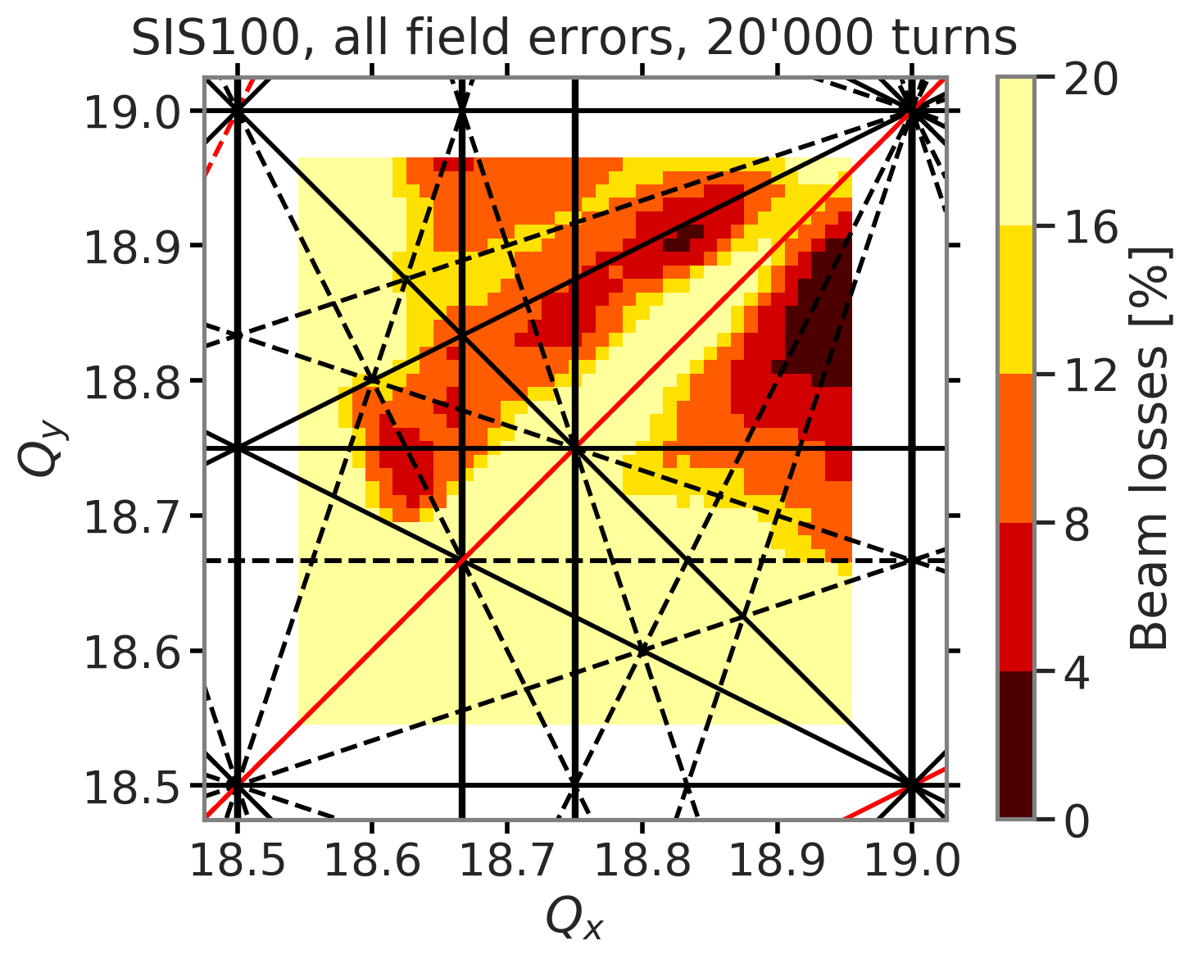
GSI Proposal: AI Assisted Loss Prevention
Critical to minimize beam loss in superconducting FAIR SIS100 machine:
Beam dynamics dominated by space charge
Computationally demanding simulations!
Now implemented fast and approximate GPU-enabled simulation models
Next steps:
Establish surrogate model with ML
Build prediction tool on top of surrogate model (e.g. for specification optimization, control room operation)
Test by applying this newly developed tool to running SIS18 for machine adjustment and online optimization
Computation time:
40 x 40 x 9 x 3 min = 30 day

Slide 2
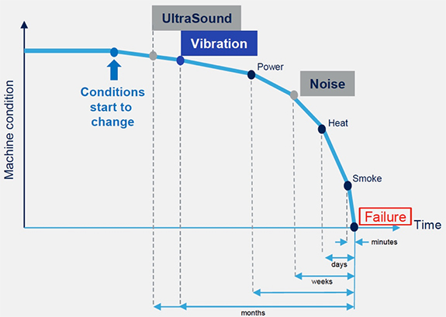
GSI Proposal: AI Assisted Failure Forecasting
Project goal / vision:
Forecasting undesired machine state
Apply ML to reduce complexity and supporting human decision making.
Leverage current industry trends („IoT“, „industry 4.0“, „predictive maintenance“).
Next Steps:
Define data model and identify ML algorithms
Implement, test and enable model for productive use
Current state:
Prototype for data acquisition and provisioning established at CRYRING@ESR.
ML-assisted automated machine optimization has been applied successfully.
O Geithner, W Geithner ACC Operations

