Slide 1
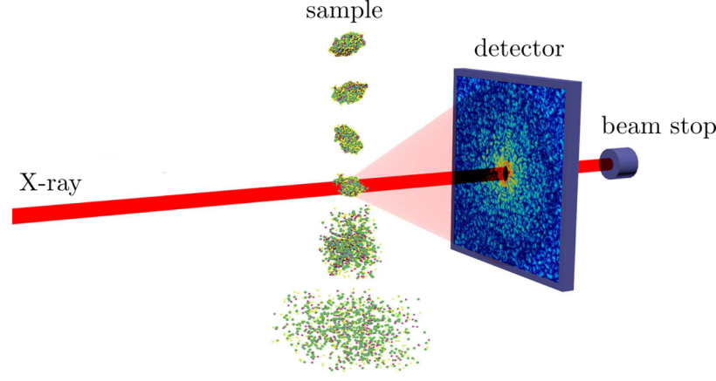
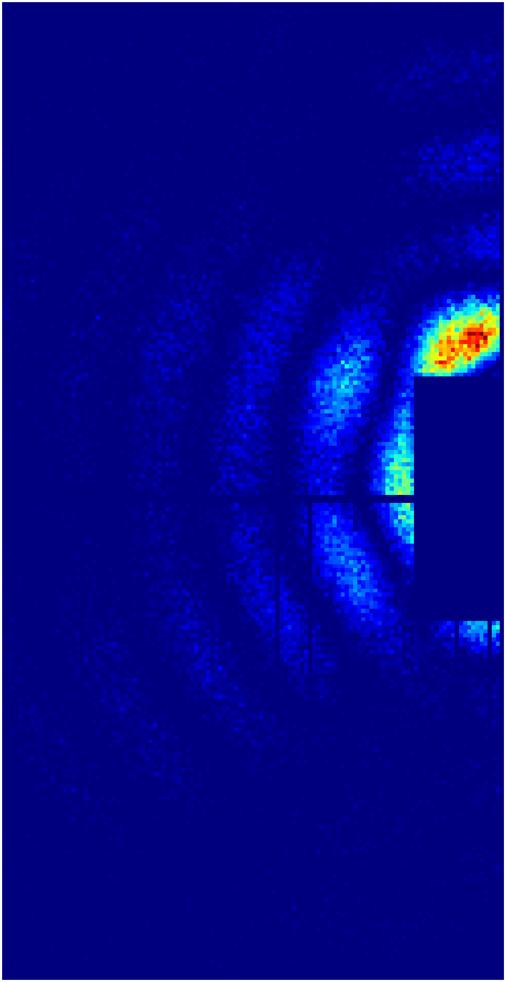
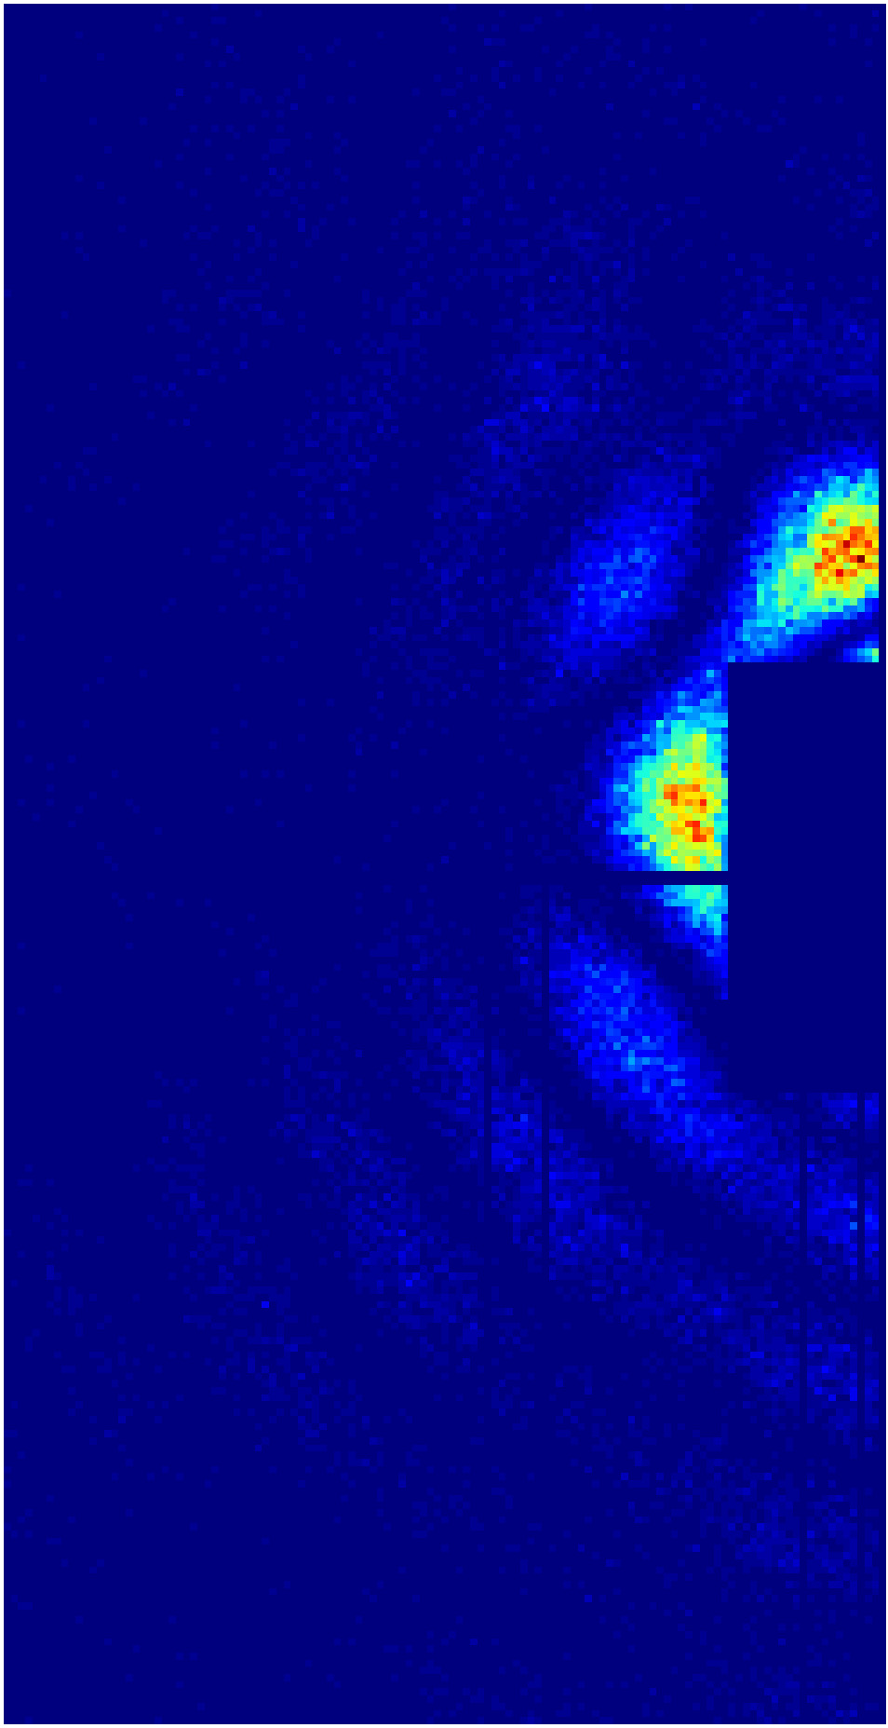
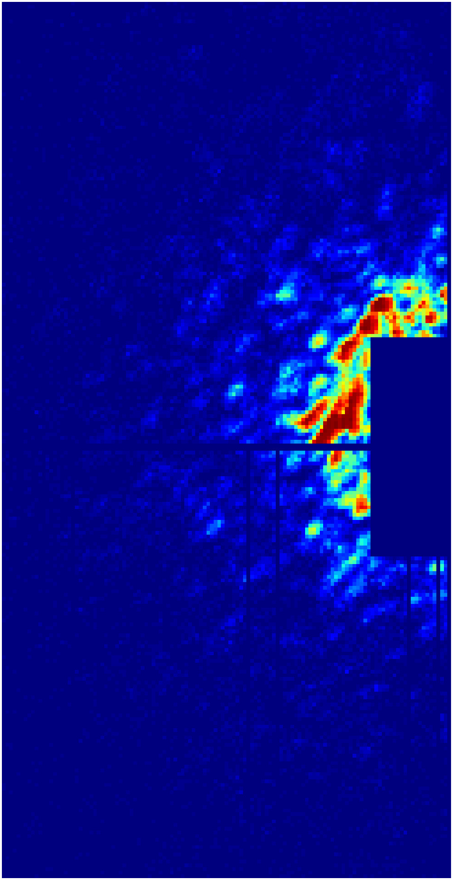
Classification in single particle imaging (SPI)
DESY Photon Science
SPI is a method for native structure determination. Single particles are injected into the XFEL beam and diffraction patterns are collected on the detector.
Classification of single hit diffraction patterns to be used for further analysis is an important step in data processing pipeline.
SPI experiment scheme
SPI data processing pipeline
S. Bobkov et al., Journal of Synchrotron Radiation, 22 (2015)
M. Rose et al., IUCrJ 5, 727 (2018)
Goal:
Find an optimal deep learning (DL) approach to correctly classify single hit diffraction patterns in SPI experiments
Achievments so far:
Convolutional neural network (CNN) based solution trained with limited amount of data for a specific object (PR772)
Further steps:
Find a solution to generalize the case for many different objects
Classification
DL
classifier
Single hit
Something
else

