Slide 1
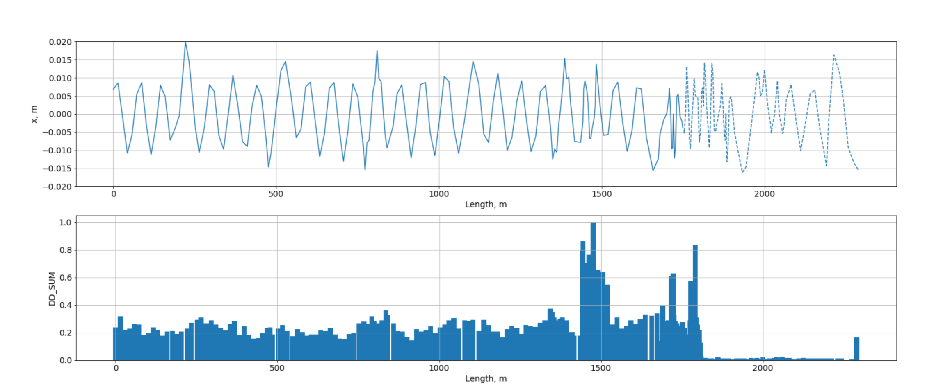
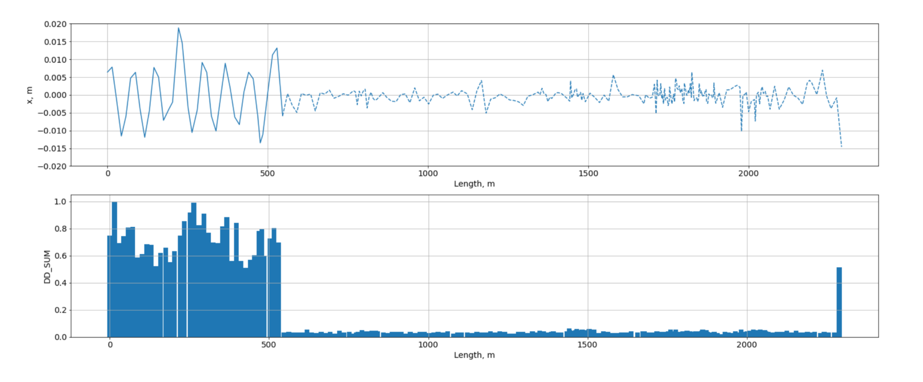
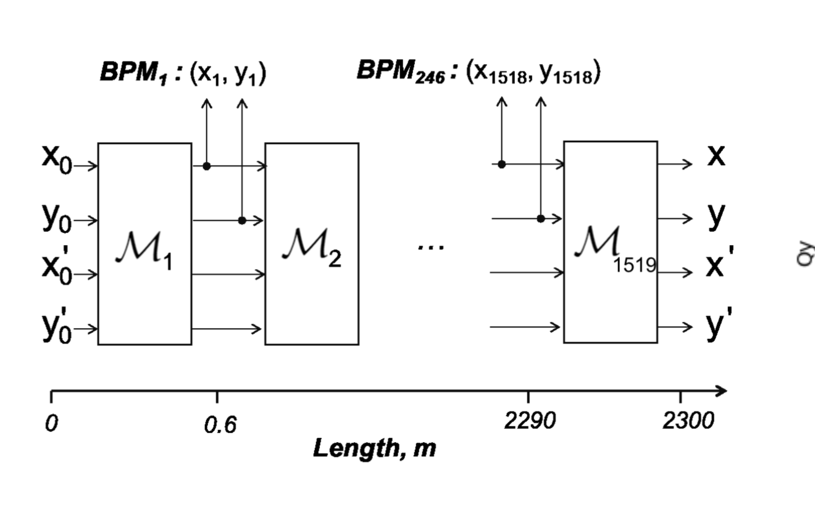
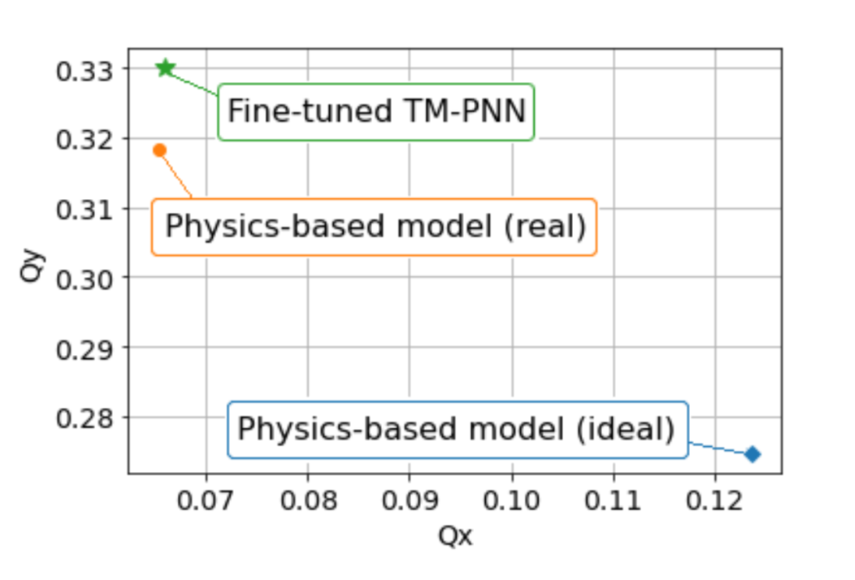
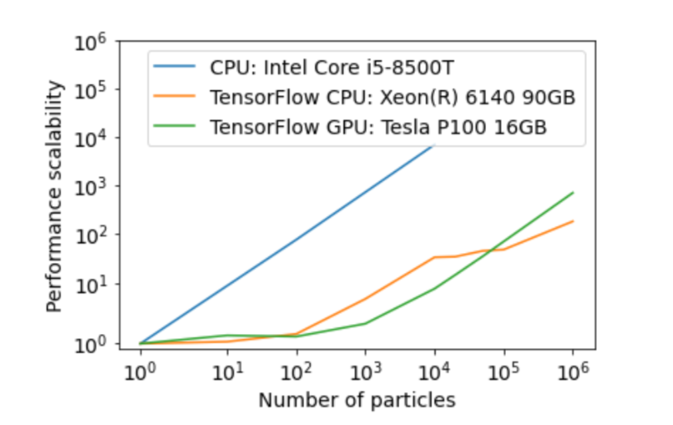
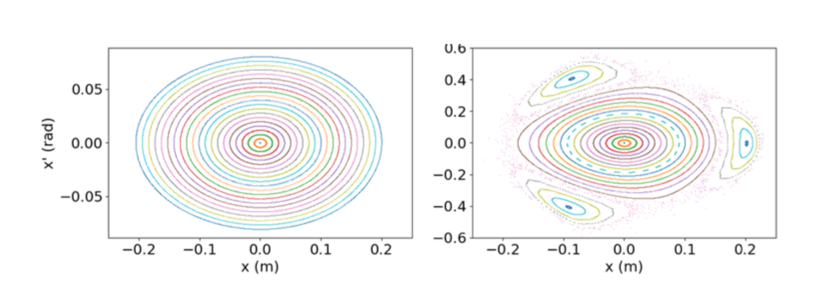
AMALEA: DESY M
ML-based accelerator (storage ring) controls and modelling building on the successful OCELOT software stack
Achievements since 11.12.2019
Paper submitted to PRAB
Novel NN architecture for accelerator modeling and control (TM-PNN)
Experimental demonstration of NN-based beam steering at PETRA III) and simulations for PETRA IV
Exact NN-based simulation models and GPU-enabled tracking code
NN model tuning and optics reconstruction with single-shot data
Experimental demonstration at PETRA III

Slide 2
AMALEA++: DESY M view
Development of NN-based accelerator control algorithms
Next steps: from NN-based beam steering to ML-assisted machine start-up and optics adjustment
Optics error reconstruction and correction
Extending TM-PNN approach to linear accelerator control
Development of fast NN-based simulations code
Root cause analysis: using NN-based simulation model for model-based root-cause analysis
In large-scale complex machines as accelerators, faults easily propagate through the system (resulting in alarm floods) → difficult to find the source of the problem
Root cause analysis (also fault isolation): Where is the fault?
Based on the NN-based physical simulation model, hybrid methods can be exploited (combining model-based and data-driven technique)
Resource needs: 2 FTE

