Slide 1
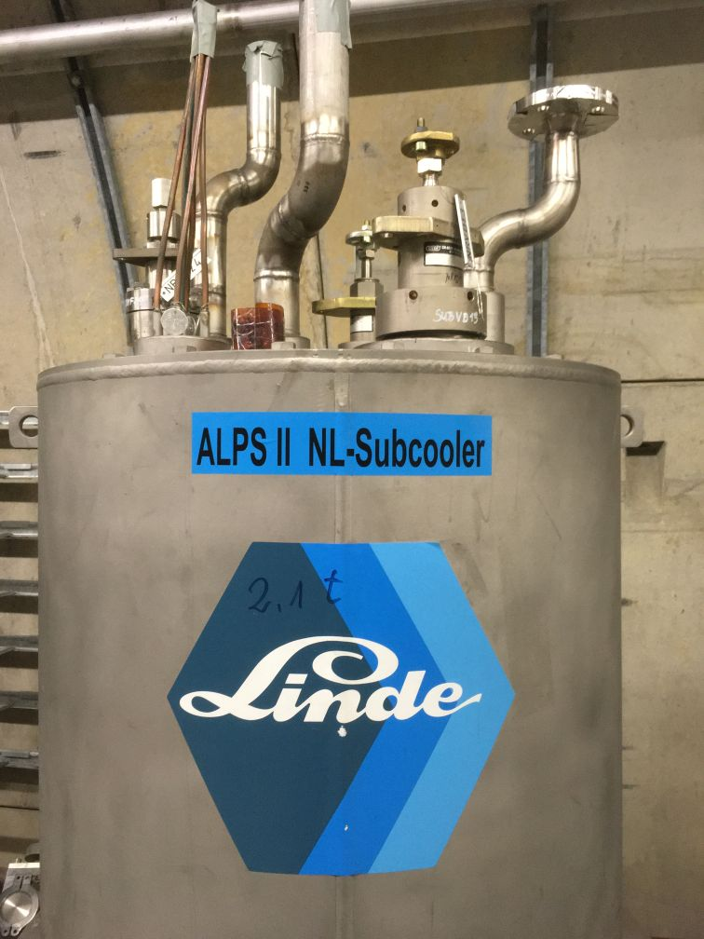
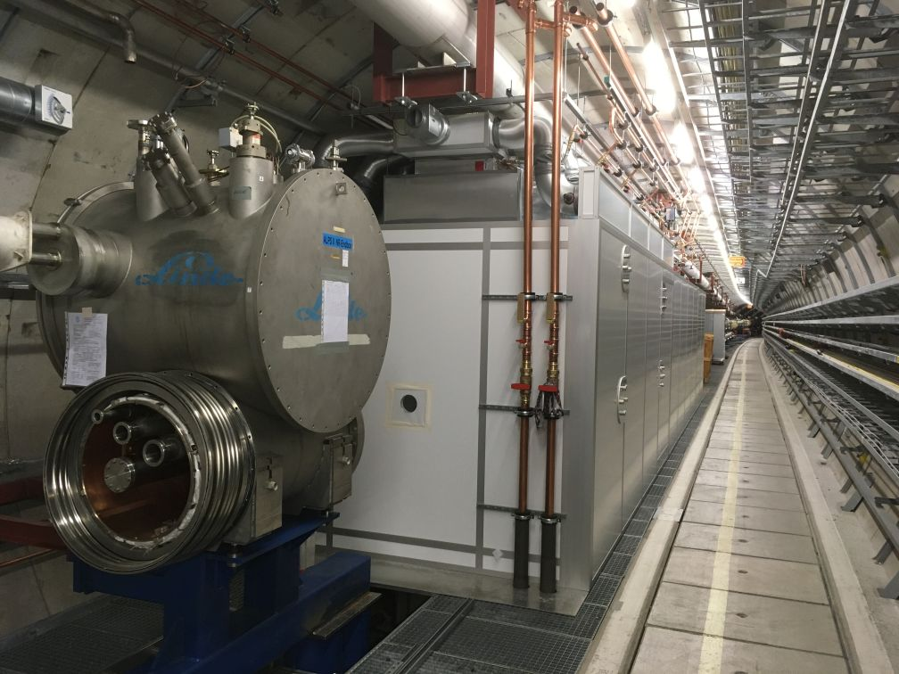
ALPS II Collaboration Meeting
8-9 June 2020, Video
2 June 2020

Slide 2
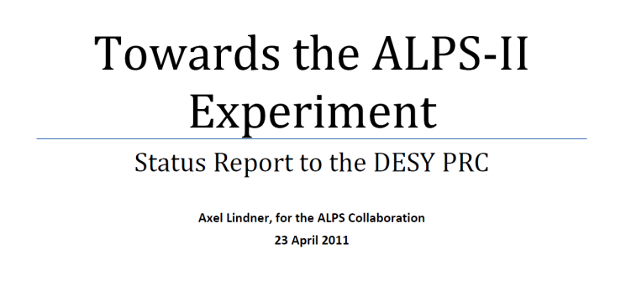
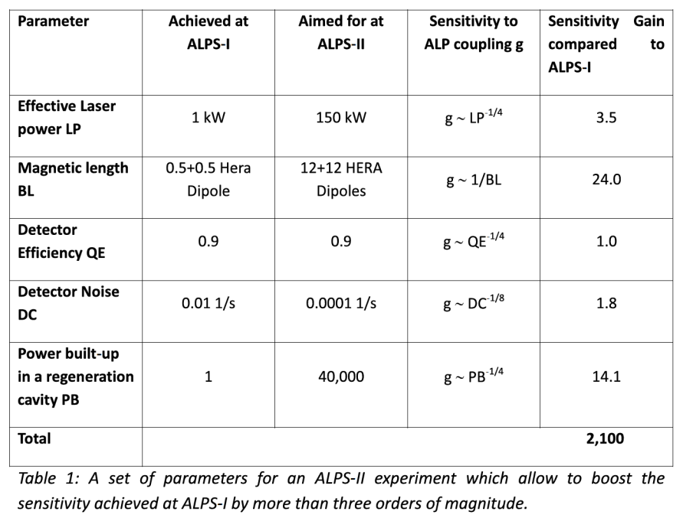
A brief history of ALPS II
It’s nearly a decade!
First presentation to the DESY PRC in April 2011:
In 2015 UF joined ALPS II, working also on HET.
ALPS II parameters did not change much!
But the schedule slipped a bit:

Slide 3
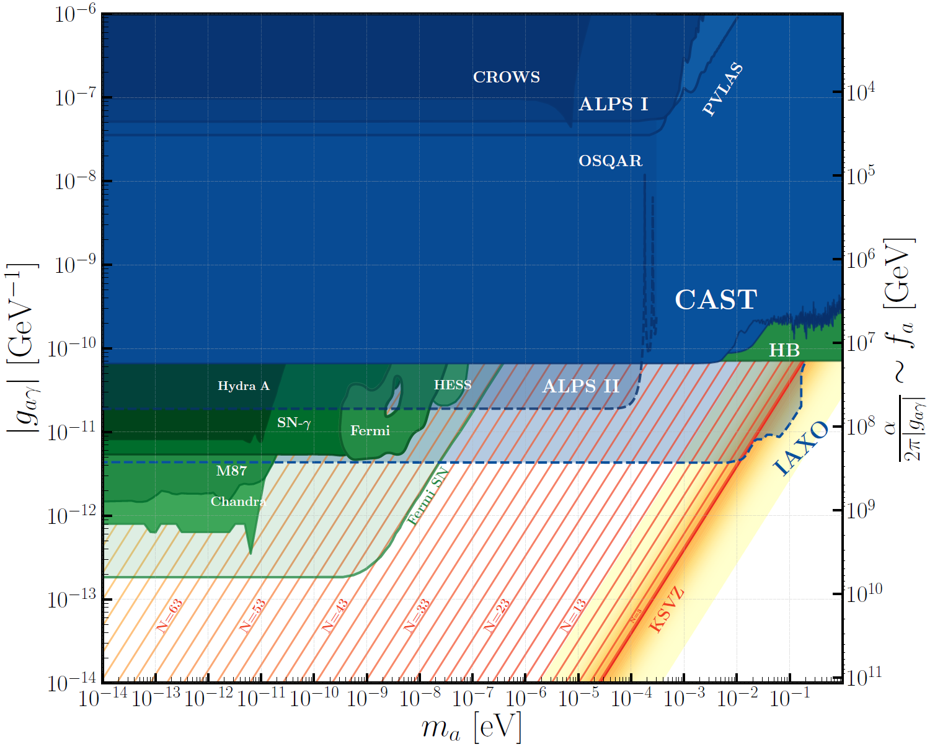
The ALPS II physics case
“Ever expanding”
We might even find the QCD axion:
A. Ringwald et al., “An even lighter axion”, in preparation
Preliminary
This requires more than 23 copies of the Standard Model.
However: If ALPS II finds a signal, it cannot be excluded by theory that this is QCD axion!

Slide 4
Thanks
Difficult times and important people
Many thanks to your engagement in ALPS II also in these difficult Corona times!
ALPS II progress never came to a stand-still.
Our first ALP / axion search could very well still happen in 2021.
Special thanks to Giuseppe, who is on the leave now to INFN.
Happy birthday to Sandy!

Slide 5
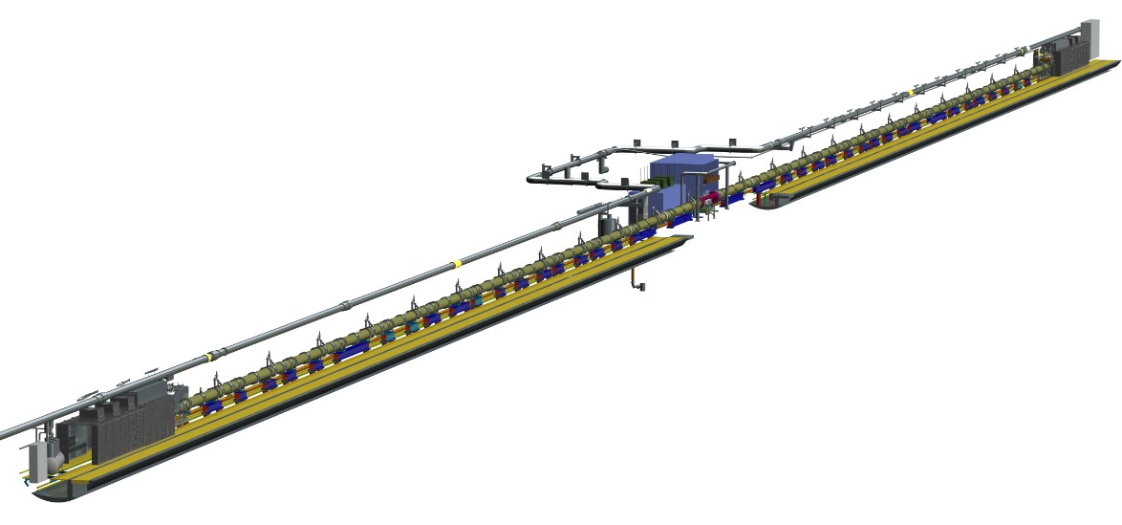
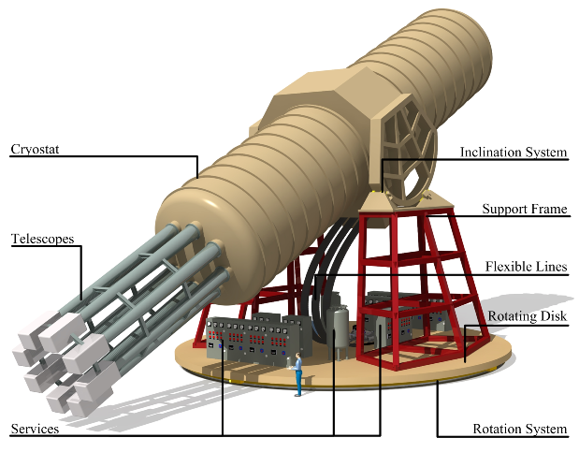
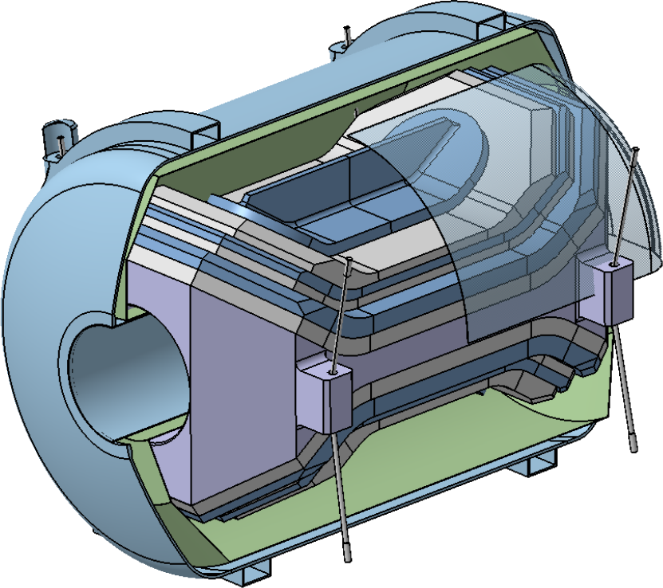
Beyond ALPS II
ALPS II
Potentially more axion search activities at DESY
To a large extend triggered also by ALPS II, further progress also depends on ALPS II success.
IAXO
MADMAX

Slide 6
Beyond ALPS II
Potentially more axion search activities at DESY
Some optimistic view (funding), assuming no surprises (axion discovery, Corona).
2020
2021
2022
2023
2024
2025
2026
2027
2028
2030
2029
ALPS II
construction operation
funded
BabyIAXO
R&D construction operation
nearly funded
IAXO
construction operation
not (fully) funded
MADMAX
R&D construction operation
DESY: also a center for experimental axion physics in this decade?
Crucial: making ALPS II a full success (technological).

Slide 7
ALPS IIc near-term main challenges
2020 and early 2021
Tunnel installation:
Closing the experimental vacuum.
HET optics:
Start installation and commissioning.
TES:
Demonstrate that a TES-based detection system is a valid alternative to HET.

Slide 8
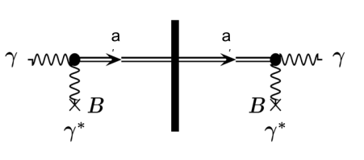
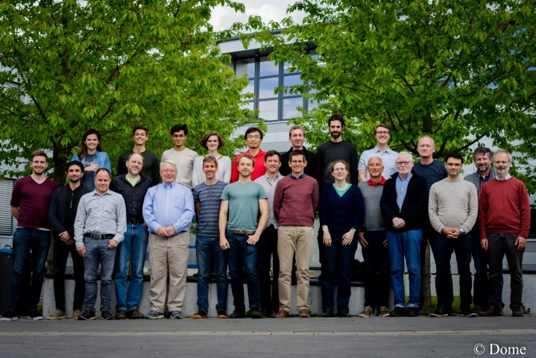
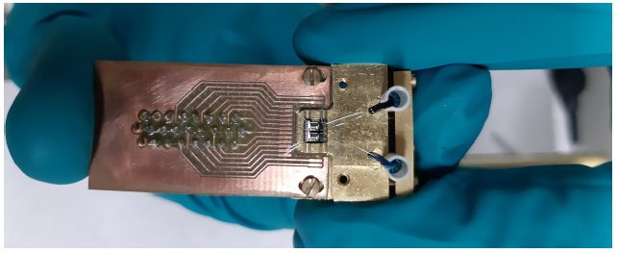
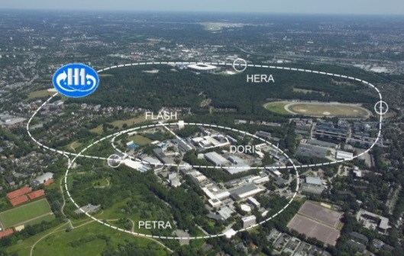
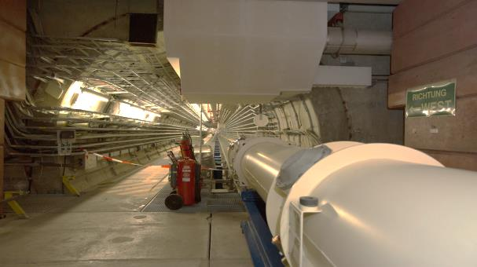
Any light particle search ALPS IIc
I hope for an in-person meeting soon!
Significant funding from

