Slide 1
Beam halo tracks from data
Andrea Parenti
04/02/2010

Slide 2
Data samples and selection
Runs 124009, 124020, 124022, 124230
  ALCARECO from E. Migliore:
    '/store/user/emiglior/ALCARECO/16Dec09/TkAlBeamHalo_124009.root',
    '/store/user/emiglior/ALCARECO/16Dec09/TkAlBeamHalo_124020.root',
    '/store/user/emiglior/ALCARECO/16Dec09/TkAlBeamHalo_124022.root',
    '/store/user/emiglior/ALCARECO/16Dec09/TkAlBeamHalo_124230.root',
  # events: 84751 (selected by PhysDecl bit) → 231213 tracks
See “Beam halo tracks from data” presentation in https://indico.desy.de/conferenceDisplay.py?confId=2659
  Here some additional checks have been done

Slide 3
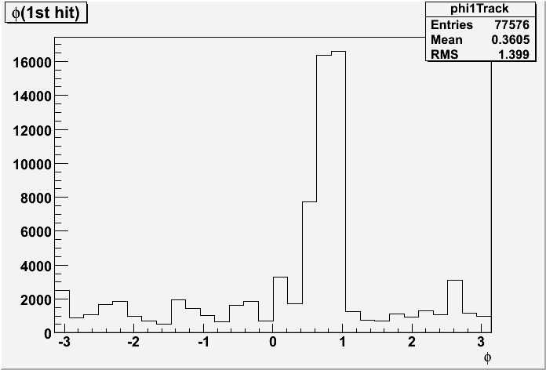
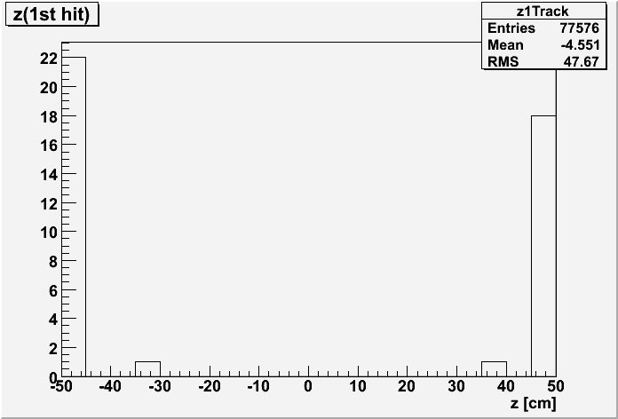
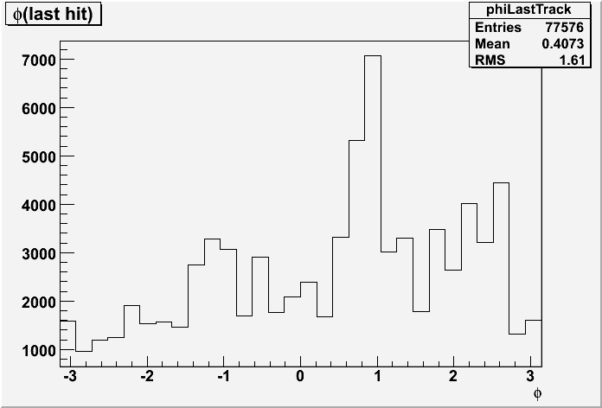
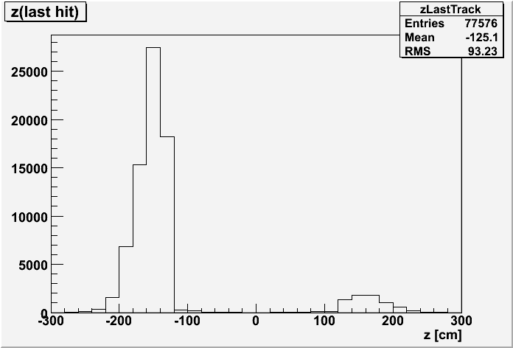
Phi,z at first and last hit
From Pede job, normChi2<50: 77576 trks

Slide 4
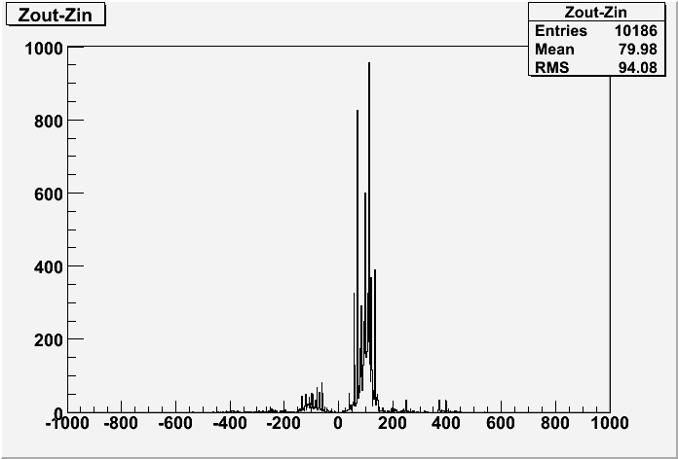
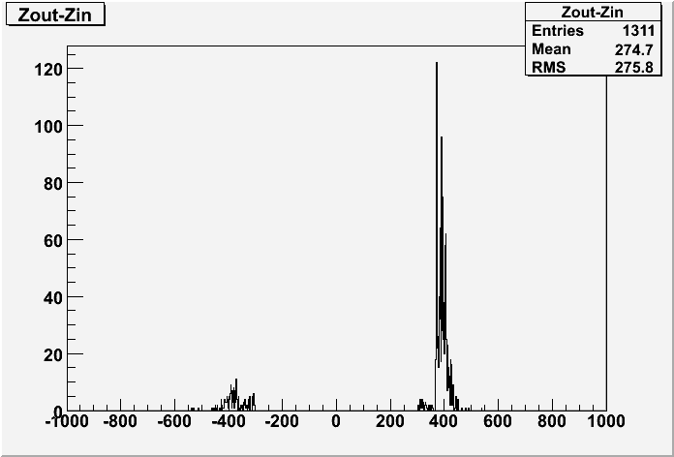
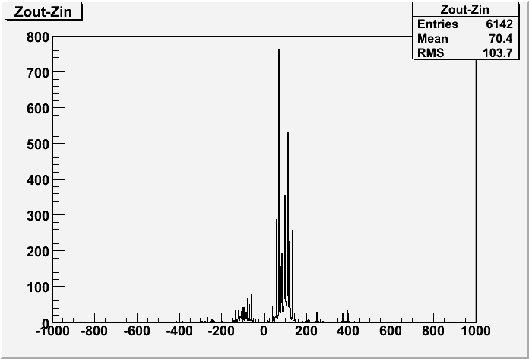
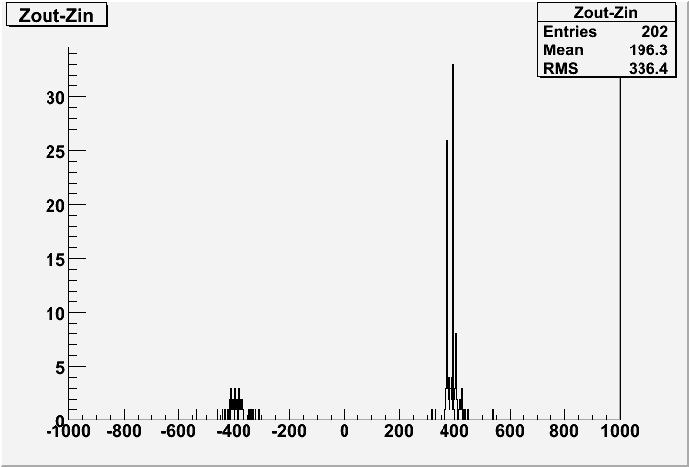
Zin-Zout
Different track selections applied:
|eta| > 2.5
|Zin-Zout| > 300.
|eta| > 2.5
|d0| > 20.
|eta| > 2.5
|Zin-Zout| > 300.
|d0| > 20.

Slide 5
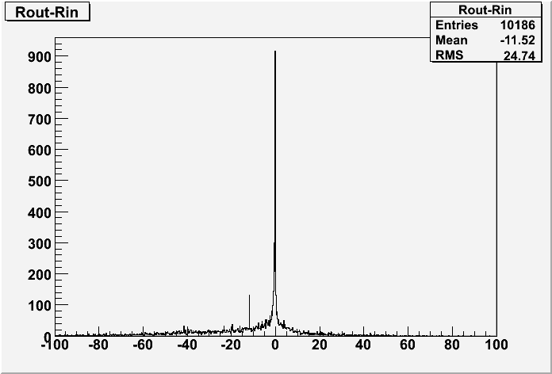
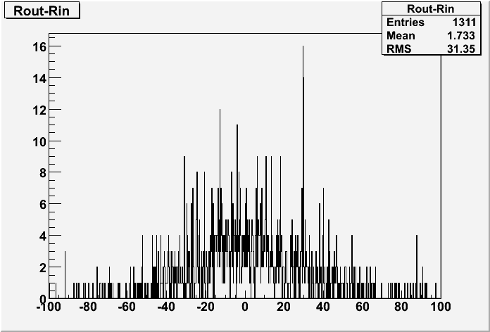
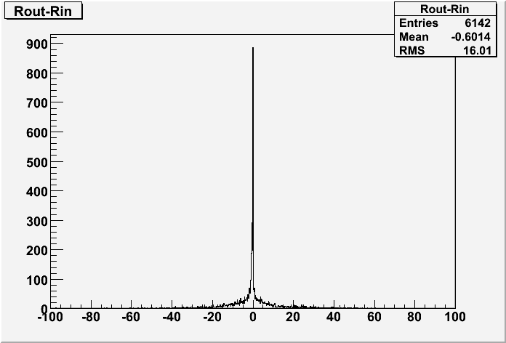
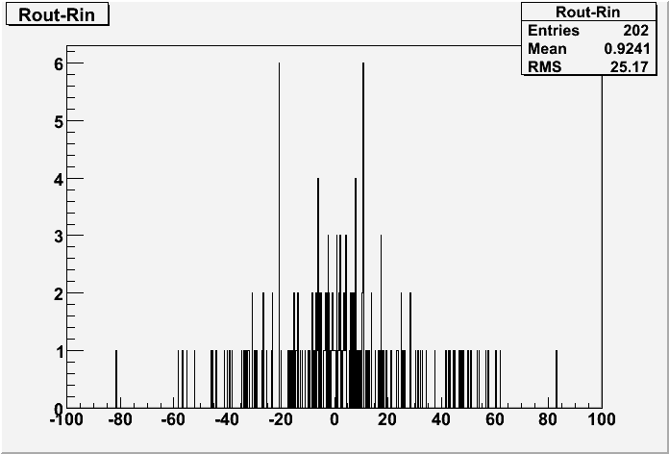
Rin-Rout
|eta| > 2.5
|Zin-Zout| > 300.
|eta| > 2.5
|d0| > 20.
|eta| > 2.5
|Zin-Zout| > 300.
|d0| > 20.

Slide 6
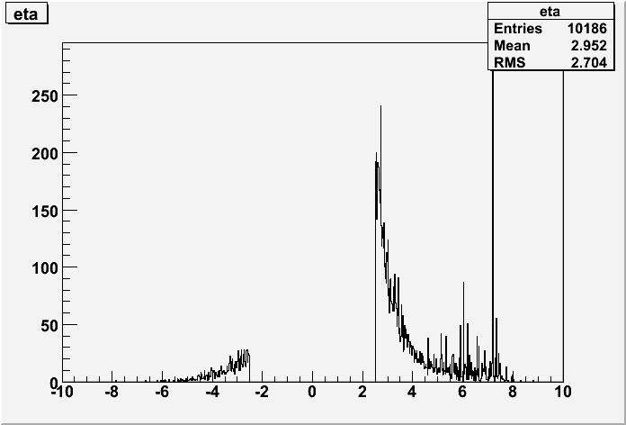
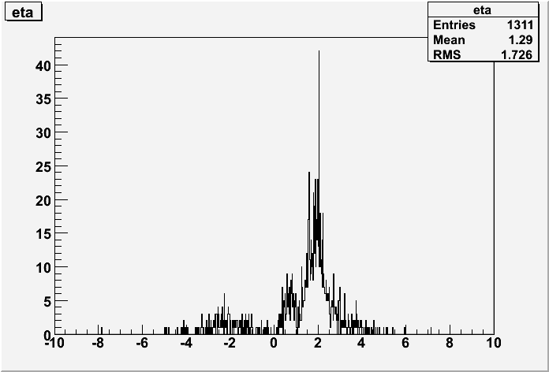
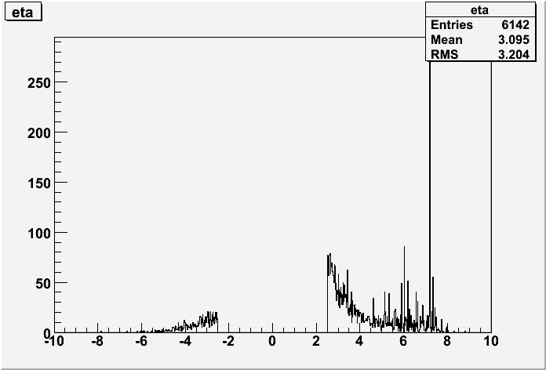
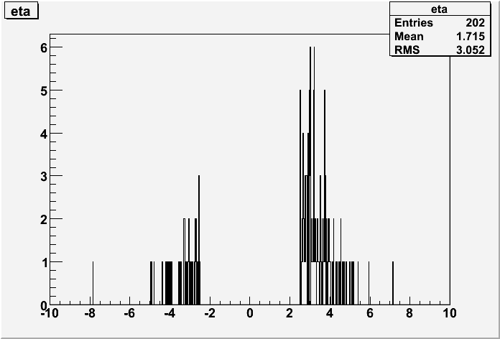
Eta
|eta| > 2.5
|Zin-Zout| > 300.
|eta| > 2.5
|d0| > 20.
|eta| > 2.5
|Zin-Zout| > 300.
|d0| > 20.

Slide 7
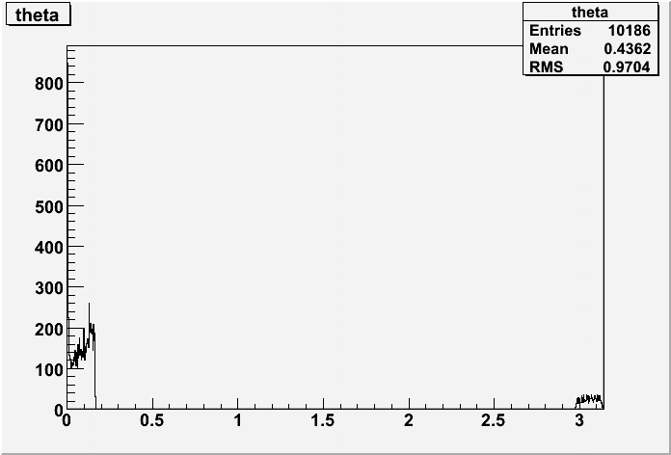
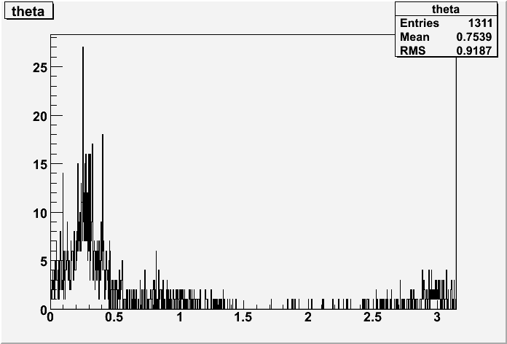
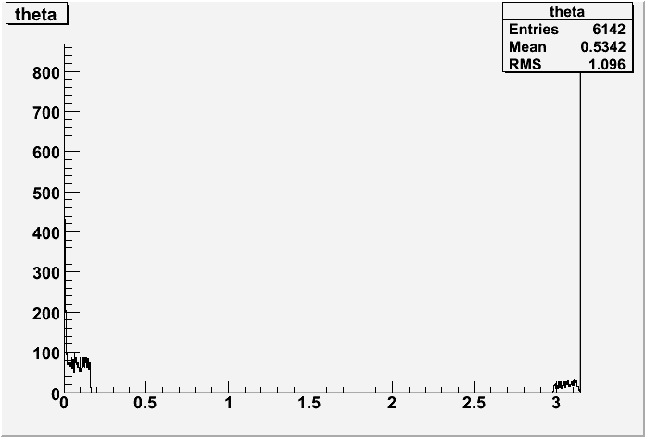
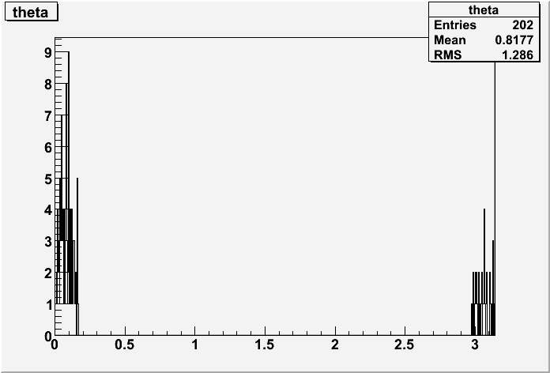
Theta
|eta| > 2.5
|Zin-Zout| > 300.
|eta| > 2.5
|d0| > 20.
|eta| > 2.5
|Zin-Zout| > 300.
|d0| > 20.

Slide 8
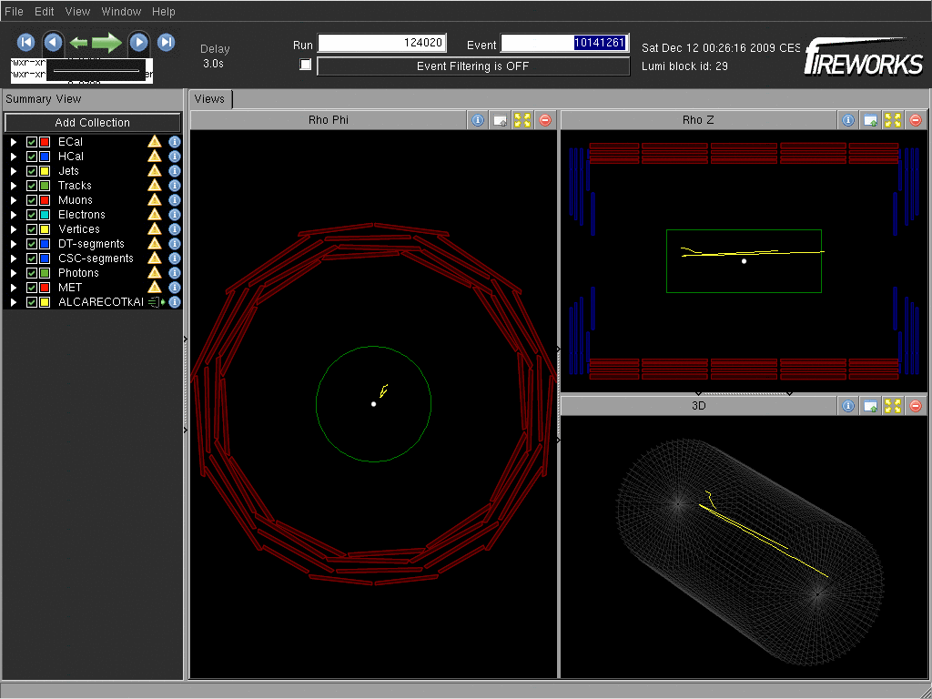
Run=124020 Evt=10141261
One of the event
having tracks with:
|eta| > 2.5
|Zin-Zout| > 300.
|d0| > 20.

