Slide 1
Bunch Compression Operation at the European XFEL
Bolko Beutner
Operator Training
July 2020

Slide 2
FEL Performance
FEL performance is determined by the peak current and the emittance – the charge density in 6D.
Low emittance and high peak current beams are required in the undulators, but not available at feasible electron sources.
Typically long beams are produced with low emittance and the compressed later.

Slide 3
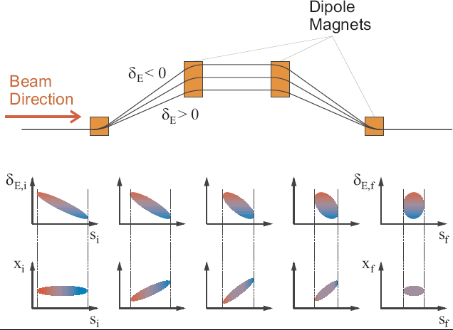
Basic Principle

Slide 4
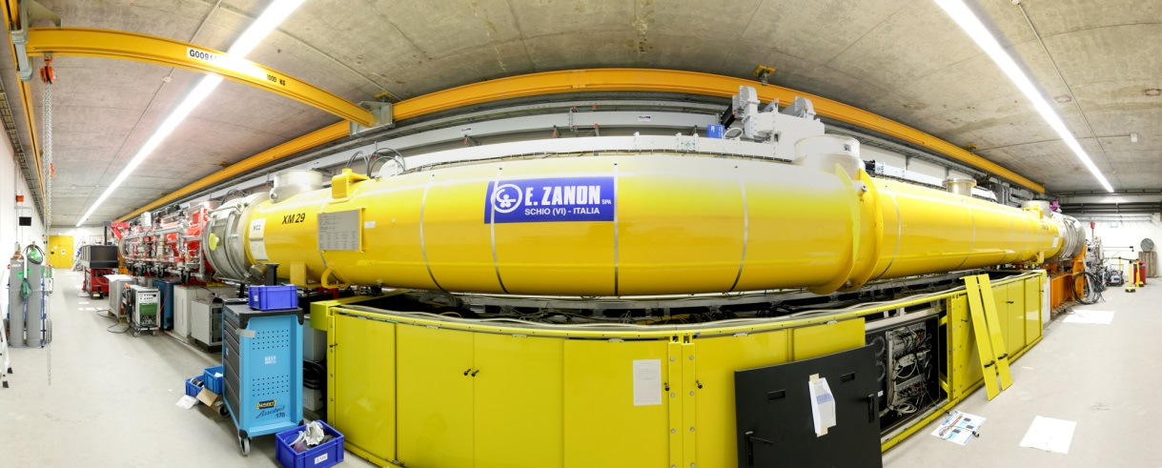
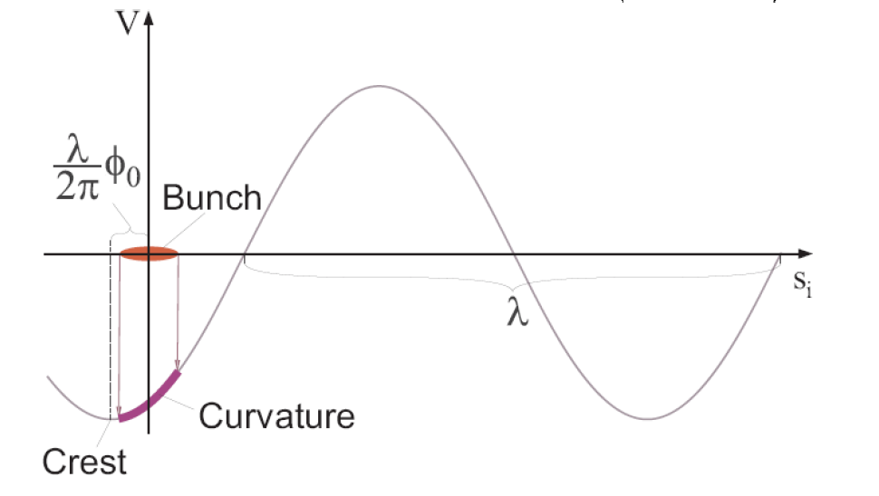
Energy Chirp Generation

Slide 5
“Non-linear” Compression
Linear Compression:
Non-Linear Compression:

Slide 6
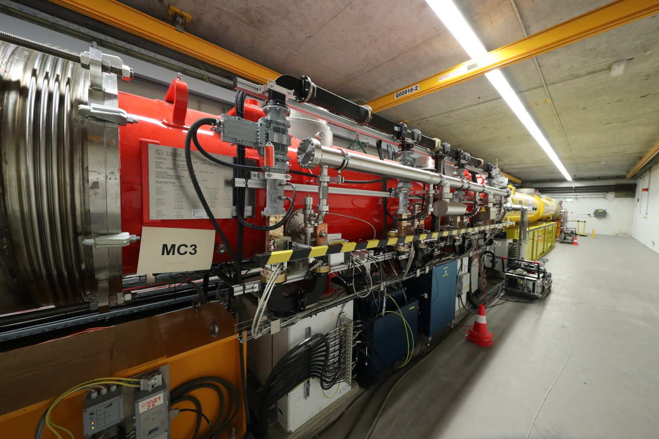
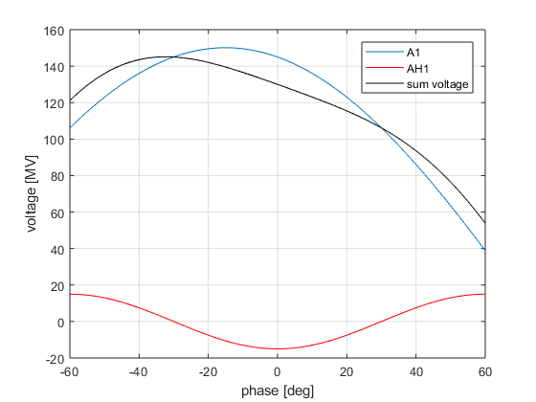
Phase Space Linearisation
Higher harmonic RF system is used to remove non-linear chirp
3rd harmonic (3.9GHz) at XFEL and FLASH

Slide 7
Sum Voltage
Setup of RF phase and voltages to get a certain energy chirp is cumbersome
RF parameters can be directly calculated from the Taylor coefficients (energy, chirp, curvature) at the beam position
Tuning one of the Taylor coefficients do not change the others, especially the beam energy is not changed (provided that the on-crest phases are correct)

Slide 8
Sum Voltage Effects
Chirp (mostly A1 phase):
Curvature (mostly AH1 voltage):
Third Order “Skewness” (AH1 voltage and phase):
Current profiles

Slide 9
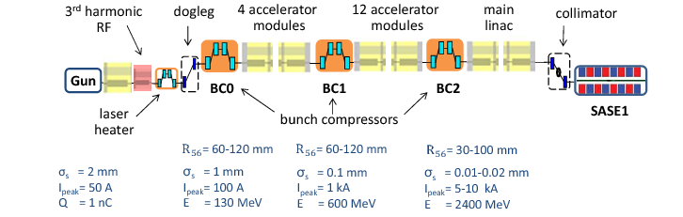
Multi-Stage Compression
Too much compression at low energies will lead to space-charge dilution of the beam
Too little compression in the early stage lead to problems with transport of long beams
Too strong chicanes distort the beam due to synchrotron radiation emission
  => Multi-stage compression

Slide 10
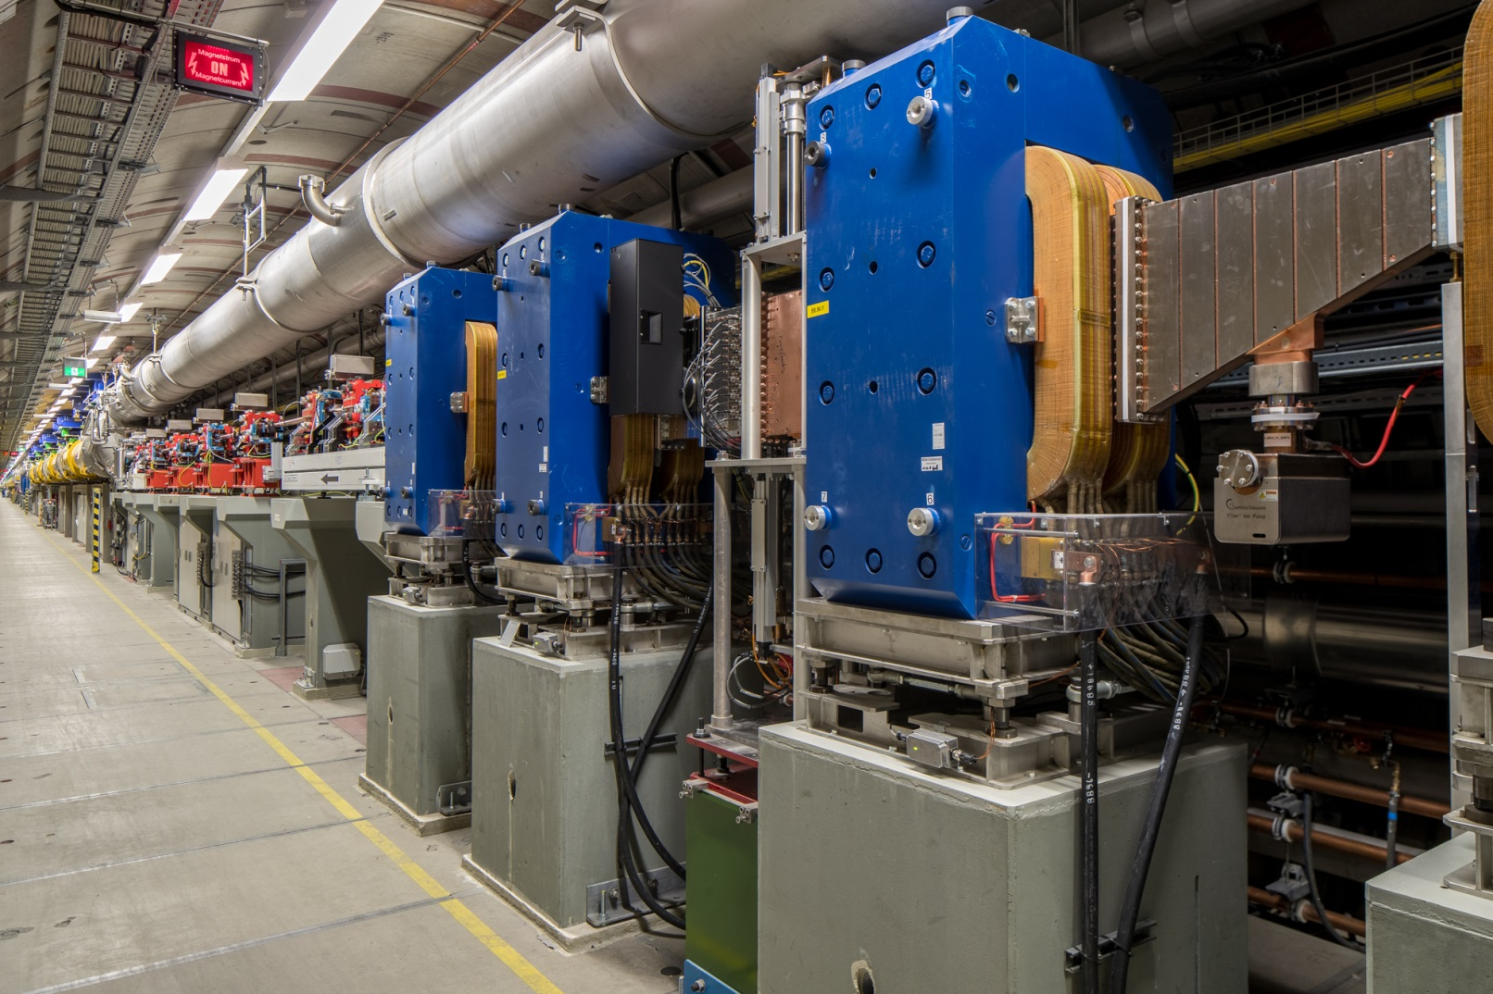
BC0

Slide 11
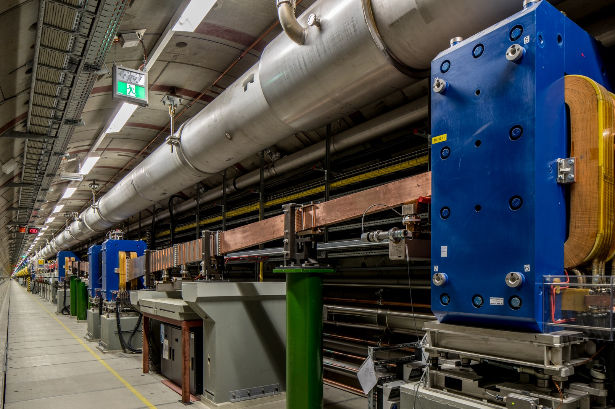
BC1

Slide 12
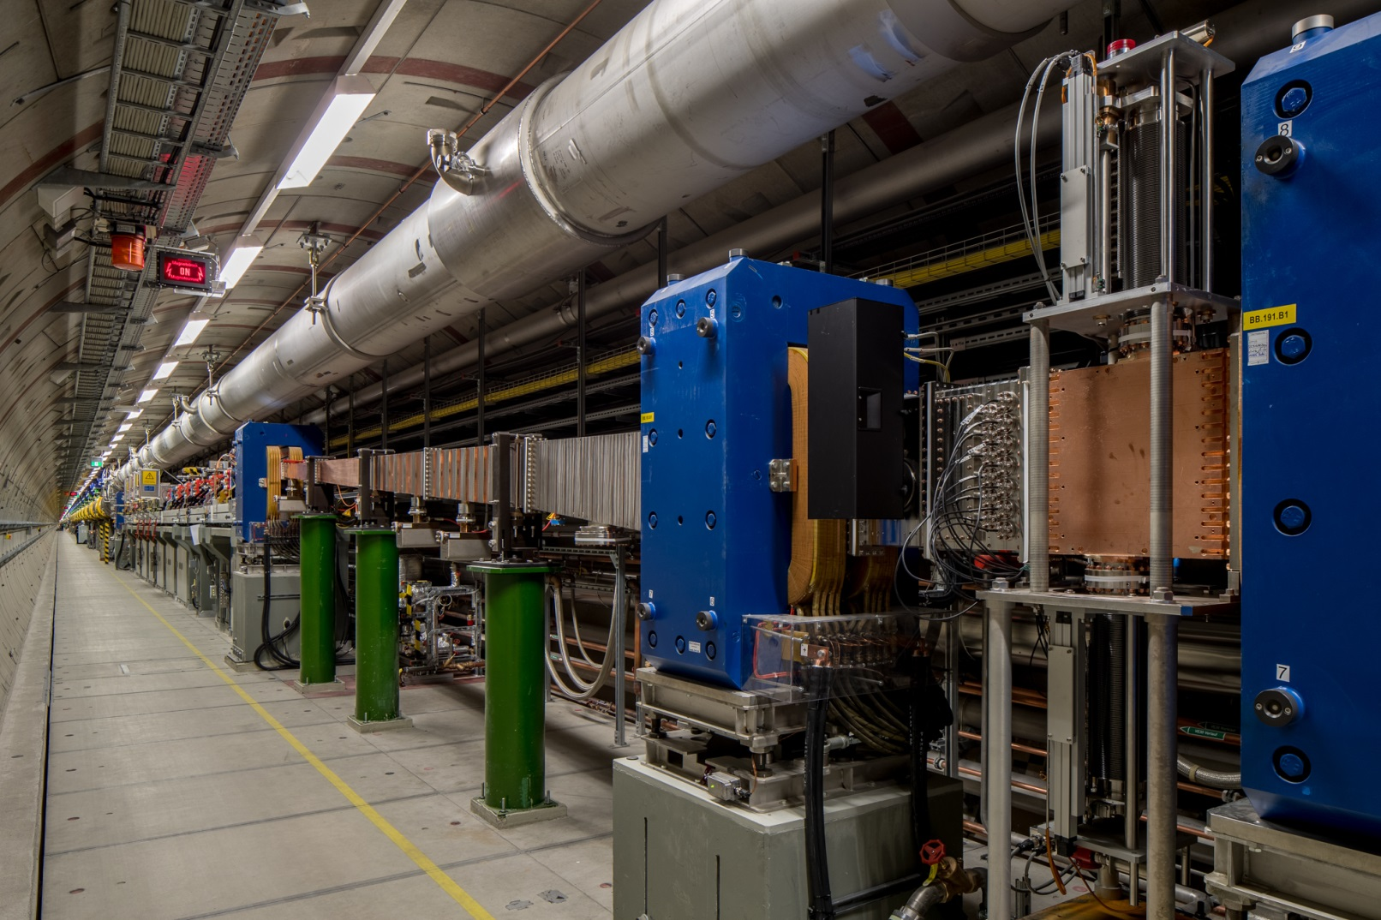
BC1
Screen
station
Collimator
BPM

Slide 13
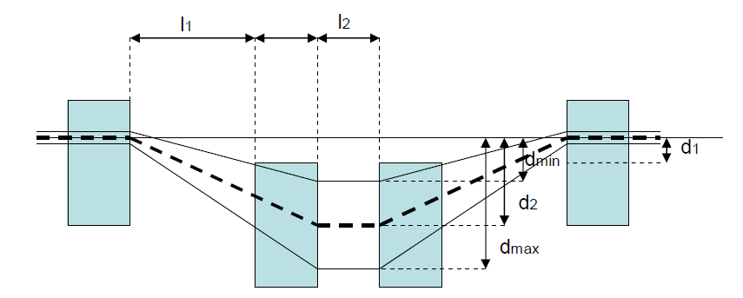
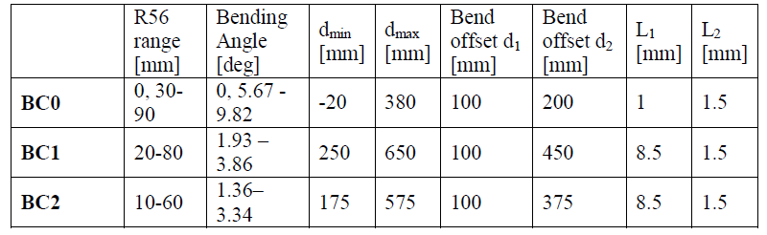
XFEL BC Overview

Slide 14
Chamber Overview
Screen
Collimator
Not to scale!

Slide 15
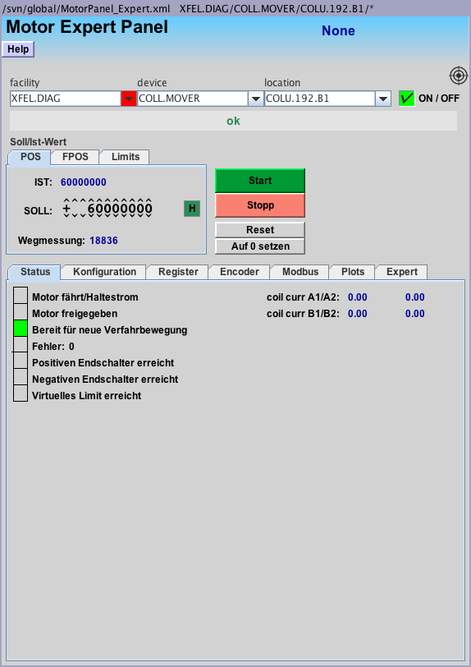
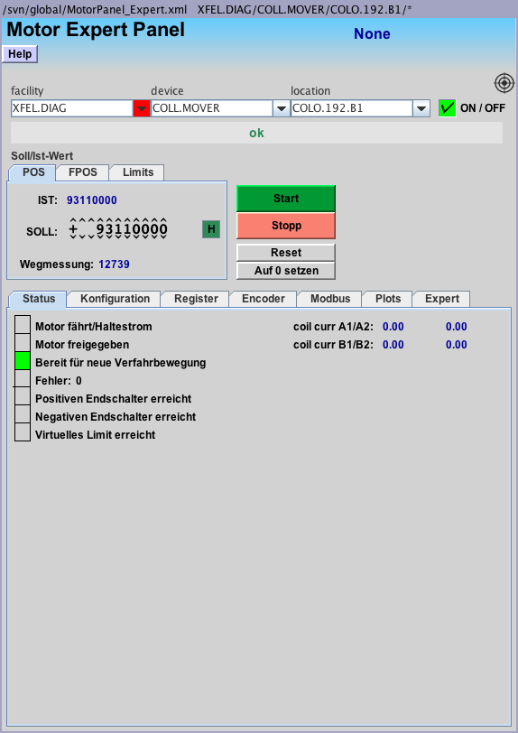
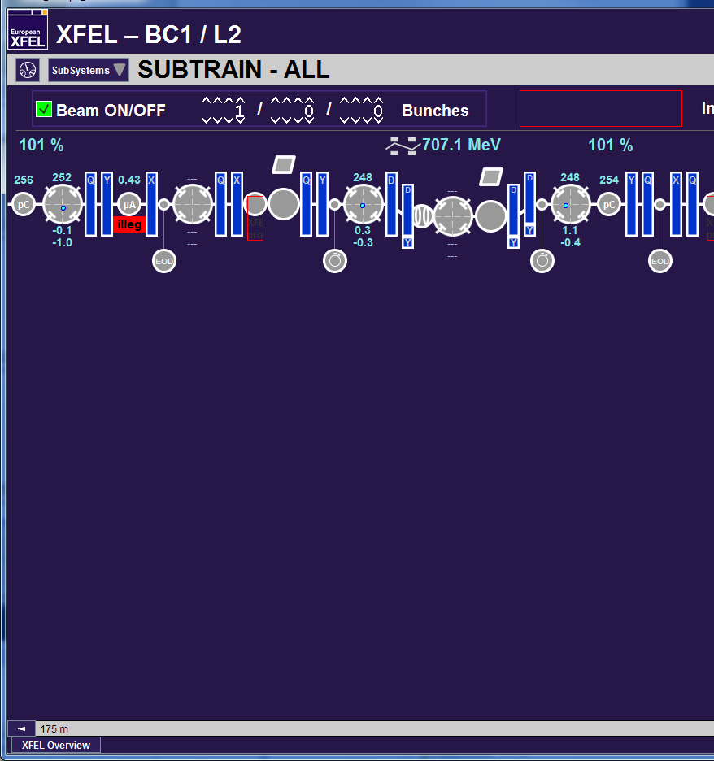
BC Collimator Control
Set “Sollwert” and the press “start”
Move collimators to in direction 0 to remove them
COLU is down “unten”, COLO is up “oben”

Slide 16
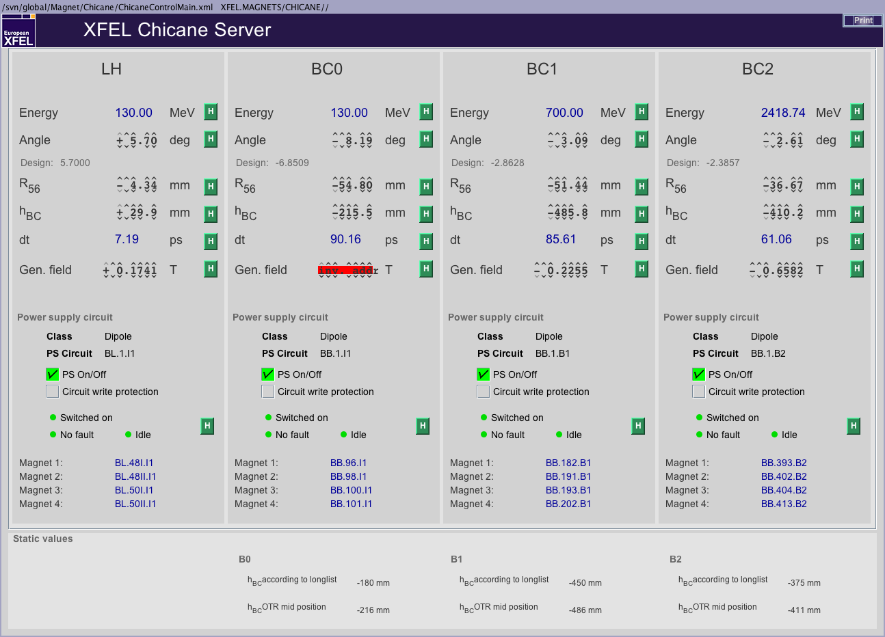
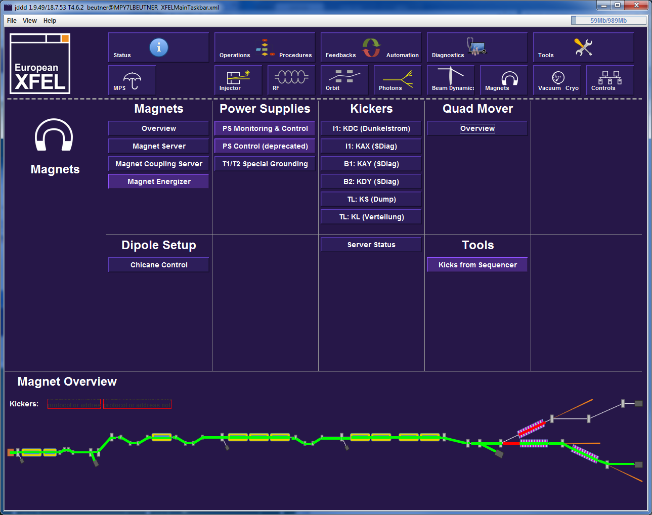
Dipole Setup
These Values are the design parameters, which do not necessarily reflect the current configuration!
Always use the current values defined by the run coordination (will be discussed later)

Slide 17
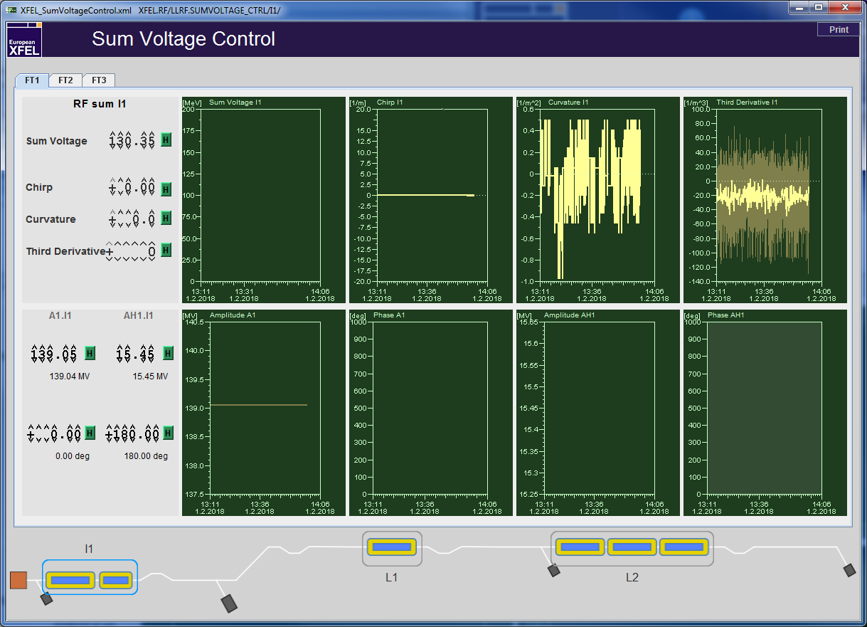
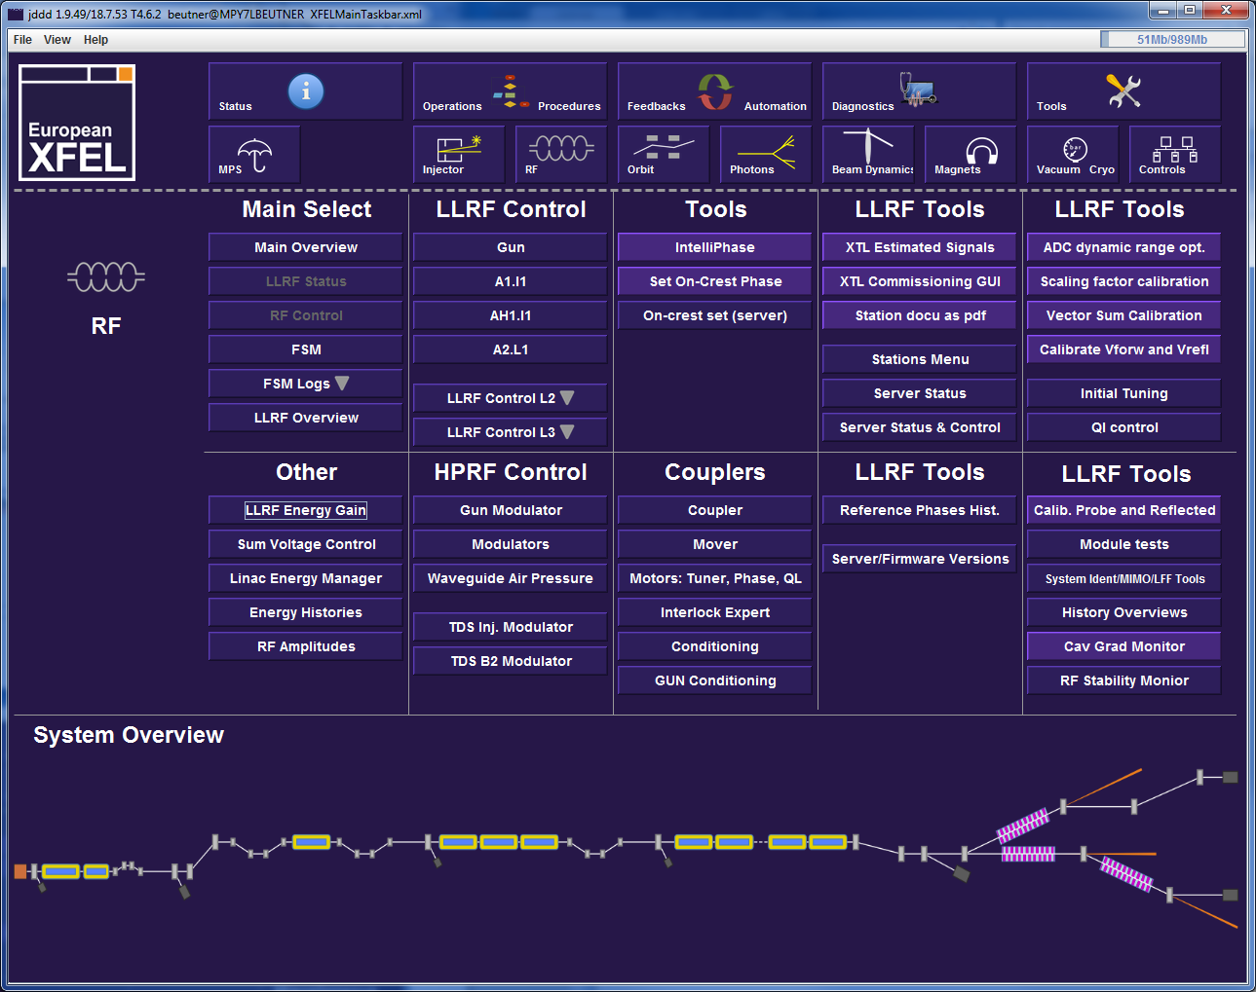
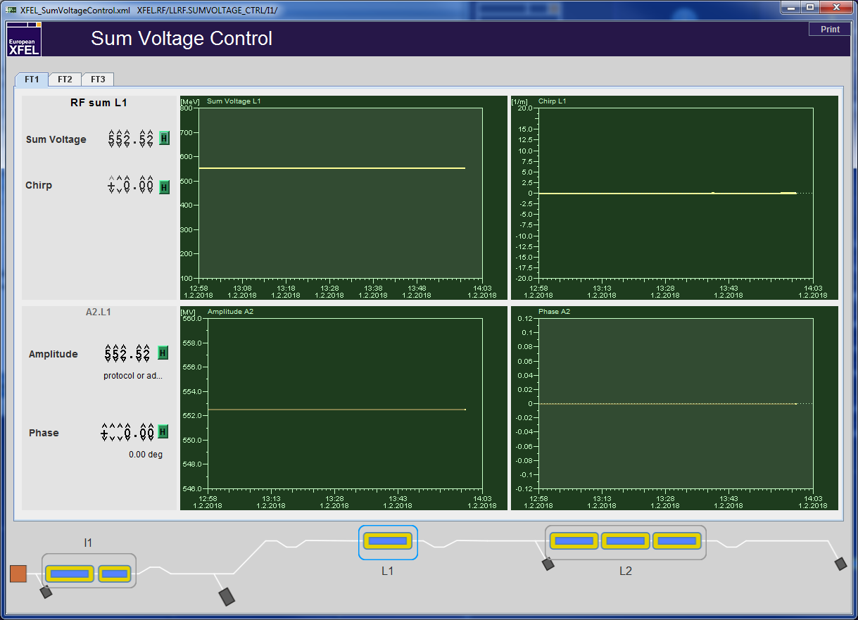
RF Setup and Tuning

Slide 18
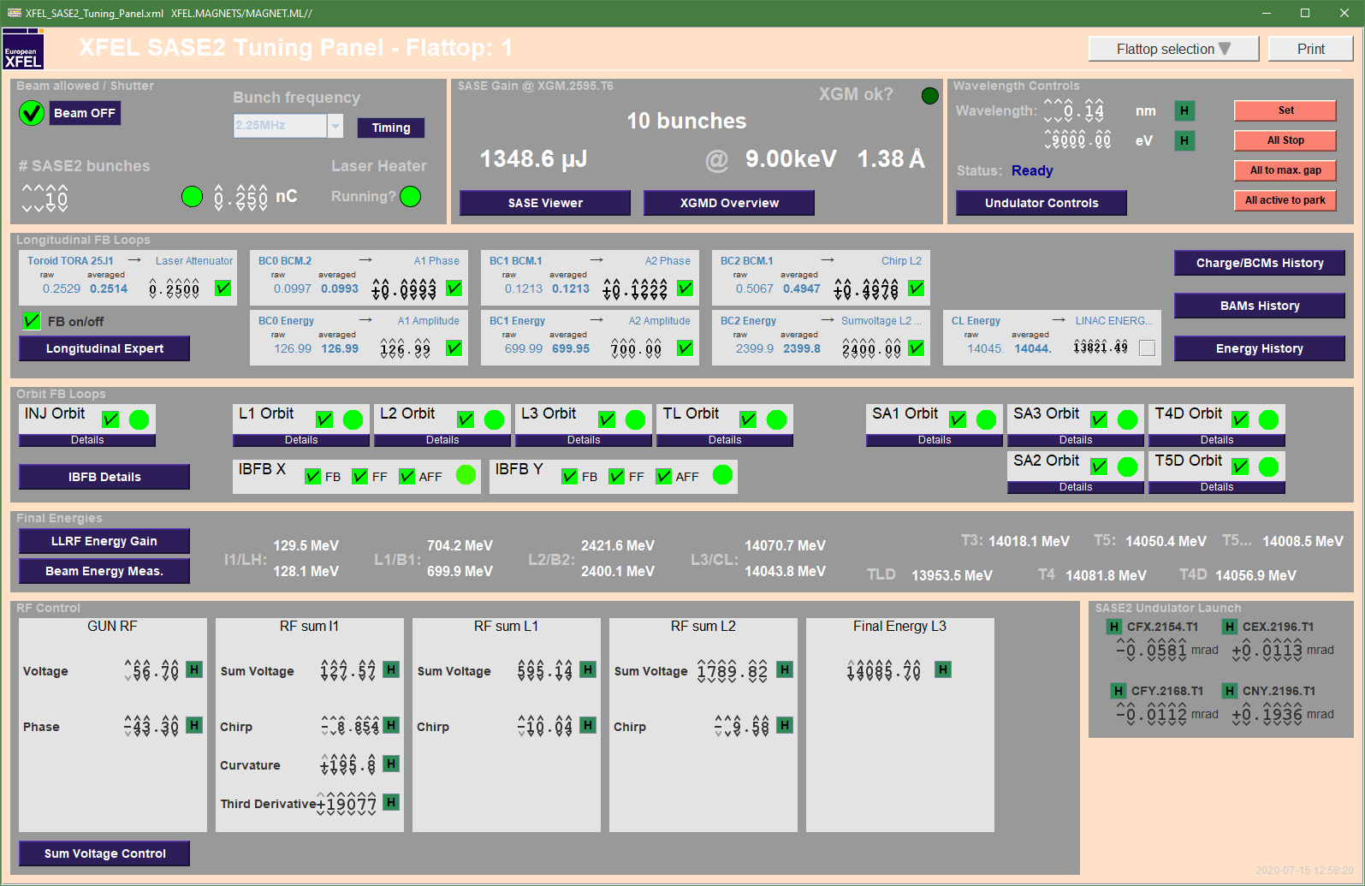
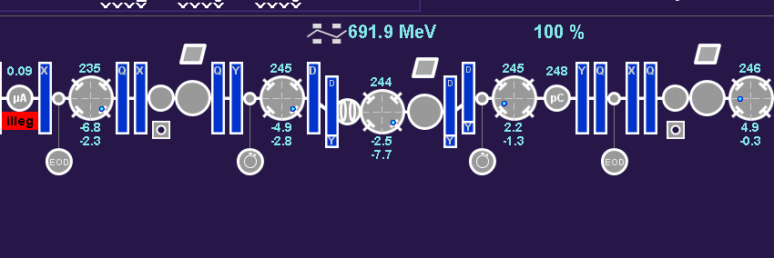
BCM
Diffraction Radiation downstream
of the chicanes depends on
compression
Diffraction radiators must be moved in
BCM Signals are kept to tuned values
with the compression feedback – do not
just switch the feedbacks on to unknown
targets

Slide 19
Compression Setup Procedure I
make sure BC dipoles are set and cycled to angle = (-7.83, -3.05, -2.36)deg in BC0, BC1, and BC2 respectively.
  these values result in R56 = (-50, -50, -30)mm.
  make sure the correct optics for this bending angle is set in the machine
make sure the compression feedbacks are deactivated
phase scan to set on-(anti-)crest to A1,AH1,L1,L2 to 0(180)deg
Set the design configuration by using the Sum Voltage Knobs to:
use magnet energizer to scale the cold magnets between A1 and AH1 to the correct energy
 | sum voltage | chirp | curvature | third derivative
I1 | 130.0 | -9.1 | 270 | 25966
L1 | 569.8 | -9.1 | - | -
L2 | 1698.7 | -12 | - | -

Slide 20
Compression Setup Procedure II
confirm that beam energy is set to 130, 700, 2400MeV at I1, B1, and B2
  Check with B1D and B2D or at least with the BPMS energy server if in hurry.
  Correct by using the sum voltage knob in the corresponding linac (L1 or L2).
  The I1T energy server should read 130 which typically corresponds to about 128MeV in the LH.
When set up the above values subtract up to 150 from the 'curvature' parameter in I1 do this in steps of max 10.
close compression feedbacks by transferring the current compression monitor reading to the target value (arrow button) and then set the activation checkbox.

Slide 21
SASE Tuning
open longitudinal feedback loops
use chirps first L1, I1, and L2 in that order
  I1 is the most sensitive tune in the 0.1 or 0.01 range
  L1 should be tuned in with 0.1 steps
  L2 is the least sensitive knob step sizes of 0.1 to 1 can be used.
  Make sure that the L2 phase does not exceed 30deg!
If chirp tuning is not successful adjust curvature in I1. Steps of 1 or 10.
The I1 third derivative knob can be used in steps of 100 or 1000. Smaller steps have no real impact!
After tuning is finished e.g. after reaching a new SASE optimum, close the longitudinal feedbacks after transferring the BCM signals to the target values using the arrow button.
Up-to-date version in elog /doc/Beam Dynamics/…

Slide 22
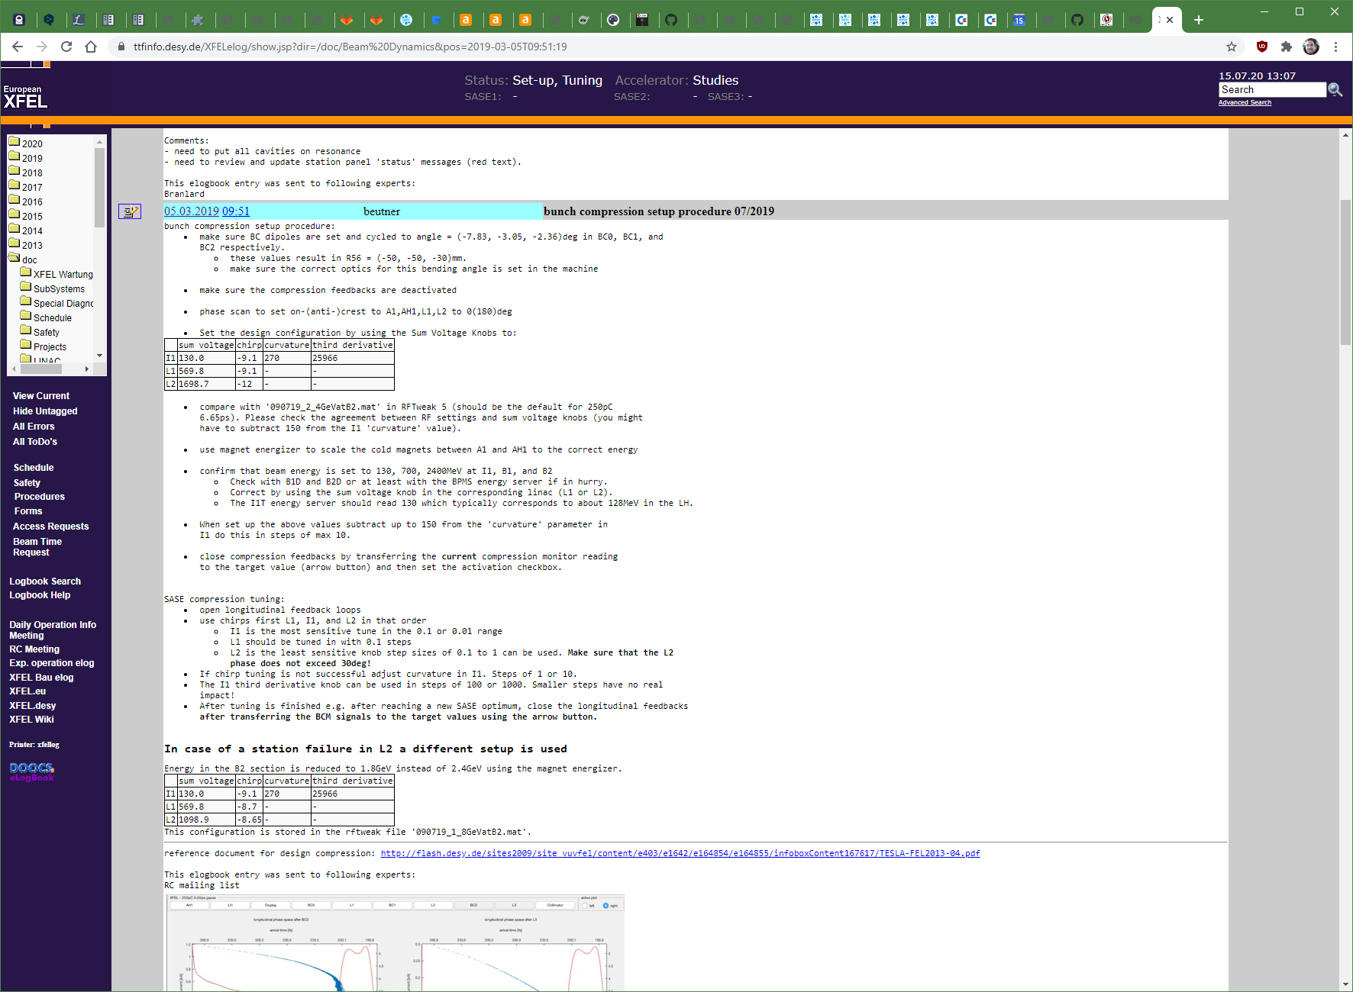

Slide 23
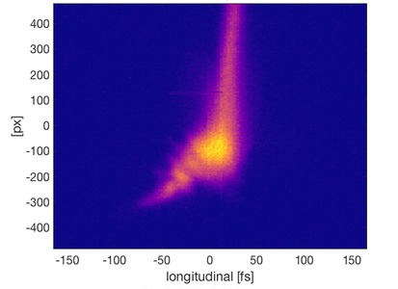
Thank You for Your Attention!

Slide 24
Questions?
Literature:
Igor Zagorodnov and Martin Dohlus, “Semianalytical modeling of multistage bunch compression with collective effects”
Phys. Rev. ST Accel. Beams 14, 014403 – Published 13 January 2011
ICFA Beam Dynamics Newsletter No. 38, ( http://icfa-usa.jlab.org/archive/newsletter/icfa_bd_nl_38.pdf )
Various PhD theses:
Frank Stulle ( http://www-library.desy.de/cgi-bin/showprep.pl?desy-thesis-04-041 ),
BB (http://www-library.desy.de/cgi-bin/showprep.pl?desy-thesis-07-040 ), …
In-house Experts: Martin Dohlus, Igor Zagorodnov, Torsten Limberg, BB

Slide 25

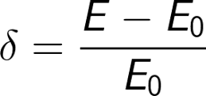
Bunch Compression – with Formulas

Slide 26
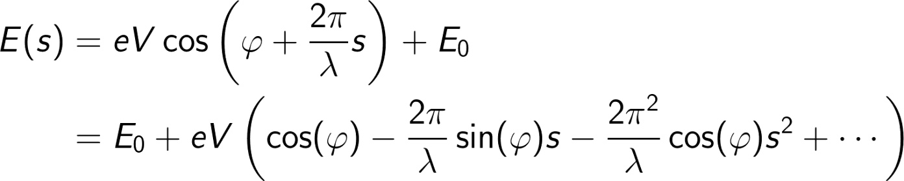
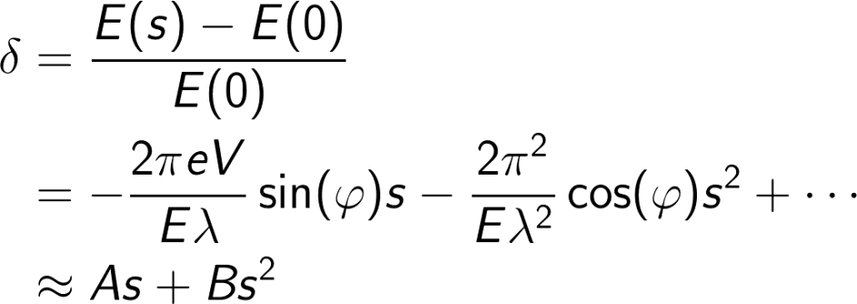
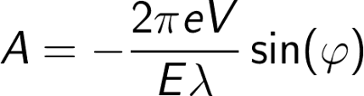
Energy Chirp Generation

Slide 27

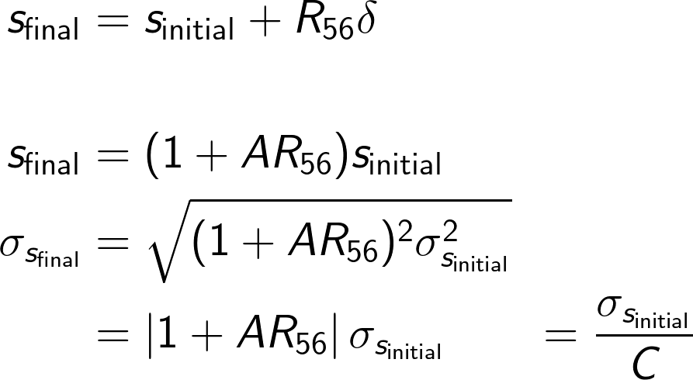
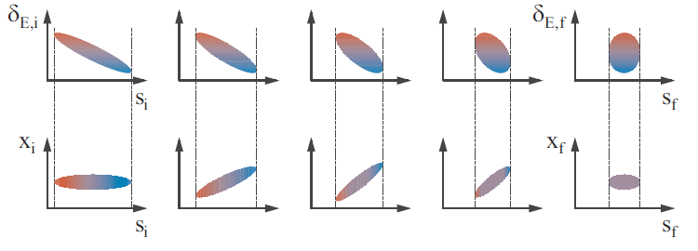

Linear Compression
Full compression at , however C = 1/0 !

Slide 28

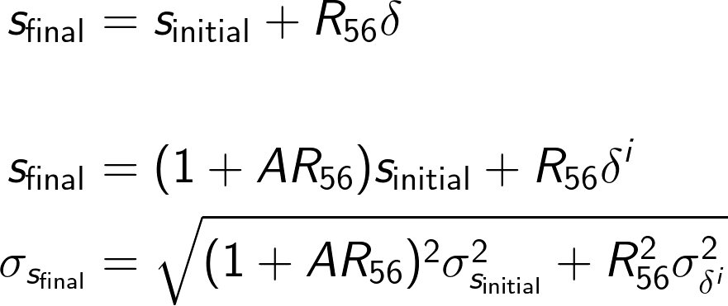

Linear Compression with Uncorrelated Energy Spread
each particle i has an individual “random” energy offset
Typically the “full” compression is avoided…

Slide 29
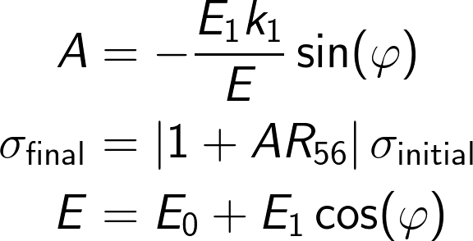
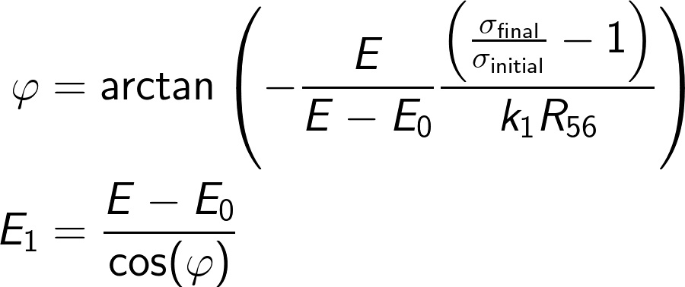

Simple Compression Setup
E₀,k₁,0 deg
E₁,k₁,phi
total energy E
Is this Ok?

Slide 30
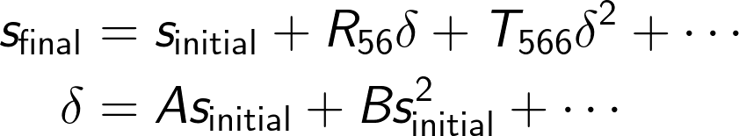
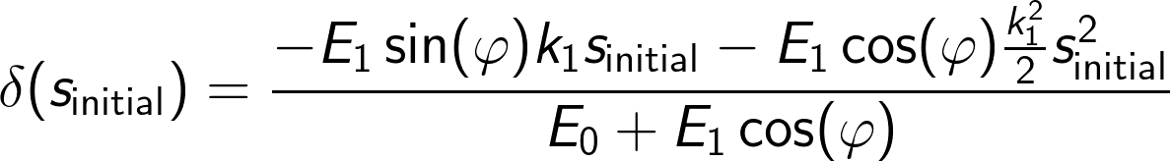
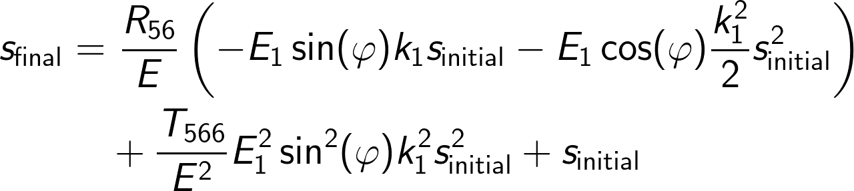
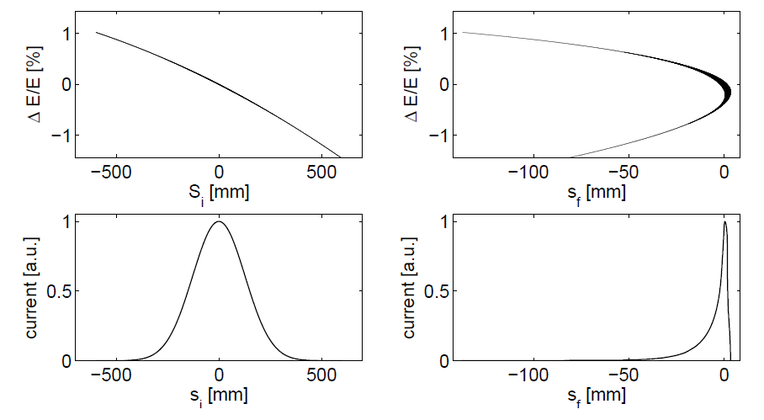
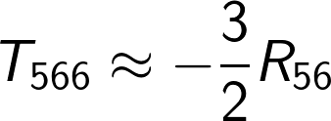
Non-linear Compression
E₀,k₁,0 deg
E₁,k₁,phi
total energy E
Can we tune the T₅₆₆-term to compensate the E₁ quadratic-term?
No since
This is NOT Ok!

Slide 31
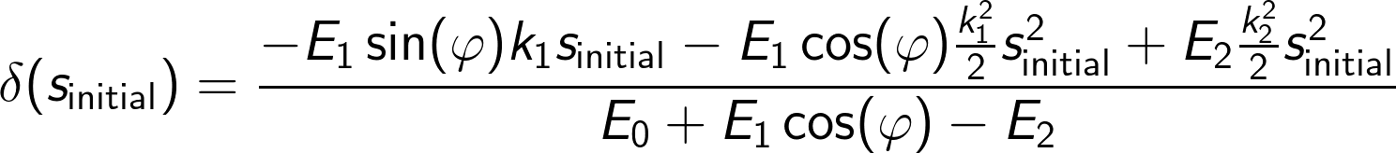
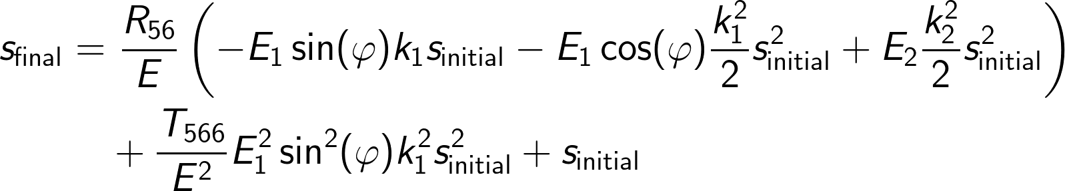
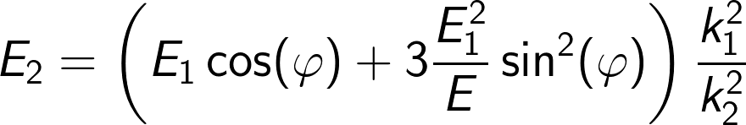
Linarised Compression
E₀,k₁,0 deg
E₁,k₁,phi
E₂,k₂,180deg
total energy E

Slide 32
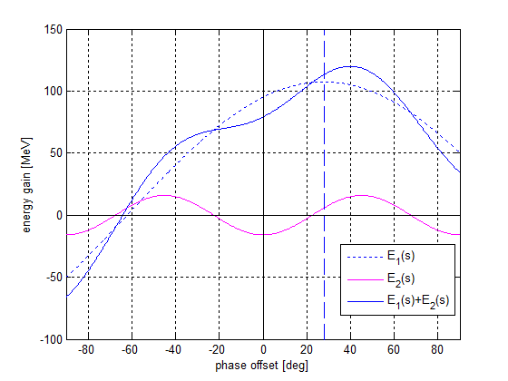
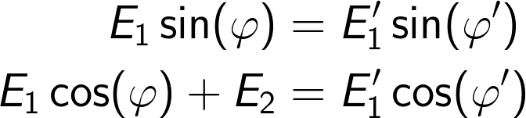
Energy Compensation
E₀,k₁,0 deg
E₁,k₁,phi
E₂,k₂,180deg
total energy E
Compensation of energy loss is required while the slope must be maintained.

Slide 33
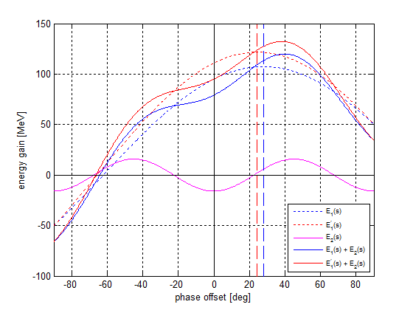
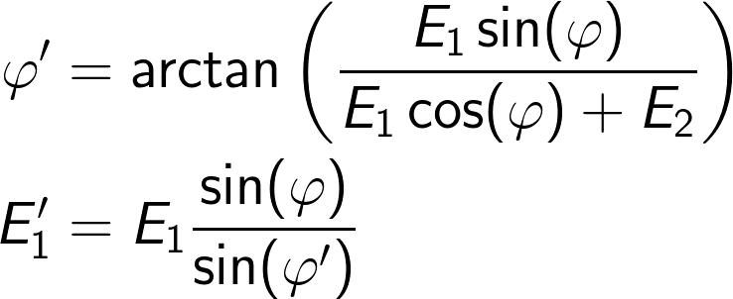
Energy Compensation
E₀,k₁,0 deg
E₁,k₁,phi
E₂,k₂,180deg
total energy E
Compensation of energy loss is required while the slope must be maintained.

Slide 34
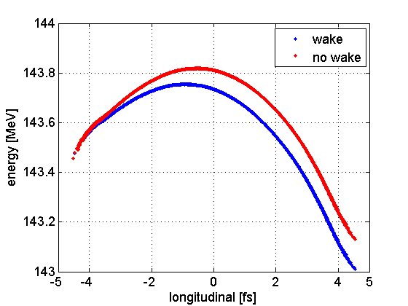

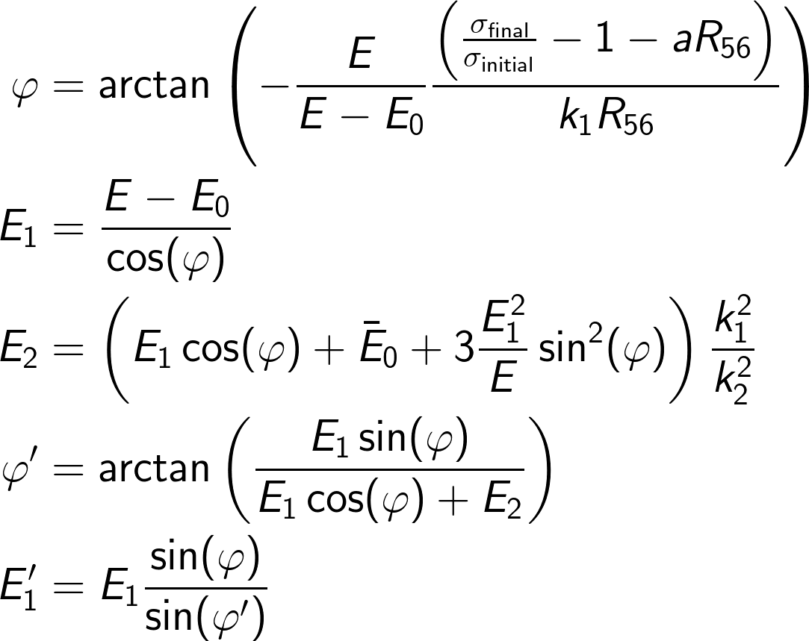
(Almost) General Solution for Single Stage BC
E₀,k₁,0 deg
E₁,k₁,phi
E₂,k₂,180deg
total energy E
head
If x-band is not operated “anti-on-crest” an additional linear compression term plays a role.

Slide 35
The End

