Slide 1
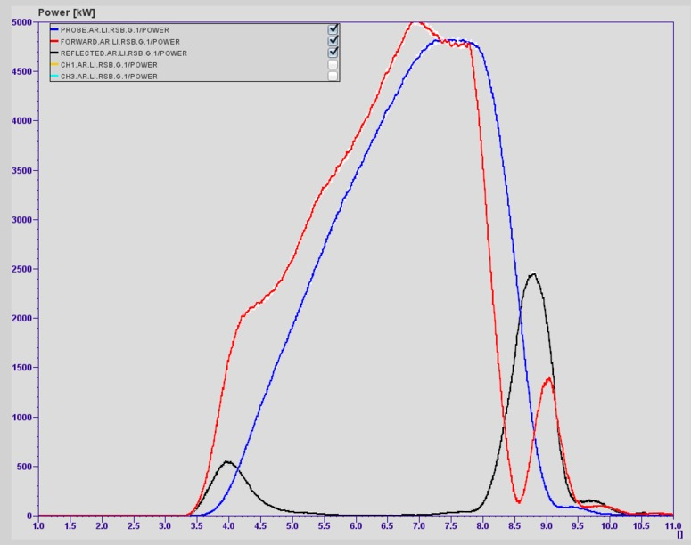
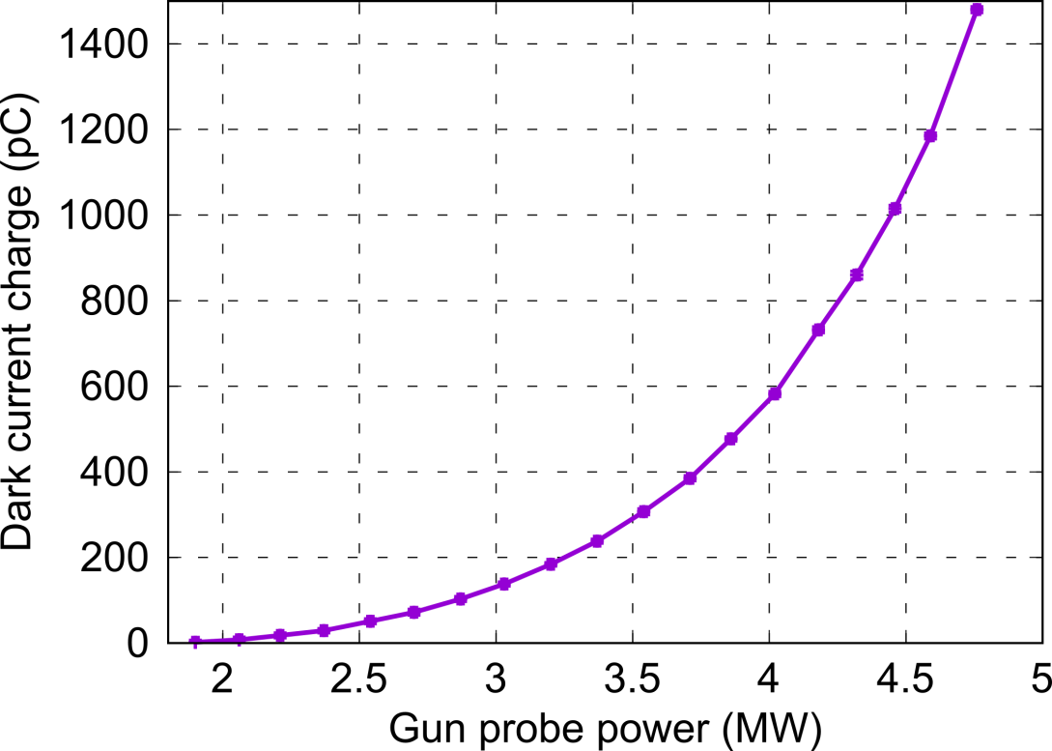
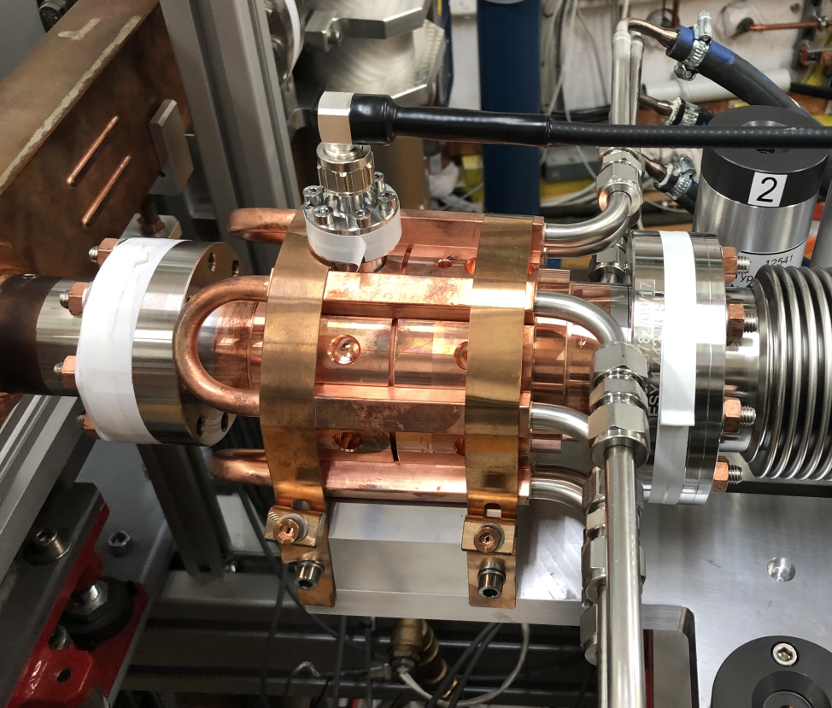
Accelerator R&D – SINBAD / ARES
RF conditionig finished - very smooth, no bigger vacuum avtivity.
Issues: water leak gun cooling, magnet power supplies earth fault.
Dark current too high – Investigations ongoing.
DC characterization
Cathode exchanged (Mo → Cs2Te)

