Slide 1
ECAL for the LUXE CDR
Wolfgang Lohmann

Slide 2
Phase 1 calorimeter
LUXE needs an electromagnetic calorimeter to count the number of electrons and to measure the energy spectrum
Highly granular
Highly compact
Fiducial volume 50 x 10 x 10 cm³
Good energy resolution
Moderate timing
Moderate radiation hardness

Slide 3
Calorimter of the LUXE experiment

Slide 4
Phase 1 calorimeter
Ideal case:
Compact detector planes
a la FCAL
Pad size 5 x 5 mm²
Tungsten absorber thickness
1 X₀

Slide 5
Phase 1 calorimeter
Weigth: 50 kg
Sensor area: 12000 cm²
Readout channels: 50000
Investment: 500 k
Engineering personpower
Lets call it Phase 1

Slide 6
Phase 1 calorimeter
What we have so far:
MC simulations to estimate the performance for energy resolution, shower position resolution, electron counting using energy deposition as a function of the abcissa,
ideal conditions, old geometry, no background, no acceptance limits
A preliminary cost estimate for the simulated version.
What is missing:
A more realistic MC simulation including current geometry, backgroud and geometric acceptance limits.
A mechanical concept
A concept for readout, daq
A more realistic cost estimate, including person power
Potential collaborators

Slide 7
Phase 0 calorimeter
What we have so far:
Three potential option for an ECAL
Calice prototype
LumiCal
A dedicard demonstrator of the phase 1 calorimeter
What is missing:
For 1: the calorimeter is less compact, i.e. some simulation on the performace needed,
Technical: who will install it, who will pay for it, how to integrate it in the LUXE readout
For 2: Compactness fine, segmentation different, also some simulation needed, FLAME readout needs to be completed, potential problem of money
For 3: prefered solution, but needs investment in tungsten plates (JINR?), sensors, and FE electronics, DAQ, physics potential.

Slide 8
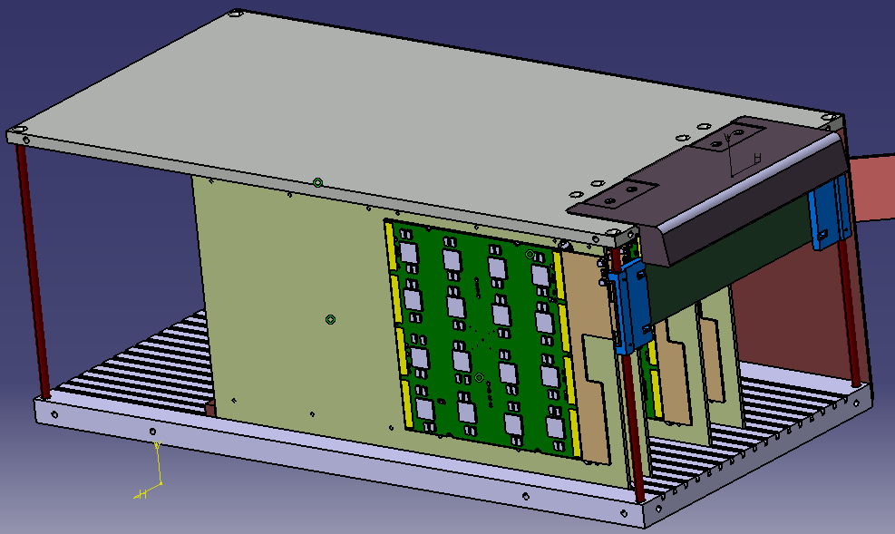
Phase 0 calorimeter
Option 1: Calice prototype
Fiducial volume 18 x 18 cm²
Pad size 5 x 5 mm²
20 detector planes correspond to 12 X₀
FE chip on sensor (less compact)
Readout using Calice standard

Slide 9
Phase 0 calorimeter
Option 2: LumiCal
Detector planes and tungsten absorber available
Pitch in x: 1.8 mm, in y: 1 cm
20 X₀ depth
FLAME readout, 5000 channels
FCAL data concentrator

Slide 10
Phase 0 calorimeter
Option 3: LUXE phase 1 demonstrator
6‘‘ sensors, 15 x 6 cm² , 5 x 5 mm² pad size, 25 pieces
Detector planes using FCAL technology
Flame readout, 7200 channels, plus data concentrator
Tungsten plates (25) from JINR
Excellent device for high granularity and compact electromagnetic calorimeter studies

Slide 11
ECAL LUXE CDR
Who may do what (phase 1):
I offer to do editorial work. Then, sharpen the cost estimate, drawings for a mechanical concept, on the level that it can potentially done like this, keeing connection to JINR for tungsten plates.
Hopes:
Yan may cover electrical and readout concepts, with drawings same level as above, review and complete the cost estimate, close collaboration with Marek
Gleb, potentially supported by Maryna may work on a more realistic simulation of the performance, including new geometry, laser parameters, beam parameters, background
Who else can do what?

Slide 12
ECAL LUXE CDR
Who may do what (phase 0):
We cannot offer three options, we have to prioritize
Hopes:
Yan may find out with Roman what is a realistic way to include the Calice prototype in LUXE.
Yan may discuss with Marek if LumiCal can be used, and who will do what
For the demonstrator some clarification is needed from TAU and UST
For all options we need simulations:
Less compact Calice prototype- how it matters on the performance
For all three options the physics potential should be quantified
Gleb and, potentially Maryna? Somebody else??

