Slide 1
ARES operation meeting, Monday 10th August 2020
by the ARES shift crew
Shutdown (Monday = Maintenance day)
RF Conditioning (Gun)
Beam Commissioning (Gun section)
Beam Commissioning (Linac section + EA1)

Slide 2
Summary of KW32
 | Tuesday 4th august | Wednesday 5th August | Thursday 6th August | Friday 7th August
Achievements | * Comparison steerer - spectrometer (momentum) * Measurement momentum vs phase | * Dark current study (analysis by H. Delsim) * MDI access: Screen R2 now operational | * Beam on screen R2 (after TWS1) * Measurement of transverse emittance for several charges * 10 MW in TWS2 | * Measurement of Schottky scans and momentum vs power * 38 MW in TWS2
Perturbating events | None | * Laser problem (RA) Solved by Caterina | * Second horizontal steerer not useable | * Sudden power drop and laser overheating (simultaneous)
Notes | * Momentum (spread) measurement with dipole limited by field of view | * Frank‘s 2D scanning tool operational | * „Dust“ still visible on screen X1 although cleaned. | * Baseline of Faraday cup reading is not zero and is dependent on the gun power.

Slide 3
MKK problems
FRI afternoon.
20 deg Water switched off → Laser switched off, power drop, MSK racks warmed up.
MKK shift and water on-call investigating.
Water pressure too low and new pump not yet regulated.
Work ongoing.

Slide 4
Other technical issues
Screen R3 not working – repaired.
Problems with Dual Plane Steerer X2 – MKK informed.
Power-dependent baseline FC1 – MDI informed, problem not understood.
Collimator movement – MDI informed.
Signal calibration for TWS1 is ongoing.

Slide 5
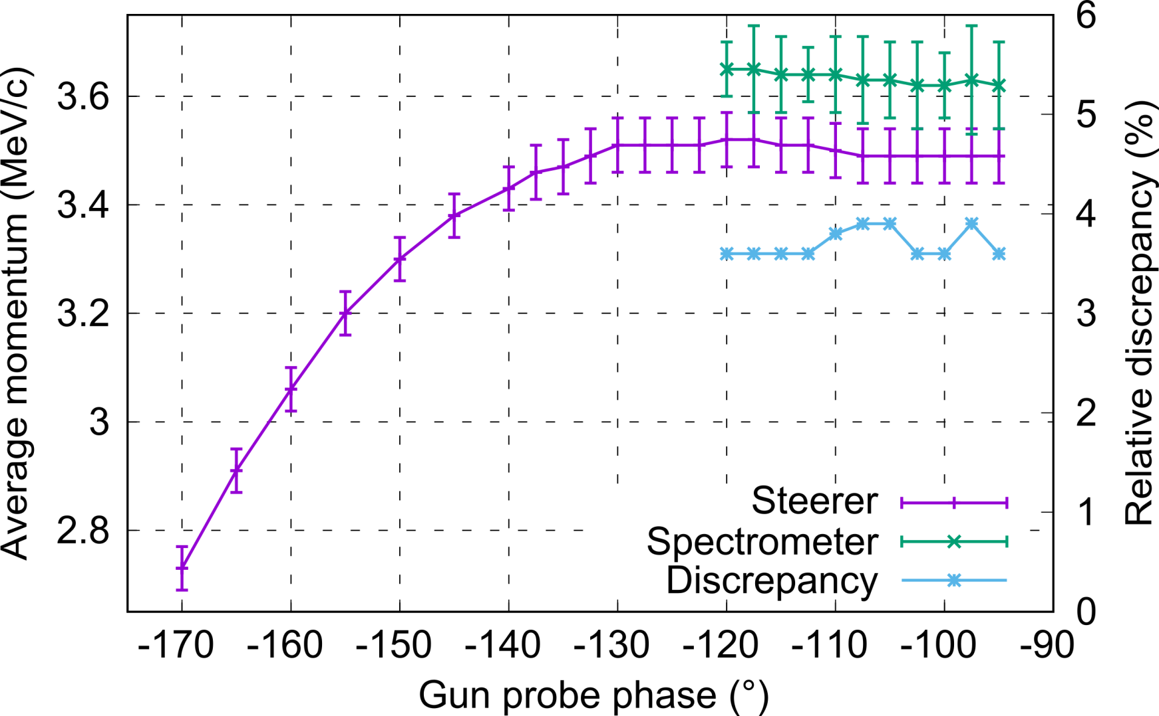
Momentum measurement vs phase
(comparison steerer – spectrometer)
* Steerer and spectrometer give compatible results (< 4% discrepancy).
* To determine which one is the most accurate we need to know precisely the power in the gun and the conversion law to field amplitude.

Slide 6
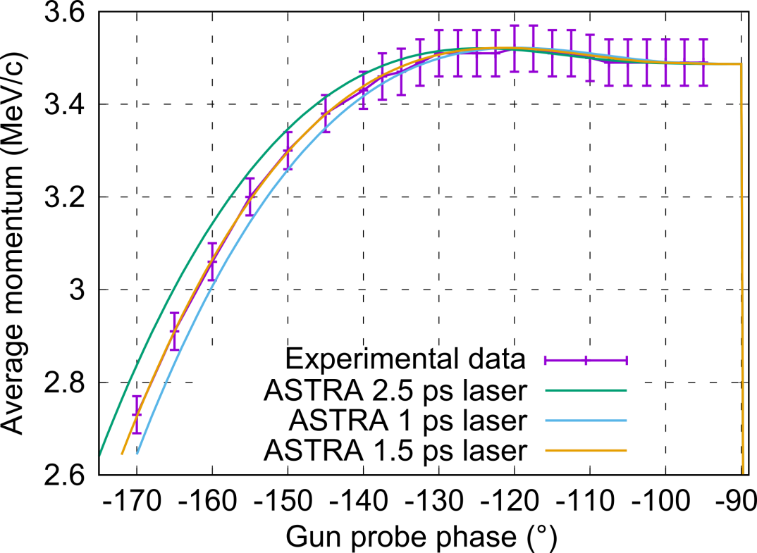
Momentum measurement vs phase
(comparison with ASTRA simulations)
* Comparison of the max. momentum with ASTRA simulations lead to an accelerating field of 67 MV/m (steerer) or 69.7 MV/m for a reading of 3.04 MW in the gun. For the previous gun, it was 83.1 MV/m for the same power.
$$\text{Estimated} \text{power}\text{−}\text{to}\text{−}\text{field} \text{conversion} \text{law}\text{ (}\text{to} \text{be} \text{validated}\text{): }\left\{\begin{matrix}steerer:E({MV}/{m)=38.40\sqrt{P(MW)}} \\ dipole:E({MV}/{m)=39.97\sqrt{P(MW)}} \\ old gun:E({MV}/{m)=47.67\sqrt{P(MW)}}\end{matrix}\right.$$
* Fitting curve of momentum vs phase with ASTRA (ongoing, see below) will give a first hint on the cathode emission time (to be cross-checked with Schottky scan, 3-phase method, etc.).
Knowledge of the threshold phase for beam emission is crucial for the accuracy of the laser pulse duration estimation
Measurement to be performed again with finer steps around -90° to refine the estimation

Slide 7
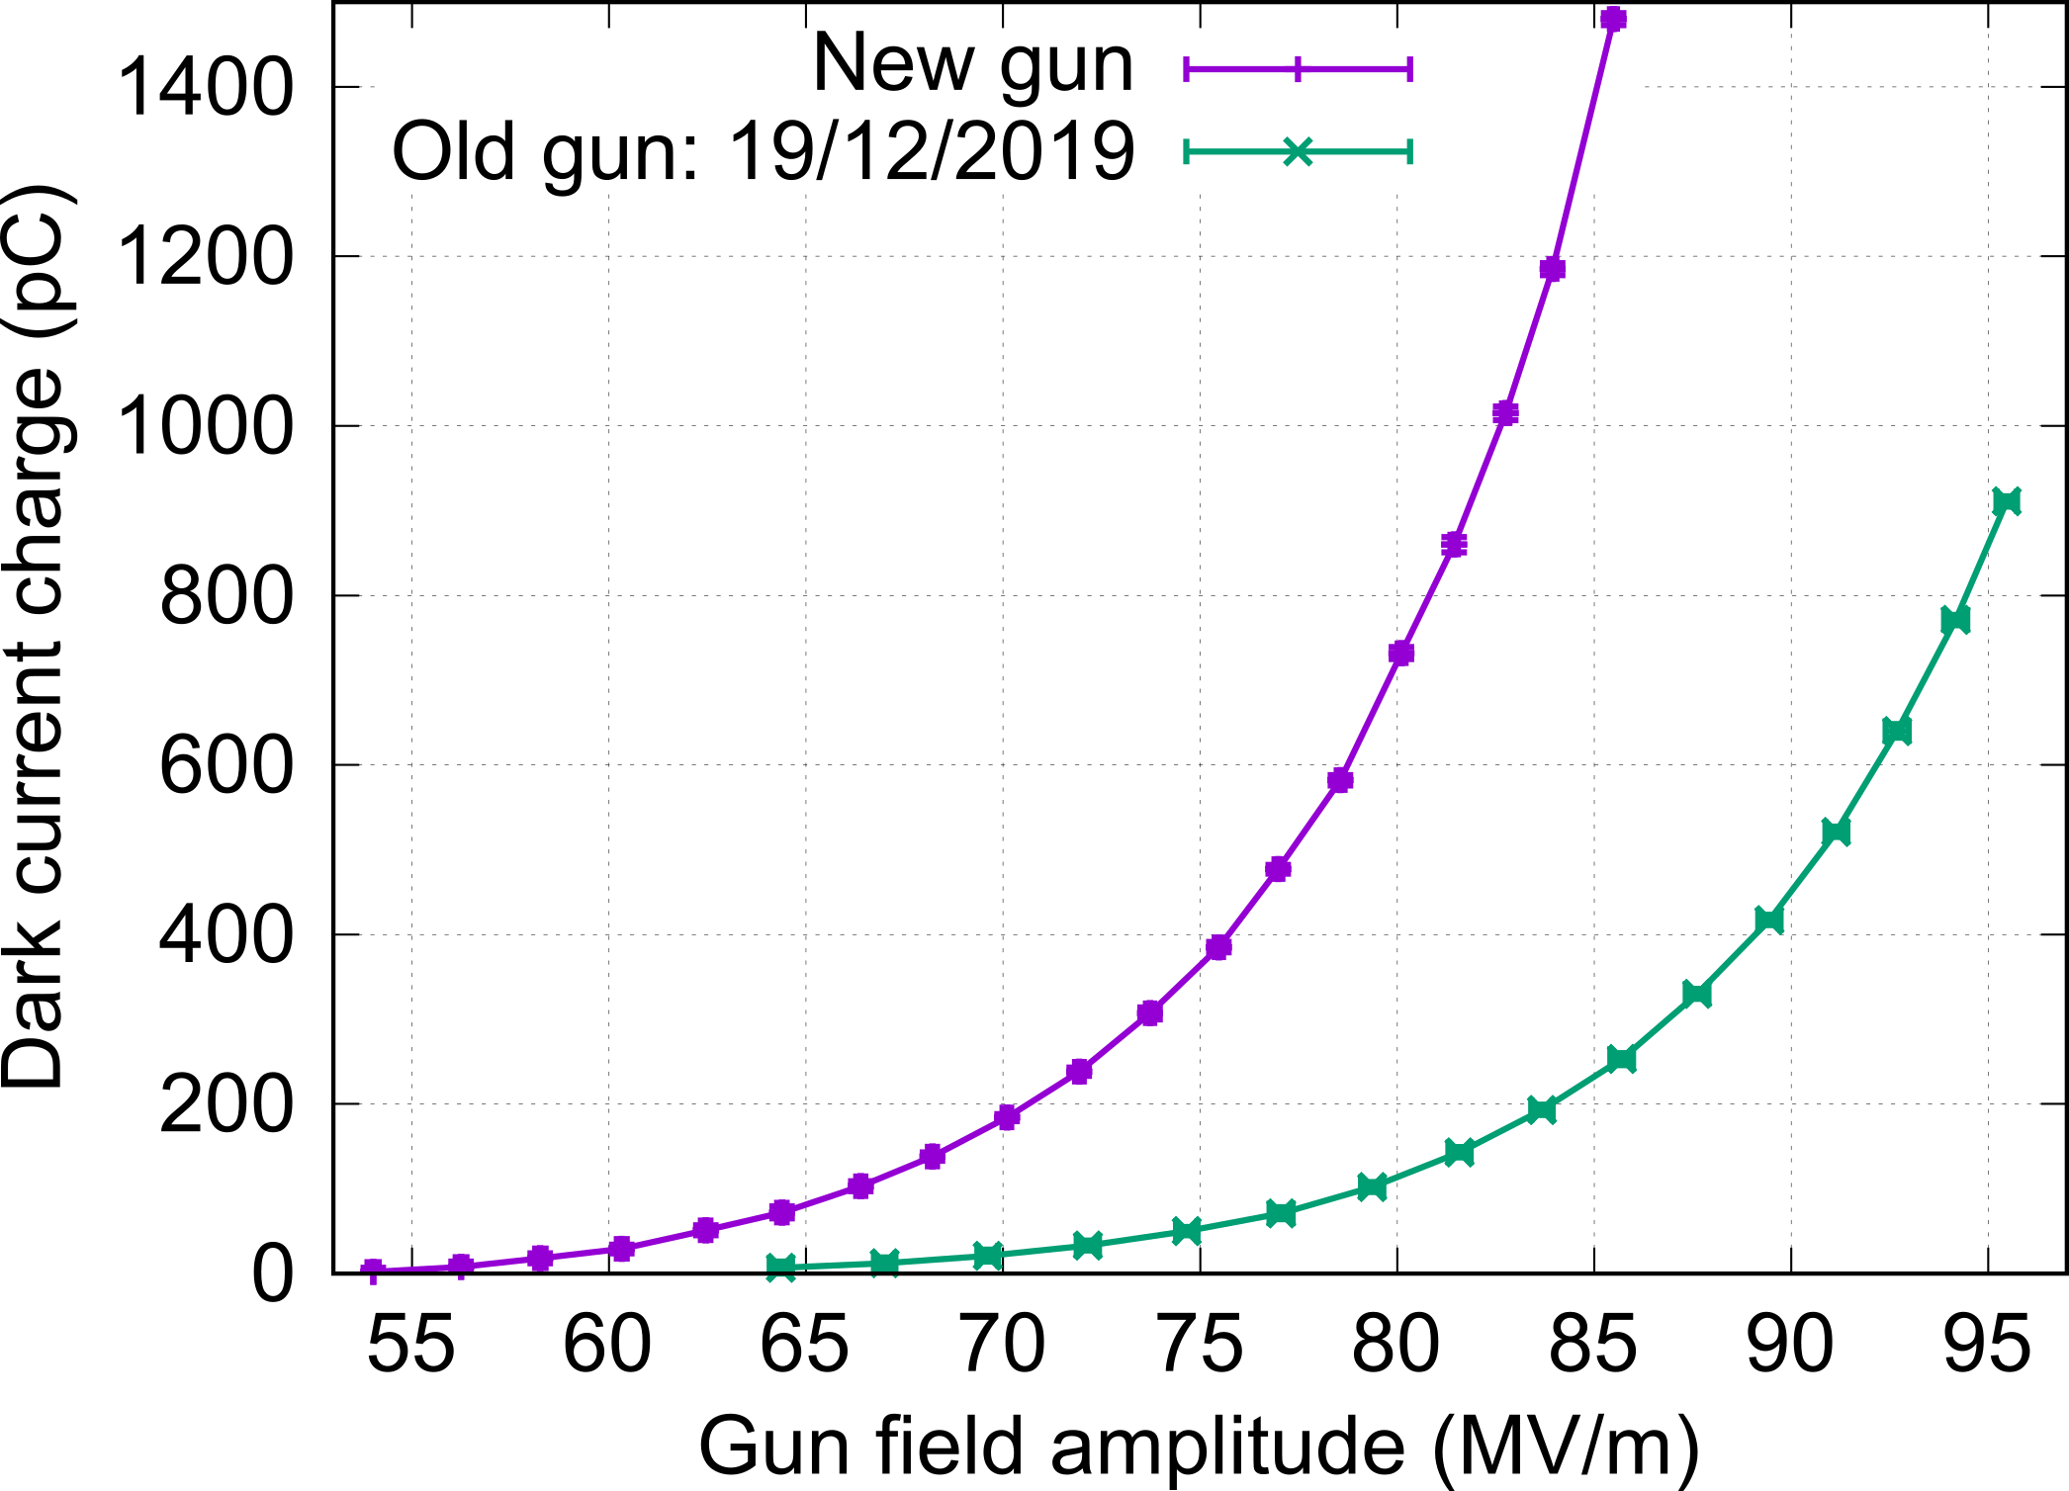
Data taken on July 17th 2020 (current gun) and December 19th 2019 (previous gun): Comparison of the dark current charge at FC1 vs Gun field amplitude.
Conditions: Cs₂Te cathode (the same one), All magnets off, RF pulse settings ? (to be checked).
* If the estimated power to field conversion law (see previous slide) is correct, the new gun is currently delivering more dark current than the old one (around a factor 6). We will check if this could come from different RF pulse settings.

Slide 8
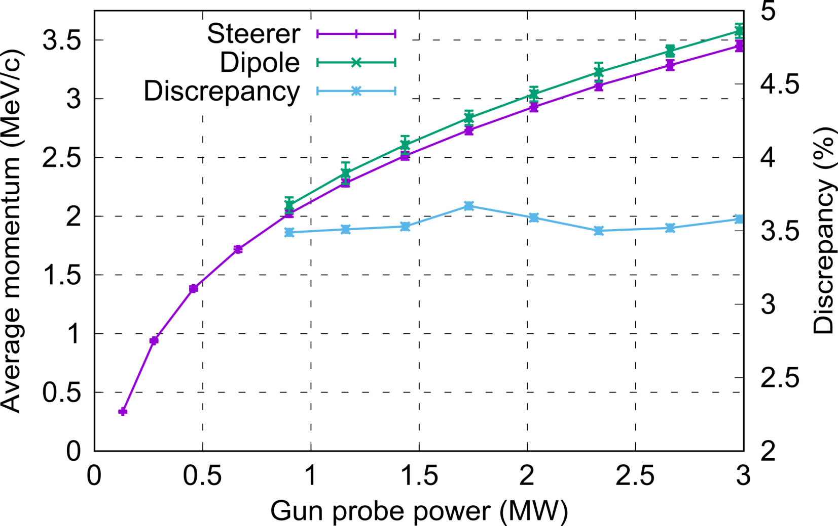
Momentum measurement vs power
(comparison steerer – spectrometer)
* Steerer and spectrometer give compatible results (≈ 3.5% discrepancy) + Relative discrepancy constant with power.
* Comparison with ASTRA (to be performed this week) will allow to perform a first check of the estimated power-to-field conversion law.

Slide 9
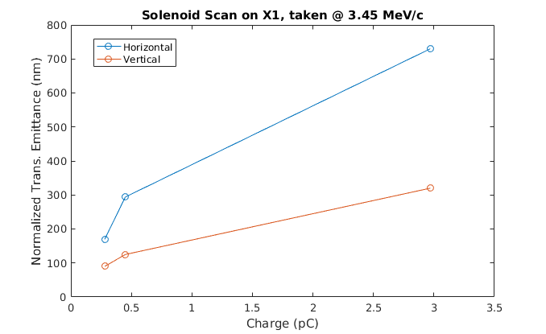
Transverse emittance vs charge
F. Mayet wrote a Python script, which analyses image data and produces Mathematica compatible data that can be used in Max Hachmann’s Mathematica notebook.
Took data on 06.08.2020 for different charges at 3.45 MeV/c using the X1 screen and gun solenoid.
Preliminary data
Error analysis will be added

Slide 10
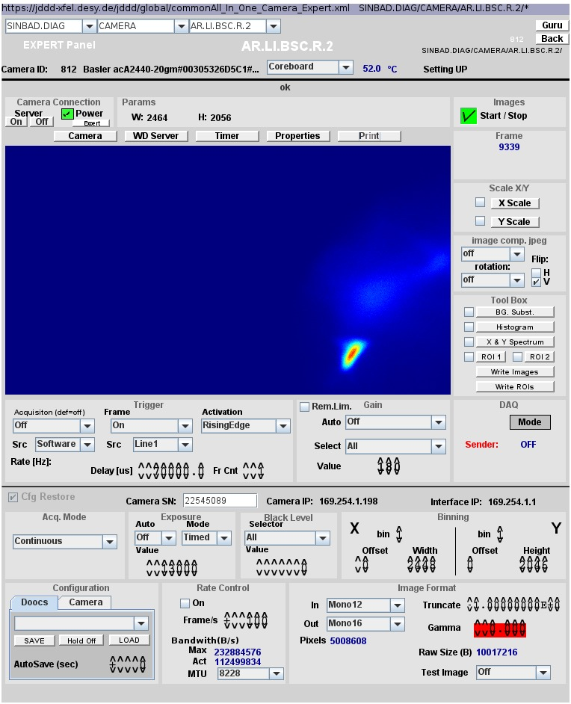
Beam after TWS1
Beam clearly visible on screen R2 (no acceleration yet!):
Beam was transported through the first TWS.
But: TWS solenoids are clearly misaligned (fast beam movement with changing field).

Slide 11
Plans for KW33
RF Conditioning TWS2
MDI collimator investigations
Repeat beam measurements with aligned solenoid:
Measurement: coupling factor
Phase scan vs. Centroid
Momentum (spread) vs. Phase
Laser movement and QE measurements
Emittance vs. Charge
Collimator studies
Stability measurements
MDI FC tests

Slide 12
Shift planning for KW33
Date | Shiftleader
10.8. | MIN/MSK in the tunnel
11.8. | MSK in the tunnel Florian / Thomas
12.8. | Thomas / Florian – MDI FC experts will join at 10.00!
13.8. | Frank
14.8. | Thomas

