Slide 1
ARES Operation Meeting
Summary of week 33
by the ARES shift crew

Slide 2
Summary of KW33
 | Tuesday 11th August | Wednesday 12th August | Thursday 13th August | Friday 14th August
Achievements | Dark current studies MKK magnet current tests / MIN modulator tests in parallel Collimator studies by MDI Beam charge as function of gun power | Momentum spread as a function of charge Visit by MDI Faraday cup experts TWS2 RF conditioning Collimator studies | Tunnel access for MDI and MVS Dark charge studies Solenoid alignment studies | Momentum measurement as function of RF-pulse delay Schottky scans for various delays Momentum measurement as function of phase
Difficulties | Jumps in baseline reading of Faraday cup | Collimator movement (horizontal) not sufficient |  | Python tools not working after doocs update (fixed)

Slide 3
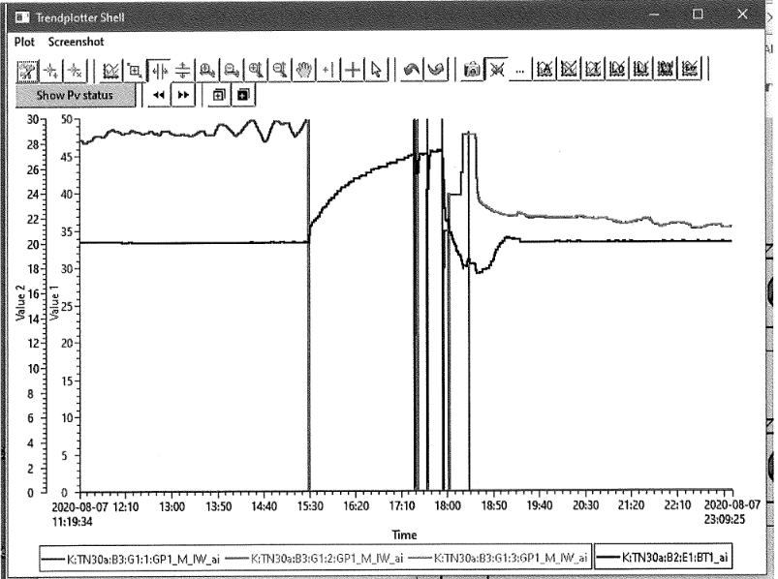
MKK problems
Summary MKK
Pump frequency
Temperature
VE30 am 28.07.20 - 6:24 Uhr
Broken frequency converter → redundancy pump not yet ready after installation.
This was repaired and the new pump connected to the system.
Kaltwasser 8°C am 07.08.20 - 15:25 Uhr
Temperature rise in the 20 deg water was due to pump failure of the 8deg water. High demand of cooling water, only one chiller in operation.
This was too fast to start the second chiller. Now both chillers are constantly in operation.

Slide 4
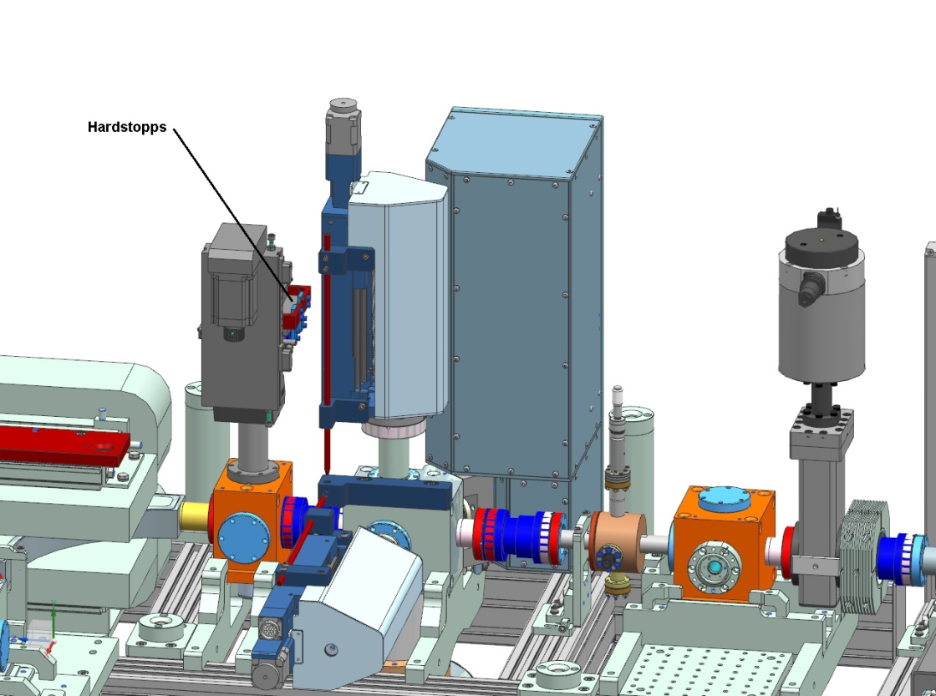
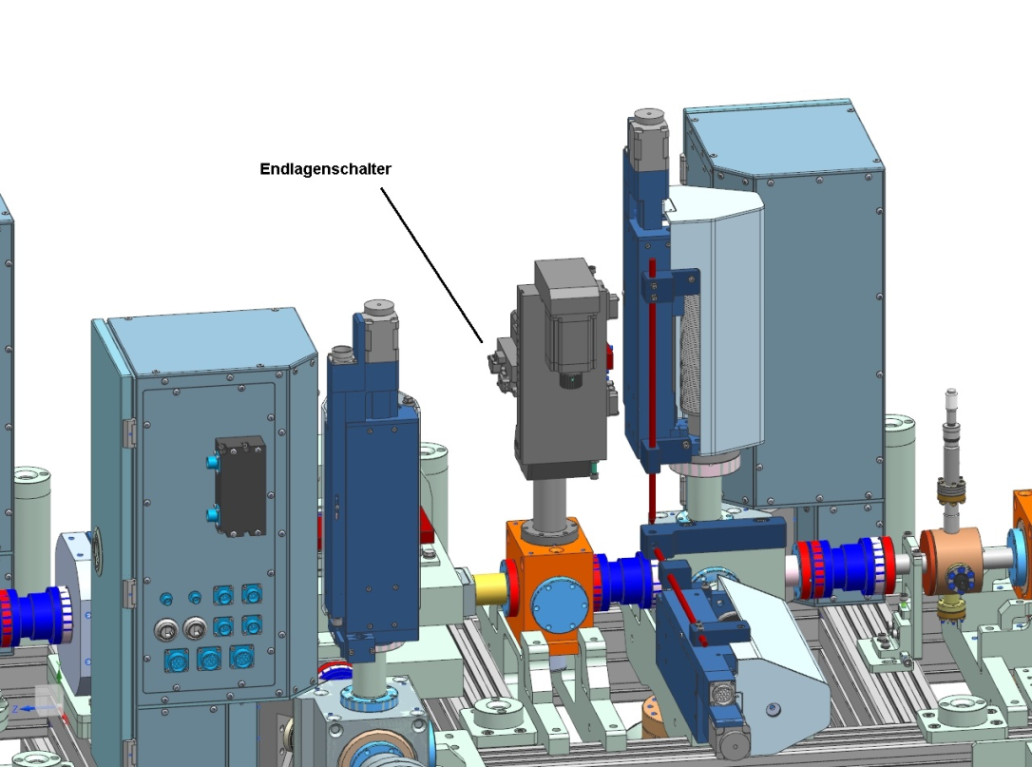
MDI
Installation new optics box – full screen
MON.24th on S1
3 weeks later on R1
Collimator adjustment of end switches – today (MVS and MDI)

Slide 5
MVS activity
MVS had a look at the cathode.
Cathode looks ok.
But cathode spring might be damaged. Replacement foreseen MON/TUE.

Slide 6
Other technical stuff
RF conditioning TWS2 finished
RF conditioning TWS1 – MIN analysis ongoing
Old gun in the MVS workshop for analysis.
Magnet current tests ongoing. Debug old HERA systems.
Dual Plane Steerer Problems X2 – MKK informed.
Power dependend base line FC – MDI informed problem not understood. Please send screenshot to MDI (M. Werner).

Slide 7
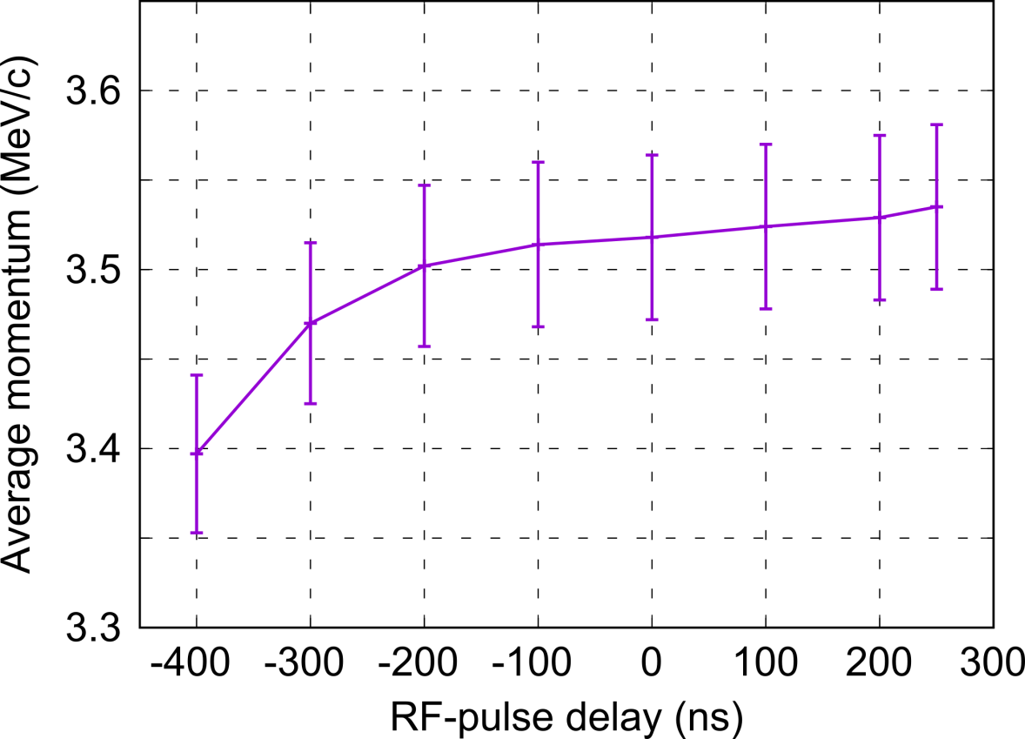
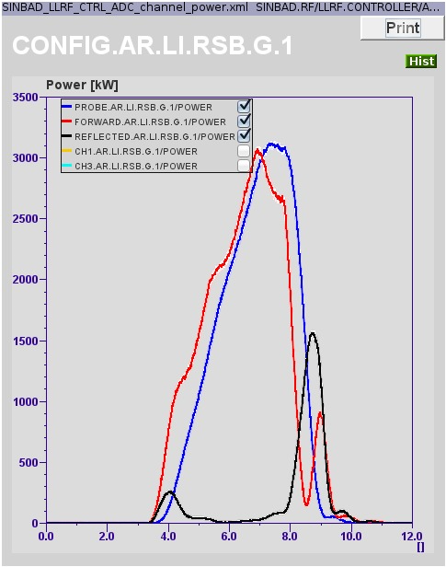
Scan average momentum vs RF-pulse delay
Goal: Evaluate if the laser pulse is hitting the cathode in the flat-top region of the RF-pulse (→ max. gain)
Likely position of the laser pulse in the RF-pulse
* Laser pulse is likely in the flat-top region of the RF-pulse, but not on the peak and more towards the end of the plateau → It has to be evaluated what is the maximal error we could have on the accelerating field (very likely ≤ 1 MV/m).

Slide 8
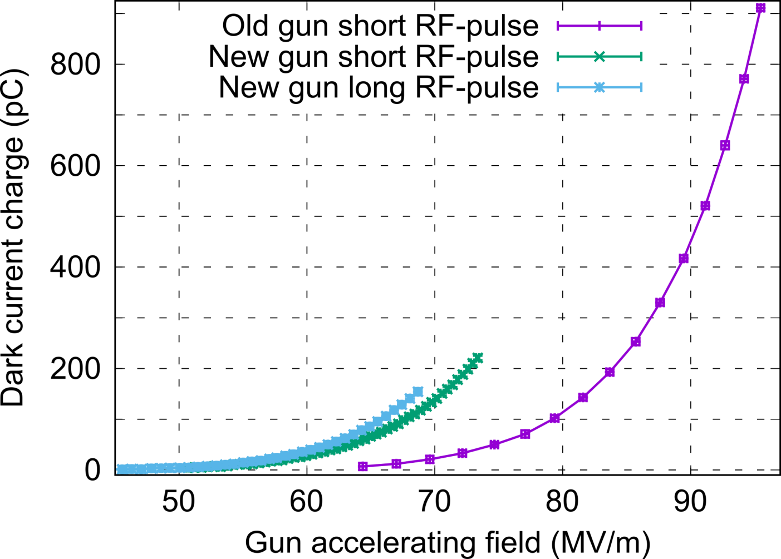
Dark current measurements
Comparison between previous and current gun for long (5.76 μs) and short (4.03 μs) RF-pulses
* Ratio of the dark current charge between the previous and current gun is not inverted (current gun seems to give more than the previous one) whatever the RF-pulse settings.
* Comparison with other DESY machines at 60.5 MV/m: ARES (42 μA); EuXFEL (25 μA); REGAE (2-3 μA) → Quite different values between the DESY machines (measurement conditions for each one have to be clarified before drawing conclusions).

Slide 9
Plans for week 34
MDI collimator investigations
Repeat beam measurements with aligned solenoid:
Measurement: coupling factor
Phase scan vs. Centroid
Laser movement and QE measurements
Emittance vs. Charge
Collimator studies
Stability measurements
MDI FC tests in parallel.

Slide 10
Summary
Week 34
Date | Shiftleader
17.8. | MVS/MEA/MDI
18.8. | MVS
19.8. | Frank
20.8. | Florian/Hannes
21.8. | Thomas/Hannes

Slide 11
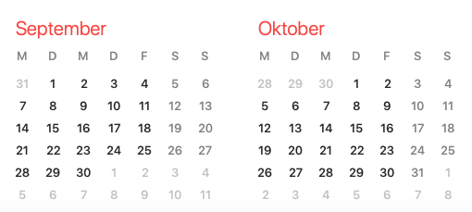
ARES schedule
Week 34
Shutdown (Monday = Maintenance day)
RF Conditioning (Gun)
Beam Commissioning (Gun section)
Beam Commissioning (Linac section + EA1)

