Slide 1
Phase velocity measurement
Calibration free characterization of integrated Terahertz waveguides
Max Kellermeier
Francois Lemery, Klaus Flöttmann, Ralph Aßmann, Wolfgang Hillert
max.kellermeier@desy.de
17 August 2020

Slide 2
Agenda
Introduction
Measurement Principle and Four term error model
Current measurement results
Discussion and Outlook
Notes:
Why?
What and how?
Show results
Limits and outlook

Slide 3
Agenda
Introduction
Measurement Principle and Four term error model
Current measurement results
Discussion and Outlook
Notes:
Why?
What and how?
Show results
Limits and outlook

Slide 4
Introduction: AXSIS
Frontiers in Attosecond X-Ray Science: Imaging and Spectroscopy
Fully Coherent Attosecond X-ray Source
Based on THz Acceleration and Inverse Compton Scattering
Notes:
to outrun radiation damage effects due to the necessary high X-ray irradiance
Phase velocity here not refering to the accelerating mode but the fundamental mode
Still useful insights about the waveguide

Slide 5
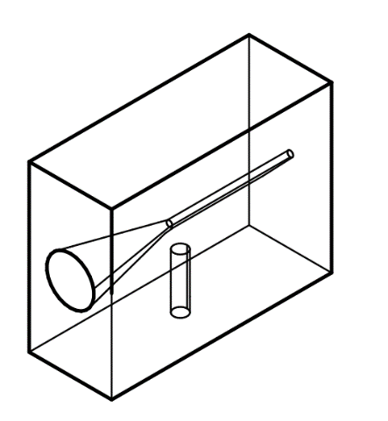
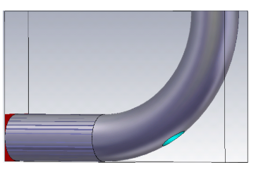
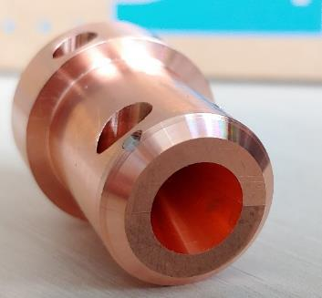
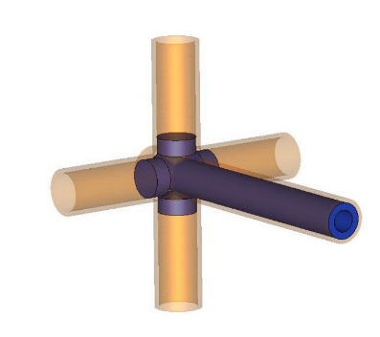
Introduction
Emerging interest in THz waveguides in the accelerator community:
“Active devices” which are driven by external THz sources (streaking, accelerating)
“Passive devices”: Beam-driven, acts as THz source
Due to small feature sizes → monolithically integrated coupler and waveguide preferential
How to characterize the waveguide if you cannot separate it from the coupler?
Critical quantity: phase velocity
In case of horn coupler: Causes additional phase shift
Notes:
A more general introduction
Waveguides:
Simple funnel and tube in a solid block
More advanced couplers like the one from Francois proposal for THz generation
Or this fancy side couplers foreseen by our CFEL collegues for AXSIS
Phase velocity: keep phase slippage as small as possible
Relatively short waveguides → phase shift at horn matters

Slide 6
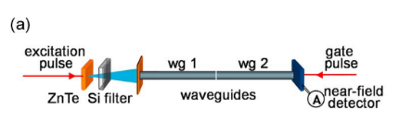
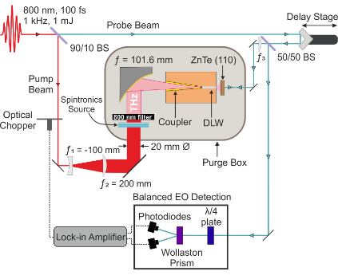
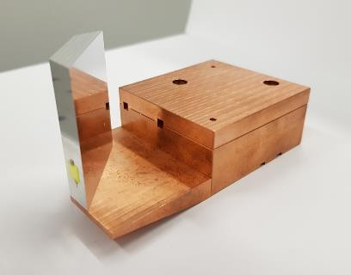
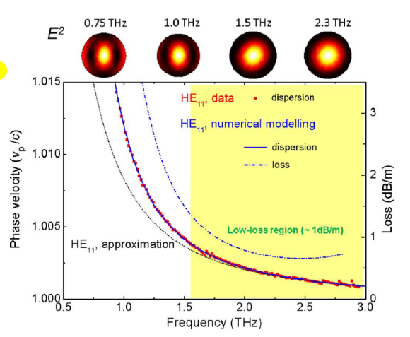
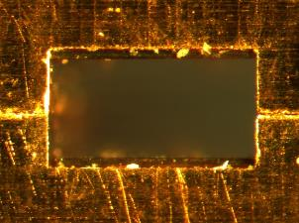
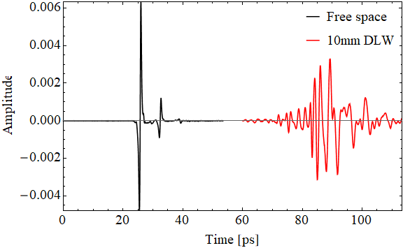
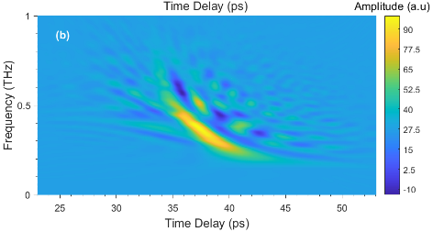
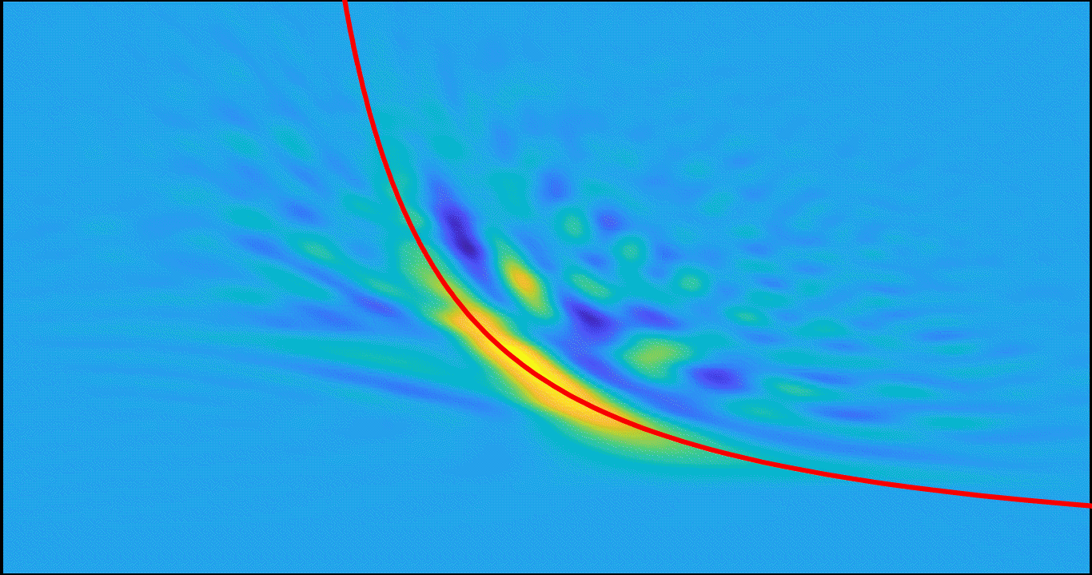
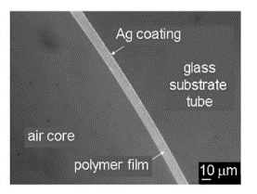
Introduction
State of the art
DLW exit
575 μm
695 μm
1200 μm
Mitrofanov, O. et al. “Reducing Transmission Losses in Hollow THz Waveguides.” IEEE Trans. THz Sci. Tech, 2011.
Georgiadis, V. et al. “Characterizing the Accelerating Mode of a Dielectric-Lined Waveguide Designed for Terahertz-Driven Manipulation of Relativistic Electron Beams.” 44th IRMMW-THz, 2019.
S.P. Jamison, “Terahertz Driven
Particle Acceleration of relativistic beams”, 4th EAAC, 2019. (unpublished)
Notes:
Mitrofanov:
Optically generated THz
First waveguide used as luncher, no coupler included
Long waveguide (120 cm) → phase shift from coupling negligible
2.2 mm diameter Ag/PS waveguide
Single cycle pulse, using spectrogram, i.e. frequency depending on time → limited by capabilities of the transform
Group at CLARA in Daresbury applied same optical setup:
Traces shown → Phase and power spectra extracted but haven’t seen a dispersion line so far
My guess: Horn contribution can’t be taken out

Slide 7
Agenda
Introduction
Measurement Principle and Four term error model
Current measurement results
Discussion and Outlook
Notes:
Why?
What and how?
Show results
Limits and outlook

Slide 8
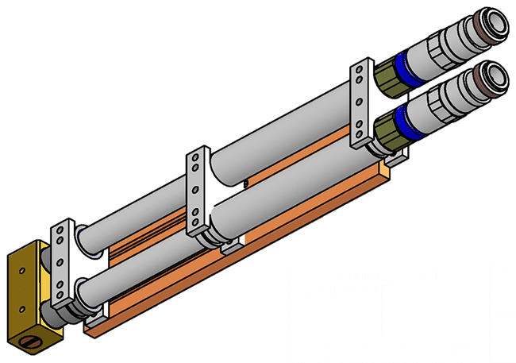
Measurement Principle
$$v_{ph}= \frac{ω}{β} = fλ$$
VNA: Fixed frequency → unknown wavenumber and wavelength in waveguide
Inspired by lower frequency techniques: Trombone for impedance matching (Constant impedance adjustable coaxial line)
By varying the length of the coaxial → change circuit from “open” to “short” (180° phase)
Measured length corresponds to half wavelength → phase velocity
Short-circuit
VNA Testport
Notes:
In RF field: wavevector usually beta instead of k
VNA sends out CW signal
Trombone: same principle applied in music instrument
RF device: Denoted as phase adjusters, line stretchers
One port to VNA, one short-circuited

Slide 9
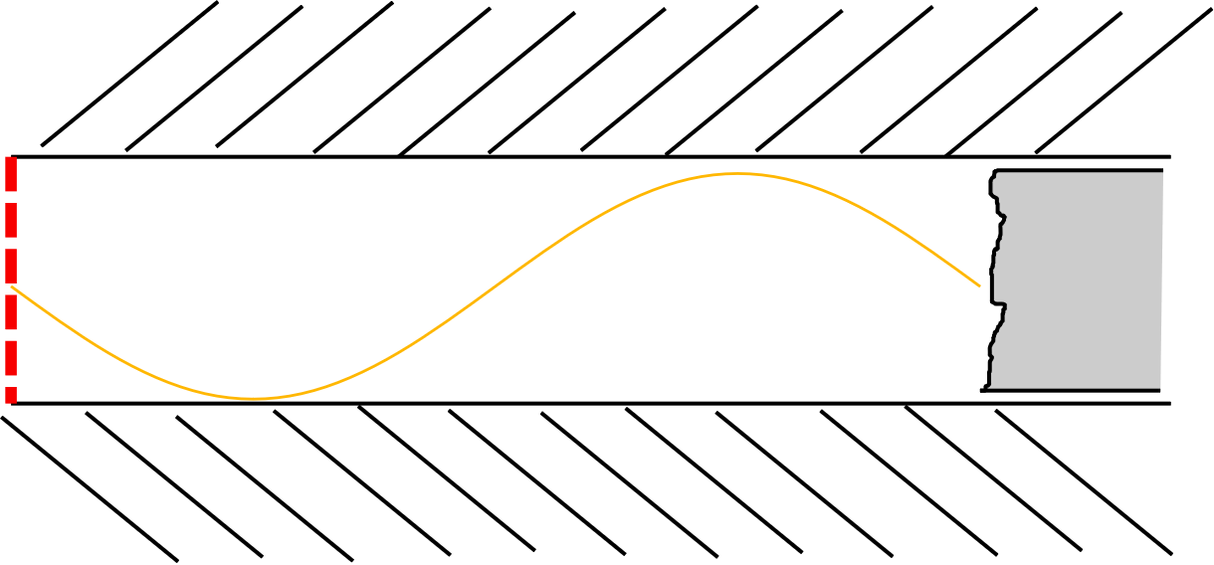
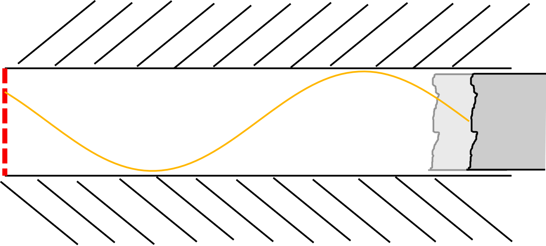
Measurement Principle
Why not trombone?
Current upper frequency limit: ~ 20 GHz
Required feature sizes of transition infeasible
Connector can cause significant effect
Reflection Method
Circuit does not have to be closed, only a reflecting obstacle
Obstacle movable (subwavelength scale) → measure phase difference
Transmission Method
Using phase difference between S₂₁ and S₁₁
But phase ambiguity
Notes:
Two main aspects:
Feature sizes required for a trombone mechanism infeasible at these high frequencies
Connector can cause significant contribution, similar to horn
At low frequencies the impedances of the connectors are matched
Generalization:
Why short-circuit? Any reflection exploited
Length of device fixed → change position of the origin of the reflection
Comment on Transmission technique:
S-parameters are applied for Linear Time invariant systems → no time information
Even though both reflection and transmission → phase ambiguity (30° vs. 390°)

Slide 10
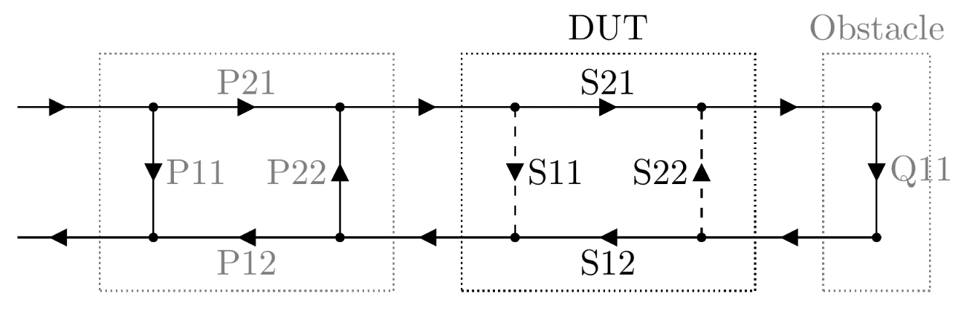
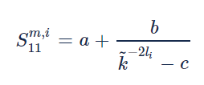
Four Term Error Network Model
Issue: Waveguide embedded in single block with horn → can’t be attached to VNA port (ref. plane)
Additional out-coupling horn and free space
Goal: self-calibration with measurements at different positions
Four Term Error Model
i-th measurement
Notes:
But: Principle does not account for couplers and freespace propagation → multiple reflections at interfaces and interference
→ Self-calibration method, denoted as 4-term error model
Illustrated here: horns , freespace, waveguide, obstacle
S-matrix for a waveguide, gamma includes the wavevector beta, k denoted as propagation factor
Doing the math:
Reflection from each network interface is a Möbius transform
arrive at S-parameter measured at test port
Terms similar to a standard Open-Short-Match calibration (directivity, source match, reflection tracking)

Slide 11
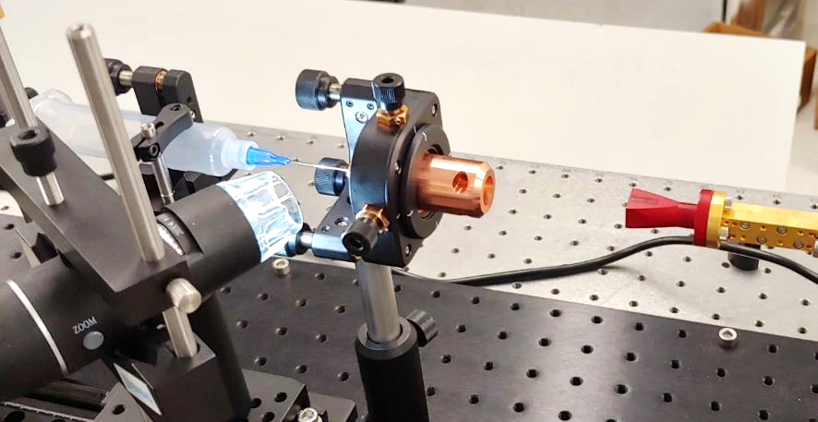
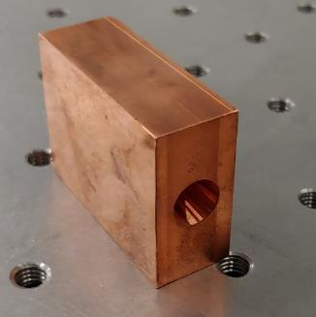
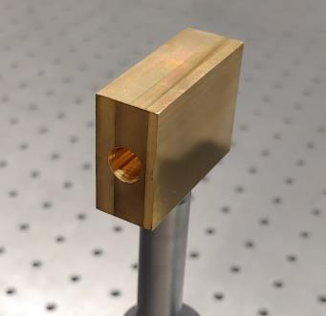
Experimental Setup and Waveguide Structure
Frequency range: 220 GHz – 330 GHz (Streaking: 267 GHz, AXSIS: 300 GHz)
Obstacles:
Syringe + Canula as obstacle (OD = 0.72 mm, ID = 0.41 mm), on motorized stage (+/- 1 µm)
Paper clip (OD = 0.89mm)
New: steel welding wire
Three different waveguide structures:
Conical horn drilled in copper monolithically
Same, but in brass
EDM machined in two half shelves, “split waveguide”

Slide 12
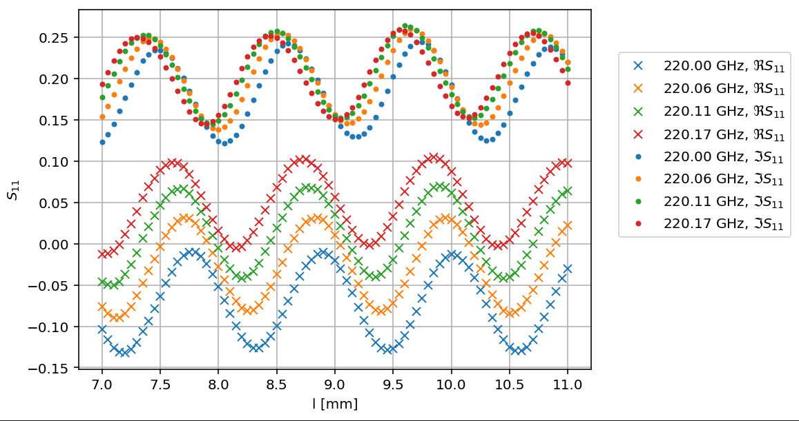
S11 depending on position in 4-term error model
Copper Waveguide 1
Measured: $S_{11}\left(f, l\right)$
analyzed independently for each frequency point:
$$S_{11}\left(l\right){\left.​\right|}_{f=f_{0}}$$
Notes:
After measurement set: data set of S_11(f,l)
Analyzed separately for each frequency point by fitting the 4-term error model to it
Example: Real and Imaginary part versus obstacle position, for selected frequency point
Nice sine wave, but does not have to be the case in the 4-term error model
Contributions from error term b and c can significantly distort the shape of the waveform
Here: b and c small

Slide 13
Agenda
Introduction
Measurement Principle and Four term error model
Current measurement results
Discussion and Outlook
Notes:
Why?
What and how?
Show results
Limits and outlook

Slide 14
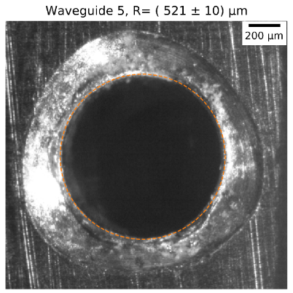
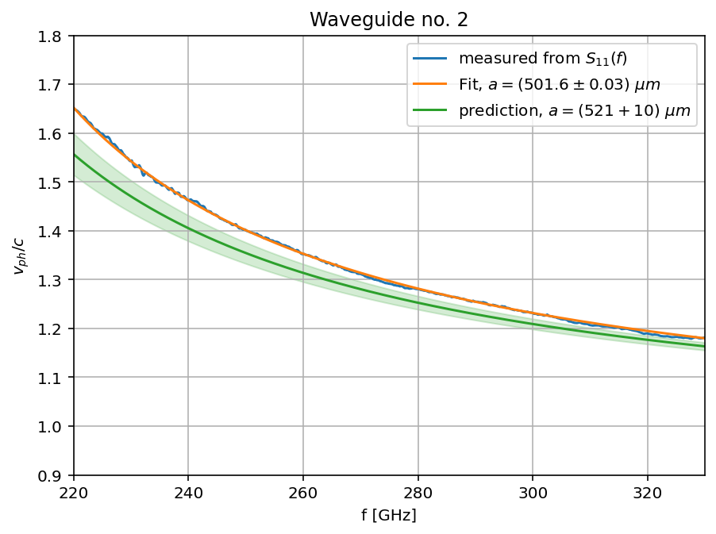
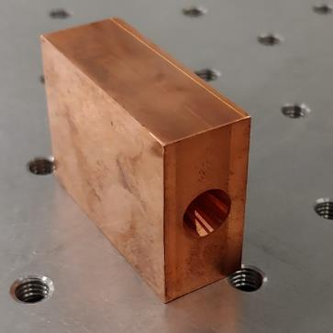
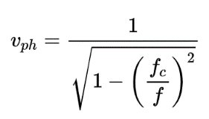
Analysis based on 4-term error model
Copper waveguide
Tweaking initial parameters for least squares problem → Curve fit works
Better result than harmonic analysis (FDM)
Notes:
Measurement 05
What do you see here?
In blue (behind the orange one): phase velocity computed from the 4-term error model (for each frequency point independently!)
In orange: fitting the dispersion line of the analytical solution for a metallic waveguide
In green: prediction based on the aperture measured under the microscope → a circle detection algorithm applied to the microscope image (Hough transform + accumulator)
Measurement does not fall into the error band of the prediction
Uncertainty in radius might be too optimistic
Hole drilled → might be larger at the outside than inside
→ fit result more trusted than the microscope image

Slide 15
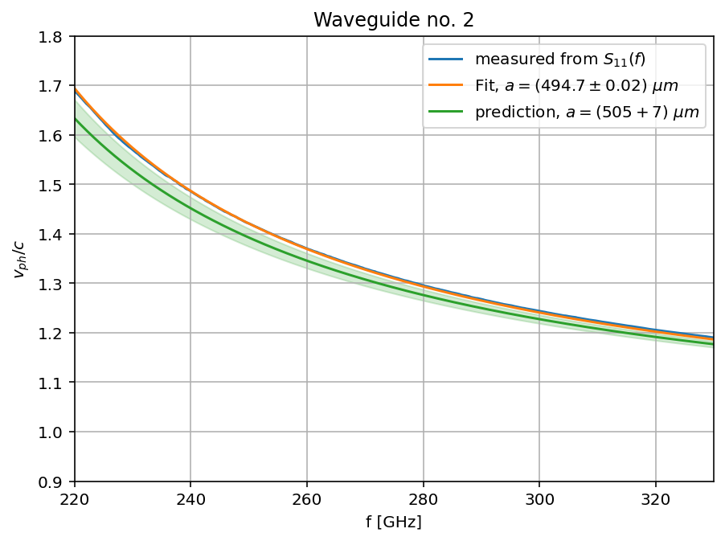
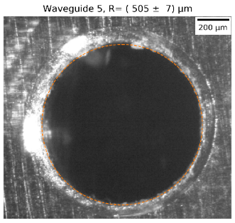
Brass waveguide
Notes:
Measurement 7
Same as before, with brass wvg
Measured dispersion line smoother than the copper one
Microscope image looks already cleaner

Slide 16
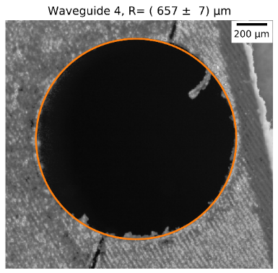
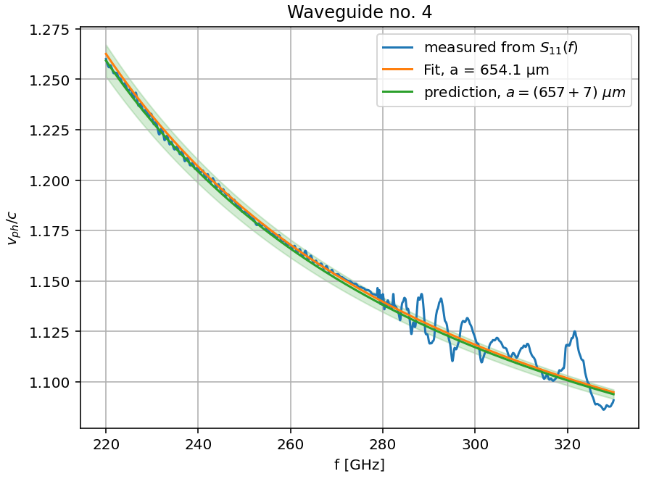
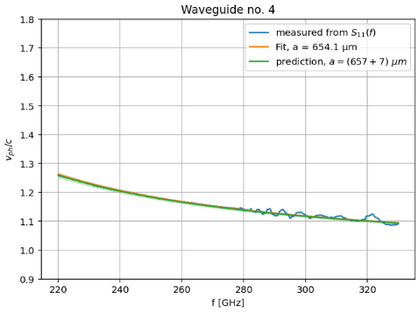
Split waveguide
Measured with different obstacles
Checked reproducibility
Notes:
Measurement 12
Third Last metallic waveguide
Cross section at exit and inside are more likely to be the same as EDM machined, not drilled
Prediction and Measurement match well up to a certain frequency of 280 GHz
What happened there? Verified by another measurement

Slide 17
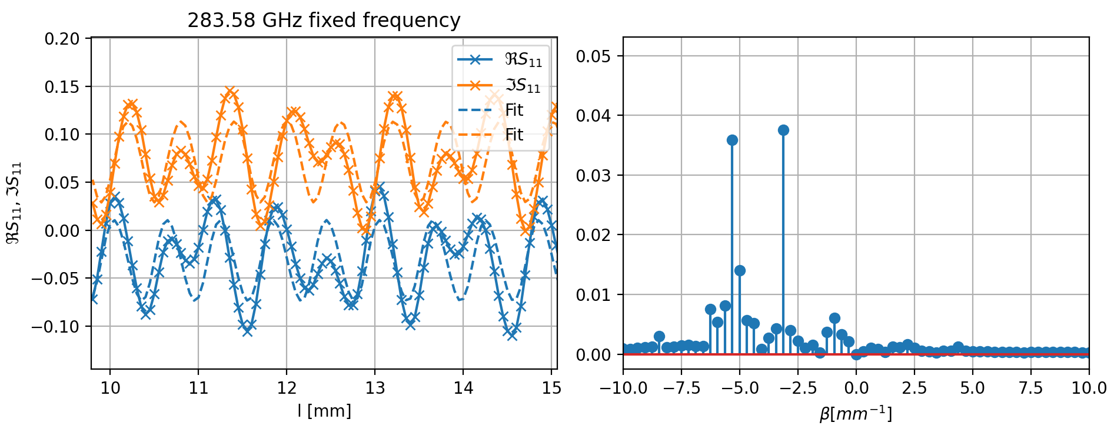
Multimode excitation in split waveguide,
Above failing frequency
Amplitude (a.u.)
Notes:
At single frequency point: S_11(l)
Beat of two different wavelengths directly visible → Fit fails, 4-term error model does not include multiple modes
Transform to Fourier Domain (k-space) confirms the interpretation: Two wavevector components with almost equal amplitude

Slide 18
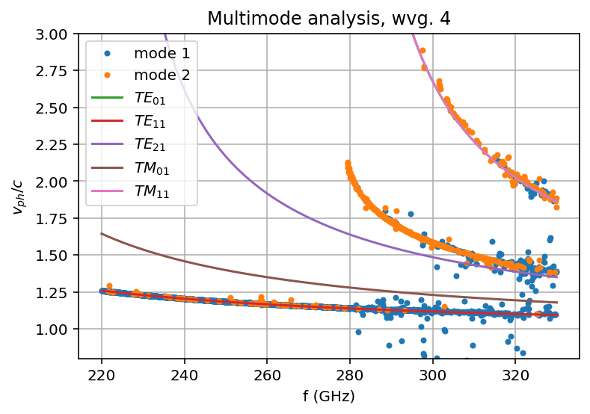
Higher order modes in metallic waveguide
TE_{mn}/TM_{mn} refer to analytical dispersion relations
Using radius from microscope image: $a=657 µm$
FDM finds a lot more modes, only selected “mode 1” and “mode 2”
Notes:
Measurement 12
Applying a Fourier Domain analysis using FDM → multiple dispersion lines found
FDM useful but can’t describe error terms so not as accurate as 4-term error model in general
Solid lines: Analytical modes expected from radius
TE_01 hidden behind TM_11
Apart from fundamental mode:
Dispersion line close to TE21 but clearly separate
TM11 matches very well
Still unclear why TE_21 is so far off

Slide 19
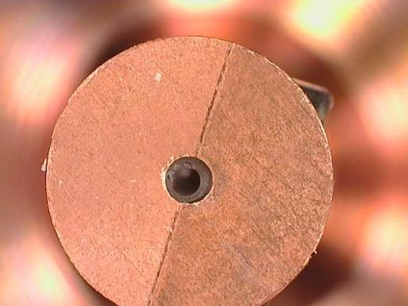
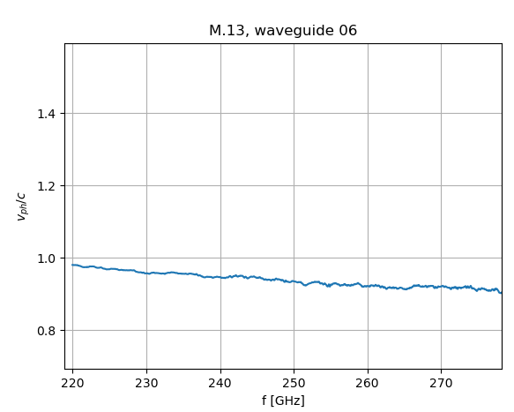
Split waveguide with dielectric
Preliminary result
Truncated S₁₁(l) due to poor signal probably due to movement of the dielectric
Notes:
M.13
Capillary inserted in waveguide
3d printed capillary → far from perfect (not centered, sprues on the outside distorting the waveguide inside)
Dispersion line got pulled down (in fact, pulled down too far)
We would like to cross the speed of light

Slide 20
Agenda
Introduction
Measurement Principle and Four term error model
Current measurement results
Discussion and Outlook
Notes:
Why?
What and how?
Show results
Limits and outlook

Slide 21
Discussion
Uncertainty in S-parameter below 1‰ (95% confidence interval)
4-term error model sufficient for modelling the studied waveguides
Effective inner diameter for metallic waveguides
Phase velocity below c in dielectric loaded waveguide
Limits of 4-term error model:
Effects of transitions should be small → long waveguide section
No reflection from behind the obstacle → obstacle not too small
extended model includes 9 unknown terms
Single mode excitation necessary
Improving obstacle:
Ideal: Closed circuit, “short”, infeasible
Set of rods of different outer diameters
Waveguides:
Imperfect Environment (oxidation of copper) and material (standard copper)
Dielectric layer far from acceptable

Slide 22
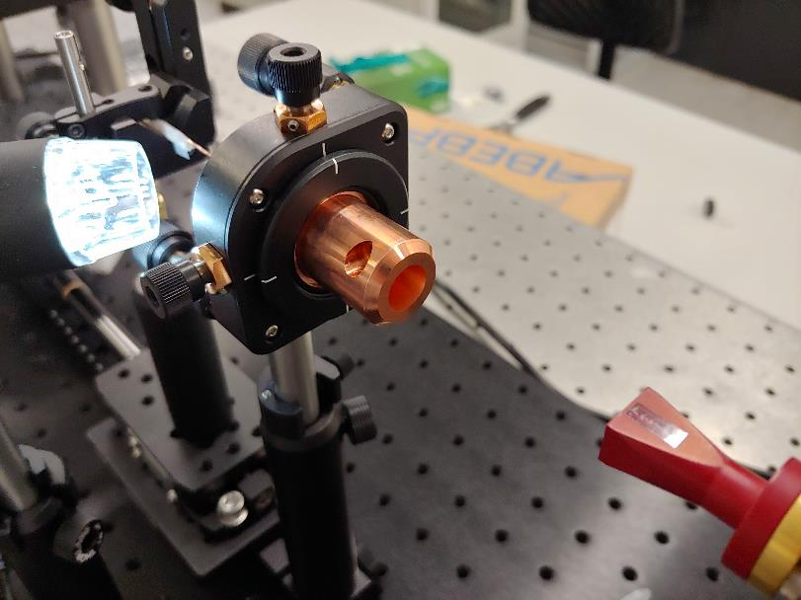
Outlook
Improve obstacle
Continue uncertainty evaluation
Compare result of brass waveguide with EO sampling measurement
Continue measurements with dielectric (better capillaries) → matching phase velocity
Acknowledgements:
Francois Lemery, Thomas Vinatier, Klaus Flöttmann, Wolfgang Hillert, Ralph Aßmann, Hannes Dinter, Frank Mayet, Christian Henkel, Immo Bahns, Patrick Rauer, Markus Hünning

Slide 23
Backup

Slide 24
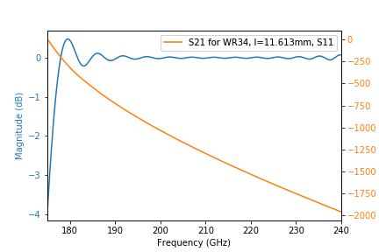
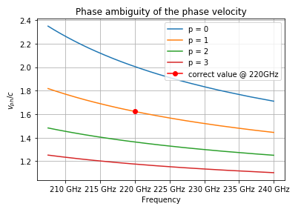
S-Parameters for Phase Velocity Measurement (Simulation)
Simple rectangular waveguide (WR-3)
Length: 11.613mm
Simulated S_21
Phase velocity from unwrapped phase

Slide 25
Extended 9-Term Error model
Issue: canula and waveguide wall form coaxial line → additional reflection from waveguide end (interpretation after first measurements)

Slide 26
Extended 9-Term Error model
Issue: canula and waveguide wall form coaxial line → additional reflection from waveguide end (interpretation after first measurements)
Doesn’t work!
Not even in simulation, too many unknowns (9)

Slide 27
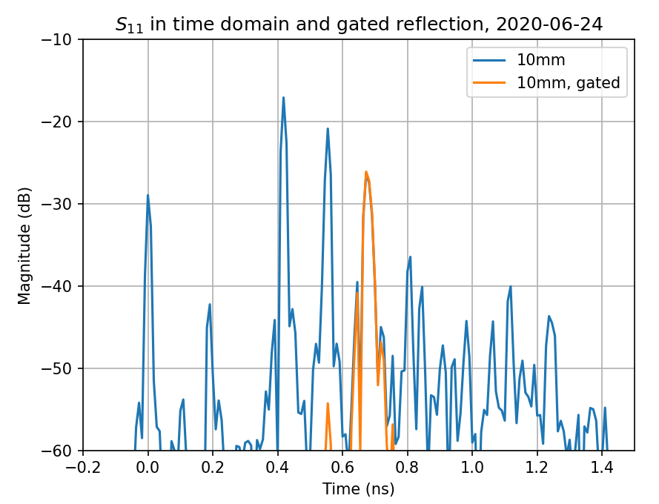
Poor man’s solution: Time Gating
Time Domain Gating (without free space calibration):
Transform from Frequency domain to Time Domain (incomplete time domain information, but helpful tool)
apply window (here: Kaiser instead of Hann)
transform back
Drawbacks:
Wiggles in frequency domain
Result depends on window parameters (center and span)
Frequency band must be truncated at the edges (DFT assumes a periodic signal, which the S-parameter clearly isn’t)
Phase information in bandpass transform susceptible to transform
$$τ_{c}=0.680 ns, Δτ=0.252 ns$$

Slide 28
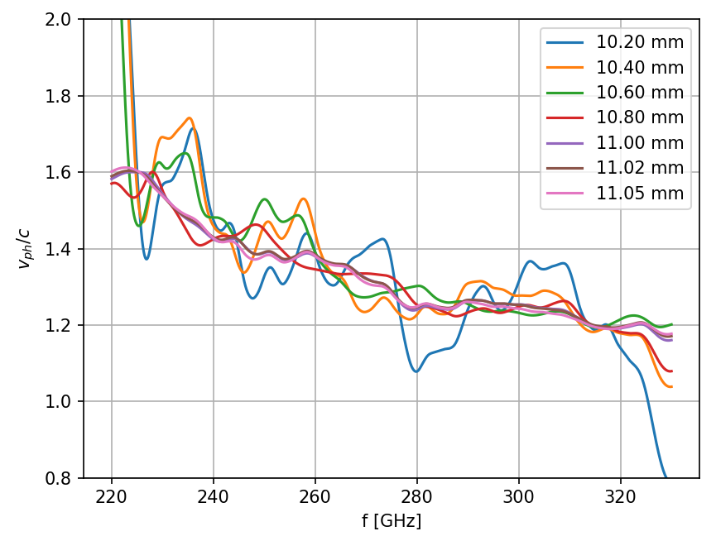
Measurement result with Time Domain Gating, I

Slide 29
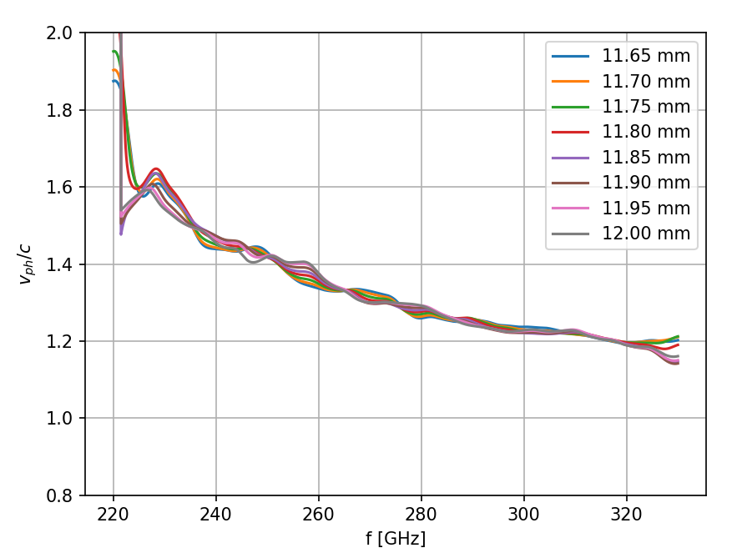
Measurement result with Time Domain Gating, II

Slide 30
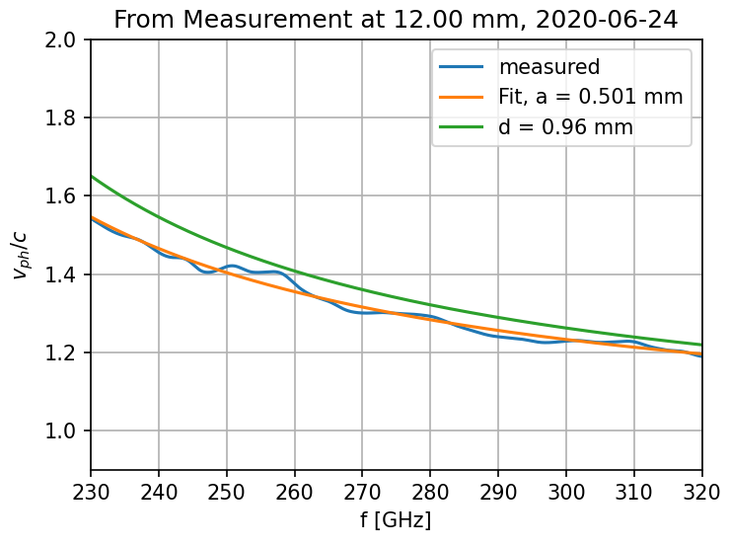
Fit dispersion curve
Comparing dispersion curves
Measured (using time gating)
Fit to measured data → 0.50 mm
Expected from measured aperture diagonal
Fits from last 10 measurements (from 11.5 mm):
$$a=(0.500±0.002) mm$$

Slide 31
Impact of Gate parameters

Slide 32
4-term error model would be better
Per-Frequency analysis
Does not rely on incomplete time domain information
But:
error function depends on starting point
Complex error function
Sensitive to phase error
$$F={(S}_{11}^{(m,j)} −a)(k^{\left(j\right)}−c )−b=0$$
solving for a, c, b with pairs of measurements and back-substitution
Root finding problem

Slide 33
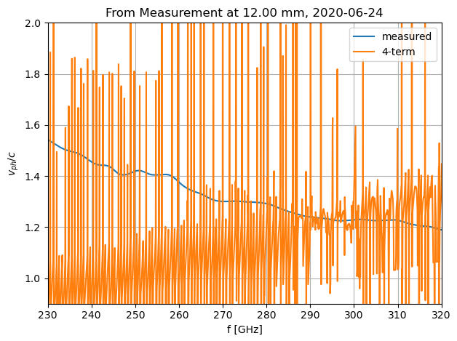
Four-term error model applied
Using measurement at 10.00, 10.50, 11.00, 11.50 mm

Slide 34
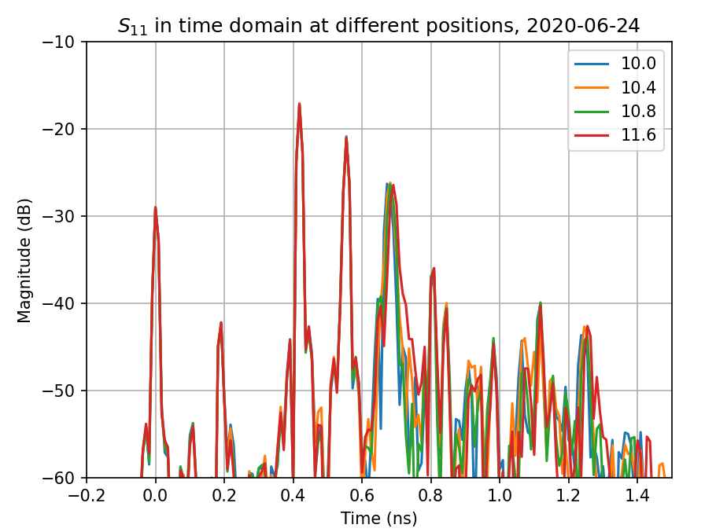
Time domain transform at different obstacle position

Slide 35
Time domain transform of obstacle free measurements
Measurement from 2020.07.02

Slide 36
Harmonic analysis
Comparison to time domain gating
Based on harmonic analysis
Based on time domain gating

Slide 37
Analysis based on 4-term error model
While tweaking initial parameters for least squares problem: Found sign error
→ Curve fit works
Better result than harmonic analysis

Slide 38
Phase velocity measured with EO sampling

Slide 39
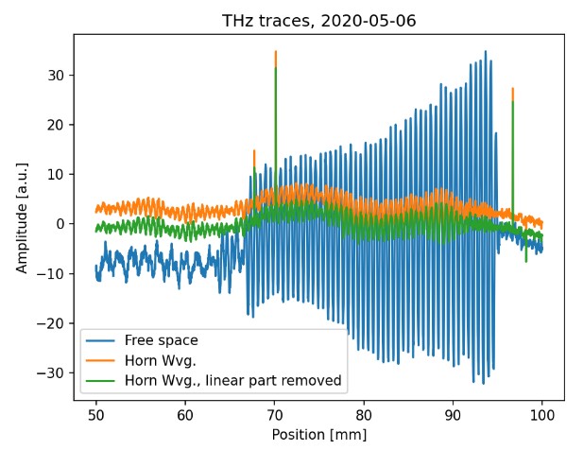
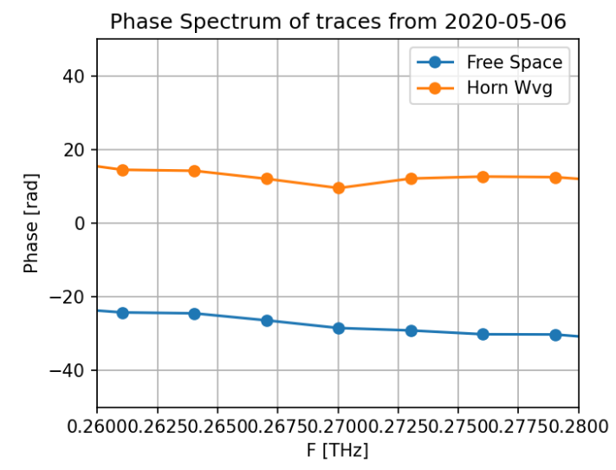
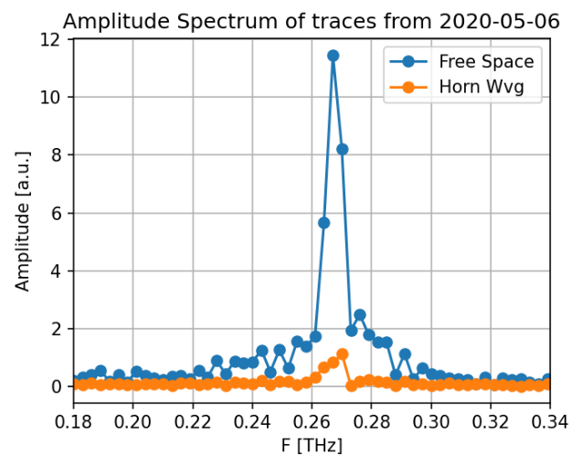
THz traces with EO sampling

Slide 40
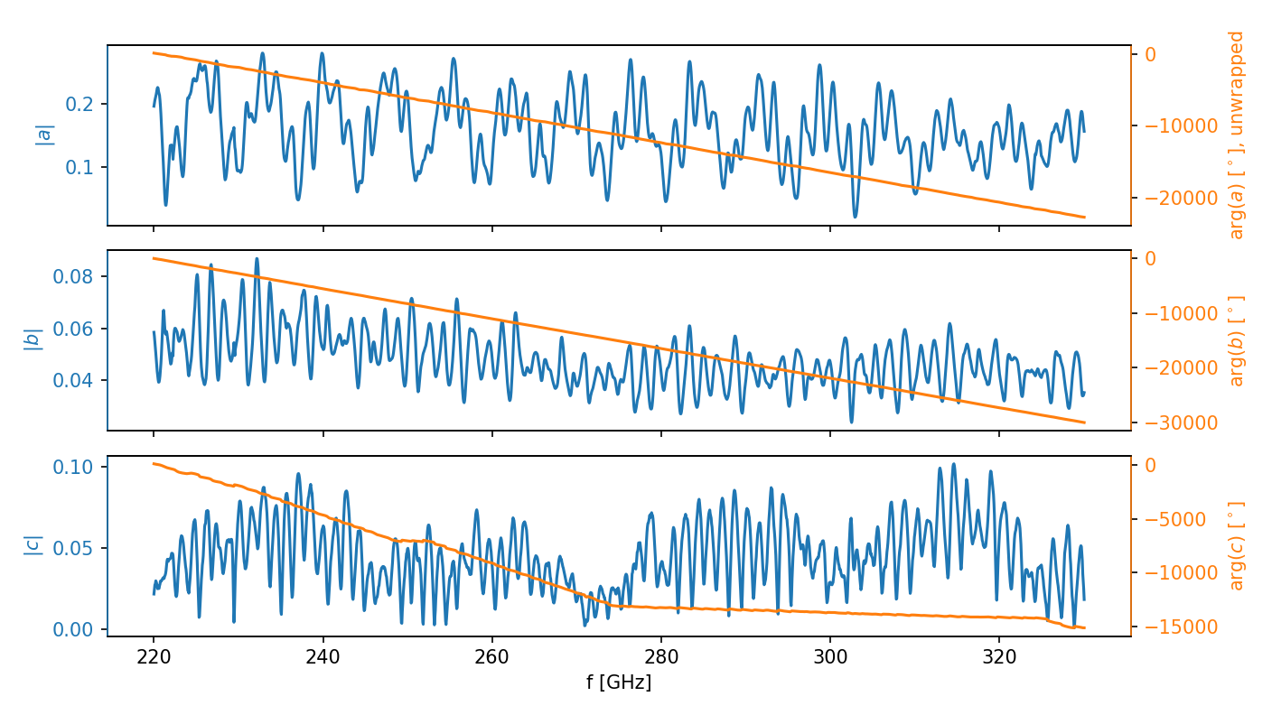
Calibration coefficients
Magnitude and unwrapped phase

Slide 41
Calibration coefficients
Real and Imaginary

Slide 42
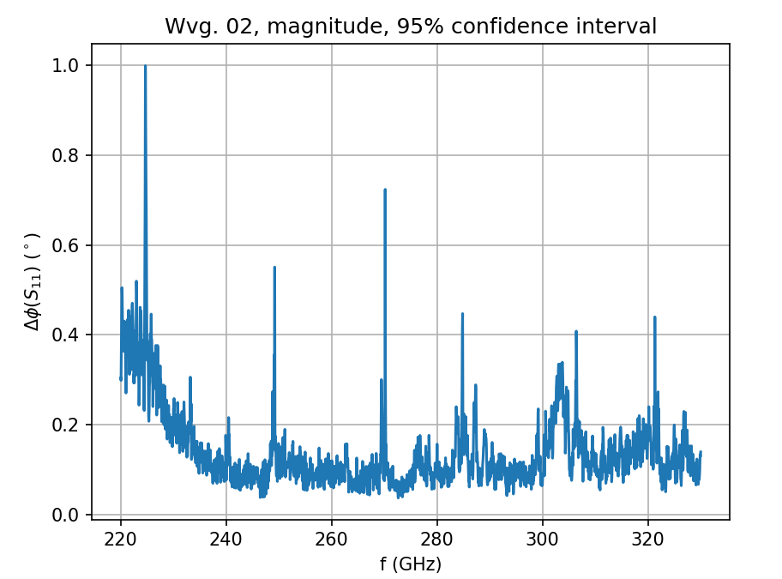
Uncertainty in S-parameter
Waveguide 2 (brass)
At a fixed position of the obstacle
Notes:
Measurement 17

Slide 43
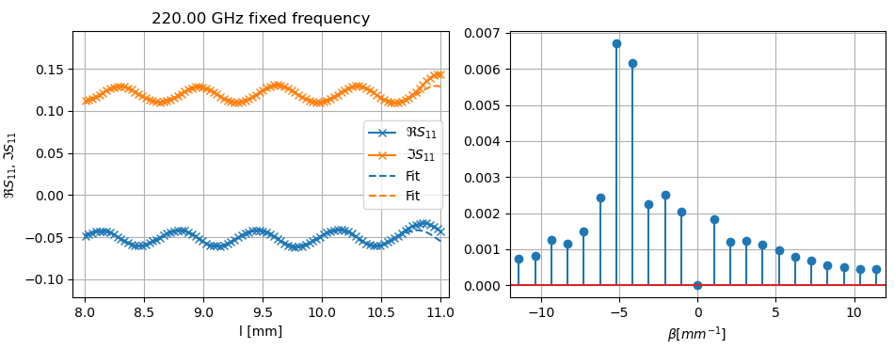
Split waveguide with dielectric, S₁₁
S₁₁ at low frequency

Slide 44
Split waveguide with dielectric, S₁₁
S₁₁ at medium frequency

Slide 45
Split waveguide with dielectric, S₁₁
S₁₁ at high frequency

