Slide 1

ARES Operation Meeting
Summary of week 34
Florian Burkart , on behalf of the ARES shift crew

Slide 2
ST3 annual meeting
https://indico.desy.de/indico/event/25669/
On Wed 23rd September, 2020, from 14:00 to 17:00, we start with a welcome address from KIT, followed by presentations on the status of the ST3 test facilities and future plans at the Helmholtz centers.
On Thu 24th September, 2020, from 9:00 to 17:00, we will commence with highlighted presentations and speed talks. Since we cannot organize a poster session, we will try a slightly different speed-talk format than usual.
The Annual Meeting in subtopic 3 (ST3) in the topic Accelerator R&D (ARD) of the programme Matter and Technologies (MT) is designed to provide the platform for colleagues including students who are in the fields of advanced beam control, diagnostics and dynamics across the HGF to exchange the progress and ideas.
The workshop and registration can be found here: https://indico.desy.de/indico/event/25669/.
Your registration is highly appreciated.

Slide 3
MVS activity
MVS had a look at the cathode.
Cathode looks ok.
But cathode spring might be damaged. Replaced – now fine.
Mo cathode in the gun – fresh and new.

Slide 4
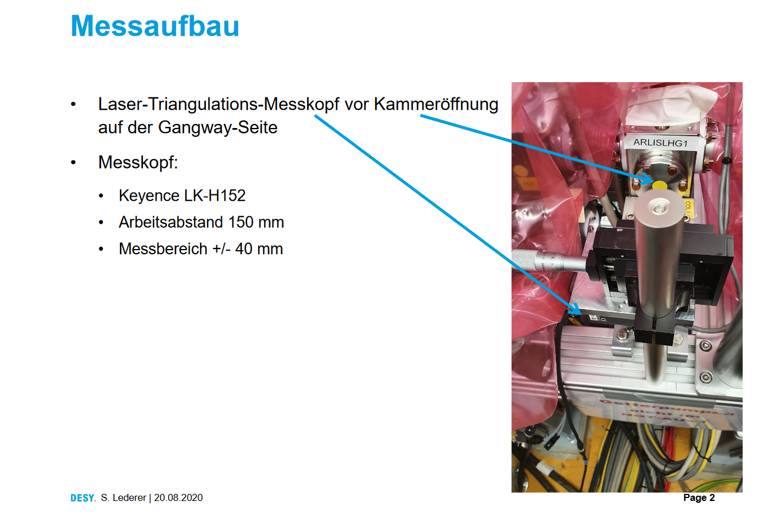
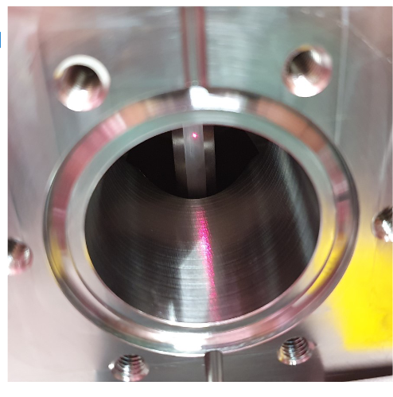
Collimator investigations

Slide 5
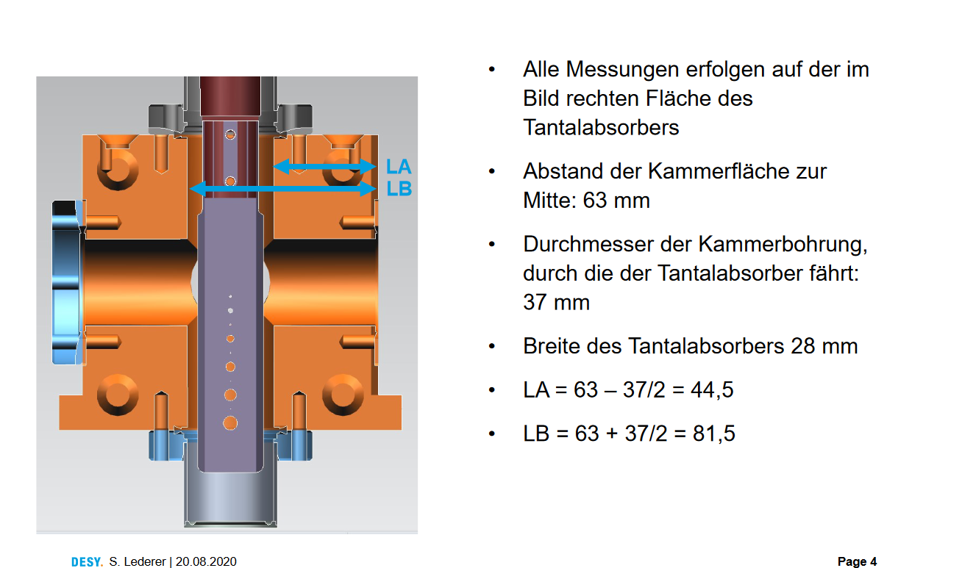
Collimator investigations

Slide 6
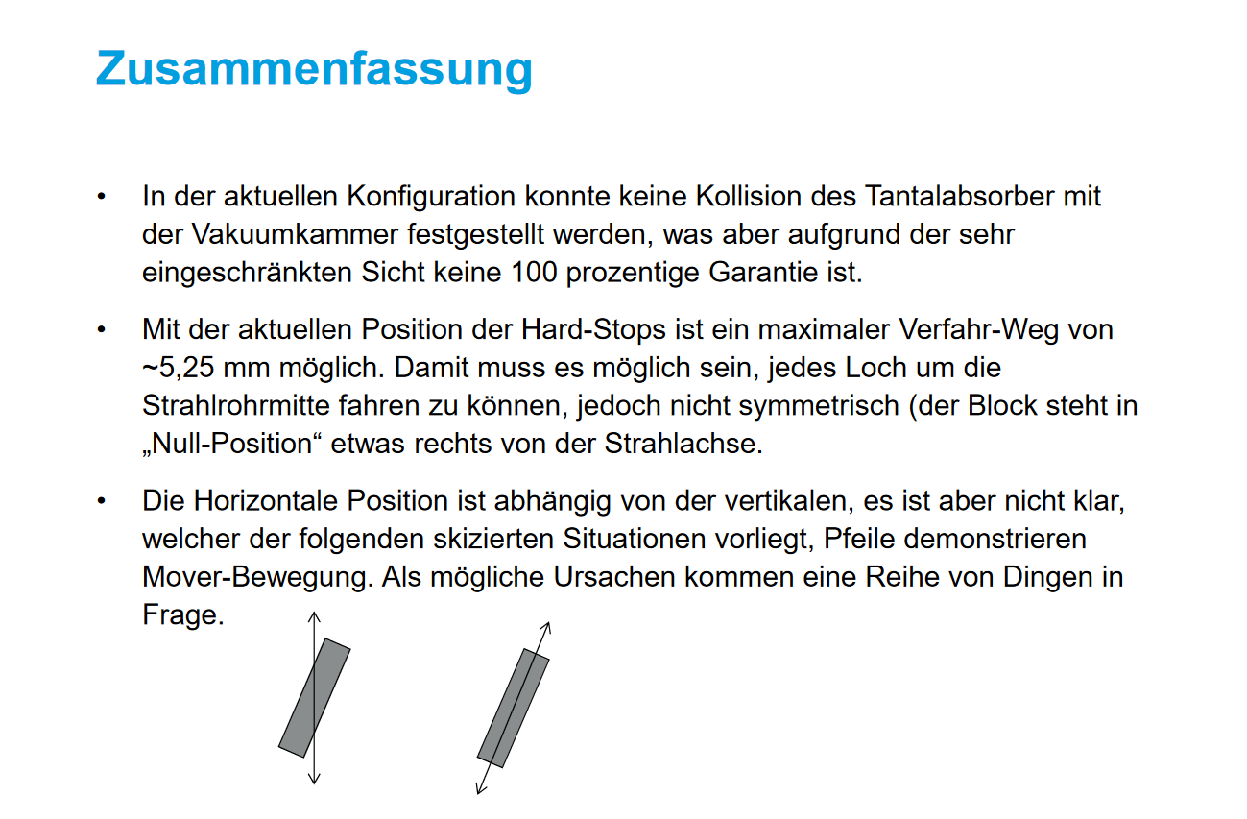
Collimator investigations

Slide 7
Other (technical) stuff
Collimator lost steps – adjusted by Gunnar during the Weekend.
Crane works and construction work expected – going back to BKR under discussion.
Dark Current comparison ongoing.
Power dependend base line FC – MDI informed problem not understood. Please send screenshot to MDI (M. Werner).

Slide 8
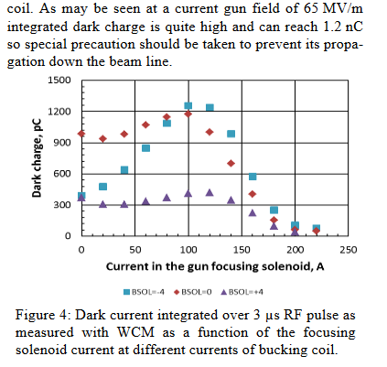
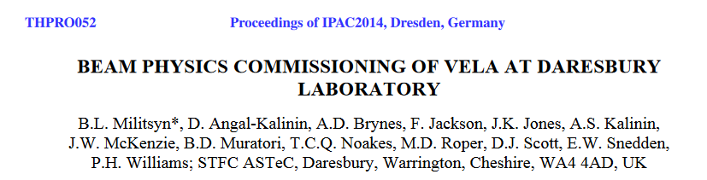

Slide 9
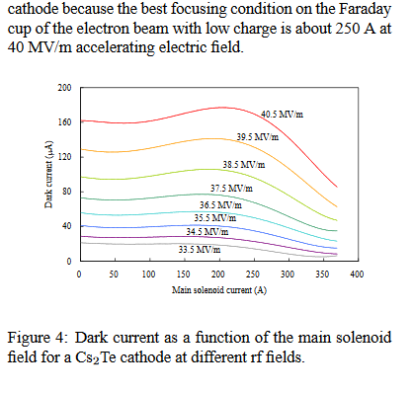
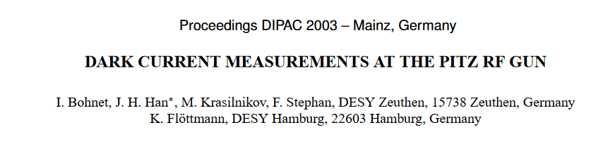

Slide 10
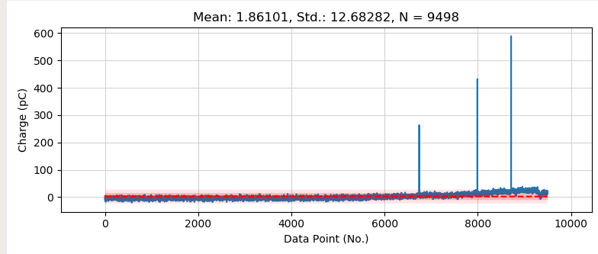
Dark Current Burst

Slide 11
Plans for week 35
Data analysis
Hardware Studies:
Screen station S1
Collimator
Laser
Beam Measurements
Measurement: coupling factor
Dark current with Mo cathode
Phase scan vs. Centroid
Laser movement and QE measurements (with FS-LA)
Emittance vs. Charge
Stability measurements

Slide 12
Schedule
Week 35
Date | Shiftleader
24.8. | MDI
25.8. | Florian/Hannes
26.8. | Frank
27.8. | Frank / Hannes – FS-LA
28.8. | Thomas

Slide 13
Schedule
Week 36
Date | Shiftleader
31.8. | ACHIP laser alignment
1.9. | Florian
2.9. | Frank / Willi
3.9. | Florian / Willi
4.9. | Thomas / Hannes

Slide 14
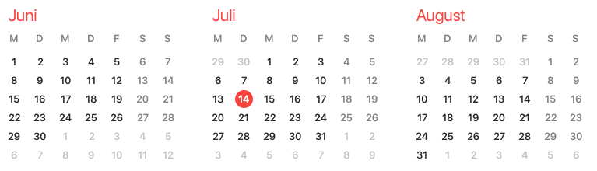
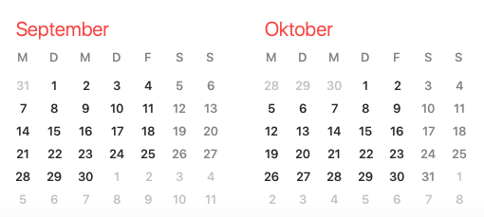
ARES schedule
Week 34
Shutdown (Monday = Maintenance day)
RF Conditioning (Gun)
Beam Commissioning (Gun section)
Beam Commissioning (Linac section + EA1)

