Slide 1
CDR

Slide 2
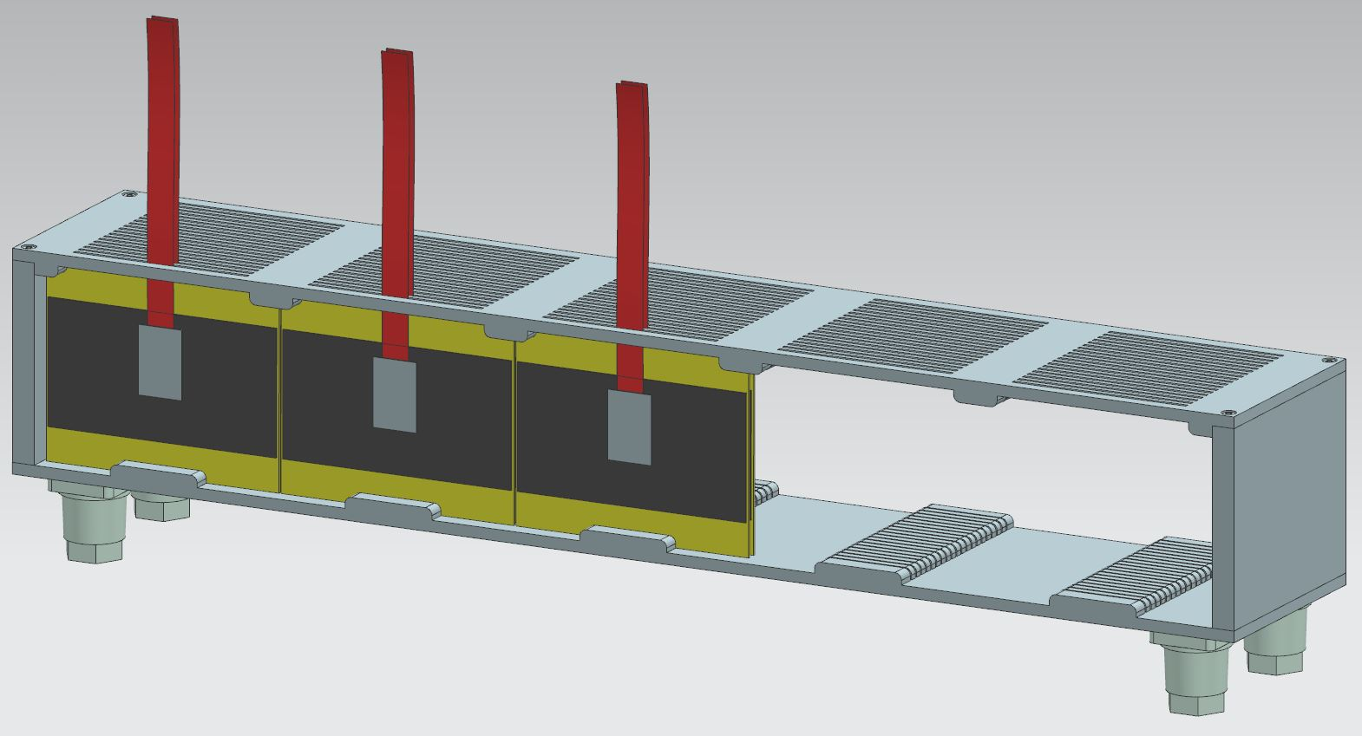
What I supposed :
Si sensor : 5.5x10.5 cm2
5 tower of 20 sensors
One long tungsten plane
Box : I need from Wolfgang the 3D model
What I didn’t draw : elx support

Slide 3
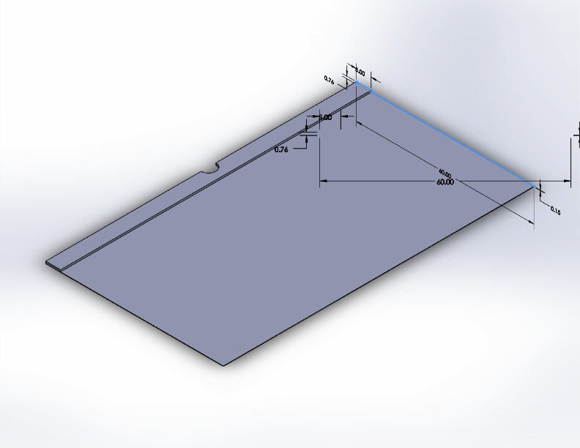
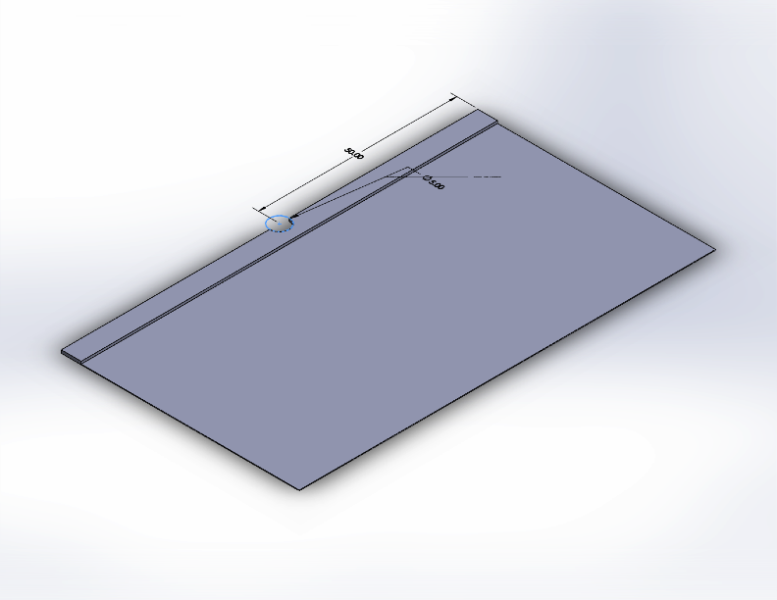
Carbon envelop

Slide 4
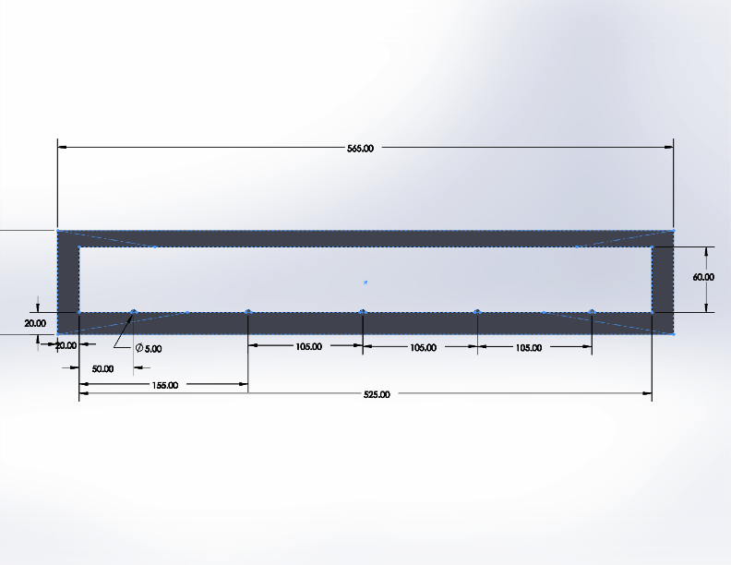
Precise positioning of the envelop on the tungsten plane : jig (CNC)
Precision bumps

Slide 5
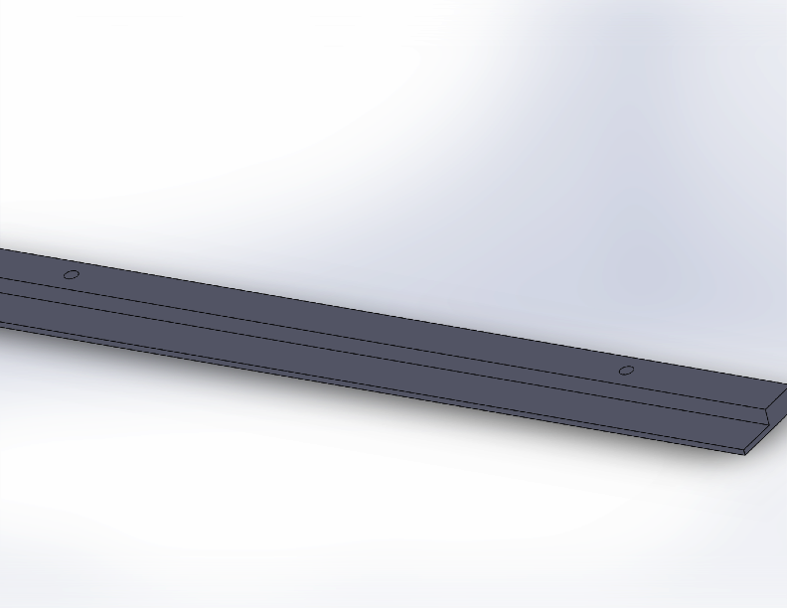
Alignment tool between the jig and the tungsten plane (CNC)
Holes to screw it on a granite table

Slide 6
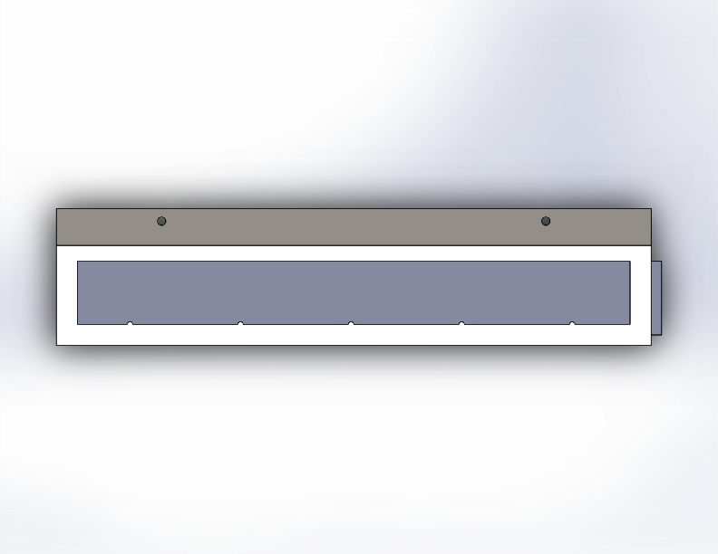
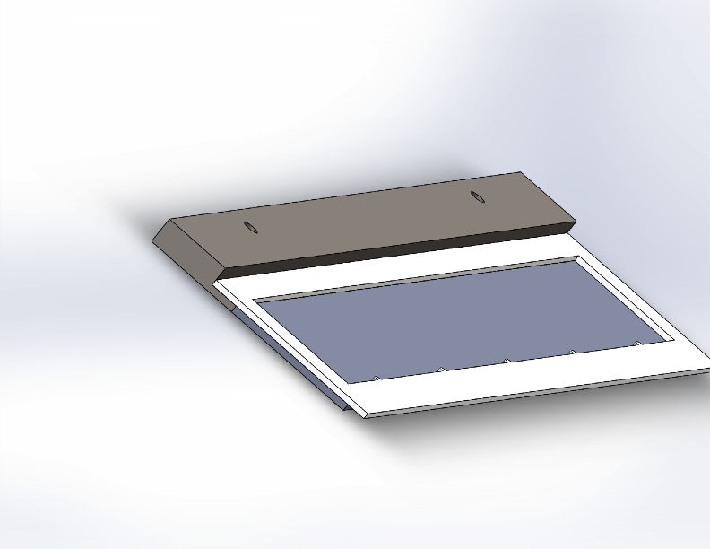
assembly
tungsten
jig

Slide 7
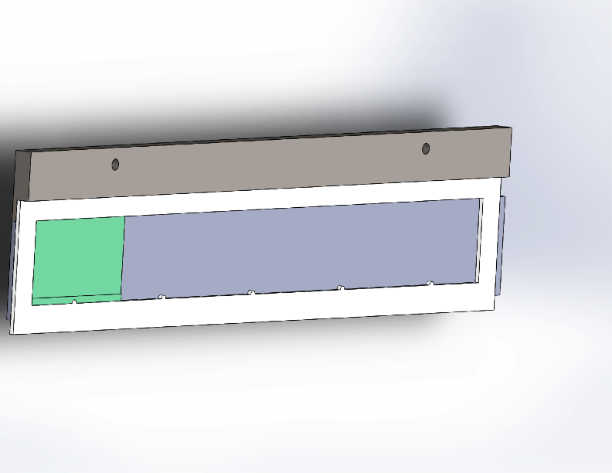
Gluing of the envelop
Carbon envelop

Slide 8
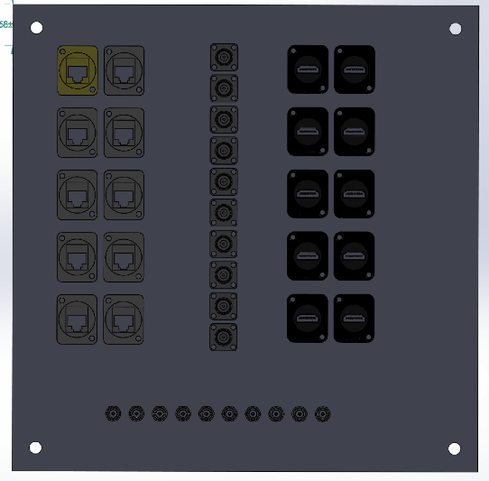
Patch panel

Slide 9
Elx question
How many FEBs will we have per plane ?
Do we consider to use FELIX (like the tracker) or do we continue with the FPGA board to read/configure the FEB ?
Where will be located the FPGA boards ?
How many FPGA boards will we have ? What are the specs of the switch which concentrate the FPGA board ethernet cables ?
Which type of cables between the FEBs and the FPGA boards ?
Consumption of the FPGA boards ? What is the topology of the LV distribution?
Where do we distribute the trigger (FEBs or FPGA) ?
How many computers for the data taking ?

Slide 10
Si questions
How is topology of the HV distribution ?

Slide 11
commissioning
We will test the whole system before we install it (with muons for example -> trigger?)
We install on the alignment pins respect to the tracker (Noam is on vacation this week, next week I will meet with him and the mechanical engineer)
We connect all the cables from the rack(s) to the patch panel.
We take a cosmic run to be sure that everything is well connected (?)

Slide 12
Trigger
Cosmic trigger
electron beam trigger

Slide 13
Operations during the data taking
Monitoring of the sensor current
Monitoring of the temperature/humidity inside the box (?)
Monitoring of the FEB current (?)
Monitoring of the FPGA current (?)
Do we want an expert system to take care of this or the shifter is enough (difference is the time response) ?

Slide 14
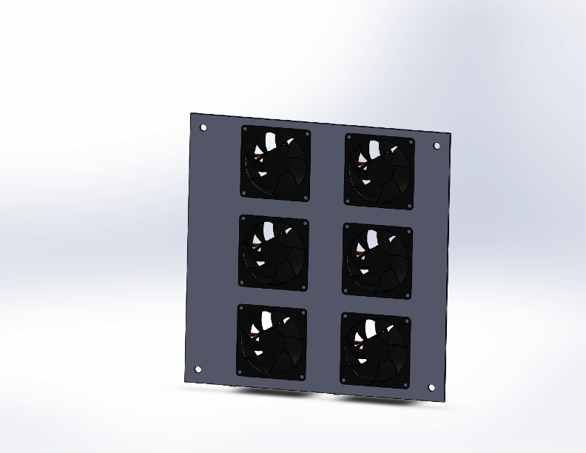
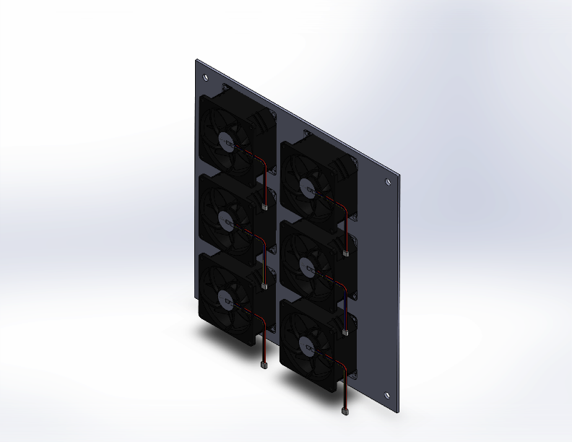
cooling
Only air cooling
Nitrogen inside the box

