Slide 1
XFEL Operations and LUXE beam time
B. Heinemann, Sep 2020
(with help of Winnie Decking)

Slide 2
Introduction
Aim of this talk is to propose parameters used for the CDR for operations
Using 2019 as example (as 2020 was compromised by pandemic)
I propose we assume we take data worth 1e7 seconds/year once we are fully commissioned => see next two slides
Then we get
for electron-laser run:
Year 1: 0.5e7s (due to commissioning)
Year 2+: 1e7s
for photon-laser run the same:
Year 1: 0.5e7s
Year 2+: 1e7s

Slide 3
Scheduled down:
Winter shutdown: 5-7 weeks
Week-long stops: 3-4/year
Access/setup/tuning:
1-2 days/week
X-ray programm:
~40%

Slide 4
2019 Operations Summary
Status | hours
Scheduled downtime | 2280
Setup, tuning, unscheduled access | 1176
Facility development (accelerator and photon systems) | 1656
Photon delivery (user program and exp. commissioning) | 3648
Total | 8760
Assume that ~40% of the year we will have beam
Assume data taking efficiency of 80% => 1e7 seconds/year

Slide 5
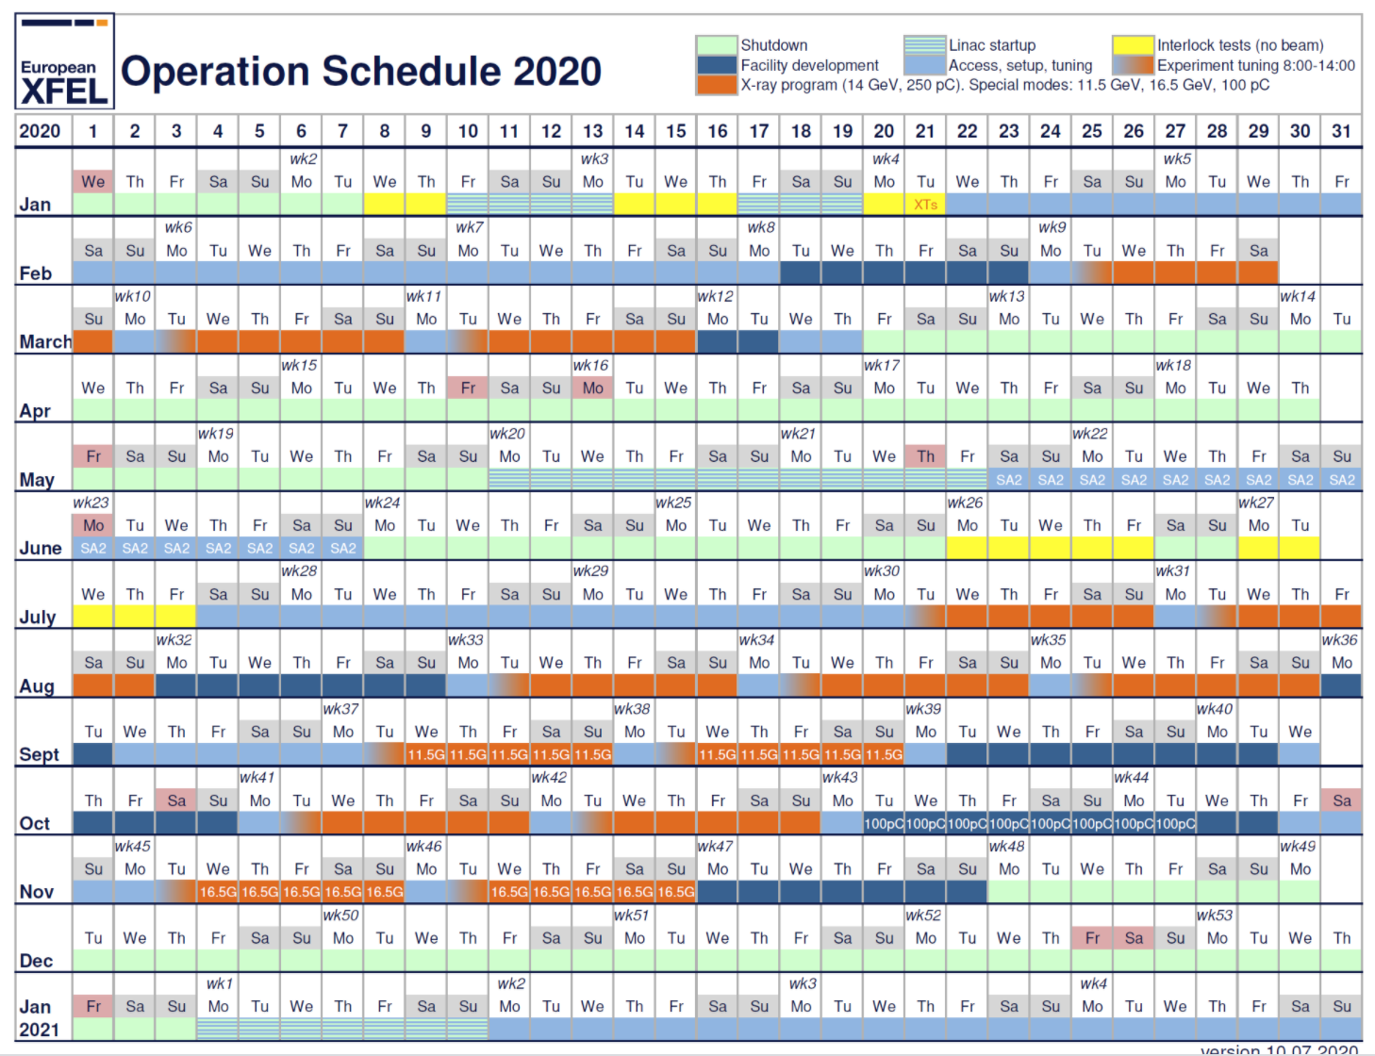
Beam Currents:
14 GeV: 250 pC
Other energies: 100 pC
=> Assume 16.5 GeV:
Default: 250 pC
Worst case: 100 pC
Best case: 1 nC

Slide 6
Backup

