Slide 1
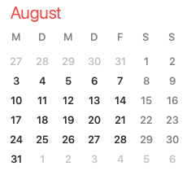

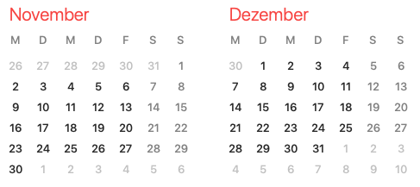
ARES operation meeting, Monday 7th September 2020
by the ARES shift crew
Shutdown (Monday = Maintenance day)
RF Conditioning (Gun)
Beam Commissioning (Gun section)
Beam Commissioning (Linac section + EA1)

Slide 2
Summary of KW36
 | Tuesday 1st September | Wednesday 2nd September | Thursday 3rd September | Friday 4th September
Achievements | * Test of steerers and screens displacements * Measurement of momentum vs phase of TWS1 up to the maximum | - | * Discussion of laser auto-alignment with Lutz and Caterina * Training of Willy | * As complete as possible momentum phase scan for TWS1 * Beam accelerated (decelerated) in TWS2 for 360° of phase
Perturbating events | - | * Gun modulator crashed during the night and several times during restart | * Gun modulator crash and laser trip during the night * Problem of access to certain tools (PS monitoring) | * Power cut in TWS1 (vacuum event) * Logbook server instabilities
Notes | * A PCB steerer has to be repaired and one needs horizontal and vertical to be swapped | * Gun modulator works only at limited charge voltage * Phase scale shifted | * Phase scale shifted | * Phase scale shifted

Slide 3
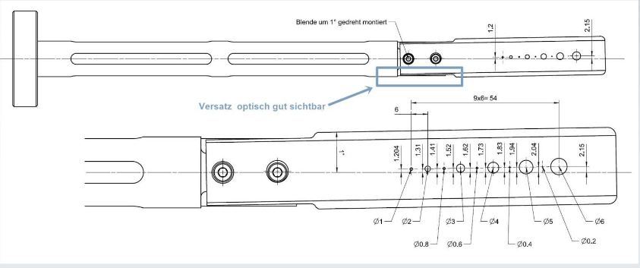
Collimator investigations
Meeting with MVS and MDI
Maybe there is a angle due to misalignment between mover and blade.
To be checked in week 41 (tbc).
Together with the installation of the pepper pot.

Slide 4
Grounding issues
Suspected source of noise on Faraday cup signal and of beam jittering after TWS
MKK and MIN analysis ongoing.

Slide 5
Other technical aspects
Scheduled MSK (THU at 8 am) and MDI (WED at 10 am, tbc) shifts.
Gun Klystron arcing – solved by reducing operating voltage and increasing amplitude.
Crane works and construction work expected – going back to BKR under discussion.

Slide 6
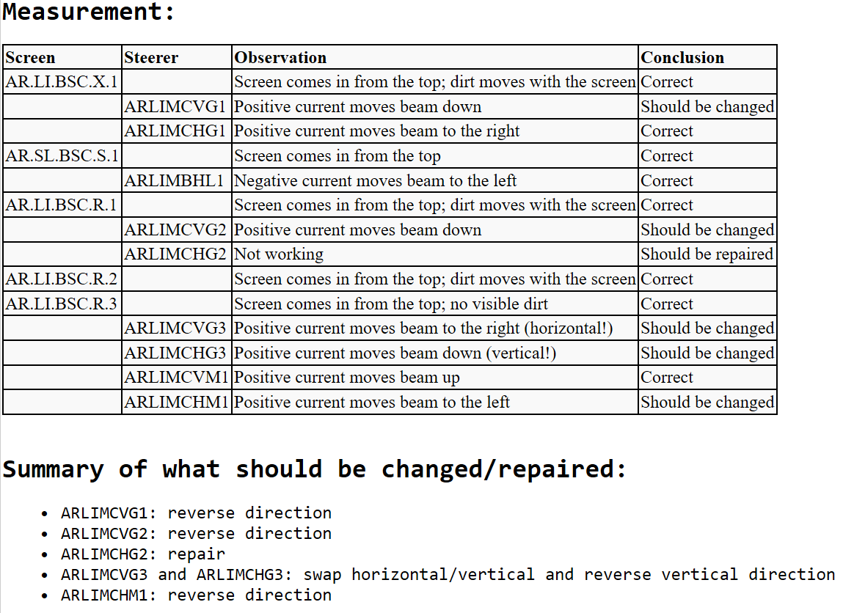
Screens and steerers test

Slide 7
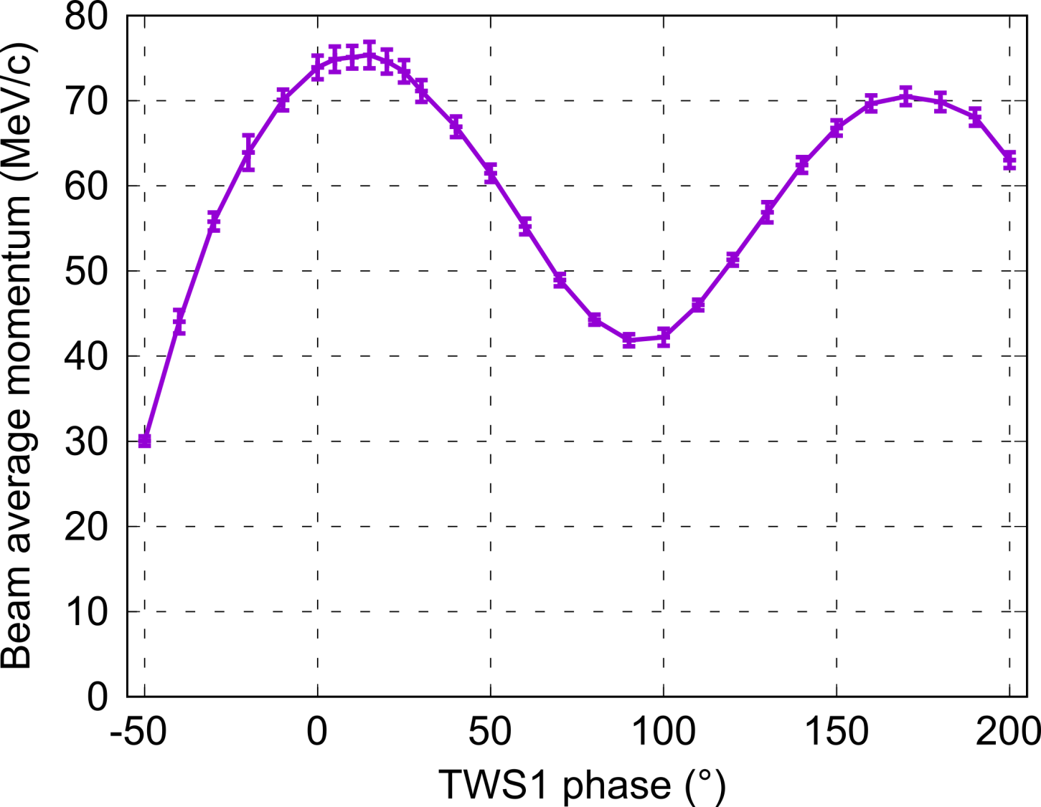
Momentum phase scan of TWS1
* Momentum measured over 250° of phase, but uncertainty on the absolute value of the momentum obtained (75 MeV/c does not fit with TWS1 power reading): Power reading ? Measurement method ? To be clarified.
* Comparison of the curve shape (i.e. normalized) with ASTRA might help inferring the accelerating field in TWS1.

Slide 8
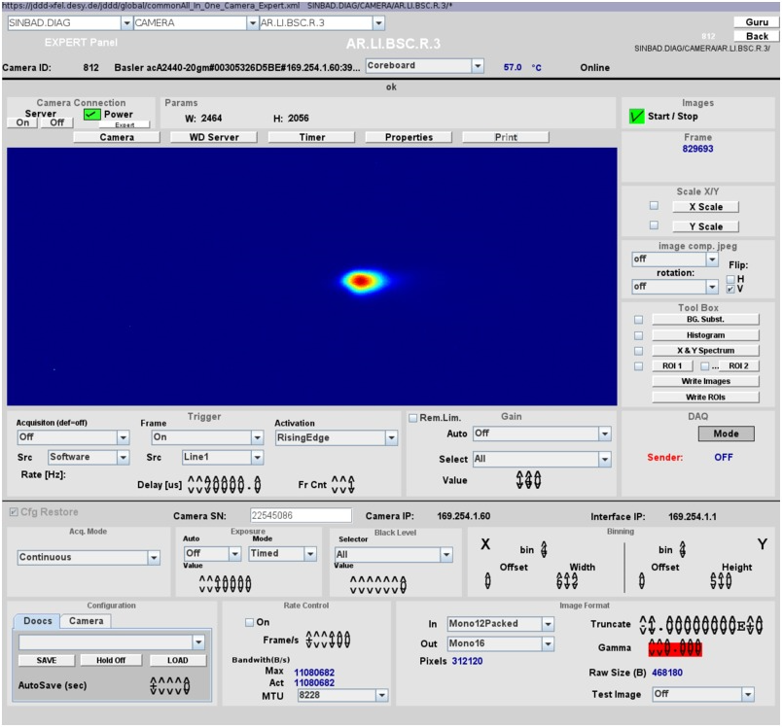
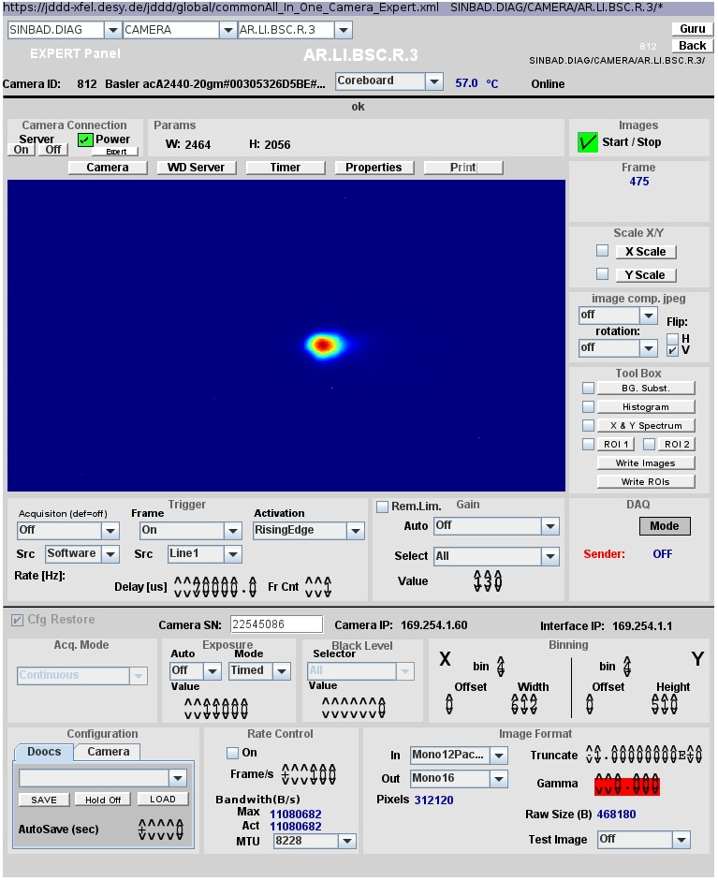
Beam through powered TWS2
Beam on screen R3 through unpowered TWS2
Beam on screen R3 through powered TWS2 (no change in magnet settings)
* Beam sent through powered TWS2 (38 MW) on screen R3 (right at the exit). Beam still visible on R3 for 360° of phase scan of TWS2 with slight displacement (≈ 20% of the screen) and (de)focusing (< factor 2) without using TWS2 solenoids.
* Beam was not found on the next screen (Experimental area) which is just 2.5 m away from R3: Beam defocusing ? Strong angle on beam trajectory ? Obstacle in beamline ? Problem with experimental area screen ? To be clarified.

Slide 9
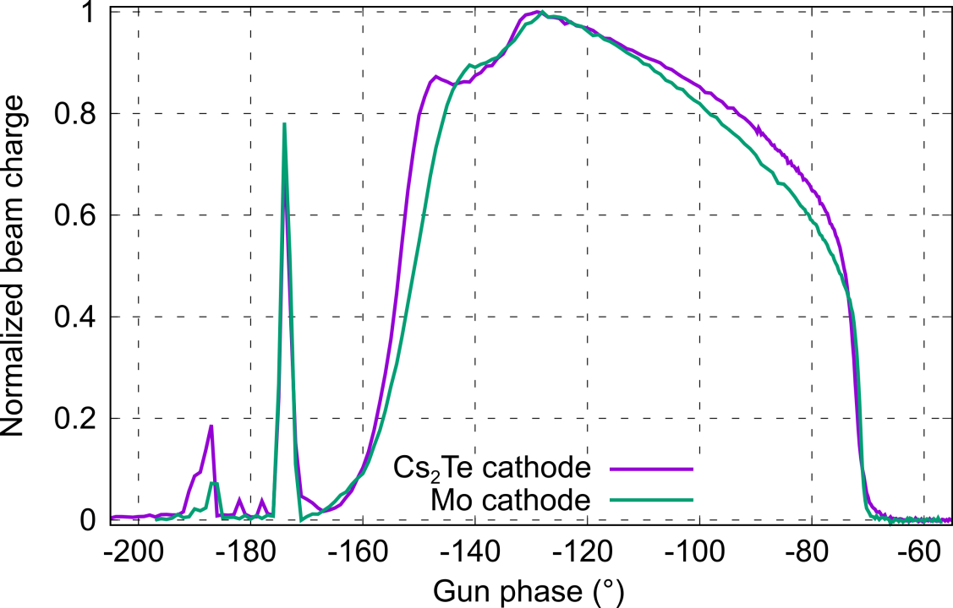
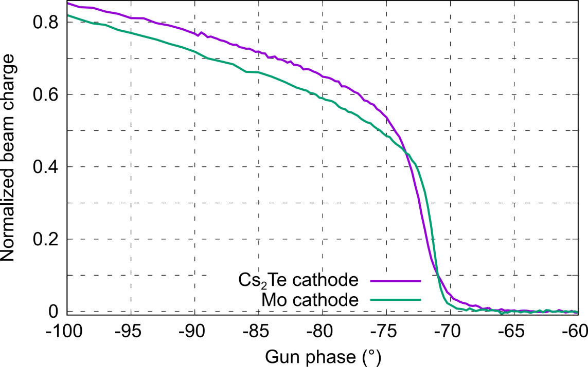
Schottky scan: Cathode comparison
* Charge was very low in each case (1.5 pC max.) → space-charge forces effect are very weak.
* The charge rise at the beginning of the scan is significantly different for the two cathodes (tail and slope) → Emission process is significantly different.
* Mo exhibits a steeper rise and shorter tail than Cs₂Te → As expected from litterature, Mo (metal) has a shorter emission time than Cs₂Te (semi-conductive)
* If the laser pulse time profile was unchanged (could the aperture have an effect ?) → Cs₂Te has a response time which is longer than the laser pulse duration.
* Cannot say for the moment if Mo has a response time (longer than the laser pulse duration) or not.
* Comparison with ASTRA ongoing (more details next week). Confirms the existence of a Cs₂Te response time in the ps range.

Slide 10
Plans for KW37
Data analysis
Hardware Commissioning – Screens and Magnets downstream TWS2.
Beam Measurements
Phase scan vs. Centroid
QE measurements (please inform Max!)
Emittance vs. Charge
Stability measurements

Slide 11
Shift planning for KW37
Date | Shiftleader
7.9. | MDI
8.9. | Hannes / Willi
9.9. | Thomas / Willi
10.9. | MSK / Florian
11.9. | Frank / Willi

